Slide 1
Smart Warehouse Grid Locator
Using 2D Arrays and Object-Oriented Programming in Java

Slide 2
Introduction
• Simulates a warehouse using a 2D grid
• Stores items with row and column coordinates
• Enables quick item location using Item IDs
• Built using Java OOP concepts

Slide 3
Objectives
• Implement OOP concepts
• Use 2D arrays
• Search items efficiently
• Simulate warehouse management

Slide 4
Technologies Used
• Java
• Classes & Objects
• Encapsulation
• Constructors
• 2D Arrays
• Nested Loops

Slide 5
System Design
GridItem Class
- Item ID
- Item Name
- Quantity
Warehouse Class
- Add Item
- Search Item
- Update Quantity
- Remove Item

Slide 6
Working of the Project
1. Create warehouse grid
2. Add items
3. Search by Item ID
4. Return row and column
5. Update or remove items

Slide 7
Algorithm
Initialize Grid
Insert Items
Accept Item ID
Traverse using Nested Loops
Compare IDs
Display Location

Slide 8
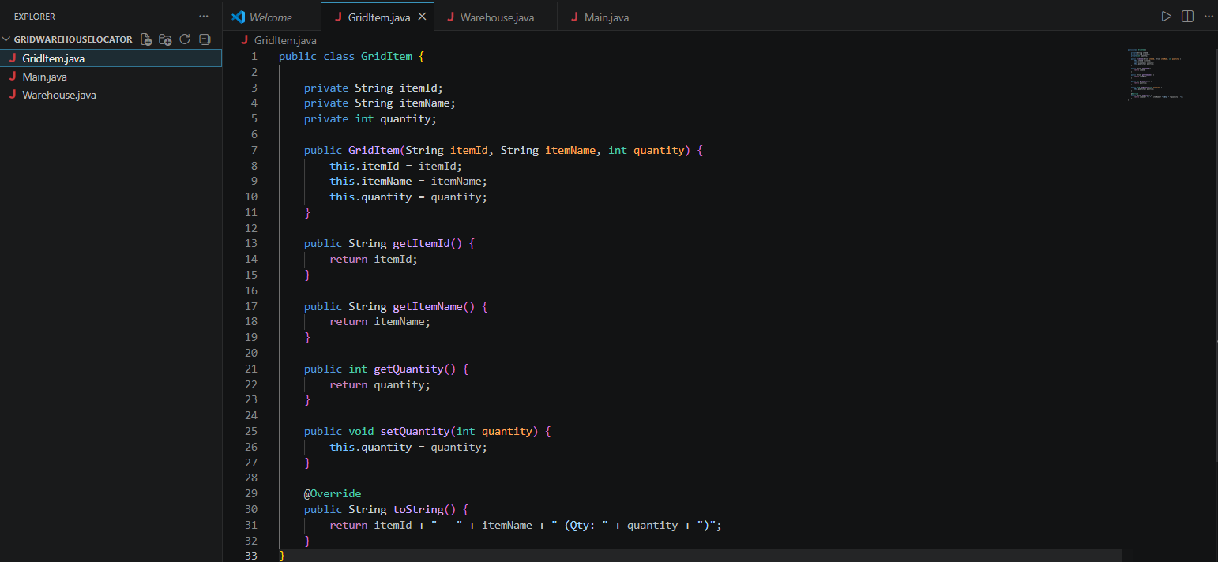
Screenshots
1. Grid Item

Slide 9
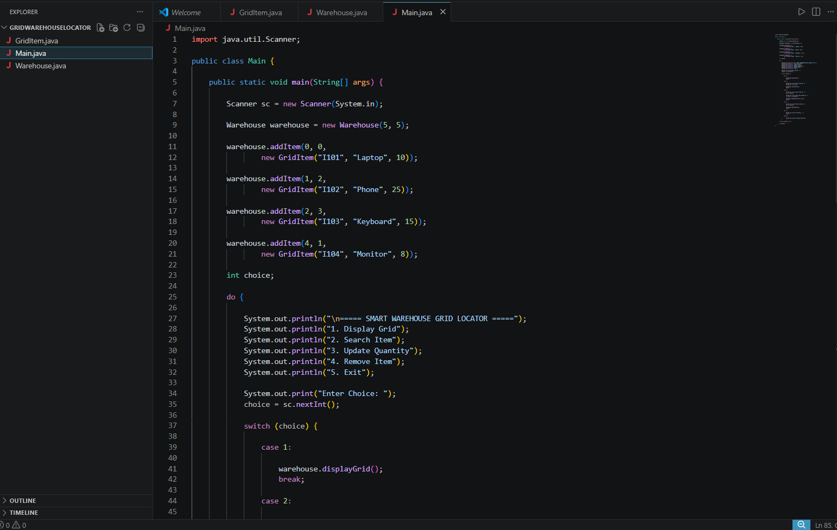
Screenshots
2. Main Java

Slide 10
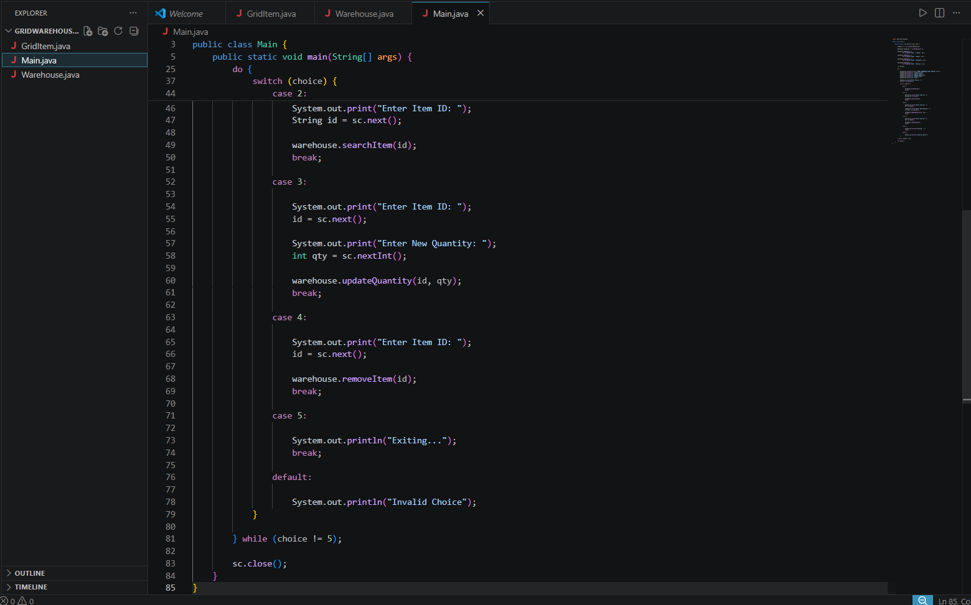
Screenshots
2. Main Java

Slide 11
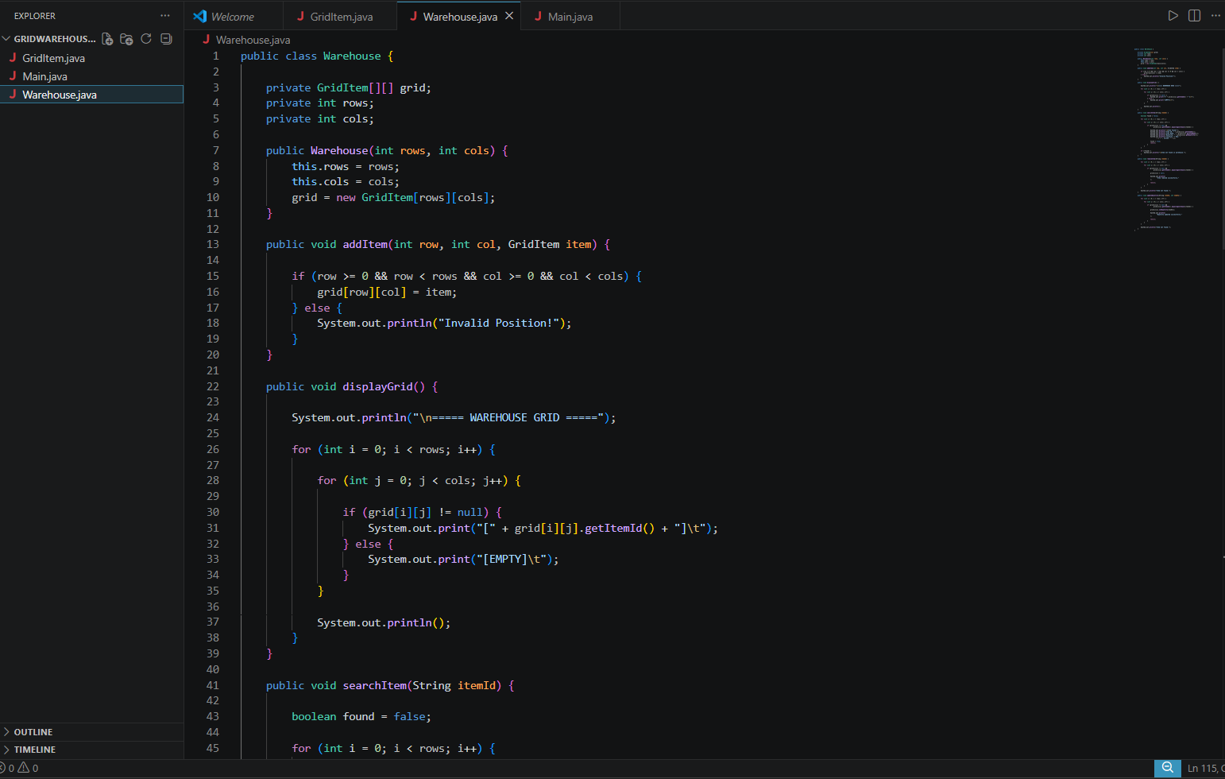
Screenshots
3. Warefare house Java

Slide 12
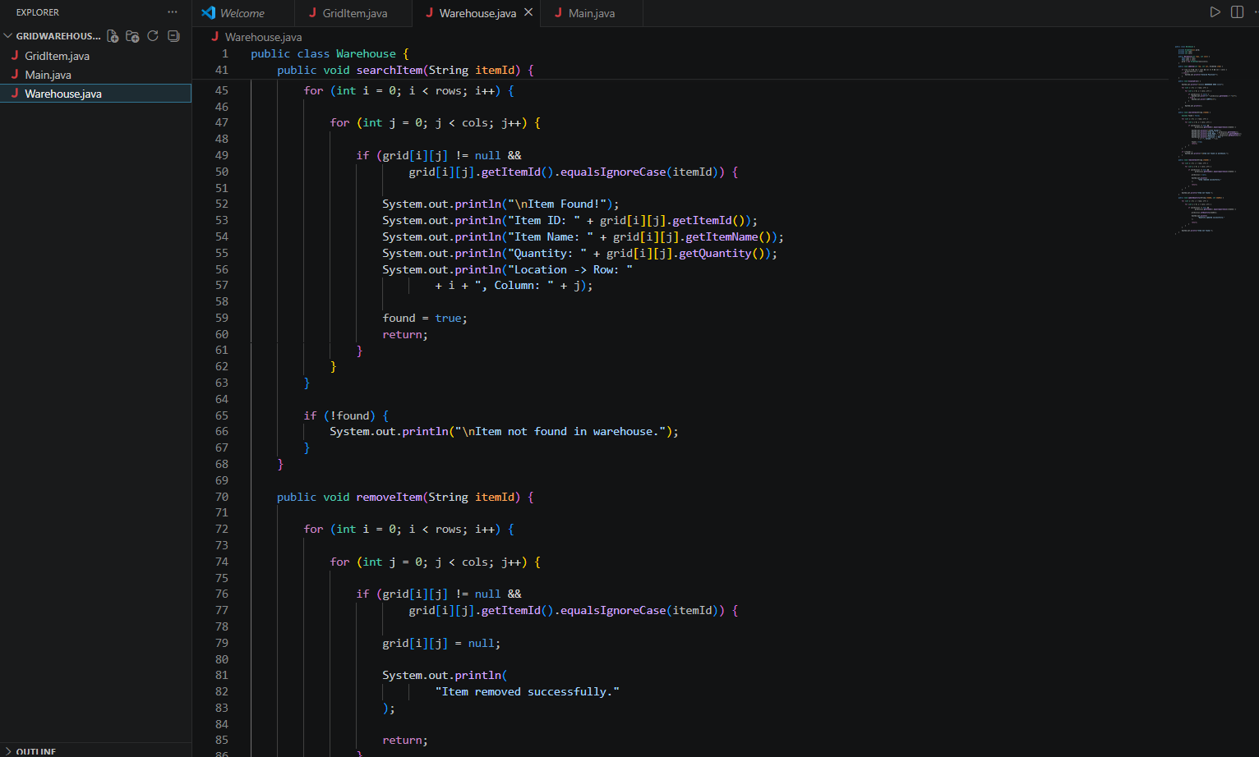
Screenshots
3. Warefare house Java

Slide 13
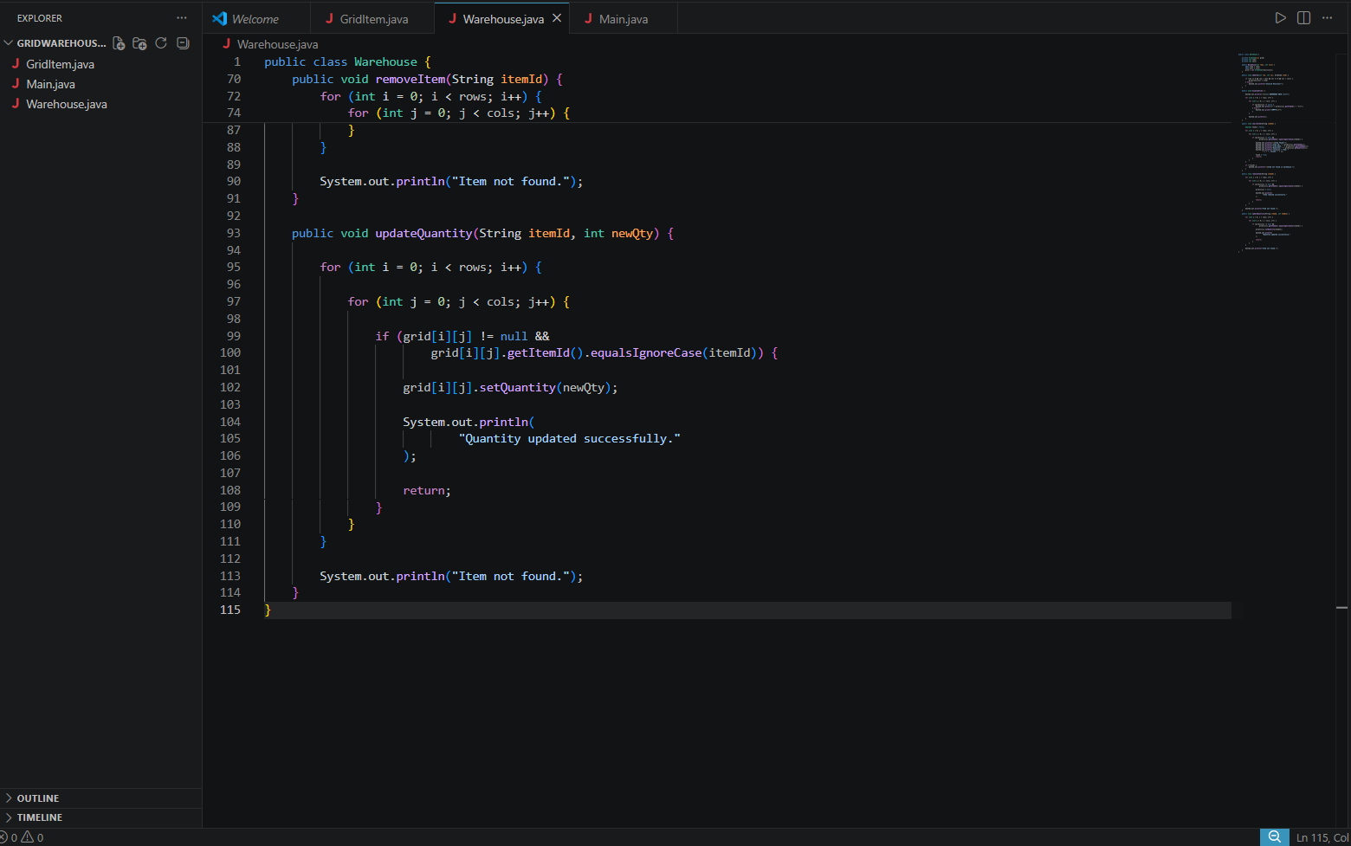
Screenshots
3. Warefare house Java

Slide 14
Sample Output
Searching for I102
Item Found
Row: 1
Column: 2
Searching for I999
Item Not Found

Slide 15
OOP Concepts Used
• Classes and Objects
• Encapsulation
• Constructors
• Methods
• Abstraction

Slide 16
Advantages
• Fast searching
• Organized storage
• Easy tracking
• Scalable design

Slide 17
Future Scope
• GUI Application
• Database Integration
• Barcode Scanning
• Cloud Storage

Slide 18
Conclusion
Project demonstrates practical use of Java OOP and 2D arrays for warehouse item tracking.

Slide 19
Thank You

