Slide 1
Rungta international skills university (RISU)
Fundamental with C
project file
Guided by :- Presented by :-
Ms. Naina Devi Ravi Sharma
IBM SME ERP – 11147
Section - 1B

Slide 2
Introduction
Loan EMI & Interest Calculator
Mini Project using C Language
Helps calculate EMI and interest easily

Slide 3
Tools & Technologies
Programming Language: C
Compiler: GCC Compiler
Editor: VS Code
Version Control: GitHub

Slide 4
Development Environment
GCC Compiler for compiling C code
VS Code for writing and running code
GitHub for code hosting and sharing

Slide 5
Project Code Overview
Project written in C language
Uses basic arithmetic and loops
Takes user input from console

Slide 6
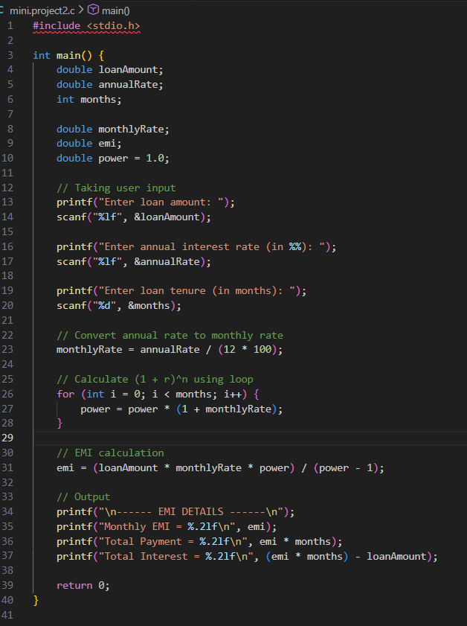
C code

Slide 7
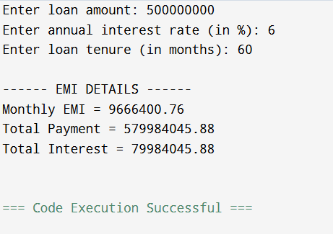
Output

Slide 8
Core Logic of Project
Accept loan amount, interest rate, and duration
Convert annual rate to monthly rate
Apply EMI formula

Slide 9
Function Explanation
Main function handles input and output
EMI calculation logic inside code
Uses loops for calculations

Slide 10
Program Flow
Start Program
Take User Input
Calculate EMI
Display Result
Exit Program

Slide 11
Working Demonstration
Program executes once
Displays EMI and interest
After displaying result, program exits

Slide 12
Application
Used in banking systems
Helpful for students and learners
Useful for financial planning

Slide 13
Advantages
Simple and user-friendly
Accurate EMI calculation
Easy to modify and extend

Slide 14
Sharing & Access
GitHub Repository Link: (Add link here)
Shared with others via WhatsApp
Easy access for learning and reuse

Slide 15
Future Scope
Add EMI table schedule
Create GUI-based application
Convert to web or mobile app

Slide 16
THANK YOU

