Slide 1

INDIA BEFORE INDIPENDENCE ??

Slide 2

Before independence, India was under British rule for almost 200 years, from 1757 to 1947. This period, known as the British Raj, saw significant changes in India's political, social, and economic landscape. The British East India Company initially established trading posts, gradually expanding their control through military conquest and political maneuvering.

Slide 3
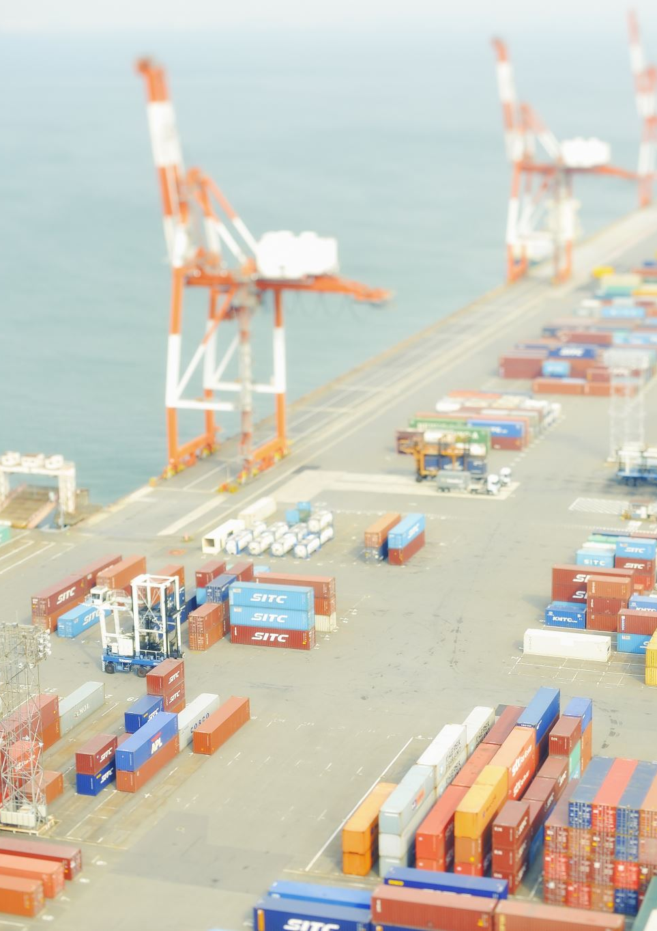
WHY BRITISHERS WANT TO TRADE IN INDIA
The British primarily wanted to trade in India to access valuable goods, establish a trade route, and eventually control India's economy and expand their empire. India provided a rich source of raw materials and a large market for British manufactured goods, contributing significantly to Britain's economic growth.

Slide 4

Access to Valuable Goods:
India was known for its production of valuable goods like spices, cotton, silk, tea, and indigo, which were in high demand in Europe. The British sought to control the production and trade of these goods to maximize profits.
Establishment of a Trade Route:
The British East India Company, initially formed for trade, gradually expanded its influence and eventually took control of vast territories in India. This allowed them to establish a direct trade route and access resources within India and its surrounding areas.
Control of India's Economy:
By controlling the trade and production of key goods, the British aimed to control India's economy and use it as a source of raw materials and a market for British manufactured goods. This also meant they could extract wealth from India and use it to fund their own industrial growth.
INDIA WAS SUPERB IN TERMS OF SPICES , GOLD AND OTHER MINIRAL RRESOURCES

Slide 5
COMPANY OPENED BY BRITISHERS !
The most notable company opened by the British in India was the East India Company (EIC), founded in 1600. Initially a trading company, it eventually transformed into a ruling body, playing a significant role in shaping the history of India and the British Empire
Established in 1600 by English merchants, the EIC was chartered to trade with the East Indies (later including India).
Trading Company to Ruling Body:
While initially focused on trade, the EIC gradually gained political power and military influence, eventually controlling vast territories in India.
Royal Charter:
The company received a royal charter from Queen Elizabeth I in 1600, granting them the right to trade in the East.
Expansion and Conflict:
The EIC's presence in India led to conflicts with other European powers (like the Portuguese and Dutch), as well as with various Indian rulers.
British Raj:
The EIC's rule in India eventually transitioned to the British Raj, where the British Crown directly administered India after the Indian Rebellion of 1857.
Dissolution:
The EIC was eventually dissolved in 1874, but its legacy continued to influence India's political, economic, and social landscape.

Slide 6
NAME – Saatvik Sharma CLASS- X-B ROLL NO - 23

