Slide 1
Journal Mining
Bhupesh ravish

Slide 2
Introductions!

Slide 3
Current Situation
Journal Mining is not easy…
All Manual effort.
Time consuming.
Error Prone(Human).

Slide 4
Possible Solution
Create a Journal Mining module.
API Based – NCBI.
Less Manual Effort.
Possible No Manual Effort in Future.
Less Time Consuming.
Less Error Prone.

Slide 5
NCBI API
Entrez programming Utilities (E-utilities)
E-(Info/Search/Post/Summary/Fetch/Link/GQuery/Spell/CitMatch)
BLAST URL API
PubChem power User Gateway(PUG)
PubMed Central (PMC) APIs
OAI-PMH

Slide 6
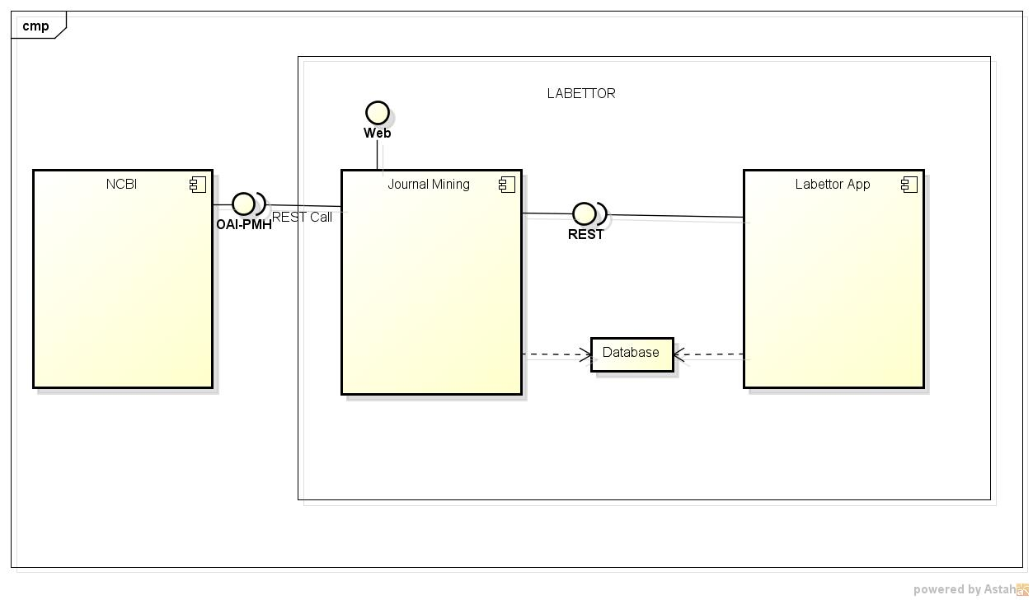
High Level Solution

Slide 7
Solution POC
Basic random search for keywords with timeframe of last 5 years.
Spring boot based application.
Web based endpoint to access the application.
No storage.

Slide 8
Solution – In addition to POC
Database.
Detailed Information about the journals.
Pagination.
Cloud Readiness.
REST based endpoint.
So existing application(Lab) can also connect to.
Solution will be a API which can be extended to multiple Journals, and not just NCBI.
XML/JSON/TXT based exchange of information.

Slide 9
Further More…
Enable Intelligence in the Journal Mining Module.
Understand the Methods and identify Products, Brands, possibly more!
A bit of Machine Learning….

Slide 10
Thoughts? ravishbhupesh@gmail.com

