Slide 1


Indian Institute of Technology Gandhinagar
WEEK 4 · MONDAY · BUSINESS METRIC DESIGN · UBER, HYDERABAD
ADMINISTERED THROUGH THE COMPETENCY ADVANCEMENT ACADEMY
Business metric design: the number a plan chases
Which number should a plan chase, and what stops the people paid on it from gaming it?
Monday answers one question with six topics: which single number should a plan chase, and what stops the people paid to raise it from raising it the wrong way? The topics come first, each taught on an everyday example whose numbers are invented and small enough to count by hand. Then Uber's Hyderabad driver app uses all six to judge a peak-hour earnings guarantee, an illustrative case: the company is real, the situation and the data are synthetic, built for this class.
FIRST
THEN
IN THE LAB
Six topics
The case
Kalpa Retail
A canteen, a driving school, a cricket chase, a register and a kirana shop, all invented.
Uber's Hyderabad guarantee, paid on peak online hours.
The number the head of Retail-Plus, Kalpa's paid membership tier, wants.
What is a number for?
Which number to chase?
Which number warns?
Which four lines?
How is a number gamed?
What does the page hold?
What does an hour count?
S1 · 1 / 93
…
Notes:
LIVE, 1 minute, on screen as the room sits down. Read the subtitle: it is the row's Day focus, the
number the growth plan chases and what stops it being gamed. Say the order of the day once: six
topics on everyday examples, then the Uber case, then Kalpa in the TA lab. The row's own scenario,
the growth plan of Meera Raghavan, Kalpa Retail's CEO, back after Build 1's Kalpa Health week, and the fight over which number the company chases, comes back
in the lab, where the head of Retail-Plus wants "reorders per member". Transition: where Monday sits
in the week.

Slide 2
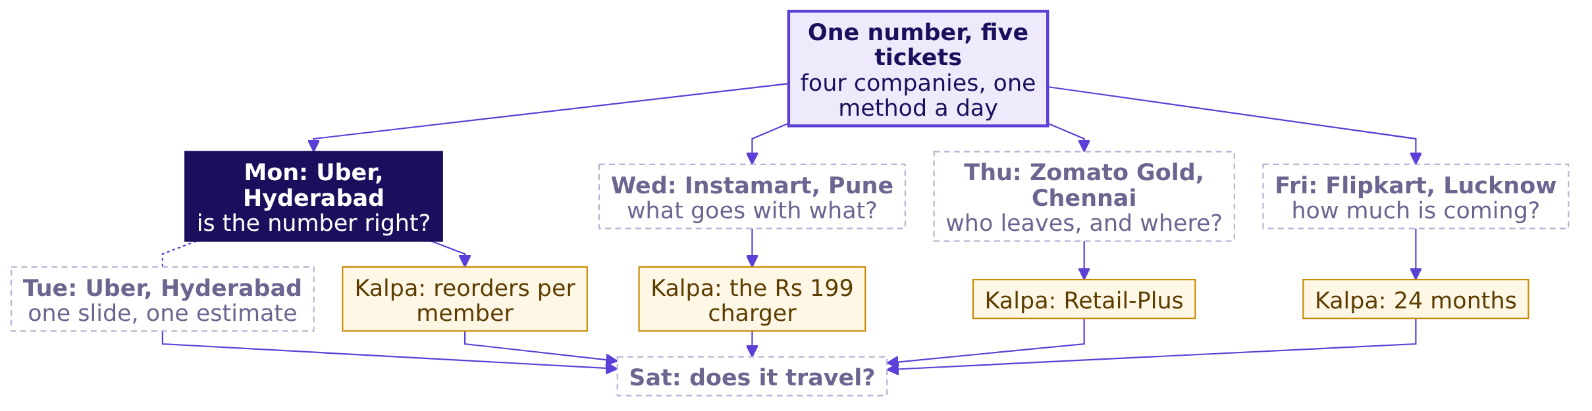
Indian Institute of Technology Gandhinagar
WEEK 4 · MONDAY · BUSINESS METRIC DESIGN · UBER, HYDERABAD
ADMINISTERED THROUGH THE COMPETENCY ADVANCEMENT ACADEMY
The week: five tickets, one method a day
Where does today's ticket sit among the week's five?
What is a number for?
Which number to chase?
Which number warns?
Which four lines?
How is a number gamed?
What does the page hold?
What does an hour count?
S2 · 2 / 93
…
Notes:
LIVE, 1 minute. Point to Monday, lit, and to the four dashed days. Each day is a ticket at a company
the room uses, and each day's TA lab moves the same method to Kalpa Retail. Monday is first, so no
earlier day has a number on its node yet; by Saturday every node carries the number the room
produced on it. The week explorer (demos/C2_W04_D01_week_explorer_STUDENT.html, which ships with the
week) opens on this map; light Monday there if it is on the projector. Transition: the six topics.

Slide 3
Indian Institute of Technology Gandhinagar
WEEK 4 · MONDAY · BUSINESS METRIC DESIGN · UBER, HYDERABAD
ADMINISTERED THROUGH THE COMPETENCY ADVANCEMENT ACADEMY
Six topics, then the case that uses them
Which topics does Monday teach, in which order, and where is each practised?
Chapter | Topic, as the curriculum words it | Minutes | Notebook
1 | What to measure and why; the proxy test | 13 minutes | 01
2 | North-star and guardrail metrics | 10 minutes | 02
3 | Leading against lagging indicators | 10 minutes | 03
4 | Definitions: numerator, denominator, window, exclusions | 10 minutes | 04
5 | Gaming, and definitions that resist it | 10 minutes | 05
6 | The metric definition artifact | 10 minutes | 06
7 to 9 | The case: Uber's Hyderabad peak-hour guarantee, after a 10-minute break | 100 minutes | 07 to 09
10 and 11 | The case's last round and the interview room, after lunch | 40 minutes | 10 and 11
Lab | Kalpa Retail's growth plan, the same method, in the practice lab | the lab's length | 12
A 7-minute opening comes first; after chapter 11, 20 minutes hold the Kahoot, the handoff and the close, then the IITGN faculty session (tentative). Each notebook in notebooks/ carries its chapter's number and topic.
What is a number for?
Which number to chase?
Which number warns?
Which four lines?
How is a number gamed?
What does the page hold?
What does an hour count?
S3 · 3 / 93
…
Notes:
LIVE, 2 minutes. Read the topic column aloud: these are the six subtopics of the curriculum row, in
its order, word for word. Chapters 1 to 3 decide what to count; chapters 4 to 6 decide how it is
written down so it cannot be gamed. Then read the running order the table and the line under it
give: the opening, the six chapters, the break, chapters 7 to 9 to lunch, chapters 10 and 11 and the
20-minute close, then the IITGN faculty session (tentative), or the metric clinic in its place. The
row's own Kalpa scenario, Meera's growth plan and the three numbers its teams propose, runs in the
practice lab on the same method. Transition: how the six topics join.

Slide 4
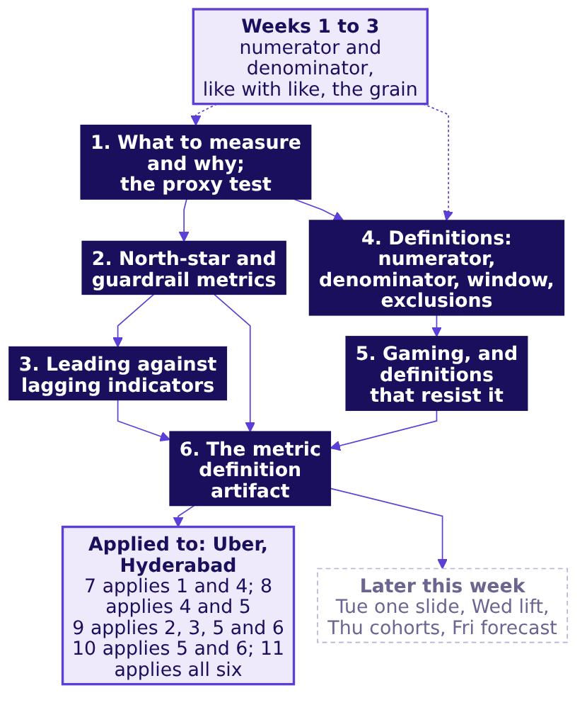
Indian Institute of Technology Gandhinagar
WEEK 4 · MONDAY · BUSINESS METRIC DESIGN · UBER, HYDERABAD
ADMINISTERED THROUGH THE COMPETENCY ADVANCEMENT ACADEMY
Six topics: what each rests on and what it feeds
How do Monday's six topics connect to each other, to earlier weeks and to the case?
What is a number for?
Which number to chase?
Which number warns?
Which four lines?
How is a number gamed?
What does the page hold?
What does an hour count?
S4 · 4 / 93
…
Notes:
LIVE, 2 minutes. ByteByteGo's move: one connected map before any detail. The lit boxes are the six
topics of the row, in its order. Two chains: chapters 1 to 3 choose the number (is it safe to pay
for, which one to chase, which one warns first), and chapters 4 and 5 write it down so it cannot be
gamed; chapter 6 puts both on one page, its guardrails from chapter 2. The Uber box says which case
chapter applies which topic. On the slide all six are lit as today's topics; on the board, draw them
unlit and light each as its chapter closes. The dashed box is what the chapters reuse, each named again at
the point of reuse: Week 1 Monday's numerator and denominator for every rate, Week 1 Tuesday's like
with like, Week 2 Friday's grain and one number with its denominator. Tuesday defends today's number
on one slide; Wednesday's lift, Thursday's cohorts and Friday's forecast each consume a number written
today's way. Every concept chapter closes on this map with its own box lit. Explorer: the home screen.
Transition: the destination.

Slide 5
Indian Institute of Technology Gandhinagar
WEEK 4 · MONDAY · BUSINESS METRIC DESIGN · UBER, HYDERABAD
ADMINISTERED THROUGH THE COMPETENCY ADVANCEMENT ACADEMY
The case: a guarantee paid on hours, six weeks on
Where will the six topics be used, and what must the analyst hand in?
On the ticket | What it says
Company, city, surface | Uber, Hyderabad, the driver app: from Monday 31 August 2026 an enrolled driver (one signed up for the scheme) online through a whole peak window (two a day, three hours each) is guaranteed Rs 300 per peak online hour, and Uber tops up the gap between the driver's trip earnings and that floor
Before and after, six weeks each side | Peak online hours 118,000 to 146,300, up 24 percent; completed peak trips 224,200 to 230,900, up 3 percent; trips per peak online hour 1.90 to 1.58; top-up Rs 0 to Rs 1.9 crore
The data | drivers, driver_weeks (one row per driver per week) and zone_weeks (rider requests and waits by zone)
The ask, due Friday | Is the scheme working, which number should it pay for, and is anyone gaming it?
Caveats | The monsoon ended mid-window; 140 drivers are new; online means the app is open; three outer zones get few requests
*Illustrative case: the company is real, the situation and the data are synthetic, built for this class.*
What is a number for?
Which number to chase?
Which number warns?
Which four lines?
How is a number gamed?
What does the page hold?
What does an hour count?
S5 · 5 / 93
…
Notes:
LIVE, 1 minute. Show it as the destination: read the before and after line and the ask, nothing
more. Ask which of these numbers the city team would put in Monday's headline; most hands go to peak
online hours, up 24 percent. Write it on the whiteboard with the board's question above it, "What
makes a number safe to pay for?", and leave both up: chapter 7 opens on the full ticket after the
break and fills the board region by region. Transition: chapter 1.

Slide 6

Indian Institute of Technology Gandhinagar
PG DIPLOMA IN AI-ML AND AGENTIC AI ENGINEERING · COHORT 2
ADMINISTERED THROUGH THE COMPETENCY ADVANCEMENT ACADEMY
01
What to measure and why; the proxy test
What is a number for?
Say what a number is for, and test whether a team could raise it while the thing it stands for got no better.
What is a number for?
Which number to chase?
Which number warns?
Which four lines?
How is a number gamed?
What does the page hold?
What does an hour count?
Where did the fall sit?
What should it pay for?
Week 4, Day 1. Business metric design: which number should the plan chase, and what stops it being gamed?
6 / 93
Notes:
LIVE, 30 seconds. Concept 1 of 6, 13 minutes, the longest, because it opens on the instinct round
the curriculum row asks for. The topic is the row's subtopic, word for word. Every number in this
chapter except the bank's on its last slide is invented. Notebook 01 runs beside the chapter. Transition: what a metric is, and who needs the answer.

Slide 7
Indian Institute of Technology Gandhinagar
WEEK 4 · MONDAY · BUSINESS METRIC DESIGN · UBER, HYDERABAD
ADMINISTERED THROUGH THE COMPETENCY ADVANCEMENT ACADEMY
A metric is a number someone decides with
Who needs the answer, and which questions lead to it?
A metric is a number a person watches in order to decide something: how much rice to cook, whom to pay, whether to keep a scheme. A target is a metric with a value somebody is asked to hit, and a person paid on a target works to hit it.
Who needs the answer. A school canteen's owner (invented), whose kitchen cooks rice to the count of tokens the counter hands out and who pays the servers by the same count: a count that drifts from the plates wastes rice and money every day.
THE JOB
THE PULL
THE COST
THE TEST
What is it for?
What did pay change?
What did it cost?
Is it safe to pay for?
The decision it feeds, and who makes it.
The count the servers were paid on.
Rice cooked from the wrong count.
Could a team raise it while the goal got no better?
What is a number for?
Which number to chase?
Which number warns?
Which four lines?
How is a number gamed?
What does the page hold?
What does an hour count?
S6 · 7 / 93
…
Notes:
LIVE, 1 minute. Read the two definitions, then the four questions; each gets a number before the
next is asked. Most of the room has never been paid on a number, so the canteen makes the pull of a
target concrete. Transition: the instinct round.

Slide 8




Indian Institute of Technology Gandhinagar
WEEK 4 · MONDAY · BUSINESS METRIC DESIGN · UBER, HYDERABAD
ADMINISTERED THROUGH THE COMPETENCY ADVANCEMENT ACADEMY
Which teacher number can rise as children learn less?
A principal (invented) proposes three numbers to judge teachers by. Which could a teacher raise while the children learned less?
A
B
C
D
Attendance marked
Homework collected
Term exam average
All three of them
Only the share of children marked present.
Only the notebooks handed in each week.
Only the class's average mark in the exam.
Attendance, homework and the exam average.
What is a number for?
Which number to chase?
Which number warns?
Which four lines?
How is a number gamed?
What does the page hold?
What does an hour count?
S7 · 8 / 93
…
Notes:
LIVE, 3 minutes, the row's instinct round at small scale: three proposed targets, and the room says
how each could be hit while the thing it stands for got no better. Letters on paper, a show of letters,
two minutes with a neighbour, a second vote. Most pick c, since an exam feels hard to fake. Write the
room's ways of raising each number on the board before the answer goes up. Transition: the answer.

Slide 9
Indian Institute of Technology Gandhinagar
WEEK 4 · MONDAY · BUSINESS METRIC DESIGN · UBER, HYDERABAD
ADMINISTERED THROUGH THE COMPETENCY ADVANCEMENT ACADEMY
Answer: d, all three can rise with no extra learning
How could each number rise, and what does that make each of them?
The number | How a teacher could raise it while the children learned less
Attendance marked | Mark a child present who is not in the room: the register is the teacher's own
Homework collected | Collect every notebook and never read one
Term exam average | Teach only the questions the paper repeats, or keep the weakest children away from the exam
Each number stands in for the children's learning, which nobody can count directly. A proxy is a number that stands in for the thing somebody wants. The belief the vote tested is the common one: if the number goes up, the thing it stands for has improved.
What is a number for?
Which number to chase?
Which number warns?
Which four lines?
How is a number gamed?
What does the page hold?
What does an hour count?
S8 · 9 / 93
…
Notes:
LIVE, 1 minute 30 seconds. Take each row in turn. The room usually finds the first two and argues
about the third: the exam average is a proxy too, and its last move, keeping the weakest children
away, returns in chapter 2 at a driving school as a shrinking denominator. Transition: the same pull,
counted by hand.

Slide 10
Indian Institute of Technology Gandhinagar
WEEK 4 · MONDAY · BUSINESS METRIC DESIGN · UBER, HYDERABAD
ADMINISTERED THROUGH THE COMPETENCY ADVANCEMENT ACADEMY
Tokens doubled once servers were paid per token
What did ten days of a school canteen's counts do when pay followed tokens (invented)?
Days | Servers paid per token? | Tokens a day | Plates a day | Tokens per plate
1 to 5 | no | 200 | 200 | 200 / 200 = 1.0
6 to 10 | yes | 400 | 200 | 400 / 200 = 2.0
Counted by hand. The kitchen cooks 150 g of rice for every token the counter hands out, batch by batch through lunch. From the plates: 200 x 0.15 = 30 kg. From the tokens on day 6: 400 x 0.15 = 60 kg, so 30 kg is thrown away that day, Rs 1,500 a day at Rs 50 a kg and Rs 7,500 over the five paid days. Every number here is invented.
What is a number for?
Which number to chase?
Which number warns?
Which four lines?
How is a number gamed?
What does the page hold?
What does an hour count?
S9 · 10 / 93
…
Notes:
LIVE, 2 minutes, StatQuest: say each number aloud and write the four sums on the board.
Ask what changed on day 6: only the pay rule. A server who hands two tokens to each diner is paid
twice for one plate, and nobody else loses anything they can see that day. Transition: the picture,
and the rule named last.

Slide 11
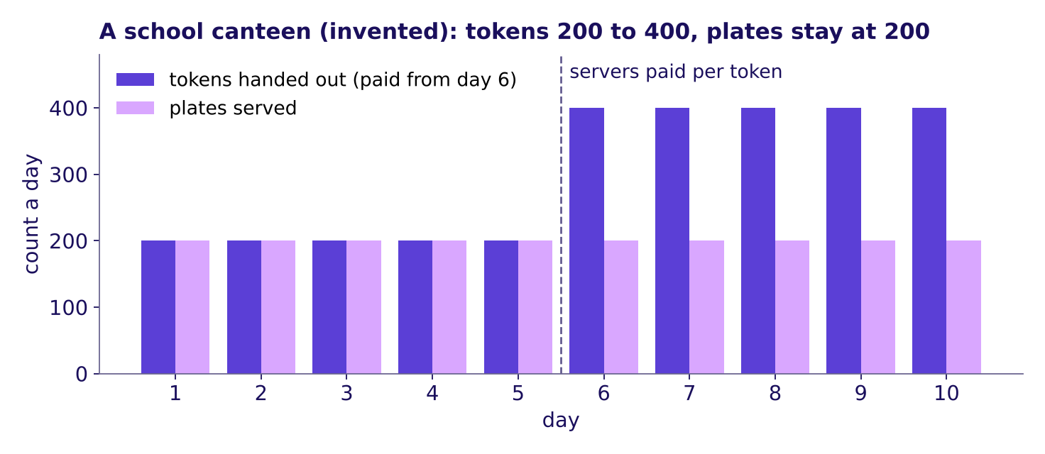
Indian Institute of Technology Gandhinagar
WEEK 4 · MONDAY · BUSINESS METRIC DESIGN · UBER, HYDERABAD
ADMINISTERED THROUGH THE COMPETENCY ADVANCEMENT ACADEMY
The paid count drifted from the plates it stood for
What does the picture show, and what is the rule called?
Ten days at a school canteen (invented): tokens doubled on day 6, plates stayed at 200
The tokens stood in for plates until the servers were paid on them; from day 6 the paid number doubled and the plates stayed flat. Named last: the proxy test asks whether a team could hit this number while the thing it stands for got worse or stayed the same. Tokens fail it, and the curriculum's rule says why: any target bends behaviour toward itself.
What is a number for?
Which number to chase?
Which number warns?
Which four lines?
How is a number gamed?
What does the page hold?
What does an hour count?
S10 · 11 / 93
…
Notes:
LIVE, 1 minute 30 seconds, 3Blue1Brown: the picture first, the name after it. The rule in the
curriculum row's own words: "if a department could hit the number while the business got worse, the
number is a proxy that has drifted." The word proxy as research uses it: Chou, "Blending Proxy
Metrics with a North Star", arXiv 2606.21745 (June 2026), whose abstract describes proxies as numbers
used in place of outcomes the experimenter does not observe:
https://arxiv.org/abs/2606.21745 (checked 13 October 2026). Explorer: scene M1 draws the same drift
on the city's drivers; it belongs to chapter 8, which opens it at S67. Transition: the same test in
code.

Slide 12
Indian Institute of Technology Gandhinagar
WEEK 4 · MONDAY · BUSINESS METRIC DESIGN · UBER, HYDERABAD
ADMINISTERED THROUGH THE COMPETENCY ADVANCEMENT ACADEMY
Five lines of pandas run the proxy test
How does code reproduce the count and the test?
days = pd.read_csv("../data/C2_W04_D01_canteen_days_STUDENT.csv") # ten invented days
days["per_plate"] = days["tokens"] / days["plates"] # 1.0, then 2.0
days["rice_kg"] = days["tokens"] * 0.15 # what the kitchen cooks from tokens
first, last = days.iloc[0], days.iloc[-1]
drifted = last.tokens > first.tokens and last.plates <= first.plates # True
drifted prints True: the paid number rose and the thing it stands for did not. Notebook 01 runs the same lines on the ten days, draws the picture and tries the test on a second number, a school bus driver's kilometres (invented).
What is a number for?
Which number to chase?
Which number warns?
Which four lines?
How is a number gamed?
What does the page hold?
What does an hour count?
S11 · 12 / 93
…
Notes:
LIVE, 1 minute, Krish Naik's move: one plain sentence for each line. Line one loads the ten days;
line two divides tokens by plates; line three cooks rice from tokens the way the kitchen did; the
last two lines ask the proxy test of the two columns, first day against last. Transition: the rules.

Slide 13

Indian Institute of Technology Gandhinagar
WEEK 4 · MONDAY · BUSINESS METRIC DESIGN · UBER, HYDERABAD
ADMINISTERED THROUGH THE COMPETENCY ADVANCEMENT ACADEMY
Four rules for choosing what to measure
Which rules does the chapter leave, and what does an interviewer ask?
01
Name the decision a number feeds before you count it.
02
A proxy stands in for the thing wanted, and nearly every number on a dashboard is one.
03
Before anyone is paid on a number, ask whether a team could raise it while the goal got no better.
04
Any target bends behaviour toward itself, so read a paid number beside the thing it stands for.
IN THE INTERVIEW
[S] How would you measure the success of a new feature?
*Each interview line carries a tag: [S] is asked everywhere, [F] often in product screens and in global capability centres (GCCs, the offices global companies run in India), and [D] sets a strong candidate apart.*
What is a number for?
Which number to chase?
Which number warns?
Which four lines?
How is a number gamed?
What does the page hold?
What does an hour count?
S12 · 13 / 93
…
Notes:
LIVE, 1 minute 30 seconds. The rules are the slide a learner photographs. Ask the proxy-test set's
first item aloud (exercises/unguided/C2_W04_D01_proxy_test_set_STUDENT.md, Q1), take letters, then
say the key and one reason from its solution file; Q2 and Q3 wait for the practice lab. Transition:
where the idea goes, and what it cost a bank.

Slide 14
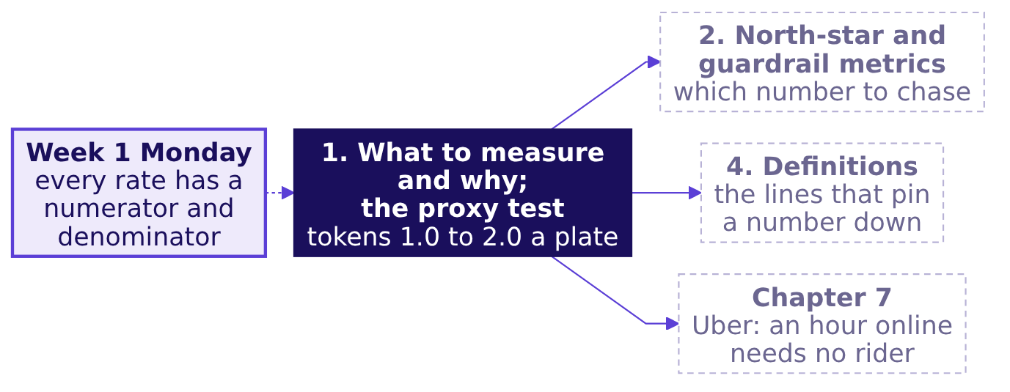
Indian Institute of Technology Gandhinagar
WEEK 4 · MONDAY · BUSINESS METRIC DESIGN · UBER, HYDERABAD
ADMINISTERED THROUGH THE COMPETENCY ADVANCEMENT ACADEMY
The proxy test feeds chapter 2 and the case's hours
Where did the idea come from, and where does it go next?
The same test failed at a bank. Cross-selling is selling an existing customer one more product, such as a credit card to someone with a savings account. Wells Fargo judged branch staff on products sold, through sales targets and bonuses, and showed investors a cross-sell number, products per household; staff opened accounts customers never asked for or used, and both counts rose. It paid USD 185 million in penalties in 2016 (100 to the US consumer-finance regulator, 35 to a US bank regulator, 50 to Los Angeles) and USD 3 billion in 2020.
What is a number for?
Which number to chase?
Which number warns?
Which four lines?
How is a number gamed?
What does the page hold?
What does an hour count?
S13 · 14 / 93
…
Notes:
LIVE, 1 minute. The idea joins the map. Then the bank, in order: the numbers (products sold, on
which the CFPB says staff chased "sales targets" and "bonuses", and the cross-sell number, products
per household, which investors read), the missing condition (nobody had to use the account), what it cost (USD 185 million in
2016: the CFPB's USD 100 million, the OCC's USD 35 million and Los Angeles's USD 50 million, all named
in the CFPB's release; USD 3 billion in 2020, and the bank dropped product sales goals). Do not quote a firing count or
Goodhart; neither is verified in the week's sources. Sources:
https://www.consumerfinance.gov/about-us/newsroom/consumer-financial-protection-bureau-fines-wells-fargo-100-million-widespread-illegal-practice-secretly-opening-unauthorized-accounts/ (checked 13 October 2026)
https://www.sec.gov/newsroom/press-releases/2020-38 (checked 13 October 2026)
Transition: chapter 2, the number a plan chases.

Slide 15
Indian Institute of Technology Gandhinagar
PG DIPLOMA IN AI-ML AND AGENTIC AI ENGINEERING · COHORT 2
ADMINISTERED THROUGH THE COMPETENCY ADVANCEMENT ACADEMY
02
North-star and guardrail metrics
Which number to chase?
Pick the one number a plan chases, and the numbers that must not fall while it rises.
What is a number for?
Which number to chase?
Which number warns?
Which four lines?
How is a number gamed?
What does the page hold?
What does an hour count?
Where did the fall sit?
What should it pay for?
Week 4, Day 1. Business metric design: which number should the plan chase, and what stops it being gamed?
15 / 93
Notes:
LIVE, 30 seconds. Concept 2 of 6, 10 minutes. The example is a driving school whose numbers are all
invented; its four instructors teach 25 learners each. Notebook 02 runs beside the chapter.
Transition: who needs the answer.

Slide 16
Indian Institute of Technology Gandhinagar
WEEK 4 · MONDAY · BUSINESS METRIC DESIGN · UBER, HYDERABAD
ADMINISTERED THROUGH THE COMPETENCY ADVANCEMENT ACADEMY
A plan chases one number and watches others
Who needs the answer, and which questions lead to it?
When a plan has many numbers, a team needs one it chases and a few it watches so the chase does no harm. The one it chases is the north star; the ones that must not get worse while it rises are the guardrails.
Who needs the answer. A family choosing a driving school (invented) from its hoarding, and the owner who pays instructors on the hoarding's number: a rate read alone can sell a year in which fewer learners got a licence.
THE CLAIM
THE MOVE
THE OUTCOME
THE GUARD
What does the hoarding count?
What else changed?
What did learners pay for?
What must not fall?
How many took the test.
A licence, per learner who enrolled.
The share who got to take the test.
Passes over learners who took the test.
What is a number for?
Which number to chase?
Which number warns?
Which four lines?
How is a number gamed?
What does the page hold?
What does an hour count?
S14 · 16 / 93
…
Notes:
LIVE, 1 minute. Read the two names and the four questions. A learner who has never worked in a
business has seen this pull in coaching ads and school results, so the driving school is chosen to
feel familiar. Transition: the prediction.

Slide 17



Indian Institute of Technology Gandhinagar
WEEK 4 · MONDAY · BUSINESS METRIC DESIGN · UBER, HYDERABAD
ADMINISTERED THROUGH THE COMPETENCY ADVANCEMENT ACADEMY
A pass rate rose from 60 to 90 percent: why?
A driving school (invented) prints "90 percent pass the licence test" on its hoarding; last year it printed 60. What most likely happened?
A
B
C
D
Better teaching
An easier test
Fewer took the test
More enrolled
Instructors taught more this year.
The transport office made it simpler.
Instructors booked it only for their surest learners.
A bigger intake lifted the rate.
What is a number for?
Which number to chase?
Which number warns?
Which four lines?
How is a number gamed?
What does the page hold?
What does an hour count?
S15 · 17 / 93
…
Notes:
LIVE, 1 minute 30 seconds. Vote, a neighbour, vote again. The plausible first instinct is a, the
reading the hoarding is written for. Transition: the answer, counted by hand.

Slide 18
Indian Institute of Technology Gandhinagar
WEEK 4 · MONDAY · BUSINESS METRIC DESIGN · UBER, HYDERABAD
ADMINISTERED THROUGH THE COMPETENCY ADVANCEMENT ACADEMY
Answer: c, 40 took the test where 100 had
How do the school's counts show it, counted by hand?
Year | Enrolled | Took the test | Passed | Passed / took | Took / enrolled | Passed / enrolled
2025 | 100 | 100 | 60 | 0.60 | 1.00 | 0.60
2026 | 100 | 40 | 36 | 0.90 | 0.40 | 0.36
Counted by hand, invented numbers. In 2025 all 100 learners took the test and 60 passed: 60 / 100 = 0.60. In 2026 each instructor booked the test only for the learners they were surest of, 40 in all, and 36 passed: 36 / 40 = 0.90. Licences per learner who enrolled fell from 60 / 100 = 0.60 to 36 / 100 = 0.36.
What is a number for?
Which number to chase?
Which number warns?
Which four lines?
How is a number gamed?
What does the page hold?
What does an hour count?
S16 · 18 / 93
…
Notes:
LIVE, 1 minute 30 seconds. Write the six numbers on the board and divide aloud. The hoarding's
rate rose by half while 24 fewer learners got a licence. Transition: the picture, and the two names.

Slide 19
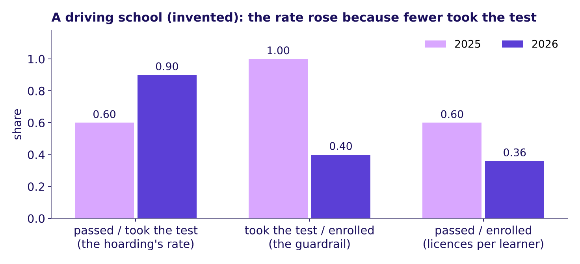
Indian Institute of Technology Gandhinagar
WEEK 4 · MONDAY · BUSINESS METRIC DESIGN · UBER, HYDERABAD
ADMINISTERED THROUGH THE COMPETENCY ADVANCEMENT ACADEMY
The pass rate rose because its denominator shrank
What does the picture show, and what are the two numbers called?
A driving school (invented): the pass rate rose as the share who took the test fell
The hoarding's rate rose because the share who took the test fell: a seesaw, one side up because the other went down. Named last: a north star is the one number that best captures the value the people served get; here it is licences per enrolled learner, 0.60 then 0.36, which no instructor can raise by holding learners back. The hoarding chased the pass rate instead. A guardrail is a number watched beside the number being chased, so that hitting it does no hidden harm: beside the pass rate, the share who took the test, 1.00 then 0.40, catches this school's move.
What is a number for?
Which number to chase?
Which number warns?
Which four lines?
How is a number gamed?
What does the page hold?
What does an hour count?
S17 · 19 / 93
…
Notes:
LIVE, 1 minute 30 seconds, 3Blue1Brown: point at the seesaw before naming it. The two numbers
multiply into the honest one: 0.90 x 0.40 = 0.36. Sources for the names: Amplitude's "What Makes a
Good vs Bad North Star Metric" (Julia Sholtz, 15 August 2024): "A North Star Metric is a single metric
that best captures the value customers derive from your product":
https://www.amplitude.com/blog/good-bad-north-star-metric.md (checked 13 October 2026); Spotify
Confidence's glossary: "A guardrail metric is a metric monitored during an experiment to ensure the
change doesn't cause unintended harm, even when the success metric improves":
https://confidence.spotify.com/glossary/guardrail-metric (checked 13 October 2026). Explorer: scene
M2, the seesaw, on the city's drivers; it belongs to chapter 9, which opens it at S75 and S80.
Transition: the same split in code.

Slide 20
Indian Institute of Technology Gandhinagar
WEEK 4 · MONDAY · BUSINESS METRIC DESIGN · UBER, HYDERABAD
ADMINISTERED THROUGH THE COMPETENCY ADVANCEMENT ACADEMY
Five lines of pandas split the rate in two
How does code reproduce the count?
school = pd.read_csv("../data/C2_W04_D01_driving_school_STUDENT.csv") # invented
year = school.groupby("year")[["enrolled", "took_test", "passed"]].sum()
year["pass_rate"] = year["passed"] / year["took_test"] # 0.60, 0.90
year["took_share"] = year["took_test"] / year["enrolled"] # 1.00, 0.40
year["per_learner"] = year["pass_rate"] * year["took_share"] # 0.60, 0.36
The last line multiplies the hoarding's rate by its guardrail and gives licences per learner who enrolled, the number the families wanted.
What is a number for?
Which number to chase?
Which number warns?
Which four lines?
How is a number gamed?
What does the page hold?
What does an hour count?
S18 · 20 / 93
…
Notes:
LIVE, 1 minute. One sentence a line: load, add up each year, divide twice, multiply. The product
equals passed over enrolled, which notebook 02 checks a second way. Transition: the rules.

Slide 21
Indian Institute of Technology Gandhinagar
WEEK 4 · MONDAY · BUSINESS METRIC DESIGN · UBER, HYDERABAD
ADMINISTERED THROUGH THE COMPETENCY ADVANCEMENT ACADEMY
Four rules for a north star and its guardrails
Which rules does the chapter leave, and what does an interviewer ask?
01
Chase one number: the one that best captures the value the people served get.
02
Read the number a plan chases beside a guardrail that catches a harmful way of hitting it.
03
Choose a guardrail by the harm or gaming it catches: a second growth target, such as "orders up 20 percent", is one more number to chase and catches none.
04
A rate can rise because its denominator shrank, so print the count beside the rate.
IN THE INTERVIEW
[F] North-star against guardrail, with one example pair.
What is a number for?
Which number to chase?
Which number warns?
Which four lines?
How is a number gamed?
What does the page hold?
What does an hour count?
S19 · 21 / 93
…
Notes:
LIVE, 1 minute 30 seconds. Ask the north-star set's first item aloud (exercises/unguided/
C2_W04_D01_north_star_guardrails_set_STUDENT.md, Q1), take letters, then say the key and one reason.
Transition: two companies whose headline number had to match what they were trying to do.

Slide 22
Indian Institute of Technology Gandhinagar
WEEK 4 · MONDAY · BUSINESS METRIC DESIGN · UBER, HYDERABAD
ADMINISTERED THROUGH THE COMPETENCY ADVANCEMENT ACADEMY
Orders per user would have read a success as a fall
What happens when a north star counts the wrong thing for what the business is trying to do?
over 28%
Rs 612
NOV
OF MTUS, IN SWIGGY'S WORDS
AVERAGE ORDER VALUE
ETERNAL'S HEADLINE
monthly transacting users on Maxxsaver, April to June 2025
up 16 percent on the quarter: selection and Maxxsaver
net order value: gross order value minus discounts
Swiggy Instamart's Maxxsaver unlocks extra discounts once a cart passes a threshold, so some users put more into fewer orders. Swiggy puts the slower order growth down to that and to letting go of some low-value orders and unprofitable users: orders per user alone would read the quarter as a fall, and the letter adds that the ramp-up kept contribution flat. Eternal, whose businesses include Zomato and Blinkit, stopped disclosing gross order value from its letter for the quarter to 30 June 2026, saying in its food delivery line that "NOV more accurately reflects underlying performance": a discount is value handed back to the customer, which gross order value still counts.
What is a number for?
Which number to chase?
Which number warns?
Which four lines?
How is a number gamed?
What does the page hold?
What does an hour count?
S20 · 22 / 93
…
Notes:
LIVE, 1 minute. Each company chose a headline number that matched what it was trying to do;
neither letter says a number was used badly, so do not say it either. Swiggy's and Eternal's
financial years start in April, so Q1 FY26 is the quarter to 30 June 2025 and Q1 FY27 the quarter to
30 June 2026. Sources: Swiggy's Q1 FY26
shareholder letter: https://www.swiggy.com/corporate/wp-content/uploads/2025/07/Q1-FY2026-Shareholder-letter.pdf
(checked 13 October 2026); Eternal's Q1 FY26 letter for NOV = GOV minus discounts:
https://drive.google.com/file/d/1VtoiLsA2OpKauFnkKIlhXRmnbvxL-6ha/view (checked 13 October 2026);
its Q1 FY27 letter for the sunset:
https://drive.google.com/file/d/1jb9KWd4Ap4RTKHFHxzEOO7jgQqVZEGcd/view (checked 13 October 2026),
linked from https://www.eternal.com/blog/q1fy27/ (checked 13 October 2026). Transition: where the
idea goes.

Slide 23
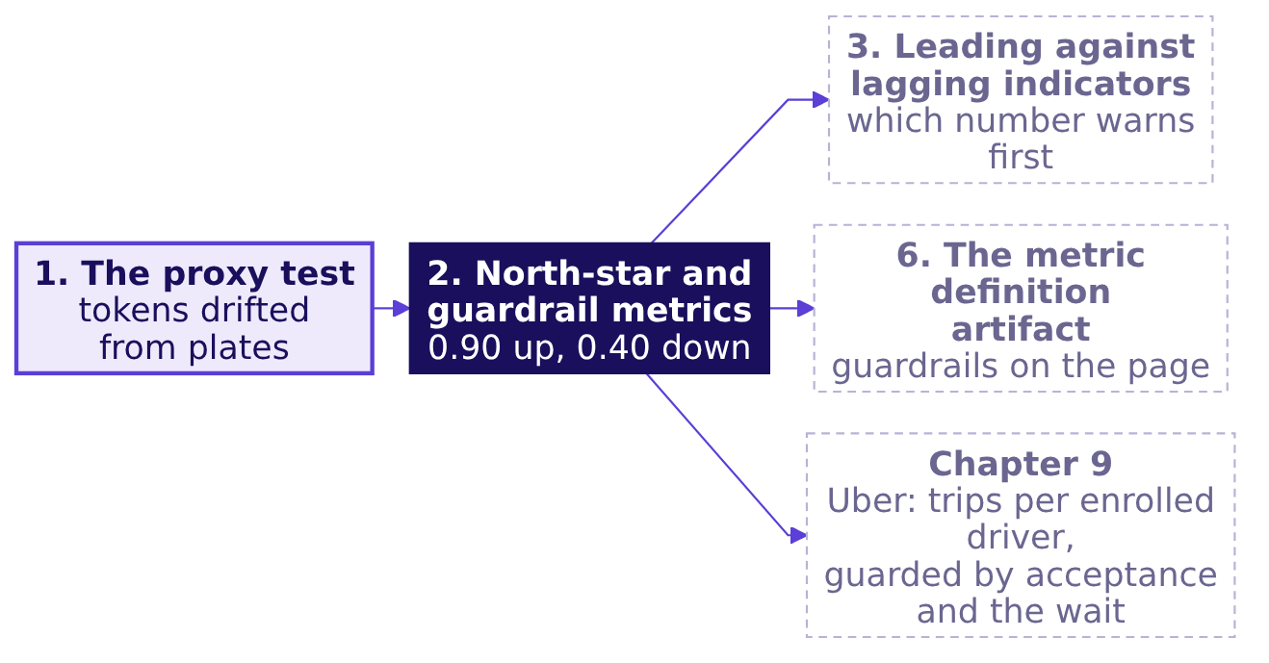
Indian Institute of Technology Gandhinagar
WEEK 4 · MONDAY · BUSINESS METRIC DESIGN · UBER, HYDERABAD
ADMINISTERED THROUGH THE COMPETENCY ADVANCEMENT ACADEMY
The north star feeds chapter 3 and Uber's redesign
Where did the idea come from, and where does it go next?
At Uber's Hyderabad scheme the same pair returns in chapter 9: completed peak trips per enrolled driver as the north star, with the share of offers accepted (an offer is one rider's request shown to one driver, who may accept or decline it) and the rider's wait as the guardrails that catch a driver who stays online and declines.
What is a number for?
Which number to chase?
Which number warns?
Which four lines?
How is a number gamed?
What does the page hold?
What does an hour count?
S21 · 23 / 93
…
Notes:
LIVE, 30 seconds. The idea joins the map. Transition: chapter 3, which number warns first.

Slide 24
Indian Institute of Technology Gandhinagar
PG DIPLOMA IN AI-ML AND AGENTIC AI ENGINEERING · COHORT 2
ADMINISTERED THROUGH THE COMPETENCY ADVANCEMENT ACADEMY
03
Leading against lagging indicators
Which number warns?
Tell a number that warns while a team can still act from one that confirms the result later.
What is a number for?
Which number to chase?
Which number warns?
Which four lines?
How is a number gamed?
What does the page hold?
What does an hour count?
Where did the fall sit?
What should it pay for?
Week 4, Day 1. Business metric design: which number should the plan chase, and what stops it being gamed?
24 / 93
Notes:
LIVE, 30 seconds. Concept 3 of 6, 10 minutes. The example is a T20 chase whose every run is
invented. Notebook 03 runs beside the chapter. Transition: who needs the answer.

Slide 25
Indian Institute of Technology Gandhinagar
WEEK 4 · MONDAY · BUSINESS METRIC DESIGN · UBER, HYDERABAD
ADMINISTERED THROUGH THE COMPETENCY ADVANCEMENT ACADEMY
Some numbers arrive while a team can still act
Who needs the answer, and which questions lead to it?
A number that moves before the north star, while a team can still act on it, is leading; one that confirms the north star after the result is fixed is lagging. Leading and lagging say when a number moves, which is a separate question from the job it does, so one number can be a guardrail and a leading number at once.
Who needs the answer. The captain of a side chasing a T20 total (invented), who can still change the batting order at over 11 and cannot change the scoreboard at over 20.
THE GOAL
THE WARNING
THE GUARD
THE RECORD
When is a chase lost?
Which number moves first?
What is it read with?
Which number confirms?
The final score against the target.
The runs an over still needed.
The wickets still in hand.
The margin, after the last ball.
What is a number for?
Which number to chase?
Which number warns?
Which four lines?
How is a number gamed?
What does the page hold?
What does an hour count?
S22 · 25 / 93
…
Notes:
LIVE, 1 minute. Read the two names. Cricket is chosen because the room already reads a required
rate without being taught it, so the idea arrives on something they know. Transition: the prediction.

Slide 26

Indian Institute of Technology Gandhinagar
WEEK 4 · MONDAY · BUSINESS METRIC DESIGN · UBER, HYDERABAD
ADMINISTERED THROUGH THE COMPETENCY ADVANCEMENT ACADEMY
When does the chase first need 10 an over?
The other side made 159, so 160 wins in 20 overs (invented); after 10 overs at six an over the chase is 60 for 3. When does the runs-an-over needed first reach 10?
A
B
C
D
After over 5
After over 10
After over 15
Only at the end
A third of the way in.
Halfway, at 60 for 3.
Five overs from the end.
When the last ball is bowled.
What is a number for?
Which number to chase?
Which number warns?
Which four lines?
How is a number gamed?
What does the page hold?
What does an hour count?
S23 · 26 / 93
…
Notes:
LIVE, 1 minute 30 seconds. Letters on paper. The plausible wrong answer is d: "you know a chase is
lost when the last over ends". Transition: the answer, counted by hand.

Slide 27
Indian Institute of Technology Gandhinagar
WEEK 4 · MONDAY · BUSINESS METRIC DESIGN · UBER, HYDERABAD
ADMINISTERED THROUGH THE COMPETENCY ADVANCEMENT ACADEMY
Answer: b, 10.0 an over after over 10
How is the runs-an-over needed counted, and when does the result arrive?
After over | Runs so far | Runs still needed | Overs left | Needed an over
0 | 0 | 160 | 20 | 160 / 20 = 8.0
5 | 30 | 130 | 15 | 130 / 15 = 8.7
10 | 60 | 100 | 10 | 100 / 10 = 10.0
15 | 102 | 58 | 5 | 58 / 5 = 11.6
20 | 147 | lost by 12 | 0 | the result
Counted by hand, invented numbers. Six an over for ten overs is 60, so 100 are still needed from 10 overs, 10.0 an over. The side ends on 147, and the other side's 159 wins by 12 runs: the scoreboard confirms the loss at over 20, ten overs after the rate needed warned.
What is a number for?
Which number to chase?
Which number warns?
Which four lines?
How is a number gamed?
What does the page hold?
What does an hour count?
S24 · 27 / 93
…
Notes:
LIVE, 1 minute 30 seconds, StatQuest: fill the table row by row aloud. The runs in overs 11 to 20
are 7, 8, 9, 10, 8, 9, 10, 11, 9 and 6. Transition: the picture, and the names.

Slide 28
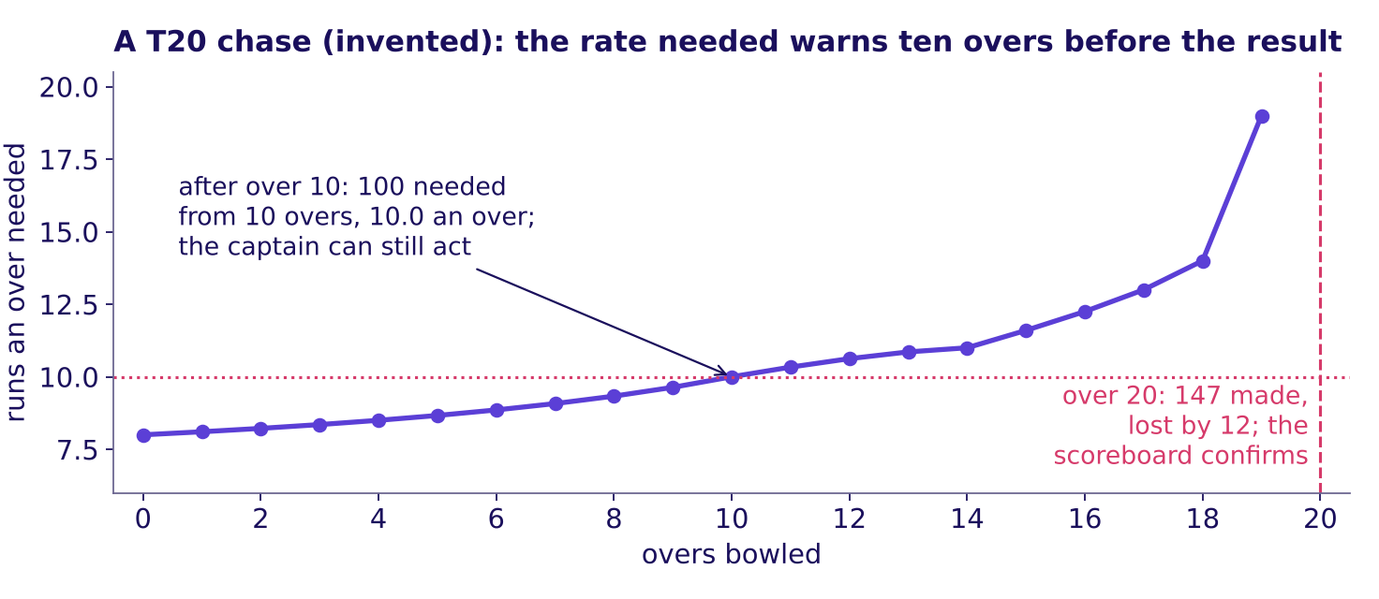
Indian Institute of Technology Gandhinagar
WEEK 4 · MONDAY · BUSINESS METRIC DESIGN · UBER, HYDERABAD
ADMINISTERED THROUGH THE COMPETENCY ADVANCEMENT ACADEMY
The rate needed warned ten overs before the result
What does the picture show, and what are the two kinds of number called?
A T20 chase (invented): the runs an over needed passed 10 at over 10, and the loss was confirmed at over 20
The runs an over needed climbed past 10 at over 10, while the captain could still promote a hitter; the margin arrived at over 20. Named last: a leading indicator moves before the north star while the team can act, and a lagging indicator confirms it later. Wickets in hand, 7 at over 10, are the guardrail read beside it: a side that chases the rate by swinging at every ball loses wickets, and the wickets show that harm before the score does.
What is a number for?
Which number to chase?
Which number warns?
Which four lines?
How is a number gamed?
What does the page hold?
What does an hour count?
S25 · 28 / 93
…
Notes:
LIVE, 1 minute 30 seconds. The words in Amplitude's article on north star metrics (Julia Sholtz,
15 August 2024): "Some metrics tell you what has already happened to your business; these are
lagging indicators", and "Revenue is a lagging indicator", with a good north star described as "a
leading indicator of revenue": https://www.amplitude.com/blog/good-bad-north-star-metric.md (checked
13 October 2026). Transition: the same count in code.

Slide 29
Indian Institute of Technology Gandhinagar
WEEK 4 · MONDAY · BUSINESS METRIC DESIGN · UBER, HYDERABAD
ADMINISTERED THROUGH THE COMPETENCY ADVANCEMENT ACADEMY
Four lines of pandas give the rate needed
How does code reproduce the count?
overs = pd.read_csv("../data/C2_W04_D01_chase_overs_STUDENT.csv") # invented
overs["so_far"] = overs["runs"].cumsum() # 60 after over 10
overs["needed_an_over"] = (160 - overs["so_far"]) / (20 - overs["over"])
overs.loc[overs["over"] == 10, "needed_an_over"] # 10.0
cumsum keeps a running total, so each row holds the runs made so far; the division is the board's sum, one row per over.
What is a number for?
Which number to chase?
Which number warns?
Which four lines?
How is a number gamed?
What does the page hold?
What does an hour count?
S26 · 29 / 93
…
Notes:
LIVE, 1 minute. One sentence a line. Over 20 divides by zero overs left; notebook 03 stops the
column at over 19, where the result takes over. Transition: the rules.

Slide 30
Indian Institute of Technology Gandhinagar
WEEK 4 · MONDAY · BUSINESS METRIC DESIGN · UBER, HYDERABAD
ADMINISTERED THROUGH THE COMPETENCY ADVANCEMENT ACADEMY
Four rules for leading and lagging numbers
Which rules does the chapter leave, and what does an interviewer ask?
01
A leading number moves before the north star, while the team can still act on it, and history shows it predicts the north star.
02
A lagging number confirms the north star after the result is fixed.
03
Read a leading number beside its guardrail: 10 an over with 7 wickets in hand is a different chase from 10 an over with 2.
04
A dashboard of lagging numbers alone lets a drift run for weeks before anyone sees it.
IN THE INTERVIEW
[F] North-star against guardrail, with one example pair.
What is a number for?
Which number to chase?
Which number warns?
Which four lines?
How is a number gamed?
What does the page hold?
What does an hour count?
S27 · 30 / 93
…
Notes:
LIVE, 1 minute 30 seconds. Ask the leading-lagging set's first item aloud: the eight Kalpa numbers,
called leading or lagging by letter, then say the key and one reason; two learners defend one call
each in a sentence, as the curriculum row asks
(exercises/unguided/C2_W04_D01_leading_lagging_set_STUDENT.md, Q1). Explorer: scene M4 asks which
line turns first; use it here, before S28 shows the turn, if it is on the projector. Transition: the
same split on the case's own weeks.

Slide 31
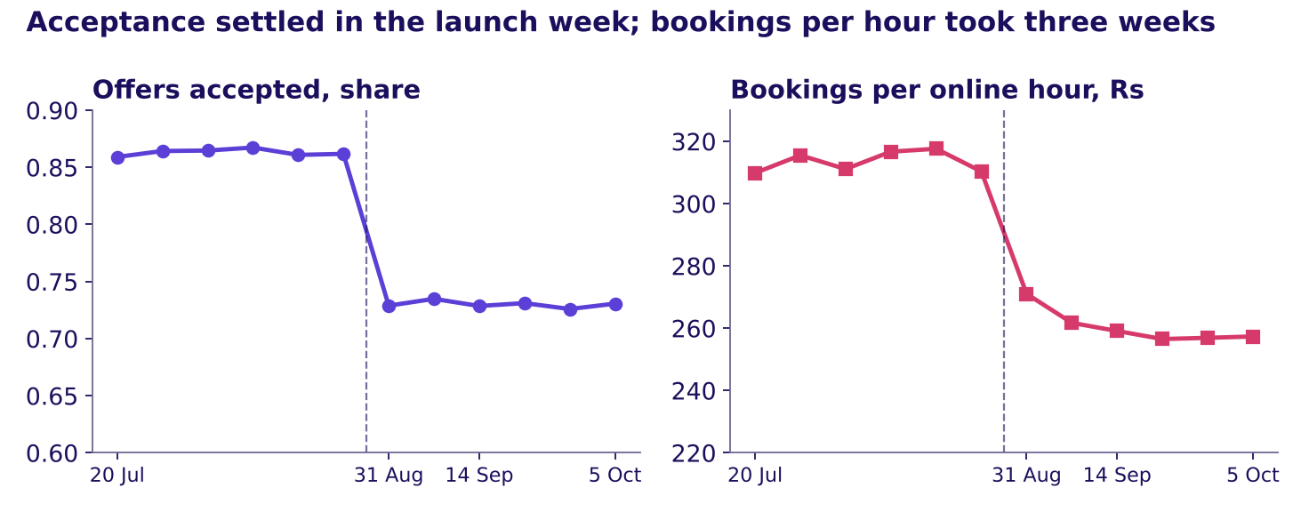
Indian Institute of Technology Gandhinagar
WEEK 4 · MONDAY · BUSINESS METRIC DESIGN · UBER, HYDERABAD
ADMINISTERED THROUGH THE COMPETENCY ADVANCEMENT ACADEMY
Acceptance settled in week one; bookings kept falling
Which of the city's numbers would have warned in the first week of Uber's scheme?
Weekly share of offers accepted beside bookings per online hour, twelve weeks
On the case's twelve weeks the share of offers accepted went from 0.862 in the week before the launch to 0.729 in the launch week and stayed there, while bookings per online hour, the fares riders paid per hour online, went from Rs 310.3 to Rs 271.0 that week and kept falling to Rs 259.1 by the third. Both fell at the launch; acceptance reached its new level at once, so a city team watching it had the whole change in week one.
What is a number for?
Which number to chase?
Which number warns?
Which four lines?
How is a number gamed?
What does the page hold?
What does an hour count?
S28 · 31 / 93
…
Notes:
LIVE, 1 minute. The connected example, on the case's synthetic data: acceptance is guardrail 1 in
chapter 9 and a leading number here, the job and the timing being two questions. Transition: where
the idea goes.

Slide 32
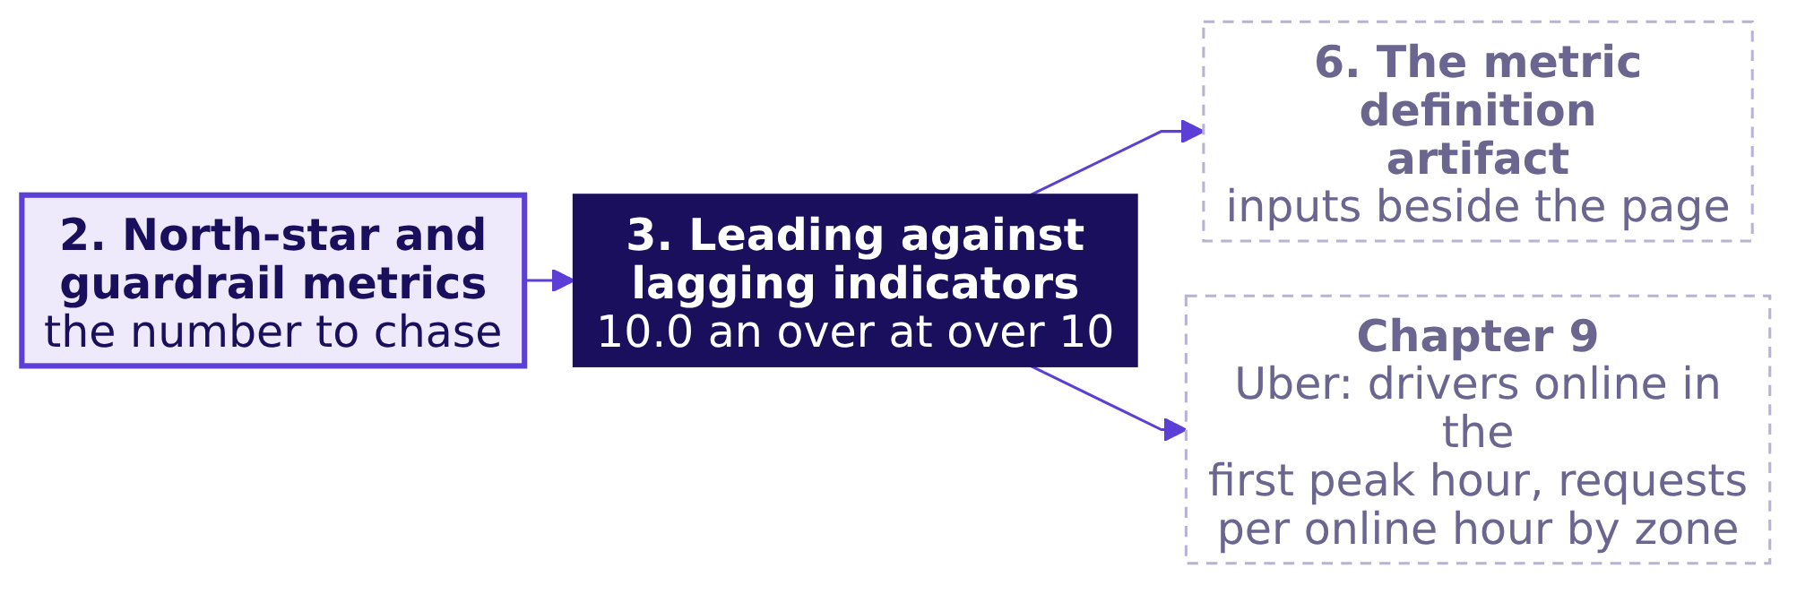
Indian Institute of Technology Gandhinagar
WEEK 4 · MONDAY · BUSINESS METRIC DESIGN · UBER, HYDERABAD
ADMINISTERED THROUGH THE COMPETENCY ADVANCEMENT ACADEMY
Leading inputs feed chapter 6 and the case's tree
Where did the idea come from, and where does it go next?
In chapter 9 the city's two leading inputs sit under its north star: enrolled drivers online in the first peak hour, and rider requests per online hour by zone.
What is a number for?
Which number to chase?
Which number warns?
Which four lines?
How is a number gamed?
What does the page hold?
What does an hour count?
S29 · 32 / 93
…
Notes:
LIVE, 30 seconds. The idea joins the map. Transition: chapter 4, the lines that pin a number down.

Slide 33
Indian Institute of Technology Gandhinagar
PG DIPLOMA IN AI-ML AND AGENTIC AI ENGINEERING · COHORT 2
ADMINISTERED THROUGH THE COMPETENCY ADVANCEMENT ACADEMY
04
Definitions: numerator, denominator, window, exclusions
Which four lines?
Write the four lines that make a number computable, and watch each line move the same number.
What is a number for?
Which number to chase?
Which number warns?
Which four lines?
How is a number gamed?
What does the page hold?
What does an hour count?
Where did the fall sit?
What should it pay for?
Week 4, Day 1. Business metric design: which number should the plan chase, and what stops it being gamed?
33 / 93
Notes:
LIVE, 30 seconds. Concept 4 of 6, 10 minutes. The example is one student's term register, every
day of it invented; the programme's own attendance rule is not used. Notebook 04 runs beside the
chapter. Transition: who needs the answer.

Slide 34
Indian Institute of Technology Gandhinagar
WEEK 4 · MONDAY · BUSINESS METRIC DESIGN · UBER, HYDERABAD
ADMINISTERED THROUGH THE COMPETENCY ADVANCEMENT ACADEMY
Four written lines let two people count alike
Who needs the answer, and which questions lead to it?
Week 1 Monday wrote every rate as a numerator over a denominator. Two more lines finish the job: the window, the stretch of time the count covers, and the exclusions, what is left out of both counts, with the date of any change.
Who needs the answer. A school principal (invented) who prints one attendance figure on a student's transfer certificate, and the two clerks who must compute it alike: a figure computed two ways can cost a student a scholarship.
LINE 1
LINE 2
LINE 3
LINE 4
The numerator
The denominator
The window
The exclusions
What is counted on top.
What it is divided by.
Which stretch of days.
What leaves both counts.
What is a number for?
Which number to chase?
Which number warns?
Which four lines?
How is a number gamed?
What does the page hold?
What does an hour count?
S30 · 34 / 93
…
Notes:
LIVE, 1 minute. Backward hook, said once: Week 1 Monday's numerator and denominator. Today adds the
two lines Week 1 left implicit. Transition: the prediction.

Slide 35


Indian Institute of Technology Gandhinagar
WEEK 4 · MONDAY · BUSINESS METRIC DESIGN · UBER, HYDERABAD
ADMINISTERED THROUGH THE COMPETENCY ADVANCEMENT ACADEMY
How many numbers can one honest register give?
One student's 60-day term (invented): five honest clerks compute the attendance percentage from the same register. How many different numbers come out?
A
B
C
D
One
Two
Four or more
It cannot be told
A register is a register.
With holidays, or without them.
One for each choice a clerk makes.
Not without the register in hand.
What is a number for?
Which number to chase?
Which number warns?
Which four lines?
How is a number gamed?
What does the page hold?
What does an hour count?
S31 · 35 / 93
…
Notes:
LIVE, 1 minute 30 seconds. The misconception under a: "attendance is one number; everyone computes
it the same way". Transition: the answer, counted by hand.

Slide 36
Indian Institute of Technology Gandhinagar
WEEK 4 · MONDAY · BUSINESS METRIC DESIGN · UBER, HYDERABAD
ADMINISTERED THROUGH THE COMPETENCY ADVANCEMENT ACADEMY
Answer: c, five numbers from one register
Which line moved, and what did each reading count?
The line that changed | Numerator | Denominator | Reading
None: the school's rule | 40 present | 50 working days | 80.0 percent
Denominator: calendar days | 40 | 60 days | 66.7 percent
Exclusions: medical leave out of both counts | 40 | 48 | 83.3 percent
Numerator: medical leave counted present | 42 | 50 | 84.0 percent
Window: the last 20 working days | 14 | 20 | 70.0 percent
The register, invented. A 60-day term holds 10 holidays, so 50 working days; the student was present on 40, absent on 8 and on medical leave for 2. In the term's last 20 working days the student was present on 14.
What is a number for?
Which number to chase?
Which number warns?
Which four lines?
How is a number gamed?
What does the page hold?
What does an hour count?
S32 · 36 / 93
…
Notes:
LIVE, 1 minute 30 seconds, StatQuest: divide each row aloud, one clerk a row. Every reading is
honest; each answers a different question, and only a written definition says which one the
certificate means. Transition: the
picture, and the rule.

Slide 37
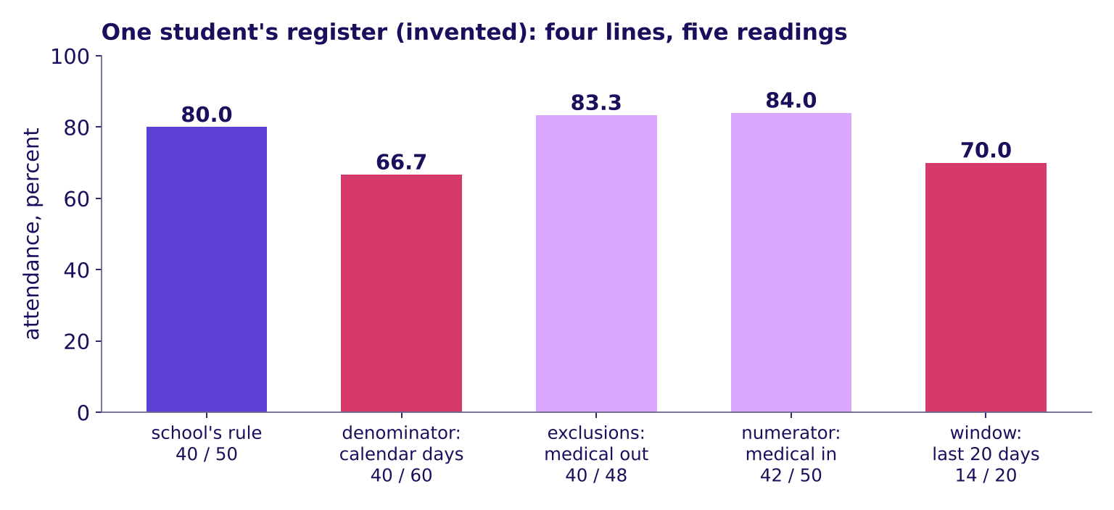
Indian Institute of Technology Gandhinagar
WEEK 4 · MONDAY · BUSINESS METRIC DESIGN · UBER, HYDERABAD
ADMINISTERED THROUGH THE COMPETENCY ADVANCEMENT ACADEMY
Each line moved the same student's number
What does the picture show, and what is the rule called?
One student's register (invented): four lines, five readings from 66.7 to 84.0 percent
The same register printed every figure from 66.7 to 84.0 percent as one line at a time changed. Named last: four lines make a number computable, its numerator, its denominator, its window and its exclusions, and with them written down two people compute the same number. A count, such as licences in a year, has no denominator; in its place it says what one unit is and how repeats are removed. The course outline adds that a definition is complete only when it also says what it deliberately does not reward, a line chapter 6's page carries.
What is a number for?
Which number to chase?
Which number warns?
Which four lines?
How is a number gamed?
What does the page hold?
What does an hour count?
S33 · 37 / 93
…
Notes:
LIVE, 1 minute 30 seconds. The same four lines in a public specification: the US Centers for
Medicare and Medicaid Services' Measures Management System lists a measure's denominator, its
denominator exclusions, its numerator and its time interval, and says "Denominator exclusions refer
to criteria that result in removal of patients or cases from the denominator before calculating the
numerator": https://mmshub.cms.gov/measure-lifecycle/measure-specification/develop-specification and
https://mmshub.cms.gov/measure-lifecycle/measure-specification/develop-specification/denominator-exclusions
(both checked 13 October 2026). Explorer: scene M3 rebuilds a definition line by line on chapter
7's six drivers; it belongs to chapter 9, which opens it at S81. Transition: the four lines in code.

Slide 38
Indian Institute of Technology Gandhinagar
WEEK 4 · MONDAY · BUSINESS METRIC DESIGN · UBER, HYDERABAD
ADMINISTERED THROUGH THE COMPETENCY ADVANCEMENT ACADEMY
One small function holds the four lines
How does code reproduce all five readings?
reg = pd.read_csv("../data/C2_W04_D01_attendance_register_STUDENT.csv") # invented
def attendance(days, top=("present",), bottom=("present", "absent", "medical")):
return round(100 * days.status.isin(top).sum() / days.status.isin(bottom).sum(), 1)
attendance(reg) # 80.0, the school's rule
attendance(reg, bottom=("present", "absent")) # 83.3, medical leave left out
The two arguments are the numerator and the denominator; the window is the rows passed in, and an exclusion is a status left out of both.
What is a number for?
Which number to chase?
Which number warns?
Which four lines?
How is a number gamed?
What does the page hold?
What does an hour count?
S34 · 38 / 93
…
Notes:
LIVE, 1 minute. One sentence a line. Notebook 04 calls the same function five times and checks each
result against a count made by filtering the table directly. Transition: the rules.

Slide 39
Indian Institute of Technology Gandhinagar
WEEK 4 · MONDAY · BUSINESS METRIC DESIGN · UBER, HYDERABAD
ADMINISTERED THROUGH THE COMPETENCY ADVANCEMENT ACADEMY
Four rules for writing a definition
Which rules does the chapter leave, and what does an interviewer ask?
01
Write the numerator and the denominator as counts of named things.
02
Write the window as dates or periods: the same register reads 80.0 over the term and 70.0 over its last 20 working days.
03
List every exclusion, and date any change to the list.
04
Print the definition beside the number wherever the number travels.
IN THE INTERVIEW
[F] What makes a metric gameable, and how do you write one that is not?
What is a number for?
Which number to chase?
Which number warns?
Which four lines?
How is a number gamed?
What does the page hold?
What does an hour count?
S35 · 39 / 93
…
Notes:
LIVE, 1 minute 30 seconds. Ask the definition-lines set's first item aloud
(exercises/unguided/C2_W04_D01_four_definition_lines_set_STUDENT.md, Q1), take letters, then say the
key and one reason. Transition: a company that writes its lines down.

Slide 40
Indian Institute of Technology Gandhinagar
WEEK 4 · MONDAY · BUSINESS METRIC DESIGN · UBER, HYDERABAD
ADMINISTERED THROUGH THE COMPETENCY ADVANCEMENT ACADEMY
Swiggy's filings write each line down
What do the four lines look like in a public filing?
Swiggy term, as filed | Numerator | Denominator | Window | Exclusions, read from the words
Average Monthly Transacting Users (MTU) | Unique users with at least one completed order on the app or website | none: a count | the month, averaged over the period | users with no completed order
Platform frequency | Completed orders | transacting users | the month, averaged over the period | orders not completed
In the quarter to 30 September 2024 Swiggy reported platform frequency of 4.53 orders per user a month and an MTU of 17.1 million. MTU is a count, so it has no denominator. Because "completed order" and "per month, averaged" are written down, a reader cannot mistake MTU for registered users.
What is a number for?
Which number to chase?
Which number warns?
Which four lines?
How is a number gamed?
What does the page hold?
What does an hour count?
S36 · 40 / 93
…
Notes:
LIVE, 1 minute. Read the two rows, naming numerator, denominator and window each time; the
exclusions column is read from the filed words, since "completed" leaves out every order that was
not. Source:
Swiggy's Q2 FY25 shareholder letter, filed with BSE:
https://www.bseindia.com/xml-data/corpfiling/AttachHis/2495f39b-e1d1-4018-8f69-6ff250345e98.pdf
(checked 13 October 2026). Transition: where the idea goes.

Slide 41
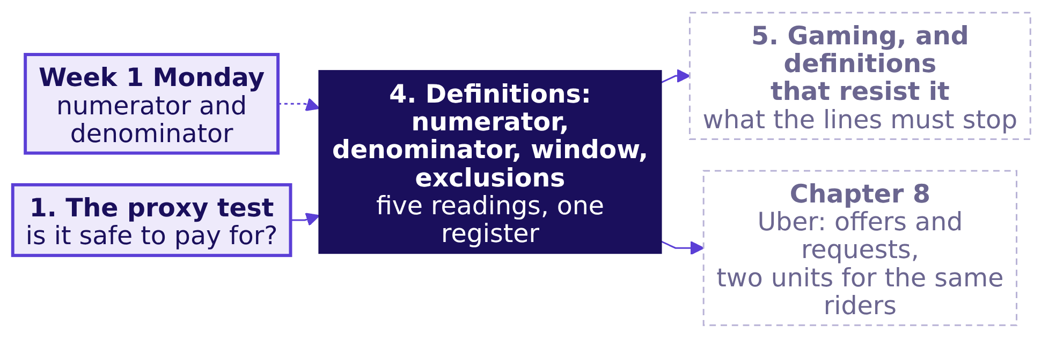
Indian Institute of Technology Gandhinagar
WEEK 4 · MONDAY · BUSINESS METRIC DESIGN · UBER, HYDERABAD
ADMINISTERED THROUGH THE COMPETENCY ADVANCEMENT ACADEMY
The four lines feed chapter 5 and chapter 8
Where did the idea come from, and where does it go next?
The unit moves the number too. In February 2018 Delhi Metro carried nearly 27 lakh riders a day; its new "line utilisation" count read 45,35,932 on 29 May 2018, since a rider who changes across three lines counts three times: one crowd, two units, and two windows too. After the change it did not share the daily ridership figure.
What is a number for?
Which number to chase?
Which number warns?
Which four lines?
How is a number gamed?
What does the page hold?
What does an hour count?
S37 · 41 / 93
…
Notes:
LIVE, 30 seconds. The idea joins the map, then Delhi Metro in one breath; chapter 8 meets the same
lesson in offers against rider requests. PTI's copy gives February's "nearly 27 lakh commuters ...
daily", the 29 May line utilisation, and that DMRC "did not share the daily average ridership
figures" after the new section opened, ridership having "taken a hit after two fare hikes in 2017":
a new count printed without the old one beside it, which is why chapter 5 dates every change. Sources:
https://www.latestly.com/agency-news/dmrc-uses-new-count-metric-on-traffic-flow-doesnt-share-ridership-190870.html/amp
(PTI's copy, checked 13 October 2026);
https://www.deccanherald.com/india/delhi/delhi-metro-records-highest-ever-footfall-on-aug-29-2666561
("Journey or line utilisation is calculated by the number of corridors passengers use to reach their
destinations", checked 13 October 2026). Transition: chapter 5, what the lines must resist.

Slide 42
Indian Institute of Technology Gandhinagar
PG DIPLOMA IN AI-ML AND AGENTIC AI ENGINEERING · COHORT 2
ADMINISTERED THROUGH THE COMPETENCY ADVANCEMENT ACADEMY
05
Gaming, and definitions that resist it
How is a number gamed?
Name the four ways a paid number is gamed, and the line of a definition that stops each.
What is a number for?
Which number to chase?
Which number warns?
Which four lines?
How is a number gamed?
What does the page hold?
What does an hour count?
Where did the fall sit?
What should it pay for?
Week 4, Day 1. Business metric design: which number should the plan chase, and what stops it being gamed?
42 / 93
Notes:
LIVE, 30 seconds. Concept 5 of 6, 10 minutes. The example is Balaji Kirana, an invented corner shop
in Hyderabad, and its four weeks of home deliveries. Notebook 05 runs beside the chapter.
Transition: who needs the answer.

Slide 43
Indian Institute of Technology Gandhinagar
WEEK 4 · MONDAY · BUSINESS METRIC DESIGN · UBER, HYDERABAD
ADMINISTERED THROUGH THE COMPETENCY ADVANCEMENT ACADEMY
Gaming raises a number without the work
Who needs the answer, and which questions lead to it?
Gaming is raising a number without doing what it stands for. Some of it is false reporting, a done press with nothing delivered, which a receipt and an audit stop; some is honest work steered to the count, such as booking only the surest learners, which pay design and a guardrail catch. Either way a paid number pulls behaviour toward it.
Who needs the answer. The owner of Balaji Kirana (invented), who pays the delivery boy Rs 20 for each delivery marked done in the shop's app and promises customers delivery within 30 minutes: a count the boy controls pays him for parcels nobody received.
THE COUNT
THE PROOF
THE CLOCK
THE RULES
Who controls it?
Does it need a receipt?
Who starts it?
Did they change unannounced?
The person paid, or the person served.
A press, or a customer's OTP.
The person timed, or the system.
A new kind of count, undated.
…
Which number warns?
Which four lines?
How is a number gamed?
What does the page hold?
What does an hour count?
Where did the fall sit?
What should it pay for?
S38 · 43 / 93
Notes:
LIVE, 1 minute. Read the definition and its two kinds, false reporting and steered work; the people
in the stories are ordinary.
An OTP is the one-time code the customer reads out at the door. Transition: the prediction.

Slide 44


Indian Institute of Technology Gandhinagar
WEEK 4 · MONDAY · BUSINESS METRIC DESIGN · UBER, HYDERABAD
ADMINISTERED THROUGH THE COMPETENCY ADVANCEMENT ACADEMY
What can rise with no parcel changing hands?
Balaji Kirana (invented) pays Rs 20 for each delivery the boy marks done; in four weeks he marks 50. Against the deliveries customers confirmed with their OTP, what does the shop find?
A
B
C
D
The same 50
Fewer than 50
More than 50
It cannot be told
A delivery marked is a delivery made.
Some were marked at the gate and never handed over.
Customers confirm orders he forgot to mark.
The app keeps no second record.
…
Which number warns?
Which four lines?
How is a number gamed?
What does the page hold?
What does an hour count?
Where did the fall sit?
What should it pay for?
S39 · 44 / 93
Notes:
LIVE, 1 minute 30 seconds. The misconception under a: "if we pay per delivery, we get more deliveries".
Transition: the answer, counted by hand.

Slide 45
Indian Institute of Technology Gandhinagar
WEEK 4 · MONDAY · BUSINESS METRIC DESIGN · UBER, HYDERABAD
ADMINISTERED THROUGH THE COMPETENCY ADVANCEMENT ACADEMY
Answer: b, 50 marked done and 40 confirmed
Who controls each count, and what does each one pay?
The count | Who controls it | Four weeks | At Rs 20
Deliveries marked done | the delivery boy | 50 | Rs 1,000
Deliveries confirmed with the customer's OTP | the customer | 40 | Rs 800
Within 30 minutes of the dispatch time the boy types | the delivery boy | 50 of 50, 1.00
Within 30 minutes of the shop's bill | the shop's system | 35 of 50, 0.70
Counted by hand, invented numbers. The Rs 200 gap is the gaming: 10 orders were marked done at the gate and never handed over, and all 6 of the month's complaints came from those 10. Both clocks stop at the boy's done press, so they time all 50 marked orders; chapter 6's page times only the 40 the customer confirmed.
…
Which number warns?
Which four lines?
How is a number gamed?
What does the page hold?
What does an hour count?
Where did the fall sit?
What should it pay for?
S40 · 45 / 93
Notes:
LIVE, 1 minute 30 seconds. Read each row with its owner. Ask what the boy gains by typing the
dispatch time late: every delivery reads on time. Transition: the picture, and the rule.

Slide 46
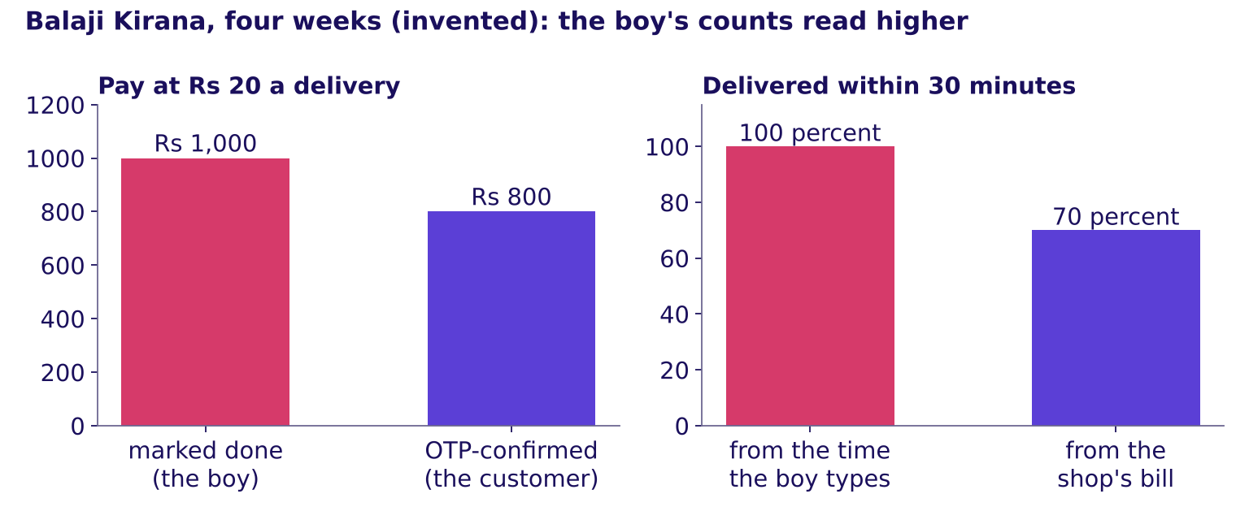
Indian Institute of Technology Gandhinagar
WEEK 4 · MONDAY · BUSINESS METRIC DESIGN · UBER, HYDERABAD
ADMINISTERED THROUGH THE COMPETENCY ADVANCEMENT ACADEMY
The boy's own counts read higher than the shop's
What does the picture show, and when does a definition resist gaming?
Balaji Kirana's four weeks (invented): pay and on-time read higher on the counts the boy controls
Both of the boy's counts read better than the counts the customer and the shop keep. Named last: a definition resists gaming when its numerator needs a receipt, its denominator is set by someone other than the people paid, its clock starts at a time the system records, its exclusions are dated, and it says what it does not reward.
…
Which number warns?
Which four lines?
How is a number gamed?
What does the page hold?
What does an hour count?
Where did the fall sit?
What should it pay for?
S41 · 46 / 93
Notes:
LIVE, 1 minute 30 seconds. The five properties are the programme's own summary of the four failures
on the next slide, each taken from a written record: the SEC's 2020 order against Wells Fargo
(Release 34-88257) and the VA inspector general's 2014 report, both re-read on 13 October 2026.
Transition: the four ways, side by side.

Slide 47
Indian Institute of Technology Gandhinagar
WEEK 4 · MONDAY · BUSINESS METRIC DESIGN · UBER, HYDERABAD
ADMINISTERED THROUGH THE COMPETENCY ADVANCEMENT ACADEMY
Four common ways to game a count, and their lines
How is each way done at the shop and in public, and which line catches it?
How it is gamed | At Balaji Kirana (invented) | In public, or in the case | The line that stops it
The paid person controls the count | The boy presses done | The illustrative Uber case: an open app counts as online (chapter 7) | A count the person served confirms
No receipt or use is needed | Done with no OTP | Wells Fargo: accounts nobody used | A receipt condition in the numerator
The person timed sets the clock's start | The boy types the dispatch time | US Veterans Affairs: the wait ran from a "desired date" the scheduler typed | A clock that starts at the system's time
A quiet change of definition | The shop starts counting attempts | Wells Fargo, 2013: accounts for sending money abroad added to the count, unannounced | Exclusions and changes dated on the page
At its Phoenix facility, 30 of the 40 primary-care schedulers and supervisors the inspectors asked said they set the desired date from the next open appointment or the provider's availability, so a long wait read as zero days.
…
Which number warns?
Which four lines?
How is a number gamed?
What does the page hold?
What does an hour count?
Where did the fall sit?
What should it pay for?
S42 · 47 / 93
Notes:
LIVE, 1 minute. Read across each row. Wells Fargo: in the SEC's order, global remittance
accounts joined the cross-sell count during 2013 without investors being told, giving 0.04 of that
year's 0.11 rise. VA: after the inspector general's interim report the 14-day goal left employee
performance contracts. Sources: https://www.sec.gov/files/litigation/admin/2020/34-88257.pdf
(checked 13 October 2026); https://www.vaoig.gov/sites/default/files/reports/2014-08/VAOIG-14-02603-267.pdf
(checked 13 October 2026). Transition: one condition in code.

Slide 48
Indian Institute of Technology Gandhinagar
WEEK 4 · MONDAY · BUSINESS METRIC DESIGN · UBER, HYDERABAD
ADMINISTERED THROUGH THE COMPETENCY ADVANCEMENT ACADEMY
One condition turns a press into a delivery
How does code reproduce the counts?
orders = pd.read_csv("../data/C2_W04_D01_kirana_deliveries_STUDENT.csv") # invented
orders["marked_done"].sum() # 50, the boy's count
orders["otp_confirmed"].sum() # 40, the customer's
(orders["minutes_from_bill"] <= 30).mean() # 0.70, the shop's clock
Each line counts the same 50 orders under a different owner: summing True values counts them, and the mean of True and False is a share.
…
Which number warns?
Which four lines?
How is a number gamed?
What does the page hold?
What does an hour count?
Where did the fall sit?
What should it pay for?
S43 · 48 / 93
Notes:
LIVE, 1 minute. One sentence a line. Notebook 05 adds the second route: the 6 complaints matched to
the 10 orders with no OTP. Transition: the rules.

Slide 49
Indian Institute of Technology Gandhinagar
WEEK 4 · MONDAY · BUSINESS METRIC DESIGN · UBER, HYDERABAD
ADMINISTERED THROUGH THE COMPETENCY ADVANCEMENT ACADEMY
Four rules for a definition that resists gaming
Which rules does the chapter leave, and what does an interviewer ask?
01
Let the person served confirm the count, as an OTP does.
02
Start the clock at a time the system records and the person timed cannot reset, never at one they type in.
03
Date every change to what is counted, and print the change beside the number.
04
Say in one line what the number deliberately does not reward.
IN THE INTERVIEW
[F] What makes a metric gameable, and how do you write one that is not?
…
Which number warns?
Which four lines?
How is a number gamed?
What does the page hold?
What does an hour count?
Where did the fall sit?
What should it pay for?
S44 · 49 / 93
Notes:
LIVE, 1 minute 30 seconds. Ask the gaming set's first item aloud
(exercises/unguided/C2_W04_D01_gaming_set_STUDENT.md, Q1), take letters, then say the key and one
reason. Transition: where the idea goes.

Slide 50
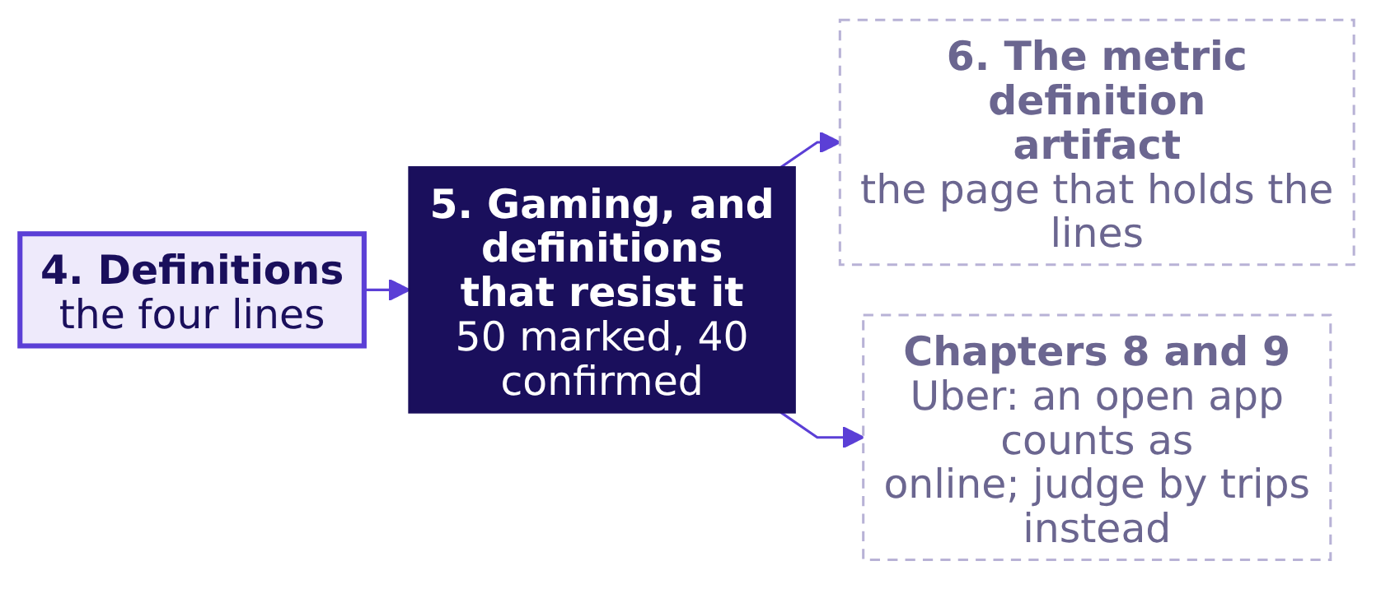
Indian Institute of Technology Gandhinagar
WEEK 4 · MONDAY · BUSINESS METRIC DESIGN · UBER, HYDERABAD
ADMINISTERED THROUGH THE COMPETENCY ADVANCEMENT ACADEMY
Resistant lines feed the page and the case's pay rule
Where did the idea come from, and where does it go next?
At Uber the driver controls the count of online hours; chapter 9's redesign judges the scheme by completed trips, which need a rider's request, and chapter 10 pays the Rs 300 floor only to driver-weeks that clear an acceptance floor, a least share of offers accepted.
…
Which number warns?
Which four lines?
How is a number gamed?
What does the page hold?
What does an hour count?
Where did the fall sit?
What should it pay for?
S45 · 50 / 93
Notes:
LIVE, 30 seconds. The idea joins the map. Transition: chapter 6, the page.

Slide 51
Indian Institute of Technology Gandhinagar
PG DIPLOMA IN AI-ML AND AGENTIC AI ENGINEERING · COHORT 2
ADMINISTERED THROUGH THE COMPETENCY ADVANCEMENT ACADEMY
06
The metric definition artifact
What does the page hold?
Fill the seven-line page a company can adopt, so that three teams argue about one written thing.
What is a number for?
Which number to chase?
Which number warns?
Which four lines?
How is a number gamed?
What does the page hold?
What does an hour count?
Where did the fall sit?
What should it pay for?
Week 4, Day 1. Business metric design: which number should the plan chase, and what stops it being gamed?
51 / 93
Notes:
LIVE, 30 seconds. Concept 6 of 6, 10 minutes, on the same invented shop as chapter 5. Notebook 06
runs beside the chapter. Transition: who needs the answer.

Slide 52
Indian Institute of Technology Gandhinagar
WEEK 4 · MONDAY · BUSINESS METRIC DESIGN · UBER, HYDERABAD
ADMINISTERED THROUGH THE COMPETENCY ADVANCEMENT ACADEMY
One written page ends three remembered numbers
Who needs the answer, and which questions lead to it?
The metric definition artifact is one page a company adopts, so teams argue about one written thing instead of three remembered ones. Its first four lines, from chapter 4, make the number computable; its last three, from chapters 2 and 5, make it safe to pay for.
Who needs the answer. The owner of Balaji Kirana (invented), whose son wants "deliveries up 20 percent" as the shop's growth target; after the break, the Hyderabad city head, who signs Uber's page.
THE SHAPE
THE GAP
THE FILL
THE PROOF
What are the seven lines?
What does a weak page lack?
What does a full page say?
Is anything missing?
The skeleton, with blanks.
Five of the seven.
The shop's lines, filled.
A check that names the gap.
…
Which number warns?
Which four lines?
How is a number gamed?
What does the page hold?
What does an hour count?
Where did the fall sit?
What should it pay for?
S46 · 52 / 93
Notes:
LIVE, 1 minute. Read the definition and the four questions. Transition: the prediction.

Slide 53

Indian Institute of Technology Gandhinagar
WEEK 4 · MONDAY · BUSINESS METRIC DESIGN · UBER, HYDERABAD
ADMINISTERED THROUGH THE COMPETENCY ADVANCEMENT ACADEMY
How many of seven lines does this page hold?
The shop's growth plan (invented) reads: "Deliveries, monthly, plus 20 percent". How many of a complete definition's seven lines are on it?
A
B
C
D
One
Two
Four
All seven
Only what is counted.
What is counted, and over when.
The lines that make it computable.
A name, a window and a target.
…
Which number warns?
Which four lines?
How is a number gamed?
What does the page hold?
What does an hour count?
Where did the fall sit?
What should it pay for?
S47 · 53 / 93
Notes:
LIVE, 1 minute 30 seconds. The misconception under d: "a metric is defined when it has a name and a
target". Transition: the answer, and the skeleton.

Slide 54
Indian Institute of Technology Gandhinagar
WEEK 4 · MONDAY · BUSINESS METRIC DESIGN · UBER, HYDERABAD
ADMINISTERED THROUGH THE COMPETENCY ADVANCEMENT ACADEMY
Answer: b, what is counted and the window
What are the seven lines, and which two does the weak page hold?
LINE 1
LINE 2
LINE 3
LINE 4
LINE 5
LINE 6
LINE 7
Numerator
Denominator
Window
Exclusions
Not rewarded
Guardrails
Gaming note
What is counted, with its receipt.
Divided by what, count printed.
Over which period.
Left out of both, each change dated.
Behaviour the number refuses to pay for.
Two or three numbers that must not fall past a margin.
The way of gaming each guardrail catches.
"Deliveries" is line 1 with no receipt and "monthly" is line 3; "plus 20 percent" is a target, which says how much and never what. The weak page leaves five lines blank.
…
Which number warns?
Which four lines?
How is a number gamed?
What does the page hold?
What does an hour count?
Where did the fall sit?
What should it pay for?
S48 · 54 / 93
Notes:
LIVE, 1 minute 30 seconds. The skeleton before the instance: say the seven names, then point at the
two the weak page fills. Transition: the same seven lines, filled for the shop.

Slide 55
Indian Institute of Technology Gandhinagar
WEEK 4 · MONDAY · BUSINESS METRIC DESIGN · UBER, HYDERABAD
ADMINISTERED THROUGH THE COMPETENCY ADVANCEMENT ACADEMY
Balaji Kirana's page, filled line by line
What does a full page say for the shop's deliveries?
Line | Balaji Kirana's page (invented)
Numerator | Deliveries confirmed with the customer's OTP
Denominator | Orders billed that week, the count printed beside the rate
Window | The calendar week
Exclusions | Orders the customer cancelled before dispatch, each change dated; none in these four weeks
What it does not reward | A done press with no OTP, a dispatch time typed by hand, a shrinking order count
Guardrails | Complaints per 100 orders billed; the share of confirmed deliveries within 30 minutes of the bill
Gaming note | Complaints catch an OTP asked for by phone before the goods arrive; the bill clock catches a late-typed dispatch time
Read on the four weeks: 40 of 50 orders confirmed, 0.80; complaints 12 per 100 orders billed; 30 of the 40 within 30 minutes of the bill, 0.75.
…
Which number warns?
Which four lines?
How is a number gamed?
What does the page hold?
What does an hour count?
Where did the fall sit?
What should it pay for?
S49 · 55 / 93
Notes:
LIVE, 1 minute 30 seconds. Fill each line with the room before showing it; ask which chapter each
line comes from. Once the numerator needs an OTP, a press at the gate pays nothing, so complaints
watch for the move that is left: the OTP taken over the phone. Transition: the weak page and the full one, week by week.

Slide 56
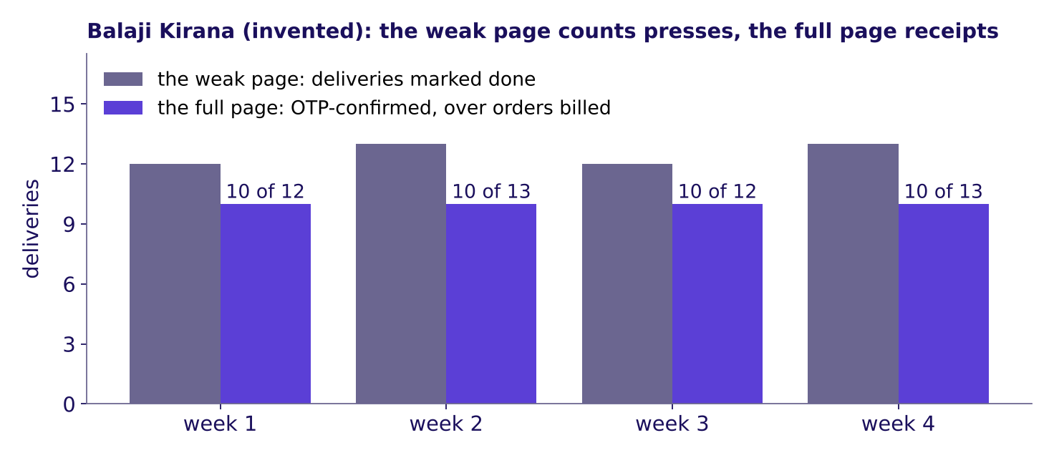
Indian Institute of Technology Gandhinagar
WEEK 4 · MONDAY · BUSINESS METRIC DESIGN · UBER, HYDERABAD
ADMINISTERED THROUGH THE COMPETENCY ADVANCEMENT ACADEMY
The weak page counted presses; the full one, receipts
What does the picture show, and what is the page called?
Balaji Kirana's four weeks (invented): deliveries marked done against OTP-confirmed deliveries over orders billed
Week by week the weak page reads 12 or 13 deliveries; the full page reads 10 confirmed of the orders billed. Named last: the metric definition artifact is the seven-line page a company adopts, four lines that make the number computable and three that make it safe to pay for.
…
Which number warns?
Which four lines?
How is a number gamed?
What does the page hold?
What does an hour count?
Where did the fall sit?
What should it pay for?
S50 · 56 / 93
Notes:
LIVE, 1 minute. The same lines in public: a US quality measure's specification lists its
numerator, denominator, exclusions and time interval among its building blocks (CMS Measures Management
System, https://mmshub.cms.gov/measure-lifecycle/measure-specification/develop-specification,
checked 13 October 2026). The seven lines are assembled from the curriculum row's own words:
numerator, denominator, window and exclusions, what it deliberately does not reward, the guardrails
and the gaming note. Transition: the page in code.

Slide 57
Indian Institute of Technology Gandhinagar
WEEK 4 · MONDAY · BUSINESS METRIC DESIGN · UBER, HYDERABAD
ADMINISTERED THROUGH THE COMPETENCY ADVANCEMENT ACADEMY
A seven-key dictionary and a one-line check
How does code hold the page, and find what is missing?
LINES = ["numerator", "denominator", "window", "exclusions",
"does_not_reward", "guardrails", "gaming_note"]
weak = {"numerator": "deliveries", "window": "monthly"}
[line for line in LINES if not weak.get(line)] # the five blank lines
A page is a dictionary with one key per line, and the check lists every line left blank: five for the weak page, none for the full one.
…
Which number warns?
Which four lines?
How is a number gamed?
What does the page hold?
What does an hour count?
Where did the fall sit?
What should it pay for?
S51 · 57 / 93
Notes:
LIVE, 1 minute. Notebook 06 holds both pages as dictionaries and flags a guardrail whose gaming
note names nothing it catches. Transition: the rules.

Slide 58
Indian Institute of Technology Gandhinagar
WEEK 4 · MONDAY · BUSINESS METRIC DESIGN · UBER, HYDERABAD
ADMINISTERED THROUGH THE COMPETENCY ADVANCEMENT ACADEMY
Four rules for the page a company signs
Which rules does the chapter leave, and what does an interviewer ask?
01
Write all seven lines before anyone is paid on the number.
02
The first four lines make it computable; the last three make it safe to pay for.
03
A target is no line of a definition: "plus 20 percent" says how much and never what.
04
When teams disagree, change a line on the page and date it.
IN THE INTERVIEW
[D] Three departments each want their own target; how do you get to one, and what do you say to the two who lose?
…
Which number warns?
Which four lines?
How is a number gamed?
What does the page hold?
What does an hour count?
Where did the fall sit?
What should it pay for?
S52 · 58 / 93
Notes:
LIVE, 1 minute 30 seconds. Ask the artifact set's first item aloud
(exercises/unguided/C2_W04_D01_artifact_set_STUDENT.md, Q1), take letters, then say the key and one
reason. Transition: the page goes to the case.

Slide 59
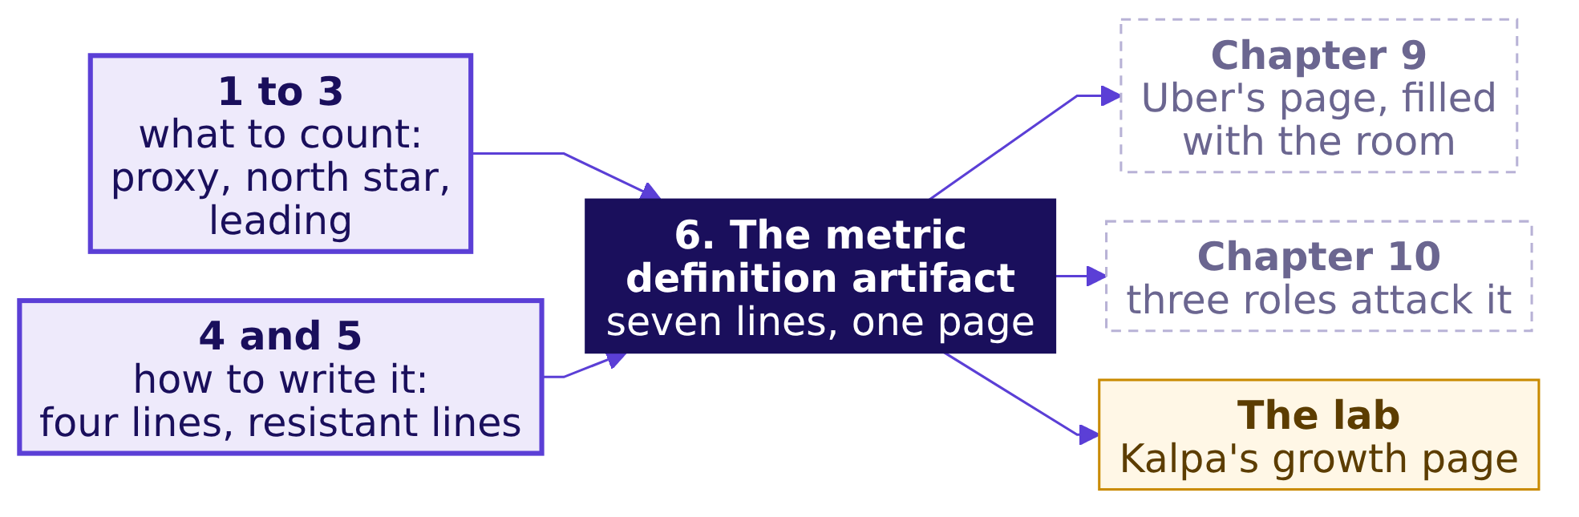
Indian Institute of Technology Gandhinagar
WEEK 4 · MONDAY · BUSINESS METRIC DESIGN · UBER, HYDERABAD
ADMINISTERED THROUGH THE COMPETENCY ADVANCEMENT ACADEMY
The page is filled for Uber in chapter 9
Where do the six ideas go next?
A published page. Uber's annual report defines a monthly active platform consumer as a unique consumer who completed a ride or received a delivery at least once in a month, averaged over the quarter: a count with a receipt and a window, written down; as a count, it has no denominator.
…
Which number warns?
Which four lines?
How is a number gamed?
What does the page hold?
What does an hour count?
Where did the fall sit?
What should it pay for?
S53 · 59 / 93
Notes:
LIVE, 30 seconds. The concept block is done: six boxes lit on the map from S4. Source: Uber's 10-K
for 2025: https://www.sec.gov/Archives/edgar/data/1543151/000154315126000015/uber-20251231.htm
(checked 13 October 2026). Then the break: 10 minutes. Transition: after the break, chapter 7 opens
the case on its full ticket.

Slide 60
Indian Institute of Technology Gandhinagar
PG DIPLOMA IN AI-ML AND AGENTIC AI ENGINEERING · COHORT 2
ADMINISTERED THROUGH THE COMPETENCY ADVANCEMENT ACADEMY
07
Twelve driver-weeks by hand, with the proxy test and the four definition lines
What does an hour count?
Applies the proxy test (chapter 1) and the four lines of a definition (chapter 4) to six drivers counted by hand, before the city head reads "hours up 24 percent" as success.
What is a number for?
Which number to chase?
Which number warns?
Which four lines?
How is a number gamed?
What does the page hold?
What does an hour count?
Where did the fall sit?
What should it pay for?
Week 4, Day 1. Business metric design: which number should the plan chase, and what stops it being gamed?
60 / 93
Notes:
LIVE, 30 seconds. The first case chapter, level L1, 32 minutes: the full ticket and round 1 of the
war game (12), then the twelve rows by hand (20). No laptops until the hand count is on the board.
Notebook 07 repeats the count in code. Styles: Brilliant (the question first), Veritasium (predict,
then reveal), StatQuest (tiny numbers said aloud), the case method (three roles with partly-right
numbers). Transition: what the chapter answers, and for whom.

Slide 61
Indian Institute of Technology Gandhinagar
WEEK 4 · MONDAY · BUSINESS METRIC DESIGN · UBER, HYDERABAD
ADMINISTERED THROUGH THE COMPETENCY ADVANCEMENT ACADEMY
Twelve rows apply the proxy test and the four lines
Who needs the answer, and which questions lead to it?
Applies: What to measure and why; the proxy test (chapter 1); Definitions: numerator, denominator, window, exclusions (chapter 4).
Who needs the answer. The Hyderabad city head, who decides on Friday whether the scheme is working and whether to extend it to two more cities: if "hours up 24 percent" is read as "riders picked up much faster" while the wait moved only from 4.8 to 4.6 minutes, the same top-up goes to two more cities.
THE TICKET
THE ROLES
THE ROWS
THE GAP
What launched, and what moved?
How could each number rise badly?
What did six drivers do?
Why do six fall further?
Twelve driver-weeks, counted by hand.
Two of the six logged hours with almost no trips.
The full ticket, read in order.
Round 1 of the war game.
…
Which number warns?
Which four lines?
How is a number gamed?
What does the page hold?
What does an hour count?
Where did the fall sit?
What should it pay for?
S54 · 61 / 93
Notes:
LIVE, 1 minute 30 seconds. The room knows the proxy test from the canteen and the four lines from the register;
here they meet the case's own rows. Transition: the ticket, read in full.

Slide 62
Indian Institute of Technology Gandhinagar
WEEK 4 · MONDAY · BUSINESS METRIC DESIGN · UBER, HYDERABAD
ADMINISTERED THROUGH THE COMPETENCY ADVANCEMENT ACADEMY
Ticket: Uber Hyderabad's peak-hour guarantee
What did the city team launch, what moved in six weeks, and what does the city head ask?
Uber, Hyderabad, the driver app. From Monday 31 August 2026 an enrolled driver (one signed up for the scheme) online through a whole peak window (two a day, three hours each) is guaranteed Rs 300 per peak online hour: Uber tops up the gap between the driver's trip earnings and that floor. The goal: riders picked up faster.
Data: drivers (1,200; 140 joined after the launch), driver_weeks (one row per driver per week: hours, offers, accepted, cancels, trips, hours with no trip, bookings as fares riders paid, top-up; a request one driver declines is shown to the next, so one request can appear as several offers), zone_weeks (rider requests, fulfilled, median wait). Ask, due Friday: is it working, what should it pay for, is anyone gaming it, raising the number without doing what it stands for? Caveats: the monsoon ended mid-window; 140 drivers are new; online means the app is open; three outer zones (Shamshabad, Rajendranagar, Patancheru) get few requests; drivers can be on two apps; trip earnings, the driver's share of the fares, are not in the data.
Six weeks each side | 20 Jul to 30 Aug | 31 Aug to 11 Oct
Peak online hours; completed peak trips | 118,000; 224,200 | 146,300 (up 24%); 230,900 (up 3%)
Trips per peak online hour | 1.90 | 1.58
Share of offers accepted; share of accepted trips the driver cancelled | 0.86; 0.04 | 0.73; 0.09
Share of online hours with no trip; median rider wait | 0.22; 4.8 min | 0.38; 4.6 min
Share of rider requests unfulfilled; top-up paid | 0.11; Rs 0 | 0.10; Rs 1.9 crore
*Illustrative case: the company is real, the situation and the data are synthetic, built for this class.*
…
Which number warns?
Which four lines?
How is a number gamed?
What does the page hold?
What does an hour count?
Where did the fall sit?
What should it pay for?
S55 · 62 / 93
Notes:
LIVE, 3 minutes. Read the ticket top to bottom in the order it is written: company and surface,
the table, the data, the ask, the caveats, the label line. Say the label line in full: the company
is real, the situation and the data are synthetic, built for this class. Then return to the
headline the room chose before chapter 1, "peak online hours up 24 percent", still on the board; the
case's chapters decide whether that number deserves the headline.
Transition: where today ends.

Slide 63
Indian Institute of Technology Gandhinagar
WEEK 4 · MONDAY · BUSINESS METRIC DESIGN · UBER, HYDERABAD
ADMINISTERED THROUGH THE COMPETENCY ADVANCEMENT ACADEMY
Where today ends: one sentence and seven lines
What will the room hand the city head when the morning is done?
By the close of the afternoon's first hour the room writes one sentence with its blanks filled from the data, and chapter 6's seven-line page for the city, which the three city-team roles, who each lose something under it, cannot break.
"Judge the scheme by ________, guarded by ________ and ________, because paying for hours cost Rs ____ in six weeks for ________."
The sentence names the two guardrails for riders; the budget's guardrail, top-up per trip, sits on the page.
LINE 1
LINE 2
LINE 3
LINE 4
LINE 5
LINE 6
LINE 7
Numerator
Denominator
Window
Exclusions
What it does not reward
Guardrails
Gaming note
What is counted, and when it counts
Per whom, with the count printed beside the rate
Over which period
What is left out on purpose, each change dated
Must not get worse: two for riders, one for the budget
How each guardrail catches a way of hitting the number
The behaviour it refuses to pay for
…
Which number warns?
Which four lines?
How is a number gamed?
What does the page hold?
What does an hour count?
Where did the fall sit?
What should it pay for?
S56 · 63 / 93
Notes:
LIVE, 1 minute. Read the sentence with its blanks and the seven line names, which the room met on
Balaji Kirana's page in chapter 6; nothing to write yet. Say: every blank gets a number from the
data before lunch, and every line gets tested by three people this afternoon.
Transition: the board the day fills, region by region.

Slide 64
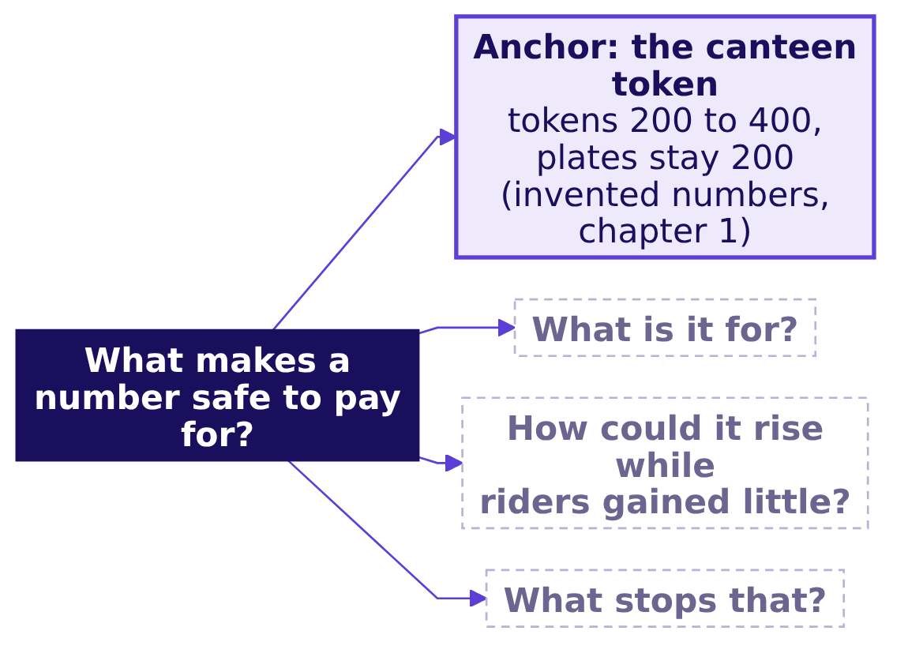
Indian Institute of Technology Gandhinagar
WEEK 4 · MONDAY · BUSINESS METRIC DESIGN · UBER, HYDERABAD
ADMINISTERED THROUGH THE COMPETENCY ADVANCEMENT ACADEMY
The day's board: four questions before paying
Which questions must a number answer before anyone is paid for it?
Each case chapter fills one region of this board: chapter 7 answers what the number is for, chapter 8 how it rose while riders gained little, chapter 9 what stops it.
…
Which number warns?
Which four lines?
How is a number gamed?
What does the page hold?
What does an hour count?
Where did the fall sit?
What should it pay for?
S57 · 64 / 93
Notes:
LIVE, 1 minute. The board's question went up before chapter 1; add its three questions and the
anchor now, and keep the board up all day; each case chapter's close adds its region. The finished
board is the cheat sheet's second panel. Transition: the war game's first round.

Slide 65



Indian Institute of Technology Gandhinagar
WEEK 4 · MONDAY · BUSINESS METRIC DESIGN · UBER, HYDERABAD
ADMINISTERED THROUGH THE COMPETENCY ADVANCEMENT ACADEMY
War game, round 1: three roles, three numbers
Which number does each of the city team's three roles want the scheme judged on, and how could each look good while riders gained little?
DRIVER-OPERATIONS LEAD
MARKETING LEAD
FINANCE PARTNER
Peak online hours
Enrolled drivers
Top-up per trip
Wants supply at peak, the city's oldest problem; hours rose 24 percent
The guarantee is the story that wins new drivers; every sign-up counts
Holds the budget; wants each rupee of top-up to buy a trip, so wants this number low
Three questions per number. Could a team hit it while riders gained little (the proxy test, chapter 1)? Who controls the count (chapter 5)? What does it deliberately not reward (chapter 6)? Round 2 is the data in chapters 7 to 9; round 3, after lunch, attacks the redesign.
…
Which number warns?
Which four lines?
How is a number gamed?
What does the page hold?
What does an hour count?
Where did the fall sit?
What should it pay for?
S58 · 65 / 93
Notes:
LIVE, 5 minutes, the war game's round 1 (run sheet: trainer/C2_W04_D01_war_game_TRAINER.md).
The trainer voices the three role cards, or three learners read them. Each of the nine groups has
two minutes to give one way to game each number, now with chapter 1's proxy test and chapter 5's
four ways in hand, and its scorer holds the proxy-test card. Write the answers on the board under each
role. Expect: hours rise if drivers stay logged in and idle; enrolled drivers rise if people sign up
and never drive; top-up per trip falls if drivers take only short trips. Park "what would the data
show" until chapter 8.
When it stalls: recall the canteen's tokens from chapter 1 (who controls the count?), then ask who
decides when the app is open; drivers E and F wait for S60.
Transition: chapter 1's test, asked of an hour.

Slide 66
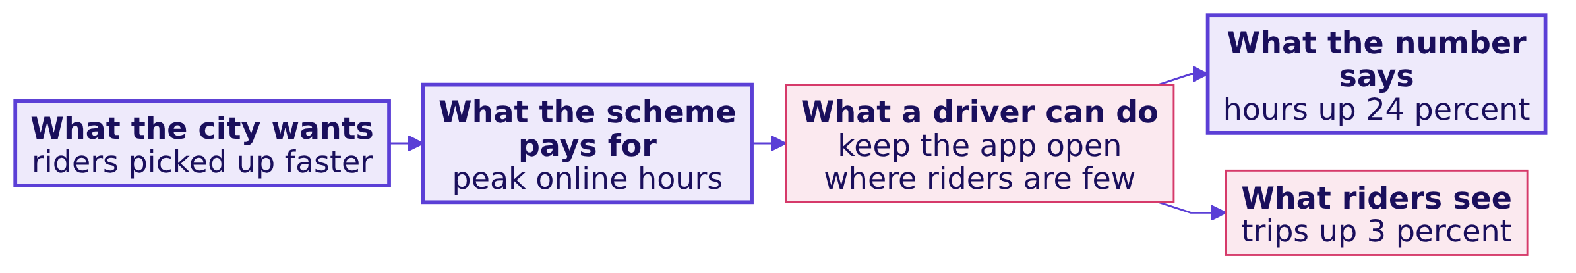
Indian Institute of Technology Gandhinagar
WEEK 4 · MONDAY · BUSINESS METRIC DESIGN · UBER, HYDERABAD
ADMINISTERED THROUGH THE COMPETENCY ADVANCEMENT ACADEMY
An hour needs only an open app, as a token did
Which of the city's numbers can a driver raise with no rider at all, by chapter 1's proxy test?
Peak online hours fail chapter 1's test the way the canteen's tokens did: the app logs a driver as online whenever the driver app is open and the driver is marked available, wherever the phone is. Trips need a rider who asked, accepted offers need an offer, and the wait is measured on riders; hours need only an open app.
…
Which number warns?
Which four lines?
How is a number gamed?
What does the page hold?
What does an hour count?
Where did the fall sit?
What should it pay for?
S59 · 66 / 93
Notes:
LIVE, 1 minute, a recall by name and straight to the data. Say: the driver controls the count, the
first of chapter 5's four ways. Point back to the board's first question, what is it for. Name round
2 once: chapters 7 to 9 answer each of round 1's attacks with the data, one board region at a time.
Transition: six drivers from the case's own data.

Slide 67
Indian Institute of Technology Gandhinagar
WEEK 4 · MONDAY · BUSINESS METRIC DESIGN · UBER, HYDERABAD
ADMINISTERED THROUGH THE COMPETENCY ADVANCEMENT ACADEMY
Six drivers, two weeks, counted by hand
What did six drivers' hours, offers and trips do between one week before and one week after?
Driver | Zone | Hours, before → after | Trips, before → after | Offers accepted, after
A | Jubilee Hills | 10 → 11 | 21 → 22 | 22 of 25
B | Banjara Hills | 9 → 10 | 17 → 18 | 18 of 21
C | Gachibowli | 11 → 12 | 22 → 23 | 23 of 26
D | Madhapur | 10 → 11 | 19 → 20 | 20 of 23
E | Shamshabad | 10 → 16 | 18 → 3 | 4 of 14
F | Rajendranagar | 10 → 14 | 17 → 2 | 3 of 12
The before week begins 10 August 2026 and the after week 21 September 2026. These are twelve rows of the case's own driver_weeks; E and F drive in two of the three outer zones, where riders are few. Their 16 and 14 hours are short beside the drivers who idle like them, who average about 39 peak online hours a week after the launch, as chapter 8's full data shows.
…
Which number warns?
Which four lines?
How is a number gamed?
What does the page hold?
What does an hour count?
Where did the fall sit?
What should it pay for?
S60 · 67 / 93
Notes:
LIVE, 7 minutes, StatQuest: say each number aloud. Add the hours column for the before week (60)
and the after week (74), then the trips (114 and 88), writing the four sums on the board. Point at
E and F before saying anything about them: hours up, few offers because Shamshabad and
Rajendranagar get few requests, and most of those offers declined.
Transition: the prediction before the ratio.

Slide 68
Indian Institute of Technology Gandhinagar
WEEK 4 · MONDAY · BUSINESS METRIC DESIGN · UBER, HYDERABAD
ADMINISTERED THROUGH THE COMPETENCY ADVANCEMENT ACADEMY
What does trips per hour do on the six?
Before dividing, what will trips per peak online hour do on the six drivers?
a) Holds near 1.9
b) Falls to about 1.6, as the city's did
c) Falls to about 1.2
d) Rises above 2.0
…
Which number warns?
Which four lines?
How is a number gamed?
What does the page hold?
What does an hour count?
Where did the fall sit?
What should it pay for?
S61 · 68 / 93
Notes:
LIVE, 2 minutes. Everyone writes a letter. Most write b, because the ticket says 1.58.
Transition: the hand count.

Slide 69
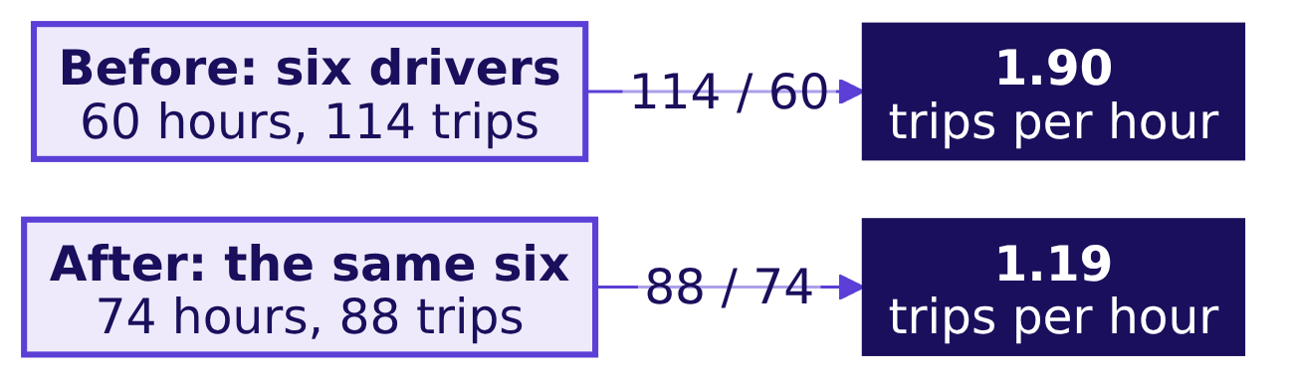
Indian Institute of Technology Gandhinagar
WEEK 4 · MONDAY · BUSINESS METRIC DESIGN · UBER, HYDERABAD
ADMINISTERED THROUGH THE COMPETENCY ADVANCEMENT ACADEMY
Answer: 1.90 before, 1.19 after, by hand
How is the ratio counted, and why do the six fall further than the city's 1.58?
Answer: c. Hours rose 23 percent and trips fell 23 percent, so trips per peak online hour fell from 1.90 to 1.19: add the trips, add the hours, divide once, chapter 4's numerator over its denominator. The city fell to 1.58; the six fall further because they were chosen to show the mechanism, and two of them, E and F, logged hours with almost no trips, a third of this sample. How common such drivers are in the city is chapter 8's question.
…
Which number warns?
Which four lines?
How is a number gamed?
What does the page hold?
What does an hour count?
Where did the fall sit?
What should it pay for?
S62 · 69 / 93
Notes:
LIVE, 6 minutes. Say the step aloud: for every ten hours online the six made 19 trips before and 12
after. Then say why the six are not the city: the rows were picked so the mechanism shows in
miniature. Watch for anyone averaging each driver's own ratio; chapter 8 shows what that average
prints on the full data and why it misleads.
Transition: the chapter's close.

Slide 70
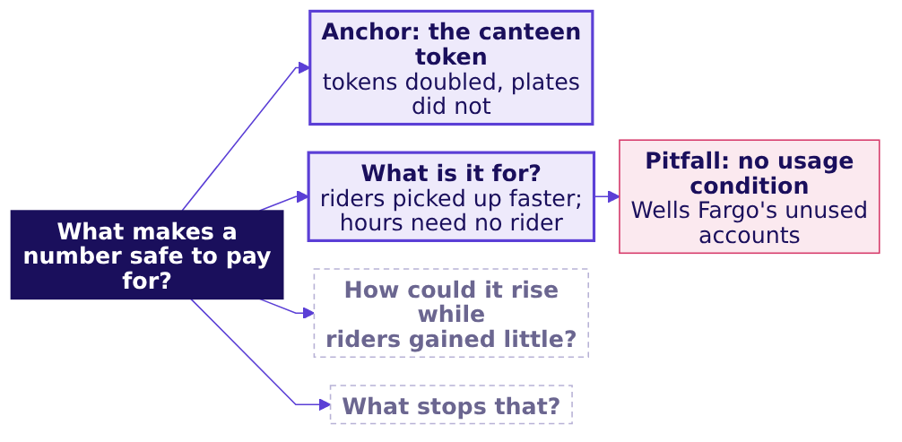
Indian Institute of Technology Gandhinagar
WEEK 4 · MONDAY · BUSINESS METRIC DESIGN · UBER, HYDERABAD
ADMINISTERED THROUGH THE COMPETENCY ADVANCEMENT ACADEMY
Close: a paid proxy drifts from its goal
What has chapter 7 answered, and what does the board now hold?
The crux. A number is safe to pay for only if hitting it requires the thing it stands for; hours online do not require a rider.
The senior analyst's check. Before trusting a rate, read its baseline (1.90 before), its denominator (hours the app was open, which the driver controls) and the evidence that the goal moved (city trips rose only 3 percent).
…
Which number warns?
Which four lines?
How is a number gamed?
What does the page hold?
What does an hour count?
Where did the fall sit?
What should it pay for?
S63 · 70 / 93
Notes:
LIVE, 4 minutes. Add the region to the board: what is it for, and the first pitfall, the bank from
chapter 1. Read the crux line twice; it is the line the cheat sheet repeats. The interview question
the day earns, [S] how would you measure the success of a new feature, stays open until the
afternoon. Transition: chapter 8, the full data.

Slide 71
Indian Institute of Technology Gandhinagar
PG DIPLOMA IN AI-ML AND AGENTIC AI ENGINEERING · COHORT 2
ADMINISTERED THROUGH THE COMPETENCY ADVANCEMENT ACADEMY
08
All 12,860 driver-weeks, with the definition lines and gaming
Where did the fall sit?
Applies the denominator and the window (chapter 4) and who controls the count (chapter 5) to every driver-week, before a proposal goes out to extend the scheme.
What is a number for?
Which number to chase?
Which number warns?
Which four lines?
How is a number gamed?
What does the page hold?
What does an hour count?
Where did the fall sit?
What should it pay for?
Week 4, Day 1. Business metric design: which number should the plan chase, and what stops it being gamed?
71 / 93
Notes:
LIVE, 30 seconds. Levels 2 and 3, 30 minutes: the opener and map (2), the demand question (4), the
twelve weeks and the groupby (7), the average that misleads (6), the idle tail (8), the close (3). Laptops open on
notebooks/C2_W04_D01_08_denominators_on_full_data_STUDENT.ipynb. Styles: Krish Naik (one line of
narration per cell), Veritasium (predict before each reveal), Brilliant (the question first),
ByteByteGo (the board grows at the close). Transition: what the chapter answers.

Slide 72
Indian Institute of Technology Gandhinagar
WEEK 4 · MONDAY · BUSINESS METRIC DESIGN · UBER, HYDERABAD
ADMINISTERED THROUGH THE COMPETENCY ADVANCEMENT ACADEMY
The full data apply chapters 4 and 5
Who needs the answer, and which questions lead to it?
Applies: Definitions: numerator, denominator, window, exclusions (chapter 4); Gaming, and definitions that resist it (chapter 5).
Who needs the answer. The city head, before a proposal to extend the scheme to two more cities goes out: a fall read as weak demand, or measured with the wrong denominator, sends the same top-up further.
DEMAND
THE WEEKS
THE TRAP
THE TAIL
Did riders ask for less?
What do twelve weeks show?
What does an average print?
Who sits under one trip an hour?
Rider requests, from a second table.
One groupby, a ratio of two sums.
The mean of each week's rate.
The drivers behind the fall.
…
Which number warns?
Which four lines?
How is a number gamed?
What does the page hold?
What does an hour count?
Where did the fall sit?
What should it pay for?
S64 · 72 / 93
Notes:
LIVE, 1 minute 30 seconds. Read the Applies line: chapter 4's lines and chapter 5's first way are
the two ideas the full data test. Transition: the first question of the chapter.

Slide 73
Indian Institute of Technology Gandhinagar
WEEK 4 · MONDAY · BUSINESS METRIC DESIGN · UBER, HYDERABAD
ADMINISTERED THROUGH THE COMPETENCY ADVANCEMENT ACADEMY
Which column would show riders asked for less?
If riders simply asked for fewer trips, where would the data show it?
a) peak_online_hours in driver_weeks
b) peak_requests in zone_weeks
c) topup_rs in driver_weeks
d) peak_bookings_rs divided by trips
…
Which number warns?
Which four lines?
How is a number gamed?
What does the page hold?
What does an hour count?
Where did the fall sit?
What should it pay for?
S65 · 73 / 93
Notes:
LIVE, 1 minute. Letters on paper. The trap the question guards against: "trips per hour fell
because demand fell", said before anyone looked at demand.
Transition: the answer, with the numbers.

Slide 74
Indian Institute of Technology Gandhinagar
WEEK 4 · MONDAY · BUSINESS METRIC DESIGN · UBER, HYDERABAD
ADMINISTERED THROUGH THE COMPETENCY ADVANCEMENT ACADEMY
Answer: rider requests rose 1.8 percent
Did demand fall, and why do the two tables count different things?
Answer: b. Demand lives in zone_weeks. Rider requests rose from 251,910 to 256,556 (up 1.8 percent), the unfulfilled share went from 0.11 to 0.10 and the median wait from 4.8 to 4.6 minutes. The fall in trips per hour is not demand.
1.07
1.35
OFFERS PER REQUEST, BEFORE
OFFERS PER REQUEST, AFTER
269,773 offers shown to drivers for 251,910 rider requests
347,583 offers for 256,556 requests: more declines, more re-offers
A request one driver declines is offered to the next driver, so driver_weeks counts offers and zone_weeks counts requests: two units for the same riders, as Delhi Metro's riders and line uses were in chapter 4, and the gap between them grew with the declining.
…
Which number warns?
Which four lines?
How is a number gamed?
What does the page hold?
What does an hour count?
Where did the fall sit?
What should it pay for?
S66 · 74 / 93
Notes:
LIVE, 3 minutes. Read the three demand numbers, then the two stats. Ask what could make offers per
request rise while requests barely moved: drivers declining, so each request is shown again.
Transition: twelve weeks, one week at a time.

Slide 75
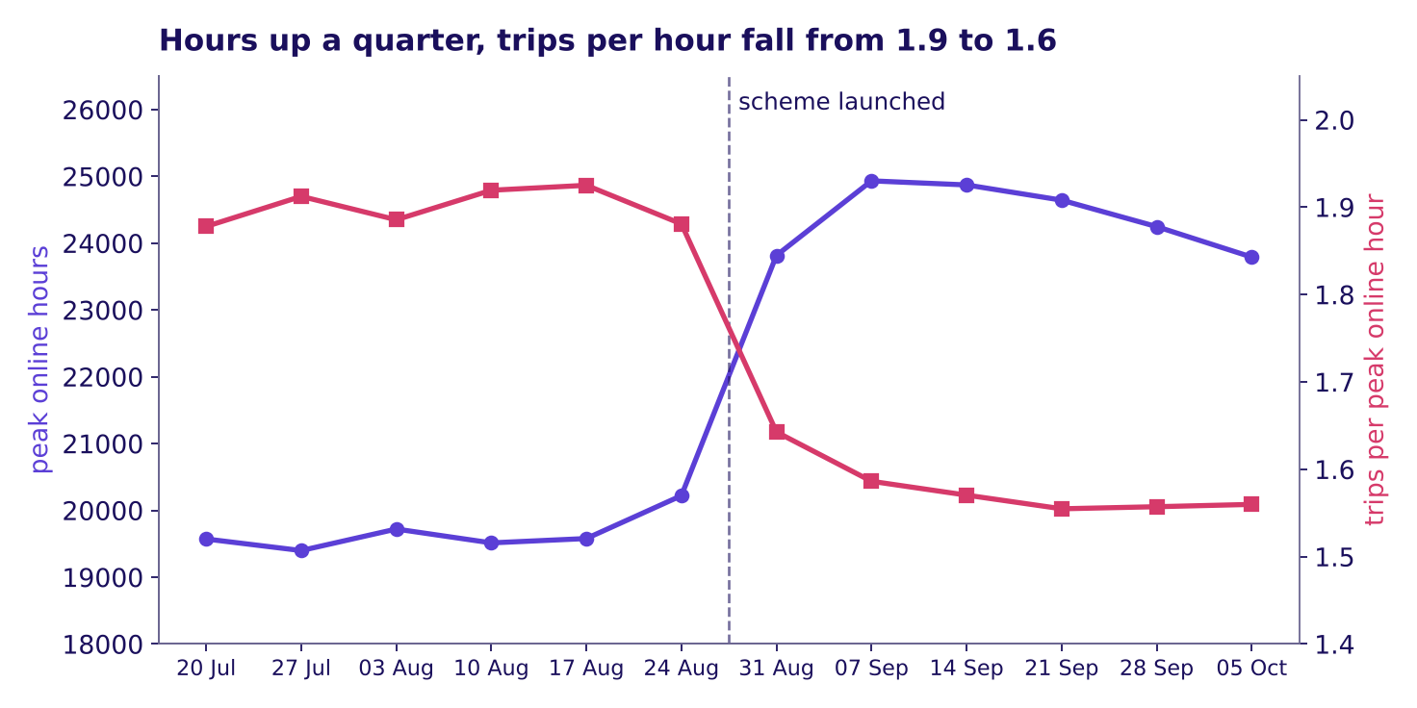
Indian Institute of Technology Gandhinagar
WEEK 4 · MONDAY · BUSINESS METRIC DESIGN · UBER, HYDERABAD
ADMINISTERED THROUGH THE COMPETENCY ADVANCEMENT ACADEMY
Twelve weeks: hours jumped, trips per hour fell
Was the fall two odd weeks, or a level that held for six?
Hours rose at the launch while trips per hour fell and stayed down, twelve weeks
Before the launch, trips per hour wandered between 1.88 and 1.93. In the launch week it read 1.64, then held between 1.55 and 1.59 for five weeks, while hours rose from about 20,000 a week to about 24,000. The two lines use two different scales, so the point where they cross means nothing.
…
Which number warns?
Which four lines?
How is a number gamed?
What does the page hold?
What does an hour count?
Where did the fall sit?
What should it pay for?
S67 · 75 / 93
Notes:
LIVE, 3 minutes. The animated version, whiteboards/C2_W04_D01_drift_STUDENT.gif, draws the twelve
weeks one at a time; play it on the projector and stop at the dashed line to ask what the next week
will show. Then show this full picture and read the two ranges. Explorer scene M1 draws the same
drift with drivers as dots; use it here if it is on the projector.
Transition: the groupby that produced these totals.

Slide 76
Indian Institute of Technology Gandhinagar
WEEK 4 · MONDAY · BUSINESS METRIC DESIGN · UBER, HYDERABAD
ADMINISTERED THROUGH THE COMPETENCY ADVANCEMENT ACADEMY
One groupby gives the city's totals
What is the smallest code that turns 12,860 driver-weeks, one row for every driver on the app each week, into the ticket's numbers?
dw["window"] = dw["week_start"].lt("2026-08-31").map({True: "before", False: "after"})
city = dw.groupby("window")[["peak_online_hours", "peak_trips"]].sum()
city["trips_per_hour"] = city["peak_trips"] / city["peak_online_hours"]
Window | Hours | Trips | Trips per hour | Accepted share | No-trip share
Before | 118,000 | 224,200 | 1.90 | 0.863 | 0.22
After | 146,300 | 230,900 | 1.58 | 0.730 | 0.38
The rate is a ratio of two sums, chapter 4's numerator and denominator over chapter 4's window: every trip over every hour, six weeks each side. .lt(...) asks whether a week starts before the launch, and .map turns True and False into before and after; the notebook adds the two shares the same way, sum first, then divide.
…
Which number warns?
Which four lines?
How is a number gamed?
What does the page hold?
What does an hour count?
Where did the fall sit?
What should it pay for?
S68 · 76 / 93
Notes:
LIVE, 4 minutes, Krish Naik: scroll back to the notebook's totals cell, the first after its setup,
and run it line by line, saying what each line is for; its numbers are the ticket's, so running it
before S65 spoils nothing. The table is the cell's output, rounded as the ticket rounds it.
Transition: a shortcut a colleague might take.

Slide 77
Indian Institute of Technology Gandhinagar
WEEK 4 · MONDAY · BUSINESS METRIC DESIGN · UBER, HYDERABAD
ADMINISTERED THROUGH THE COMPETENCY ADVANCEMENT ACADEMY
What does an average of weekly rates print?
A colleague averages every driver-week's own trips per hour; what does that print for the after window?
a) 1.58
b) 1.71
c) 1.19
d) 1.90
…
Which number warns?
Which four lines?
How is a number gamed?
What does the page hold?
What does an hour count?
Where did the fall sit?
What should it pay for?
S69 · 77 / 93
Notes:
LIVE, 2 minutes. Letters on paper. This is the chapter's first trap, the plausible wrong number.
Transition: the answer, and why it is wrong.

Slide 78
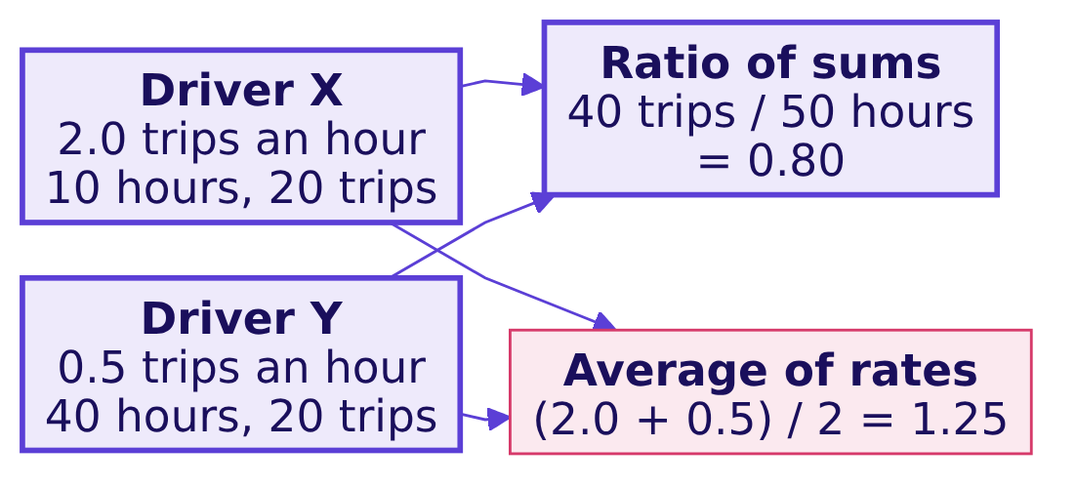
Indian Institute of Technology Gandhinagar
WEEK 4 · MONDAY · BUSINESS METRIC DESIGN · UBER, HYDERABAD
ADMINISTERED THROUGH THE COMPETENCY ADVANCEMENT ACADEMY
Answer: 1.71, which hides two-fifths of the fall
Why does averaging each week's rate understate the fall, and what is the fix?
Answer: b. The average of rates prints 1.71 after the launch, against 1.58 from the sums. Before the launch the same average read 1.90, so set beside itself it shows a fall of 0.19; the true fall is 0.32, from 1.90 to 1.58, so the average hides 0.13, about two-fifths. It gives a 42-hour week the same weight as a 10-hour one, so the long, slow weeks of the drivers online longest count no more than anyone's short, busy ones.
The drivers are invented: Y's 40 slow hours count as one week, like X's 10, so the average reads 1.25 against a true 0.80, too high, as the city's 1.71 is. The decision it would mislead: a fall two-fifths smaller reads as noise, and the scheme is extended. The check: recompute from the sums. The fix: a ratio of sums, its denominator named, as Swiggy's filings name theirs (chapter 4).
…
Which number warns?
Which four lines?
How is a number gamed?
What does the page hold?
What does an hour count?
Where did the fall sit?
What should it pay for?
S70 · 78 / 93
Notes:
LIVE, 4 minutes. Work the invented pair aloud first, then return to 1.71 against 1.58. Week 1 met
the same rule on Kalpa's orders: the city's rate is two sums divided once, and the mean of the rows
answers another question, the typical driver-week.
Transition: who is behind the fall.

Slide 79
Indian Institute of Technology Gandhinagar
WEEK 4 · MONDAY · BUSINESS METRIC DESIGN · UBER, HYDERABAD
ADMINISTERED THROUGH THE COMPETENCY ADVANCEMENT ACADEMY
How many drivers sit under one trip an hour?
Of the 1,200 drivers, how many made fewer than one trip per peak online hour after the launch?
a) About 30
b) About 100
c) About 180
d) About 400
…
Which number warns?
Which four lines?
How is a number gamed?
What does the page hold?
What does an hour count?
Where did the fall sit?
What should it pay for?
S71 · 79 / 93
Notes:
LIVE, 3 minutes, the your-turn cell of notebook 08. Everyone writes a letter, then types the four
lines from the notebook's markdown into the empty cell and runs it. Wait until most of the room has
a number before the reveal.
Transition: the answer and the picture.

Slide 80
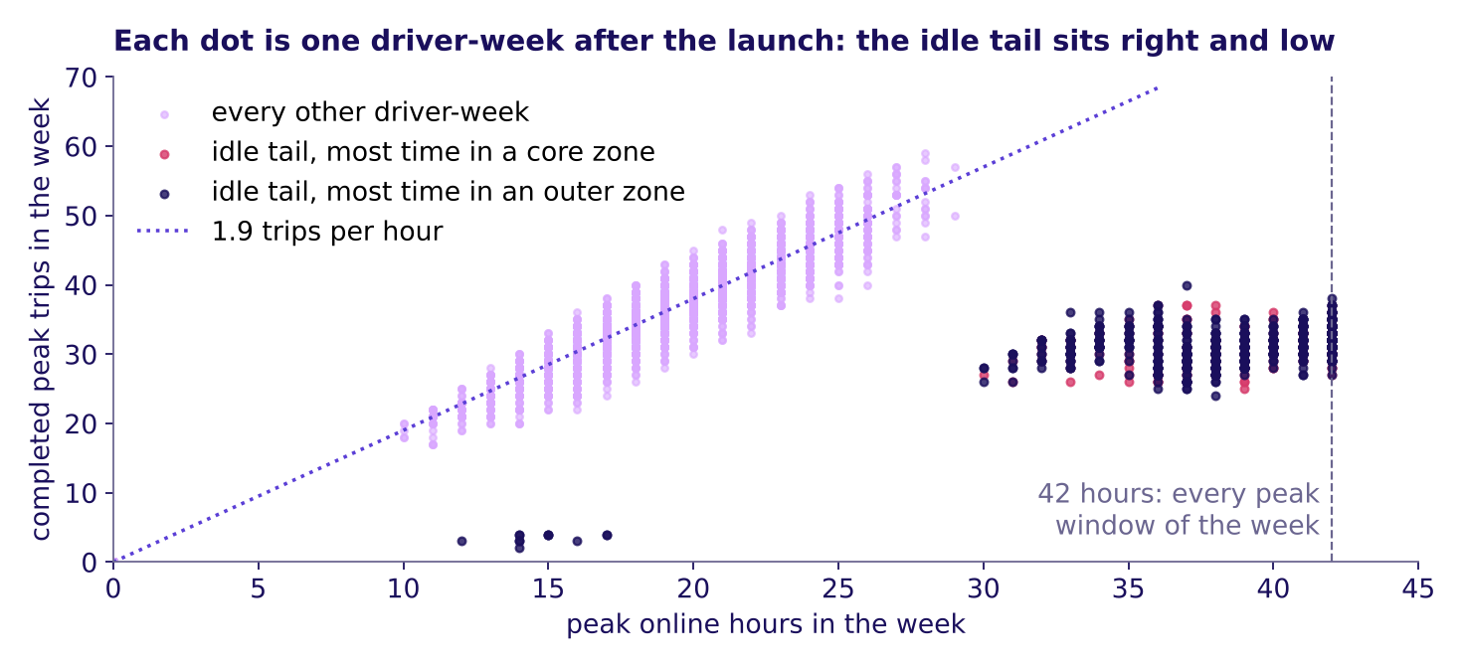
Indian Institute of Technology Gandhinagar
WEEK 4 · MONDAY · BUSINESS METRIC DESIGN · UBER, HYDERABAD
ADMINISTERED THROUGH THE COMPETENCY ADVANCEMENT ACADEMY
Answer: 180 drivers, more hours, fewer trips
Who are they, what did their hours and trips do, and where were they online?
After the launch, every driver-week by hours and trips; the idle tail sits far right and low
Answer: c. 180 drivers, 15 percent of the city: the idle tail, named for the long online hours in which they completed few trips. Their hours went to 2.1 times their level before the launch while their trips fell 12 percent, and 72 percent of their new hours were in the outer zones. Each dot is one driver-week. Most of the tail sits far right and low, at about 39 hours a week; E's and F's weeks sit apart at the bottom left, short weeks with almost no trips, the extreme of the 180, which is why the six fall further than the city.
…
Which number warns?
Which four lines?
How is a number gamed?
What does the page hold?
What does an hour count?
Where did the fall sit?
What should it pay for?
S72 · 80 / 93
Notes:
LIVE, 5 minutes. Point at the cluster to the right of 30 hours with 25 to 35 trips: weeks online in
almost every peak window with far fewer trips than the dotted line. Say what the data cannot say:
why they did it. The likely reading is that the floor pays for being online and the outer zones are
quiet, so a driver parked there earns the floor without a trip: chapter 5's first way, the paid
person controls the count. A second route in the notebook finds the same 180 by acceptance alone.
Watch for "these drivers are lazy": they are doing what the number pays for, as Wells Fargo's staff
did in chapter 1.
Transition: the chapter's close.

Slide 81
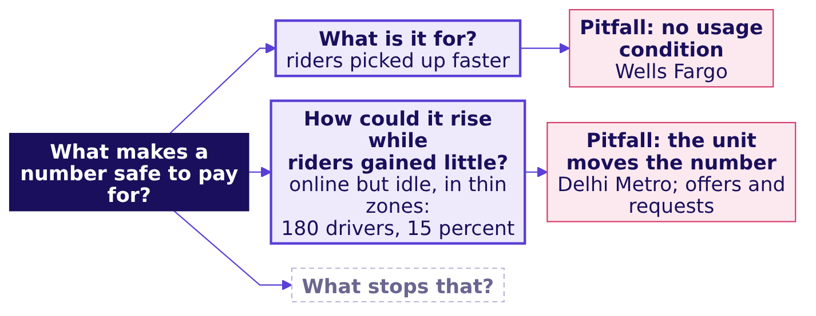
Indian Institute of Technology Gandhinagar
WEEK 4 · MONDAY · BUSINESS METRIC DESIGN · UBER, HYDERABAD
ADMINISTERED THROUGH THE COMPETENCY ADVANCEMENT ACADEMY
Close: hours rose where riders were few
What has chapter 8 answered, and what does the board now hold?
The crux. The city's rate is two sums divided once, with its denominator named; the city's 1.90 to 1.58 is real, demand rose, and 180 drivers sitting online in thin zones carry the fall.
The senior analyst's check. Baseline (1.90), denominator (online hours), evidence from a second table (requests rose 1.8 percent), and the segment reached a second way (acceptance finds the same 180).
…
Which number warns?
Which four lines?
How is a number gamed?
What does the page hold?
What does an hour count?
Where did the fall sit?
What should it pay for?
S73 · 81 / 93
Notes:
LIVE, 3 minutes. Add the region to the board. Transition: chapter 9 asks what the scheme should pay
for instead.

Slide 82
Indian Institute of Technology Gandhinagar
PG DIPLOMA IN AI-ML AND AGENTIC AI ENGINEERING · COHORT 2
ADMINISTERED THROUGH THE COMPETENCY ADVANCEMENT ACADEMY
09
The redesign's north star, guardrails, leading inputs, resistant lines and seven-line page
What should it pay for?
Applies the north star and guardrails (chapter 2), the leading inputs (chapter 3), the lines that resist gaming (chapter 5) and the seven-line page (chapter 6) to the redesign, before the city head decides on Friday.
What is a number for?
Which number to chase?
Which number warns?
Which four lines?
How is a number gamed?
What does the page hold?
What does an hour count?
Where did the fall sit?
What should it pay for?
Week 4, Day 1. Business metric design: which number should the plan chase, and what stops it being gamed?
82 / 93
Notes:
LIVE, 30 seconds. Levels 3 and 4, 38 minutes: the opener and map (2), the opener question (4), the
wrong memo and its cost (8), the tree and the inputs (4), the Uber page line by line, guided (11), the caveats (7), the
close (2). Notebook: notebooks/C2_W04_D01_09_north_star_guardrails_cost_STUDENT.ipynb. Styles:
Brilliant (question first), 3Blue1Brown (the tree built region by region), the case method,
ByteByteGo (the finished board). Transition: what the chapter answers.

Slide 83
Indian Institute of Technology Gandhinagar
WEEK 4 · MONDAY · BUSINESS METRIC DESIGN · UBER, HYDERABAD
ADMINISTERED THROUGH THE COMPETENCY ADVANCEMENT ACADEMY
The redesign applies chapters 2, 3, 5 and 6
Who needs the answer, and which questions lead to it?
Applies: North-star and guardrail metrics (chapter 2); Leading against lagging indicators (chapter 3); Gaming, and definitions that resist it (chapter 5); The metric definition artifact (chapter 6).
Who needs the answer. The city head, who must say by Friday what the scheme pays for, and the finance partner, who holds the top-up budget: a scheme that keeps paying for hours keeps paying drivers to sit online in zones with few riders.
THE RULE
THE COST
THE PAGE
THE DOUBTS
Which number to pay for?
What did hours cost?
What do the seven lines say?
What can the data not show?
Four rules, voted.
The top-up, split at half accepted.
Each caveat and the fact that settles it.
Chapter 6's page, filled for the city.
…
Which number warns?
Which four lines?
How is a number gamed?
What does the page hold?
What does an hour count?
Where did the fall sit?
What should it pay for?
S74 · 83 / 93
Notes:
LIVE, 1 minute 30 seconds. Every idea in this chapter was taught on an invented example this morning; here
each is recalled by name and goes straight to the data. Transition: the question that opens it.

Slide 84
Indian Institute of Technology Gandhinagar
WEEK 4 · MONDAY · BUSINESS METRIC DESIGN · UBER, HYDERABAD
ADMINISTERED THROUGH THE COMPETENCY ADVANCEMENT ACADEMY
Which number should the scheme reward?
Which number, if the scheme rewarded it, would make drivers drive and serve riders, without rewarding idling or picking only easy trips?
a) Peak online hours, as now
b) Completed peak trips, nothing beside it
c) Completed peak trips, with a minimum share of offers accepted
d) Enrolled drivers
…
Which number warns?
Which four lines?
How is a number gamed?
What does the page hold?
What does an hour count?
Where did the fall sit?
What should it pay for?
S75 · 84 / 93
Notes:
LIVE, 2 minutes. Letters on paper. Explorer scene M2 lets the room move the choice and watch the dots
re-behave; use it after the vote if it is on the projector.
Transition: the answer.

Slide 85
Indian Institute of Technology Gandhinagar
WEEK 4 · MONDAY · BUSINESS METRIC DESIGN · UBER, HYDERABAD
ADMINISTERED THROUGH THE COMPETENCY ADVANCEMENT ACADEMY
Answer: trips, with an acceptance floor
Why does each of the other three fail?
Answer: c. Hours pay for an open app, which the idle tail showed. Trips alone let a driver accept only short or nearby trips and decline the rest, which the share of offers accepted catches. Enrolled drivers rise with every sign-up whether or not anyone drives. Trips with an acceptance floor, a least share of offers accepted, reward the service and catch the cherry-picking: chapter 2's north star with its guardrail. Two floors now run through the case: the Rs 300 floor is what a driver-week is guaranteed, and the acceptance floor is what a driver-week must clear to earn it, the pay rule chapter 10 prices.
…
Which number warns?
Which four lines?
How is a number gamed?
What does the page hold?
What does an hour count?
Where did the fall sit?
What should it pay for?
S76 · 85 / 93
Notes:
LIVE, 2 minutes. Take each wrong letter in turn and say the gaming it invites; the room should hear
that every wrong answer is a number someone would really propose.
Transition: the memo that the celebrated number would have produced.

Slide 86
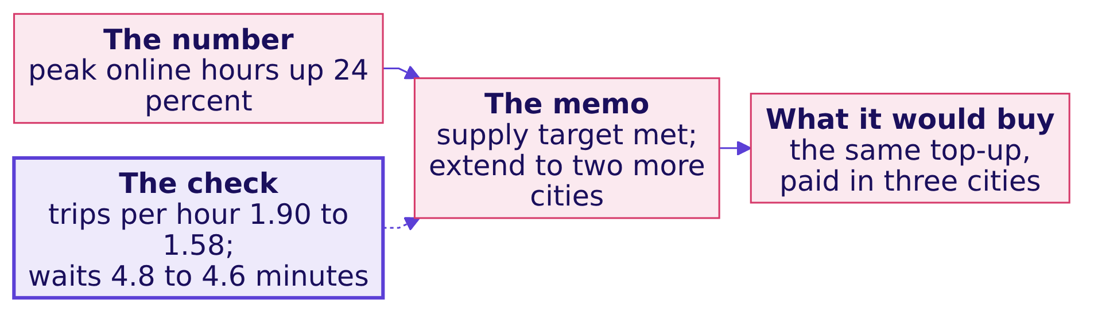
Indian Institute of Technology Gandhinagar
WEEK 4 · MONDAY · BUSINESS METRIC DESIGN · UBER, HYDERABAD
ADMINISTERED THROUGH THE COMPETENCY ADVANCEMENT ACADEMY
The wrong memo: "supply met, extend it"
What decision does "peak online hours up 24 percent" send to the city head, and what catches it?
The plausible wrong answer: "Peak online hours up 24 percent over six weeks. Supply target met. Recommendation: extend the scheme to two more cities." The check that catches it: trips per peak online hour fell from 1.90 to 1.58 and the median wait moved only from 4.8 to 4.6 minutes, so riders were served barely better, at about Rs 2,836 of top-up for each extra trip. The fix: judge the scheme by completed peak trips, with an acceptance guardrail.
…
Which number warns?
Which four lines?
How is a number gamed?
What does the page hold?
What does an hour count?
Where did the fall sit?
What should it pay for?
S77 · 86 / 93
Notes:
LIVE, 3 minutes. Present the memo as the one a hurried analyst writes on Monday morning. Then the
check, then the fix. The next slide prices what the memo would have kept buying.
Transition: where the Rs 1.9 crore went.

Slide 87
Indian Institute of Technology Gandhinagar
WEEK 4 · MONDAY · BUSINESS METRIC DESIGN · UBER, HYDERABAD
ADMINISTERED THROUGH THE COMPETENCY ADVANCEMENT ACADEMY
How much top-up went to declining weeks?
What share of the Rs 1.9 crore went to driver-weeks that accepted fewer than half their offers?
a) 15 percent
b) 39 percent
c) 61 percent
d) 88 percent
…
Which number warns?
Which four lines?
How is a number gamed?
What does the page hold?
What does an hour count?
Where did the fall sit?
What should it pay for?
S78 · 87 / 93
Notes:
LIVE, 2 minutes. Letters on paper; notebook 09's first cell answers it.
Transition: the answer.

Slide 88
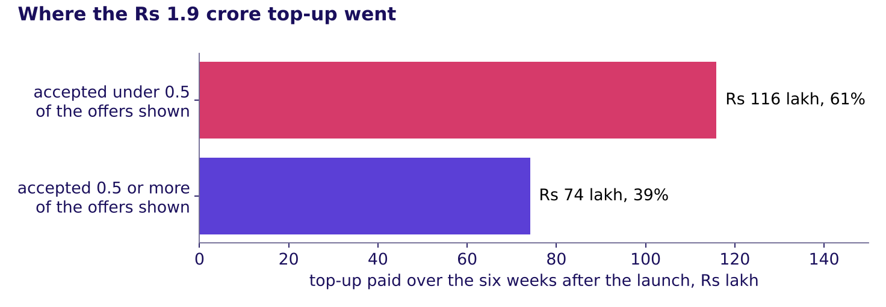
Indian Institute of Technology Gandhinagar
WEEK 4 · MONDAY · BUSINESS METRIC DESIGN · UBER, HYDERABAD
ADMINISTERED THROUGH THE COMPETENCY ADVANCEMENT ACADEMY
Answer: 61 percent, Rs 1.16 crore of 1.9
Where did the money go, and what is the honest way to state a saving?
Where the Rs 1.9 crore top-up went, split at an accepted share of 0.5
Answer: c. Rs 1.159 crore, 61 percent, went to driver-weeks that accepted fewer than half the offers they were shown; Rs 74 lakh went to the rest. Rs 74 lakh is what the six weeks would have cost had only the second group been paid and every driver behaved the same, which a new rule would not guarantee: some idle drivers would start accepting enough to qualify.
…
Which number warns?
Which four lines?
How is a number gamed?
What does the page hold?
What does an hour count?
Where did the fall sit?
What should it pay for?
S79 · 88 / 93
Notes:
LIVE, 3 minutes. Say the behaviour line clearly, because the finance partner and every interviewer
will ask it: a saving that assumes nobody changes is the most the redesign could save, and an honest
saving says how drivers respond. Chapter 10, round 3 of the war game after lunch, prices the saving
under a stated range, in notebook 10.
Transition: the tree that replaces the single number.

Slide 89
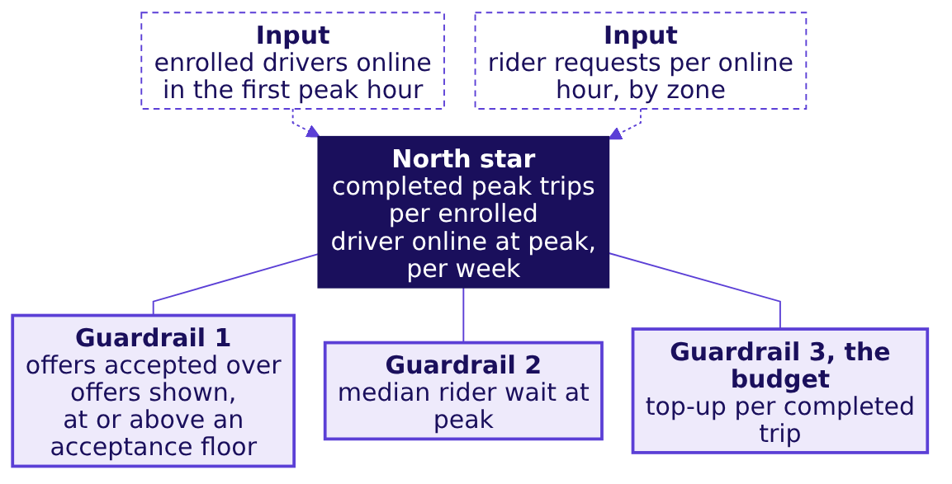
Indian Institute of Technology Gandhinagar
WEEK 4 · MONDAY · BUSINESS METRIC DESIGN · UBER, HYDERABAD
ADMINISTERED THROUGH THE COMPETENCY ADVANCEMENT ACADEMY
The tree: a north star, guardrails, inputs
How does the number the scheme pays for connect to the numbers that must not get worse and the ones the city team can act on this week?
Chapter 2's north star and guardrails and chapter 3's leading inputs, on the city. A completed trip is a rider served, counted with a receipt; the wait covers only riders who were picked up, so it can improve while more requests go unserved, which is why it guards from beside the north star. Read it as chapter 2's seesaw: if the north star rises while a guardrail moves the wrong way, riders or the budget paid for the rise. Acceptance, guardrail 1, also settled first in the launch week (chapter 3's S28). The first input needs a record the tables do not hold, drivers online by peak hour, so the city starts logging it.
…
Which number warns?
Which four lines?
How is a number gamed?
What does the page hold?
What does an hour count?
Where did the fall sit?
What should it pay for?
S80 · 89 / 93
Notes:
LIVE, 4 minutes, 3Blue1Brown: build it on the board one region at a time, first the north star
alone, then each guardrail with the gaming it catches (a driver online and declining; trips so short
or so cherry-picked that waits rise; a top-up that runs away), then the two inputs. Explorer scene
M2, the seesaw, shows the north star against its guardrails. Tuesday's slide, Thursday's funnel and
Friday's forecast all hang off this north star.
Transition: the definition, line by line.

Slide 90
Indian Institute of Technology Gandhinagar
WEEK 4 · MONDAY · BUSINESS METRIC DESIGN · UBER, HYDERABAD
ADMINISTERED THROUGH THE COMPETENCY ADVANCEMENT ACADEMY
Seven lines make the number hard to game
What does each line of the redesign's definition say, and which gaming does it stop?
Line | The redesign's definition
Numerator | Trips completed inside the peak windows, one per paying rider: Uber's annual report counts an UberX Share ride with three paying riders as three trips
Denominator | Enrolled drivers online at least one peak hour that week, the count printed beside the rate
Window | The calendar week
Exclusions | Trips cancelled by either side, test accounts, trips outside the windows
What it does not reward | Hours online; offers declined; a shrinking enrolled base, since fewer drivers in the count would raise the rate with no extra trip
Guardrails | For riders: accepted share at or above an acceptance floor the city sets, read with the share of accepted trips the driver cancels, and the median rider wait. For the budget: top-up per completed trip
Gaming note | Guardrail 1 catches declining and cherry-picking, and the cancel share beside it accepting then cancelling; guardrail 2, supply that stops serving riders; guardrail 3, a top-up that runs away from the trips it pays for
Chapter 6's page, filled for the city. On the data, the north star read 35.76 trips per online driver-week before and 35.89 after: hours rose 24 percent and the number the scheme exists for barely moved. Every driver in the table enrolled, so the weeks before the launch count the same drivers.
…
Which number warns?
Which four lines?
How is a number gamed?
What does the page hold?
What does an hour count?
Where did the fall sit?
What should it pay for?
S81 · 90 / 93
Notes:
LIVE, 11 minutes, guided: the room writes each line with the trainer (exercises/guided/
C2_W04_D01_definition_STUDENT.md), the skeleton they filled for Balaji Kirana in chapter 6 now on the
city. Pause after every line and ask which gaming it stops: the denominator's "online at least one
peak hour" stops a sign-up who never drives from diluting the rate; "what it does not reward" names
hours. Uber's 10-K counts an UberX Share ride with three paying riders as three trips and an UberX
ride with three passengers as one, which is why the numerator says "per paying rider" (checked 13
October 2026). The wait's clock starts at the rider's request, never at a time a driver sets,
chapter 5's third way. Explorer scene M3 recomputes the metric as each line changes.
Transition: what the data cannot show.

Slide 91
Indian Institute of Technology Gandhinagar
WEEK 4 · MONDAY · BUSINESS METRIC DESIGN · UBER, HYDERABAD
ADMINISTERED THROUGH THE COMPETENCY ADVANCEMENT ACADEMY
Without the 140 new drivers, what remains?
Take out every driver who joined after the launch: what does trips per hour read for the six weeks after?
a) 1.90
b) 1.79
c) 1.58
d) 1.19
…
Which number warns?
Which four lines?
How is a number gamed?
What does the page hold?
What does an hour count?
Where did the fall sit?
What should it pay for?
S82 · 91 / 93
Notes:
LIVE, 2 minutes. The trap here is a caveat used as an excuse: "the new drivers explain it".
Transition: the answer and the other cuts.

Slide 92
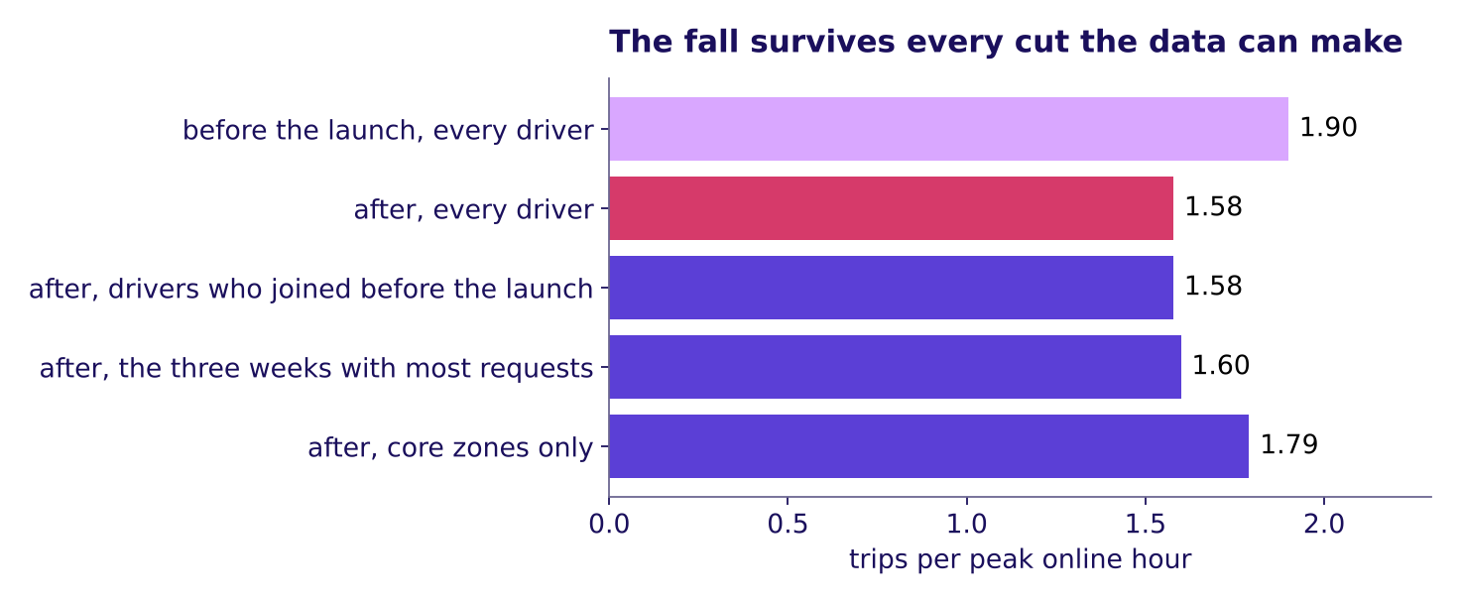
Indian Institute of Technology Gandhinagar
WEEK 4 · MONDAY · BUSINESS METRIC DESIGN · UBER, HYDERABAD
ADMINISTERED THROUGH THE COMPETENCY ADVANCEMENT ACADEMY
Answer: 1.58; the fall survives each cut
Which doubts does the fall survive, and which stay open until someone gathers more?
Trips per peak online hour after the launch under each cut the data can make
Answer: c. Without the new drivers the rate is still 1.58. In the three weeks with the most rider requests, the first three after the launch and still in the rains, it already read 1.60, so the monsoon's end does not explain the step at the launch; whether the season moved the later weeks stays partly open, since last year's weeks are not in the data. In the nine core zones it fell from 1.90 to 1.79, so the fall sits mostly in the three outer zones. Three doubts stay open: drivers on two apps (the data holds weekly totals, so it cannot show a decline made because another app's trip was under way), who chose to enrol (every driver here enrolled, so no group stayed out to compare with), and cause (only a test of the redesign settles it).
…
Which number warns?
Which four lines?
How is a number gamed?
What does the page hold?
What does an hour count?
Where did the fall sit?
What should it pay for?
S83 · 92 / 93
Notes:
LIVE, 5 minutes. Walk the six caveats in order, each with the fact that would settle it: data quality
(online means the app is open; hours with no trip rose from 0.22 to 0.38), mix (new drivers: 1.58
without them), seasonality (the three weeks with most requests: 1.60; last year's weeks are not in the data, so the
caveat narrows and stays partly open), drivers on two apps (needs hourly data and the other app), who chose to
enrol (needs the city's full driver list), cause (the tentative faculty block designs the test).
Transition: the finished board.

Slide 93
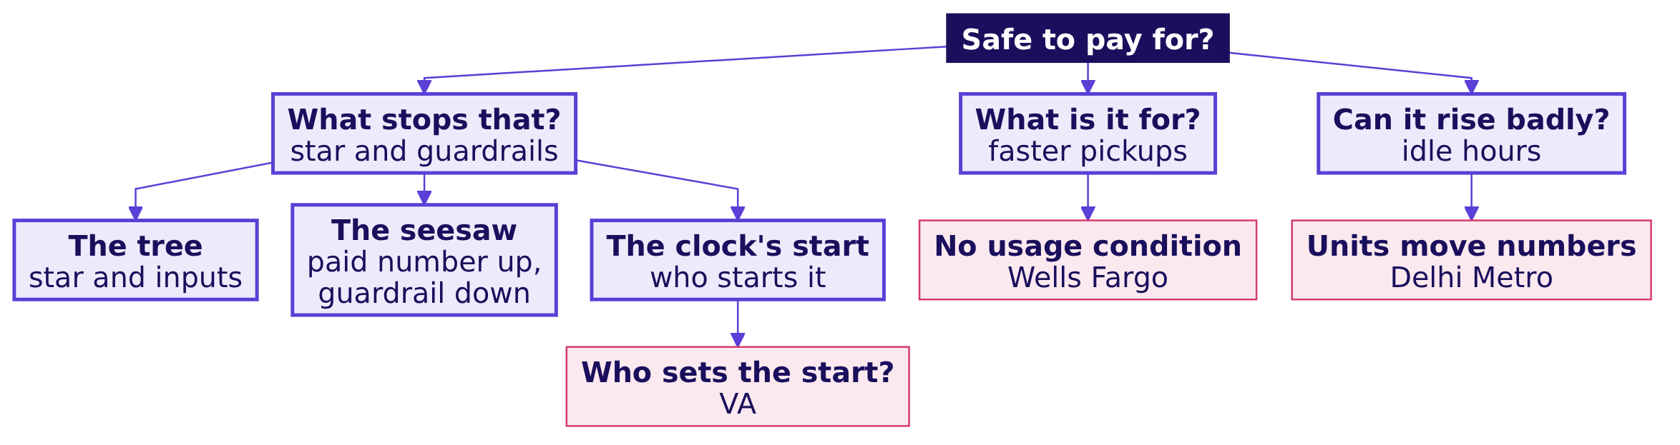
Indian Institute of Technology Gandhinagar
WEEK 4 · MONDAY · BUSINESS METRIC DESIGN · UBER, HYDERABAD
ADMINISTERED THROUGH THE COMPETENCY ADVANCEMENT ACADEMY
Close: judge by trips, guarded three ways
What does the finished board say?
The crux. Judge the scheme by completed peak trips per enrolled driver online at peak, guarded for riders by acceptance and the wait, and for the budget by the top-up per trip; chapter 10 prices the pay rule that follows.
…
Which number warns?
Which four lines?
How is a number gamed?
What does the page hold?
What does an hour count?
Where did the fall sit?
What should it pay for?
S84 · 93 / 93
Notes:
LIVE, 2 minutes. The board is finished; it is the cheat sheet's second panel. Read the crux line:
paying for hours sent 61 percent of Rs 1.9 crore to driver-weeks that declined most of what they were
offered. The pitfalls on its last row were each taught this morning: the bank in chapter 1, the
units in chapter 4, the clock in chapter 5. The interview line the chapter earns: [F] north-star
against guardrail, with one example pair, completed peak trips per enrolled driver, guarded by the
share of offers accepted. Then lunch; the afternoon's running order is on the topics slide, S3.
Transition: half two opens on chapter 10, round 3 of the war game.

