Slide 1
UST Revision – RAG to Stateful LangGraph
Topics:
• Traditional RAG
• LangChain Pipelines
• Stateful LangGraph
• AgentState
• Planner / Executor / Verifier
• STM / LTM
• Checkpointers

Slide 2
4-Day Agentic/Multi-Agent workshop
End Objective
To create RAG pipelines (relate with the Parishiksha Assistant project)
Softwares : langchain, langgraph, autogen, crewAI, flowise, n8n.
Day 1 : Move from linear LangChain/RAG chains to stateful graph thinking. Refactor last week's RAG pipeline as a graph. No new abstractions before students see the connection.
Day 2: Transition intent: Make the graph remember and act through tools. Same Q&A graph from Tuesday, now with short-term memory via checkpointer + tool routing via ToolNode.
Day 3: Transition intent: Move from one agent to coordinated specialist roles. Supervisor decides whether to research more, write, or stop. Workers stay simple and inspectable.
Day 4: Transition intent: Convert toy graphs into demo-worthy workflows with recovery. Add retries, human-in-the-loop, streaming, and lightweight observability to Thursday's multi-agent system. (Flowise, n8n)

Slide 3
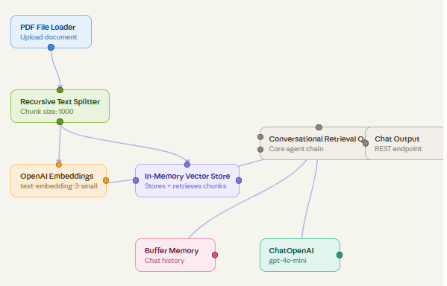
Colab 1 Skeleton — RAG Agent in Flowise (helpful for your ASSISTANT project)

Slide 4
Day 1
Intent : Move from linear LangChain/RAG chains to stateful graph thinking. Refactor last week's RAG pipeline as a graph. No new abstractions before students see the connection.
RAG as a graph: state, nodes, edges, conditional routing
Different types of RAGs.

Slide 5
Today we build the simplest version of this pattern as a LangGraph StateGraph. By Friday you will be running a multi-agent version of it (flowise).

Slide 6
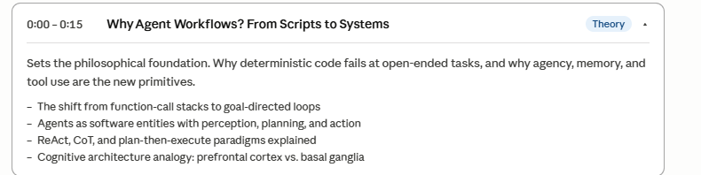
Workflows vs Agents

Slide 7
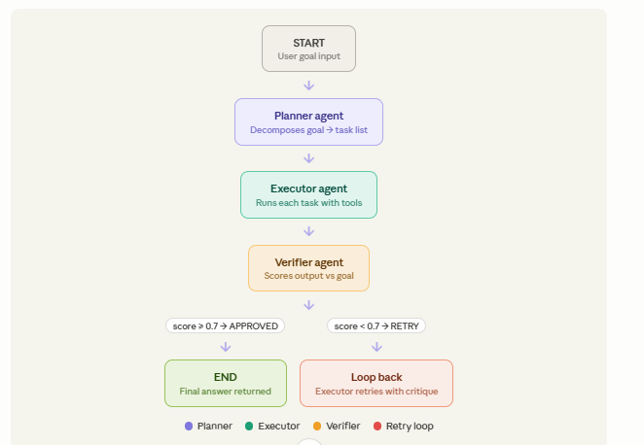
LangChain Pipeline Diagram

Slide 8
Lab breakdown (git commit before lunch)
AgentState + Imports + groq integration
Planner agent (with retry, exception tested individually)
Executor (Planner + Executor tested)
Verifier (tested with conditional edge )
Langgraph Assemble nodes.

Slide 9
Key things that differ from the workshop skeleton shown earlier:
The earlier code was a minimal illustration. This full version adds three important production elements — a json.loads() try/except on every LLM response (because GPT occasionally wraps JSON in markdown code fences), an iterations counter that force-approves after 3 cycles (prevents infinite loops), and the critique_ctx string that gives the Executor targeted feedback on retry rather than blindly repeating itself. Those three additions are what separates a demo from something that actually runs reliably end-to-end.

Slide 10
PM
Build a Week 1-10 learner Q&A graph from scratch. It must decide whether to retrieve notes or answer directly, then generate a response. Reuse only Anish's RAG pipeline as inspiration - rebuild it as a graph.

Slide 11
Day 2
Short-term versus long-term memory in agents. Context-window management. Conversation summarisation.
Persistent memory stores: vector memory, episodic memory. Hands-on: Chroma-backed long-term memory.

Slide 12
Checkpointers in Langgraph (short-term memory)
Checkpointer keeps memory within a thread

Slide 13
Store in langgraph is long-term memory
Store keeps memory across threads

Slide 14
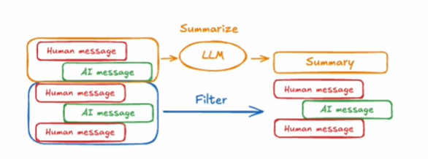
Filtering (short-term memory)
Based on last n messages
Based on token count.
Summarize previous messages and pass in summary (context compression)
Summary is stored as part of graph State.

Slide 15
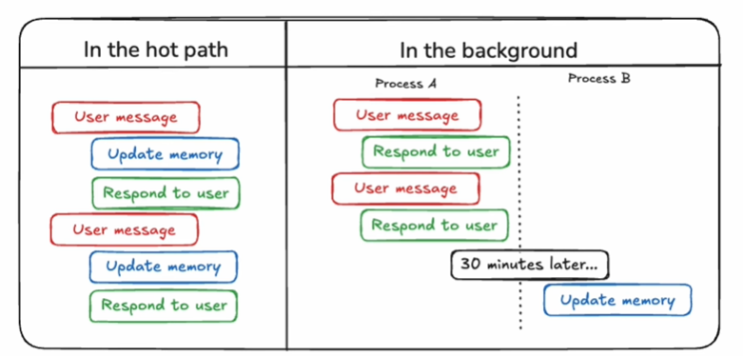
Long-term memory
Updates in Hot path
Updates in Background
Pros and Cons?

Slide 16
Pros and Cons
Hot path :
Pros :
There is no separate bookkeeping
Cons:
Application logic becomes convoluted.
Latency increases
Background:
Pros :
No interference with application logic or latency
Cons
Surfacing to user is difficult
Memory may not be updated when you start a new conversation

Slide 17
Add memory to below model

Slide 18
Hackathon Analogy
The scenario — hospital triage — was picked deliberately. It maps cleanly to every concept you built: conditional edges handle severity routing (P1 goes one path, P4 another), RAG pulls from a real knowledge base (medical protocols), STM handles a nurse reviewing the same patient twice in a shift, LTM handles a returning patient across shifts, and the supervisor's retry/recovery isn't just a tech demo — in this domain a graceful failure with a clear reason is literally safer than a wrong confident answer.

