Slide 1
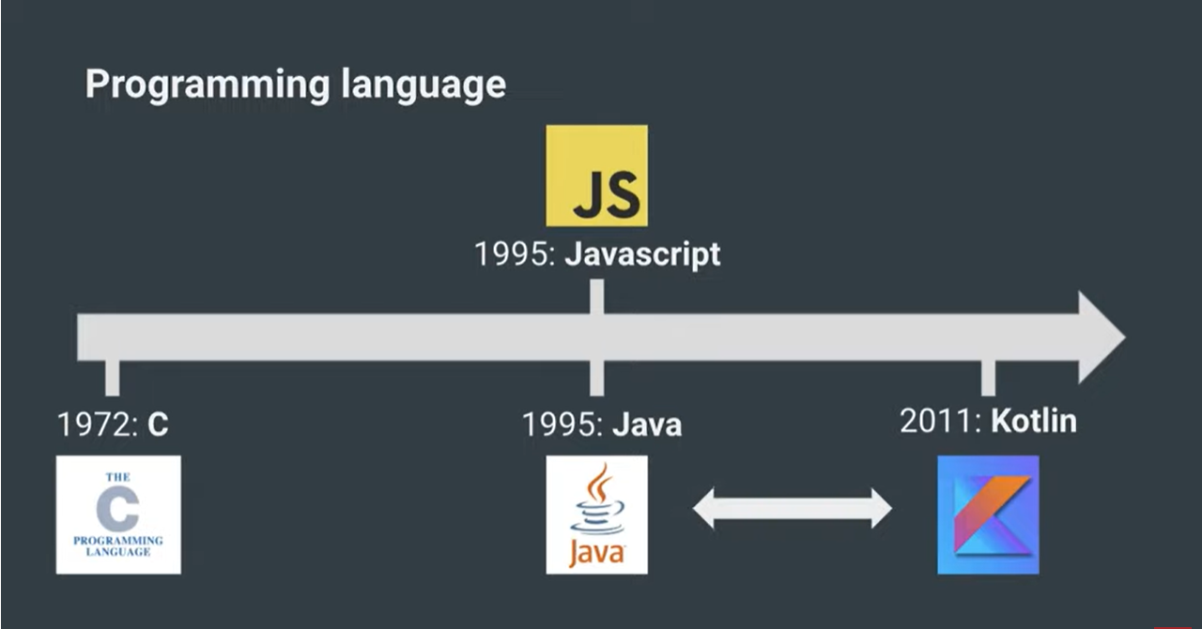

Slide 2


Kotlin Timeline
2010 Project started
2016 Kotlin 1.0
2017 Official on Android
2018 Kotlin 1.3
2020 Kotlin 1.4
2021 Kotlin 1.5

Slide 3
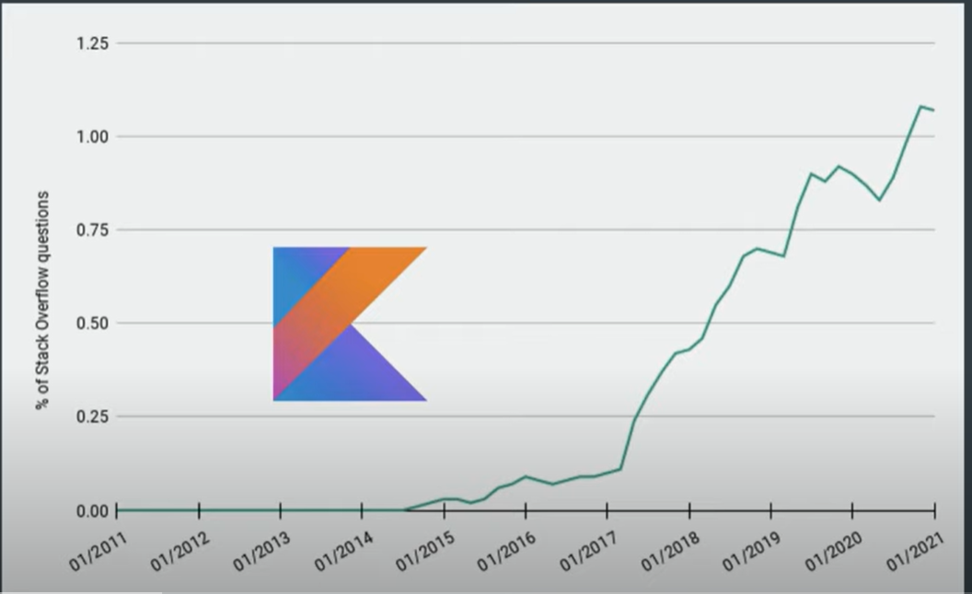

Slide 4
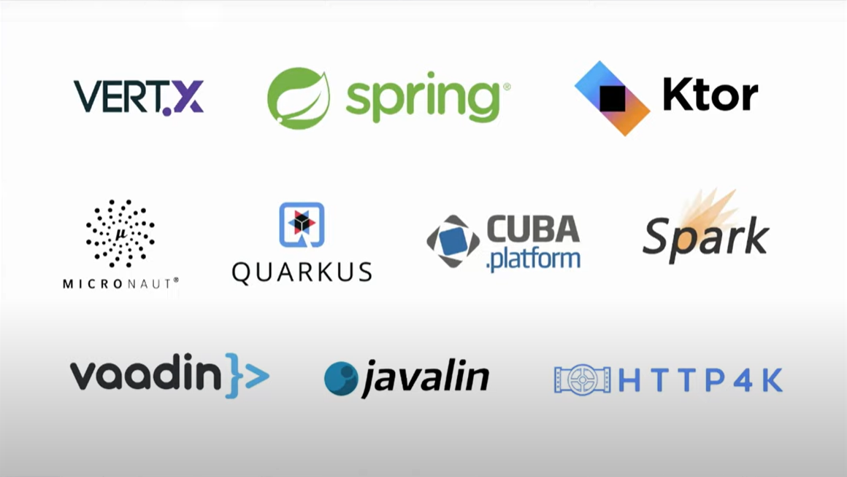
Frameworks

Slide 5
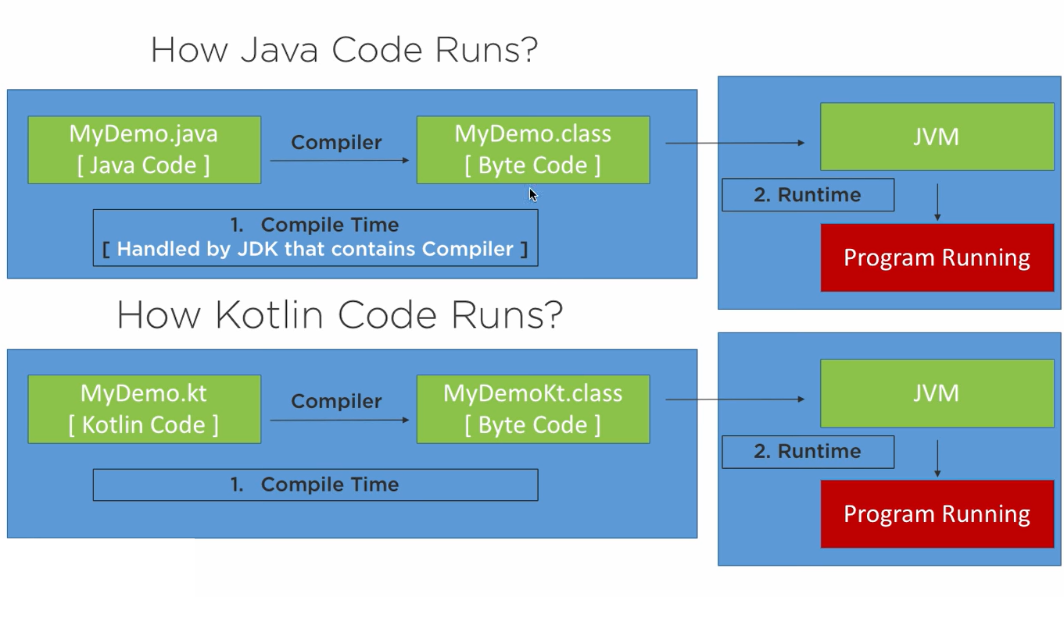

Slide 6
