Slide 1
🎭 AI-POWERED · PLAYWRIGHT · TYPESCRIPT
EventHub
Test Automation Framework
Production-grade · Self-healing locators · AI-assisted · CI-verified ·
70
65
11
4m
Test Cases
Passing in CI
Modules
CI Runtime
Ravi Tanna | Senior QA Engineer | May 2026 | github.com/ravitanna-jeavio/2.Playwright-Training

Slide 2
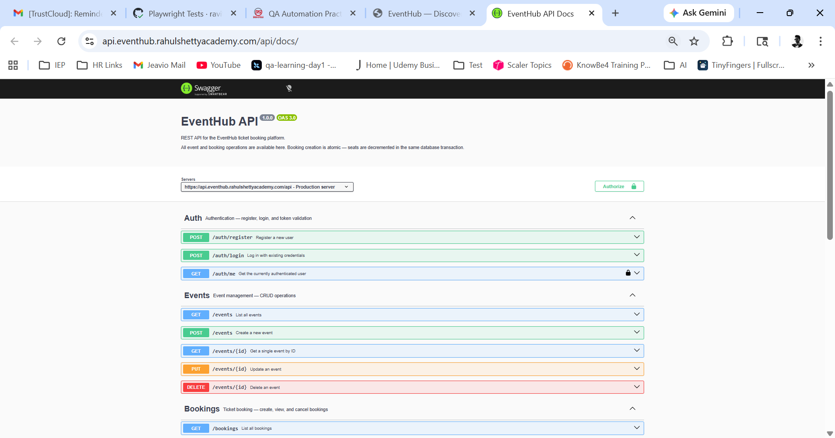
Application Under Test
EventHub — Real-world event booking platform. Live APIs. Real data. No mocks.
9 MODULES AUTOMATED
🔐
Login / Auth
📋
Event Listing
TC-001–006
TC-007–012
🎟
Event Detail
✅
Event Booking
TC-013–018
TC-019–024
📂
My Bookings
⚙️
Admin Events
TC-025–030
TC-031–038
🗂
Admin Bookings
🔌
REST API
TC-039–042
TC-043–066
🔄
E2E Flows
TC-067–070
🔌 Live REST APIs · Swagger Docs · Admin Access · Sandbox

Slide 3
Framework Architecture
Data flows left to right through 3 layers — each with a single responsibility.
LAYER 1
DATA IN
Excel
test-cases-v4.xlsx
Swagger
swagger.json
.env File
Secrets
Playwright MCP
Browser Control
Auth State
user.json
70 TCs · 9 sheets
Auto-gen API types
Credentials · URLs
Live UI inspection
Global login setup
LAYER 2
CORE
utils/env.ts
constants.ts
excel-reader.ts
+ Zod Validation
SelfHealingLocator
utils/self-healing-locator.ts
Page Objects
pages/*.ts (7 classes)
Safe env · No magic strings
Parse · Validate · Type
Priority fallback · Auto-warn
All UI abstracted · POM
LAYER 3
OUTPUT
Test Scripts
GitHub Actions
HTML Report
+ JSON
Slack / Email
tests/ui/ · api/ · e2e/
CI Pipeline · Scheduled
Artifacts · 30 day retention
Failure notifications
📐 Real arrows show actual data flow between framework components

Slide 4
Journey of One Test Case: TC-019
Traced from Excel row through every framework layer to CI green — with real self-healing in action.
1
2
3
4
5
6
📊
⚙️
🔧
📄
🧪
✅
Excel Row
excel-reader.ts
SelfHealing
Locator
POM Class
Test Script
CI: Green
TestID: TC-019
parseExcelTestCases()
Tries getByRole()
EventBookingPage
[TC-019] should
GitHub Actions
Module: EventBooking
reads TC-019 row
Priority 1 → ✓ found
fillBookingForm()
confirm booking
runs in 3.7s
Priority: High
Zod validates schema
fillEmail(email)
selectSeats(1)
@smoke tag
HTML: PASSED
Enabled: TRUE
Returns typed
fillPassword(pw)
clickBook()
AAA structure
JSON: recorded
InputData: name,
TestCase object
Falls back if needed
assertBooking
Screenshot on
No Email if all pass
email, phone
ready for use
Warns, never fails
Confirmed()
final assertion
(no failures)
⚡ Real CI log: [SelfHealingLocator] Falling back to strategy "button text cancel" — test continued and PASSED without any manual fix

Slide 5
Self-Healing Locators
The standout feature — locators try multiple strategies so tests survive UI changes automatically.
❌ WITHOUT Self-Healing
✅ WITH Self-Healing
Dev renames label
Dev renames label
→ test immediately fails
→ Priority 1 fails silently
Engineer digs through CI
SelfHealingLocator tries P2
Finds broken selector
getByLabel finds it → fills
Manually fixes → re-pushes
Logs: '[SelfHealing] Falling back'
Time lost: 30-60 minutes
Time lost: 0 minutes ✓
PRIORITY FALLBACK CHAIN (emailInput · LoginPage.ts)
P1
P2
P3
P4
P5
getByRole()
getByLabel()
getByPlaceholder()
getByTestId()
locator('css')
Accessibility first
Form labels
No-label inputs
data-testid attr
Last resort only
🔌 Playwright MCP — Claude Code controls a real browser during development, inspects live DOM, builds locator strategies from actual elements — not guesses.

Slide 6
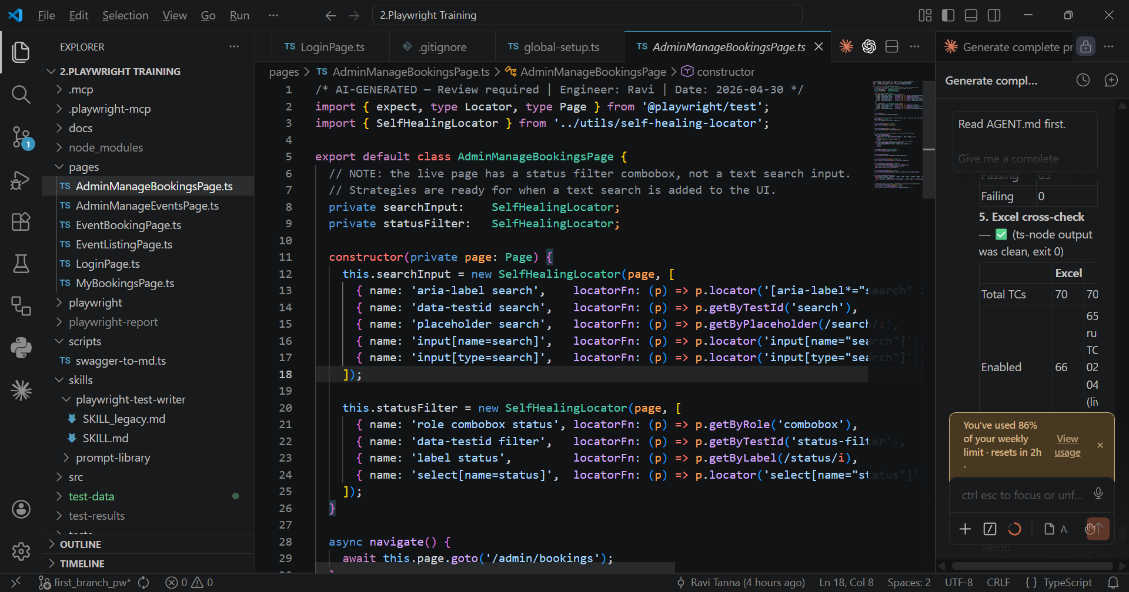
Page Object Model
All UI interactions hidden in page classes. Tests call methods, never touch selectors directly.
7 PAGE CLASSES
LoginPage.ts
navigate() · login() · assertRedirectedTo()
EventListingPage.ts
navigate() · clickFirstEventCard() · assertPageLoaded()
EventDetailPage.ts
assertAllFieldsPresent() · assertPriceVisible()
EventBookingPage.ts
fillBookingForm() · book() · assertBookingConfirmed()
AdminManageEventsPage.ts
createEvent() · deleteEvent() · assertEventRowVisible()
AdminManageBookingsPage.ts
filterByStatus() · cancelFirstBooking()
MyBookingsPage.ts
cancelFirstBooking() · assertBookingVisible()
Rule: Tests NEVER touch raw locators — POM methods only

Slide 7
How to Add New Test Cases
Two workflows using prompt-library/prompts.md — any team member can add tests in minutes.
WORKFLOW A
WORKFLOW B
Add by TC Number
Add by Module
Know the TC ID? One line gets it done.
Want all cases for a module? One prompt.
1
Type in Claude Code
1
Type in Claude Code
Copy prompt from prompts.md, replace TC-XXX with TC-056
Copy prompt from prompts.md, specify module name
2
Claude reads Excel
2
Claude filters Excel
Finds TC-056 → reads Module, Steps, InputData
All Enabled:TRUE rows for that module
3
Writes test script
3
Writes all tests
Correct file · POM methods · TC# in name · tag
TC numbers, tags, AAA, POM — all correct
4
Verifies it passes
4
Verifies full file
npx tsc --noEmit + playwright test --grep TC-056
Every new test passes before finishing
5
Done ✓
5
Done ✓
Test is live in the framework
Entire module covered in one session
📁 Both workflows use prompt-library/prompts.md · No onboarding needed · Any team member can contribute from day one

Slide 8
AI-Assisted Development + Playwright MCP
Claude Code reads AGENT.md + SKILL.md at session start — it knows your framework before you type a word.
🔌 What is Playwright MCP?
Model Context Protocol lets Claude Code control a real browser. During development, it navigates to EventHub, clicks elements, reads the actual DOM, and writes locator strategies based on what really exists — not guesses. Configured in .mcp/config.json.
🤖
📖
⚡
AGENT.md
SKILL.md
prompts.md
Full project briefing — Claude reads this before every session
Code generation rulebook — ensures consistent output
Team task library — day-to-day operations
▸ Project structure & folder map
▸ Selector priority order (strict)
▸ Add test by TC number
▸ App URL + credentials (from .env)
▸ POM-only — no raw locators in tests
▸ Add tests for entire module
▸ TC number & tagging conventions
▸ SelfHealingLocator in page classes
▸ Fix a failing test
▸ What Claude may do autonomously
▸ File location rules per module
▸ Add new page class
▸ What requires human approval
▸ AAA structure requirement
▸ Run specific suite
▸ Output checklist before finishing
▸ Worked example with real output
▸ Regenerate API types & docs
💬 "Read prompt-library/prompts.md and execute section Add test by TC number" → Complete test written, verified, committed.

Slide 9
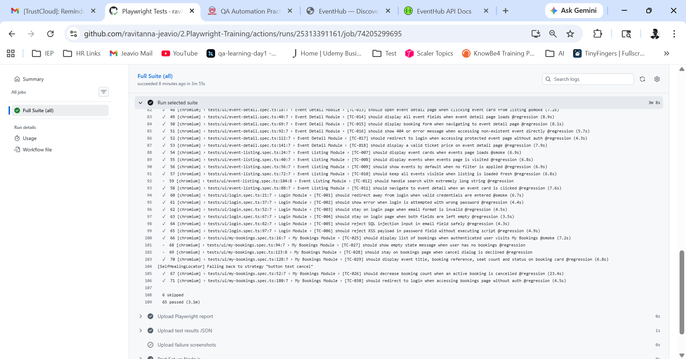
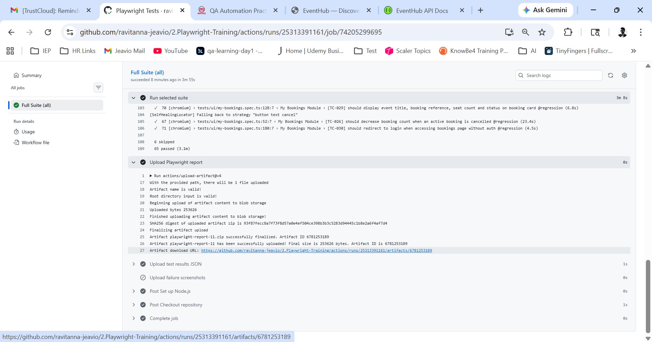
Data-Driven Excel Pipeline
One source of truth — QA adds a row to Excel, framework generates the test. Zero code change needed.
EXCEL COLUMN SCHEMA
TestID
Module
Priority
e.g. TC-001
e.g. Login
e.g. High
InputData
Enabled
e.g. {email,pw}
e.g. TRUE
PIPELINE FLOW
📊
⚙️
🧪
✅
Excel row
added by QA
Zod parse
& validate
Test script
generated
CI green
automatically
▸ Add row to Excel → test appears next CI run
▸ TC numbers in every test name → full traceability
▸ Priority column drives @smoke / @regression tags

Slide 10
Test Coverage
100% Excel traceability — TC-001 to TC-070, every row maps to a spec line.
70
65
6
0
Total TCs in Excel
Active & Passing
Skipped (documented)
Failures in CI
MODULE BREAKDOWN
Module | TC Range | Tests | Tags | Type
🔐 Login | TC-001–006 | 6 | @smoke:1 @regression:5 | UI
📋 Event Listing | TC-007–012 | 5+1skip | @smoke:1 @regression:4 | UI
🎟 Event Detail | TC-013–018 | 6 | @smoke:1 @regression:5 | UI
✅ Event Booking | TC-019–024 | 6 | @smoke:1 @regression:5 | UI
📂 My Bookings | TC-025–030 | 4+2skip | @smoke:1 @regression:3 | UI
⚙️ Admin Events | TC-031–038 | 8 | @smoke:1 @regression:7 | UI
🗂 Admin Bookings | TC-039–042 | 3+1skip | @smoke:1 @regression:2 | UI
🔌 API (Auth/Events/Bookings) | TC-043–066 | 22+2skip | @smoke:3 @regression:19 | API
🔄 E2E Cross-layer | TC-067–070 | 4 | @smoke:1 @regression:3 | E2E

Slide 11
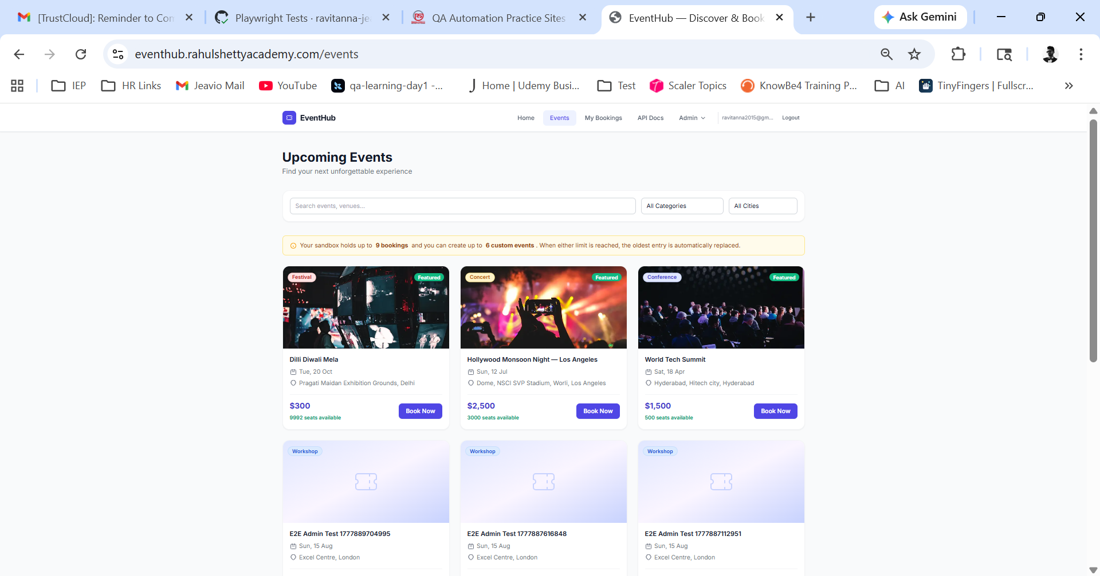
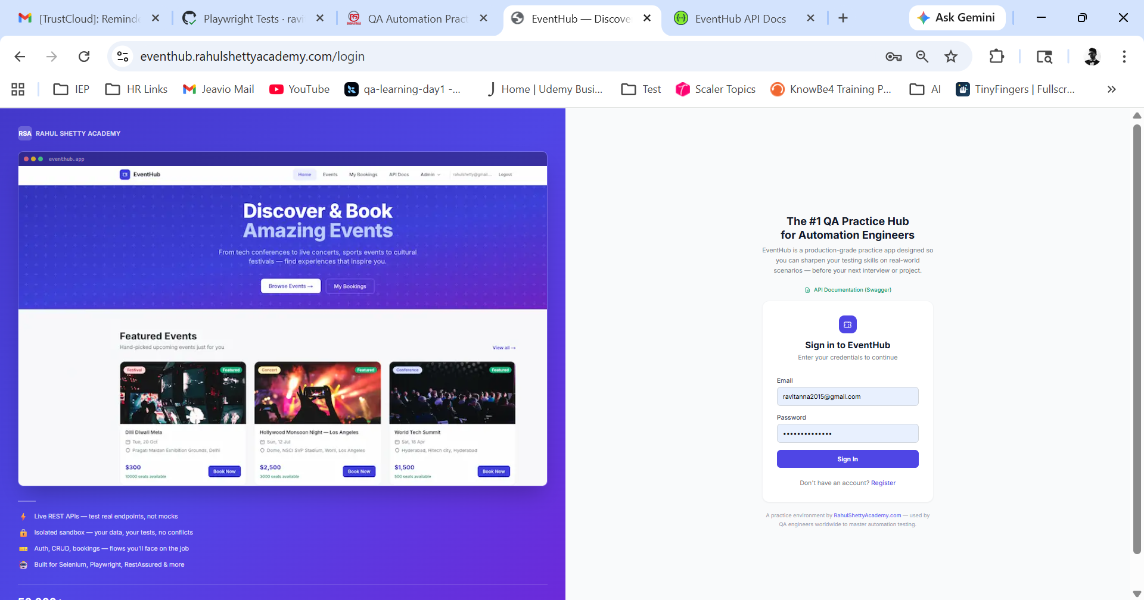
GitHub Actions CI/CD
Tests run automatically every weekday at 7am IST — email + Slack on failure — zero human intervention.
TRIGGER STRATEGY
🕖
Schedule — 7am IST Mon–Fri
cron: '30 1 * * 1-5'
Runs full suite automatically, no human needed
🖱
Manual (workflow_dispatch)
Button in GitHub Actions tab
Suite selector: all / smoke / regression / ui / api / e2e
EVERY RUN DOES THIS
1 Fresh Ubuntu VM → checkout → npm ci (npm cache used)
2 Install Chromium → global-setup.ts saves auth state
3 65 tests run in parallel with 2 workers — ~3-4 min
4 HTML report + JSON results uploaded (30 day retention)
5 Email on failure via GitHub

Slide 12
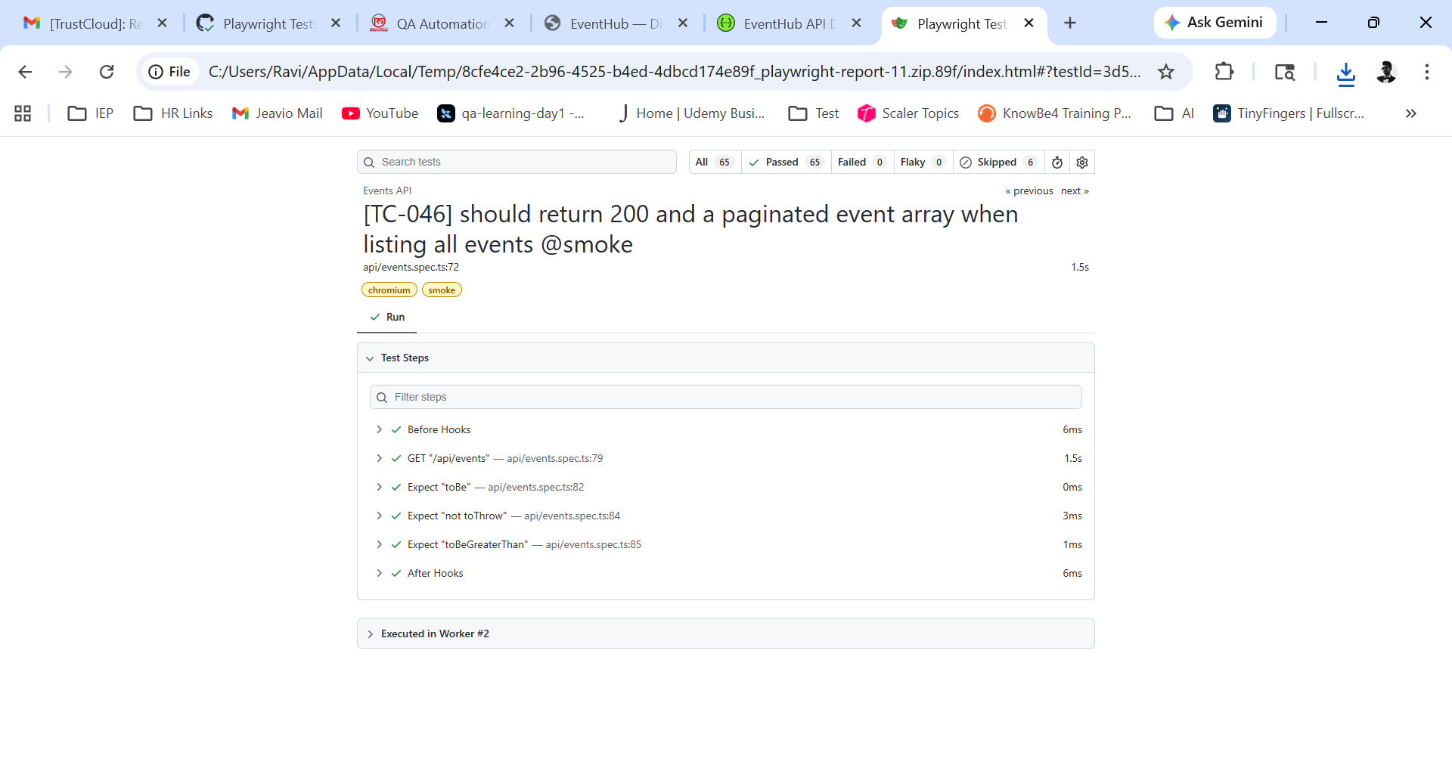
Live CI Results
This is real output from GitHub Actions run #11 — not a mock, not a demo environment.
65 PASSED
6 SKIPPED
0 FAILED
3.1m RUNTIME
11 CI RUNS

Slide 13
Tech Stack
Every tool is battle-tested and in active production use — nothing experimental.
🎭
🔷
🤖
🛡
Playwright
TypeScript
Claude Code + MCP
Zod
Browser automation · API testing · parallel execution · trace viewer
Strict typing · compile-time errors · interfaces · auto-complete in IDE
AI coding assistant — navigates live browser, writes tests, fixes failures
Runtime schema validation — Excel rows and API responses validated at runtime
📊
⚙️
🔌
💬
Excel / XLSX
GitHub Actions
Swagger / OpenAPI
GitHub Actions
70 test cases across 9 module sheets — QA-maintained single source of truth
Cloud CI — free, scheduled daily, artifact upload, 11 runs completed
Auto-generated TypeScript types (Api.ts) from live EventHub spec
Automatic failure notifications — no per-user setup required

Slide 14
EventHub Playwright Framework
Production-grade · AI-assisted · Self-healing · CI-verified ·
🎭
🔧
📄
Playwright
TypeScript
Self-Healing
Locators
Page Object
Model
📊
🤖
⚙️
Excel-Driven
Pipeline
Claude Code
+ MCP
GitHub Actions
CI/CD
Built by Ravi Tanna | github.com/ravitanna-jeavio/2.Playwright-Training | May 2026

