Slide 1
CS 5392 Formal Methods Project – CTL Model Checker
Spring 2021
Group 1

Slide 2
Group Members
Nishanth Gurung – n_g294
Shishira Arun Kumar – s_a607
Satya Annavaram – sma182
Nagendra Kammari – k_n185

Slide 3
Aim
To develop an application to implement model checking analysis tool to verify properties of CTL.
Inputs are Kripke structure file, state ID and property.
Output is whether the property holds good or not for the give state.

Slide 4
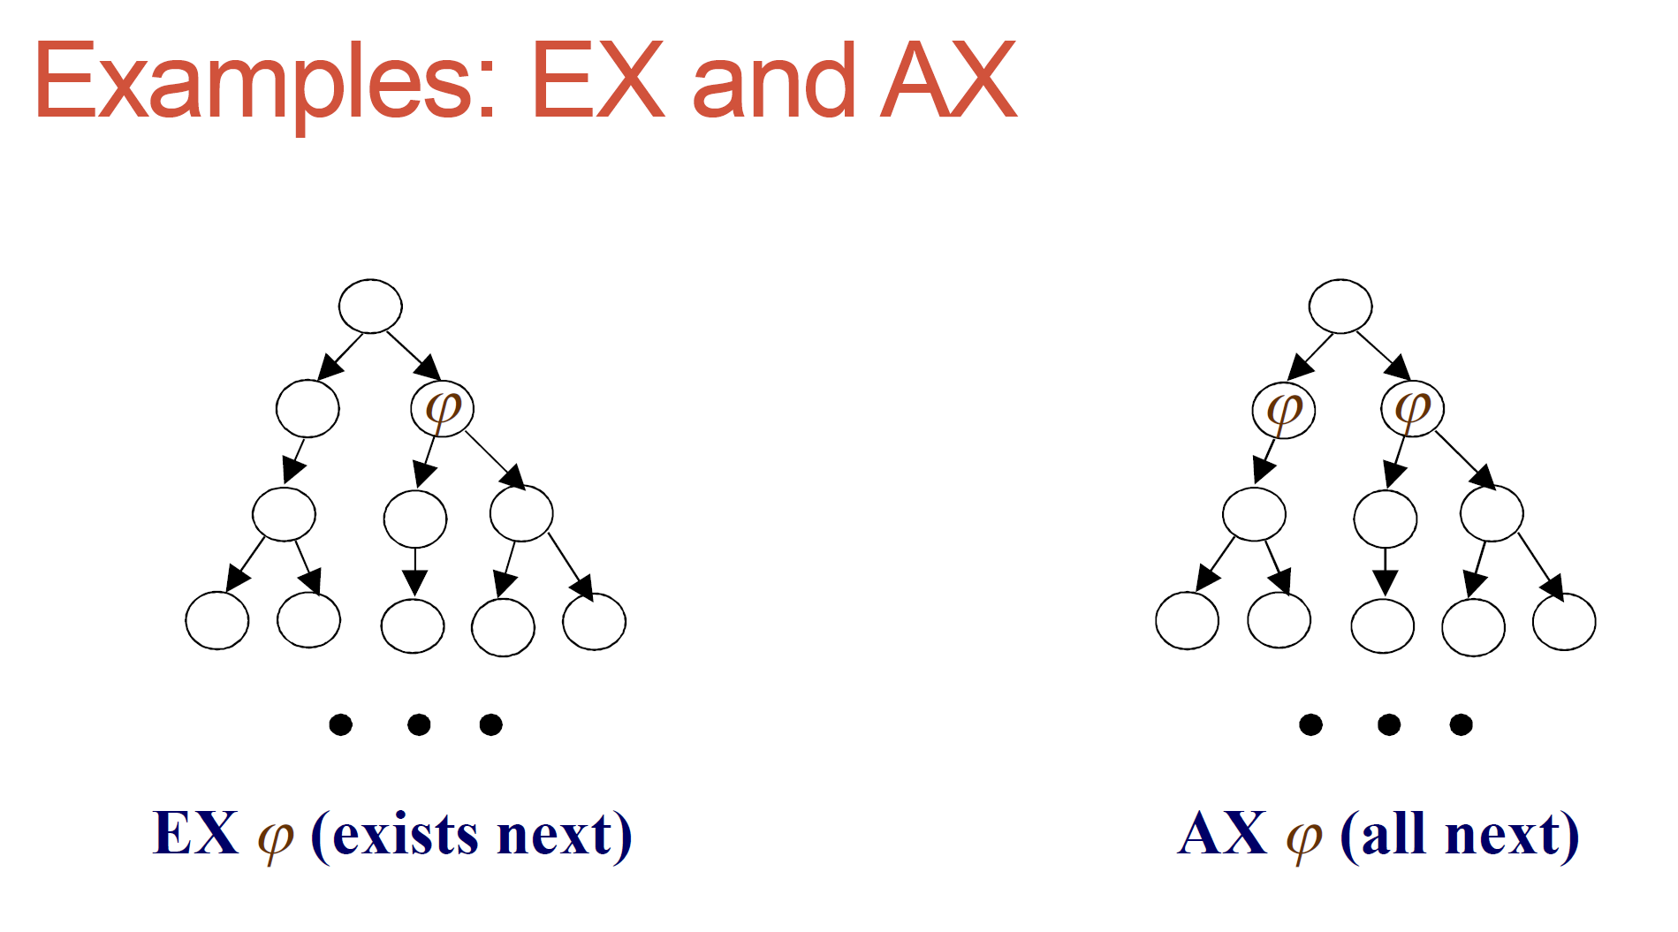
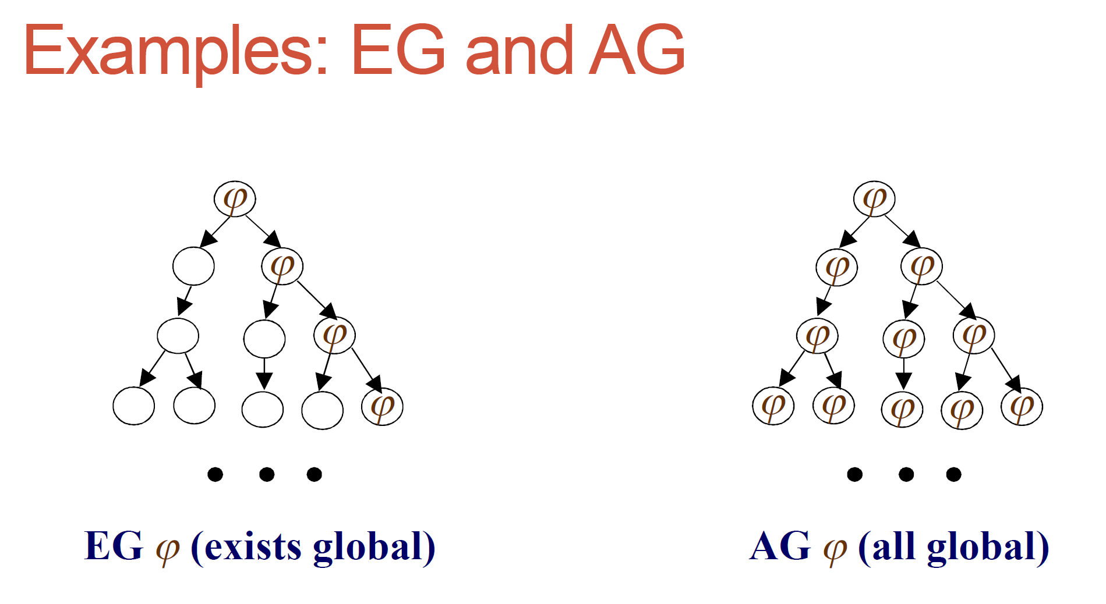
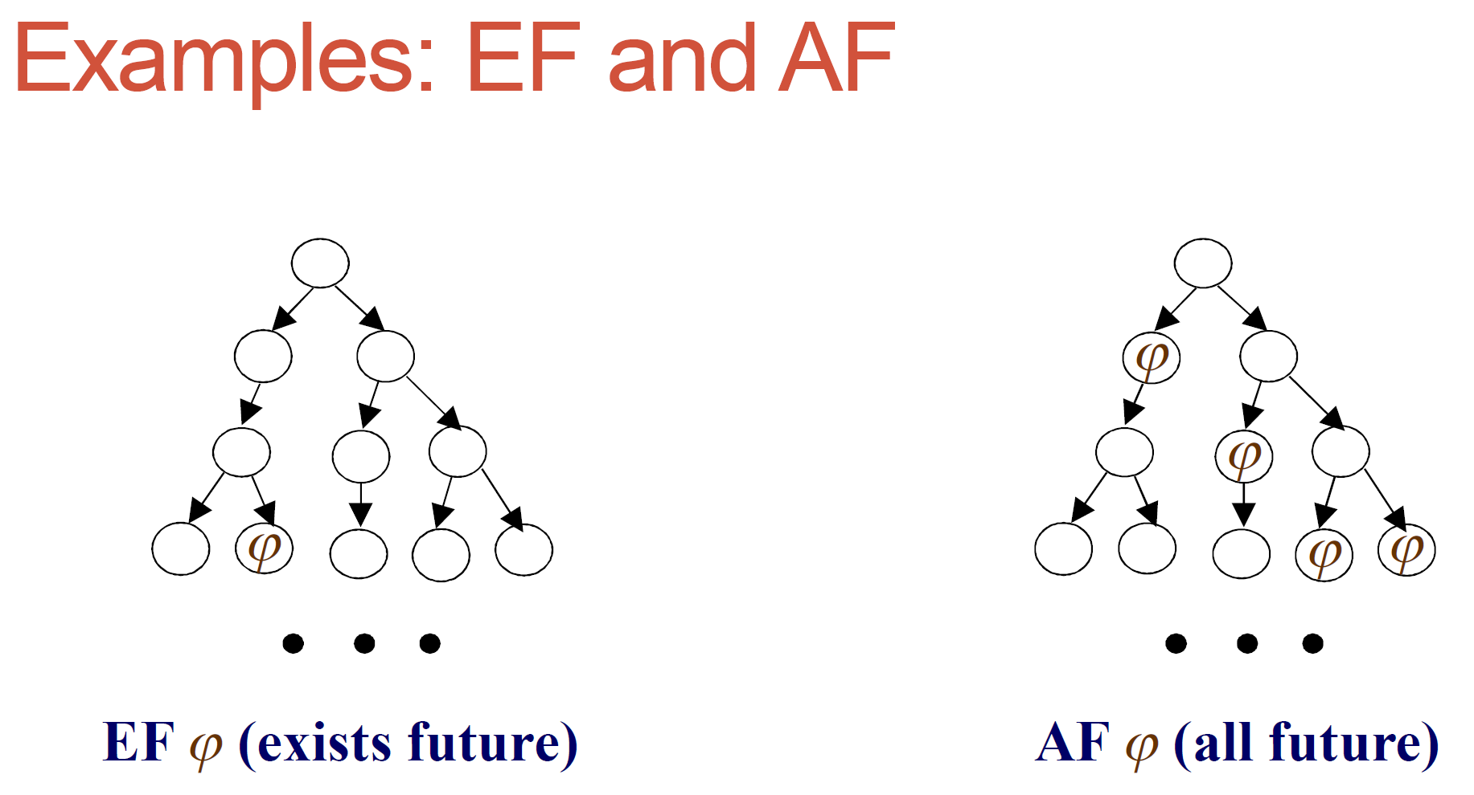
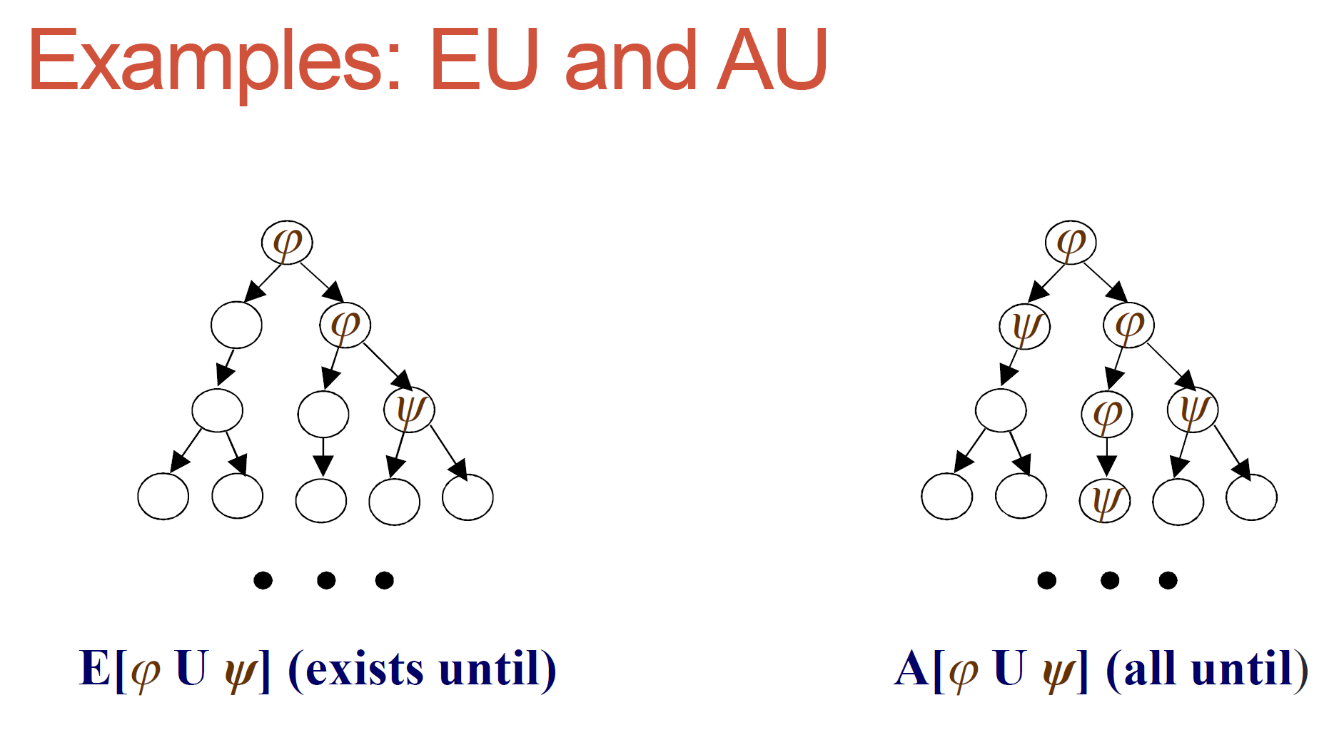
Examples

Slide 5
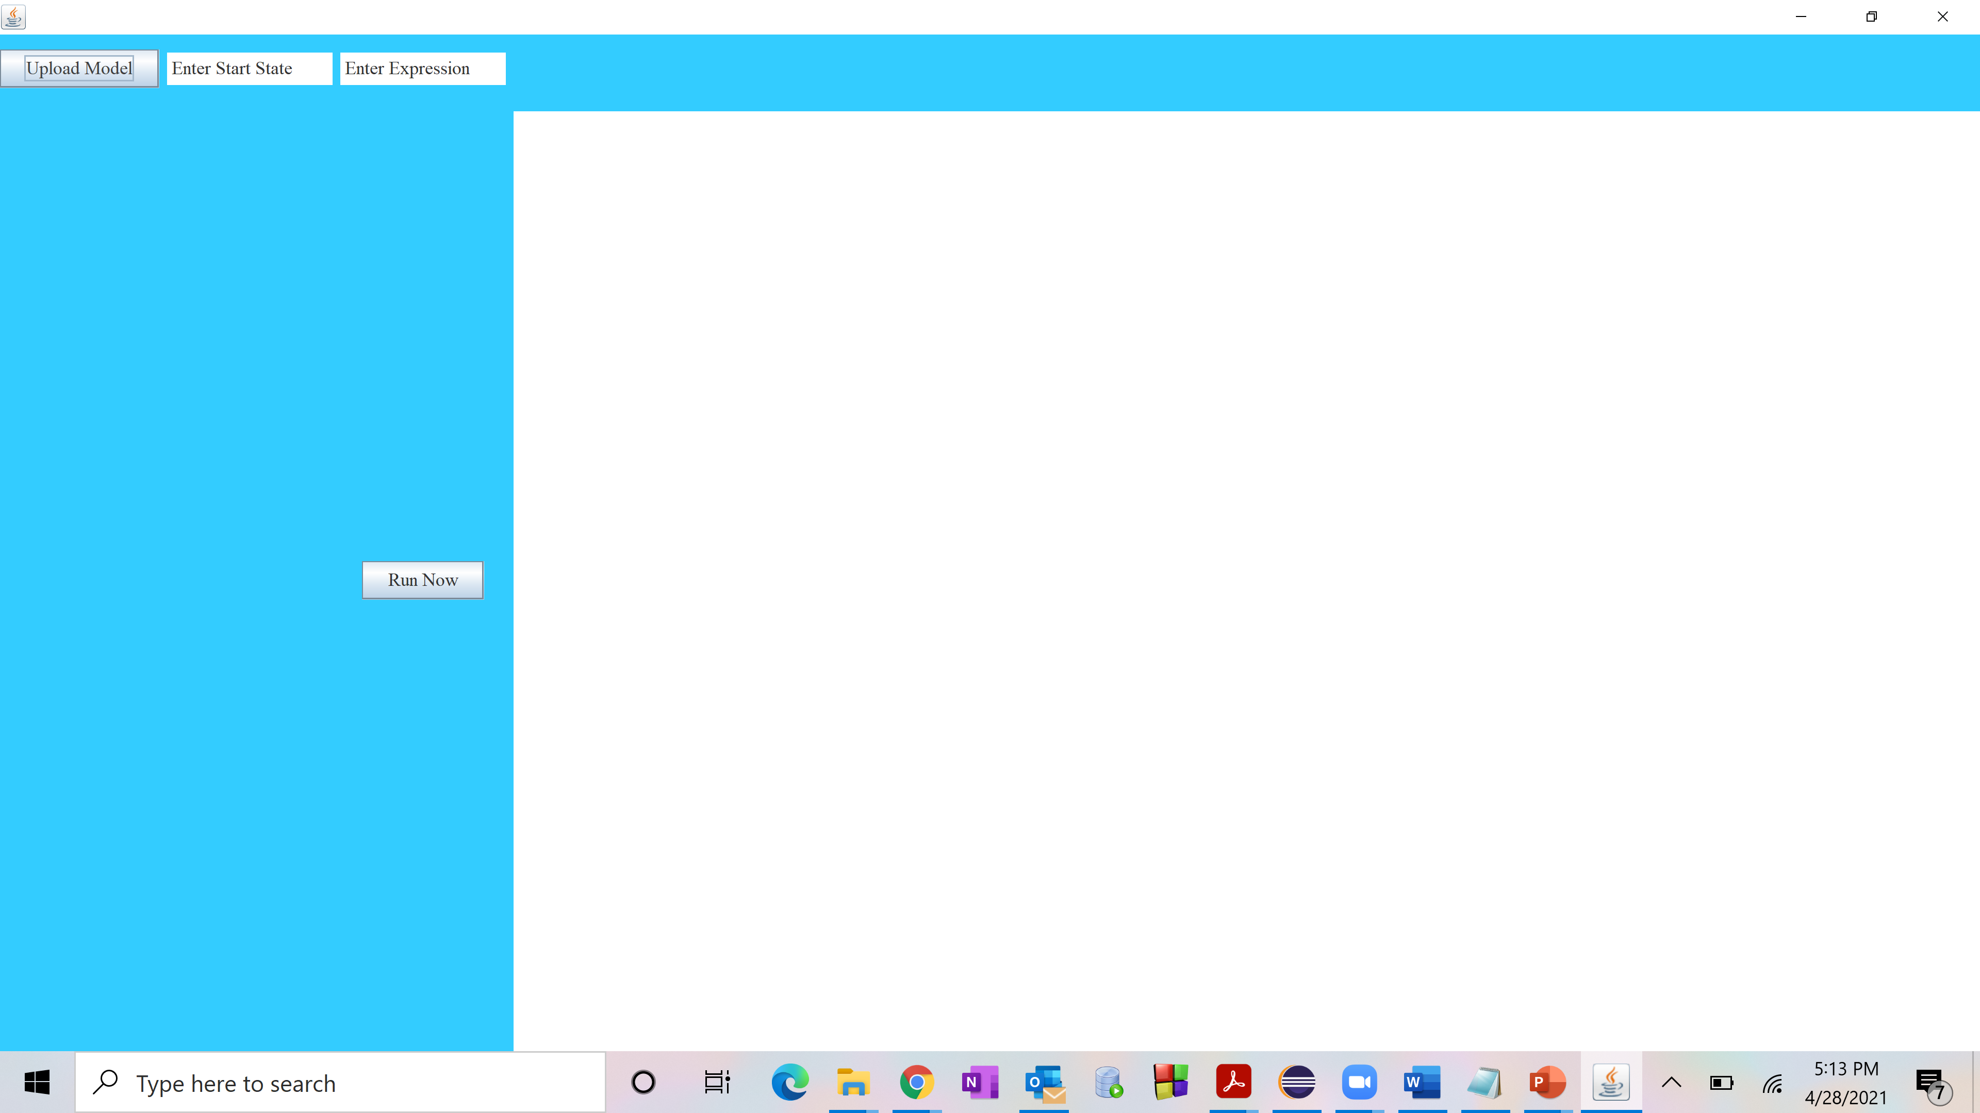
Implementation
All the Inputs are given through GUI.
Upload model takes model file, Enter start state is a text field here we mention the start state and Enter Expression is also a text field where property value is mentioned.
Run Now is a button, on click of this we get the results on text box which in on right hand side.

Slide 6
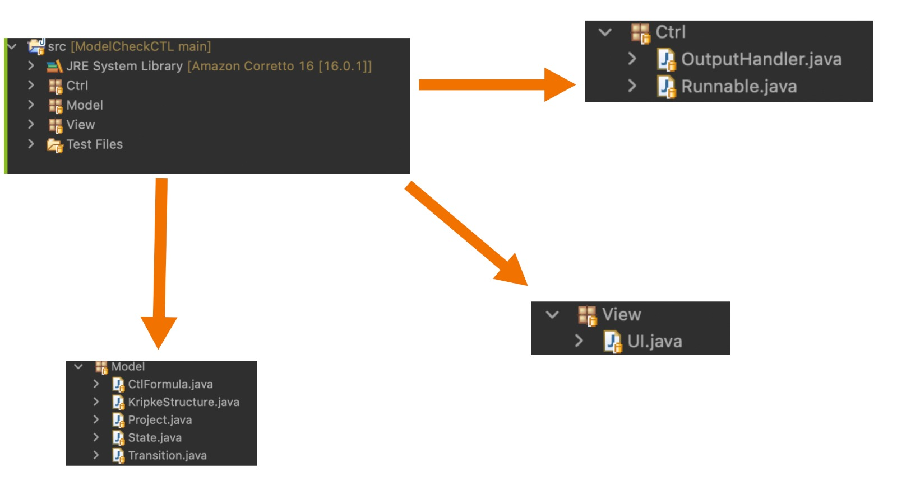
Class Diagram

Slide 7
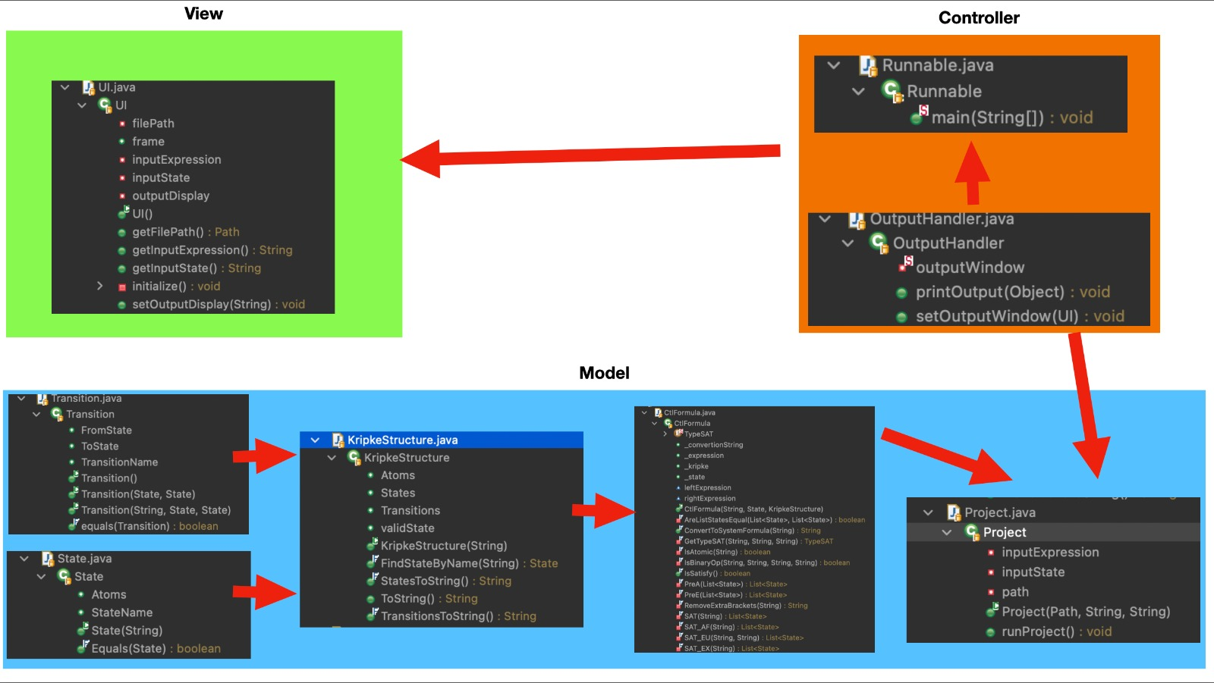
UML Diagram

Slide 8
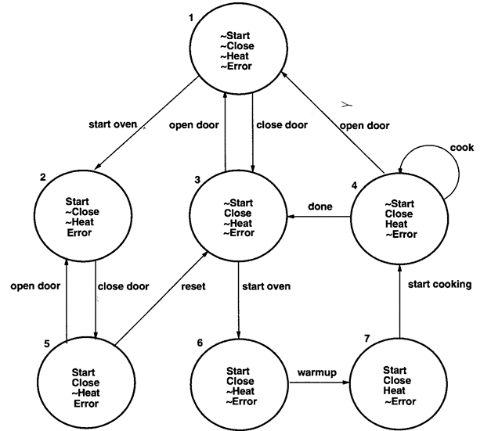
Microwave Model
States: s1, s2, s3, s4, s5, s6, s7;
State Values: s1 : ,
s2 : s e,
s3 : c,
s4 : c h,
s5 : s c e,
s6 : s c,
s7 : s c h;
Transitions: t1 : s1 - s2,
t2 : s1 - s3,
t3 : s3 - s1,
t4 : s4 - s1,
t5 : s4 - s4,
t6 : s4 - s3,
t7 : s2 - s5,
t8 : s5 - s2,
t9 : s5 - s3,
t10 : s3 - s6,
t11 : s6 - s7,
t12 : s7 - s4;

Slide 9
Results
This will be explained in detail in demo session.

Slide 10

Thank You!!

