Slide 1
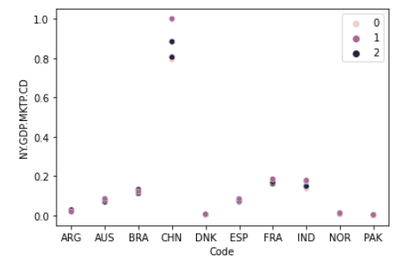

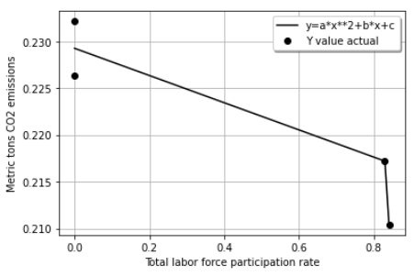
APPLIED DATA SCIENCE 3
INDICATORS
ANALYSIS COUNTRIES
The clustering of the data would be based on the electricity power consumption in different countries. Three clusters would be High, Medium and Low
The countries which have been chosen for analysis are Australia, Pakistan, Denmark, Norway, France, Brazil, Spain, China, Argentina and India
OBSERVATION
China has a high GDP. Countries like India and France and mid-level GDP. The other countries like Argentina, Norway and Pakistan has low GDP
OBSERVATION
It can be concluded that in Argentina there is an indirect relation between metric tons of CO2 emissions and total labor force participation rate

