Slide 1

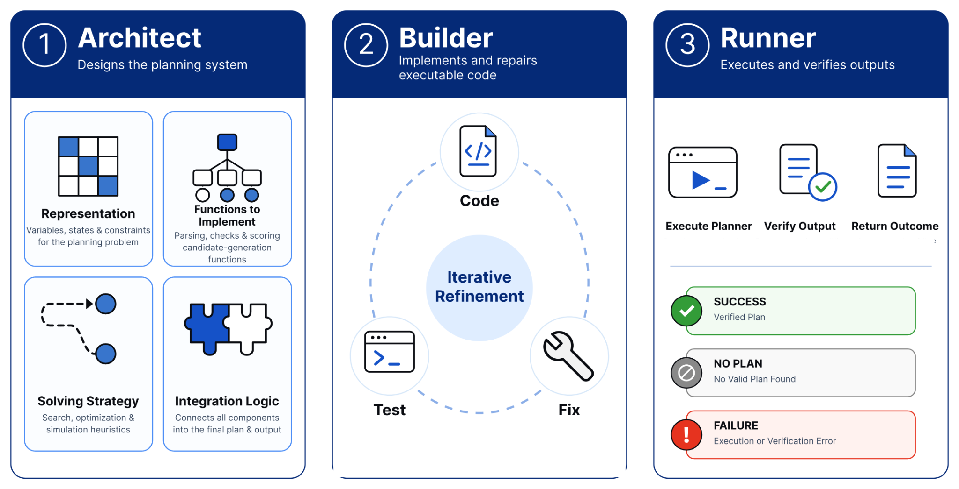
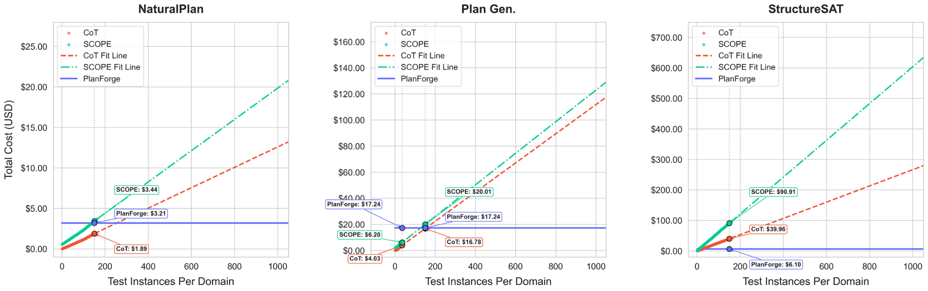
PlanForge: Synthesizing Planners from Natural Language
with an LLM-Driven Architect–Builder–Runner Pipeline
Sarvesh Baskar¹,* , Raviteja Bommireddy¹,* , Saksham Kumar Sharma¹, Harsha Kokel²,
Manas Gaur¹, Michael Katz², Shirin Sohrabi², Kavitha Srinivas²
¹ University of Maryland, Baltimore County, USA ² IBM
COLM 2026 Workshop
sarvesh@umbc.edu
ravitejab1978@gmail.com
Compiling Reusable planners at ZERO test-time cost from natural language specifications is a promising alternative to instance by instance generation .
01 Motivation
02 Methodology
Large language models can generate plausible step-by-step plans, but such plans are not necessarily executable or correct. Reliable planning requires translating a natural-language task into a computational procedure that tracks state, enforces constraints, selects valid actions, and searches for a solution.
Given a domain description and a few validation examples, the Architect designs the state representation, function signatures, solving strategy and integration logic.
Feature | AutoToS | SCOPE | PlanForge
No human-curated state schema | × | × | ✓
No predefined function signatures | × | × | ✓
No fixed search/solver algorithm | × | × | ✓
Domain-level reusable planner | ✓ | × | ✓
Table 1 (excerpt). Reuse alone doesn’t remove the need for a human-designed planner blueprint.
Research Gap
Recent programmatic methods such as SCOPE and Thought-of-Search enforce execution constraints by compiling problem instances into code, but rely on a predefined, human-designed planner blueprint, including fixed state representations, search templates or solver schemas.
Research Statement
Can an LLM induce a planner blueprint, compile it into a program, and produce valid solutions on unseen instances? PlanForge studies this at the task-family level.
The Builder implements and repairs the program using validation feedback. Implementation errors return to the Builder; deficiencies in representation or strategy return to the Architect. After synthesis, the program is frozen. The deterministic Runner executes held-out instances without LLM calls for plan generation at zero cost.
03 Results and Analysis
04 Ablation Studies
Method | NaturalPlan | Plan Gen. | Plan Gen Easy | StructureSAT
CoT | 86.10 | 21.30 | 27.10 | 30.37
SCOPE | 96.00 | 15.74 | 42.20 | 99.70
PlanForge | 100.00 | 92.41 | 100.00 | 100.00
On Plan Gen Easy, Guided PlanForge uses an adopted AutoToS configuration with a fixed PDDL-style state representation, is_goal and successor functions, and greedy best-first search. Autonomous PlanForge selects the representation and solution procedure for each domain.
Blueprint flexibility matters: The largest gains occur in Alfworld and Goldminer, where the fixed blueprint introduces grounding mismatches and inefficient search. This supports adapting both the representation and solving strategy to each domain.
Table 1 (%). NaturalPlan and StructureSAT: success rate. Plan Gen.: VAL-verified accuracy. On Baselines: CoT and our SCOPE re-implementation.
NaturalPlan : trip, meeting and calendar planning; 97.55% Exact Match, with an LLM judge for unmatched outputs.
Plan Gen Easy uses reference plans with 0–2 actions, separately from long-horizon Plan Gen.
Plan Gen. : 15 ACPBench-inspired domains, with plans exceeding 600 actions. With Plan-existnce vs generation accuracy (%) for CoT
(91.85 vs 21.30), and SCOPE (18.52 vs 15.74) over estimating, where PlanForge as 98.89 existence and 92.41 generation accuracy scores.
Guided ( 91.10%) to Autonomous (100%) for Plan Gen Easy accuracy (%)
Both variants are 100% for naturalPlan
StructureSAT : nine CNF families; no natural-language descriptions. Success requires a valid assignment when one exists.
06 Conclusion
Higher planning accuracy: PlanForge achieves 100% success on NaturalPlan and StructureSAT and 92.41% VAL-verified accuracy on Plan Gen., outperforming the evaluated baselines.
Compile once, reuse without test-time LLM calls: Synthesized planners execute locally on new instances within the evaluated task families, amortizing the one-time synthesis cost across repeated use.
05 Planner Synthesis Cost
A one-time synthesis cost enables reuse without additional LLM calls. CoT and SCOPE invoke a model for each new instance.
References
Daniel Cao, Michael Katz, Harsha Kokel, Kavitha Srinivas, and Shirin Sohrabi. 2026. Automating Thought of Search: A journey towards soundness and completeness. In ICAPS.
Subbarao Kambhampati, Karthik Valmeekam, Lin Guan, Mudit Verma, Kaya Stechly, Siddhant Bhambri, Lucas Saldyt, and Anil Murthy. 2024. Position: Llms can’t plan, but can help planning in llm-modulo frameworks. In ICML.
Foot note : * Equal contribution
planforge-abr.github.io/
Notes:
34 × 34 inch editable poster. Source: current supplied PlanForge_COLM_CR_draft.pdf, main paper pages 1–10, freshly extracted as poster_story/source-current-review.txt. Motivation follows the Abstract's definition of reliable planning, and Table 1 supports the blueprint gap. The Table 1 excerpt preserves the exact feature names and supported/unsupported entries for AutoToS, SCOPE and PlanForge; it does not imply AutoToS lacks reuse. Research Gap and Research Statement retain the accepted wording. The unrelated StructureSAT prediction table from Table 6 is removed from Motivation. Table 2 reproduces the complete main-paper performance block, with original methods, metrics and values. The cost block is omitted because the user explicitly requested the separately supplied updated cost graphic. NaturalPlan success rate checks constraint satisfaction; exact match is checked first, then an LLM judge checks unmatched outputs, per Section 4.1. NaturalPlan's 97.55% Exact Match is from Section 5.1. Plan Gen. has 15 domains and plans exceeding 600 actions; accuracy is VAL-verified and errors concentrate in Hanoi and Alfworld. StructureSAT has nine CNF families, no natural-language descriptions, and requires a valid satisfying assignment when one exists. GPT-5.4 Architect, Codex Builder, zero-shot CoT and reimplemented SCOPE follow Section 4.2. The methodology and updated cost figures are embedded unchanged, with proportional placement and no internal edits or crops. The cost graphic is widened from 1480 to 2440 px. The Guided PlanForge configuration and 91.10% versus 100.00% results are from Section 5.6 and Table 7, on Plan Gen Easy with 0–2 reference actions. AutoToS-inspired identifies the source's inspiration from Katz et al. 2024 and Cao et al. 2026; these are not presented as results of a separately measured original AutoToS implementation. NaturalPlan uses JSON rather than PDDL for its Guided representation, per Section 5.6; the poster's PDDL configuration describes the displayed Plan Gen Easy experiment. The conclusion follows Section 6 and concerns measured performance and amortized API cost, not universally lower upfront cost or zero local computation cost. Title, full author list, affiliations and original UMBC, IBM and COLM branding retained. All narrative text, headings, feature table, results table and ablation scores are native editable objects. Only source figures and logos are pictures.

