Slide 1
RxAndroid
Reactive Extensions for Android

Slide 2
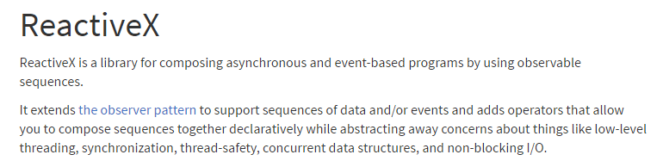
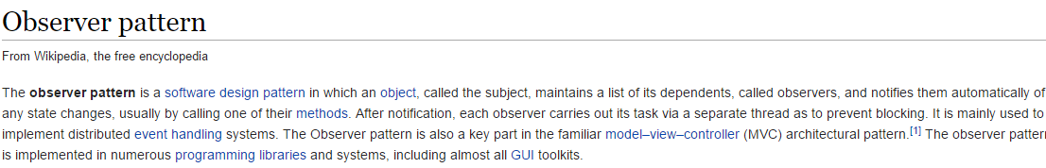
ReactiveX?

Slide 3
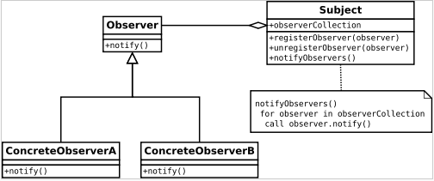
Observer Pattern?
Observer pattern is used when there is one-to-many relationship between objects such as if one object is modified, its dependent objects are to be notified automatically. Observer pattern falls under behavioral pattern category.
Remember notifyDataSetChanged() from recyclerView. It uses observer pattern to update views

Slide 4
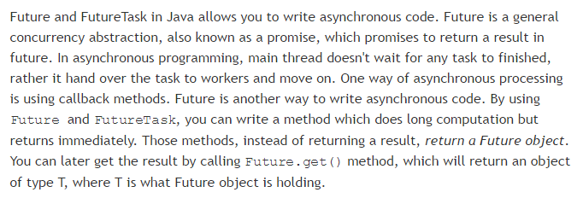
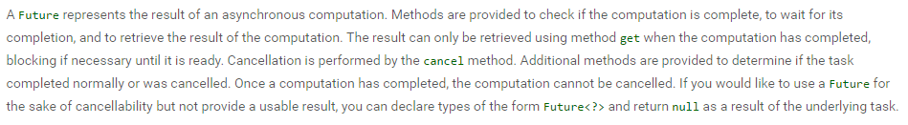
Java Future?

Slide 5
THE BIG PICTURE
OBSERVABLES
OBSERVERS
SUBSCRIPTIONS

Slide 6
Key elements
Observables, processes that produces data
Observers, uses data
Subscription, connects an observer to an observable
Subscribe, where to execute
Observe, where to get

Slide 7
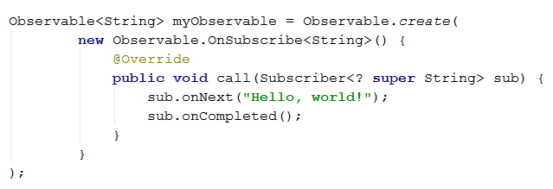
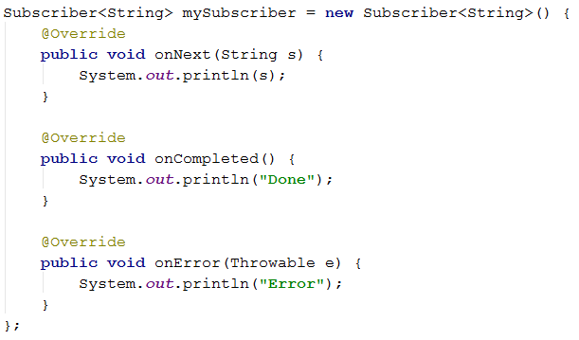


Slide 8
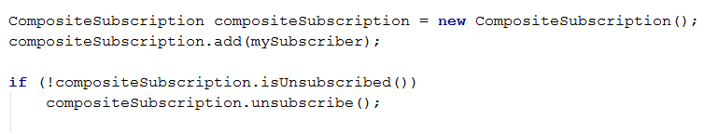
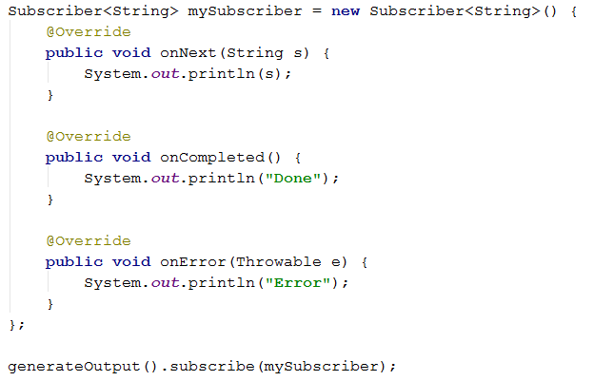
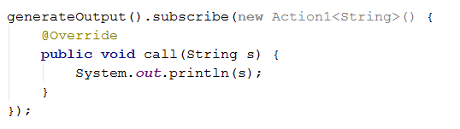

Slide 9
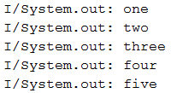

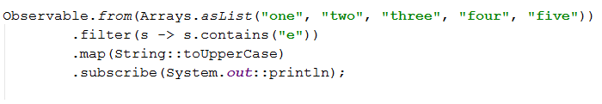

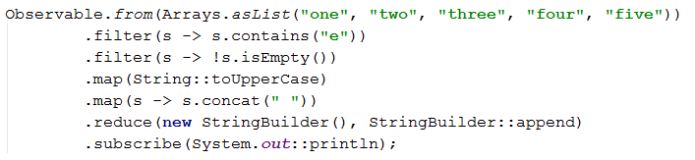

Slide 10
