Slide 1
RxAndroid
Reactive Extensions for Android

Slide 2
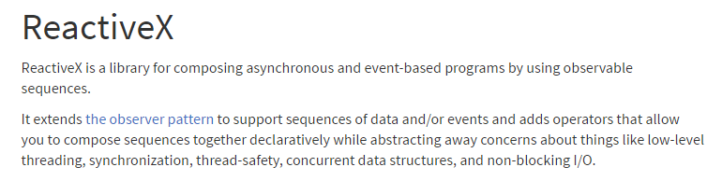
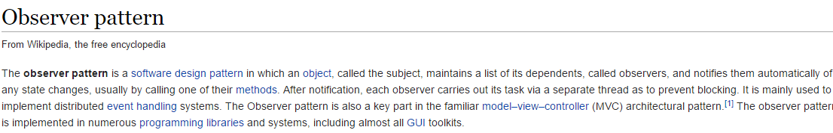
ReactiveX?

Slide 3
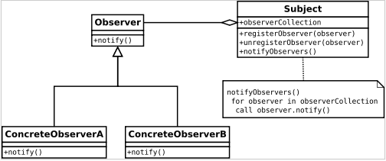
Observer Pattern?
Observer pattern is used when there is one-to-many relationship between objects such as if one object is modified, its dependent objects are to be notified automatically. Observer pattern falls under behavioral pattern category.

