Slide 1

Intrusion Detection System using Machine Learning Models
Atal Bihari Vajpayee-Indian Institute of Information Technology and Management, Gwalior
Big Data and Cyber Fraud Analysis Project
ADITYA KUMAR
2023ICS-03
I.RAVITEJA
2023ICS-09
KANISHKA SINGH
2023ICS-10

Slide 2
Contents
Motivation
Introduction
Literature Review
Strategies Explored
Datasets Explored
Preprocessing
ML Model
Results
Conclusion
Future Work

Slide 3
Motivation
The Internet of Things (IoT) describes the network of smart devices embedded with sensors, software, etc., to connect and exchange data with other devices and systems over the internet.
The Verkada Hack(March 9, 2021):Verkada is a famous cloud-based video monitoring and recording service provided through the cloud to users. It is mainly used as security cameras in hospitals, schools, factories, shops, prisons, etc. But due to the lack of security issues of Verkada itself, hackers find a way to access those mounted video surveillance and steal sensitive information of Verkada software clients. Hackers could able to access the mind-boggling more than 150000 cameras located at different places due to all-over access. Later on, to prevent this from happening again, many sectors and sub-sectors are created, giving admin access to certain people only [1].
These range from smart automation solutions for home use to highly sensitive and costly equipment used in industries. The number of IoT devices currently in use is projected to be around 15 billion devices. All of these devices constitute a vast attack surface for malicious attacks.[2]

Slide 4
Introduction
Conventional intrusion detection systems (IDS) traditionally hinge upon pre-established rules or known attack signatures to pinpoint potential threats. However, they fall short in detecting novel or unfamiliar attacks, posing a notable constraint. Attackers frequently employ new or unfamiliar strategies to elude detection and compromise IoT networks and devices.
This lead us to propose Intrusion Detection System using Machine Learning Models.
In our project, we propose a framework for Intrusion detection in IoT networks that is based on anomalous detection of network traffic.
Our framework uses a machine learning model to learn the normal behavior of the network and identify deviations from this behavior that may indicate a potential threat.

Slide 5
Literature Review - Important Papers
Name of Paper | Dataset Used | Purpose of use | Conclusion
N. Chaabouni, M. Mosbah, A. Zemmari, C. Sauvignac and P. Faruki, "Network Intrusion Detection for IoT Security Based on Learning Techniques“(IEEE COMMUNICATIONS SURVEYS & TUTORIALS, VOL. 21, NO. 3, THIRD QUARTER 2019)[3] | KDDCUP99 (KDD99), and NSL-KDD, UNSW-NB15 | This survey paper uses these free dataset for compairision ,identifying the advantage | It has been noted that traditional IDS based on signature matching is highly effective but lacks the required tangibility to deal with changing threats. Thus, a technique that adapts itself to the changes in attacks (learns through experience).
G. Bendiab, S. Shiaeles, A. Alruban and N. Kolokotronis, "IoT Malware Network Traffic Classification using Visual Representation and Deep Learning,“ (Research Gate October 2020)[4] | IoT 23 dataset | Used to feed pcap file to Binvis tool. | The malicious network pcap files were transformed into an RGB visual image[3] using a visual representation tool known as Binvis. The images were then fed to the ResNet50 neural network which is used for Image Classification. They reported that their model had an accuracy of 94.5%.

Slide 6
Literature Review - Important Papers
Name of Paper | Dataset Used | Purpose of use | Conclusion
Austin, Michael, "IoT Malicious Traffic Classification Using Machine Learning" (Research Gate 2021). Graduate Theses, Dissertations, and Problem Reports. 8024.[5] | IOT 23 dataset | It is used for training and testing the Machine learning Models | Signature matching for malware is one of the most common techniques for detecting malware, it cannot stop all attacks due to the dynamic nature of threats. Different classifiers such as Naive Bayes, SVM with a linear kernel, and a linear classifier with Stochastic Gradient Descent and Random Forest. Random Forest was seen as the best classifier
F. Mosaiyebzadeh, et al "A Network Intrusion Detection System using Deep Learning against MQTT Attacks in IoT" (2021 IEEE Latin-American Conference on Communications)[6] | MQTT-IoT-IDS2020 (Message Queuing Telemetry Transport ) | Dataset containing MQTT attacks. Training for the Deep learning model. | The performance evaluation of their DL-based Network IDS showed that it obtained 97.09% of accuracy and an F1-score equal to 98.33% when detecting MQTT attacks.

Slide 7
Strategies Explored - SIDS
IDS systems aim to prevent unauthorized use of computer resources and manage malicious network traﬃc. They are divided into two categories: SIDS-Signature based detection system, AIDS-Anomaly based detection system
SIDS:
SIDS uses pattern matching methods to detect malicious attacks by comparing incoming traﬃc signatures to known malicious signatures. When a match is found the system generates an alert to warn the user. It has very good accuracy in detecting intrusion when the signature DB already has a match for the intrusion attempt.
However, it fares poorly on zero-day exploits(unknown or unaddressed intrusions) or against attacks that may span a large number of packets. Also if small mutations are introduced in the exploit it may be able to evade detection because of its changed signature.

Slide 8
Strategies Explored - AIDS
AIDS
Anomaly-based intrusion detection is a method of identifying potential security threats in a network by detecting deviations from normal or expected behavior. It uses machine learning algorithms to learn what constitutes normal behavior in a network, and then raises an alert if it detects any deviations from this norm.
One of the main advantages of anomaly-based intrusion detection is that it can detect previously unknown threats that may not be covered by the pre-deﬁned signatures used in signature-based detection. This makes it particularly useful for detecting zero-day exploits and other advanced threats.

Slide 9
Datasets Explored
IoT 23 Dataset - The IoT 23 dataset is a collection of network traﬃc data that was collected from a variety of IoT devices. It includes both benign and malicious traﬃc, and is commonly used for testing and evaluating the performance of intrusion detection systems (IDS) in the context of IoT networks. It was collected by the Stratosphere Lab and is considered to be the most comprehensive IoT Malware dataset [7]. This is our primary dataset.
UNSW NB15 Dataset - Data in this is classiﬁed on the basis of the type of attacks. This dataset has nine types of attacks, namely, Fuzzers, Analysis, Backdoors, DoS, Exploits, Generic, Reconnaissance, Shellcode, and Worms [8].

Slide 10
Dataset Preprocessing
Total of 23 scenarios, 20 containing malicious activity and 3 completely benign.
Benign scenarios are Honeypot captures of devices such as Somfy Door Lock, Philips HUE, and Amazon Echo while the malicious activity was captured by running malwares on IoT devices.
The total number of features in our combined dataset were 22 which were later sized down to 9.

Slide 11
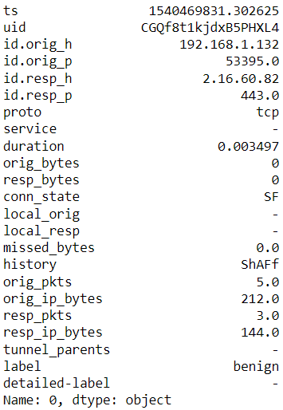
Snapshot of an Instance

Slide 12
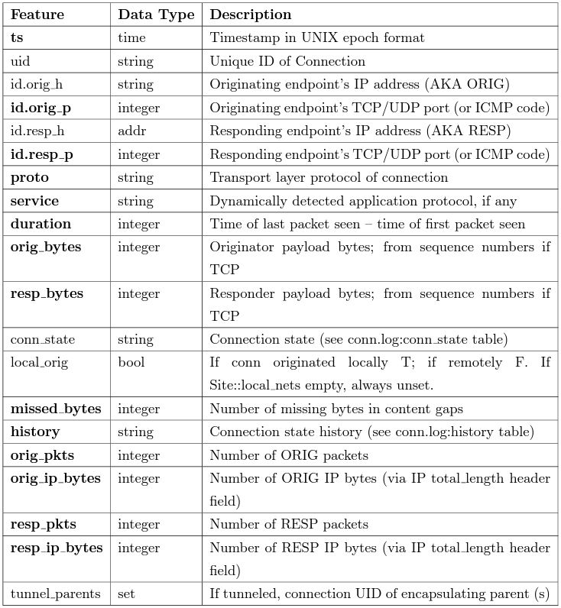

Slide 13
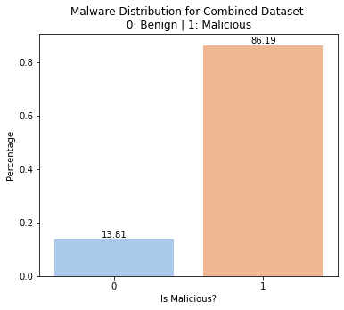
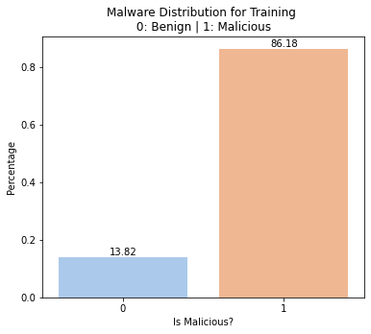

Relative Distribution of Labels in Dataset

Slide 14
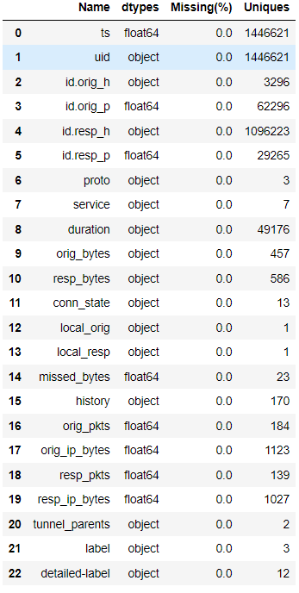
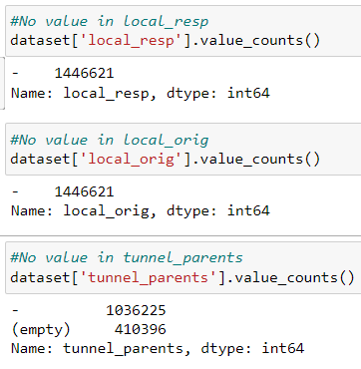

Slide 15
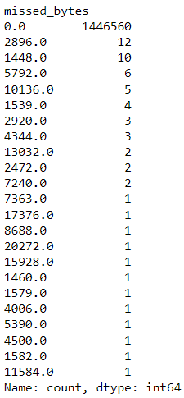
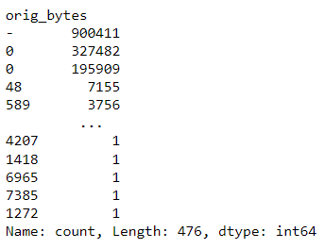
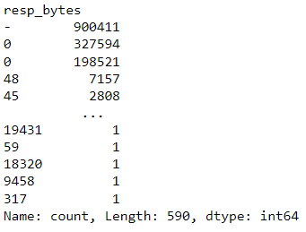

Slide 16
uid : The feature was dropped because it uniquely identified network flows
id.orig_h and id.resp_h : These features were dropped because they had information about IP addresses.
detailed-label: This feature was dropped because we had no interest in knowing the Malware behind the Intrusion attempt.
duration : duration was removed because it had very less std deviation
history : history was removed because it wasn’t a suitable feature due to it holding only the recent conn state

Slide 17
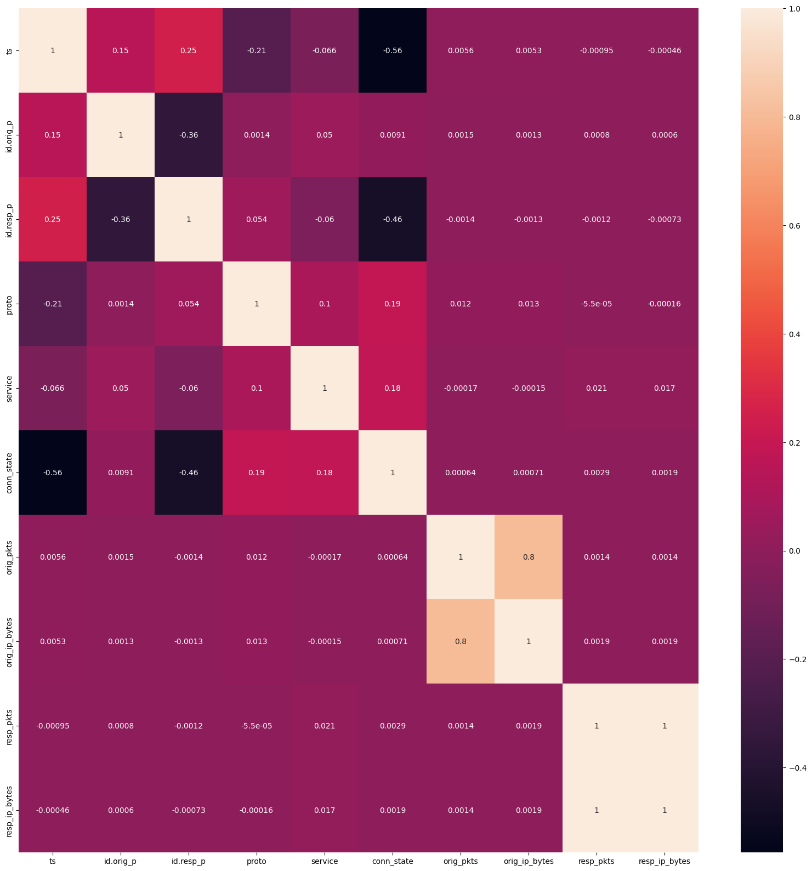
Correlation Matrix of Features

Slide 18
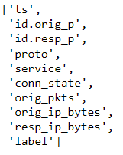
Final Feature set

Slide 19
Random Forest
Random Forest uses multiple decision trees where each decision tree is trained using a subset of the data. This process is repeated multiple times across all the decision trees using a diﬀerent subset of data. This provides the algorithm with its “random” behaviour.
Once we have our collection of decision trees, we can use them to make predictions on new data. To do this, we feed the new data to each tree in the forest and let each tree make a prediction. We then combine the predictions from all of the trees to get a ﬁnal prediction for the new data. This is typically done by taking the average of the predictions from all of the trees, although other methods can be used as well.
Across the models we used, Random Forest performed the best in various metrics; therefore, we used it as our ﬁnal model for prediction in our AIDS.

Slide 20
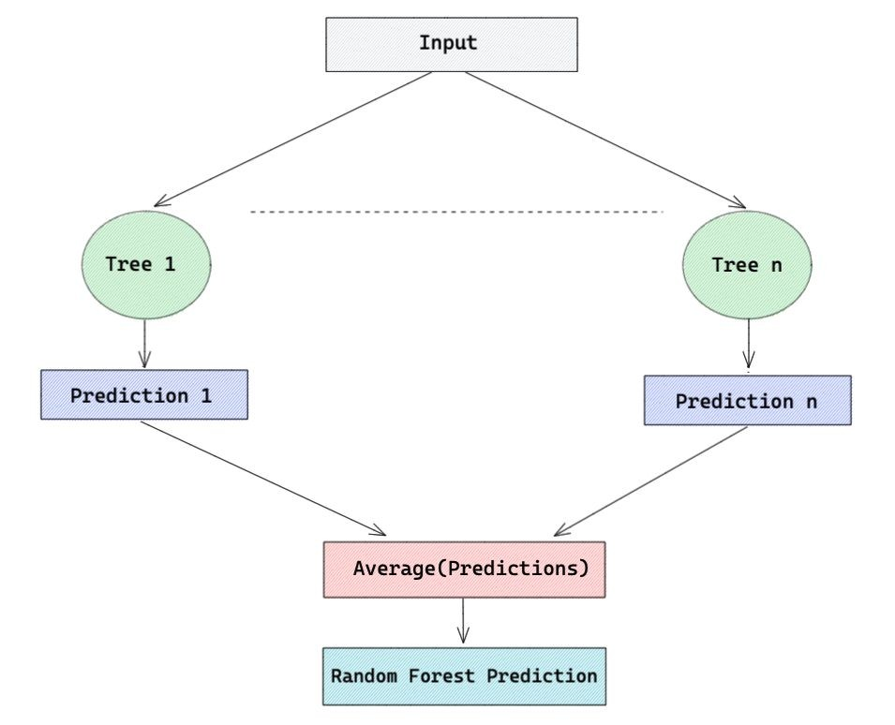


Slide 21
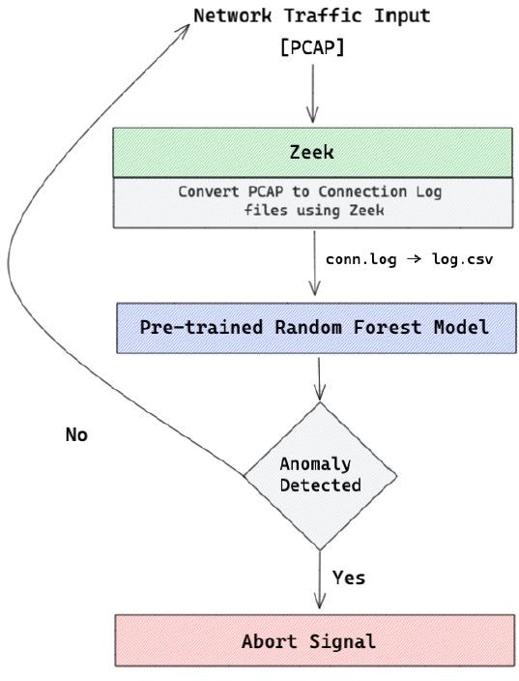
Workflow of IDS in Typical scenario

Slide 22
ML Models Performance
MODEL | ACCURACY | PRECISION | RECALL | F1-SCORE
GNB | 0.8989 | 0.8984 | 0.8989 | 0.8764
SGD | 0.8999 | 0.9102 | 0.8999 | 0.8742
Linear SVM | 0.8982 | 0.9036 | 0.8982 | 0.8729
Random Forest | 0.9862 | 0.9927 | 0.9876 | 0.9901

Slide 23
Testing Model on UNSW Dataset
We tested our Model on other available dataset like UNSW NB 15 and we found that our model was successful in classifying the dataset as malicious.
UNSW was a completely malicious dataset

Slide 24
Conclusion
Our experimental results demonstrated the effectiveness of the IDS model in accurately detecting intrusions in IoT networks. The model achieved a high detection rate with minimal false positives, indicating its potential for real-world deployment. Specifically, the Random Forest classifier emerged as the top-performing model, achieving an accuracy of over 95% on the test dataset.The machine learning model performed well on both the IoT 23 and UNSW NB-15 dataset.
We have provided a proof of concept (POC) to demonstrate how the ML model can be leveraged in real world scenarios.
We see Machine Learning as a possible solution to tackle challenges in the domain of IoT security.

Slide 25
Future Work
Classifying the exact type of Malware/Attack in real-time.
Exploration of Deep Learning Models and Neural Networks.
Integrating our ML model using SIDS.

Slide 26
References
https://www.malwarebytes.com/blog/news/2021/03/150000-verkada-security-cameras-hacked-to-make-a-point
https://explodingtopics.com/blog/number-of-iot-devices
Chaabouni, Nadia, et al. "Network intrusion detection for IoT security based on learning techniques." IEEE Communications Surveys & Tutorials 21.3 (2019): 2671-2701.
Bendiab, Gueltoum, et al. "IoT malware network traffic classification using visual representation and deep learning." 2020 6th IEEE Conference on Network Softwarization (NetSoft). IEEE, 2020.
Austin, Michael. IOT malicious traffic classification using machine learning. West Virginia University, 2021.
Mosaiyebzadeh, Fatemeh, et al. "A network intrusion detection system using deep learning against mqtt attacks in iot." 2021 IEEE Latin-American Conference on Communications (LATINCOM). IEEE, 2021.

Slide 27
Sebastian Garcia, Agustin Parmisano, & Maria Jose Erquiaga. (2020). IoT-23: A labeled dataset with malicious and benign IoT network traffic (Version 1.0.0) [Data set]. Zenodo. http://doi.org/10.5281/zenodo.4743746

Slide 28
THANK YOU

