Slide 1
CINESENTINEL AI · IMDb SENTIMENT INTELLIGENCE LAB
Machine Learning-Based Classification for Sentiment Analysis of IMDb Reviews
UE24CS352A — Machine Learning · Mini-project
Team
[Team member 1 — SRN] [Team member 2 — SRN] [Team member 3 — SRN]
[Section / Guide / Date]

Slide 2
Problem statement and objectives
Problem
Objectives
• Decide whether an IMDb movie review is positive or negative
• Document-level binary text classification
• Reference: Wu & Shin (Stanford CS229) compare six classifier families on this task
• Question: how do the six compare in accuracy and in training cost?
• Reproducible pipeline: data → cleaning → features → training → evaluation
• Train six classifiers on identical features
• Evaluate with standard metrics on the official held-out test split
• Interactive app: live prediction, model comparison, batch CSV scoring
CineSentinel AI · UE24CS352A — Machine Learning
2

Slide 3
Dataset and preprocessing
50,000
labelled reviews
25k / 25k
official train / test split
50% / 50%
positive / negative
174
median words per review
Stanford Large Movie Review Dataset
Preprocessing and features
• Positive = rating ≥ 7, negative = rating ≤ 4
• Official split used unchanged; test split used only for final evaluation
• 123 test reviews (0.49%) also occur in train — a property of the public data, left in place and disclosed
• Content verified identical to the official Stanford archive
• Strip HTML → lowercase → remove punctuation and digits
• Remove stop words → lemmatize (NLTK)
• TF-IDF, unigrams + bigrams, 50,000 terms
• Vectorizer fitted on the training split only
CineSentinel AI · UE24CS352A — Machine Learning
3

Slide 4
Methodology and system architecture
Offline: training and evaluation
Dataset
25k train / 25k test
Cleaning
preprocessing.py
TF-IDF
features.py
Training
train.py · six models
Evaluation
evaluate.py · test split
Online: Streamlit dashboard
Saved files
models + metrics
Inference
predict.py
Dashboard
5 pages · Plotly charts
• All six models share one feature matrix, so the comparison is like-for-like
• Model selection uses training data only (cross-validation, validation split); the test split is evaluated once
• The dashboard reads saved metrics files — no figure is typed into the app. Runs on a laptop CPU, no GPU or paid API
CineSentinel AI · UE24CS352A — Machine Learning
4

Slide 5
Six machine-learning classifiers
Model | Family | Key settings
Logistic Regression | Linear | L2 penalty; C from {0.01, 0.05, 0.25, 0.5, 1} by 3-fold CV → C = 1
Linear SVM | Linear | L2 penalty; same C grid → C = 0.25; Platt-calibrated
Multinomial Naive Bayes | Probabilistic | Laplace smoothing = 1
Random Forest | Tree ensemble | 100 trees, Gini criterion, no depth limit
Gradient Boosting | Tree ensemble | 270 trees (chosen on validation data), learning rate 0.1
Neural network (MLPClassifier) | Neural network | hidden layers (30, 30, 20, 10, 10), logistic activation, Adam, early stopping
• Settings follow §3.3 of the reference paper, except the Gradient Boosting tree count
• The SVM is Platt-calibrated so that it can report a probability rather than a raw decision score
CineSentinel AI · UE24CS352A — Machine Learning
5

Slide 6
Experimental results
Model | Acc. | Prec. | Recall | F1 | Train
DNN (MLP) | 89.48 | 89.44 | 89.52 | 89.48 | 239 s
SVM | 89.38 | 89.88 | 88.74 | 89.31 | 3.4 s
LogReg | 89.22 | 89.04 | 89.46 | 89.25 | 8.4 s
Naive Bayes | 86.33 | 87.87 | 84.30 | 86.05 | 0.1 s
Rand. Forest | 85.60 | 86.84 | 83.91 | 85.35 | 72 s
Grad. Boosting | 84.41 | 82.65 | 87.10 | 84.82 | 477 s
Percent, on 25,000 test reviews. Chart axis does not start at zero.
• Highest: Deep Neural Network (MLP) (89.48%)
• Top three within 0.25 points — one run each, so effectively tied
• Weakest: Gradient Boosting (84.41%)
CineSentinel AI · UE24CS352A — Machine Learning
6

Slide 7
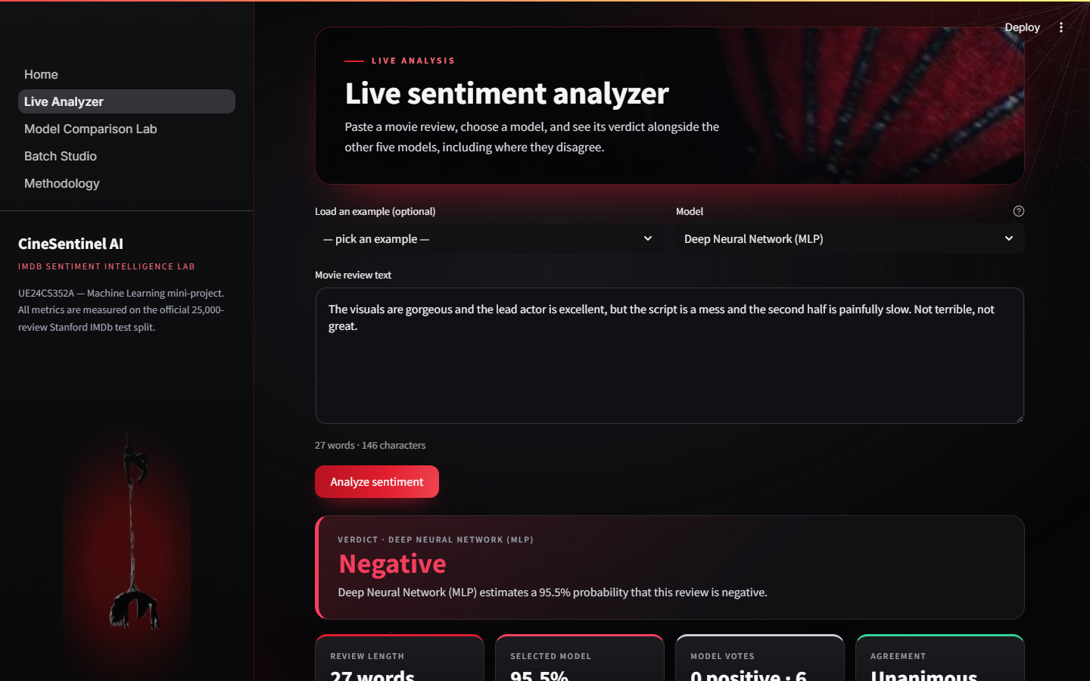
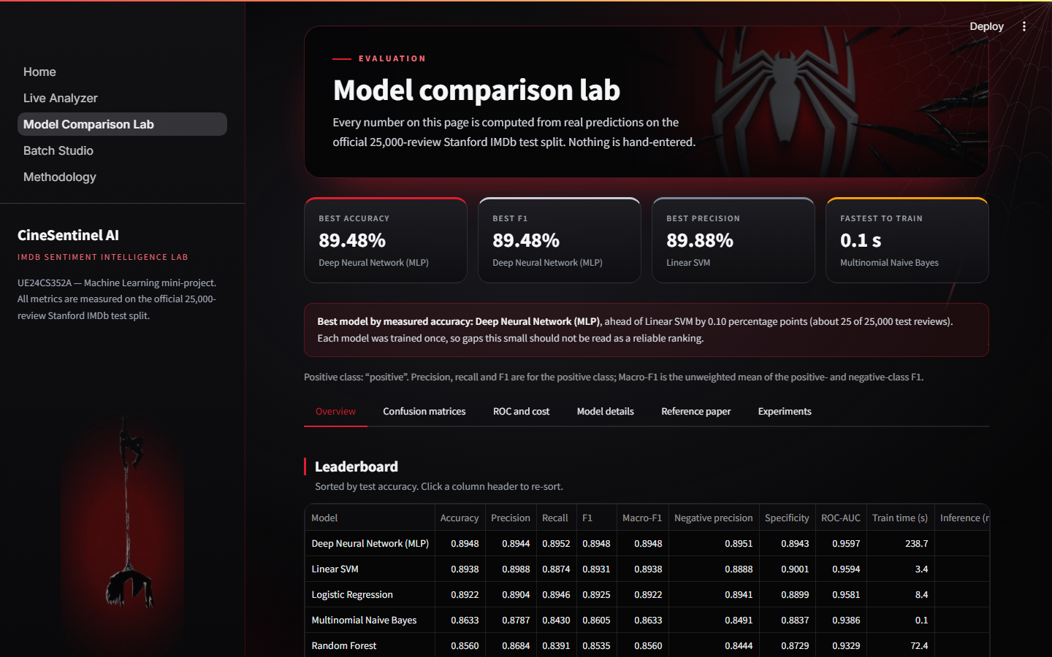
Application interface and demo workflow
Five pages
• Home / overview
• Live Sentiment Analyzer
• Model Comparison Lab
• Batch Prediction Studio
• Methodology
Live Sentiment Analyzer
Model Comparison Lab
Demo workflow
1. Home: dataset statistics and the measured leaderboard
2. Live analyzer: paste a review, pick a model, compare all six verdicts and see any disagreement
3. Comparison lab: metrics, confusion matrices, ROC curves, training time
4. Batch studio: upload a CSV, score it, download the predictions
CineSentinel AI · UE24CS352A — Machine Learning
7

Slide 8
Conclusion, limitations and future scope
Conclusion
Limitations
Future scope
• All six classifiers implemented, trained and evaluated on the official test split
• Linear models and the neural network reach about 89% accuracy
• A linear model gives the best balance of accuracy, training time and interpretability
• Not an exact reproduction of the paper (1–2-grams, not 3-grams)
• One training run per model — no confidence intervals
• Bag-of-words features ignore word order
• Repeat runs over several seeds
• Tune the tree ensembles further
• Binary and word-count features for all six models
• Sequence models: RNN, transformer
CineSentinel AI · UE24CS352A — Machine Learning
8

