Slide 1
AZ-305T00A Designing Microsoft Azure Infrastructure Solutions

Slide 2

Design an application architecture solution

Slide 3
Introduction
Describe message and event scenarios
Design a messaging solution
Design an event solution (Event Hub and Event Grid)
Design an application optimization solution
Design application lifecycle
Case study
Summary and resources
AZ-305: Design infrastructure solutions (25-30%)
Design an Application Architecture
Recommend a caching solution for applications
Recommend a messaging architecture
Recommend an event-driven architecture
Recommend an automated deployment solution for your applications
Recommend an application configuration management solution
Recommend a solution for API integration
Notes:
Exam page - https://docs.microsoft.com/learn/certifications/exams/az-305
Prerequisites
Working experience with developing cloud applications.
Conceptual knowledge of messaging, events, deployments, configurations, API, and caching.

Slide 4

Describe message and event scenarios

Slide 5
Determine message and event scenarios
Does the sending component expect the communication to be processed in a specific way?
Action | Description | When to use
Event | Light weight Includes a publisher and a subscriber | Used for broadcasts and are often ephemeral. Ephemeral means the communication might not be handled by any receiver if none is currently subscribing.
Message | Contains raw data, produced by one component, that will be consumed by another component. Contains the data itself, not just a reference to that data. | Used where the distributed application requires a guarantee that the communication will be processed.
Notes:
https://forms.office.com/r/XHgm9kDCiS
Events - https://docs.microsoft.com/azure/event-grid/compare-messaging-services#event
Messages - https://docs.microsoft.com/azure/event-grid/compare-messaging-services#message
Discussion: Suppose you have a distributed application with a web service that authenticates users. When a user logs on, the web service notifies all the client applications so they can display that user's status as "Online". Is the login notification an example of a message or an event? The login notification is an event: it contains only a simple piece of status data and there is no expectation by the authentication service for the client applications to react to the notice in any way.
Discussion: Suppose you have a distributed application with a web service that lets users manage their account. Users can sign up, edit their profile, and delete their account. When a user deletes their account, your web service notifies your data layer so the user's data will be removed from the database. Is the delete-account notification an example of a message or an event? The delete-account notification is a message. The key factor is that the web service has an expectation about how the data layer will process the message: the data layer must remove the user's data from the database for the system to function correctly. Note that the message itself contains only simple information so this aspect of the communication could be considered an event; however, the fact that the web service requires the data layer to handle the notification in a specific way is sufficient to make this a message.

Slide 6

Design a messaging solution

Slide 7
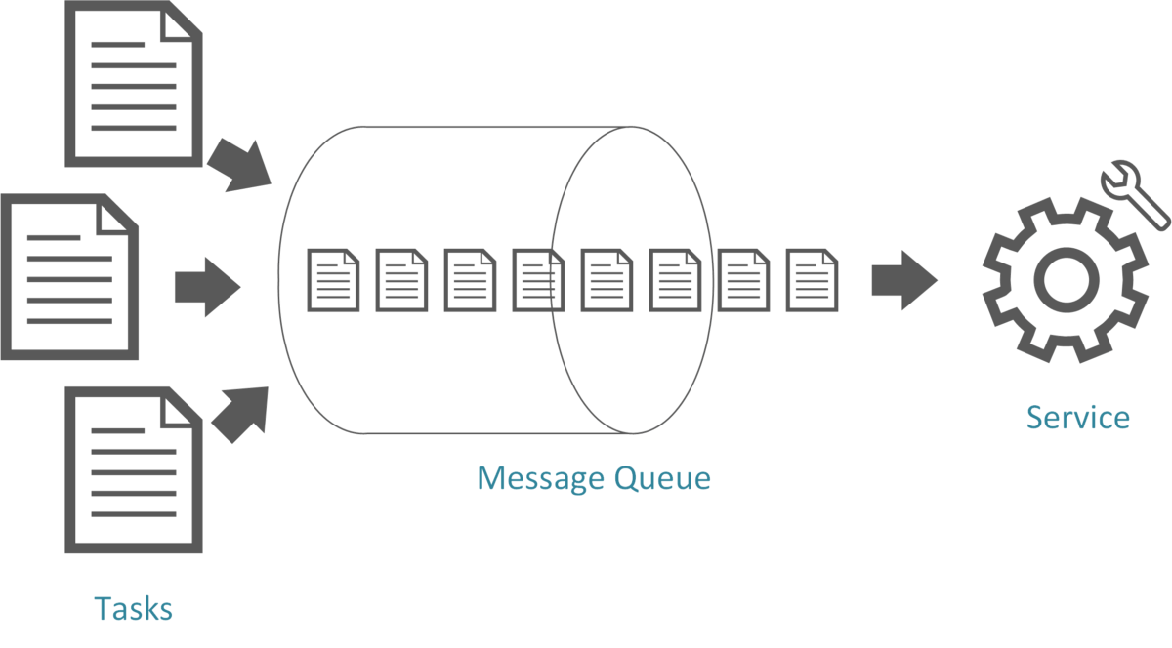
Design for Azure Queue storage
Azure Storage Queue is a service for storing large number of messages.
Accessed with authenticated calls using HTTP or HTTPS
Messages can be up to 64 KB in size
May contain millions of messages, up to the total capacity limit of a storage account
Create a backlog of work to process asynchronously
Example: customer placing orders online added to the queue and processed
Notes:
Azure Queue storage - https://docs.microsoft.com/azure/storage/queues/storage-queues-introduction

Slide 8

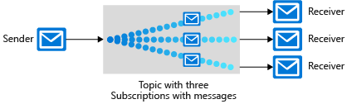
Design for Service Bus queues and topics
Service Bus decouples applications and services from each other.
Service bus queues
Service bus publish-subscribe topics
Built on top of a dedicated messaging infrastructure
Holds messages until the target is ready to receive them – different from queues
Like bus queues but with multiple subscribers
When a message is sent to a topic, multiple components can be triggered to perform a task
Notes:
Azure Service Bus queues - https://docs.microsoft.com/azure/service-bus-messaging/service-bus-queues-topics-subscriptions
Azure Service Bus topics - https://docs.microsoft.com/azure/service-bus-messaging/service-bus-queues-topics-subscriptions
Examples: Sports reporting passing information to multiple agencies.

Slide 9
Compare messaging solutions
Solution | Usage cases | SLA
Queue storage | A simple queue to organize messages. Queue to exceed 80 GB in size. To track progress for processing a message inside of the queue. | Based on storage tier
Service bus queues | A first-in-first-out guarantee. At-Least-Once message processing (PeekLock receive mode) At-Most-Once message processing (ReceiveAndDelete receive mode) Can group operations into transactions Receive messages without polling the queue. Publish and consume batches of messages. | 99.9%
Service bus topics | Multiple receivers to handle each message. Multiple destinations for a single message. | 99.9%
Notes:
Storage queues and Service Bus queues - compared and contrasted - https://docs.microsoft.com/azure/service-bus-messaging/service-bus-azure-and-service-bus-queues-compared-contrasted#foundational-capabilities
Overview of transaction processing in Azure Service Bus - https://docs.microsoft.com/azure/service-bus-messaging/service-bus-transactions
TTL – time to live

Slide 10

Design an event solution
Notes:
There are 2 Learn units that are covered under this one divider: Event Hub and Event-driven. There is no student content for IoT Hub which is not on the exam, but included for completeness.

Slide 11
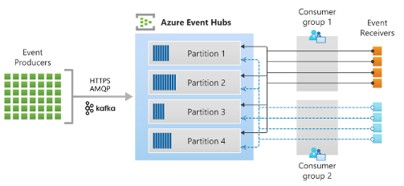
Design an Event Hub messaging solution
Azure Event Hubs is a fully managed, real time data ingestion service
Orders events by when they are received - by time offsets
Uses a pull model allowing multiple reads from consumers
Scaling is controlled by how many throughput units or processing units you purchase
Receiving IoT and real-time streaming data
Notes:
Azure Event Hubs — A big data streaming platform and event ingestion service - https://docs.microsoft.com/azure/event-hubs/event-hubs-about
Use event hub from Apache Kafka app - https://docs.microsoft.com/azure/event-hubs/event-hubs-for-kafka-ecosystem-overview
Online retailer uses cloud database to deliver world-class shopping experiences - https://customers.microsoft.com/story/asos-retail-and-consumer-goods-azure
Discussion: What is the main consideration for the ‘pull’ model provided by Event Hubs? Pull models make it the responsibility of the consumer(s) to ensure data are processed before they expire. This provides flexibility but also can mean that messages are lost in exceptional circumstances.

Slide 12
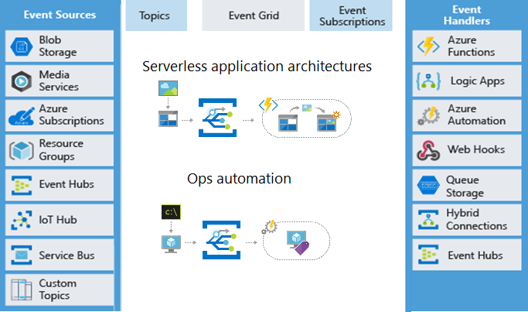
Design an event-driven solution
Azure Event Grid is a routing service connecting data sources with event handlers.
Events sources include Azure resources or custom topics (you create)
Event handlers react to an event
Useful for serverless applications and operations automation
Uses a pay-per-operation or pay-per-use pricing models
Notes:
Azure Event Grid - https://docs.microsoft.com/azure/event-grid/overview
Serverless application architectures - Event Grid connects data sources and event handlers. For example, use Event Grid to trigger a serverless function that analyzes images when added to a blob storage container.
Ops automation - Event Grid allows you to speed automation and simplify policy enforcement. For example, use Event Grid to notify Azure Automation when a virtual machine or database in Azure SQL is created. Use the events to automatically check that service configurations are compliant, put metadata into operations tools, tag virtual machines, or file work items.

Slide 13
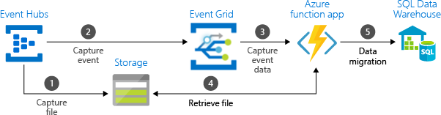
Comparison of message and event solutions
Consider combining several solutions
Service | Purpose | Type | When to use
Event Grid | Reactive programming | Event distribution (discrete) | React to status changes
Event Hubs | Big data pipeline | Event streaming (series) | Telemetry and distributed data streaming
Service Bus | High-value enterprise messaging | Message | Order processing and financial transactions
Notes:
Diagram shows example but table is a summary of options. Treat as separate topics.
In some cases, you use the services side by side to fulfill distinct roles. For example, an e-commerce site can use Service Bus to process the order, Event Hubs to capture site telemetry, and Event Grid to respond to events like an item was shipped. In other cases, you link them together to form an event and data pipeline. You use Event Grid to respond to events in the other services.

Slide 14
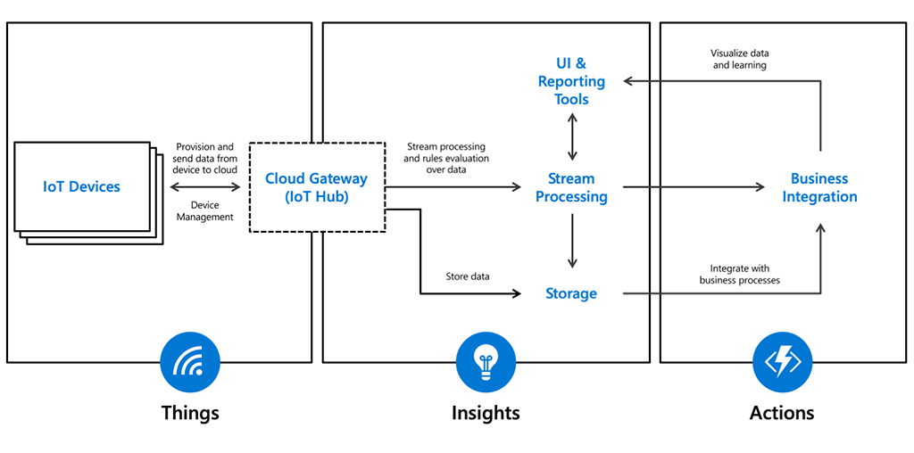
Design an IoT Hub solution
Central message hub for IoT applications and its attached devices.
When to use IoT Hub?
Application complexity
Data throughput
Securing solution end to end allowing for per-device authentication
Bi-directional communication
Capabilities over Event Hub:
Per-device identity
File upload from devices
Device provisioning service
Notes:
When to use IoT hub - https://docs.microsoft.com/learn/modules/introduction-to-iot-hub/4-when-to-use-iot-hub
IoT Concepts and Azure IoT Hub - https://docs.microsoft.com/azure/iot-hub/iot-concepts-and-iot-hub
Connecting IoT Devices to Azure: IoT Hub and Event Hubs - https://docs.microsoft.com/azure/iot-hub/iot-hub-compare-event-hubs
Other times to use IoT hub: telemetry services, geographic coverage, device support, track and managing devices, message routing, and security.
IoT Hub offers richer features than Event Hub when it comes to devices.
Discussion: What are the most common IoT solutions used across industries? Remote monitoring, predictive maintenance, facilities management, connected manufacturing, and fleet management.
Example: You work in a large retail environment where IoT is deployed. The shelves have sensors monitoring the product for replenishment. The aisles in the store have cameras to monitor flow of people taking items off shelves. The combination of the sensors and cameras helps make the restocking of shelves quick and efficient.

Slide 15

Design an application optimization solution
Notes:
There are two Learn units under this banner: Redis and API management.

Slide 16
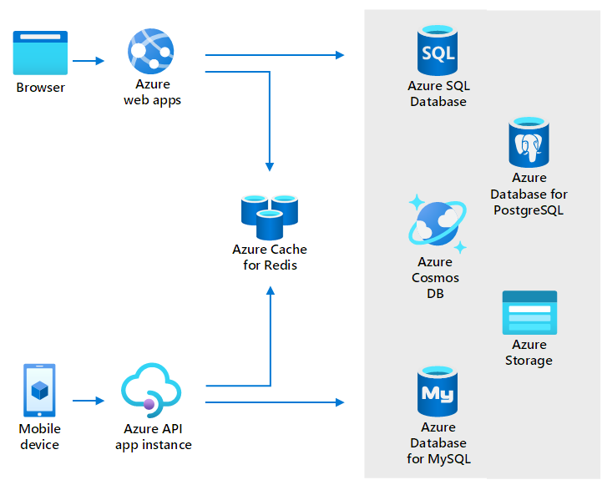
When to use Azure Cache for Redis
Store frequently accessed data so that applications can be responsive to users.
Key scenarios - data cache, content cache, session store, job and message queuing, and distributed transactions
Fully managed solution
High availability - responds automatically to both anticipated and unanticipated changes in demand
Same performance and scaling benefits throughout the world – network isolation, data encryption in transit
Notes:
About Azure Cache for Redis - https://docs.microsoft.com/azure/azure-cache-for-redis/cache-overview
What is Azure Cache Redis - https://docs.microsoft.com/learn/modules/intro-to-azure-cache-for-redis/2-what-is-azure-cache-for-redis

Slide 17
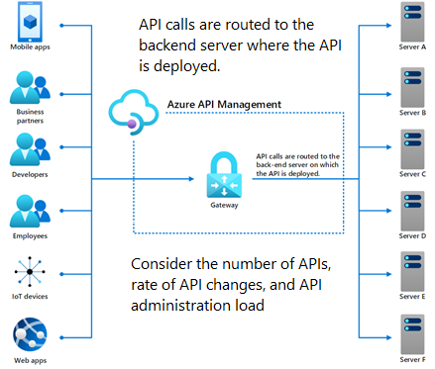
Design an Azure API management solution
Publish, secure, maintain, and analyze all your company's APIs.
Bring multiple APIs under a single administrative umbrella – centralized management
Manage permissions and access
Ensure compliance across API
Standardize API specs
Protect the APIs from malicious usage
Notes:
Azure API Management - https://docs.microsoft.com/azure/api-management/api-management-key-concepts

Slide 18
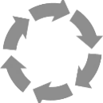
Design an application lifecycle
Notes:
There are 2 Learn units under this banner: Automated Deployment and App Configuration.

Slide 19
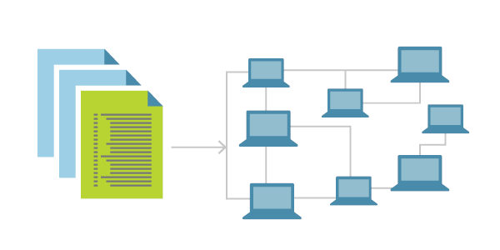
What is Infrastructure as Code?
Infrastructure as Code (IaC) is the process of automating your infrastructure provisioning.
The IaC model generates the same environment every time it is applied
Solves the problem of environmental drift
Enables teams to test applications in production-like environments early
Where possible, uses declarative definition files
Notes:
What is Infrastructure as Code? https://docs.microsoft.com/devops/deliver/what-is-infrastructure-as-code
Use this slide to introduce IaC and why it is important. The next slide covers the tooling that can be used.

Slide 20
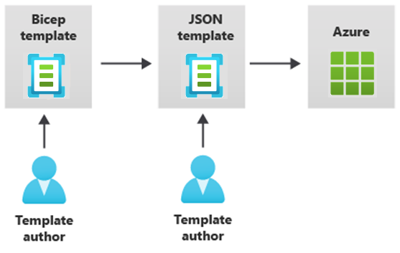

Provision resources with Infrastructure as Code
Azure supports IaC with Azure Resource Manager and third-party platforms.
Azure Resource Manager templates – Bicep, JSON
Azure Automation
Azure DevOps services
GitHub actions
Terraform
Jenkins
Notes:
Student content does not cover all the options shown on the slide.
Azure Resource Manager (ARM) templates - https://docs.microsoft.com/azure/azure-resource-manager/templates/overview
Bicep - https://docs.microsoft.com/azure/azure-resource-manager/bicep/overview
Automation deployment - https://docs.microsoft.com/azure/virtual-machines/infrastructure-automation
Azure DevOps documentation - https://docs.microsoft.com/azure/devops
GitHub Actions - https://docs.github.com/actions
Terraform by Hashicorp - https://www.terraform.io/
Jenkins - https://www.jenkins.io/
Could also mention:
Python with Pulumi - https://devblogs.microsoft.com/devops/infrastructure-as-code-azure-python-wpulumi/
Chef Automate - https://docs.chef.io/azure_marketplace/
Ansible - https://docs.microsoft.com/azure/developer/ansible/overview
And:
Azure Chaos Studio - https://azure.microsoft.com/services/chaos-studio/

Slide 21




Design an Azure App Configuration solution
Azure App Configuration centrally manages application settings and feature flags.
Flexible key representations and mappings
Point-in-time replay of settings
Dedicated UI for feature flag management
Comparison of two sets of configurations on custom-defined dimensions
Enhanced security through Azure-managed identities and encryption
Config A
Config B
App Configuration
Notes:
Azure App Configuration - https://docs.microsoft.com/azure/azure-app-configuration/overview
While any application can make use of App Configuration, the following examples are the types of application that benefit from the use of it:
Microservices based on Azure Kubernetes Service, Azure Service Fabric, or other containerized apps deployed in one or more geographies
Serverless apps, which include Azure Functions or other event-driven stateless compute apps
Continuous deployment pipeline

Slide 22

Review

Slide 23

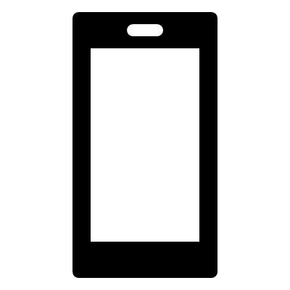
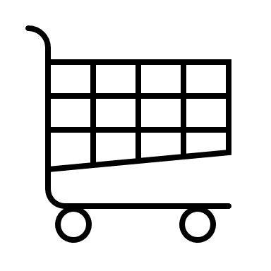
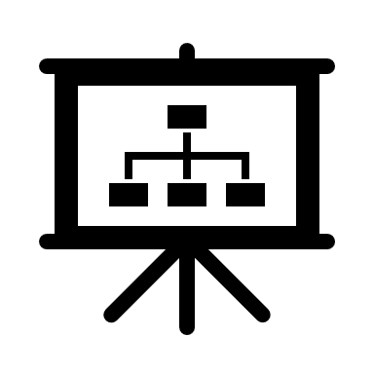
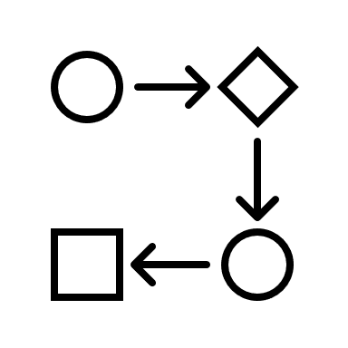

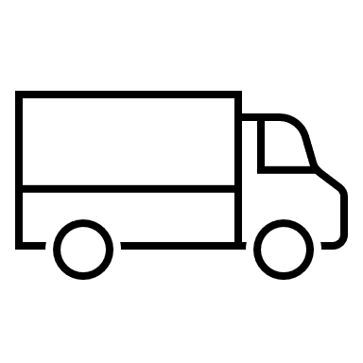
Case Study – Application architecture
A new product catalog design
New product catalog, ordering process, and shopping cart
Services will rely on a combination of relational and non-relational data
It is critical that the service hosting the application supports rapid autoscaling and high availability
Notes:
Serverless Functions reference architectures - https://docs.microsoft.com/azure/architecture/serverless-quest/reference-architectures

Slide 24





Instructor case study discussion
Web servers
Scanning API
Image storage
Notification
Event storage
Send to scanning
Trigger
Send email
Product
database
Automation
Queues
Notes:
Use this slide to discuss the process you are trying to design. Select a service from the bottom row.
Image storage = Blob
Notification = Event Grid
Event storage = Service Bus
Send messages to scanning = Function
Send email notification = Logic apps
Other solutions may be possible. Discuss pros and cons. You could discuss the web server and product database options.

Slide 25
Instructor Solution Diagram

Slide 26
Summary and resources
Check your knowledge
Microsoft Learn Modules (docs.microsoft.com/Learn)
Choose a messaging model in Azure to loosely connect your services
Introduction to Azure API Management
Introduction to Event Hubs
Deploy Azure infrastructure by using JSON ARM templates
Introduction to infrastructure as code using Bicep
Message queues and stream processing
Introduction to Azure Cache for Redis
Optional hands-on exercise - Implement a Service Bus topic and queue - Learn | Microsoft Docs
Notes:
Optional hands-on exercise - https://docs.microsoft.com/learn/modules/implement-message-workflows-with-service-bus/3-exercise-implement-a-service-bus-topic-and-queue
Learn more with self-paced training
Choose a messaging model in Azure to loosely connect your services - Learn - https://docs.microsoft.com/learn/modules/implement-message-workflows-with-service-bus/
Introduction to Azure API Management - Learn - https://docs.microsoft.com/learn/modules/introduction-to-azure-api-management/
Introduction to Event Hubs - Learn - https://docs.microsoft.com/learn/modules/intro-to-event-hubs/
Deploy Azure infrastructure by using JSON ARM templates - Learn - https://docs.microsoft.com/learn/modules/create-azure-resource-manager-template-vs-code/
Introduction to infrastructure as code using Bicep - Learn - https://docs.microsoft.com/learn/modules/introduction-to-infrastructure-as-code-using-bicep/
Message queues and stream processing - Learn - https://docs.microsoft.com/learn/modules/cmu-message-queues-streams/
Introduction to Azure Cache for Redis - https://docs.microsoft.com/learn/modules/intro-to-azure-cache-for-redis/

Slide 27

End of presentation

Slide 28
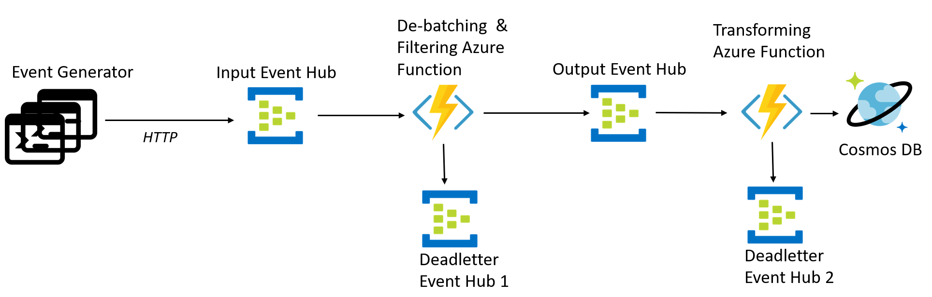
Optional - Whiteboard discussion #1
Serverless event-driven architecture
Notes:
Focus on the use of Event Hub and Functions.
Serverless event-driven architecture - https://docs.microsoft.com/azure/architecture/solution-ideas/articles/serverless-event-processing-filtering

Slide 29
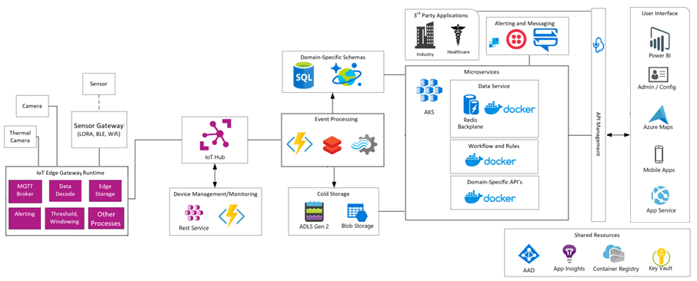
Optional - Whiteboard discussion #2
IoT connected platform for detection and prevention
Notes:
This architecture ties together many different systems.
IoT Connected Platform - https://docs.microsoft.com/azure/architecture/solution-ideas/articles/iot-connected-platform

Slide 30
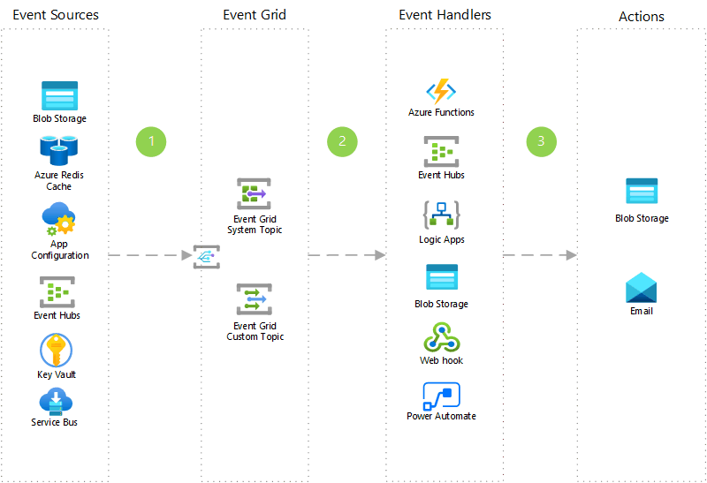
Optional - Whiteboard discussion #3
Application integration using Azure Event Grid
Notes:
Here is another way to describe how Event Grid can be used.
Application integration using Azure Event Grid - https://docs.microsoft.com/azure/architecture/solution-ideas/articles/application-integration-using-event-grid

