Slide 1
AZ-305T00A Designing Microsoft Azure Infrastructure Solutions

Slide 2

Agenda
Welcome
Introductions
Classroom experience
Azure Solution Architects
Microsoft Certifications
Course outline and schedule
Student materials
Case studies
Microsoft’s Cloud Adoption Framework
Microsoft’s Well Architected Framework

Slide 3
Welcome
Thank you for joining us today
We’ve worked together with the Microsoft Partner Network and Microsoft IT Academies to bring you a world-class learning experience. At the end of class, please complete an evaluation of today’s experience. We value your feedback!
Microsoft Certified Trainers + Instructors
Your instructor is a premier technical and instructional expert who meets ongoing certification requirements
Customer Satisfaction Guarantee
Our partners offer a satisfaction guarantee, and we hold them accountable for it
Certification Exam Benefits
After training, consider pursuing a Microsoft Certification to help distinguish your technical expertise and experience. Ask your instructor about available exam promotions and discounts
We wish you a great learning experience and ongoing career success!

Slide 4

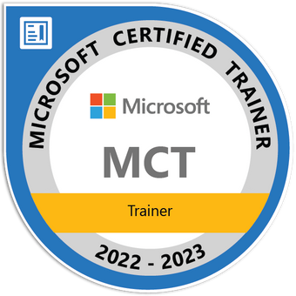

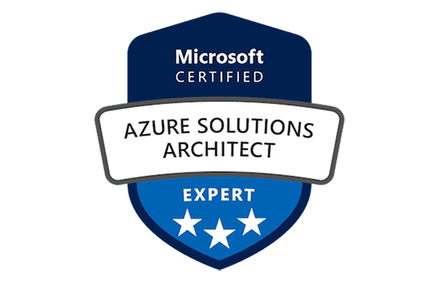
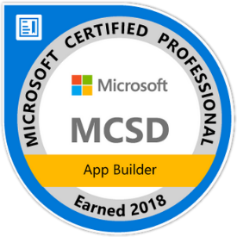
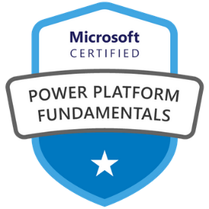
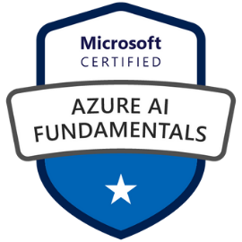
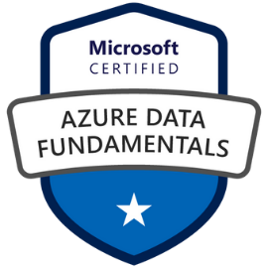
Hello, World!
Cyrus Cheng
Microsoft Certified Trainer (Since 2019) Azure Solutions Architect Azure Developer Associate
Cashout Team Tech. Lead HKMU Parttime Lecturer
Specialized in
Azure, SharePoint, .NET
Spring Boot / Spring Cloud
React, Vue
K8S Development
MicroServices Arch. Design

Slide 5
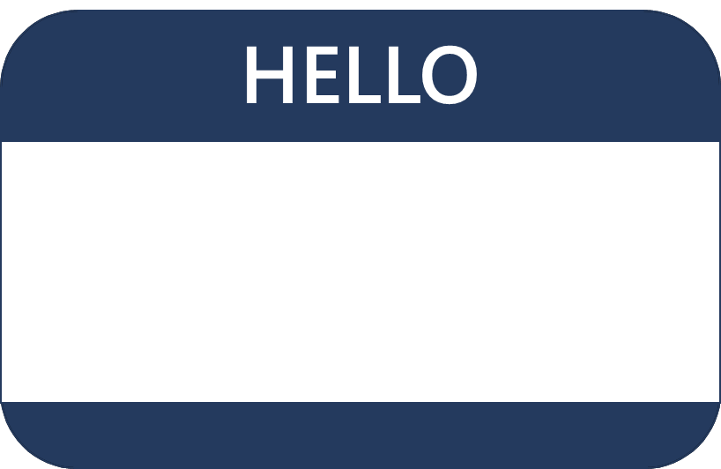
Hello! Student Introductions
Your name
Company affiliation
Title/function
Microsoft Azure experience
Your expectations for the course

Slide 6
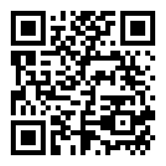
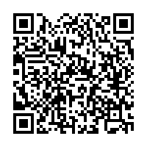
Class Logistic
Group Communication | OneDrive
This WhatsApp group can let the instructor to share information such as URL, screen capture to you. Students can start their discussion in the group as well | You can download all the materials here. There is a OneNote in the Share Drive. Please do not share to others as there are sensitive information.

Slide 7
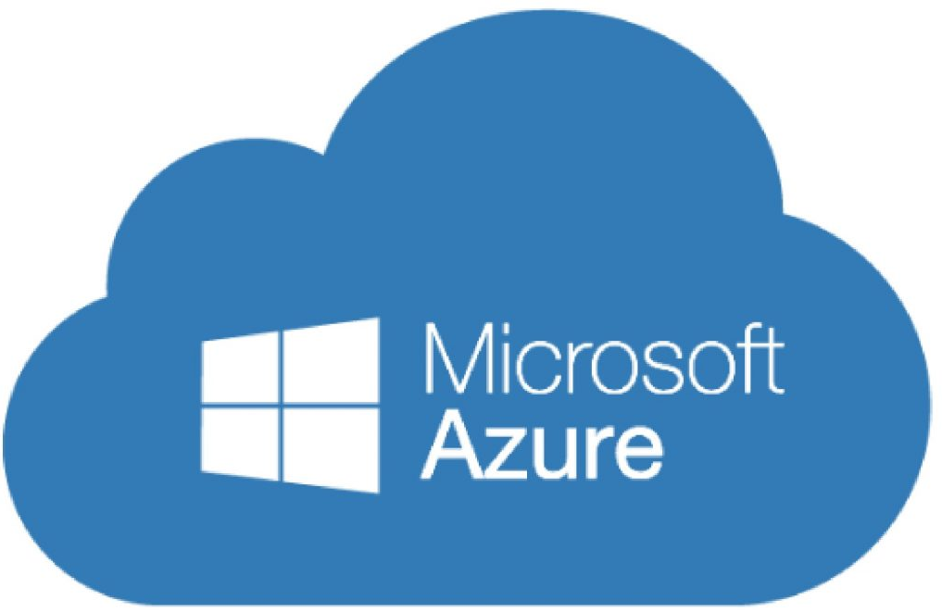
How to pronounce “Azure”
https://bit.ly/3EVYAj7
Azure 天藍色 / 藍天白雲

Slide 8
Azure Solution Architects
Azure Solution Architects have subject matter expertise in designing cloud and hybrid solutions that include compute, networking, storage, application services, data solutions, monitoring and security.
Working knowledge of networking technologies including connectivity services, application delivery services, and network architectures.
Working knowledge of compute technologies including virtual machines, containers, and PaaS compute solutions.
Working knowledge of storage technologies including relational and non-relational data solutions.
Experience architecting solutions including security, migration, and business continuity.
Notes:
Be sure to ask your students about their level of experience. Have they taken AZ-104 (Admin) or another Microsoft course?
Microsoft Learn has a series of Fundamental modules for Azure, networking, and security. More modules are added every day and can help students ramp up on Azure basics. https://docs.microsoft.com/learn/browse/?term=fundamentals&terms=fundamentals&products=azure
There is also an AZ-104: Prerequisites for Azure administrators learning path - https://docs.microsoft.com/learn/paths/az-104-administrator-prerequisites/.

Slide 9
Microsoft Certifications
Certifications give you a professional edge by providing globally recognized industry endorsed evidence of skills mastery, demonstrating your abilities and willingness to embrace new technologies
Exam AZ-900: Microsoft Azure Fundamentals
Microsoft Certified: Azure Administrator Associate
Microsoft Certified: Azure Solutions Architect Expert
Designed for candidates looking to demonstrate foundational level knowledge of cloud services and how those services are provided
Designed for Azure Administrators who implement, monitor, and maintain compute, storage, network, and security
Designed for Azure Solutions Architects who create solutions for compute, network, storage, and security
Notes:
Use this slide to introduce the different exam levels – Fundamentals, Associate, and Expert. Also, the difference between exams and certifications. Some certifications require you to pass more than one exam.
Certification journey poster - https://query.prod.cms.rt.microsoft.com/cms/api/am/binary/RE2PjDI

Slide 10
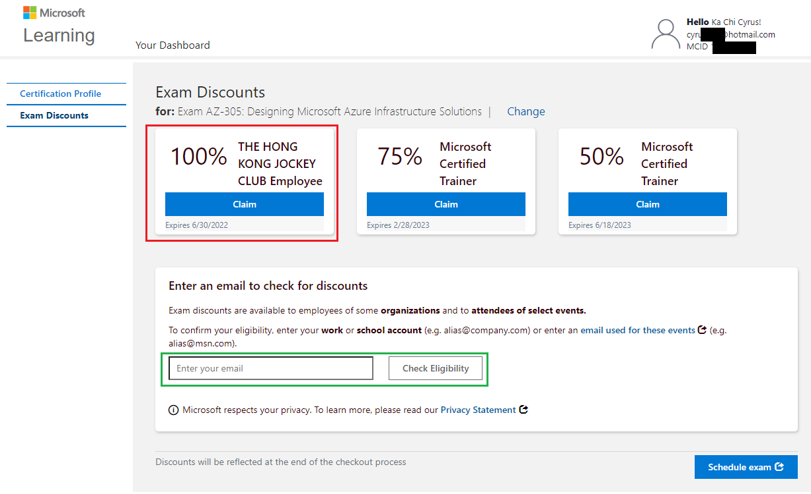
HKJC Benefit – Free Exam
HKJC offers IT&S FT staff to take free examination. You must schedule your exam. on or before 30th June, 2022.

Slide 11
HKJC Benefit – Free Azure Credit
HKJC offers IT&S FT staff to have Visual Studio Enterprise Account.

Slide 12
AZ-305 certification areas
Study Areas | Weights
Design identity, governance, and monitoring solutions | 25-30%
Design data storage solutions | 25-30%
Design business continuity solutions | 10-15%
Design infrastructure solutions | 25-30%
Percentages indicate the relative weight of each area on the exam
The higher the percentage, the more questions you are likely to see in that area
Notes:
Reimagining the Azure Solutions Architect Expert certification - https://techcommunity.microsoft.com/t5/microsoft-learn-blog/reimagining-the-azure-solutions-architect-expert-certification/ba-p/2813695
Exam AZ-305: Designing Microsoft Azure Infrastructure Solutions - https://docs.microsoft.com/learn/certifications/exams/az-305

Slide 13
Course schedule
Day 1
Day 2
Day 3
Day 4
Welcome
Storage (non-relational)*
App Architecture*
Networks*
Governance*
Storage (relational)*
Authentication and Authorization*
BCDR
Compute*
Data Integration
Monitoring**
Migrations
* Case study
** Fabrikam Residences case study
Notes:
Adjust this slide to your teaching schedule. If you are running behind, consider using the last daily case study as homework. Also, consider using the Module Review questions to recap the day before or after breaks to refocus the class. Some instructors like to complete the case study then use the lecture material for review. Lecture is estimated at 60 – 90 minutes. Case studies are estimated at 60-120 minutes. There is a Fabrikam case study for Day 3 that brings together the previous content. Modules that do not have a formal case study will have a small decision scenario at the end. Be sure to read more about the case studies in the Instructor Solution Guide.

Slide 14
Student materials on Learn
Learning Paths
Design identity, governance, and monitoring solutions
Design data storage solutions
Design business continuity solutions
Design infrastructure solutions
Notes:
The Learn modules are available from the course page – https://docs.microsoft.com/learn/certifications/courses/az-305t00
You can also view this content from the exam page or by searching the Learn content. This is only a small set of content that is available for Solutions Architects on Learn.
The course materials include a curated list of modules we think would be most helpful. These modules are listed on the last page, Summary and Resources. Students can search and find other modules. It is important to point out that additional study is needed for students to pass the exam.

Slide 15

Case studies
Tailwind Traders is modernizing its infrastructure and moving to the cloud -
You have been asked to recommend and suggest new cloud architectures - requirements and tasks are provided in case studies
Make sure to actively participate in small groups or individually
Become familiar with the Azure Architecture Center, Azure Charts, and the Azure Documentation.
Consider the Cloud Adoption Framework and Well Architected Framework as you design your case study solutions (next slides)
Optional hands-on sandboxes are provided on Learn
Notes:
AZ-305 Case Study GitHub - https://github.com/MicrosoftLearning/AZ-305-DesigningMicrosoftAzureInfrastructureSolutions
Be prepared to discuss how students should approach the case studies. How will they participate? Will they be expected to present a solution? What tools are available to them to draw architectures or answer questions?
Use this slide and the next two slides to give students areas to explore and use in class.

Slide 16
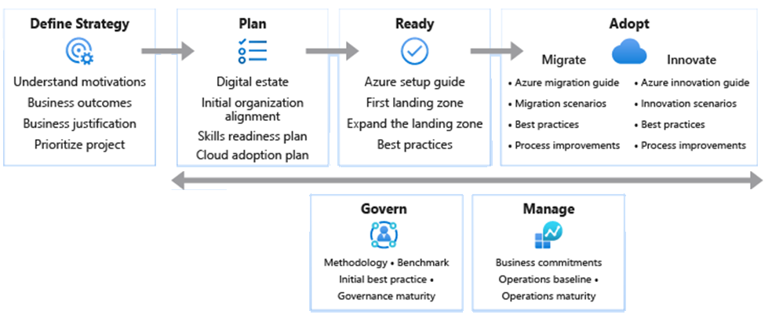
Microsoft’s Cloud Adoption Framework
Notes:
Consider talking about landing zones specifically. Use this link to review before class https://docs.microsoft.com/azure/cloud-adoption-framework/ready/landing-zone/
The cloud adoption journey - https://azure.microsoft.com/cloud-adoption-framework/#cloud-adoption-journey
Azure migration guide overview - https://docs.microsoft.com/azure/cloud-adoption-framework/migrate/azure-migration-guide
Azure cloud migration best practices checklist - https://docs.microsoft.com/azure/cloud-adoption-framework/migrate/azure-best-practices
Microsoft Cloud Adoption Framework for Azure - https://docs.microsoft.com/learn/modules/microsoft-cloud-adoption-framework-for-azure/
Strategy – Define business justification and expected outcomes of adoption
Plan – Align actionable adoption plans to business outcomes
Ready – Prepare the cloud environment for the planned changes
Adopt (Migrate/Innovate) – Migrate and modernize existing workloads / Develop new cloud-native or hybrid solutions
Govern – Govern the environment and workloads
Manage – Operations management for cloud and hybrid solutions
Organize – Align the teams and roles supporting your organization’s cloud adoption efforts

Slide 17
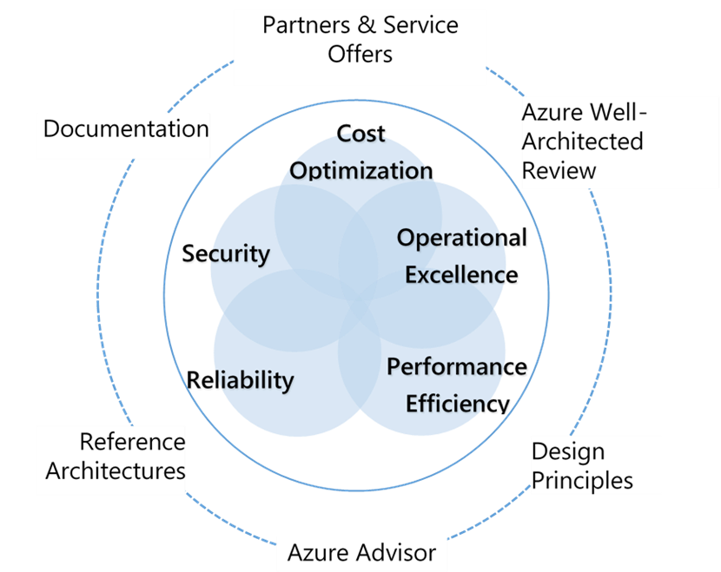
Microsoft Azure Well-Architected Framework
Cost Optimization – Managing costs to maximize the value delivered
Operational Excellence – Operations processes that keep a system running in production
Performance Efficiency – Ability of a system to adapt to changes in load
Reliability – Ability of a system to recover from failures and continue to function
Security – Protecting applications and data from threats
Notes:
Microsoft Azure Well-Architected Framework - https://docs.microsoft.com/azure/cloud-adoption-framework/
Build great solutions with the Microsoft Azure Well-Architected Framework - https://docs.microsoft.com/azure/architecture/framework/
Azure’s Well-Architected Framework targets a specific workload, and the Cloud Adoption Framework picks them up from the point of migration to the cloud.

Slide 18

End of presentation

