Slide 1
AZ-305T00A Designing Microsoft Azure Infrastructure Architect

Slide 2
Design a non-relational data storage solution

Slide 3
Introduction
Design for data storage
Design for Azure storage accounts
Design for data redundancy
Design for Azure blob storage
Design for Azure files
Design an Azure disk solutions
Design for storage security
Case study
Summary and resources
AZ-305: Design Data Storage Solutions (25-30%)
Design a Data Storage Solution for Non-relational Data
Recommend access control solutions to data storage
Recommend a data storage solution to balance features, performance, and cost
Design a data solution for protection and durability
Notes:
Exam page - https://docs.microsoft.com/learn/certifications/exams/az-305
Prerequisites
Conceptual knowledge of storage accounts, blobs, files, disks, and data protection.
Working experience with creating and securing storage systems.

Slide 4

Design for data storage

Slide 5
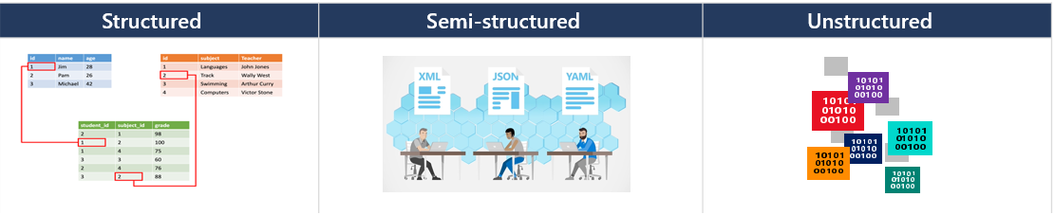
Classify your data storage
To design Azure storage, you first must determine what type of data you have.
Structured data includes relational data and has a shared schema
Semi-structured is less organized than structured data and isn’t stored in a relational format
Unstructured data is the least organized type of data
Notes:
Introduction to the core Azure Storage services - https://docs.microsoft.com/azure/storage/common/storage-introduction?toc=/azure/storage/blobs/toc.json
This is the first of two module on data storage. The next module will cover structured and semi-structured.
Discussion: Is anyone using unstructured data?

Slide 6

Design for Azure storage accounts

Slide 7
Determine the best storage account type
Select an account type based on supported services, usage cases, and SLA.
Account Type | Supported services | Usage
Standard general-purpose v2 (default) | Blobs / Data Lake, Queues, Tables, Azure Files | Recommended for most scenarios
Premium block blobs | Blob storage, Data Lake | High transactions rates, single digit storage latency, or large numbers of small transactions
Premium file shares | Azure Files | Enterprise or high-performance scale applications - supports both SMB and NFS file shares
Premium page blobs | Page blobs only | High performance and low latency storage scenarios
Notes:
Types of storage accounts - https://docs.microsoft.com/azure/storage/common/storage-account-overview#types-of-storage-accounts
Performance tiers for block blob storage - https://docs.microsoft.com/azure/storage/blobs/storage-blob-performance-tiers#premium-performance
Overview of Azure page blobs - https://docs.microsoft.com/azure/storage/blobs/storage-blob-pageblob-overview

Slide 8




Considerations for storage accounts
It is important to plan your storage accounts.
Location
For performance reasons locate the data close to users. One storage account for each location.
Replication
Data storage could have different replication strategies.
Compliance
Regulatory guidelines for keeping data in a specific location / Internal requirements for auditing or storing data.
Administrative overhead
Each storage account requires some time and attention from an administrator to create and maintain.
Cost
The settings for the account do influence the cost of services in the account.
Security - Data sensitivity
Data plane security and data storage security.
Notes:
Azure storage - https://docs.microsoft.com/azure/storage/
Discussion: Take a few minutes to think about your organization’s storage accounts. Are the storage accounts already in place? Would you make any changes? What type of storage accounts will you need, and why? Discuss the WAF pillars: security, resilience, performance, cost, operational excellence.
There is a slide on storage security. On this slide acknowledge that is a consideration. Data plane refers to user-security options. Data storage security refers to storage account security such as access key, shared access signature.

Slide 9

Design for data redundancy

Slide 10
Select a storage replication strategy
What level of redundancy do you need?
Primary Region
Secondary Region
Locally redundant storage
Geo- redundant storage
Read and write access to the secondary region are available if the primary region becomes unavailable
Zone redundant storage
Geo-zone redundant storage
A node within a data center becomes unavailable
An entire data center (zonal or non-zonal) becomes unavailable
A region-wide outage occurs in the primary region
Notes:
Azure storage redundancy - https://docs.microsoft.com/azure/storage/common/storage-redundancy
Review the pros and cons of each storage. Discuss how and application could use RA storage.
Discuss SLAs – LRS (11 9’s), ZRS (12 9’s), GRS/RA-GRS (16 9’s), GZRS/RA-GZRS (16 9’s).

Slide 11

Design for Azure blob storage

Slide 12
Determine the storage tier
Blob storage is an object store used for storing vast amounts of unstructured data.
Tier | Storage Costs | Retrieval/Read Costs | Storage Duration | Usage cases
Premium | High | Lowest | N/A | High throughout and large numbers of I/O operations per second
Standard Hot | Medium | Low | N/A | Active and frequent use Data staged for processing
Standard Cool | Low | Medium | > 30 days | Short-term backup Older media infrequently viewed Large data sets
Standard Archive | Lowest | High | > 180 days | Long-term backup Original (raw) data Compliance or archival data
Use lifecycle rules to transition blob data to the appropriate access tiers
Consider a data lifecycle rule to expire or delete data
Notes:
Hot, cool, and archive access tiers for blob data – https://docs.microsoft.com/azure/storage/blobs/access-tiers-overview
Optimize costs by automatically managing the data lifecycle - https://docs.microsoft.com/azure/storage/blobs/lifecycle-management-overview
Usage scenarios for the hot access tier:
Data that's in active use or expected to be accessed (read from and written to) frequently.
Data that's staged for processing and eventual migration to the cool access tier.
Usage scenarios for the cool access tier:
Short-term backup and disaster recovery datasets.
Older media content not viewed frequently anymore but is expected to be available immediately.
Large data sets that need to be stored cost effectively while more data is being gathered for future processing.
Usage scenarios for the archive access tier:
Long-term backup, secondary backup, and archival datasets.
Original (raw) data that must be preserved, even after it has been processed into final usable form.
Compliance and archival data that needs to be stored for a long time and is seldom accessed.

Slide 13
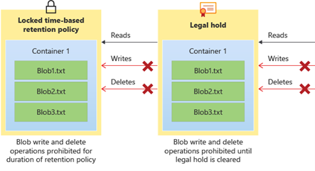
Consider immutable storage policies
Determine regulatory compliance, secure document retention, and legal hold policies.
Apply immutable storage policies at the container level
Use time-based retention policies for business-critical data
Use legal-hold policies for sensitive information to ensure a tamper proof state
Policies apply only to new content
Audit logs are available
Notes:
Store business-critical blob data with immutable storage – https://docs.microsoft.com/azure/storage/blobs/immutable-storage-overview
Immutable storage helps healthcare organization, financial institutions, and related industries—particularly broker-dealer organizations—to store data securely. Immutable storage can be leveraged in any scenario to protect critical data against modification or deletion.
Discussion: Take a few minutes to determine if your organization will need immutable blob storage policies. Which data sets and policies would be most helpful?

Slide 14

Design for Azure files

Slide 15
Compare Azure files to Azure blobs
The technology you choose depends on the use case, protocol, and performance.
Category | Azure Files | Azure Blob Storage
Use cases | Replace or supplement traditional on-premises file servers or NAS devices Access files shares from anywhere Lift and shift content to the cloud Replicate and cache with Azure File Sync Share stored application settings | Large scale analytical data Throughput sensitive high-performance computing Backup and archive Autonomous driving, media rendering, or genomic sequencing data
Available protocols | SMB REST NFS 4.1 | NFS 3.0 REST Data Lake Storage Gen2
Performance (Per volume) | Better IOPS | Better throughput
Notes:
Compare access to Azure Files, Blob Storage, and Azure NetApp Files with NFS - https://docs.microsoft.com/azure/storage/common/nfs-comparison
Tip: Take a few minutes to think through your company file share strategy. Will you need files shares? Will you need file sync?
Azure file share scale targets - https://docs.microsoft.com/azure/storage/files/storage-files-scale-targets#azure-file-share-scale-targets
Management concepts - https://docs.microsoft.com/azure/storage/files/storage-files-planning#management-concepts
Identity - https://docs.microsoft.com/azure/storage/files/storage-files-planning#identity
Networking - https://docs.microsoft.com/azure/storage/files/storage-files-planning#networking
Encryption - https://docs.microsoft.com/azure/storage/files/storage-files-planning#encryption
Data protection - https://docs.microsoft.com/azure/storage/files/storage-files-planning#data-protection
Redundancy - https://docs.microsoft.com/azure/storage/files/storage-files-planning#redundancy

Slide 16

Select a file storage tier (activity)
Tailor your file tiers to the performance and price you need
File storage tiers
Premium
Transaction optimized
Hot
Cool
You have highly I/O-intensive workloads, with high throughput and low latency
You need storage optimized for general purpose file sharing scenarios such as team shares and Azure File Sync
You need cost-efficient storage optimized for online archive storage scenarios
You have transaction heavy workloads and applications that require file storage and backend storage
Notes:
Discuss the file storage tiers (on the left side) and then which of the solutions on the right would be best for that tier.
Storage tiers - https://docs.microsoft.com/azure/storage/files/storage-files-planning#storage-tiers
Premium file shares enable highly I/O-intensive workloads, with high throughput and low latency. Premium file shares are offered on high-performance solid-state drive (SSD) based storage.
Cool file shares offer cost-efficient storage optimized for online archive storage scenarios. Azure File Sync may also be a good fit for lower churn workloads.
Hot file shares offer storage optimized for general purpose file sharing scenarios such as team shares and Azure File Sync.
Transaction optimized file shares enable transaction heavy workloads that don’t need the latency offered by premium file shares with consistent latency. Transaction optimized file shares are a great fit for applications that require file storage or for backend storage.

Slide 17
Design for NetApp files
The Azure NetApp Files service is enterprise-class, high-performance, metered file storage.
Migration (Windows Apps & SQL Server | Linux OSS Apps & Databases | SAP on Azure)
Ease of migration
Workload scale
Flexibility
Storage technology
Specialized workloads (HPC | VDI | AVS)
Azure Platform Services (AKS, Azure Batch, …)
Azure NetApp Files (Enterprise NAS)
Notes:
Solution architectures using Azure NetApp Files - https://docs.microsoft.com/azure/azure-netapp-files/azure-netapp-files-solution-architectures
When to use Azure NetApp Files - https://docs.microsoft.com/learn/modules/introduction-to-azure-netapp-files/4-when-to-use-azure-netapp-files
HPC – High performance computing
VDI – Virtual Desktop Infrastructure
AVS – Azure VMware solutions

Slide 18

Design an Azure disk solution

Slide 19
Select an Azure disk solution
Azure disks are block-level storage volumes used with Azure virtual machines.
Consider disk type, scenario, throughput, and IOPS
Always use managed disks
Optimize read and write access with disk caching
Use Azure Disk Encryption
Enhance performance with multiple disks
Network acceleration feature
Share disks across multiple VMs
Disk type | Usage cases
Ultra-disk SSD | IO-intensive workloads such as SAP HANA, top tier databases (SQL, Oracle), and other transaction-heavy workloads
Premium SSD | Production and performance sensitive workloads
Standard SSD | Web servers, lightly used enterprise applications and dev/test
Standard HDD | Backup, non-critical, infrequent access
Notes:
Introduction to Azure managed disks - https://docs.microsoft.com/azure/virtual-machines/managed-disks-overview
What disk types are available in Azure? - https://docs.microsoft.com/azure/virtual-machines/disks-types
Overview of managed disk encryption options - https://docs.microsoft.com/azure/virtual-machines/disk-encryption-overview

Slide 20

Design for storage security

Slide 21



Considerations for storage security
Use a layered security model to secure and control access.
Firewall policies
Enable secure transfer
Customer-managed keys
Service endpoints
Private endpoints
Storage accounts
Grant limited access to Azure Storage resources
Enable firewall rules to limit access to access - IP addresses or subnets
Use private endpoints and private links for clients
Use virtual network service endpoints to provide direct connection
Use customer managed encryption keys
Notes:
Grant limited access to Azure Storage resources using shared access signatures (SAS) - https://docs.microsoft.com/azure/storage/common/storage-sas-overview
Security recommendations for Blob storage - https://docs.microsoft.com/azure/storage/blobs/security-recommendations
Use private endpoints for Azure Storage - https://docs.microsoft.com/azure/storage/common/storage-private-endpoints
Customer-managed keys for Azure Storage encryption - https://docs.microsoft.com/azure/storage/common/customer-managed-keys-overview

Slide 22
Review

Slide 23



Case study – Non-relational data
Media files | Marketing literature | Corporate documents
Product photos and feature videos JPEG and MP4 are most common formats | Customer stories, sales flyers, sizing charts, and eco-friendly manufacturing information PDF format is the most common | Internal documents – some sensitive Mostly Office formats like Word and Excel

Slide 24
Case study discussion
Design a storage solution for Tailwind Traders.
What type of data is represented?
What factors will you consider in your design?
What type of storage accounts are needed?
Will you use blob access tiers?
Will you use immutable storage?
How will the content be securely accessed?
Your solution should consider the media, marketing literature, and corporate documents.
Notes:
Use the Instructor solution to discuss recommendations.

Slide 25
Instructor Solution Diagram - Completed

Slide 26
Summary and resources
Check your knowledge
Microsoft Learn Modules (docs.microsoft.com/Learn)
Choose the right disk storage for your virtual machine workload
Configure blob storage
Optimize performance and costs by using Azure Disk Storage
Caching and performance in Azure storage disks
Secure your Azure virtual machine disks
Introduction to securing data at rest on Azure
Introduction to Azure NetApp Files
Optional hands-on exercise - Create a storage account using the Azure portal
Notes:
Optional hands-on exercise: Exercise - Create a storage account using the Azure portal - Learn | Microsoft Docs https://docs.microsoft.com/learn/modules/create-azure-storage-account
Learn more with self-paced training
Choose the right disk storage for your virtual machine workload - Learn | Microsoft Docs - https://docs.microsoft.com/learn/modules/choose-the-right-disk-storage-for-vm-workload/
Configure blob storage - Learn | Microsoft Docs - https://docs.microsoft.com/learn/modules/configure-blob-storage/
Optimize performance and costs by using Azure Disk Storage - Learn | Microsoft Docs - https://docs.microsoft.com/learn/modules/optimize-performance-and-costs-using-azure-disk-storage/
Caching and performance in Azure storage disks - Learn | Microsoft Docs - https://docs.microsoft.com/learn/modules/caching-and-performance-azure-storage-and-disks/
Secure your Azure virtual machine disks - Learn | Microsoft Docs - https://docs.microsoft.com/learn/modules/secure-your-azure-virtual-machine-disks/
Introduction to securing data at rest on Azure - Learn | Microsoft Docs - https://docs.microsoft.com/learn/modules/secure-data-at-rest/
Introduction to Azure NetApp Files - https://docs.microsoft.com/learn/modules/introduction-to-azure-netapp-files/

Slide 27

End of presentation

Slide 28
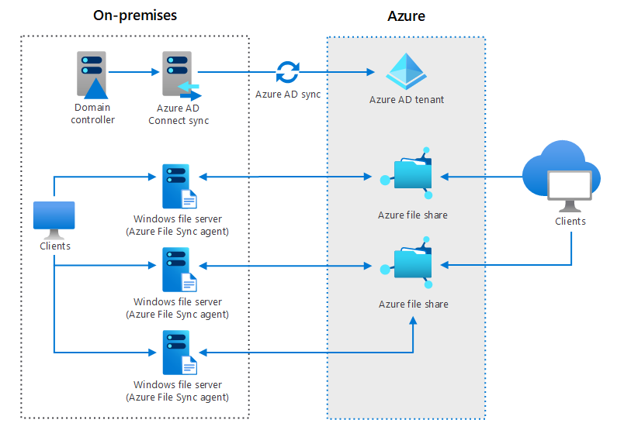
Optional – Whiteboard discussion #1
Hybrid file services
Notes:
This scenario focuses on file services.
Hybrid file services - https://docs.microsoft.com/azure/architecture/hybrid/hybrid-file-services

Slide 29
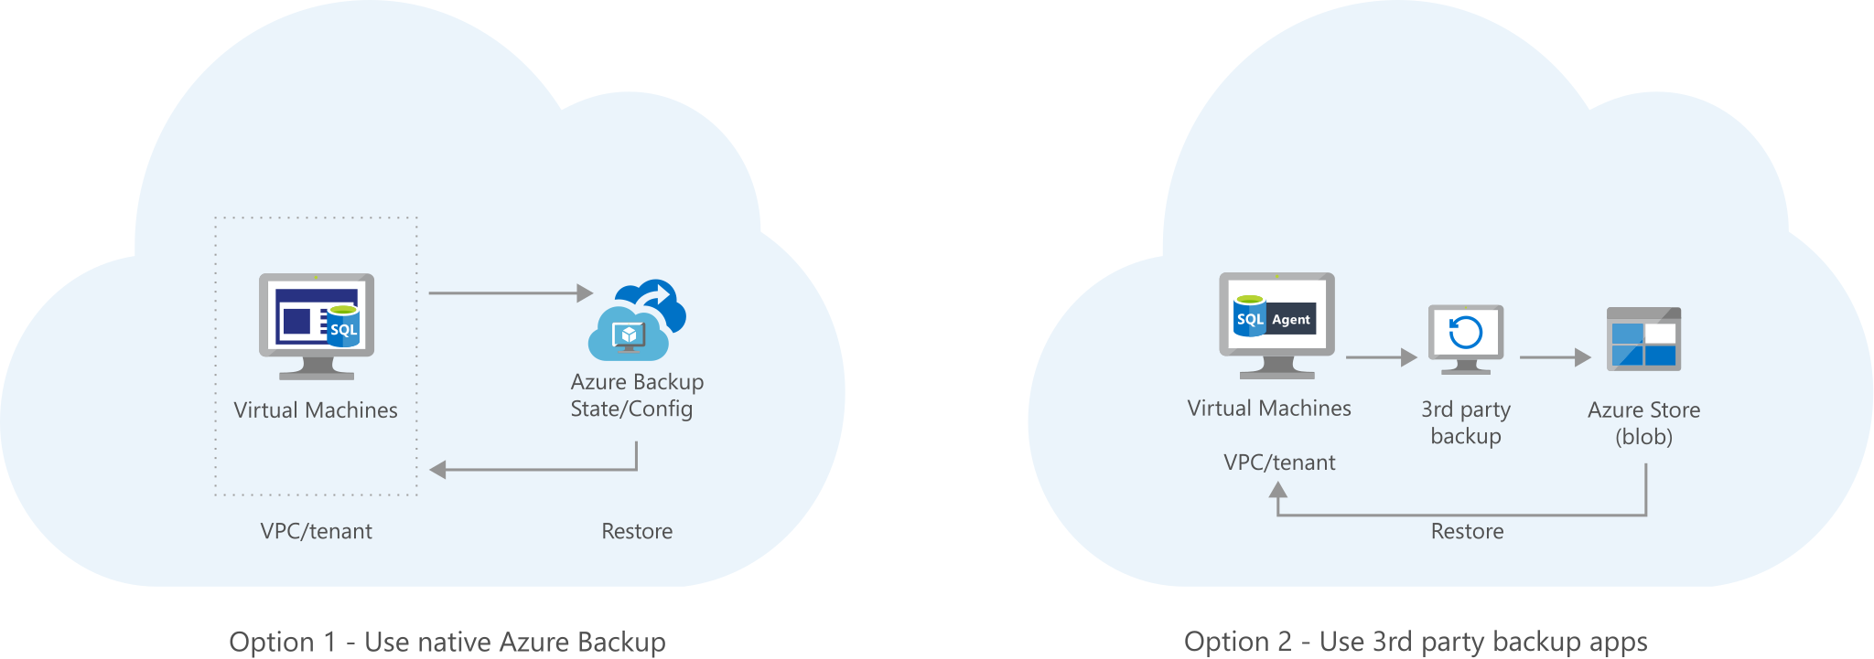
Optional – Whiteboard discussion #2
Archive your on-premises data to Azure Blob storage
Notes:
Backup will be covered in a later module, but you could discuss backing up to blob storage.
Archive your on-premises data to Azure Blob storage - https://docs.microsoft.com/azure/architecture/solution-ideas/articles/backup-archive-on-premises

