Slide 1
AZ-305T00A Designing Microsoft Azure Infrastructure Solutions

Slide 2
Design a data storage solution for relational data

Slide 3
Introduction
AZ-305: Design Data Storage Solutions (25-30%)
Design a Data Storage Solution for relational Data
Recommend database service tier sizing
Recommend a solution for database scalability
Recommend a solution for encrypting data at rest, data in transmission, and data in use
Recommend a Data Storage Solution
Recommend a solution for storing relational data
AZ-305: Design Business Continuity Solutions (10-15%)
Design for High Availability
Recommend a high availability solution for relational data storage
Design for data storage
Design for Azure SQL databases
Recommend a solution for database scalability
Recommend a solution for database availability
Design security for data at rest, data in transmission, and data in use
Design for Azure SQL Edge
Design for Azure Cosmos DB and tables
Notes:
Exam page - https://docs.microsoft.com/learn/certifications/exams/az-305
Prerequisites
Working experience with database solutions
Conceptual knowledge of SQL Server
The Learn student content has 3 units for Design for Azure SQL databases and 2 units for Azure Table Storage and Azure Cosmos DB.

Slide 4

Design for data storage

Slide 5
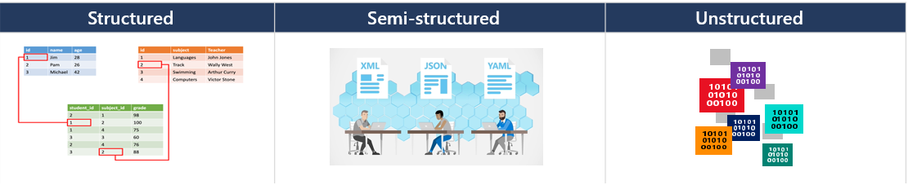
Design for structured and semi-structured data
To design Azure storage, you first must determine what type of data you have.
Structured data includes relational data and has a shared schema
Semi-structured is less organized than structured data and isn’t stored in a relational format
Unstructured data is the least organized type of data
Notes:
Introduction to the core Azure Storage services - https://docs.microsoft.com/azure/storage/common/storage-introduction?toc=/azure/storage/blobs/toc.json
This is the first of two module on data storage. The next module will cover structured and semi-structured.
Discussion: Is anyone using unstructured data?
Discussion: When to use Relational vs. NoSQL data, possibly CAP theorem - https://docs.microsoft.com/dotnet/architecture/cloud-native/relational-vs-nosql-data

Slide 6

Design for Azure SQL databases
Notes:
The are three units in Learn for this section.

Slide 7




When to use Azure SQL databases
SQL virtual machines
Managed instances
Databases
Best for migrations and applications requiring OS-level access
Best for most lift-and-shift migrations to the cloud
Best for modern cloud applications
SQL virtual machine
Single instance
Instance pool
Single database
Elastic pool
SQL Server and OS server access
Expansive SQL and OS version support
Automated manageability features
SQL Server surface area (vast majority)
Native virtual network support
Fully managed service
Resource sharing between multiple instances to price optimize
Simplified performance management for multiple databases
Fully managed service
Hyperscale storage (up to 100TB)
Serverless compute
Fully managed service
Resource sharing between multiple databases to price optimize
Simplified performance management for multiple databases
Fully managed service
Notes:
Features comparison: Azure SQL Database and Azure SQL Managed Instance - https://docs.microsoft.com//azure/azure-sql/database/features-comparison
This doc compares all three: https://docs.microsoft.com/azure/azure-sql/azure-sql-iaas-vs-paas-what-is-overview#comparison-table
- Mention SQL database compared to elastic pool

Slide 8

Recommend a solution for database scalability

Slide 9
Database scaling strategy
The following table identifies scenarios that require different scaling solutions
Requirement | Solution
Do you have to manage and scale multiple Azure SQL databases that have varying and predictable resource requirements? | SQL elastic pools.
Are you developing a new application with a single database that you want to test before launching it to thousands of users? | Azure SQL Database or SQL Managed Instance
Do you need to optimize the price performance for a group of databases within a prescribed budget while delivering performance elasticity for each database? | SQL elastic pools.
Consider cost together with your scaling strategy to find an optimal solution
Notes:
SQL elastic pools. Vertical scale up is a good solution for this scenario. Elastic pools solve this problem by ensuring that databases get the performance resources they need when they need it. They provide a simple resource allocation mechanism within a predictable budget. There is no per-database charge for elastic pools. You are billed for each hour a pool exists at the highest eDTU or vCores, regardless of usage or whether the pool was active for less than an hour.
Azure SQL DB or SQL MI Scale: You can adjust the resources allocated to your database by changing service objective, or scaling, to meet workload demands. This also enables you to only pay for the resources that you need, when you need them

Slide 10
Recommend a solution for database availability

Slide 11
Select an Azure SQL Database pricing model
DTU
vCore
Serverless
Compute
Compute
Storage
Storage
A simple, preconfigured purchase option.
A blended measure of CPU, memory, reads, and writes.
Flexibility, control and transparency
Independent scaling of compute, storage, and I/O resources
Intermittent, unpredictable usage
Automatically scales compute, based on workload demand
Notes:
Service tiers in the Database Transaction Unit (DTU) based purchase model - https://docs.microsoft.com/azure/azure-sql/database/service-tiers-dtu
vCore purchase model overview - Azure SQL Database - https://docs.microsoft.com/azure/azure-sql/database/service-tiers-sql-database-vcore
The vCore-based model is recommended because it allows you to independently select compute and storage resources. The DTU-based model is a bundled measure of compute, storage, and I/O resources.
Scenarios well suited for provisioned compute
Single databases with more regular, predictable usage patterns and higher average compute utilization over time.
Databases that cannot tolerate performance trade-offs resulting from more frequent memory trimming or delays in resuming from a paused state.
Multiple databases with intermittent, unpredictable usage patterns that can be consolidated into elastic pools for better price-performance optimization.
Scenarios well suited for serverless compute
Single databases with intermittent, unpredictable usage patterns interspersed with periods of inactivity, and lower average compute utilization over time.
Single databases in the provisioned compute tier that are frequently rescaled and customers who prefer to delegate compute rescaling to the service.
New single databases without usage history where compute sizing is difficult or not possible to estimate prior to deployment in SQL Database.

Slide 12
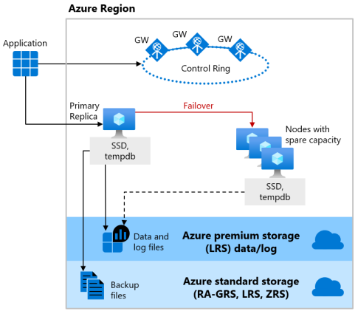
High availability with the General Purpose/Standard tier
Azure SQL Database offers three service tiers that are designed for different types of applications:
Designed for common workloads
Budget oriented balanced compute and storage
Uses nodes with spare capacity to spin up a new SQL Server instances
Uses LRS and RA-GRS (backup files)
Notes:
Basic, Standard, and General Purpose service tier locally redundant availability - https://docs.microsoft.com/azure/azure-sql/database/high-availability-sla#basic-standard-and-general-purpose-service-tier-locally-redundant-availability

Slide 13
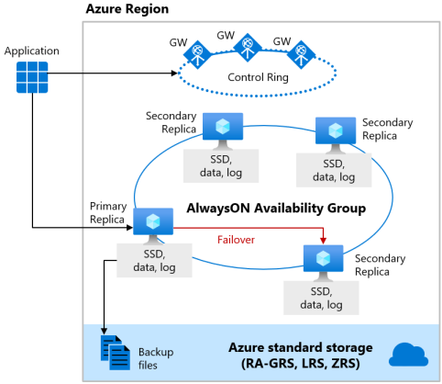
High availability with the Business Critical/Premium tier
Azure SQL Database offers three service tiers that are designed for different types of applications:
Designed for OLTP applications
High transaction rate and low I/O latency
Offers the highest resilience to failures by using several isolated replicas
Deploys an Always On availability group using multiple synchronously updated replicas
Uses local SSD storage and RA-GRS (backup files)
Notes:
Premium and Business Critical service tier locally redundant availability - https://docs.microsoft.com/azure/azure-sql/database/high-availability-sla#premium-and-business-critical-service-tier-locally-redundant-availability

Slide 14
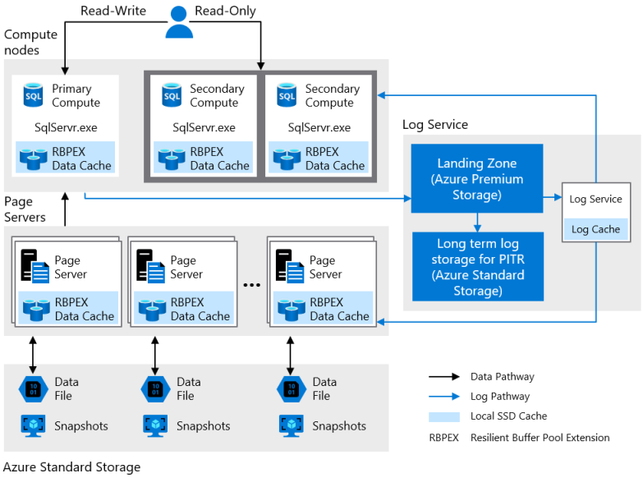
High availability with the Hyperscale tier
Azure SQL Database offers three service tiers that are designed for different types of applications:
Designed for very large OLTP databases – as large as 100 TB
Able to autoscale storage and scale compute
Captures instantaneous backups (using snapshots)
Restores in minutes rather than hours and days
Scale up or down in real time to accommodate workload changes
Notes:
This doc covers the comparison of SQL DB and SQL MI HA https://docs.microsoft.com/azure/azure-sql/database/high-availability-sla

Slide 15



Select a database failover strategy
Consider datacenter and regional failover.
Regional failover
In the same region -use AlwaysOn availability zones with failover to secondary replicas
Across regions – use geo-replication and failover groups
Primary SQL
Secondary
SQL
Failover group
Geo-replication
Primary region
Secondary region
Notes:
Regions and zones -https://docs.microsoft.com/azure/availability-zones/az-overview
Going further with availability - https://docs.microsoft.com/learn/modules/describe-high-availability-disaster-recovery-strategies/3-explore-high-availability-disaster-recovery-options
Instructor - https://docs.microsoft.com/azure/azure-sql/database/service-tier-hyperscale

Slide 16

Select a database strategy (activity)
Highly available Azure SQL database that is over 16 TB
On-premises SQL migration to Azure
Known database usage at minimal cost
Replicates across regions
A cloud platform that tracks inventory for multiple car dealerships.
Auto-failover group
Hyperscale
Business critical
Managed instances
SQL elastic pools
SQL Server on a VM
SQL Database
vCore pricing
Always On
DTU pricing
Notes:
Examine the scenarios on the left and determine which solution on the right could be used. A combination of things may be needed. Here are some suggested answers.
Highly available Azure SQL database that is over 40TB. (Hyperscale)
On-premises SQL migration to Azure. (SQL Database or SQL Server on a VM)
Known database usage at minimal cost (DTU pricing)
Replicates across regions (Geo-replication and Auto-failover group)
A cloud platform that tracks car dealership inventory. (SQL elastic pools - It's likely each dealership's data would be stored in a separate database. This scenario would likely benefit from elastic pools.)

Slide 17

Design security for data at rest, data in transit, and data in use

Slide 18
Protect your database
Use a layered (defense in depth) approach to data protection.
Network security
Identity and access
Data protection
Security management
VNet
Firewall rules, NSG
Private link
Authentication options: Azure AD, SQL Auth, Windows Auth
Azure RBAC
Roles and permissions
Row level security
Encryption-in-use (Always encrypted)
Encryption-at-rest (TDE)
Encryption-in-flight (TLS)
Customer-managed keys
Dynamic data masking
Advanced threat protection
SQL audit
Audit integration with log analytics and event hubs
Vulnerability assessment
Data discovery and classification
Microsoft Defender for Cloud
Notes:
Azure encryption overview - https://docs.microsoft.com/azure/security/fundamentals/encryption-overview
Security capabilities and tasks - https://docs.microsoft.com/learn/modules/azure-sql-secure-data/2-security-capabilities
Protect your database - https://docs.microsoft.com/learn/modules/azure-sql-secure-data/6-data-protection
Authentication has a separate slide (next).

Slide 19




Authenticate to an Azure SQL database
SQL database supports two types of authentication - SQL server authentication and Azure AD authentication
SQL server authentication credentials are stored in the database
Azure AD authentication uses managed identities
Azure AD Database Administrator
SQL Database Administrator
Azure AD account
SQL account
Database users mapped to Azure AD identities
Notes:
Authorizing database access to authenticated users to SQL Database and Azure Synapse Analytics using logins and user accounts - https://docs.microsoft.com/azure/sql-database/sql-database-manage-logins
Point out that SQL Database supports two types of authentication.
Azure SQL Database similarly supports two different modes of authentication, SQL Server authentication and Azure Active Directory authentication. SQL Server authentication is the same authentication method that has been supported in SQL Server since it was first introduced, where user credentials are stored within either the master database or the user database. Authentication via Azure Active Directory allows the user to enter the same username and password, which is used to access other resources such as the Azure portal or Microsoft 365.
SQL authentication uses a username and password. When creating the SQL Database server, it is necessary to specify a server admin login with a username and password. These credentials can be used to authenticate to any database on that server as the database owner.
Azure Active Directory (AD) authentication uses identities managed by Azure AD and is supported for managed and integrated domains. In order to use Azure AD authentication, it is necessary to create another server admin called Azure AD admin. This admin is allowed to administer Azure AD users and groups, in addition to performing all operations that a regular server admin can.

Slide 20

Design for Azure SQL Edge

Slide 21
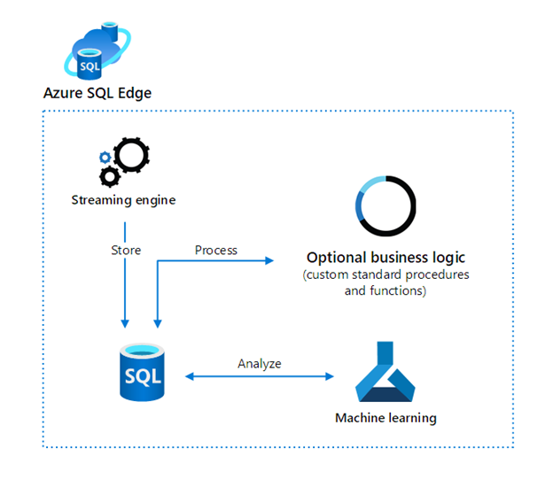
When to use Azure SQL Edge
An optimized relational database engine geared for IoT and IoT Edge deployments. It is a containerized Linux application that runs on a process that's based on ARM64 or x64.
Use SQL Edge when you need to:
Capture continuous data streams in real time
Integrate the data in a comprehensive organizational data solution
Synchronization and connectivity to back-end systems
Overcome connectivity limitations
Overcome slow or intermittent broadband connection
Notes:
Azure SQL Edge supports solutions that work with, or without, network connectivity.
Azure SQL Edge provides a powerful, local database. It negates needing to forward all data to a cloud-based database, which eliminates latency.
Azure SQL Edge implements RBAC and ABAC, encryption, and data classification. This helps you secure and control access to your IoT apps' data.
Azure SQL Edge provides ease of exchanging data with other systems like Azure SQL Database, SQL Server, and Azure Cosmos DB.
Azure SQL Edge shares the same codebase as SQL Server. Developers with skills in SQL Server or SQL Database can reuse their code and skills.

Slide 22

Design for Azure Cosmos DB
Notes:
The are two units in Learn for this section.

Slide 23
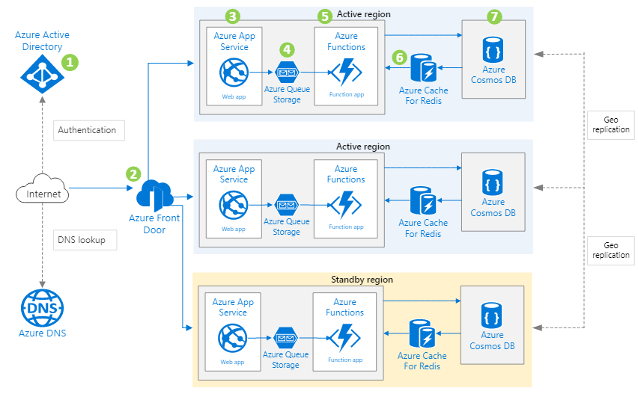
When to use Azure Cosmos DB
A fully managed NoSQL database service for modern app development. It has single-digit millisecond response times and guaranteed speed at any scale.
Web and mobile applications that store and query user generated content like Tweets or blog posts
Retail and marketing industry that store catalog data and event sourcing in order proccing pipelines
Gaming that requires single-millisecond latencies for reads and writes and can handle massive spikes in request rates during new game launches or feature updates.
IoT use cases can load data into Azure Cosmos DB for adhoc querying. New data and changes to existing data can be read on change feed. Then all data or just changes to data in Azure Cosmos DB can be used as reference data as part of real-time analytics.
Notes:
As a fully managed service, Azure Cosmos DB takes database administration off your hands with automatic management, updates, and patching. It also handles capacity management with cost-effective serverless and automatic scaling options that respond to application needs to match capacity with demand.
Automatic and instant scalability
Enterprise-grade security
Business continuity is assured with 99.999% SLA-backed availability
Turnkey multiple region data distribution anywhere in the world
Build fast with no-ETL analytics over operational data
Broad API compatibility
Pricing based on usage and storage
Link to image page with explanation: https://docs.microsoft.com/azure/architecture/solution-ideas/articles/multi-region-web-app-cosmos-db-replication#architecture
Casandra API
Mongo API
There is a slide at the bottom covering all the APIs cosmos provides if you would like to teach more on it
NOTE: Azure Cosmos DB is flexible and stores data in atom-record-sequence (ARS) format. The data is then abstracted and projected as an API.

Slide 24
Azure Storage tables and Azure Cosmos DB tables
Azure Table storage is a service that stores non-relational structured data (also known as structured NoSQL data) in the cloud, providing a key/attribute store with a schemeless design.
Azure Cosmos DB provides the Table API for applications that are written for Azure Table storage and that need premium capabilities like high availability, scalability, and dedicated throughput.
Differences in behavior
You are charged for the capacity of an Azure Cosmos DB table as soon as it is created, even if that capacity isn't used.
Query results from Azure Cosmos DB are not sorted in order of partition key and row key as they are from Storage tables.
Row keys in Azure Cosmos DB are limited to 255 bytes.
Cross-Origin Resource Sharing (CORS) is supported by Azure Cosmos DB.
Table names are case-sensitive in Azure Cosmos DB. They are not case-sensitive in Storage tables.
Notes:
Applications written for Azure Table storage can migrate to the Cosmos DB Table API with few code changes.
Azure Cosmos DB Table API and Azure Table storage share the same table data model and expose the same create, delete, update, and query operations through their SDKs.
If you currently use Azure Table Storage, you gain the following benefits by moving to the Azure Cosmos DB Table API:
Latency
Azure Table Storage - Fast, but no upper bounds on latency.
Azure Cosmos DB Table API - Single-digit millisecond latency for reads and writes, backed with <10-ms latency reads and <15-ms latency writes at the 99th percentile, at any scale, anywhere in the world.
Throughput
Azure Table Storage - Variable throughput model. Tables have a scalability limit of 20,000 operations.
Azure Cosmos DB Table API - Highly scalable with dedicated reserved throughput per table that's backed by SLAs. Accounts have no upper limit on throughput and support >10 million operations/s per table (in provisioned throughput mode).
Global distribution
Azure Table Storage - Single region with one optional readable secondary read region for high availability.
Azure Cosmos DB Table API - Turnkey global distribution from one to 30+ regions.
Indexing
Azure Table Storage - Only primary index on PartitionKey and RowKey. No secondary indexes.
Azure Cosmos DB Table API - Automatic and complete indexing on all properties, no index management.
Query
Azure Table Storage - Query execution uses index for primary key, and scans otherwise.
Azure Cosmos DB Table API - Queries can take advantage of automatic indexing on properties for fast query times.
Consistency
Azure Table Storage - Strong within primary region.
Azure Cosmos DB Table API - Five well-defined consistency levels to trade off availability, latency, throughput, and consistency.

Slide 25
What Cosmos DB APIs are supported?
No
New app?
Yes
Coming from?
Team skills and data access
Other
Optimizing for?
Modernization Guide
SQL native queries and advanced Cosmos DB features
Interop APIs
Table storage
Schema on write
Schema on read
Queries for graph traversals
Cassandra
Mongo DB
Gremlin
Cassandra API
Mongo DB API
Gremlin API
Table API
Cassandra API
Mongo DB API
Gremlin API
Core (SQL) API
Notes:
Based on your workload, you must choose the API that fits your requirement. The image shows a flow chart on how to choose the right API when building new apps or migrating existing apps to Azure Cosmos DB.
Choose an API in Azure Cosmos DB - https://docs.microsoft.com/azure/cosmos-db/choose-api

Slide 26
Review

Slide 27
Select a structured data product (activity)
You need a globally distributed, multi-model database with support for NoSQL choices.
Need control of DB software or host OS?
Yes
Custom IaaS VM deployment
No
You need a fully managed, scalable MySQL relational database that has high availability and security built in at no extra cost.
Database type?
Relational
Relational database type?
SQL Server
Apps compatible with Azure SQL Database?
You need a fully managed relational database that provisions quickly, scales on the fly, and includes built-in intelligence and security.
Document/Graph
Key/Value
SQL Server on Azure VMs
No
Yes
Azure SQL Database
Azure Cosmos DB
You need to host enterprise SQL Server applications in the cloud and have full control over the server OS.
Azure Database for MySQL
Azure Database for PostgreSQL
Azure Database for MariaDB
Notes:
https://docs.microsoft.com/azure/cloud-adoption-framework/ready/considerations/data-options
Use the flowchart to decide the best option for the scenarios listed on the left of the slide.
1st scenario – Azure Cosmos DB <insert rationale>
2nd scenario – Azure Database for MySQL <insert rationale>
3rd scenario – Azure SQL Database <insert rationale>
4th scenario – SQL Server on virtual machines <insert rationale>

Slide 28
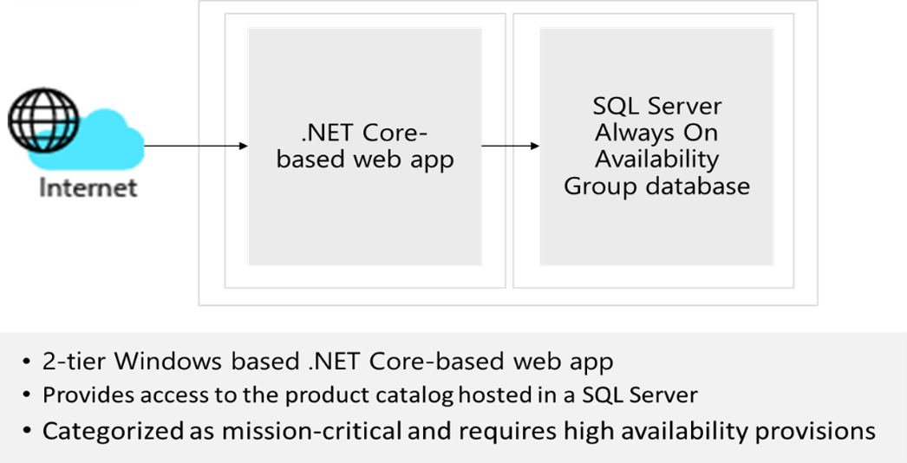
Case Study – Relational data
Design a database solution.
Your design should include authorization, authentication, pricing, performance, and high availability.
Diagram what you decide and explain your solution.
Notes:
There is no separate Instructor slide for this case study. Use the Instructor solution to discuss how authorization, authentication, pricing , and high availability can be met based on the requirements.

Slide 29








Instructor Solution Diagram
VNet
NSG
App
Services
Cosmos DB
Azure AD
Cache Redis
Private Link
Security
Center
SQL DB
App GW
Traffic Manager
Notes:
The solution is on the next slide. Drag and drop the icons on the right side onto the diagram.

Slide 30
Instructor Solution Diagram (completed)

Slide 31
Summary and resources
Check your knowledge
Microsoft Learn Modules (docs.microsoft.com/Learn)
Choose the appropriate API for Azure Cosmos DB
Introduction to securing data at rest on Azure
Secure your Azure SQL database
Scale multiple Azure SQL Databases with SQL elastic pools
Configure database authentication and authorization
Optional hands-on exercise - Create a SQL database
Notes:
Optional hands-on lab - Exercise - Create a SQL database - Learn | Microsoft Docs
Choose the appropriate API for Azure Cosmos DB - https://docs.microsoft.com/learn/modules/choose-api-for-cosmos-db/
Introduction to securing data at rest on Azure - https://docs.microsoft.com/learn/modules/secure-data-at-rest/
Secure your Azure SQL database - https://docs.microsoft.com/learn/modules/secure-your-azure-sql-database/
Scale multiple Azure SQL Databases with SQL elastic pools - https://docs.microsoft.com//learn/modules/scale-sql-databases-elastic-pools/
Configure database authentication and authorization - https://docs.microsoft.com/learn/modules/configure-database-authentication-authorization/

Slide 32

End of presentation

Slide 33
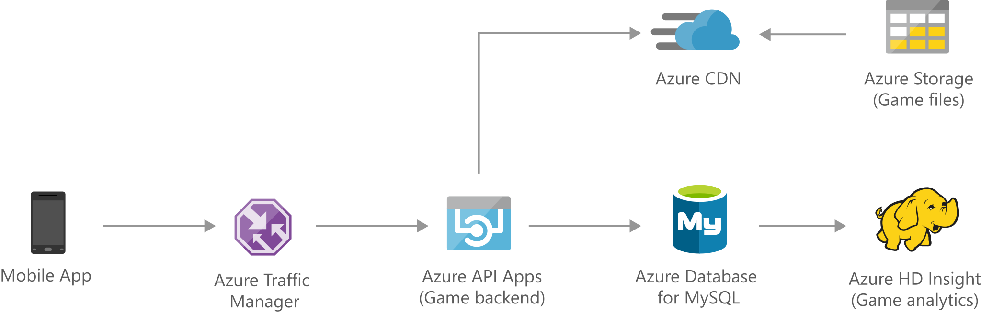
Optional - Whiteboard discussion #1
Process high-traffic web calls and API requests, such as e-commerce and retail applications
Notes:
Architecture diagram as explained in the reference page: https://docs.microsoft.com/azure/architecture/solution-ideas/articles/gaming-using-azure-database-for-mysql

Slide 34
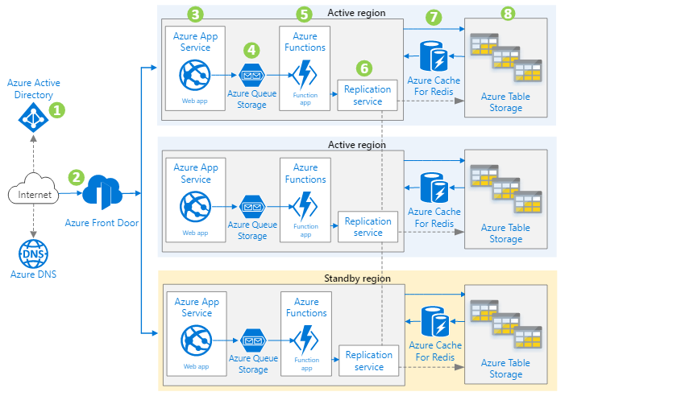
Optional - Whiteboard discussion #2
Multi-region web application with custom storage table replication
Notes:
Architecture diagram as explained in the reference page: https://docs.microsoft.com/azure/architecture/solution-ideas/articles/multi-region-web-app-multi-writes-azure-table

