Slide 1
AZ-305T00A Designing Microsoft Azure Infrastructure Solutions

Slide 2
Design a data integration solution

Slide 3
Introduction
Design a data integration solution with Azure Data Factory
Design a data integration solution with Azure Data Lake
Design a data integration and analytics solution with Azure Databricks
Design a data integration and analytics solution with Azure Synapse Analytics
Design Azure Stream Analytics solution for Data Analysis
Design a strategy for hot/warm/cold data path
AZ-305: Design Data Storage Solutions (25-30%)
Design Data Integration
Recommend a solution for data integration
Recommend a solution for data analysis
Notes:
Exam page - https://docs.microsoft.com/learn/certifications/exams/az-305
Prerequisites
Conceptual knowledge of storage accounts, blobs, files, disks, and data protection.
Working experience with creating and securing storage systems.
Different order from the Learn content: Azure Stream Analytics is ahead of hot/warm/cold data path.

Slide 4

Design a data integration solution with Azure Data Factory

Slide 5
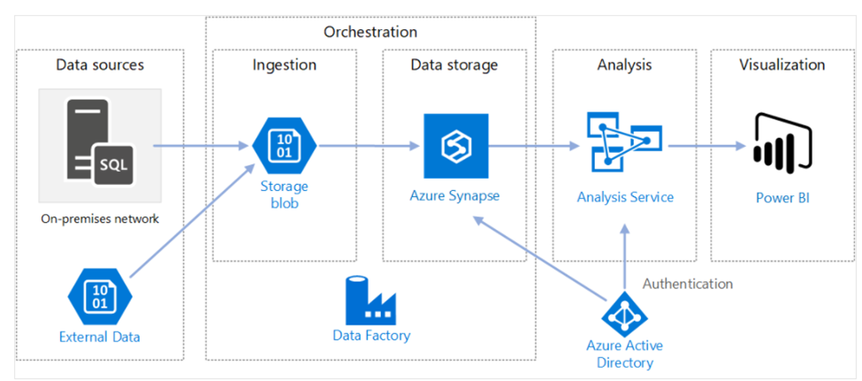
Data-driven workflows
Azure Data Factory is a cloud-based ETL and data integration service that can help you create and schedule data-driven workflows (called pipelines) that can ingest data from disparate data stores.
You can use Azure Data Factory to:
Orchestrate data movement.
Transform data at scale.
Notes:
Connect and collect – Data ingestion is the first step to collecting all the data from different sources into a centralized location.
Transform and enrich – Now you will use a compute service like Azure Databricks and Azure HDInsight Hadoop to transform the data
Continuous integration and delivery (CI/CD) and publish – Support for CI/CD through GitHub and Azure DevOps enables to deliver your ETL process incrementally before publishing the data to the analytics engine.
Monitor – Via the Azure portal, you can monitor the pipeline for scheduled activities and for any failures.
Requirements for data integration – Azure Data Factory serves two communities – Big data community and the Relational data warehousing community that uses SQL Server Integration Services (SSIS). Depending on your organization’s data needs you would set up pipelines in the cloud using Azure Data Factory that can access data from both cloud and on-premises data services.
Coding resources – If you prefer a graphical interface to set up pipelines, then Azure Data Factory authoring and monitoring tool is the right fit for your needs. Azure Data Factory provides a low code/no code process for working with data sources
Support for multiple data sources – Azure Data Factory supports 90+ connectors to integrate with disparate data sources.
Serverless infrastructure – There are advantages in using a fully managed, serverless solution for data integration - No need to maintain, configure or deploy servers, and the ability to scale with fluctuating workloads.

Slide 6

Design a data integration solution with Azure Data Lake
Notes:
There are 2 units in Learn under this one banner.

Slide 7
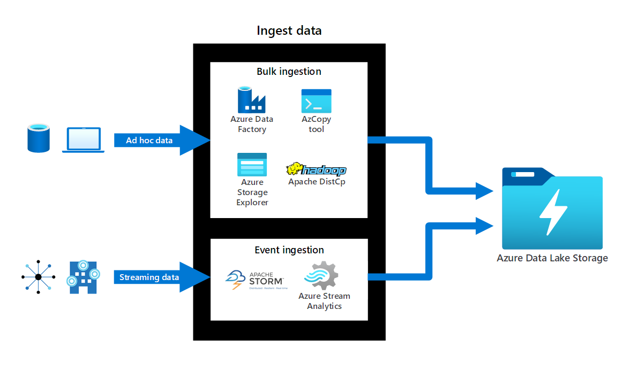
Azure Data Lake
Azure Data Lake Storage is a comprehensive, scalable, and cost-effective data lake solution for big data analytics built into Azure.
Use Azure Data Lake when you need:
a data repository on the cloud for managing large volumes of data
To manage a diverse collection of data types such as JSON files, CSV, log files or other diverse formats
Real-time data ingestion and storage
Notes:
A data lake is a repository of data that is stored in its natural format, usually as blobs or files.
Azure Data Lake Storage combines a file system with a storage platform to help you quickly identify insights into your data.
Data Lake Storage Gen2 builds on Azure Blob storage capabilities to optimize it specifically for analytics workloads.
Azure Data Lake Storage runs on virtual hardware on the Azure platform, making storage scalable, fast, and reliable without incurring massive charges.
Azure Data Lake Storage enables data democratization for your organization by storing all your data formats (including raw data) in a single location.
Azure Data Lake Storage can ingest real-time data directly from an instance of Apache Storm on Azure HDInsight, Azure IoT Hub, Azure Event Hubs, or Azure Stream Analytics.

Slide 8
Compare Azure Data Lake to Azure Blob storage
Criteria | Azure Data Lake | Azure Blob Storage
Data type | Good for storing large volumes of text data | Good for storing unstructured non- text-based data such as photos, videos, backup etc.
Namespace support | Supports hierarchical namespaces | Supports flat namespaces
Hadoop compatibility | Optimized for big data, like Hadoop | Is not Hadoop compatible
Security | Access Control Lists (ACLs), shared keys, SAS and RBAC | Shared keys, SAS, and RBAC
Blob Storage feature support in Azure storage accounts | Microsoft Docs
Notes:
https://docs.microsoft.com/azure/storage/blobs/storage-feature-support-in-storage-accounts#standard-general-purpose-v2-accounts
This article above shows whether a feature is fully supported, supported at the preview level, or is not yet supported. Support levels are impacted by storage account type, and whether certain capabilities or protocols are enabled on the account.
The items that appear in these tables will change over time as support continues to expand.

Slide 9

Design a data integration and analytics solution with Azure Databricks

Slide 10
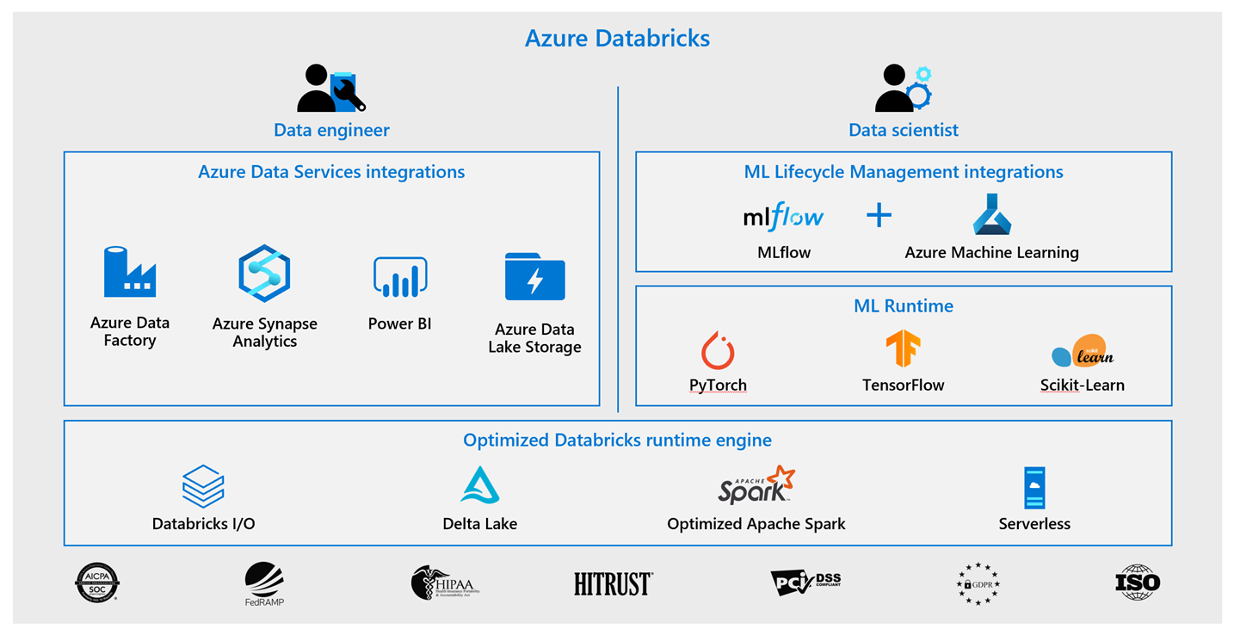
Azure Databricks
Azure Databricks is a fully managed, cloud-based Big Data and Machine Learning platform, which empowers developers to accelerate AI and innovation.
Provides data science and engineering teams with a single platform for Big Data processing and Machine Learning.
Offers three environments for developing data intensive applications:
Databricks SQL
Databricks Data Science & Engineering
Databricks Machine Learning.
Notes:
If a workload requires Spark, Databricks usually is the go-to solution.
You can use Azure Databricks as a solution for the following scenarios.
Data science preparation of data - Create, clone and edit clusters of complex, unstructured data, turn them into specific jobs and deliver them to data scientists and data analysts for review
Find relevant insights in the data - Recommendation engines, churn analysis, and intrusion detection are common scenarios that many organizations solve across multiple industries using Azure Databricks.
Improve productivity across data and analytics teams - Create a collaborative environment and shared workspaces for data engineers, analysts, and scientists to work together across the data science lifecycle with shared workspaces, saving teams precious time and resources.
Big data workloads – Leverage Delta Lake and engine to get the best performance and reliability for your big data workloads, and to create no-fuss multi-step data pipelines
Machine learning programs – Leverage integrated end-to-end machine learning environment incorporating managed services for experiment tracking, model training, feature development and management, and feature and model serving

Slide 11

Design a data integration and analytics solution with Azure Synapse Analytics
Notes:
The are two units in Learn for this section.

Slide 12
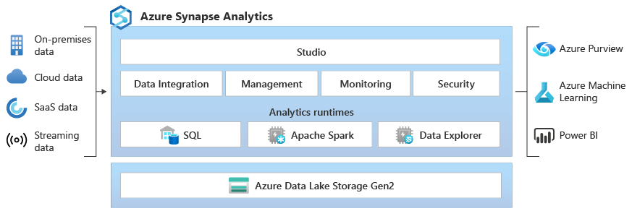
Azure Synapse Analytics
Azure Synapse Analytics is an integrated analytics platform that brings together data integration, enterprise data warehousing, big data analytics and visualization into a single service. Azure Synapse Analytics is an evolution of Azure SQL Data Warehouse.
Modern data warehousing
Advanced analytics
Data exploration and discovery
Real time analytics
Data integration
Integrated analytics
Machine Learning
Notes:
Initial analysis shows that the data needs to be cleaned, modeled, and visualized before data science can be applied.
Initial analysis would like to interface with all of their existing on-premises apps, cloud services subscriptions through a central interface.
Use Azure Synapse Analytics when:
You have a variety of data sources use Azure Synapse Analytics for code-free ETL and data flow activities.
You have a need to implement Machine Learning solutions using Apache Spark, use Azure Synapse Analytics for built-in support for AzureML.
You have existing data stored on a data lake and need integration with the Data Lake and additional input sources, Azure Synapse Analytics provides seamless integration between the two.

Slide 13
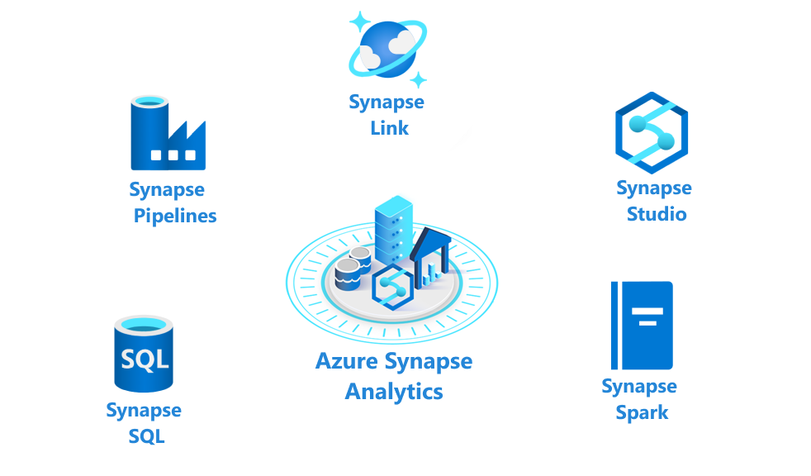
Components of Azure Synapse Analytics
Elements
Synapse SQL pool
Synapse Spark pool
Synapse Pipelines
Synapse Link
Synapse Studio
Notes:
Synapse SQL pool: Synapse SQL offers both serverless and dedicated resource models to work with using node-based architecture. For predictable performance and cost, you can create dedicated SQL pools, for unplanned or ad hoc workloads, you can use the always-available, serverless SQL endpoint.
Synapse Spark pool: This is a cluster of servers running Apache Spark to process data. You write your data processing logic using one of the four supported languages: Python, Scala, SQL, and C# (via .NET for Apache Spark). Apache Spark for Azure Synapse integrates Apache Spark-the open source big data engine used for data preparation, data engineering, ETL, and machine learning.
Synapse Pipelines: Azure Synapse Pipelines leverages the capabilities of Azure Data Factory and is the cloud-based ETL and data integration service that allows you to create data-driven workflows for orchestrating data movement and transforming data at scale. You could include activities that transform the data as it is transferred, or you might combine data from multiple sources together.
Synapse Link: This component allows you to connect to Cosmos DB. You can use it to perform near real-time analytics over the operational data stored in a Cosmos DB database.
Synapse Studio: This is a web-based IDE that can be used centrally to work with all capabilities of Azure Synapse Analytics. You can use Synapse Studio to create SQL and Spark pools, define and run pipelines, and configure links to external data sources.

Slide 14
What kind of analytics can you do with Azure Synapse Analytics?
Descriptive analytics - "What is happening?"
Azure Synapse Analytics leverages the dedicated SQL pool capability that enables you to create a persisted data warehouse to perform this type of analysis.
Diagnostic analytics - "Why is it happening?"
You can use the serverless SQL pool capability within Azure Synapse Analytics that enables you to interactively explore data within a data lake.
Predictive analytics - "What is likely to happen?"
Azure Synapse Analytics uses its integrated Apache Spark engine and Azure Synapse Spark pools for predictive analytics with other services such as Azure Machine Learning Services, or Azure Databricks.
Prescriptive analytics - "What needs to be done?"
This type of analytics looks at executing actions based on real-time or near real-time analysis of data, using predictive analytics.

Slide 15
Compare Azure Data Factory to Azure Synapse Analytics
Criteria | Azure Data Factory | Azure Synapse Analytics
Integration runtime sharing | Can be shared across different data factories | No sharing
Solution templates | Provided with Azure Data Factory template gallery | Provided with Synapse Workspace Knowledge center
Integration Runtime cross region support | Support Cross region data flows | Does not support cross region data flows
Monitoring of Spark Jobs for Data Flow | Not supported | Supported by the Synapse Spark pools
Notes:
Short discussion on different uses of Data Factory and Synapse Analytics
Available features in ADF & Azure Synapse Analytics - https://docs.microsoft.com/azure/synapse-analytics/data-integration/concepts-data-factory-differences#available-features-in-adf--azure-synapse-analytics

Slide 16
Compare Synapse to Databricks
Azure Synapse Analytics and Azure Databricks offer different capabilities which may be combined if required
Capabilities | Databricks | Synapse
Machine Learning | Optimized runtimes with support for TensorFlow, PyTorch, and Keras. GPU support | Built-in support Azure ML Train models using SparkML, MLlib and other open-source libraries GPU-accelerated pools
Feature Set | Optimized Apache Spark environment | Distributed T-SQL system Spark environment Data Integration Unified experience with Synapse Studio
Reporting | Azure Databricks connection available in PowerBI | PowerBI available directly from Synapse Studio

Slide 17

Design Azure Stream Analytics solution for Data Analysis
Notes:
Different order from the Learn content: Azure Stream Analytics is ahead of hot/warm/cold data path.

Slide 18
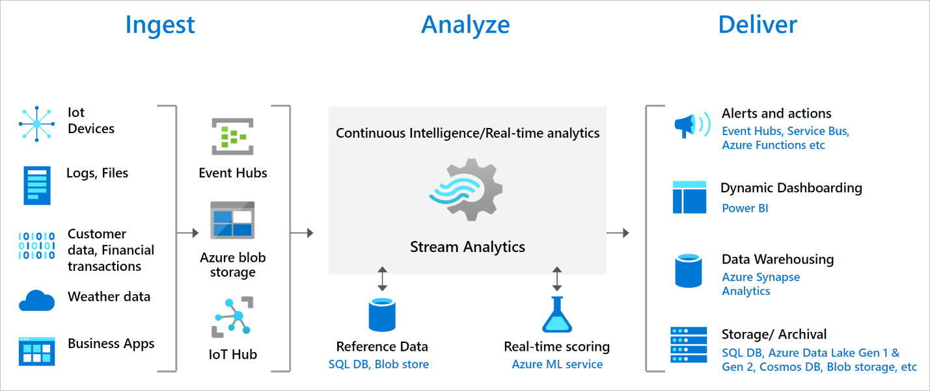
Azure Stream Analytics
Azure Stream Analytics is a real-time analytics and complex event-processing engine that is designed to analyze and process high volumes of fast streaming data from multiple sources simultaneously.
Analyze real-time telemetry streams from IoT devices
Web logs/clickstream analytics
Geospatial analytics for fleet management and driverless vehicles
Remote monitoring and predictive maintenance of high value assets
Real-time analytics on point-of-sale data for inventory control and anomaly detection
Notes:
Data stream- Data streams are continuous data generated by applications, IoT devices or sensors. These data streams are analyzed, and actionable insights are extracted from it. For example, monitoring data stream from industrial and manufacturing equipment, Monitoring data of water pipelines by utility providers. Data streams help understand change over time.
Event processing - Event processing refers to consumption and analysis of a continuous data stream to extract actionable insights from the events happening within that stream. For example, a car passing through a tollbooth should include temporal information, such as a timestamp, indicating when it occurred.
An Azure Stream Analytics job consists of an input, query, and an output. You can do the following with the job output:
Route data to storage systems like Azure Blob storage, Azure SQL Database, Azure Data Lake Store, and Azure CosmosDB.
You can send data to Power BI for real-time visualization.
You can store data in Data Warehouse service like Azure Synapse Analytics to train a machine learning model based on historical data or perform batch analytics.
You can trigger custom downstream workflows by sending the data to services like Azure Functions, Service Bus Topics or Queues.

Slide 19

Design a strategy for hot/warm/cold data path
Notes:
Different order from the Learn content: Azure Stream Analytics is ahead of hot/warm/cold data path.

Slide 20
When to use Hot/Warm/Cold data path
Path | Requirement
Hot data path | When data requirements are known to change frequently When processing or displaying data in real time
Warm data path | When you need to store or display a recent subset of data Used for data that is consumed for small analytical and batch processing
Cold data path | When data is rarely used. The data might be stored for compliance or legal reasons Used for data that is consumed for long term analytics and batch processing
Notes:
Can also be considered lambda
Hot path is typically used for processing or displaying data in real-time. It is employed for real time alerting and streaming operations are performed using this data.
The warm data path is about analyzing as the data flows through the system. We process this stream in near-real time, save it to the warm storage, and push it to the analytics clients.
The cold path includes the batch layer and the serving layers. The combination provides a long-term view of the system.

Slide 21
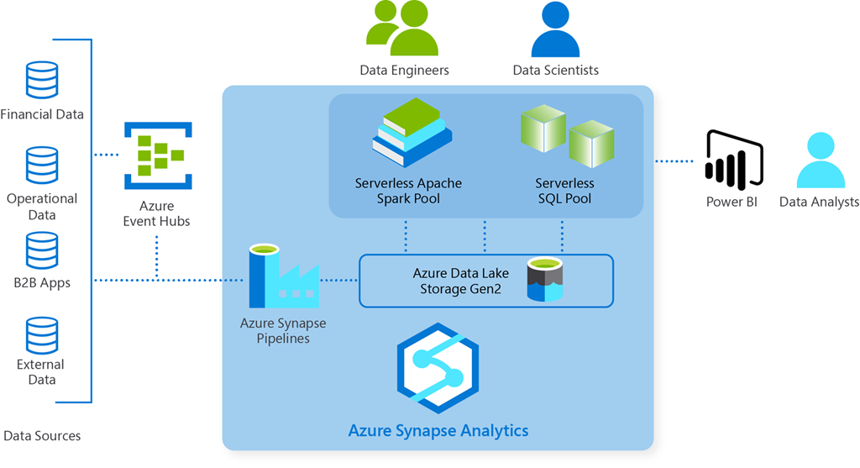
Use Case: Just-in-time inventory
Notes:
Review this article: https://azure.microsoft.com/blog/4-common-analytics-scenarios-to-build-business-agility/
Aggreko is a global leader in the supply of temporary power generation, temperature control systems, and energy services, providing backup energy and power supply whenever and wherever their customers need it. Aggreko uses Azure Synapse to increase operational efficiency with the just-in-time supply of their specialist equipment.
Aggreko’s data ingestion pipeline was set up to run every eight hours because it took four hours to run the ingestion (batch) jobs. Moreover, the data warehouse had to be rebuilt every day due to storage limitations. This meant that there was a lag of 8-24 hours between when the data arrived and when it was available for data analytics pipelines:
By adopting Azure Synapse, Aggreko was able to significantly improve its time-to-insight by reducing ingestion complexities and improving speed. Ingestion time was reduced from four hours to less than five minutes. This in turn meant that for Aggreko, data is now available for analytics pipelines in near real-time (less than five minutes’ lag). The team also estimated that they have saved 30-40 percent of their time—this time was spent solving technology problems in their legacy systems. By adopting Azure Synapse, data is now available for instant exploration, which means that the Aggreko team has more time to focus on solving business problems.
"Azure Synapse gives us a single environment to explore and query the data without moving it. So at a spectrum of the volume of data, we can achieve exponentially faster insights, by querying directly over the lake before outputting insight to Power BI." —Elizabeth Hollinger, Director of Data Insights at Aggreko
As mentioned before, this use case is based on a real-world scenario where Aggreko adopted Azure Synapse as their analytics platform. To learn more about this customer story, you can watch this interview with Aggreko’s Director of Data Insights.
2 other examples: 4 common analytics scenarios to build business agility | Azure Blog and Updates | Microsoft Azure

Slide 22
Review

Slide 23
Summary and resources
Check your knowledge
Microsoft Learn Modules (docs.microsoft.com/Learn)
Explore concepts of data analytics - Learn | Microsoft Docs
Explore Azure database and analytics services - Learn | Microsoft Docs
Data integration at scale Azure Data Factory - Learn | Microsoft Docs
Notes:
Learn more with self-paced training
Data integration at scale Azure Data Factory - Learn | Microsoft Docs - https://docs.microsoft.com/learn/paths/data-integration-scale-azure-data-factory/
Explore Azure database and analytics services - Learn | Microsoft Docs -https://docs.microsoft.com/learn/modules/azure-database-fundamentals/
Explore concepts of data analytics - Learn | Microsoft Docs - https://docs.microsoft.com/learn/modules/explore-concepts-of-data-analytics/)

Slide 24

End of presentation

Slide 25
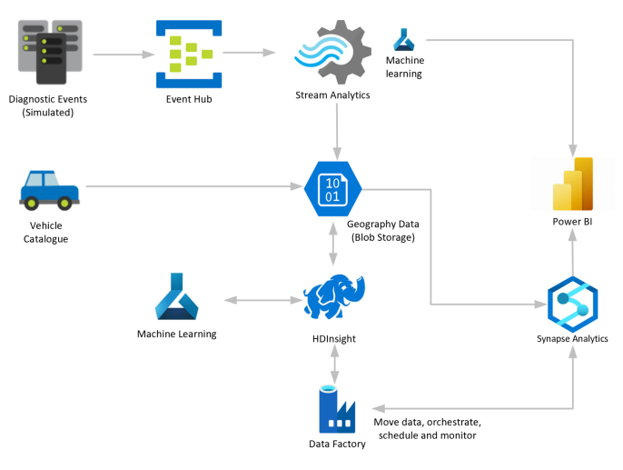
Optional - Whiteboard discussion #1
Predictive insights with vehicle telematics
Notes:
Focus on how car dealerships, manufacturers, and insurance companies can use Microsoft Azure to gain predictive insights on vehicle health and driving habits using Azure managed services like Event Hub, Stream Analytics and Synapse Analytics. See the reference architecture here: https://docs.microsoft.com/azure/architecture/solution-ideas/articles/predictive-insights-with-vehicle-telematics

