Slide 1
AZ-305T00A Designing Microsoft Azure Infrastructure Solutions

Slide 2

Design Authentication and Authorization Solutions

Slide 3
Introduction
Design for identity and access management
Design for Azure Active Directory
Design for Azure Active Directory B2B
Design for Azure Active Directory B2C
Design for conditional access
Design for identity protection
Design for access reviews
Design service principals for applications
Design for Azure key vault
Case study
Summary and resources
AZ-305: Design Identity, Governance, and Monitoring Solutions (25-30%)
Design Authentication and Authorization Solutions
Recommend a solution for securing resources with role-based access controls
Recommend an identity management solution
Recommend a solution for securing identities
Design Identities and Access for Applications:
Recommend a solution that securely stores passwords and secrets
Recommend solutions to allow applications to access Azure resources
Recommend a solution for integrating applications into Azure AD
Recommend a user consent solution for applications
Notes:
Exam page - https://docs.microsoft.com/learn/certifications/exams/az-305
Prerequisites
- Working experience creating, assigning, and securing corporate identities.
- Conceptual knowledge of identity assignment solutions, role-based access control, and identity protection methods.
earn/certifications/exams/az-305

Slide 4

Design for identity and access management

Slide 5
Follow the Zero Trust model guidelines
Never trust, always verify.
Allow/block access
Employee and partner user and roles
Trusted and compliant devices
Physical and virtual location
Client apps and authentication method
Limited access
Conditions
Require
MFA
Force password reset
Block legacy authentication
Notes:
Use this slide to introduction authentication and authorization. Zero Trust Model - https://www.microsoft.com/security/business/zero-trust
Gone are the days when security was focused on a strong perimeter defense to keep attackers out. Outside your perimeter was treated as hostile, inside the wall an organizations systems were trusted. Today's security posture is to “assume breach” and or “zero trust model”. The perimeter defense is no longer the focus of security professionals. Modern organizations must support access to data and services as evenly as from inside the corporate firewall and outside it.
The Zero Trust Model (ZTM) was introduced by analyst firm Forrester Research. ZTM states to never assume trust but instead to continually validate trust. When users, devices, and data all resided inside the organizations firewall, they were assumed to be trusted. This assumed trust allows for easy lateral movement once an endpoint device was compromised by a bad actor. The Zero Trust Model relies on verifiable user and device trust claims to grant access to organization resources. No longer is trust assumed based on the location inside an organization's perimeter. With most users now accessing apps and data from the internet, most transaction components are no longer under organizational control.
Zero Trust Architecture includes applying Zero Trust conditions and controls.
Employee and partner user and roles (Azure AD, ADFS, MSA, Google ID)
Trusted and compliant devices (Android, iOS, MacOS, Windows, Microsoft Defender ATP)
Physical and virtual location (Geo-location, corporate network)
Client apps and authentication method (Browser apps, client apps)

Slide 6


What is identity and access management
Allowed by role-based access control
Verified by conditional access
Monitored by Azure AD Identity Protection
Confirmed by Azure AD access reviews
Unified identity management
Seamless user experience
If you need this | Use this
Provide identity and access management for employees in a cloud or hybrid environment. | Azure Active Directory (Azure AD)
Collaborate with guest users and external business partners like suppliers and vendors. | Azure AD Business to Business (B2B)
Control how customers sign up, sign in, and manage their profiles when they use your applications. | Azure AD Business to Consumer (B2C)
Notes:
Azure identity management security overview - https://docs.microsoft.com/azure/security/fundamentals/identity-management-overview
In this lesson we are covering “identity” things: Azure AD, B2B, and B2C. And we are covering “access” things: RBAC, conditional access, identity protection, and access reviews.

Slide 7

Design for Azure Active Directory

Slide 8


When to use Azure Active Directory
Azure AD is the Azure solution for identity and access management. Azure AD is a multitenant, cloud-based directory, and identity management service.
Centralize identity management
Establish a single Azure AD instance
Use Azure AD Connect, or AD Connect cloud sync for hybrid identity sync
On-premises Identities
Azure Identities
Azure AD
Connect
Active Directory Domain Services
Azure Active Directory
Internal users
On-premises users
Guest users (B2B)
Notes:
What is Azure Active Directory - https://docs.microsoft.com/azure/active-directory/fundamentals/active-directory-whatis
Discussion – Is anyone responsible for on-premises users?
Establish a single enterprise directory for managing identities of full-time employees and enterprise resources
A single authoritative source for identities increases clarity and consistency for all roles in IT and Security.
Using a single authoritative source allows teams to make changes in one place that effect everywhere.
Designate a single Azure Active Directory (Azure AD) instance directory as the authoritative source for corporate and organizational accounts.
Don’t synchronize accounts to Azure AD that have high privileges in your existing Active Directory instance.
Use modern password protection offerings.

Slide 9
Design for Azure AD Business to Business

Slide 10
When to use Azure AD Business to Business (B2B)
Azure AD B2B enables you to securely collaborate with external partners.
Integrate with identity providers
Use conditional access policies to intelligently grant or deny access
Require MFA for guest users
On-premises Identities
Azure Identities
External Identities
Azure AD
Connect
Invites
Active Directory Domain Services
Azure Active Directory
Internal users
On-premises users
Guest users (B2B)
Business to Business (B2B)
Notes:
Azure Active Directory B2B best practices - https://docs.microsoft.com/azure/active-directory/external-identities/b2b-fundamentals
Azure Active Directory B2B collaboration demonstration - https://azure.microsoft.com/resources/videos/azure-active-directory-b2b-collaboration-demo
Discussion – Does anyone have a usage scenario for Azure B2B?
The following steps show how Azure AD B2B lets you collaborate with external partner users. The numbers in the diagram are explained after the diagram.
You invite external users as guest users to your directory. For example, you fill in a form with your guest user's details and a custom invitation message.
Guest user receives an invitation via email. The first time the link is used, the user is asked for consent. The user must accept the permissions needed by Azure AD B2B before they can gain access.
If you've enabled multifactor authentication (MFA), the user provides these extra details for their account. When MFA is configured, the user must enter a verification code sent to their mobile device before they're granted access.
Your guest user is then forwarded to the access panel page. This page presents all the applications and services you've shared with them. These applications and services can be cloud-based, or on-premises.
Designate an application owner to manage guest users. It’s a good idea to delegate guest user access to application owners. Application owners are in the best position to decide who should be given access to a particular application.
Use conditional access policies to intelligently grant or deny access. Conditional access policies use factors that aren't credential-based. For example, you can make it mandatory for users to be on specific device platforms, such as Android or Windows. Another example, you can block users if they don't meet the required location criteria.
Enable MFA You can use conditional access policies to require a MFA process, before they can access applications. This action ensures that everyone who uses the application must pass an additional authentication challenge before accessing it.

Slide 11

Design for Azure AD Business to Customer

Slide 12


When to use Azure AD Business to Customer (B2C)
Azure AD B2C is a type of Azure AD tenant that you use to manage customer identities and their access to your applications.
Integrate with external user stores
Provide single sign-on access with a user-provided identity
Create a custom-branded identity solution
Use policies to configure user journeys
Use progressive profiling to gradual collect user information
Pass user data to a 3rd party for validation
On-premises Identities
Azure Identities
External Identities
Azure AD
Connect
Invites
Azure Active Directory
Internal users
On-premises users
Guest users (B2B)
Business to Business (B2B)
Active Directory Domain Services
Social IDs, email, or local accounts
Business & Government IDs
App
registration
User
flow
Azure Active Directory B2C tenant
Notes:
What is Azure Active Directory B2C? - https://docs.microsoft.com/azure/active-directory-b2c/overview
Social IDs, email, or local accounts = Twitter, Facebook, Google, Microsoft ..
Discussion – Does anyone have a usage scenario for Azure B2C?
Discussion – Different licensing is required for certain features.
Use Azure AD B2C to:
Securely authenticate your customers using their preferred identity providers
Capture sign in, preference, and conversion data for customers.
Store custom attributes about customers to be leveraged by your applications
Provide branded registration and sign in experiences.
Provide separation of your organizational accounts your customer accounts

Slide 13

Compare solutions (activity)
Customers cannot be viewed by other users
Users are managed in a separate Azure AD directory
Users need to be able to self-signup for accounts
Users manage their own profiles
Users can come from SAML and WS-Fed based identity providers
Business to Business
OR
Business to Consumer
Notes:
Use this as a discussion and review. For each item determine if it is B2B or B2C or Both. Suggested answers:
Customers are invisible to other users (B2C)
Users are managed in a separate Azure AD directory (Both)
Users are managed as guest users (B2B)
Users manage their own profiles (B2C)
Users can come from SAML and WS-Fed based identity providers (Both)

Slide 14

Design for conditional access

Slide 15
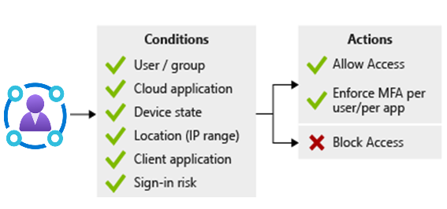
When to use conditional access
Conditional Access is an Azure AD tool that allows (or denies) access to resources.
Use to enable multifactor authentication
Require managed devices
Access only approved client applications
Exclude countries from which you never expect a sign in
Respond to potentially compromised accounts.
Completely block access
Block legacy authentication protocols.
Test using the report-only mode
Notes:
Conditional Access - https://docs.microsoft.com/azure/active-directory/conditional-access/overview

Slide 16

Design for identity protection

Slide 17
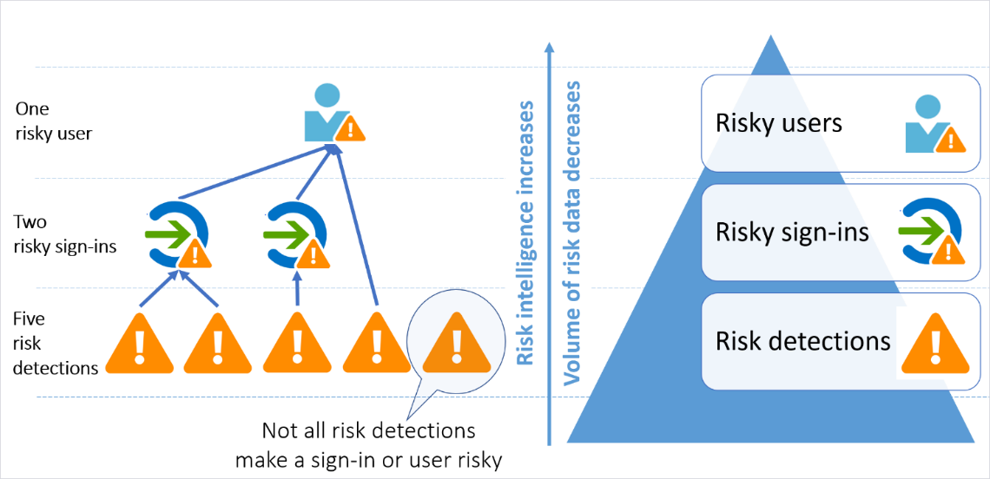
When to use identity protection
Identity protection is an Azure AD tool that automates the detection and remediation of identity-based risks.
Configure the policies and actively review the results
Set the sign-in risk policy to Medium and above and allow self-remediation options
Set the user risk policy threshold to High
Allow for excluding users - emergency access or break-glass administrator accounts
Send data to Conditional Access or other security information and event management (SIEM) tool
Notes:
What is identity protection? https://docs.microsoft.com/azure/active-directory/identity-protection/overview-identity-protection
Additional licensing may be required.
User risk policies
A user risk represents the probability that a given identity or account is compromised. For example, the user's valid credentials have been leaked. These risks are calculated offline using Microsoft's internal and external threat intelligence sources. Here are some user risks that can be identified.
Leaked credentials. Microsoft checks for leaked credentials from the dark web, paste sites, or other sources. These leaked credentials are checked against Azure AD users' current valid credentials for valid matches.
Azure AD threat intelligence. This risk detection type indicates user activity that is unusual for the given user or is consistent with known attack patterns.
Sign- in risk policies
A sign- in risk represents the probability that a given sign- in (authentication request) isn't authorized by the identity owner. Sign-in risk can be calculated in real-time or calculated offline. Here are some sign-in risks that can be identified.
Anonymous IP address. This risk detection type indicates sign-ins from an anonymous IP address. For example, a Tor browser or anonymized VPNs.
Atypical travel. This risk detection type identifies two sign-ins originating from geographically distant location. Given past behavior, at least one of the locations may also be atypical for the user.
Malware linked IP address. This risk detection type indicates sign-ins from IP addresses infected with malware. This malware is known to actively communicate with a bot server.
Password spray. This risk detection is triggered when a password spray attack has been performed. Password spray is one of the most popular attacks. Bad actors try to defeat lockout and detection by trying many users against one password.

Slide 18

Design for access reviews

Slide 19
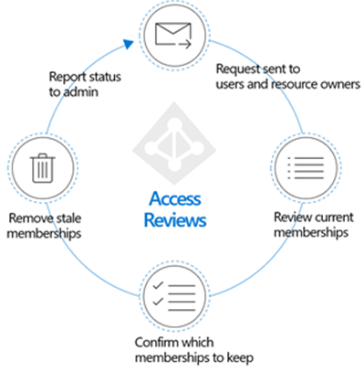
When to use access reviews
Access reviews are an Azure AD tool to review user access and ensure they should have continued access to resources.
Determine the purpose of the access review
Engage the right stakeholders
Create an access review plan
Determine who will conduct the reviews
Decide who can self-attest access
Determine what resource types will be reviewed
Start small – pilot your plan – keep people informed
Notes:
What are Azure AD access reviews? - https://docs.microsoft.com/azure/active-directory/governance/access-reviews-overview
Additional licensing may be required.

Slide 20

Design service principals for applications

Slide 21
Design managed identities
Managed identities provide an identity for application authentication.
Source
Target
Azure VMs
Azure App Service
Azure Functions
Azure Container Instances
Azure Kubernetes Service
Azure Logic Apps
…
Any target that supports Azure AD authentication
Your applications
Azure services (Azure Key Vault, Azure Storage, Azure SQL, … )
I want to build an application using
that accesses
The source is an Azure resource
The target supports Azure AD authentication and Azure RBAC
No credential rotation or certificate management
Notes:
Managed identities - https://docs.microsoft.com/azure/active-directory/managed-identities-azure-resources/overview
Resources that support system assigned managed identities allow you to:
Enable or disable managed identities at the resource level.
Use RBAC roles to grant permissions.
View create, read, update, delete (CRUD) operations in Azure Activity logs.
View sign-in activity in Azure AD sign-in logs.

Slide 22
Select managed identities
Property | System-assigned managed identity | User-assigned managed identity
Creation | Created as part of an Azure resource | Created as a stand-alone Azure resource
Life cycle | Shared life cycle with the Azure resource | Independent life cycle Must be explicitly deleted
Sharing across Azure resources | Cannot be shared Can only be associated with a single Azure resource | Can be shared Can be associated with more than one Azure resource
Common use cases | Workloads that are contained within a single Azure resource Workloads for which you need independent identities. For example, an application that runs on a single virtual machine | Workloads that run on multiple resources and which can share a single identity Workloads that need pre-authorization to a secure resource as part of a provisioning flow. Workloads where resources are recycled frequently, but permissions should stay consistent.
Notes:
Infrastructure protection – https://docs.microsoft.com/learn/modules/azure-well-architected-security/4-infrastructure-protection
Managed identities overview - https://docs.microsoft.com/azure/active-directory/managed-identities-azure-resources/overview
System-assigned example – an application that runs on a virtual machine.
User-assigned example - a workload where multiple virtual machines need to access the same resource

Slide 23
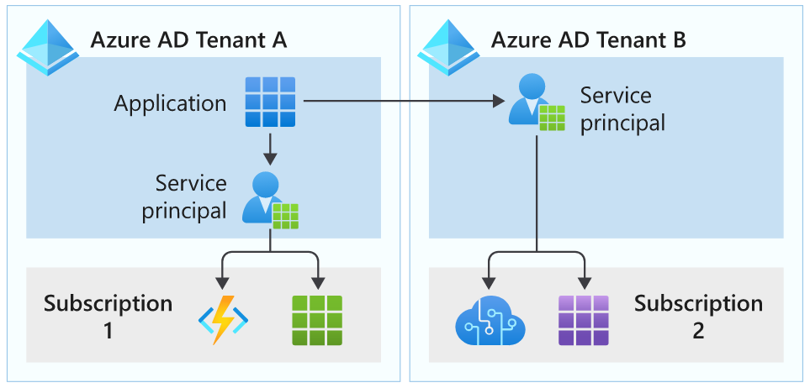
Select application service principals
This type of service principal is the local representation, or application instance, of a global application object in a single tenant or directory
Useful when Managed Identities cannot be used
Authentication is performed by the application using a secret or certificate
Often used to authenticate external applications to Azure resources
Notes:
Authenticate apps with managed identities - https://docs.microsoft.com/learn/modules/authenticate-apps-with-managed-identities/2-service-principals
Application and service principal objects in Azure Active Directory - https://docs.microsoft.com/azure/active-directory/develop/app-objects-and-service-principals

Slide 24

Best practices for requesting permissions
When building an app that uses Azure AD to provide sign-in and access tokens for secured endpoints, there are a few good practices you should follow.
When registering an application in AAD, consider business and security needs of admin consent versus user consent
Only ask for the permissions required for implemented app functionality. Don't request user consent for permissions that you haven't yet implemented for your application.
In addition, when requesting permissions for app functionality, you should request the least-privileged access.
Apps should gracefully handle scenarios where the user doesn't grant consent to the app when permissions are requested.
Notes:
Microsoft recommends restricting user consent to allow users to consent only for app from verified publishers, and only for permissions you select. For apps which do not meet this policy, the decision-making process will be centralized with your organization's security and identity administrator team.

Slide 25

Design for Azure key vault

Slide 26

Design for Azure Key Vault
Azure Key Vault provides a secure storage area for managing all your app secrets so you can properly encrypt your data in transit or while it's being stored.
Why use Key Vault?
Separation of sensitive app information from other configuration and code, reducing the risk of accidental leaks.
Restricted secret access with access policies tailored to the apps and individuals that need them.
Centralized secret storage, allowing required changes to happen in only one place.
Access logging and monitoring to help you understand how and when secrets are accessed.
Implementing Customer Managed Keys for Azure services
When to consider multiple Key Vaults:
RBAC vs Policies
Performance
Notes:
Azure Key Vault basic concepts - https://docs.microsoft.com/azure/key-vault/general/basic-concepts
Azure Key Vault helps with:
Secrets Management - Securely store and tightly control access to tokens, passwords, certificates, API keys, and other secrets.
Key Management - Can also be used as a Key Management solution.
Certificate Management - lets you easily enroll, manage, and deploy public and private Transport Layer Security/Secure Sockets Layer (TLS/SSL) certificates for use with Azure and your internal connected resources.

Slide 27
Review

Slide 28





Case Study – Authentication and authorization
A company acquisition will add 75 employees – new user accounts
New employees are in different geographic regions – new identity protection policies
New application with a SQL database – access solution

Slide 29




Instructor – New Employee Accounts
ADDS
Azure AD
Connect
Conditional Access
Identity Protection
B2B
MFA
Azure AD
Notes:
Drag and drop the icons on the right side onto the diagram to create the solution. The next slide has the completed diagram.

Slide 30
Instructor – New Employee Accounts (completed)

Slide 31
Instructor – New Identity Solution Features

Slide 32
Summary and resources
Check your knowledge
Microsoft Learn Modules (docs.microsoft.com/Learn)
Plan, implement, and administer conditional access
Plan, implement, and manage access reviews
Create custom roles for Azure resources with role-based access control
Enable secure external collaboration for your applications with Azure AD B2B
Enable secure external access to apps for external users with Azure AD B2C
Configure and manage secrets in Azure key vault
Manage secrets in your server apps with Azure key vault
Authenticate apps to Azure services by using service principals and managed identities for Azure resources
Optional hands-on lab - Exercise - Add and delete users in Azure Active Directory - Learn | Microsoft Docs
Notes:
Learn more with self-paced training
Plan, implement, and administer conditional access - Learn | Microsoft Docs - https://docs.microsoft.com/learn/modules/plan-implement-administer-conditional-access/
Plan, implement, and manage access review - Learn | Microsoft Docs - https://docs.microsoft.com/learn/modules/plan-implement-manage-access-review/
Create custom roles for Azure resources with Azure role-based access control (Azure RBAC) - Learn | Microsoft Docs - https://docs.microsoft.com/learn/modules/create-custom-azure-roles-with-rbac/
Enable secure external collaboration for your applications with Azure AD B2B - Learn | Microsoft Docs - https://docs.microsoft.com/learn/modules/enable-external-collaboration-with-b2b/
Enable secure access to apps for external users with Azure AD B2C - Learn | Microsoft Docs - https://docs.microsoft.com/learn/modules/enable-external-access-with-b2c/
Configure and manage secrets in Azure Key Vault - https://docs.microsoft.com/learn/modules/configure-and-manage-azure-key-vault/
Manage secrets in your server apps with Azure Key Vault - https://docs.microsoft.com/learn/modules/manage-secrets-with-azure-key-vault/
Authenticate apps to Azure services by using service principals and managed identities for Azure resources - https://docs.microsoft.com/learn/modules/authenticate-apps-with-managed-identities/

Slide 33

End of presentation

