Slide 1
AZ-305T00A Microsoft Azure Infrastructure Architect

Slide 2
Design a business continuity solution

Slide 3
Introduction
AZ-305: Design Business Continuity Solutions (10-15%)
Design a Solution for Backup and Disaster Recovery
Recommend a recovery solution for Azure, hybrid, and on-premises workloads that meets recovery objectives (RTO, RLO, RPO)
Understand the recovery solutions for containers
Recommend a backup and recovery solution for compute
Recommend a backup and recovery solution for databases
Recommend a backup and recovery solution for unstructured data
Design for backup and recovery
Design for Azure Backup
Design for Azure blob backup and recovery
Design for Azure Files backup and recovery
Design for Azure virtual machine backup and recovery
Design for Azure SQL backup and recovery
Design for Azure Site Recovery
Summary and resources
Notes:
Exam page - https://docs.microsoft.com/learn/certifications/exams/az-305
Prerequisites
Conceptual knowledge of Business Continuity and Disaster Recovery solutions.
Working experience with object replication, backup solution tools, and recovery options.

Slide 4
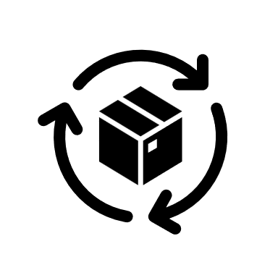
Design for backup and recovery

Slide 5
Plan for backup and recovery
Identify your business needs and create a plan to address those needs
What are your workloads and their usage?
What are the usage patterns for your workloads?
What are the availability metrics
MTTR - Mean time to recovery
MTBF - Mean time between failures
What are the recovery metrics (RTO and RPO)?
What are the workload availability targets?
What are your SLAs?
Notes:
Enterprise-scale business continuity and disaster recovery - https://docs.microsoft.com/azure/cloud-adoption-framework/ready/enterprise-scale/business-continuity-and-disaster-recovery
Backup and disaster recovery for Azure applications - https://docs.microsoft.com/azure/architecture/framework/resiliency/backup-and-recovery
MTBF is how long a component can reasonably expect to last between outages. MTTR is the average time it takes to restore a component after a failure. Use these metrics to determine where you need to add redundancy, and to determine service-level agreements (SLAs) for customers.
The recovery time objective (RTO) is the maximum acceptable time one of your apps can be unavailable following an incident. The recovery point objective (RPO) is the maximum duration of data loss that is acceptable during a disaster. Also consider the recovery level objective (RLO). This metric determines the granularity of recovery. In other words, whether you must be able to recover a server farm, a web app, a site, or just a specific item. To determine these values, conduct a risk assessment. Ensure that you understand the cost and risk of downtime or data loss in your organization.
Which regions do you need to deploy to? Are they Paired Regions?
Will the DR solution need to meet the same production requirements (ex. same/reduced traffic, lower performance)
How do users access the service now, via IP, URL etc..
Do you have an existing DR or Incident Recovery Plan?
How do you perform DR testing?

Slide 6

Design for Azure Backup

Slide 7



When to use Azure Backup
Azure Backup is a full-service backup and recovery solution.
Unlimited scaling with high availability and unlimited data transfer
Automatic replication of locally redundant storage and geo-redundant storage using a pay-as-you-use model
Application-consistent backups with secure transmission and storage of your data in Azure
No limits on the length of time you can keep the backup data
Azure Backup Service
Recovery point management
Resiliency & availability
Storage management
Data tiering
Multi-user authentication
Policy management
Monitoring & reporting
On-premises backup agents
Multi-factor authentication
Access control
Built-in
backup
Central management
Notes:
Focus on business requirements and not the technology, which will be discussed later.
Azure Backup - https://docs.microsoft.com/azure/backup/backup-overview
Recovery Services vaults overview - https://docs.microsoft.com/azure/backup/backup-azure-recovery-services-vault-overview
Vault considerations - https://docs.microsoft.com/azure/backup/guidance-best-practices#vault-considerations
Backup policy considerations - https://docs.microsoft.com/azure/backup/guidance-best-practices#backup-policy-considerations
What is Azure Backup? - https://docs.microsoft.com/learn/modules/intro-to-azure-backup/2-what-is-azure-backup

Slide 8

Design for blob backup and recovery

Slide 9
Considerations for soft delete
Consider soft delete with recovery times from 1 to 365 days
Container soft delete
Blob soft delete
Blob versioning
Version 1
Blob 1
Version 2
Container
Version 1
Blob 2
Version 2
Maintains the deleted data in the system for a specified retention period
Soft delete protects blobs, snapshot, containers, or versions from accidental deletes or overwrites
Notes:
Container soft delete - https://docs.microsoft.com/azure/storage/blobs/soft-delete-container-enable
Blob soft delete - https://docs.microsoft.com/azure/storage/blobs/soft-delete-blob-enable
Blob versioning - https://docs.microsoft.com/azure/storage/blobs/versioning-enable
Blob versioning, to automatically maintain previous versions of a blob.

Slide 10
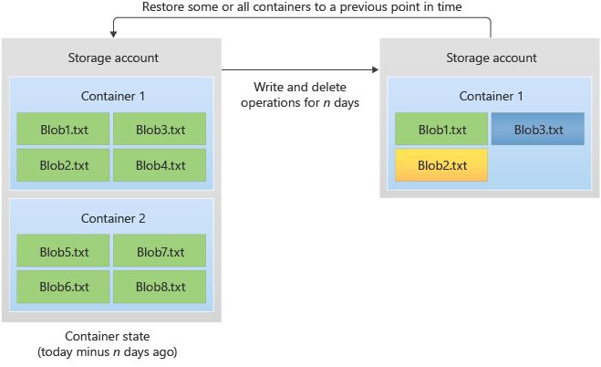
Considerations for point-in-time restore
Consider point-in-time restore for block blobs
Useful in scenarios where a user or application accidentally deletes data or where an application error corrupts data
Use policy to specify the retention period
Notes:
Point-in-time restore for block blobs - https://docs.microsoft.com/azure/storage/blobs/point-in-time-restore-overview
Discussion: How are soft delete and point-in-time restore different?
Don’t forget resource locks.

Slide 11

Design for Azure Files backup and recovery

Slide 12
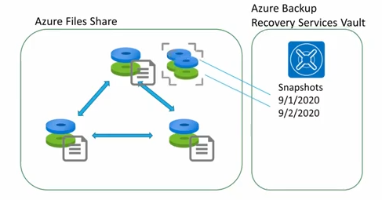
Considerations for Azure Files backup and recovery
Consider snapshots for both blobs and Azure Files
Organize file shares with backup in mind
Snapshots can be on-demand or scheduled using Azure Backup and backup policies.
Snapshots are at the file share root – retrieval is at the file
Use snapshots to cover the time between daily backups
Use instant restore – consider self service restore
Snapshots are incremental - snapshot before code deployments.
Notes:
Overview of share snapshots for Azure Files - https://docs.microsoft.com/azure/storage/files/storage-snapshots-files

Slide 13

Design for virtual machine backup and recovery

Slide 14
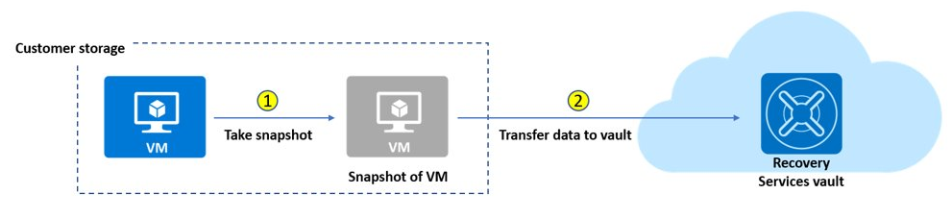
Considerations for Azure virtual machines
Guard against unintended destruction of the data on your VMs.
Consider grouping VMs within a single backup policy
Implement both short-term (daily) and long-term (weekly) backups
Determine your needs for app, crash, and file snapshot consistency
Consider Cross Region Restore for VMs in the paired region
Periodically review your policies – monitor and alert
Notes:
Azure virtual machines backups - https://docs.microsoft.com/azure/backup/backup-azure-vms-introduction
Monitoring and Alerting considerations - https://docs.microsoft.com/azure/backup/guidance-best-practices#monitoring-and-alerting-considerations

Slide 15
Tiers
Snapshot tier: In phase 1, snapshots are stored locally for a maximum period of five days. This is referred to as the snapshot tier. Snapshot tier restores are faster (than restore from vault) because they eliminate the wait time for snapshots to copy to the vault before triggering the restore. This capability is called Instant Restore.
Vault tier: In phase 2, snapshots are transferred to the vault for additional security and longer retention. This is referred to as vault tier.

Slide 16
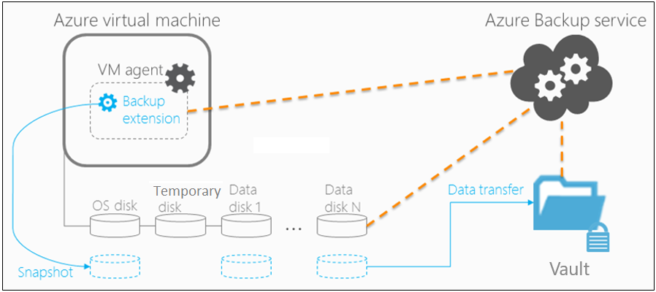
Considerations for on-premises virtual machines
Backup on-premises machines to Azure.
Back up at the machine level with system-state or bare-metal backup
Back up specific volumes, shares, folders, and files
Back up specific apps using optimized app-aware settings
Notes:
Support matrix for backup with Microsoft Azure Backup Server or System Center DPM - https://docs.microsoft.com/azure/backup/backup-support-matrix-mabs-dpm
Backup cloud and on-premises workloads to cloud - https://docs.microsoft.com/azure/backup/guidance-best-practices
Back up an Azure virtual machine by using Azure Backup - https://docs.microsoft.com/learn/modules/protect-virtual-machines-with-azure-backup/3-back-up-azure-virtual-machine

Slide 17
Lab: Back up Windows Server to Azure
https://docs.microsoft.com/en-us/azure/backup/tutorial-backup-windows-server-to-azure
Asked in Exam
Create a Recovery Services vault
Download Recovery Services agent
Install and register the agent
Configure Backup and Retention
Perform an on-demand backup

Slide 18

Design for Azure SQL backup and recovery

Slide 19
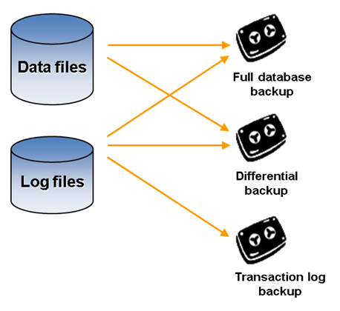
How Azure SQL backup works
SQL Database and SQL Managed Instances automatically backup.
For fully consistent backups, the following are taken:
Full backups once a week
Differential backups every 12-24 hours
Transactional log backups every 5-10 minutes
Notes:
Full backups - https://docs.microsoft.com/sql/relational-databases/backup-restore/full-database-backups-sql-server
Differential backups - https://docs.microsoft.com/sql/relational-databases/backup-restore/differential-backups-sql-server
Transaction log backups - https://docs.microsoft.com/sql/relational-databases/backup-restore/transaction-log-backups-sql-server

Slide 20
Considerations for Azure SQL backup
Restore in the retention period or use a long-term retention policy
Restore an existing database to a point in time in the past within the retention period
Restore a deleted database to the time of deletion or to any point in time within the retention period
Restore a database to another geographic region
Restore a database from a specific long-term backup of a single database or pooled database
Long term retention uses read-access geo-redundant storage (RA-GRS)
Beware Azure SQL and SQL MI. Azure SQL cannot restore deleted DB. (Must Read)
https://docs.microsoft.com/en-us/azure/azure-sql/database/recovery-using-backups?view=azuresql
Retention period
Long term retention
35 days
Up to 10 years
Notes:
Restore an existing database to a point in time in the past- https://docs.microsoft.com/azure/azure-sql/database/recovery-using-backups
Restore a deleted database to the time of deletion - https://docs.microsoft.com//azure/azure-sql/database/recovery-using-backups Restore a database to another geographic region - https://docs.microsoft.com/azure/azure-sql/database/recovery-using-backups Restore a database from a specific long-term backup - https://docs.microsoft.com/azure/azure-sql/database/long-term-retention-overview

Slide 21
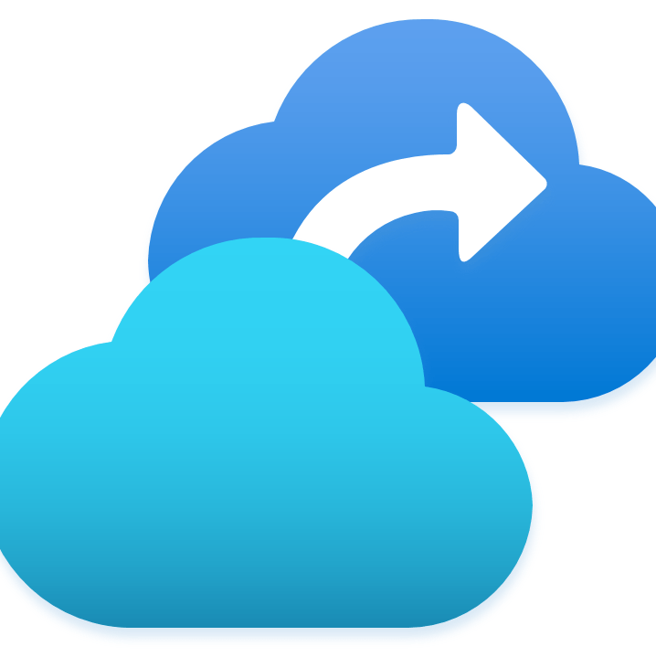
Design for Azure Site Recovery

Slide 22
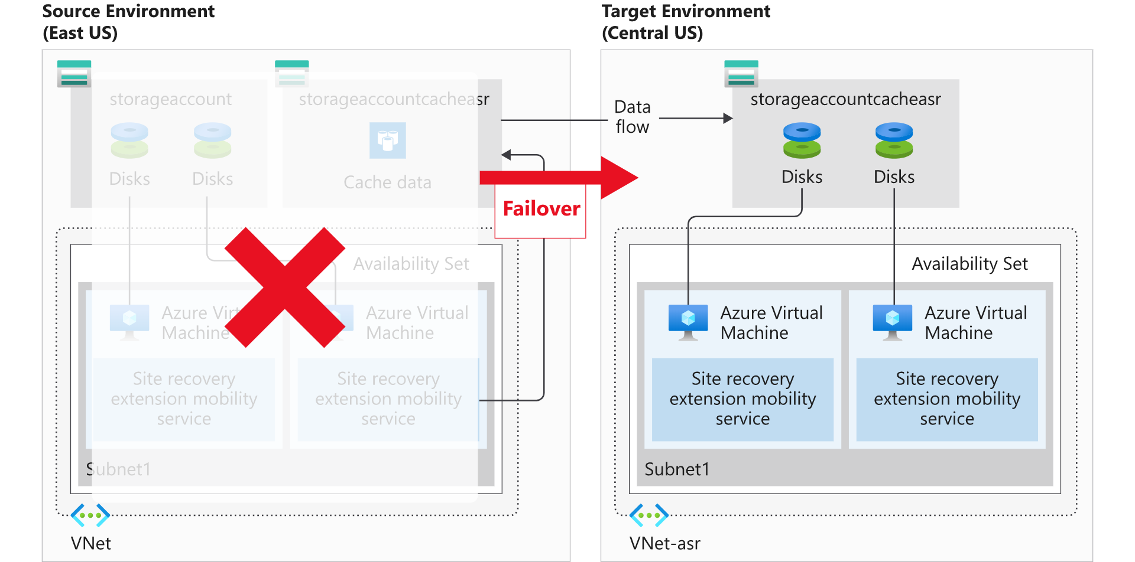
When to use Azure Site Recovery
Failover for Azure, on-premises, other cloud provider resources
Perform disaster recovery and validate the replication strategy
Migrate on-premises VMs and physical servers to Azure
Replicate virtual machines between regions
Define retention history and frequency of snapshots
Notes:
About Site Recovery - https://docs.microsoft.com/azure/site-recovery/site-recovery-overview
Azure to Azure disaster recovery architecture - https://docs.microsoft.com/azure/site-recovery/azure-to-azure-architecture
Azure Site Recovery overview - https://docs.microsoft.com/learn/modules/protect-on-premises-infrastructure-with-azure-site-recovery/2-azure-site-recovery-overview

Slide 23
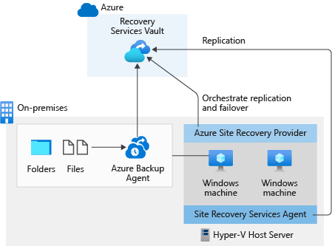
Combine Azure Site Recovery with Azure Backup
Combine ASR with Azure Backup
Requirement
Backup all the files and folders in this virtual machine to Azure.
Protect any workloads running on the virtual machine and keep running them even if the virtual machine fails.
Azure Backup
Azure Backup periodically backs up the files and folders on the Windows machine to Azure.
This process ensures they are secure and retrievable even if the whole on-premises environment stops functioning.
Notes:
Discussion: How is Azure Backup different from Azure Site Recovery? Both Backup and Site Recovery aim to make the system more resilient to faults and failures. However, while the primary goal of backup is to maintain copies of stateful data that allow you to go back in time, site-recovery replicates the data in almost real time and allows for a failover.
In that sense, if there are issues like network or power outages, you can use availability zones. For a region-wide disaster (such as natural disasters), Site Recovery is used. Backups are used in cases of accidental data loss, data corruption, or ransomware attacks.
Additionally, the choice of a recovery approach depends on the criticality of the application, Recovery Point Objective (RPO) and Recovery Time Objective (RTO) requirements, and the cost implications.
Keep in mind Azure Backup must be done to the same region as the VM and ASR will be required to be sent to a different region. This means you will need multiple vaults to support both on the same VM.

Slide 24

Review

Slide 25
Review file server backup and recovery options
Where is your file server?
On-premises
Moving to Azure Files?
Yes
Azure Virtual Machine
No
Moving to Azure?
Yes
Azure File Sync Service
No
Supported ASR configuration?
Yes
Azure Site Recovery

Slide 26

Recommend a disaster recovery method (activity)
Azure Backup
You need to back up on-premises machines and workloads
You need to back up your managed disks at any point in time
Azure Site Recovery
You have Azure VMs running production workloads
You need a read-only full copy of a managed disk
VM Snapshot
You need application-consistent backups for Linux virtual machines
You need to cover disaster scenarios like an entire regional outage
MABS
Notes:
This module does not have a case study. Use this slide to review the options.
You have Azure VMs running production workloads – Azure backup
You need application-consistent backups for Linux VM - azure backup
You need to cover disaster scenarios like an entire regional outage – Azure Site Recovery
You need a read-only full copy of a managed disk – snapshot
You need to back up your managed disks at any point in time – snapshot or azure backup
You need to back up on-premises machines and workloads – Azure Backup or MABS?

Slide 27
Summary and resources
Check your knowledge
Microsoft Learn Modules (docs.microsoft.com/Learn)
Protect your virtual machines by using Azure Backup
Disaster recovery and backup
Back up and restore your Azure SQL database
Protect your Azure infrastructure with Azure Site Recovery
Protect your on-premises infrastructure from disasters with Azure Site Recovery
Design your site recovery solution in Azure
Configure file and folder backups
Optional hands-on lab - Backup and restore your Azure SQL database - Learn | Microsoft Docs
Notes:
Learn - https://docs.microsoft.com/learn/browse/
Protect your virtual machines by using Azure Backup - https://docs.microsoft.com/learn/modules/implement-hybrid-backup-recovery-windows-server-iaas/
Disaster recovery and backup - https://docs.microsoft.com/learn/modules/cmu-disaster-recovery-backup/
Back up and restore your Azure SQL database – https://docs.microsoft.com/learn/modules/backup-restore-azure-sql/
Protect your Azure infrastructure with Azure Site Recovery - https://docs.microsoft.com/learn/modules/protect-infrastructure-with-site-recovery/
Protect your on-premises infrastructure from disasters with Azure Site Recovery - https://docs.microsoft.com/learn/modules/protect-on-premises-infrastructure-with-azure-site-recovery/
Design your site recovery solution in Azure - https://docs.microsoft.com/learn/modules/design-your-site-recovery-solution-in-azure/
Configure file and folder backups - https://docs.microsoft.com/learn/modules/configure-file-folder-backups/
Optional hands-on lab - Backup and restore your Azure SQL database - Learn | Microsoft Docs - https://docs.microsoft.com/learn/modules/backup-restore-azure-sql/3-exercise-configure-backup

Slide 28

End of presentation

Slide 29
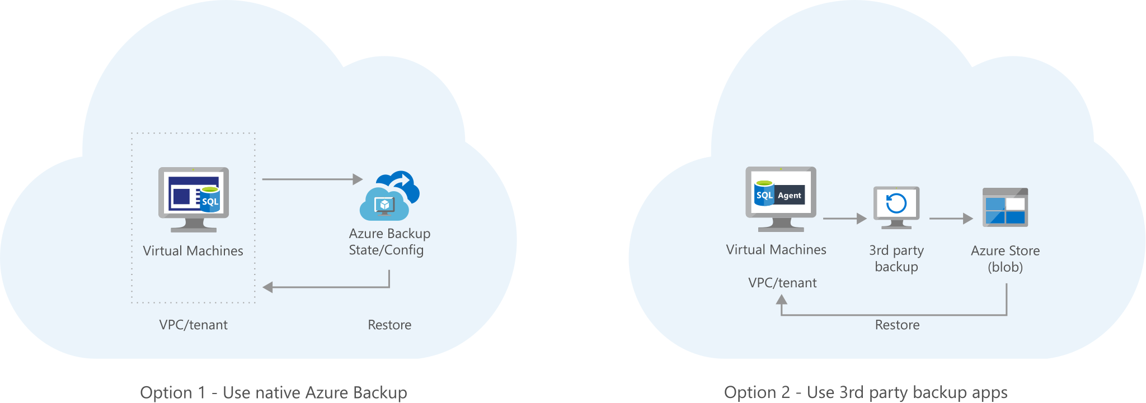
Optional – Whiteboard discussion #1
Archive your on-premises data to Azure Blob storage.
Notes:
If you didn’t use this whiteboard in the non-relational storage module, you can use it now to discuss backup options.
Archive your on-premises data to Azure Blob storage - https://docs.microsoft.com/azure/architecture/solution-ideas/articles/backup-archive-on-premises

