Slide 1
AZ-305T00A Designing Microsoft Azure Infrastructure Solutions

Slide 2
Design a network infrastructure solution

Slide 3
Introduction
AZ-305: Design Infrastructure Solutions (25-30%)
Design network solutions
Recommend a network architecture solution based on workload requirements
Recommend a connectivity solution that connects Azure resources to the Internet
Recommend a connectivity solution that connects Azure resources to on-premises networks
Optimize network performance for applications
Recommend a solution to optimize network security
Recommend a load balancing and routing solution
Recommend a network architecture solution based on workload requirements
Design for on-premises connectivity to Azure virtual networks
Design for Azure network connectivity services
Design for application delivery services
Design for application protection services
Notes:
Exam page - https://docs.microsoft.com/learn/certifications/exams/az-305
Prerequisites
- Working experience with enterprise networking.
Conceptual knowledge of software defined networking and hybrid connectivity.

Slide 4
Recommend a network architecture solution based on workload requirements

Slide 5

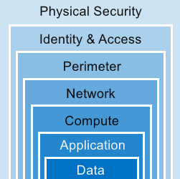
Defense in Depth (activity)
Provide a layered approach and multiple levels of protection.
Azure Information Protection
DDoS Azure Firewall
Conditional Access
Network Security Groups
Microsoft Defender for Cloud for SQL
Microsoft Defender for Cloud for Storage
Network Micro-Segmentation
Host Security
Privileged Identity Management
Application Security Groups
Container Security
Notes:
Match the items on the right with the layer on the left. This is conceptual, so kept it high level. Review previous security options and now add on the network features. Ask if there are other product capabilities or techniques not on the list. Emphasize the need to combine these capabilities.
Identity and Access – (PIM, Conditional Access)
Perimeter (DDoS Azure Firewall)
Network (NSG, ASG, Micro-segmentation)
Compute (Host security)
Application (Container security)
Data (Defender and Information Protection)
Combining services :
Azure Firewall complements the functionality of Azure Network Security Groups (NSG). Together, they provide robust “defense in depth” network security. Network Security Groups add distributed, network layer, traffic filtering to protect traffic between resources, on virtual networks, within an Azure subscription.
Azure Firewall is a fully stateful, centralized, network Firewall-as-a-Service, which provides network and application-level protection across different subscriptions and virtual networks.
WAF is a feature of Application Gateway. It provides web applications with centralized, inbound, protection against exploits and vulnerabilities. Combining WAF with Azure Firewall adds layers of protection. Azure Firewall provides
inbound protection for non-HTTP/S protocols (for example, RDP, SSH, FTP).
outbound network-level protection for all ports and protocols.
application-level protection for outbound HTTP/S.
Data - AIP Azure Information Protection

Slide 6
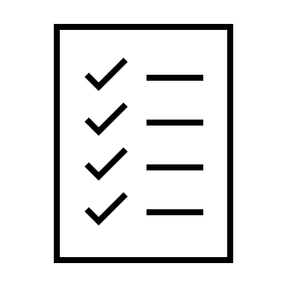
Gather Network Requirements
Plan Virtual Networks and subnets – design considerations
Naming
Regions
Subscriptions
Segmentation
Security
Connectivity
Permissions
Policy
Notes:
Plan virtual networks - https://docs.microsoft.com/azure/virtual-network/virtual-network-vnet-plan-design-arm
Remind learners that each of these may have limits that will impact decisions, such as networks not spanning regions and subscriptions. Keep the conversation broad as following slides will address many of the details.

Slide 7
Design for on-premises connectivity to Azure virtual networks

Slide 8
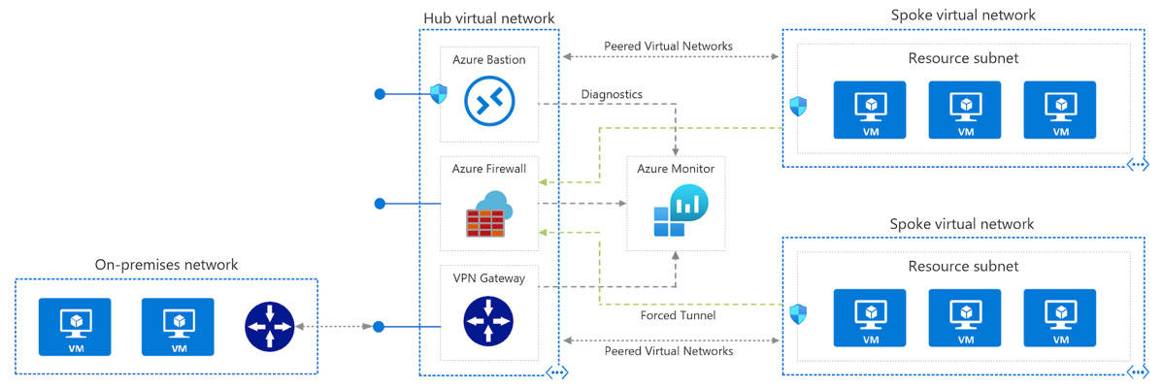
VPN connection
A VPN gateway is a type of virtual network gateway that sends encrypted traffic between an Azure virtual network and an on-premises location.
Benefits
Simple to configure
Up to 10 Gbps depending on the VPN Gateway SKU
Challenges
Requires an on-premises VPN device
The SLA only covers the VPN gateway, and not your network connection to the gateway or throughput
Notes:
There are different configurations available for VPN Gateway connections, such as, site-to-site, point-to-site, or VNet-to-VNet.
Benefits
Simple to configure.
Up to 10 Gbps depending on the VPN Gateway SKU.
Challenges
Requires an on-premises VPN device.
Although Microsoft guarantees 99.9% availability for each VPN Gateway, this SLA only covers the VPN gateway, and not your network connection to the gateway.
Reference architecture
Hybrid network with VPN gateway

Slide 9
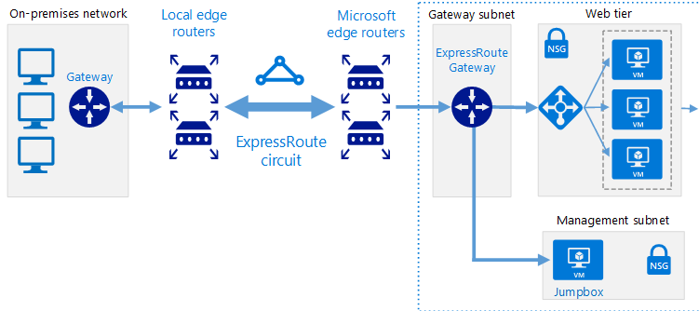
Azure ExpressRoute and ExpressRoute Direct connection
ExpressRoute connections use a private, dedicated connection through a third-party connectivity provider. This connection is private.
Benefits
Up to 100 Gbps bandwidth - supports dynamic scaling of bandwidth and direct access to national clouds
Global reach - traffic over private connection
Up to 99.95% availability SLA across the entire connection.
Challenges
Can be complex to set up
working with a third-party connectivity provider
Requires high-bandwidth routers on-premises
Notes:
What is ExpressRoute - https://docs.microsoft.com/azure/expressroute/expressroute-introduction
This architecture is suitable for hybrid applications running large-scale, mission-critical workloads that require a high degree of scalability.
Benefits
Much higher bandwidth available; up to 100 Gbps depending on the connectivity provider. (100GBps is for ExpressRoute Direct)
Supports dynamic scaling of bandwidth to help reduce costs during periods of lower demand. However, not all connectivity providers have this option.
May allow your organization direct access to national clouds, depending on the connectivity provider.
99.9% availability SLA across the entire connection.
Global reach
Traffic is over a private connection and doesn’t traverse the Internet
Challenges
Can be complex to set up. Creating an ExpressRoute connection requires working with a third-party connectivity provider. The provider is responsible for provisioning the network connection.
Requires high-bandwidth routers on-premises.
Reference architecture
Hybrid network with ExpressRoute

Slide 10
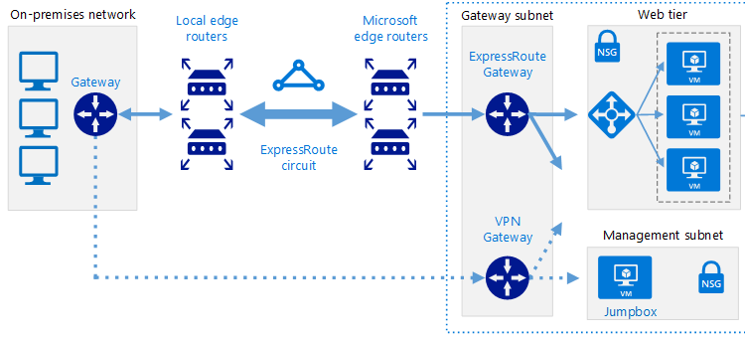
ExpressRoute with VPN failover
This options combines the previous two, using ExpressRoute in normal conditions, but failing over to a VPN connection if there is a loss of connectivity in the ExpressRoute circuit.
Benefits
High availability if the ExpressRoute circuit fails, although the fallback connection is on a lower bandwidth network.
Challenges
Complex to configure. You need to set up both a VPN connection and an ExpressRoute circuit.
Requires redundant hardware (VPN appliances), and a redundant Azure VPN Gateway connection for which you pay charges.
Notes:
This architecture is suitable for hybrid applications that need the higher bandwidth of ExpressRoute, and also require highly available network connectivity.
Benefits
High availability if the ExpressRoute circuit fails, although the fallback connection is on a lower bandwidth network.
Challenges
Complex to configure. You need to set up both a VPN connection and an ExpressRoute circuit.
Requires redundant hardware (VPN appliances), and a redundant Azure VPN Gateway connection for which you pay charges.
Reference architecture
Hybrid network with ExpressRoute and VPN failover

Slide 11
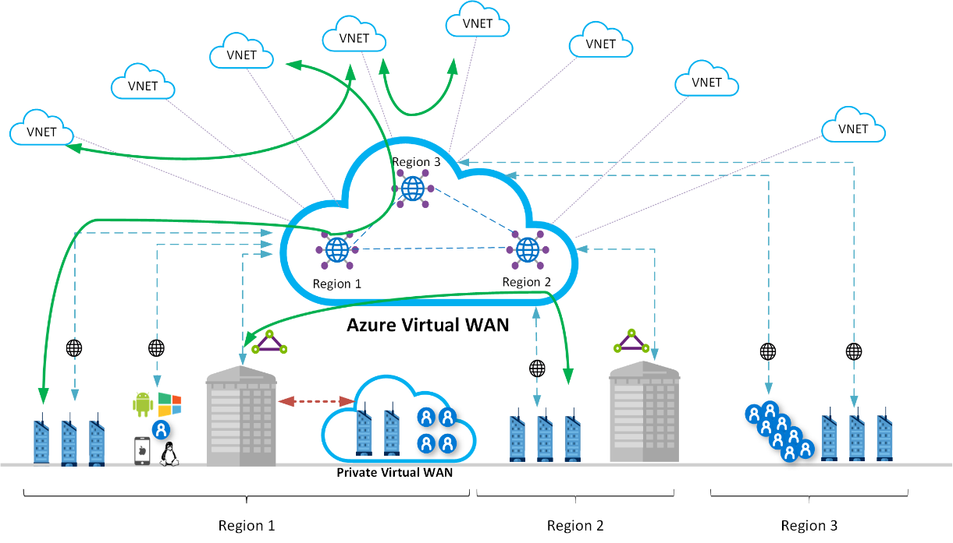
Azure Virtual WAN
Azure Virtual WAN is a networking service that brings many networking, security, and routing functionalities together to provide a single operational interface
Fully managed VWAN service.
Cost savings by using a managed service and removing the necessity of network virtual appliance.
Improved security by introducing centrally managed secured Hubs with Azure Firewall and VWAN
Separation of concerns between central IT (SecOps, InfraOps) and workloads (DevOps).
Notes:
This architecture includes the benefits of standard hub-spoke network topology and introduces new benefits:
Less operational overhead by replacing existing hubs with a fully managed VWAN service.
Cost savings by using a managed service and removing the necessity of network virtual appliance.
Improved security by introducing centrally managed secured Hubs with Azure Firewall and VWAN to minimize security risks related to misconfiguration.
Separation of concerns between central IT (SecOps, InfraOps) and workloads (DevOps).
Typical uses for this architecture include cases in which:
Connectivity among workloads requires central control and access to shared services.
An enterprise requires central control over security aspects, such as a firewall, and requires segregated management for the workloads in each spoke.
This diagram illustrates a few of the advantages that this architecture can provide:
A full meshed hubs among Azure Virtual Networks
Branch to Azure connectivity
Branch to Branch connectivity
Mixed use of VPN and Express Route
Mixed use of user VPN to the site
VNET to VNET connectivity

Slide 12
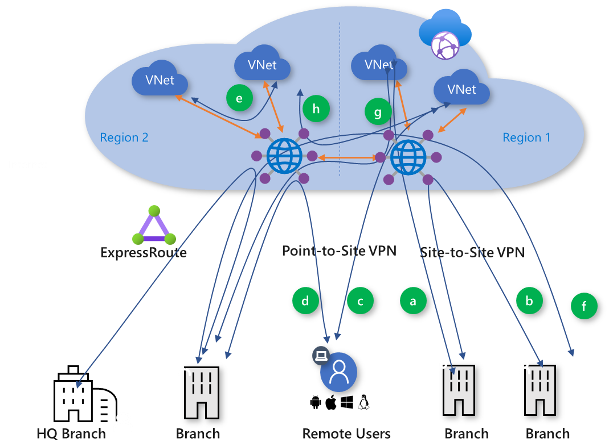
Global transit network with Virtual WAN
Global transit network architecture is being adopted by enterprises to consolidate, connect, and control the cloud-centric modern, global enterprise IT footprint
Azure Virtual WAN supports the following global transit connectivity paths:
Branch-to-VNet (a)
Branch-to-branch (b)
ExpressRoute Global Reach and Virtual WAN
Remote User-to-VNet (c)
Remote User-to-branch (d)
VNet-to-VNet (e)
Branch-to-hub-hub-to-Branch (f)
Branch-to-hub-hub-to-VNet (g)
VNet-to-hub-hub-to-VNet (h)
Notes:
Azure Virtual WAN allows a global transit network architecture by enabling ubiquitous, any-to-any connectivity between globally distributed sets of cloud workloads in VNets, branch sites, SaaS and PaaS applications, and users.
Global transit network architecture enables any-to-any connectivity via virtual WAN hubs. This architecture eliminates or reduces the need for full mesh or partial mesh connectivity between spokes, that are more complex to build and maintain. In addition, routing control in hub-and-spoke vs. mesh networks is easier to configure and maintain.
Any-to-any connectivity (in the context of a global architecture) allows an enterprise with globally distributed users, branches, datacenters, VNets, and applications to connect to each other through the “transit” hub(s). Azure Virtual WAN acts as the global transit system.

Slide 13
Design for Azure network connectivity services

Slide 14
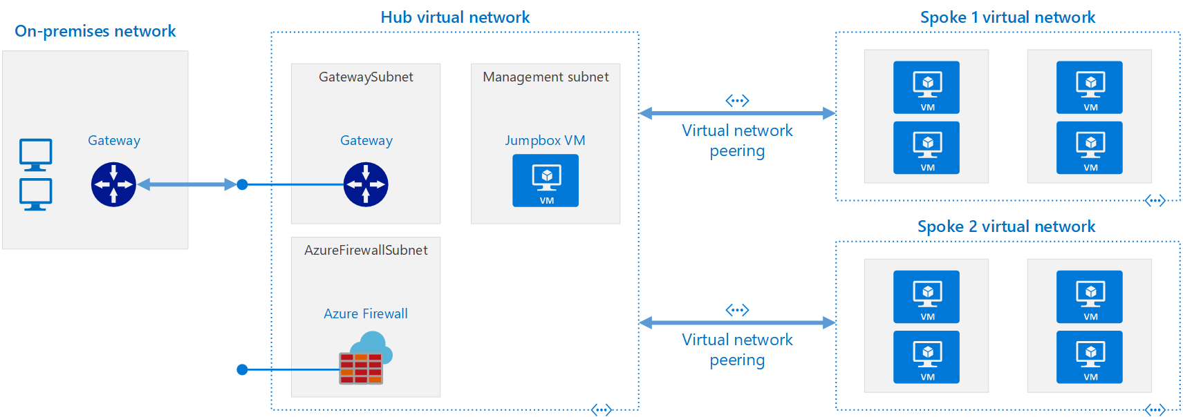
Design Azure Virtual networks
Azure Virtual Network is the fundamental building block for your private network in Azure. A virtual network is a virtual, isolated portion of the Azure public network. Use VNets to communication between Azure resources, the internet and on-premises networks.
Notes:
Communicate between Azure resources: You can deploy VMs, and several other types of Azure resources to a virtual network, such as Azure App Service Environments, the Azure Kubernetes Service (AKS), and Azure Virtual Machine Scale Sets.
Communicate between each other: You can connect virtual networks to each other, enabling resources in either virtual network to communicate with each other, using virtual network peering. The virtual networks you connect can be in the same, or different, Azure regions.
Communicate to the internet: All resources in a VNet can communicate outbound to the internet, by default. You can communicate inbound to a resource by assigning a public IP address or a public Load Balancer. You can also use Public IP addresses or public Load Balancer to manage your outbound connections.
Communicate with on-premises networks: You can connect your on-premises computers and networks to a virtual network using VPN Gateway or ExpressRoute.
Things to consider when deciding whether to create one virtual network, or multiple virtual networks in a subscription:
Do any organizational security requirements exist for isolating traffic into separate virtual networks? You can choose to connect virtual networks or not. If you connect virtual networks, you can implement a network virtual appliance, such as a firewall, to control the flow of traffic between the virtual networks. For more information, see security and connectivity.
Do any organizational requirements exist for isolating virtual networks into separate subscriptions or regions?
A network interface enables a VM to communicate with other resources. Each network interface has one or more private IP addresses assigned to it. How many network interfaces and private IP addresses do you require in a virtual network? There are limits to the number of network interfaces and private IP addresses that you can have within a virtual network.

Slide 15
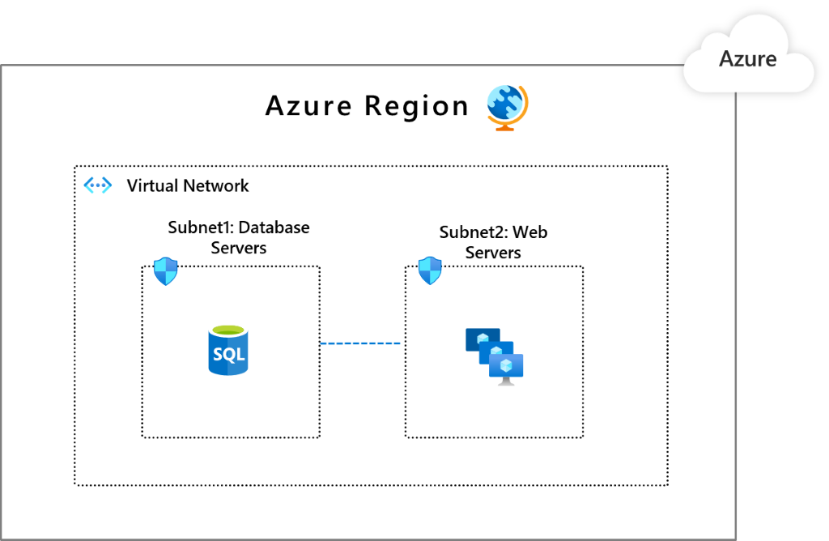
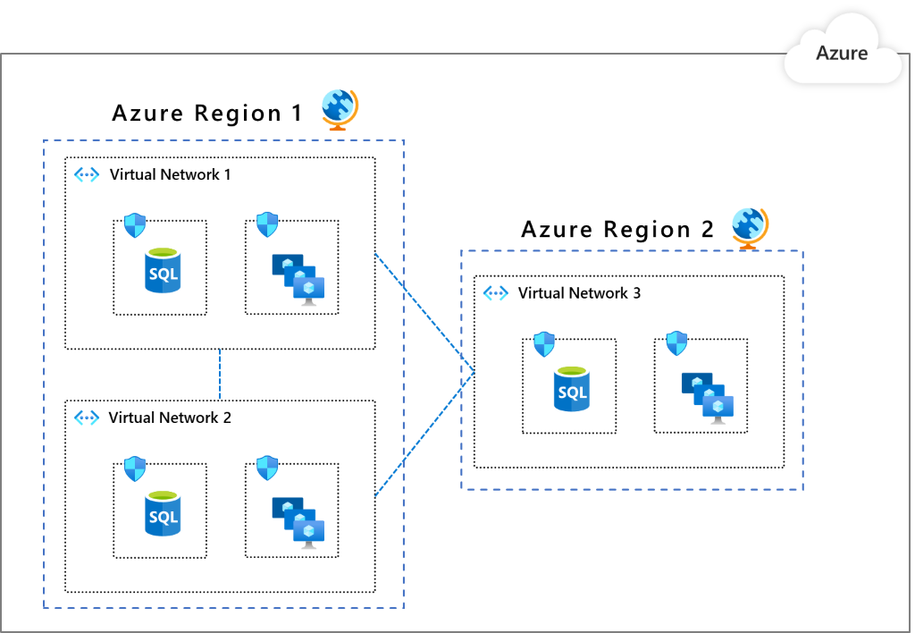
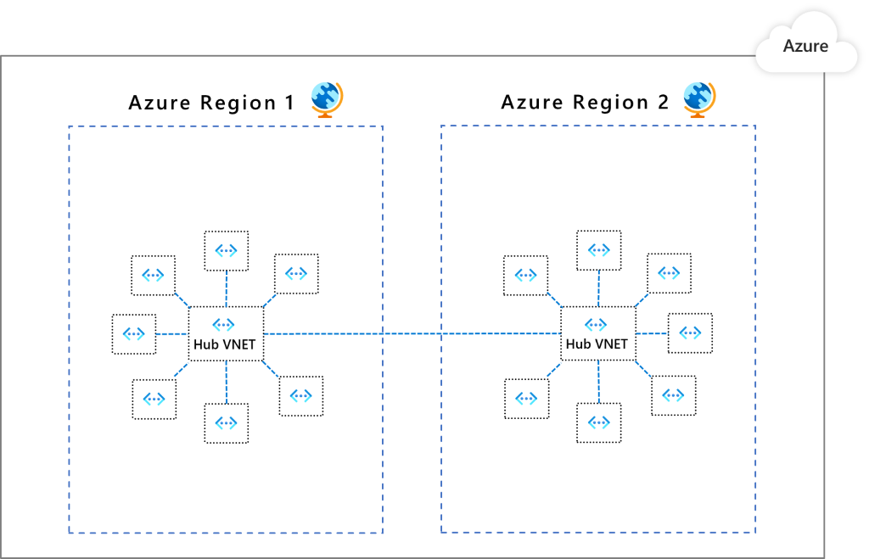
Design network topology
Segmentation is a model in which you take your networking footprint and create software defined perimeters using tools available in Microsoft Azure.
Pattern 1: Single Virtual Network
Pattern 2: Multiple Virtual Networks with peering in between them
Pattern 3: Multiple Virtual Networks in a hub & spoke model
Notes:
Focus on how to design a highly available workload using networks as your example but tie in HA for other resources like compute, storage and databases as a over arching concept
Segmentation options:
Subscription
Virtual Network
Network Security Groups (NSG)
Application Security Groups (ASGs)
Azure Firewall

Slide 16
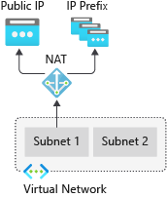
Design Outbound Connectivity
Virtual Network NAT (network address translation) simplifies outbound-only Internet connectivity for virtual networks. When configured on a subnet, all outbound connectivity uses your specified static public IP addresses. NAT is fully managed and highly resilient.
Options include:
Azure Firewall
Load balancer
Virtual Network NAT gateway
Choose Virtual Network NAT gateway when:
You need on-demand outbound to internet connectivity without pre-allocation
You need one or more static public IP addresses for scale
You need configurable idle timeout
You need TCP reset for unrecognized connections
Notes:
Virtual Networks provides the following capabilities:
On-demand outbound to Internet connectivity without pre-allocation
Fully managed and highly resilient
One or more static public IP addresses for scale
Configurable idle timeout
TCP reset for unrecognized connections
Multi-dimensional metrics and alerts in Azure Monitor
Optional zone isolation for availability zones
https://docs.microsoft.com/azure/virtual-network/nat-gateway/nat-overview
Other options include Azure Firewall and Load Balancer

Slide 17
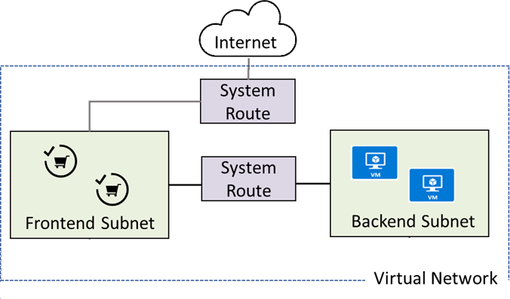
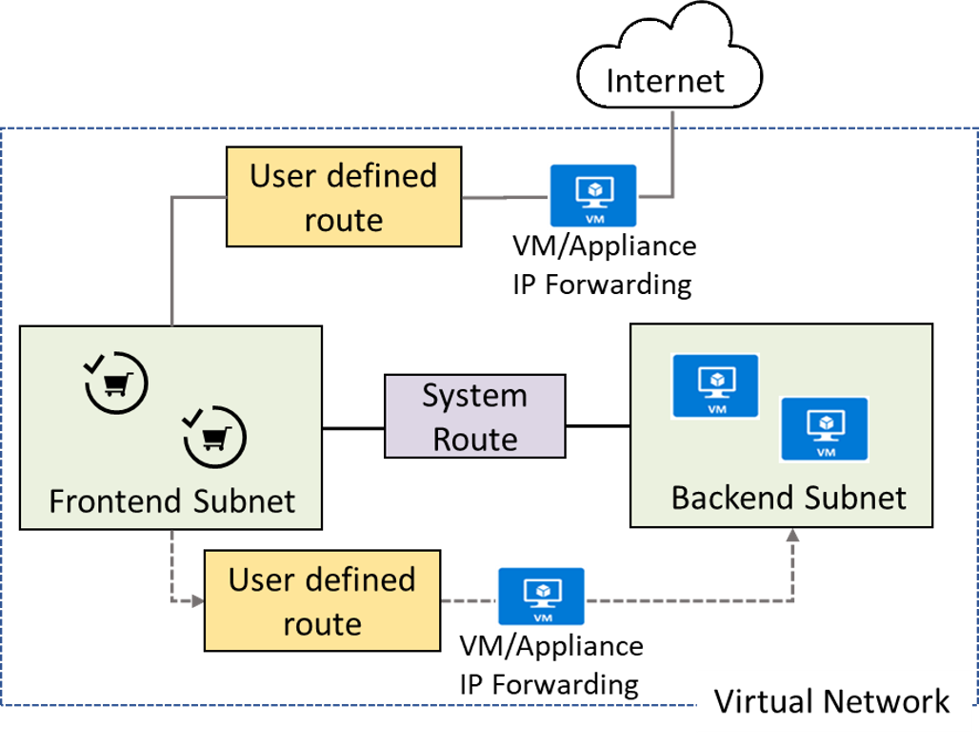
Design Routing
When you create a virtual network for the first time without defining any subnets, Azure creates routing entries in the routing table.
When creating subnets inside a virtual network, Azure creates default entries in the routing table to enable communication between subnets within a virtual network.
When creating a virtual network peering between two virtual networks, a route is added for each address range within the address space of each virtual network for which a peering is created.
Types and priority of routes:
User Defined Routes (UDR)
BGP routes
System routes
Notes:
System Routes
When you need traffic routed between VMs in the same virtual network or peered virtual networks
You need communication between VMs using a VNet-to-VNet VPN
You need site-to-site communication through ExpressRoute or a VPN gateway
User Defined Routes (UDRs)
You want to enable filtering of Internet traffic via Azure Firewall or forced tunneling.
You want traffic between subnets to flow though an NVA.
You need to create routes to specify how packets should be routed in a virtual network.
You need to create routes that control network traffic and specify the next hop in the traffic flow.

Slide 18
Design for application delivery services

Slide 19
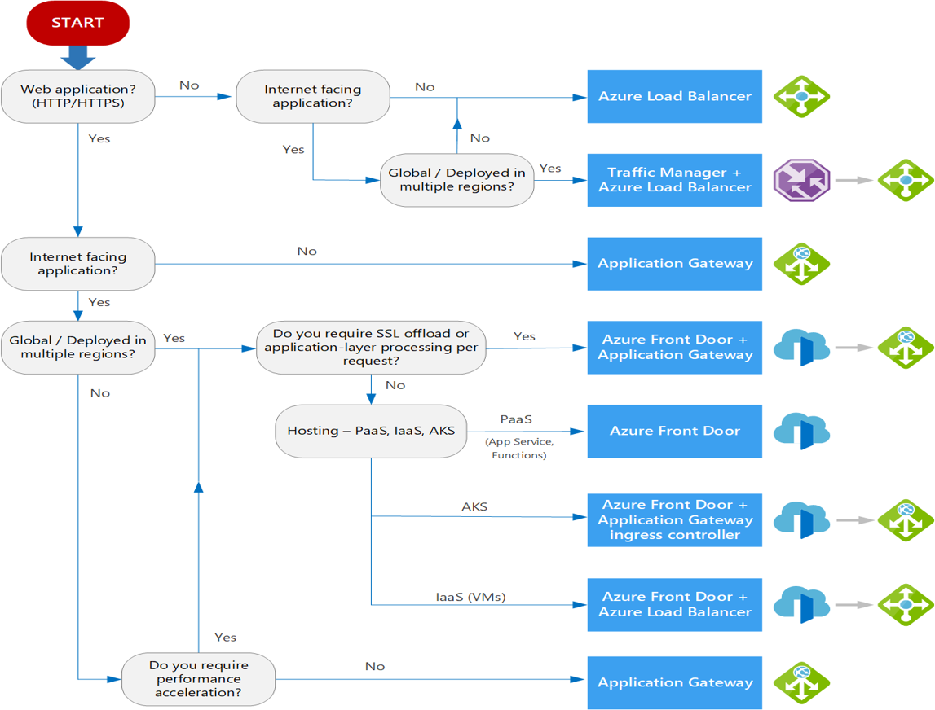
Choosing a load balancer solution
Azure provides various load balancing services that you can use to distribute your workloads across multiple computing resources – Azure Front Door, Traffic Manager, Load Balancer, and Application Gateway.
Decision criteria
Traffic type
Global versus. regional
Availability
Cost
Features and limits
Treat this flowchart as a starting point
Notes:
Decision tree - https://docs.microsoft.com/azure/architecture/guide/technology-choices/load-balancing-overview#decision-tree-for-load-balancing-in-azure
Traffic type. Is it a web (HTTP/HTTPS) application? Is it public facing or a private application?
Global versus. regional. Do you need to load balance VMs or containers within a virtual network, or load balance scale unit/deployments across regions, or both?
Availability. What is the service SLA?
Cost. See Azure pricing. In addition to the cost of the service itself, consider the operations cost for managing a solution built on that service.
Features and limits. What are the overall limitations of each service? See Service limits.
The following flowchart will help you to choose a load-balancing solution for your application. The flowchart guides you through a set of key decision criteria to reach a recommendation.
Treat this flowchart as a starting point. Every application has unique requirements, so use the recommendation as a starting point. Then perform a more detailed evaluation.

Slide 20
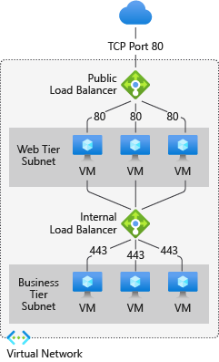
Load Balancer
High-performance, low-latency load-balancing for all UDP and TCP protocols
Layer 4 load-balancing for all UDP and TCP protocols
Manages inbound and outbound connections
Provides public and internal load-balanced endpoints
Uses rules to map inbound connections to backend destinations
Health probes manage service availability
Notes:
What is Azure Load Balancer? - https://docs.microsoft.com/azure/load-balancer/load-balancer-overview
Possible discussion points -Cross region load balancing (preview), zonal fault tolerance

Slide 21
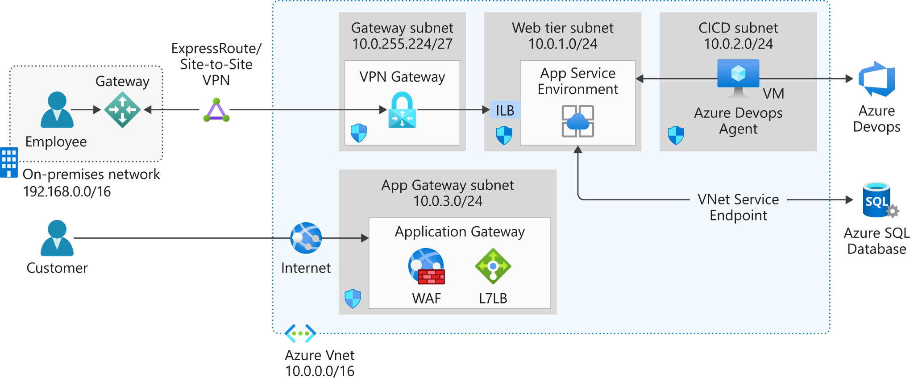
Application Gateway
Azure Application Gateway is a web traffic load balancer that enables you to manage traffic to your web applications. It is an Application Delivery Controller (ADC) as a service, offering various layer 7 load-balancing capabilities for your applications.
When to use Application Gateway
Layer 7 - HTTP(s) only
Supports WAF -stateful inspection
Traffic routing
SSL/TLS termination
Supports PaaS and Ips
Regional service
Notes:
What is Azure Application Gateway? - https://docs.microsoft.com/azure/application-gateway/overview
Discussion: Can we combine with Front Door?

Slide 22
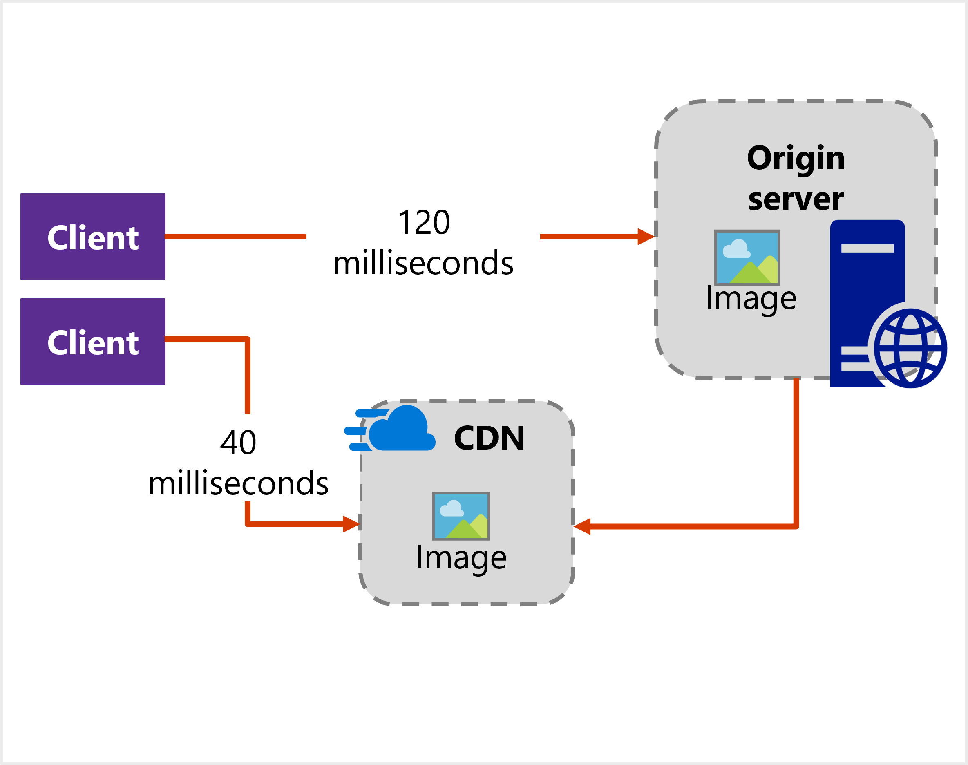
Content Delivery Network (CDN)
Azure CDN offers developers a global solution for rapidly delivering high-bandwidth content to users by caching their content at strategically placed physical nodes across the world.
When to leverage a CDN:
You want point-of-presence locations that are close to large clusters of users.
You want to reduce latency - both the transmission delay and the number of router hops.
You want custom domains, file compression, caching, and geo-filtering.
Notes:
What is a content delivery network on Azure? - https://docs.microsoft.com/azure/cdn/cdn-overview
Discussion: What are your possible CDN data sources?

Slide 23
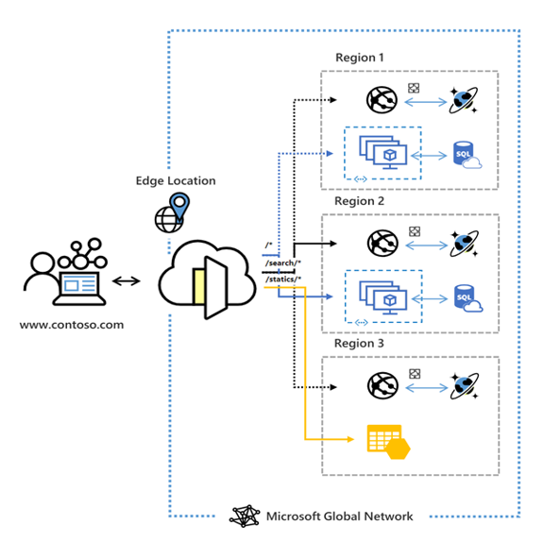
Azure Front Door Service
Azure Front Door Service enables you to define, manage, and monitor the global routing for your web traffic by optimizing for best performance and instant global failover for high availability.
Choose Front Door when:
You need to ensure that requests are sent to the lowest latency backends (low latency)
You have primary and secondary backends (priority)
You want to distribute traffic using weight coefficients (weighted)
You want to ensure requests from the same end user gets sent to the same backend (affinity)
Your traffic is HTTP(s) based and you need WAF and/or CDN integration
Notes:
What is Azure Front Door? – https://docs.microsoft.com/azure/frontdoor/front-door-overview
Choose front door when:
You need to ensure that requests are sent to the lowest latency backends (low latency)
You have primary and secondary backends (priority)
You want to distribute traffic using weight coefficients (weighted)
You want to ensure requests from the same end user gets sent to the same backend (affinity)
Your traffic is HTTP(s) based and you need WAF and/or CDN integration

Slide 24
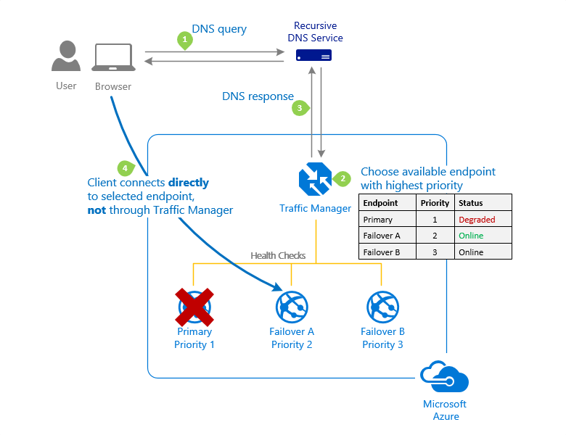
Traffic Manager
Azure Traffic Manager is a DNS-based traffic load balancer that enables you to distribute traffic optimally to services across global Azure regions. Traffic Manager provides a range of traffic-routing methods to distribute traffic such as priority, weighted, performance, geographic, multi-value, or subnet.
Choose Traffic Manager when you need:
To increase application availability
Improve application performance
Combine hybrid applications
Distribute traffic for complex deployments
Notes:
What is Traffic Manager? - https://docs.microsoft.com/azure/traffic-manager/traffic-manager-overview
Traffic Manager in reliability scenarios: Traffic Manager uses DNS to direct the client requests to the appropriate service endpoint based on a traffic-routing method. This service allows you to distribute traffic to your public facing applications across the global Azure regions.

Slide 25
Design for application protection services

Slide 26
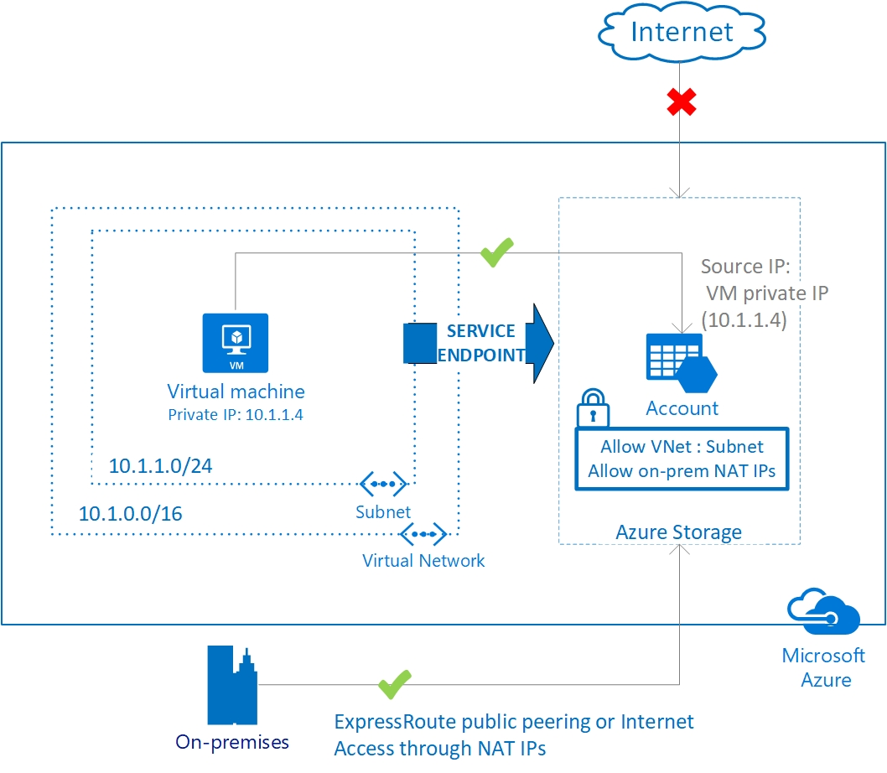
Service endpoints
Virtual Network (VNet) service endpoint provides secure and direct connectivity to Azure services over an optimized route over the Azure backbone network
Key Benefits:
Improved security for your Azure service resources
Optimal routing for Azure service traffic from your virtual network
Simple to set up with less management overhead
Notes:
Be ready to discuss possible down sides such as bypassing corporate firewalls and services having inconsistent scope.

Slide 27
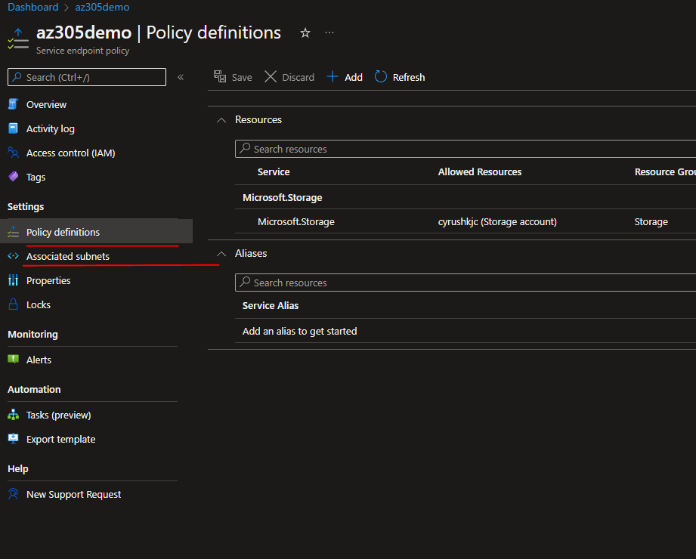

Slide 28
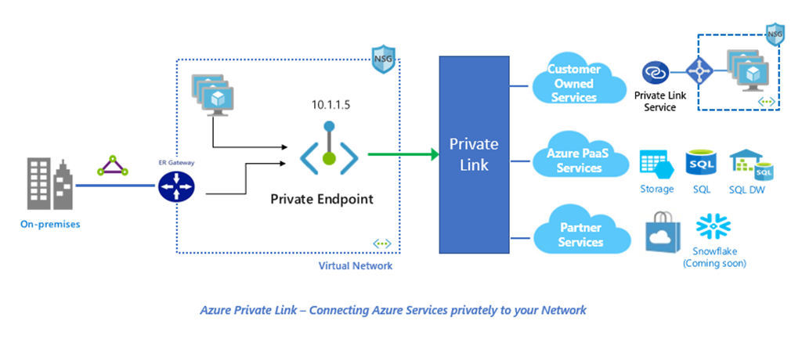
Azure Private Link
Azure Private Link enables you to access Azure PaaS Services (for example, Azure Storage and SQL Database) and Azure hosted customer-owned/partner services over a private endpoint in your virtual network. Private link is used to access PaaS services such as Azure Storage, Azure SQL, App Services and more as illustrated below.
Recommend private link or private endpoints when:
You need private connectivity to services on Azure
You need integration with on-premises and peered networks
You need traffic to remain on Microsoft network, with no public internet access

Slide 29
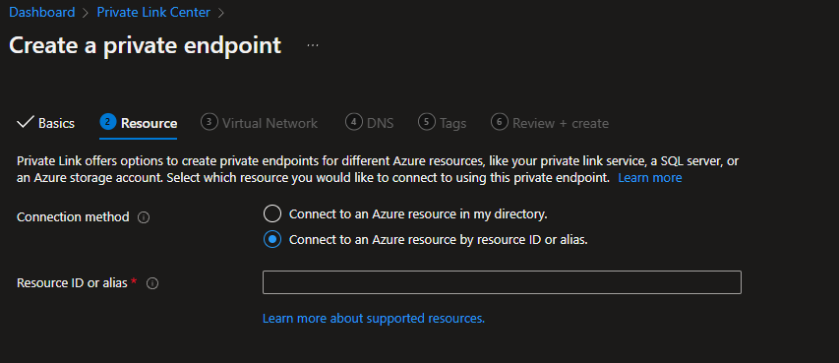
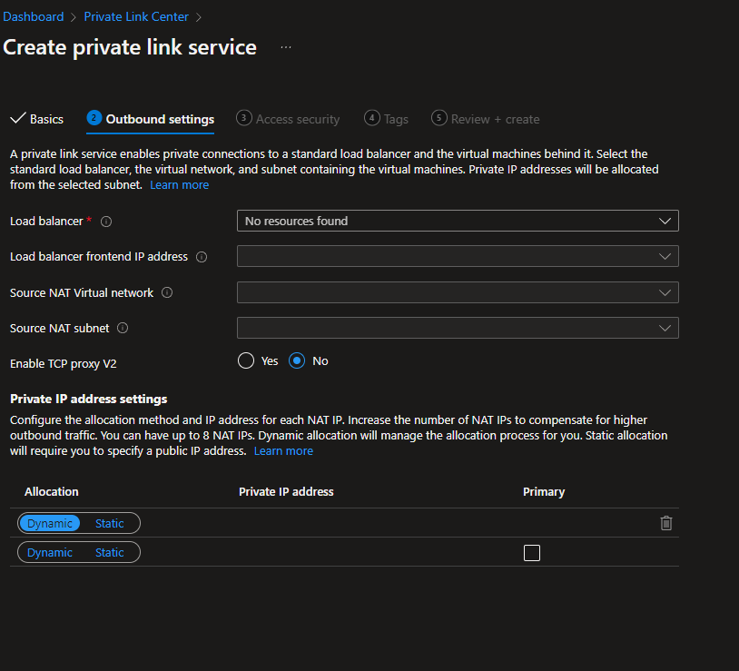

Slide 30
Network security groups
You can filter network traffic to and from Azure resources in an Azure virtual network with a network security group.
A network security group (NSG) contains a list of Access Control List (ACL) rules that allow or deny network traffic to subnets, NICs, or both.
NSGs contain two sets of rules: inbound and outbound. The priority for a rule must be unique within each set.
Notes:
Network Security Groups -
Application Security Groups can be used to simplify NSG deployments.

Slide 31
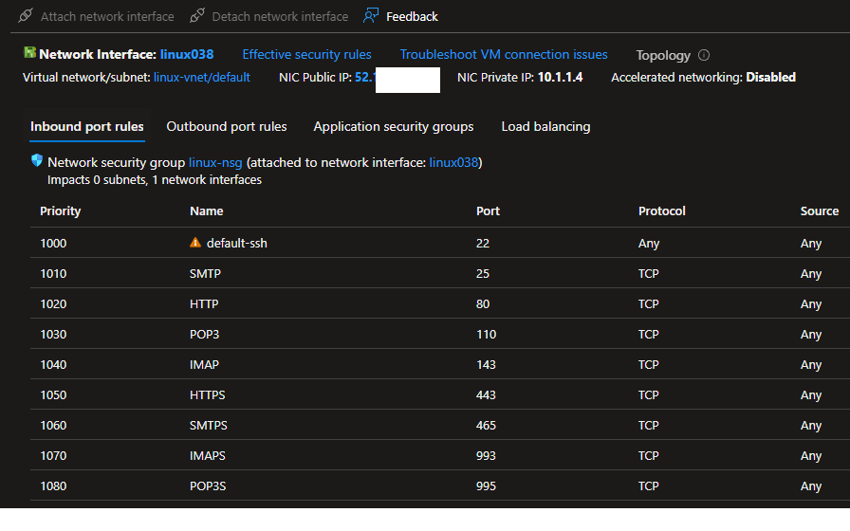

Slide 32
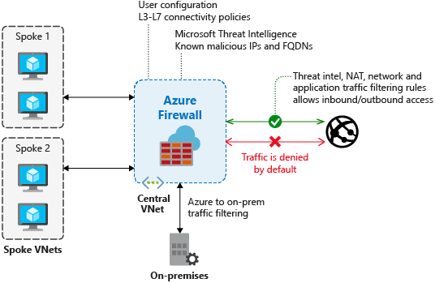
Azure Firewall
Azure firewall is a cloud-native network security service offering high-availability and scalability. Azure Firewall provides inbound protection for non-HTTP/S protocols (for example, RDP, SSH, FTP), outbound network-level protection for all ports and protocols, and application-level protection for outbound HTTP/S.
Use Azure Firewall to:
Protect your network against infiltration.
Implement hierarchical firewall policies.
Configure spoke-to-spoke connectivity.
Monitor incoming and outgoing traffic.
If you require multiple firewalls.
Premium Feature
https://docs.microsoft.com/en-us/azure/firewall/premium-features?WT.mc_id=Portal-Microsoft_Azure_HybridNetworking
Notes:
Azure Firewall (Learn) - https://docs.microsoft.com/learn/modules/introduction-azure-firewall/
What is Azure Firewall? - https://docs.microsoft.com/azure/firewall/overview

Slide 33
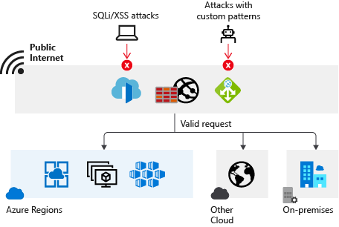
Web Application Firewall
Azure Web Application Firewall (WAF) provides centralized protection to your web applications from common web exploits and vulnerabilities such as SQL injection, and cross site scripting. Azure WAF provides out of box protection from OWASP top 10 vulnerabilities via managed rules.
When to use Web Application firewall:
To prevent attacks in application code
Centrally manage security for applications
Deploy WAF with Azure Application Gateway, Azure Front Door and Azure Content Delivery Network (CDN)
Some important point in OneNotes
Notes:
Web Application Firewall – https://docs.microsoft.com/azure/web-application-firewall/overview
Azure Firewall alone when there are no web applications in the virtual network.
Application Gateway alone when there are only web applications in the virtual network, and network security groups (NSGs) provide sufficient output filtering.
Azure Firewall and Application Gateway in parallel, the most common design, when you want Azure Application Gateway to protect HTTP(S) applications from web attacks, and Azure Firewall to protect all other workloads and filter outbound traffic.
Application Gateway in front of Azure Firewall when you want Azure Firewall to inspect all traffic and WAF to protect web traffic, and the application needs to know the client's source IP address.
Azure Firewall in front of Application Gateway when you want Azure Firewall to inspect and filter traffic before it reaches the Application Gateway.

Slide 34
Azure Firewall alone
when there are no web applications in the virtual network.
Application Gateway alone
when there are only web applications in the virtual network, and network security groups (NSGs) provide sufficient output filtering.
Azure Firewall and Application Gateway in parallel
the most common design, when you want Azure Application Gateway to protect HTTP(S) applications from web attacks, and Azure Firewall to protect all other workloads and filter outbound traffic.
Application Gateway in front of Azure Firewall
when you want Azure Firewall to inspect all traffic and WAF to protect web traffic, and the application needs to know the client's source IP address.
Azure Firewall in front of Application Gateway
when you want Azure Firewall to inspect and filter traffic before it reaches the Application Gateway.

Slide 35
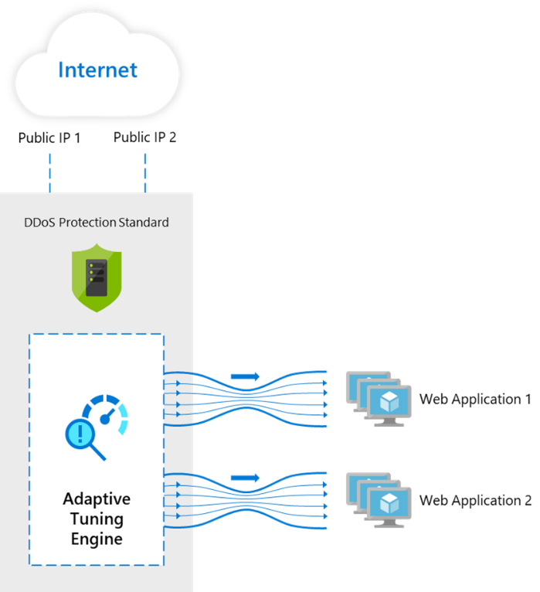
DDoS Protection
Azure DDoS Standard Protection provides countermeasures against the most sophisticated DDoS threats. The service provides enhanced DDoS mitigation capabilities for your application and resources deployed in your virtual networks.
Use DDoS protection Standard:
Always-on traffic monitoring
Adaptive tuning
Multi-layered protection
Mitigation scale
Attack analytics and metrics
Attack alerting
DDoS rapid response
Notes:
DDoS Protection - https://docs.microsoft.com/azure/ddos-protection/ddos-protection-reference-architectures
Note that features listed here are for the Standard SKU. Basic provides free limited protection.

Slide 36
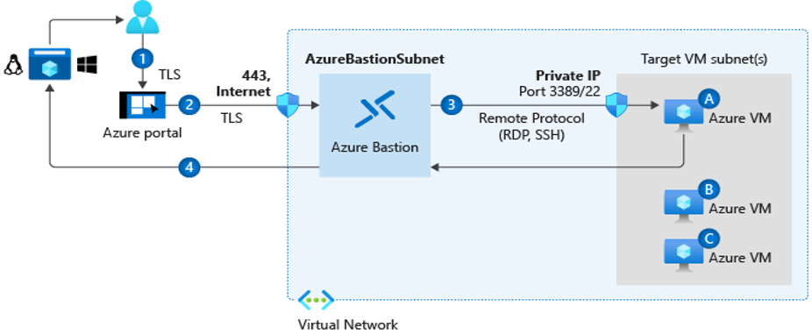
Azure Bastion
The Azure Bastion service is a fully platform-managed PaaS service which provides secure and seamless RDP/SSH connectivity to your virtual machines directly in the Azure portal over TLS.
Recommend Azure Bastion when you need to:
Secure remote connections from the Azure portal to Azure VMs
Eliminate exposing RDP and SSH public IP addresses of your Azure VMs
Access VMs across multiple, peered networks
Notes:
Azure Bastion - https://docs.microsoft.com/azure/bastion/bastion-overview
Key security features
Traffic initiated from Azure Bastion to target virtual machines stays within the virtual network or between peered virtual networks.
There's no need to apply NSGs to the Azure Bastion subnet, because it's hardened internally. For additional security, you can configure NSGs to allow only remote connections to the target virtual machines from the Azure Bastion host.
Azure Bastion helps protect against port scanning. RDP ports, SSH ports, and public IP addresses aren't publicly exposed for your VMs.
Azure Bastion helps protect against zero-day exploits. It sits at the perimeter of your virtual network. So you don't need to worry about hardening each of the virtual machines in your virtual network. The Azure platform keeps Azure Bastion up to date.
The service integrates with native security appliances for an Azure virtual network, like Azure Firewall.
You can use the service to monitor and manage remote connections.

Slide 37
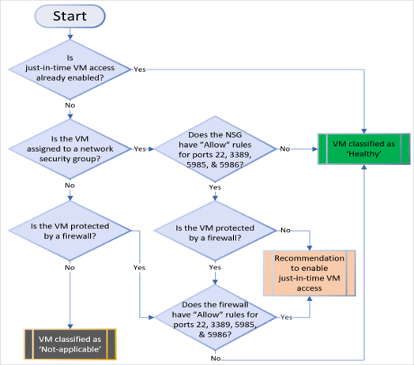
Just in Time (JIT) Network Access
With JIT, you can lock down the inbound traffic to your VMs, reducing exposure to attacks while providing easy access to connect to VMs when needed.
Supports ports other than 3389 and 22
Ports are blocked when not in use
Integrates with NSGs and Azure Firewall
Notes:
When you enable just-in-time VM access, you can select the ports on the VM to which inbound traffic will be blocked. Microsoft Defender for Cloud ensures "deny all inbound traffic" rules exist for your selected ports inhe network security group (NSG) and Azure Firewall rules. These rules restrict access to your Azure VMs’ management ports and defend them from attack.
If other rules already exist for the selected ports, then those existing rules take priority over the new "deny all inbound traffic" rules. If there are no existing rules on the selected ports, then the new rules take top priority in the NSG and Azure Firewall.
When a user requests access to a VM, Microsoft Defender for Cloud checks that the user has Azure role-based access control (Azure RBAC) permissions for that VM. If the request is approved, Microsoft Defender for Cloud configures the NSGs and Azure Firewall to allow inbound traffic to the selected ports from the relevant IP address (or range), for the amount of time that was specified. After the time has expired, Microsoft Defender for Cloud restores the NSGs to their previous states. Connections that are already established are not interrupted.
Requires Azure Defender licensing for Azure Defender

Slide 38
Review

Slide 39
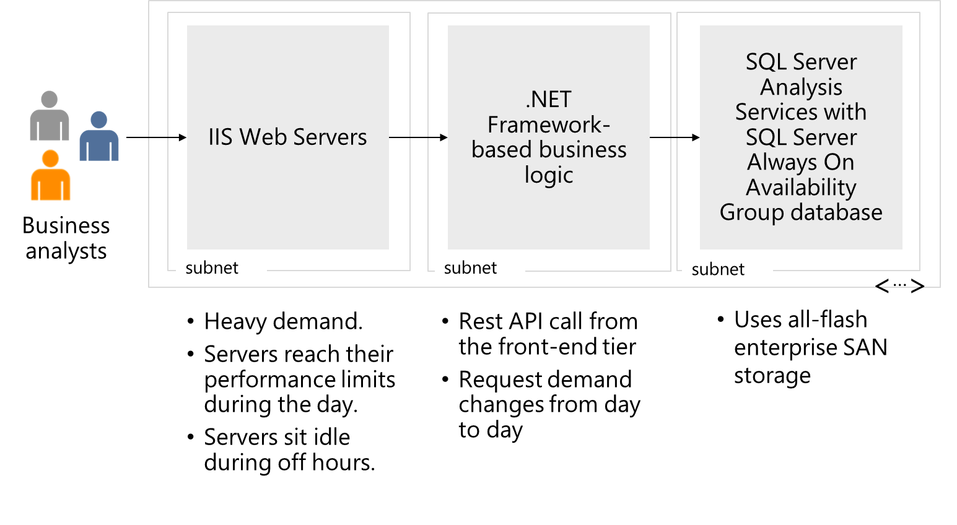
Case Study – BI enterprise application

Slide 40
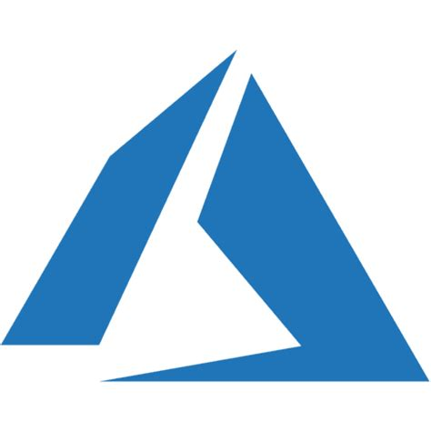












Instructor solution - BI enterprise application
Frontend tier
Middle tier
Backend tier
Not on-premises
On-premises
Perimeter network
VPN
Gateway
Azure Load Balancer
Application Security Group
Virtual
network
Application Gateway v2
Network security group
ExpressRoute Gateway
Azure
Firewall
Web App Firewall
Notes:
Your instructor case solution is in the MCT DLC.

Slide 41
Completed instructor solution - BI enterprise application
Frontend tier
Middle tier
Backend tier
Not on-premises
ER
On-premises
Perimeter network
ER
VPN
Gateway
Azure Load Balancer
Application Security Group
Virtual
network
Application Gateway v2
Network security group
ExpressRoute Gateway
Azure
Firewall
Web App Firewall
Notes:
Your instructor case solution is in the MCT DLC.

Slide 42
Summary and resources
Check your knowledge
Microsoft Learn Modules (docs.microsoft.com/Learn)
AZ-700 Designing and Implementing Microsoft Azure Networking Solutions - Learn | Microsoft Docs
Explore Azure networking services - Learn | Microsoft Docs
Secure network connectivity on Azure (AZ-900) - Learn | Microsoft Docs
Architect network infrastructure in Azure - Learn | Microsoft Docs
Optional hands-on lab - Distribute your services across Azure virtual networks and integrate them by using virtual network peering
Optional hands-on lab - Secure and isolate access to Azure resources by using network security groups and service endpoints
Notes:
### Learn more with self-paced training
- Introduction to Azure Virtual Networks - Learn - https://docs.microsoft.com/learn/modules/introduction-to-azure-virtual-networks/
- Design and implement Azure ExpressRoute - Learn - https://docs.microsoft.com/learn/modules/design-implement-azure-expressroute/
- Introduction to Azure Virtual WAN - Learn - https://docs.microsoft.com/learn/modules/introduction-azure-virtual-wan/
- Design and implement hybrid networking - Learn - https://docs.microsoft.com/learn/modules/design-implement-hybrid-networking/
- Design and implement private access to Azure Services - Learn - https://docs.microsoft.com/learn/modules/design-implement-private-access-to-azure-services/
- Enhance your service availability and data locality by using Azure Traffic Manager - Learn - https://docs.microsoft.com/learn/modules/distribute-load-with-traffic-manager/
- Introduction to Azure Bastion - Learn - https://docs.microsoft.com/learn/modules/intro-to-azure-bastion/
- Introduction to Azure Web Application Firewall - Learn - https://docs.microsoft.com/learn/modules/introduction-azure-web-application-firewall/
- Introduction to Azure Firewall - Learn - https://docs.microsoft.com/learn/modules/introduction-azure-firewall/
- Introduction to Azure Front Door - Learn - https://docs.microsoft.com/learn/modules/intro-to-azure-front-door/

Slide 43

End of presentation

Slide 44
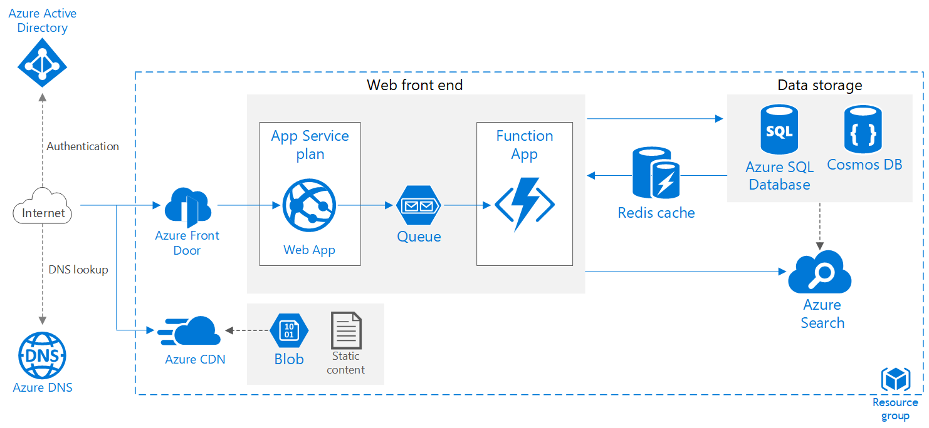
Optional - Whiteboard discussion #1
Scalable web application
Notes:
Focus on the use of Front door and Azure CDN but tie together the application scalability and performance. See reference architecture here for explanations: https://docs.microsoft.com/azure/architecture/reference-architectures/app-service-web-app/scalable-web-app

Slide 45
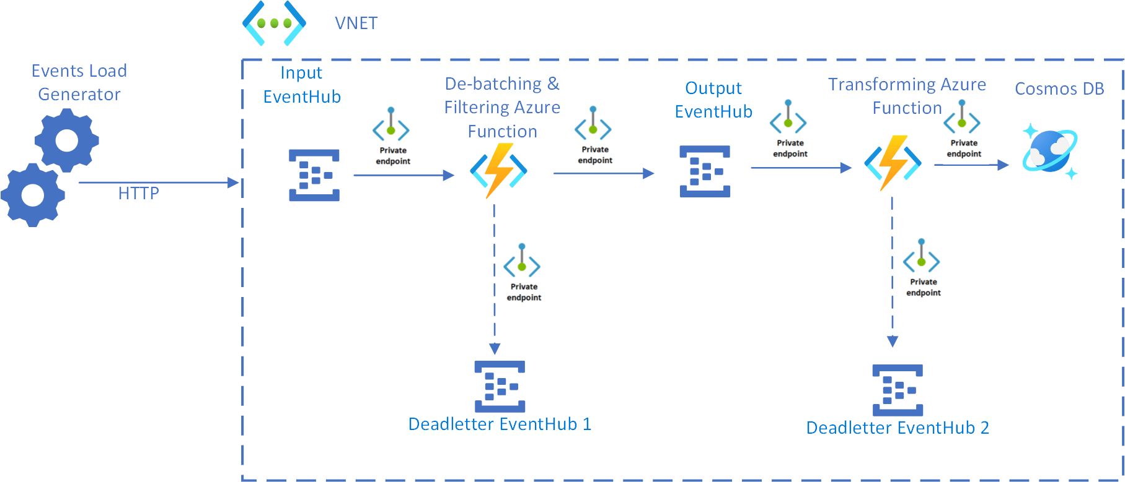
Optional - Whiteboard discussion #2
Serverless event stream processing in a VNet with private endpoints
Notes:
Focus on the use of private endpoints but tie in the application architecture and compute choices. See reference architecture here for explanations: https://docs.microsoft.com/azure/architecture/solution-ideas/articles/serverless-event-processing-private-link

