Slide 1

Code Refactoring and Bug Fixing
-- M RAVI TEJA

Slide 2
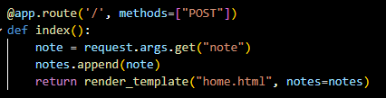
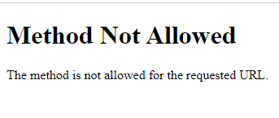
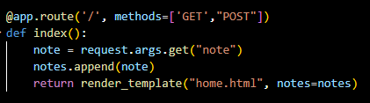

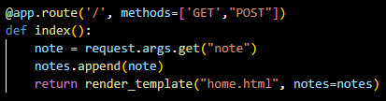
BUG_1: Incorrect Method Representation in Function Route Definition in app.py
Solution: Change Method in Route Function Definition in app.py
BUG_2: Incorrect Request Method Representation in index Function Route Definition in app.py. It only handles POST request.

Slide 3
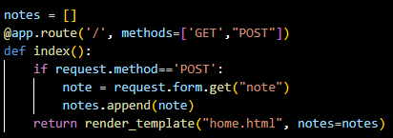
Solution: Change Request Method in Route Function Definition in app.py. It is capable of handling both GET and POST Requests and I changed “request.args.get(‘note’)” to ‘request.form.get(‘note’)’.
BUG_3: Type attribute missing in submit Button
Solution: Added type = ‘submit’ in button tag in home.html.

Slide 4
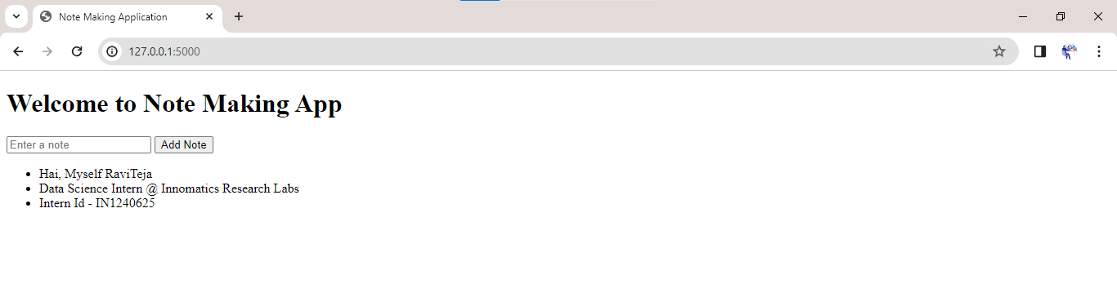
Finally, the Application was Running Successfully!

Slide 5

THANK YOU !

