Slide 1
NLP Project Phase #3
(Project High Level Architecture and Literature Survey)
Project Title : What’s app Chat Analyzer
Project ID : 16
Project Team : 1 D T Raviteja PES2UG20CS115
2 Upendra PES2UG20CS920

Slide 2
Outline
Problem Statement
Abstract
Motivation Scope of the Project
Suggestions from Review – 1
Literature Survey
Summary: Learning from Literature Survey
High Level Architecture
Work Done So far
References

Slide 3
Problem Statement
WhatsApp-Analyzer is a statistical analysis tool for WhatsApp chats. Working on the chat files that can be exported from WhatsApp it generates various plots showing.
For example, which another participant a user responds to the most. We propose to employ dataset manipulation techniques to have a better understanding of WhatsApp chat present in our phones.

Slide 4
Abstract
The most used and efficient method of communication in recent times is an application called WhatsApp. WhatsApp chat analyzer is the application deployed on heroku web which provide analysis of WhatsApp group. There are various methodologies available for analysis but here matplotlib, streamlit, seaborn, re, pandas libraries of python and some concept of NLP is used. This is the combination of machine learning and NLP. This whatsapp chat analyzer take import whatsapp chat file from user and analyze it and give different visualizations as a result.

Slide 5
Motivation and Scope of the Project
In present situations, most of the people depend on data
This project aims to provide a better understanding towards various types of chats
Our project ensures to provide an in-depth exploratory data analysis on various types of WhatsApp chats.

Slide 6
Suggestions from Review – 1
We are informed to separate the Links, Emoji’s, Media & text messages.

Slide 7
Individual Information on Literature Survey
S.N. | Name of the Student | SRN | Paper | Paper Title
1 | Raviteja | PES2UG20CS115 | 1 | What’s app chat Sentiment Analyzer(IJRASET)
 |  |  | 2 | Pre-Processing and Emoji Classification of WhatsApp Chats for Sentiment Analysis
 |  |  | 3 | Professional Chat Application based on Natural Language Processing
 |  |  | 4 | People’s Behavior Analysis in Chat message using NLP
2 | Upendra | PES2UG20CS920 | 5 | An Analysis of Interaction and Engagement in Youtube Livestream chat
 |  |  | 6 | What’s app chat Analyzer
 |  |  | 7 | What’s app chat Analyzer
 |  |  | 8 | Analysing and Predicting the Emotion of WhatsApp Chats Using Sentiment Analysis

Slide 8
Literature Survey
Paper-1,2
Paper Details (Citation) | Objective of paper, Techniques/Methods | Detailed explanation along with results | Limitations
What’s app chat Sentiment Analyzer(IJRASET) 12th Dec 2022 | Record Manipulation Techniques Regex VANDER | Changing information to make it more organized and readable It takes a string and returns a dictionary of three categories: a) Positive b) Negative c) Neutral | The system avoids the shortcomings of existing manual systems. Completely eliminates the possibility of incorrect data entry due to the system's validation capabilities.
Pre-Processing and Emoji Classification of WhatsApp Chats for Sentiment Analysis (IEEE) | Russel’s Circumplex Approach | Emotions are classified in 2 states Valence Arousal | Code-switching, which is quite prevalent in textual data obtained from social media poses a difficulty in processing

Slide 9
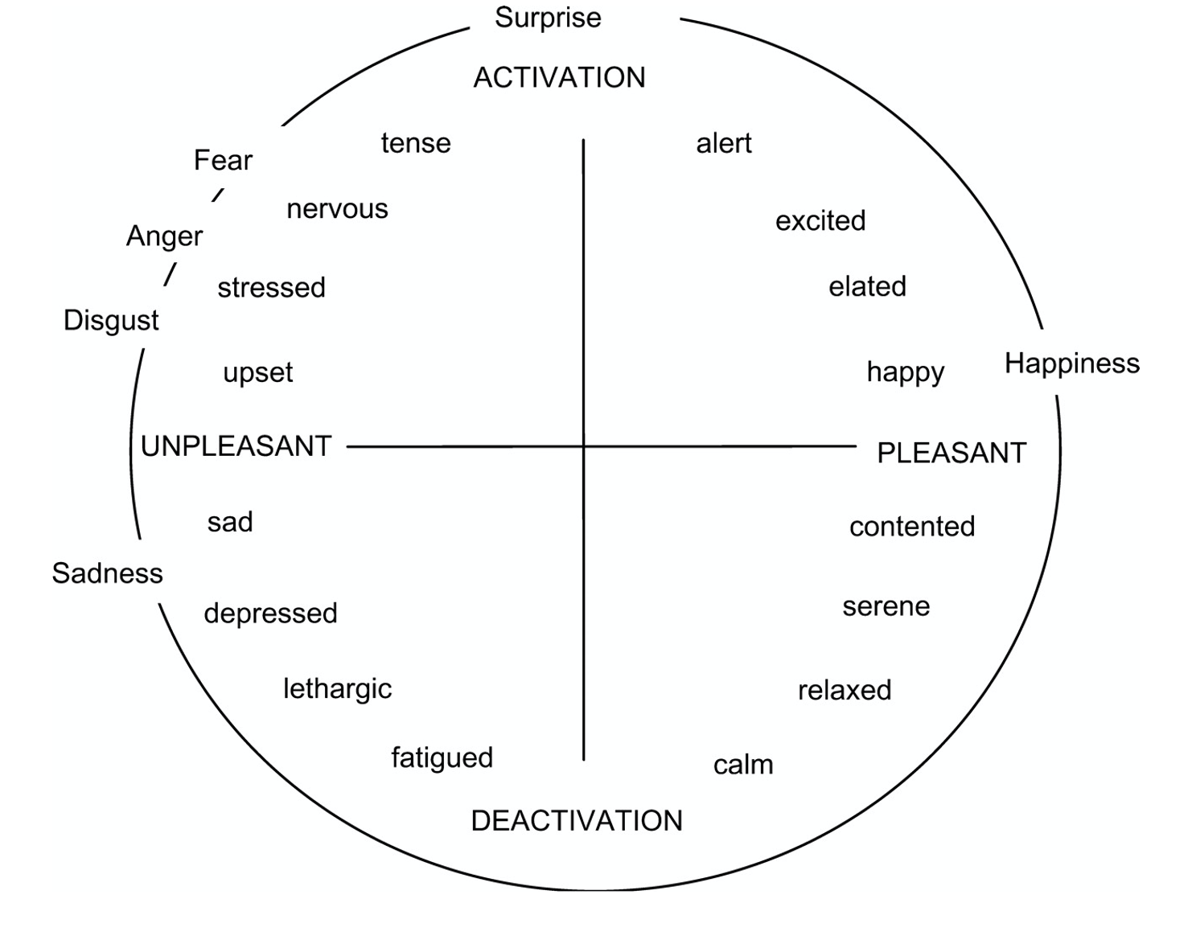
Russel’s Circumplex Model

Slide 10
Literature Survey
Paper-3, 4
Paper Details (Citation) | Objective of paper, Techniques/Methods | Detailed explanation along with results | Limitations
Professional Chat Application Based on NLP (IEEE) | Removing stop words Stemming Tokenization Named entity recognition POS tagging | If the context of the message is negative, then user not permitted to send the message. It shows warning message to the user Otherwise, it send and store message in Firebase. | The category definition is quite clear, but for computers, there is some Ambiguity in classification Ambiguity and Abbreviations
People’s Behavior Analysis in Chat message using NLP | Objective of the paper is to create word cloud | We can able to predict the most active date, the most active hours, the active day, and average message per day | The entire methodology can be implemented but for the storage the cost was little high

Slide 11
Literature Survey
Paper-5,6,7,8
Paper Details (Citation) | Objective of paper, Techniques/Methods | Detailed explanation along with results | Limitations
An Analysis of Interaction and Engagement in Youtube Livestream chat(IEEE) | Name Entity Recognition(NER) Sentiment Analysis Topic Modelling | We are also interested in investigating the heavy users specifically, to detect more specific behavior patterns that we might be able to predict | Its not easy to carry data in manual system
What’s Chat Analyzer | Eliminating Stopwords Tokenization Stemming | Analysis on What’s app chat like List of Emoji’s, Word cloud Vizualizations | The system avoids the drawbacks of the existing manual system The validation facility of the system totally eliminates the chances of wrong data entry
Analysing and Predicting the Emotion of WhatsApp Chats Using Sentiment Analysis | The main or the old text is processed to a bag of words where the emotion is predicted LSTM | Determining & Predicting the Feelings of a person | This requires huge amount of data to master the art emotion is relative to each person and varies so the system has to be trained in a particular way to keep track of the context and past history while determining the sentiment.
What’s app Chat Analyzer | Word Cloud Activity Map Monthly Timeline Sorting the messages basd on its types | The system was done with python, and the python libraries that were implemented includes, Streamlit, Emoji, NumPy, Pandas, Re, Matplotlib, URLextract, collection and Seaborn. | If the files are large, then it takes more time to process the data

Slide 12
Summary :Learning from Literature Survey
Our approach to convert Unstructured data to more structured form to perform various sentiment analysis algorithms is discussed.
Emoji’s are better to express feelings rather than describing as text
Identifying correct meaning of a key while doing the classification into set of predefined groups

Slide 13
High Level Architecture Diagram

Slide 14
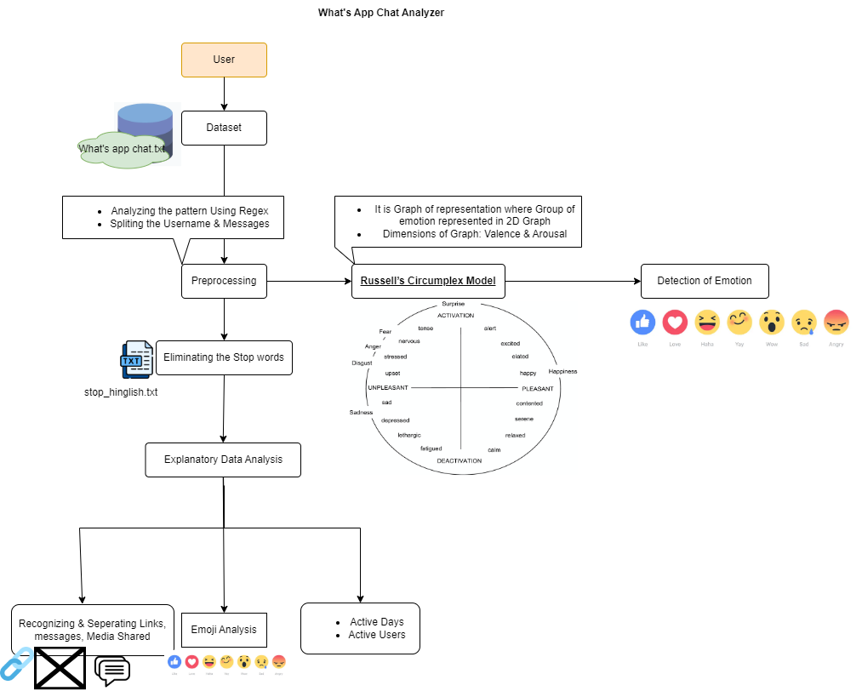
High Level Architecture Diagram

Slide 15
Work Done so far
Done with Literature Survey
We are making interface using streamlit library in python in order to analyze the messages

Slide 16
Referances
https://ieeexplore.ieee.org/abstract/document/8370395
https://ieeexplore.ieee.org/abstract/document/9388596
https://ieeexplore.ieee.org/abstract/document/9243443
https://ieeexplore.ieee.org/document/9604216

