Slide 1
ER Diagram

Slide 2
Priviledges of Admin & Student
Student Priviledges Admin Priviledges
View currently enrolled courses View all courses offered by the University View courses taken in the past Add new courses to the catalog Add courses to Cart Remove courses from the catalog Delete courses from Cart Register courses for a particular user Register Courses Drop courses for a particular user Drop Courses View course schedule for the current semester

Slide 3
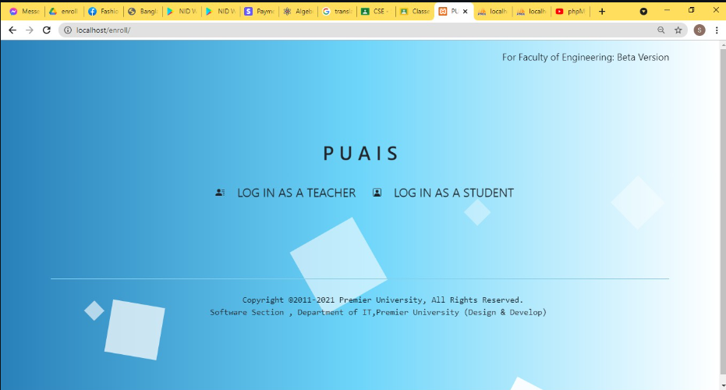
Login Page

Slide 4
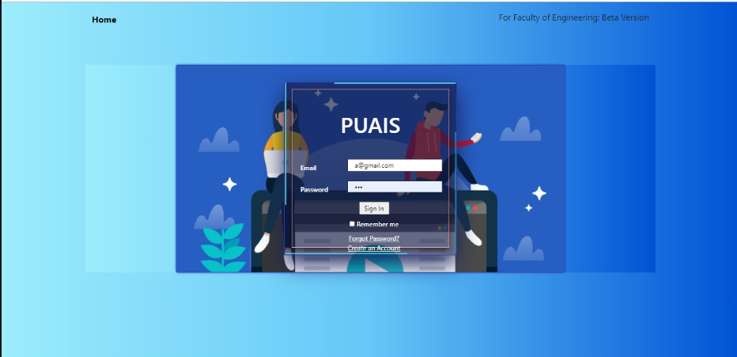
Home Page

Slide 5
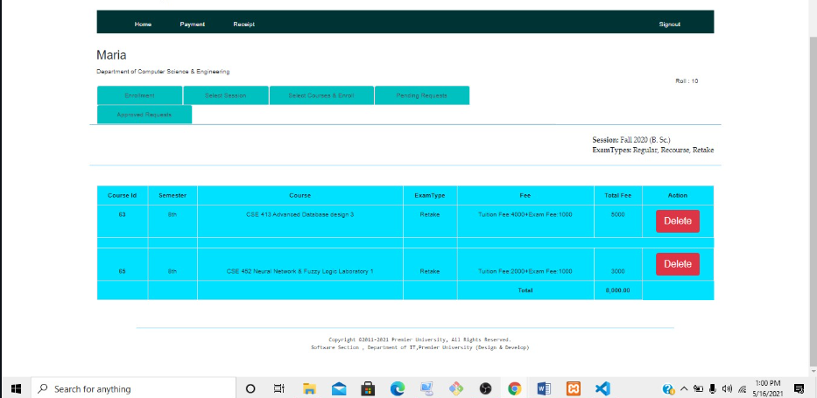
The admin has right to delete courses

Slide 6
