Slide 1

Manulife Success Story
Martin Alejandro Muriago
Program Manager for Manulife Account
GTS, Solutions, Del & Transf

Slide 2

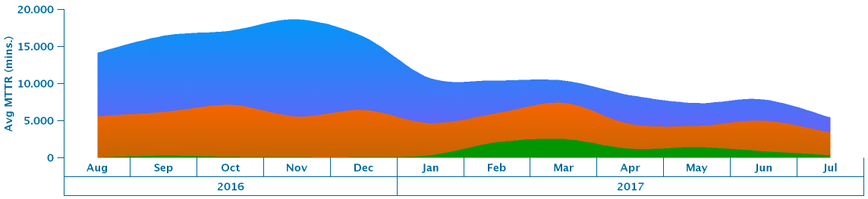
Cognitive Delivery Insights - Automation Metrics
Our account was able to reduce 62% our Mean time to Resolve midrange Incidents by improving Dynamic Automation.
CDI was a critical part of the process, as it helped us to understand where the oportunities to improve were and how to address them:
How we were able to improve DA?
We had 3 Key points to address in order to reach our objective:
1) Increase our scope of servers flowing into Auomtation IPcenter
2) Review opportunities on Incidents that were manually resolved
3) Improve the perfomance of those Automatas that were already deployed.
07

Slide 3
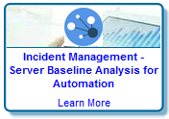
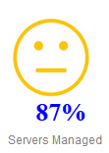
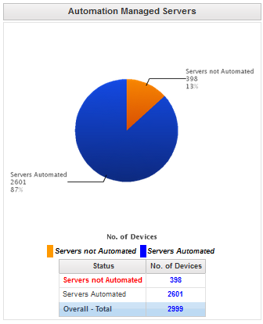
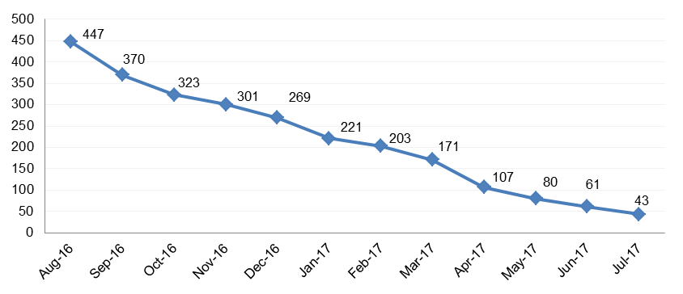
Cognitive Delivery Insights - Automation Metrics
1) Increase our scope of servers flowing into Auomtation IPcenter
How it works?
As part of our management system, our Automation Squad logs into the Server Baseline insight and review servers that should be flowing into IPcenter
As not all of our inventory is applicable for automation, squad works on the separation of those that fall within scope and address them.
Once identified those applicable, we work with the CSI global team in order to connect those servers to IPcenter and increase the scope of servers flowing into IPcenter
07
Result in our local Metrics - In Scope servers pending deployment
*0 pending servers reached in September

Slide 4
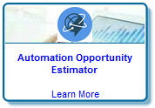
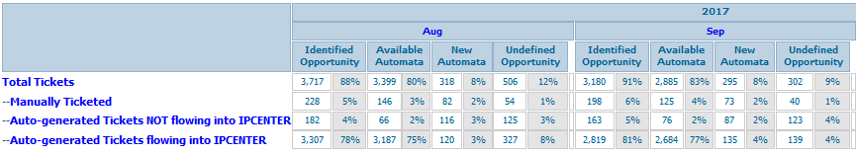
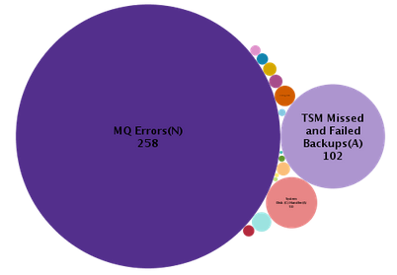
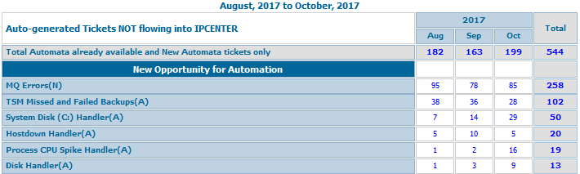
Cognitive Delivery Insights - Automation Metrics
2) Review opportunities on Incidents that were manually resolved
How it works?
As part of our management system, our Automation Squad logs into Automation Opportunity Estimator and review all those Manually Tickets and Tickets not flowing into IPcenter
Based on the filters you apply , Automation Opportunity Estimator will let you what new automatas you can develop, or which automata already deployed could attack the tickets that are not flowing into IPcenter.
14 New automatas were deployed since we started using CDI
07

Slide 5
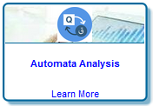
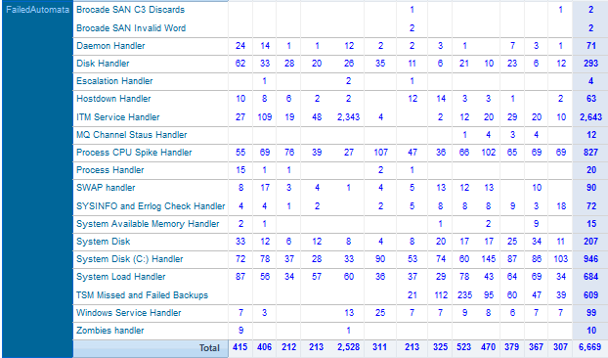
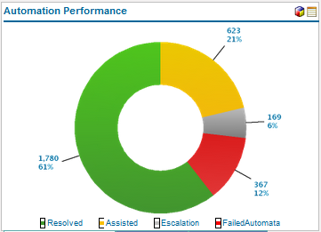
Cognitive Delivery Insights - Automation Metrics
3) Improve the perfomance of those Automatas that were already deployed.
How it works?
As part of our management system, our Automation Squad log into the Automata Analysis to see which automatas need to improve their success rate
Filtering by failed (those were the automata did not complete the assigned task) and Escalation (those were partially completed and escalated to the technical team for final completion), we identified which should be reviewed.
With this approach, we were able to move from 860 tickets resolved end to end in August 2016 to 2404 tickets resolved end to end in September 2017.
07

