Slide 1

IBM Services Platform with Watson Infrastructure Optimization with Densify at Singapore Airlines
Sanjeev Gopal
Chief Architect, Singapore Airlines
IBM Global Technology Services, Singapore

Slide 2

Singapore Airlines has been a flagship account for GTS in ASEAN since 2004
Singapore Airlines (SIA)
The flag carrier airline of Singapore with its hub at Singapore Changi Airport
Three brands: Singapore Airlines, Silk Air and Scoot
Consistently rated among the top 10 airlines worldwide in multiple categories
Rated number 2 overall for 2017 (Source: Skytrax - The Top 100 Airlines of 2017)
Was the launch customer for the Airbus A380, the world's largest passenger aircraft
IBM Services at SIA
Delivering infrastructure services since 2004!
4th consecutive contract renewal – termed Genesis 4
Covers servers/storage and end user services
Baseline: 1200 servers, 1PB storage, 25K users
TCV of USD 94M over 5 years until Nov 2021
GBS engaged on software projects – the latest being the IOS apps for pilots/crew
Refer: IBM MobileFirst for iOS Apps to be Launched on Singapore Airlines Flights

Slide 3






Software Defined Infrastructure Control is one of several initiatives under way at Singapore Airlines that are exploiting the IBM Services Platform with Watson
8
8. IBM Watson: evolves all automation and analytics to be able to achieve more e.g. to address non-deterministic use cases
SIA:
WSS with Watson
Cognitive Delivery Insights
1
2
3
4
5
6
7
Business Value
1. Automated Environment Build: Build compliant audit-ready, business-ready environments
2. Automated System Hygiene: Includes Continuous Compliance and Risk-based Continuous Patching
3. Dynamic Automation: Collation, Reduction, Automated Remediation, Measurement and Analysis of Events
4. Self Service Delivery: Self service implementation of pre-profiled automated changes
5. Robotic Process Automation: Automating both IT and business processes
6. Run Book Automation: Intelligently store operational procedures linked to down steam automation, enhancing human performance
7. Analytics, Measurement, Visualisation: Deep insights to focus automation activities and pre-emptively improve
SIA:
Automated Storage Provisioning
Automated Server Build
SIA:
Patching Automation
Continuous Compliance
SIA:
DA with IPcenter
DA with BigFix
SIA:
BluePrism
BlueZZZ
SIA:
Densify
Log Analysis
PASIR
Build Manage Change Run

Slide 4
Densify is an advanced capacity management system that enables software defined infrastructure control
Densify is an advanced capacity management system developed/supported by the company with the same name
Available in SaaS and on-premise versions
The system analyzes capacity data from multiple sources – VMware, PowerVM, Physical, AWS and others
Uses extensive policies covering technical, compliance/security and business parameters
Was called Cirba until early/mid 2017
Supports key use cases for infrastructure services delivery:
Reduce capacity-related risks
Save costs by reclaiming compute/storage resources
Identify physical servers that can be virtualized; Determine the best location for a virtual server, including cloud locations
Plan supply based on organic and inorganic growth (optimize cost/increase revenue)
Easy to use – uses hotel booking analogy, powerful graphics, and translates to $$$ where possible

Slide 5
Densify was deployed at SIA to help drive increased virtualization and enable more effective capacity management and optimization
When renegotiating the most recent contract renewal we deliberately drove a strategic shift towards increased use of virtualized environments (and public cloud in the future)
Creates potential for IBM to better optimize infrastructure usage… and also creates need to satisfy a skeptical client that performance has not been adversely impacted through virtualization
Need for automated analysis
Older tools needed someone to go through the data to make recommendations
Densify provides recommendations based on extensive policies
Need to respond faster
Densify analyzes and provides recommendations continually – as against a traditional process of monthly report generation followed by manual analysis
Densify can in fact automate some of the recommended actions too
Reduce human dependency / error / guess work
Define policies and develop scenarios, and the system does the rest
IBM investment in this solution: USD 500K over 5 years

Slide 6
The implementation of Densify has been an ongoing journey involving both IBM and SIA teams
1H-2016: Re-contracting phase when we included the system in the solution in the transformation
Q4 2016: Engaged Densify to start the implementation
Q1 2017: Base system ready; Data collection started; Active/Daily working sessions
Q2 2017: Teams trained on the system; Started weekly meetings to expand system
Q3 2017: Started expanding the system to include physical servers and AWS
Q4 2017:
Metrics established for on-premise environment
Weekly meetings with SIA started – to review/act on recommendations
Expansion completed!
Expansion to AWS was not part of the original scope – we added it in the interest of SIA
We don’t yet have any GTS-managed workloads on AWS – it’s hence a value add to SIA!

Slide 7
Densify has provided SIA with powerful insights into their virtualized environments
The following 5 slides are powerful messages of the present!
On-premise virtual: We have quite some capacity risks. Actions are in progress to mitigate though.
AWS: Initial estimate is that SIA can save 48% each month
This is an aggressive estimate though (and currently based on list prices)
We’re working with SIA to validate and fine-tune the underlying policy
Notes:
The following slides are quite self-explanatory (to understand at a high level)…

Slide 8
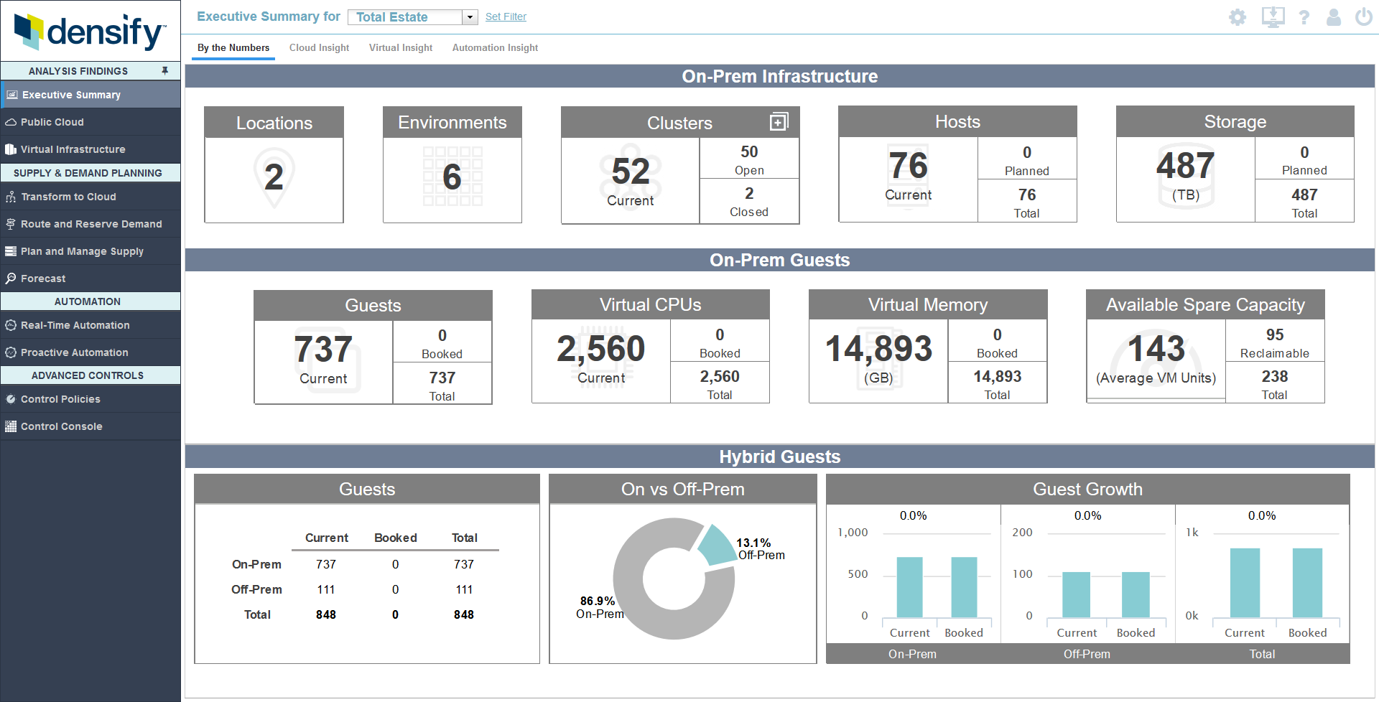
Starts with a high-level view of the entire estate (environment) – with key metrics like Planned/Booked and Reclaimable

Slide 9
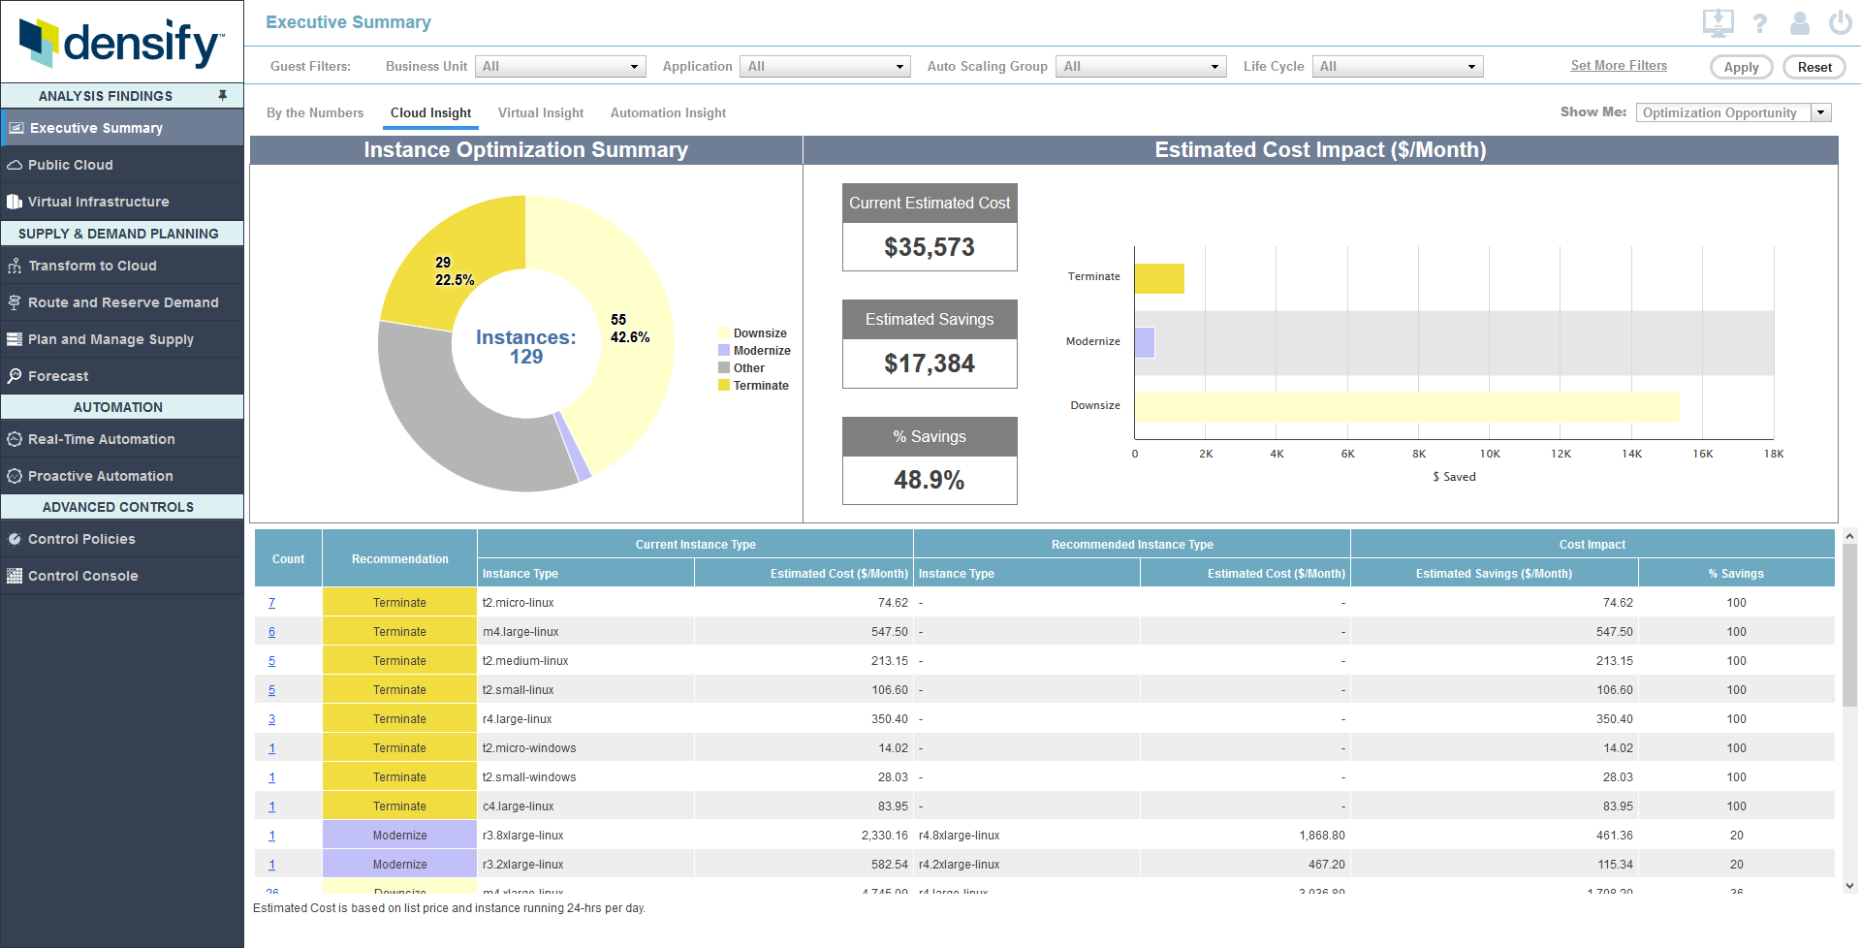
Cloud Insight view showing potential savings (48.9% here) if one performs the recommended actions – Terminate/Modernize/Downsize

Slide 10
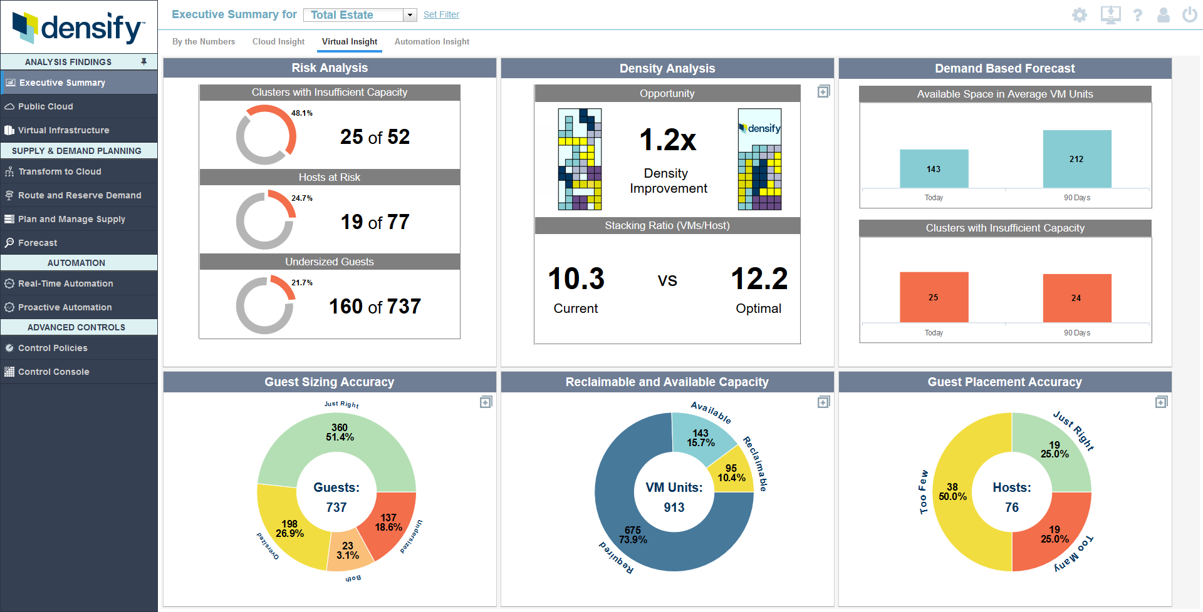
Key metrics related to the on-prem virtual environment, including PowerVM. Metrics are easy to understand.

Slide 11
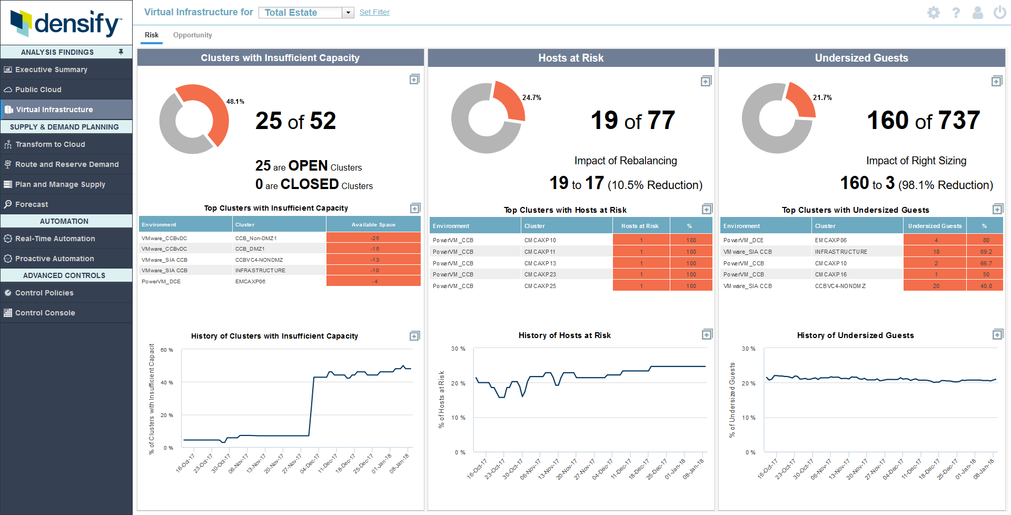
Focussed view on the risks in the on-prem environment. Reviewed with the client every week, and the history is used in executive reviews.

Slide 12
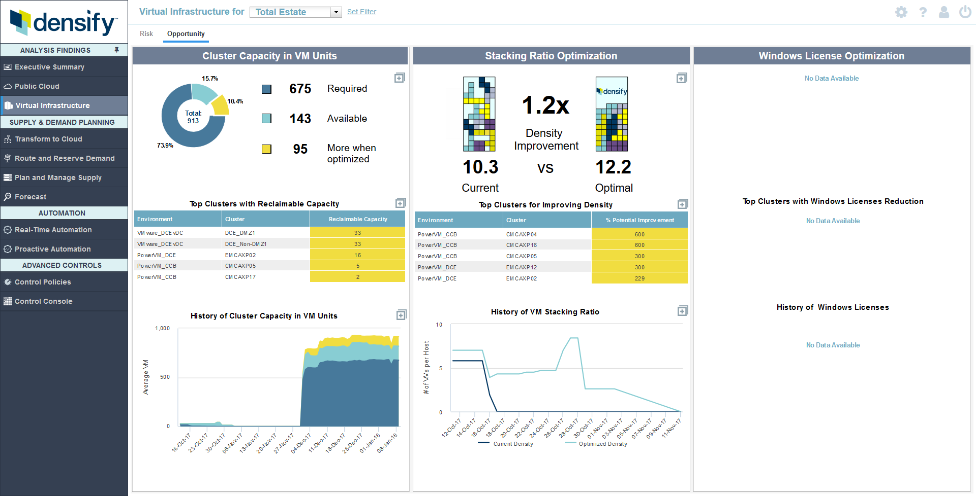
Another view – on Opportunities – where one can save $$$. These are reviewed weekly too.

Slide 13
We have plans to further extend the use of Densify during 2018
Complete PCR with Densify on the Routing/Reservation and Transformation modules
Routing/Reservation – this will allow SIA/IBM to input workload demands, and hence plan supply on time
Transformation – Help to more accurately identify what to move and where
Implement Routing/Reservation and Transformation
Continued focus on operationalising/realizing value; Measure value in $$$
Include IBM Cloud (VCS Instances)
Evaluate automation capabilities; Implement minor risk ones
Evaluate Software License Control – additional feature of Densify to optimize/reduce software cost
Plan for 2019-2021

Slide 14

Thank you!
For more information, please visit:
http://www.ibm.com

