Slide 1
Raviteja Poruri – Security Health Check Analyst
17 June 2014
Security Scan Analysis Tool
(SSAT)
Document number

Slide 2
SCS - Security Scan Analysis Tool
What When Where Why
Why was this initiated
  ISeC Parameters / Settings were missing in the Security health check scan report covered by tool. (Audit findings in XcelEnergy, Hartford on missing settings)
Where this project is applicable
  Applicable on the accounts that are using IEM (IBM Endpoint Manager) Security Scan tool.
When will this be applicable
  Any Security Health Check (Official / Un-Official scans) to ensure all the ISeC settings are covered.
What does the project do
  Automate the Manual inspection required over checking for each setting on each server to ensure all the settings are being covered on all the servers. Also, additional feature to ensure all the servers been reported in the Security scan result.

Slide 3
SCS - Security Scan Analysis Tool
Pre Vs Post
PRE | POST
1. Sanity check - Two servers were randomly picked and monitored manually, the technical specifications were validated to understand and prepare Gap settings over the servers and were sent for Manual inspection to Platform support teams. | 1. Sanity Check - Full check is performed on complete inventory on all the settings and Macro will ensure to provide all the settings coverage for all the servers and prepare gap checklist accordingly.
2. Technical specifications mapping with Coverage metrics is performed manually to check what parameters are covered in respective fixlets in IEM. | 2. Technical specifications mapping with respect to coverage metrics is fully automated.
3. Validate the technical specifications manually with the tool and with the scan result to ensure proper configuration happened over the tool and tool is checking what is required over the server setting. | 3. Technical specification validation is automated. The configured parameters will be put up by the macro stating 'Desired Value' reducing any miss in wrong configuration.

Slide 4
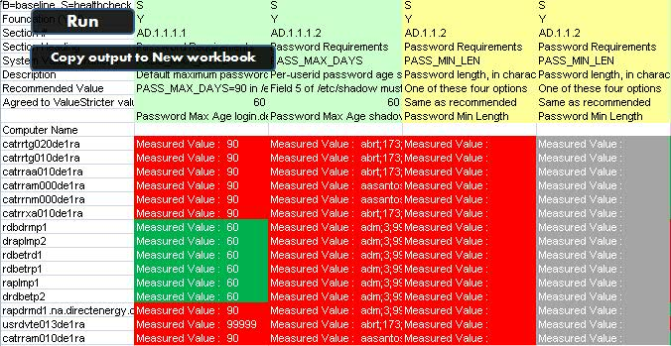
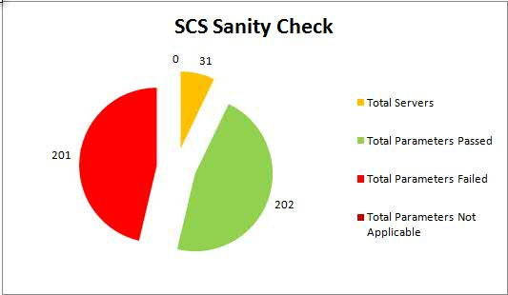
SCS - Security Scan Analysis Tool
Macro outcome projection

Slide 5
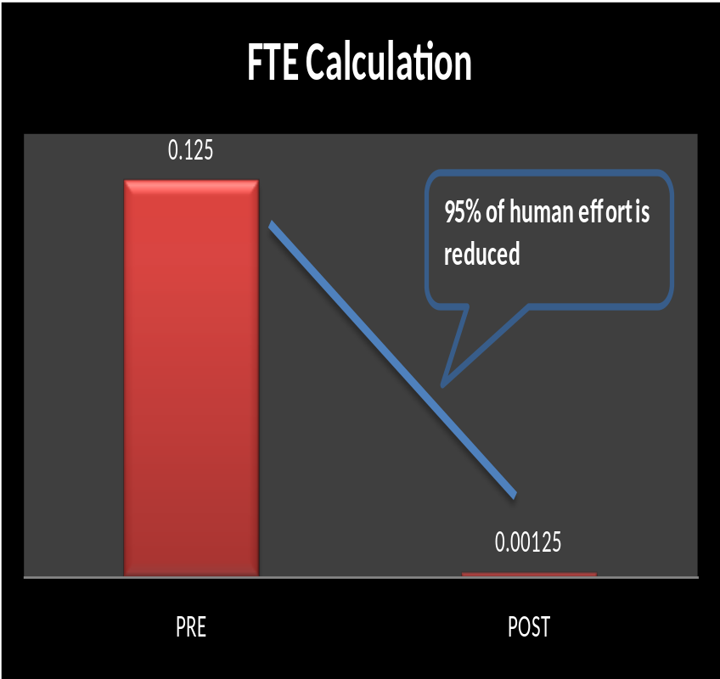
SCS - Security Scan Analysis Tool
FTE Calculation
LIST | PRE | POST
Time taken per setting in minutes | 1 | 0.01
Number of Settings per platform per week (On average) | 15 | 15
Number of servers per platform | 2 | 2
Number of platforms | 10 | 10
Time taken for 15 settings for 2 servers in Minutes | 30 | 0.3
Time taken for 15 settings for 2 servers for 10 platforms (In Minutes) | 300 | 3
Time taken for 15 settings for 2 servers for 10 platforms (In Hours) | 5 | 0.05
FTE Required to perform the above | 0.125 | 0.00125

Slide 6
SCS - Security Scan Analysis Tool
Appendix
SCS – System Compliance Services
ISeC – Information Security Controls
GSD – Global Security Document
IEM – IBM Endpoint Manager
– Earlier it used to be Tivoli Endpoint Manager.
Requirements:
MS Office - Excel 2007 (and greater)
Thank You..!!

