Slide 1
Dynamic Automation - IPCenter
CSI
Document number

Slide 2
Contents
Overview
Transformation
Event Processing
Determining Eligibility
Sample Use Case for DA

Slide 3
Dynamic Automation Overview
IBM's Strategic Solution for Incident Handling
Autonomous resolution of issues in response to incidents, requests (service) and schedules
Dynamic Automation helps in Rapid and High Quality response to incidents with Consistent outcomes and Enhanced response and remediation (fix) time.
It is highly Scalable in handling asymmetric workloads at peak times.
Educates the Human Engineers with the additional information that is captured as per the procedures over a incident, thus helping in foreseeing major issues and help in reduction of Risks in the environment.
Supports multiple Platforms and Middleware
Analytics help to identify what are the next to automate

Slide 4
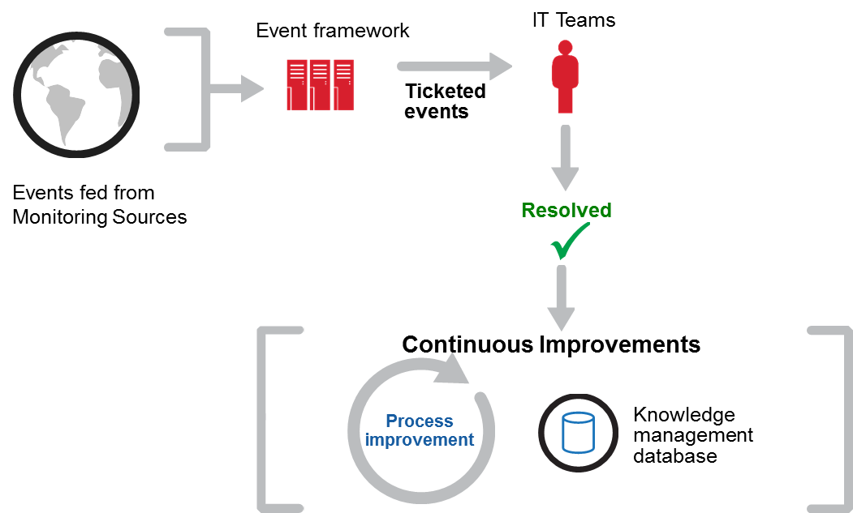
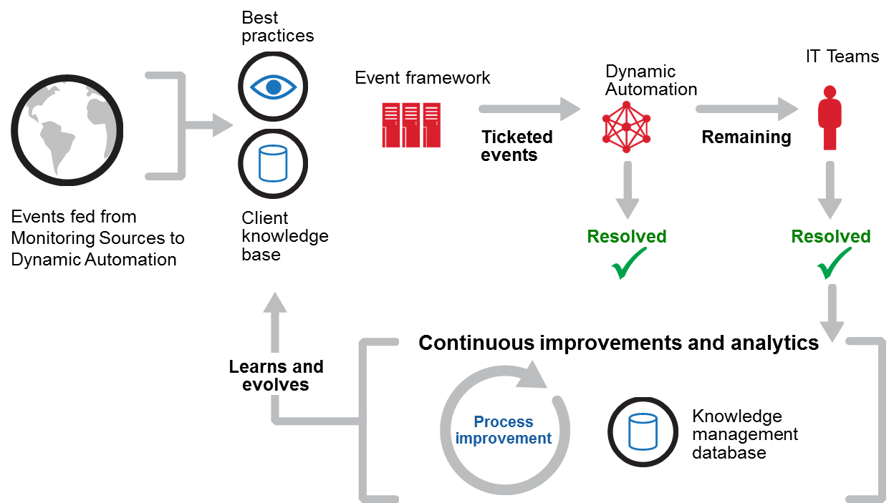
Transformation
Pre Automation
Automated IT Management provides rapid, consistent, and high quality response to incidents
Post Automation
Notes:
4

Slide 5
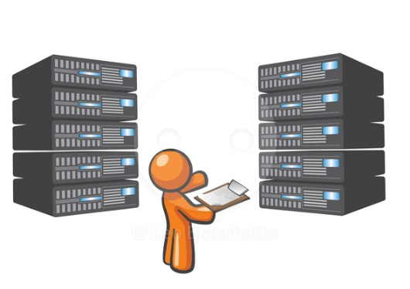

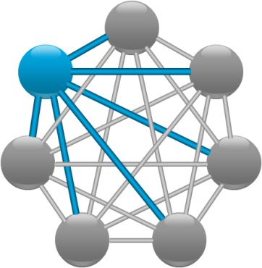
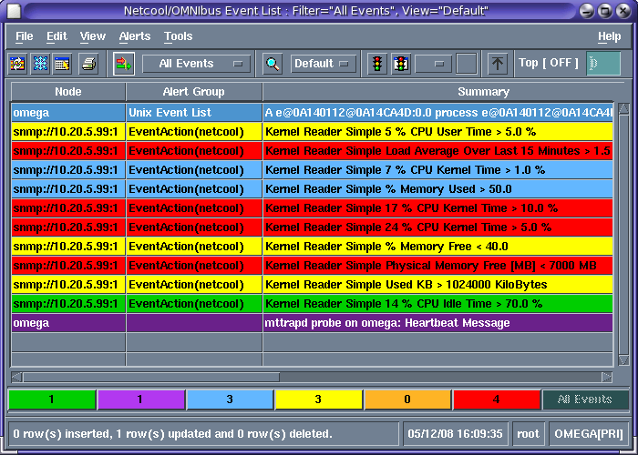
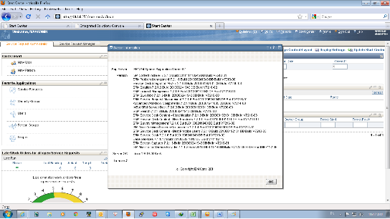


Event Processing
IPCenter
3
1. Monitoring detects issue and raises event into existing event system (eg Netcool, Nagios)
Softlayer
4. DA determines whether an Automata is applicable and sends ticket data to ISM
3. Events raised into DA
6. DA analyses and steps through workflow until complete
Customer Servers
4a Ticket raised into Ticketing System
4a
1
2
7 Ticket updated in Ticketing System
7
4a
4b
6
Integration Hub
8
5. Commands executed using standard mechanisms (eg SSH / Powershell)
6. Output sent back to DA
8. Tickets updated and/or resolved and placed in original target resolver group
5
Existing M&E and Ticketing Tools
Customer Servers

Slide 6
Determining Dynamic automation Eligibility
Is the device reachable in the network
Is it operable remotely to perform Command Line executions
Is it possible to communicate with the device programmatically
Is it possible to determine the fix to be provided in a documented procedure
# Device can be Server, Storage Device, Network Device, Database Instance
# Programatically indicates connectivity by Shell or APIs.

Slide 7
Sample Use Case for DA – Ping Down
Start
Device
Accessible?
Device
Uptime check
< 5min
Login to device
Yes
Show Version
No
Show ip eigrp neighbor
Wait for 5 Minutes
and
reconnect
No
Yes
Check
Neighbor
Uptime
< 5min
Return
type=power-on
and
Last reload:
Normal Reload
Yes
No
Show cdp neighbour
detail
Yes
Connect to the
Neighbor if down
No
No
show version
dir
more <lastest crashinfo>
show tech-support
Sh ip int brief
Sh ip bgp sum
Sh log
Close ticket as
false alarm
Yes
Neighbor down
at same time?
Update ticket and escalate
End
No
Close Ticket as
Power outage
Yes

Slide 8
Sample Business Process Use Case – Port Enablement
Business Process
Manual Re-Verification
Action / Procedure to enable Port
Update ticket to closure
Service Request Model
User Needs a
port to be open to
Access internal ntw
Ticket picked by
Network Engineer
Ticket updated with
Enablement information
Creates a Request
For Port Enablement on
Service Request tool /
Or on Call
Network Engineer
checks the approvals
and port details
And if user can be
Provided accessibility
Network Admin
Enables the port
Ticket Closed
L1 Team picks up the
request and sends to
Cross check for
approvals
Checks the port details
For enabling from the
request
Internal / External
Approvals received
In case Port details are
Different or not provided
Correctly, user will be
Intimated on the same
requesting details
Ticket transfer to
Appropriate team
Proceed to
enable?
Yes
Close the ticket
indicating
the reason
No

Slide 9
Open for Discussion

Slide 10
Thankyou

