Slide 1
DATABASE DESIGN
ONLINE SHOPPING System
Team #07
Ravi Teja , Teja Kiran, Sowmya
Hanvitha, Mohana

Slide 2
INTRODUCTION
HTML
PHP
MYSQL
FRONT END
MIDDLELEVEL
DATABASE
POST/GET
SQL queries
JSON
ANDRIOD

Slide 3
MODULES
ADMIN
CUSTOMER
ADMIN
SHIPPER
HTML
CUSTOMER
SHIPPER
Andriod
HTML
DB

Slide 4
PROJECT FLOW
CUSTOMER MAINTAINANCE
ADMIN | CUSTOMER | SHIPPER
View details of customer | Login,register | NA
 | Add/update multiple address

Slide 5
PROJECT FLOW
Product catalogue
ADMIN | CUSTOMER | SHIPPER
Add /delete/update products | View products and add to cart | Zip tables created
View all the products

Slide 6
PROJECT FLOW
Order -Shipment -returns
ADMIN | CUSTOMER | SHIPPER
Create shipper/delete | Create order /return | Zip tables created
View all the orders | View status order | View his deliveries/returns & perform necessary actions(PICK/PACK/SHIP)
Assign salestaxes in ziptable(this helps in calculating salestax while order creation.)

Slide 7
PROJECT FLOW
Subscriptions
ADMIN | CUSTOMER | SHIPPER | MYSQL
View Subscription orders | View products and subscribe | Same as order creation | Weekly and daily jobs
 | Change address/frequency |  | Triggers to add create new order and line items
This will be done automatically

Slide 8
SCHEMA DESIGN
PRODUCT
Product
category
CUSTOMER
User
Customer
Address_user
Order_user
Return_user
Order_quatity
Cart
Subscriptions
Subscription _quantity
ORDER
Shipper
Zip table

Slide 9
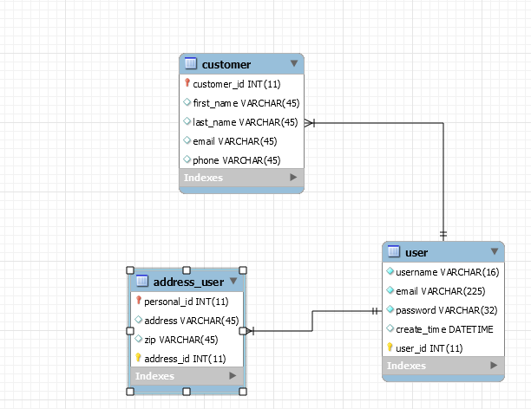
SCHEMA DESIGN

Slide 10
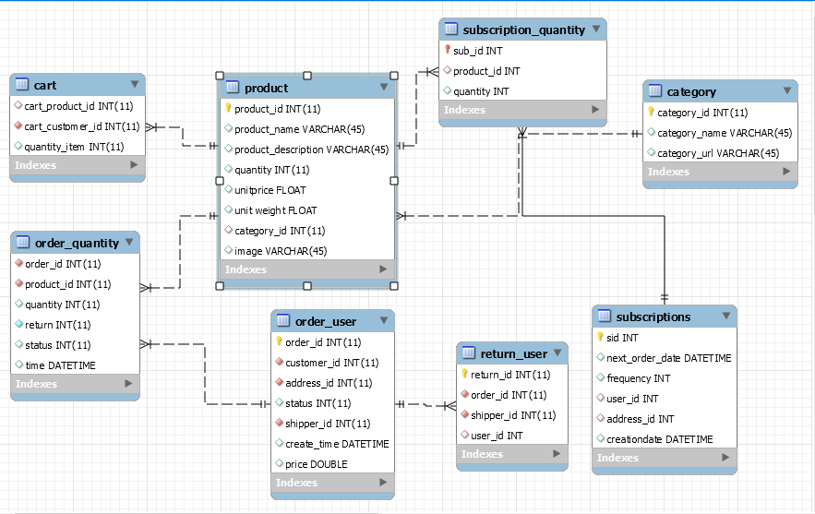
SCHEMA DESIGN

Slide 11
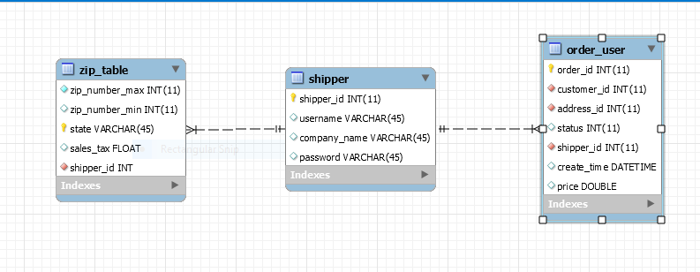
SCHEMA DESIGN

Slide 12
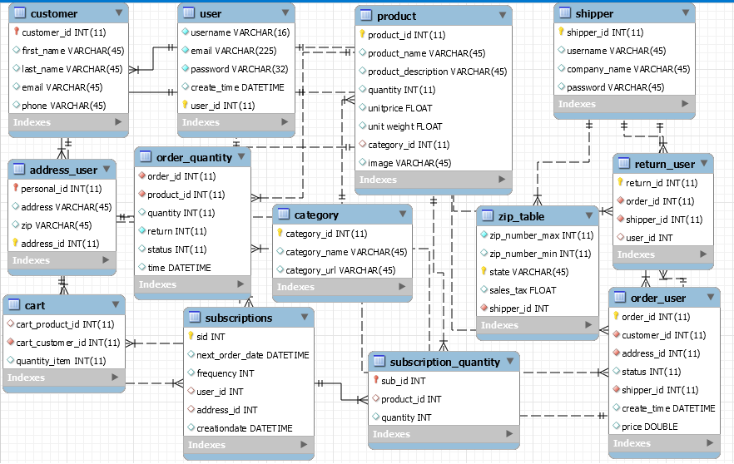

Slide 13
SQL FEATURES
Event schedulers for subscription orders-
Weekly – to create new table for that week subscriptions.
Daily – to check and place the order before the subscription day.
Update the subscription order with next order date.
TRIGGER to:
Insert new order before date.
Insert line items in the order.
We optimized the search load by reducing the search scope by weekly subscriptions table. Only once in a week, the entire subscriptions orders are traversed.
We used 3NF for our schema design thereby benefiting the decreased redundancy, fewer anomalies and improved efficiency.

Slide 14
SOFTWARES USED
ANDRIOD STUDIO
APACHE SERVER
MYSQL WORKBENCH
RJTEXTED

Slide 15
Thank you ☺

