Slide 1
Stock Prediction for FaceBook
Ravi Teja | Siddharth | Karishma | Sruthi

Slide 2
The Objective
Company
FB ~ NYSE
Objective
Founded: 2004
Market leader in Social Networking
Multiple child companies
Investors
Going public to raise capital : 2012
Strong Investment
Predict the stock value using time series model
Understanding Time series Models

Slide 3
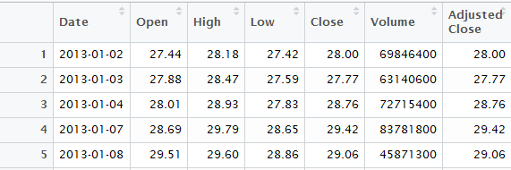
Data Description
•1008 observations of 7 variables
•Dataset contains:
Date : Date of the observation
Open : Opening price of the stock for that particular day
High : Highest price of the stock on that day
Low : lowest price of the stock on that day
Close: closing price of the stock for that day
Volume : Number of Stocks traded
Adjusted Close: Adjusted closed price of the stock

Slide 4
Challenges deep-dive
Challenge 1
Challenge 2
Challenge 3
Missing Data
No Data for Saturday and Sunday
As Stock market runs only for 5 days a week.
Managing Missing Data
Created a continuous Time Series object
Selecting the Variable
Close price / Adj Close Price
Tradeoff b/w Close & Adj. Close
Selected Close Price so that we will have clear idea of the trading day without adjustments.

Slide 5
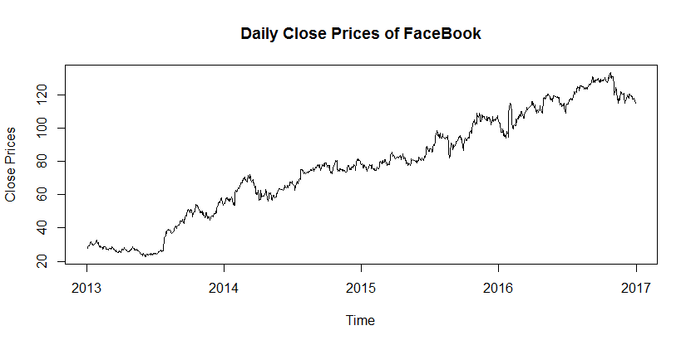
Data Analysis
Not Stationary
Increasing Trend across Time
No Seasonality
Trend of Close price across Time

Slide 6
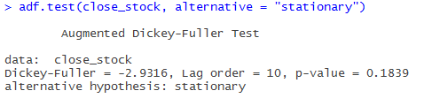
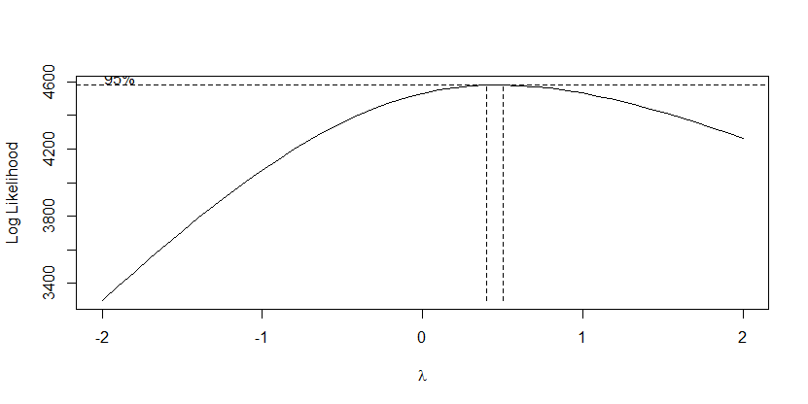
Data Analysis cntd..
ADF Test:
Not Stationary
P-value > 0.05
Failed to reject Null Hypothesis(H_{o})
Box Cox Curve:
Not Stationary
Lambda = 0.5

Slide 7
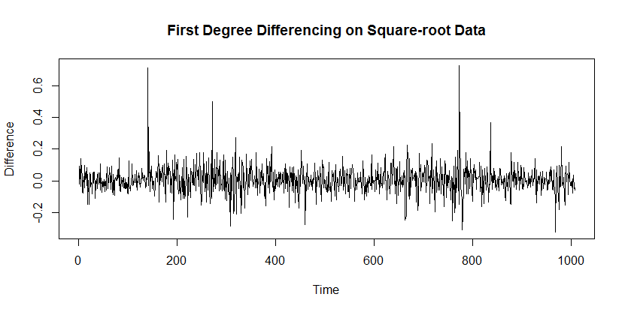
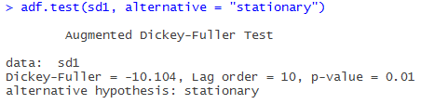
Data Analysis cntd..
Transformation and Differencing:
Transformed Data to Square root
Differencing at lag 1 to achieve stationarity
ADF Test:
Stationary
P- value < 0.05
Rejected Null Hypothesis

Slide 8
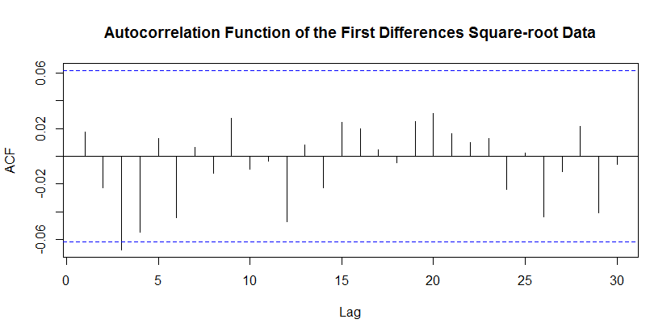
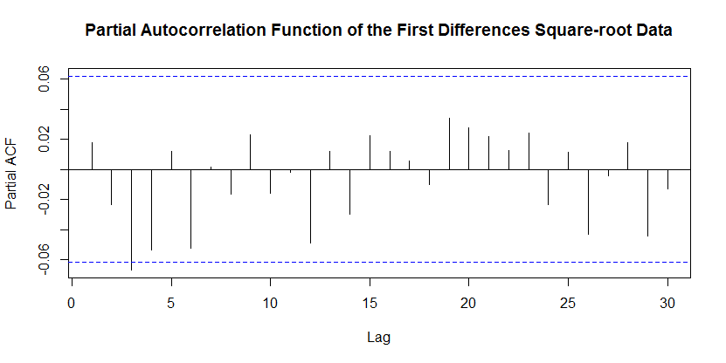
ACF & PACF Plots
Random Noise
Data is independent

Slide 9
Model Selection

Slide 10
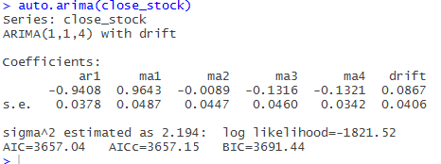
Model 1
Model 2
Model from auto.arima function:
Suggested for ARIMA(1,1,4)
AIC = 3657.15
Model from ACF & PACF plots
Random walk : ARIMA(0,1,0)
AIC = 3669.69
Y_{t} = y_{t-1} + e(t)

Slide 11
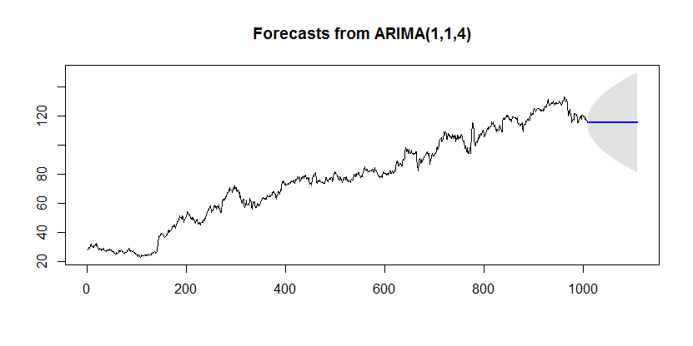
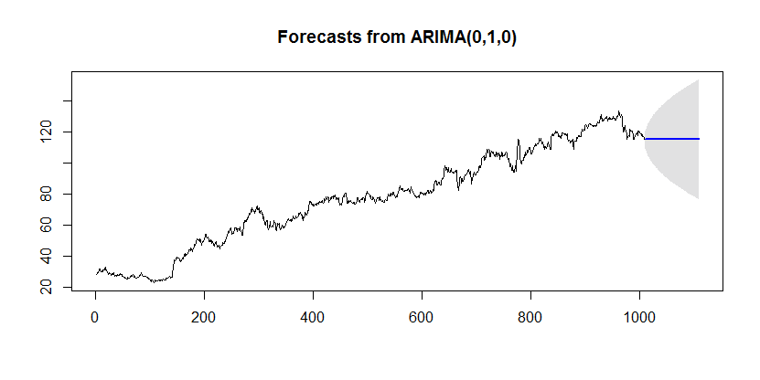
Model Forecast
Forecast from ARIMA(1,1,4)
Forecast is not following Trend
Confidence Interval = 99%
Forecast from ARIMA(0,1,0)
Forecast is not following Trend
Confidence Interval = 99%

Slide 12
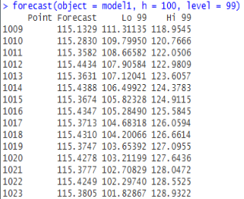
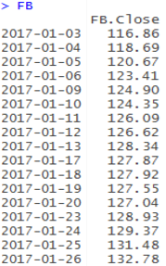
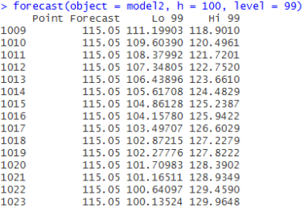
Comparing Actual Values VS Forecasted Values
Model 1 (Arima (1,1,4)
Actual Stock Price
Model 2 (Arima(0,1,0)

Slide 13
Random Walk
Change in a variable that follows no particular pattern or trend
Variance and Covariance as a function of time
Real world scenarios that follow random walk
Stock Prices
Movements of gaseous atoms
Stock Market applications of random walk
Comparison with traditional methods
Random walk with drift
Quantifying the trend as a function of time

Slide 14
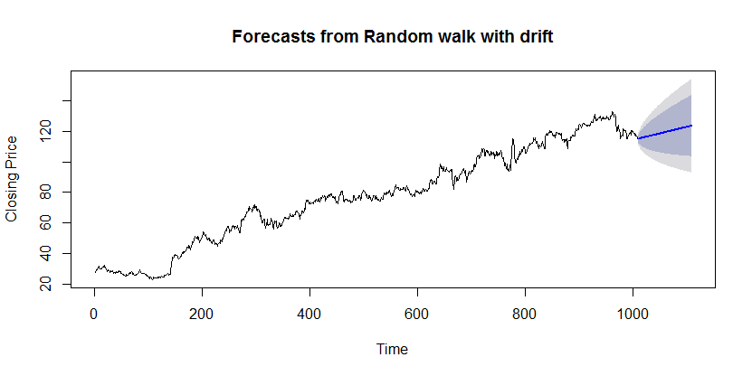
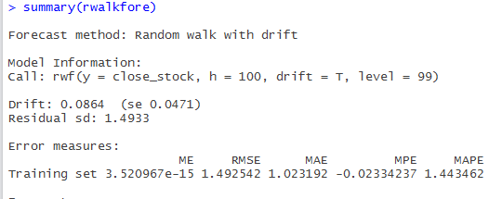
Random Walk with Drift
Y_{t} = y_{t-1} + e(t) + θ_{o}

Slide 15
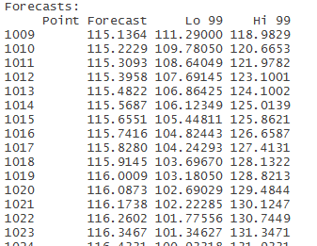
Comparing Actual Values VS Forecasted Values
Model 1 (Arima (0,1,0)) with Drift
Actual Stock Price

Slide 16
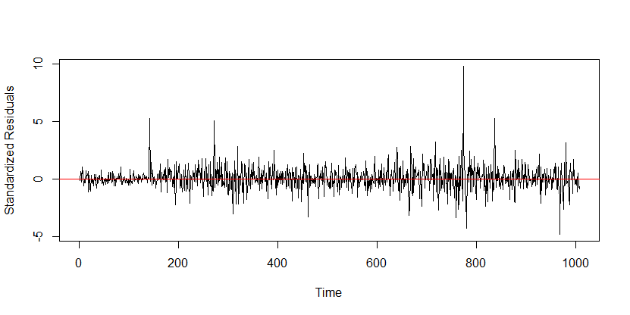
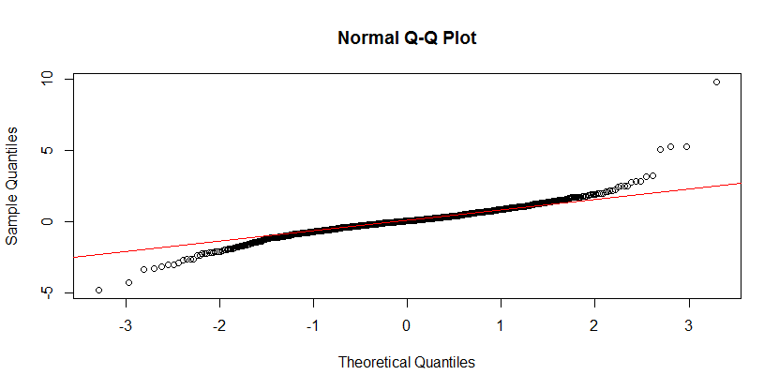
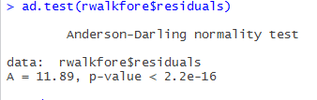
Residual Analysis
Plot for Standardized residuals
QQ plot for Residuals

Slide 17
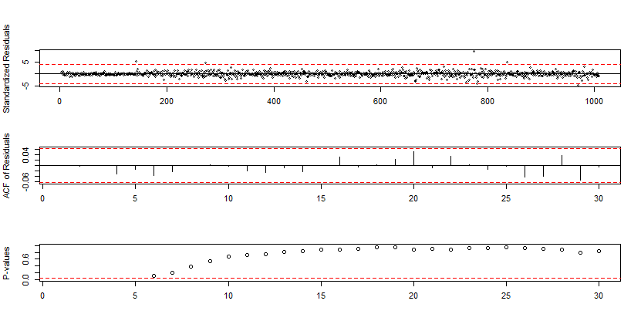
Residual Analysis
Ljung-Box test
H0: The data are random.
Ha: The data are not random

Slide 18
Conclusion
Best model is Random walk with Drift
Always Stock price is Volatile
Used for proper Timely reaction for Traders for a rough estimate

