Slide 1
Paras Aerospace
Data Science Task
Ravi Harekrishna Tiwari

Slide 2
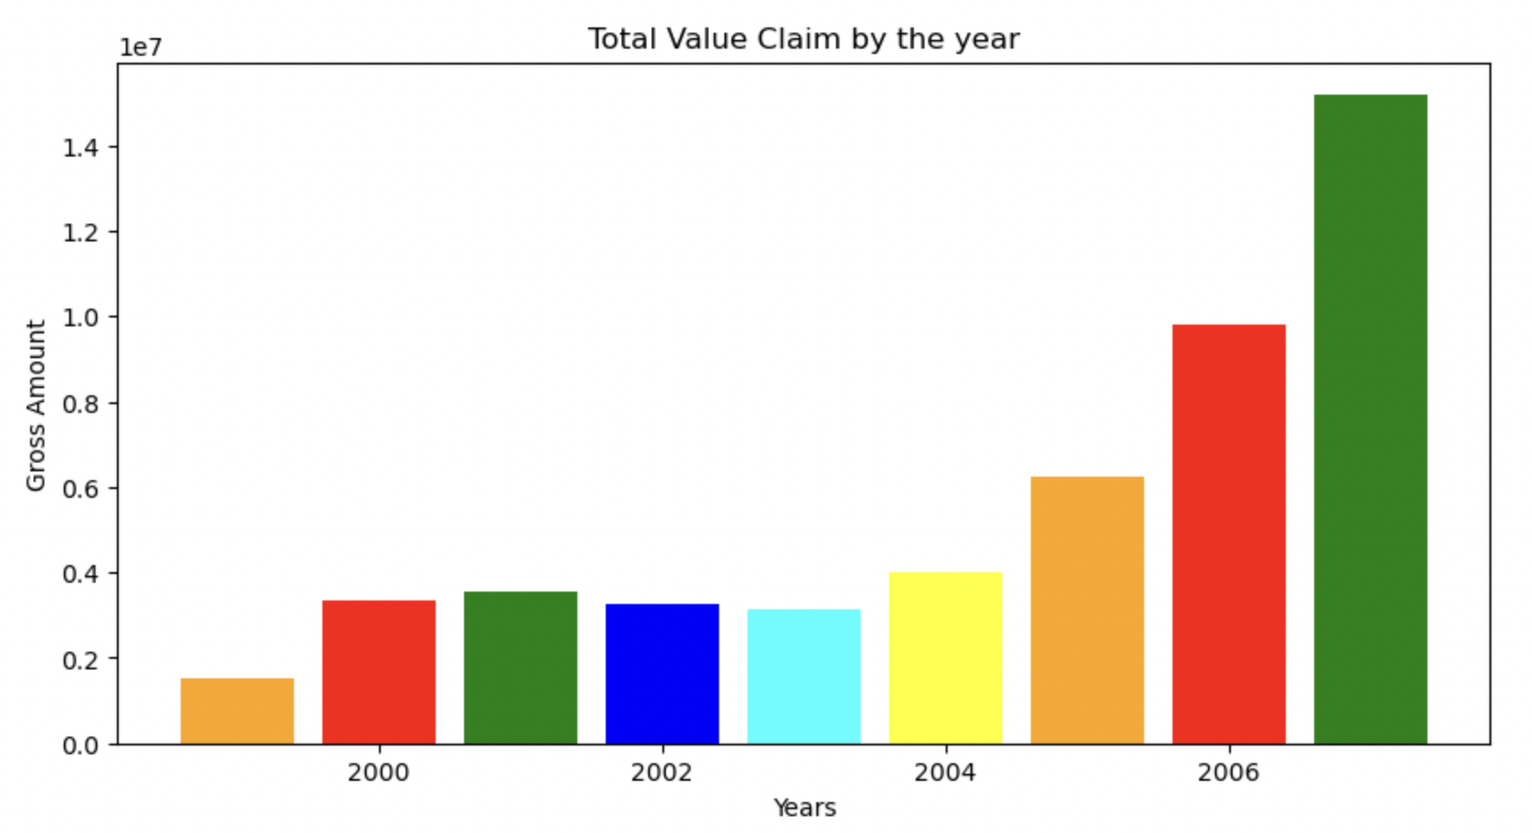
What are the total total claims by year and what trends are there? What could be driving these trends?
a) What are the total value of claims by year?
year = []
total_values=[]
for i in data_df['YEAR'].unique():
total_value =data_df.loc[data_df['YEAR'] == i, 'GROSS INCURRED AMOUNT'].sum()
year.append(i)
total_values.append(total_value.round(2))
dict = {'YEAR': year, 'GROSS INCURRED AMOUNT': total_values}
df = pd.DataFrame(dict)
df
 | YEAR | GROSS INCURRED AMOUNT
0 | 1999 | 1504421,74
1 | 2000 | 3326081,57
2 | 2001 | 3535301,70
3 | 2002 | 3262541,63
4 | 2003 | 3135699,13
5 | 2004 | 4022203,93
6 | 2005 | 6230756,87
7 | 2006 | 9818361,64
8 | 2007 | 15181791,84
CODE
Trend : As we clearly see in the above table & graph that claim of insurance is increases annually. It mean in the upcoming year we may see more insurance claim by the customer.
Caption

Slide 3
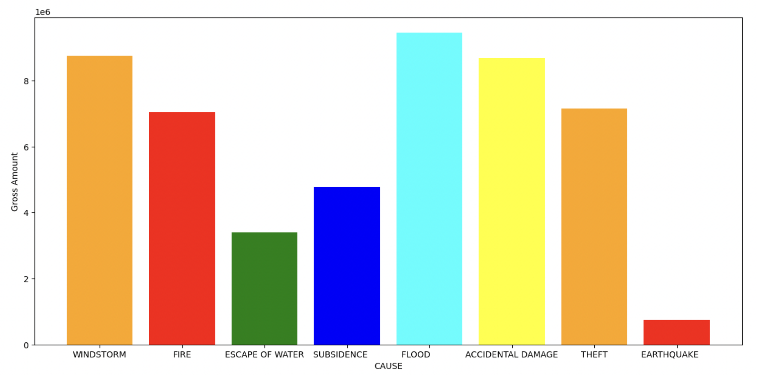
b) What factors, internal and external to the insurer, could be driving any trends that you have identified?
 | CAUSE | GROSS INCURRED AMOUNT
0 | WINDSTORM | 8751596,65
1 | FIRE | 7050611,03
2 | ESCAPE OF WATER | 3405456,11
3 | SUBSIDENCE | 4773181,49
4 | FLOOD | 9449495,10
5 | ACCIDENTAL DAMAGE | 8681913,23
6 | THEFT | 7156159,83
total_values = []
cause=[]
for i in data_df['CAUSE'].unique():
total_value =data_df.loc[data_df['CAUSE'] == i, 'GROSS INCURRED AMOUNT'].sum()
cause.append(i)
total_values.append(total_value.round(2))
dict = {'CAUSE': cause, 'GROSS INCURRED AMOUNT': total_values}
df1 = pd.DataFrame(dict)
df1
CODE
Here we see that maximum insurance amount claim
because of the FLOOD and the minimum amount
Is in EARTHQUAKE.
Observations: From the solution of both question a
& b , I observed that the insurance claim by the
people is increases yearly and most of time insurance
Claim because of FLOOD. Also we see that the factors
Windstrom, Fire, Flood, Acidental Damage and theft
are the area where insurance claim is high.
Caption

Slide 4
Which perils should the company worry about most and why?
a) Which claim types (perils) have the greatest average annual frequency and severity?
values = []
causes = []
years = []
for c in cause:
for i in year:
total_value =data_df.loc[(data_df['YEAR'] == i) & (data_df['CAUSE']==c), 'GROSS INCURRED AMOUNT'].mean()
values.append(total_value)
causes.append(c)
years.append(i)
dict = {'YEAR': years, 'CAUSE': causes, 'CLAIM': values}
df2 = pd.DataFrame(dict)
df2
CODE
print(df2[['YEAR', 'CAUSE','CLAIM']].sort_values('CLAIM', ascending=False).head(1))
YEAR CAUSE CLAIM AMOUNT
2001 SUBSIDENCE 10518.961
Here we get that SUBSIDENCE has greatest average annual claims: 10518.961 in the year 2001.

Slide 5

b) What is the average individual claim size by peril across the 9-year time period?
cause_2 = []
total_value2 = []
for c in causes:
total_value =data_df.loc[data_df['CAUSE'] == c, 'GROSS INCURRED AMOUNT'].sum()
cause_2.append(c)
total_value2.append(total_value.round(2))
dict = {'CAUSE': cause_2, 'CLAIM': total_value2}
df3 = pd.DataFrame(dict)
# Calculating average
result = df3.groupby('CAUSE')['CLAIM'].mean()
# Display result
result.round(2)
CODE
CAUSE AVERAGE CLAIM
ACCIDENTAL DAMAGE 8681913.23
EARTHQUAKE 748746.61
ESCAPE OF WATER 3405456.11
FIRE 7050611.03
FLOOD 9449495.10
SUBSIDENE 4773181.49
THEFT 7156159.83
WINDSTORM 8751596.65
Name: CLAIM, dtype: float64

Slide 6
What did Windstorm Erwin cost the company? What perils drove the loss?
a) What was the total loss, for windstorm and other related weather perils, for Windstorm Erwin (date Jan 7th to Jan 9th, 2005)
options = ['FLOOD','WINDSTORM','SUBSIDENCE']
df3 = data_df.loc[(data_df['MONTH']=='January') & (data_df['DAY']<9) & (data_df['DAY']>7) & (data_df['CAUSE'].isin(options))]
df3.head()
 | DAY | MONTH | MONTH_ID | YEAR | CAUSE | GROSS INCURRED AMOUNT
1947 | 8 | January | 1 | 2000 | WINDSTORM | 350,00
5221 | 8 | January | 1 | 2001 | WINDSTORM | 595,00
5223 | 8 | January | 1 | 2001 | WINDSTORM | 528,75
5224 | 8 | January | 1 | 2001 | WINDSTORM | 998,75
5226 | 8 | January | 1 | 2001 | WINDSTORM | 130,00
result_weather = df3.groupby('CAUSE')['GROSS INCURRED AMOUNT'].sum()
print(result_weather)
CAUSE TOTAL LOSS
WINDSTORM 205524.31
Total Loss for Windstorm weather perils in between 7th Jan to 9th Jan, 2005 is 205524.31.

Slide 7
Thank You…

