Slide 1
Foundations of Machine Learning
Module 5:
Part C: Support Vector Machine: Dual
Sudeshna Sarkar
IIT Kharagpur

Slide 2
Solving the Optimization Problem
s.t.
Optimization problem with convex quadratic objectives and linear constraints
Can be solved using QP.
Lagrange duality to get the optimization problem’s dual form,
Allow us to use kernels to get optimal margin classifiers to work efficiently in very high dimensional spaces.
Allow us to derive an efficient algorithm for solving the above optimization problem that will typically do much better than generic QP software.

Slide 3
Lagrangian Duality in brief
The Primal Problem
The generalized Lagrangian:
the α's (α_{ι}≥0) and β's are called the Lagrange multipliers
Lemma:
A re-written Primal:

Slide 4
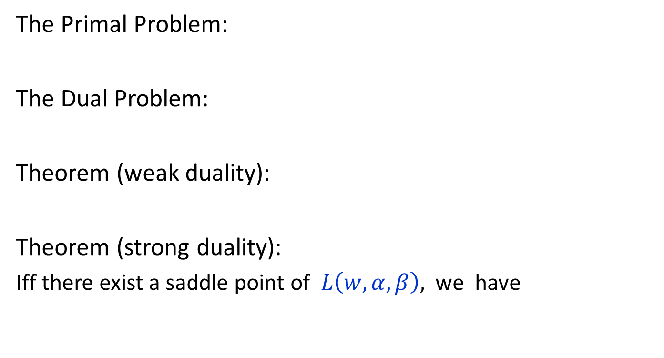
Lagrangian Duality, cont.
The Primal Problem:
The Dual Problem:
Theorem (weak duality):
Theorem (strong duality):
Iff there exist a saddle point of $L\left(w,α,β\right),$ we have

Slide 5
The KKT conditions
If there exists some saddle point of L, then it satisfies the following "Karush-Kuhn-Tucker" (KKT) conditions:
Theorem: If w*, a* and b* satisfy the KKT condition, then it is also a solution to the primal and the dual problems.

Slide 6
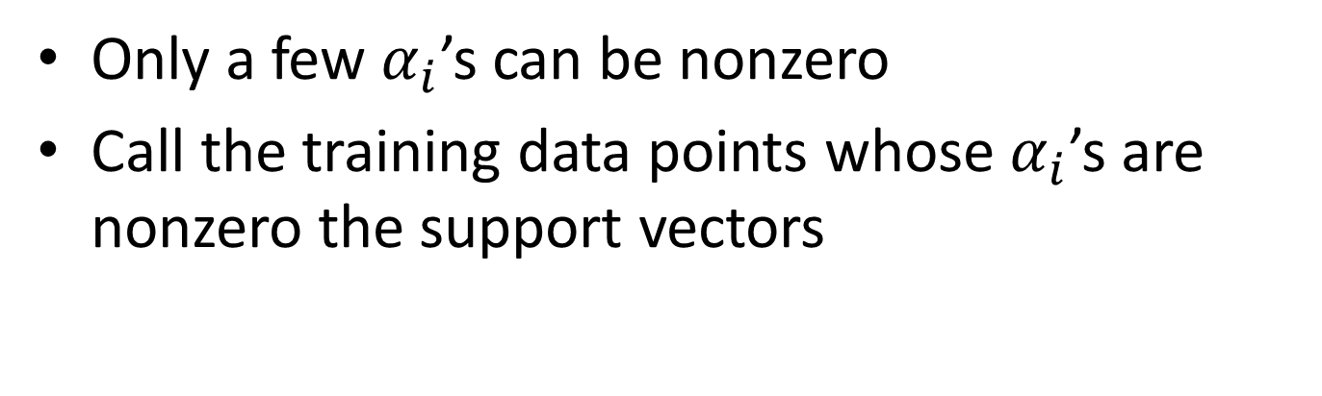
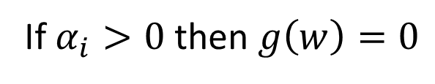
Support Vectors
Only a few $α_{i}$’s can be nonzero
Call the training data points whose $α_{i}$’s are nonzero the support vectors
If $α_{i}>0$ then $g\left(w\right)=0$

Slide 7
Solving the Optimization Problem
Quadratic programming
with linear constraints
s.t.
Lagrangian Function
s.t.

Slide 8
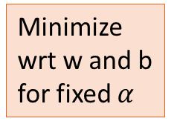
Solving the Optimization Problem
s.t.
Minimize wrt w and b for fixed $α$

Slide 9
The Dual problem
Now we have the following dual opt problem:
This is a quadratic programming problem.
A global maximum of α_{i} can always be found.

Slide 10
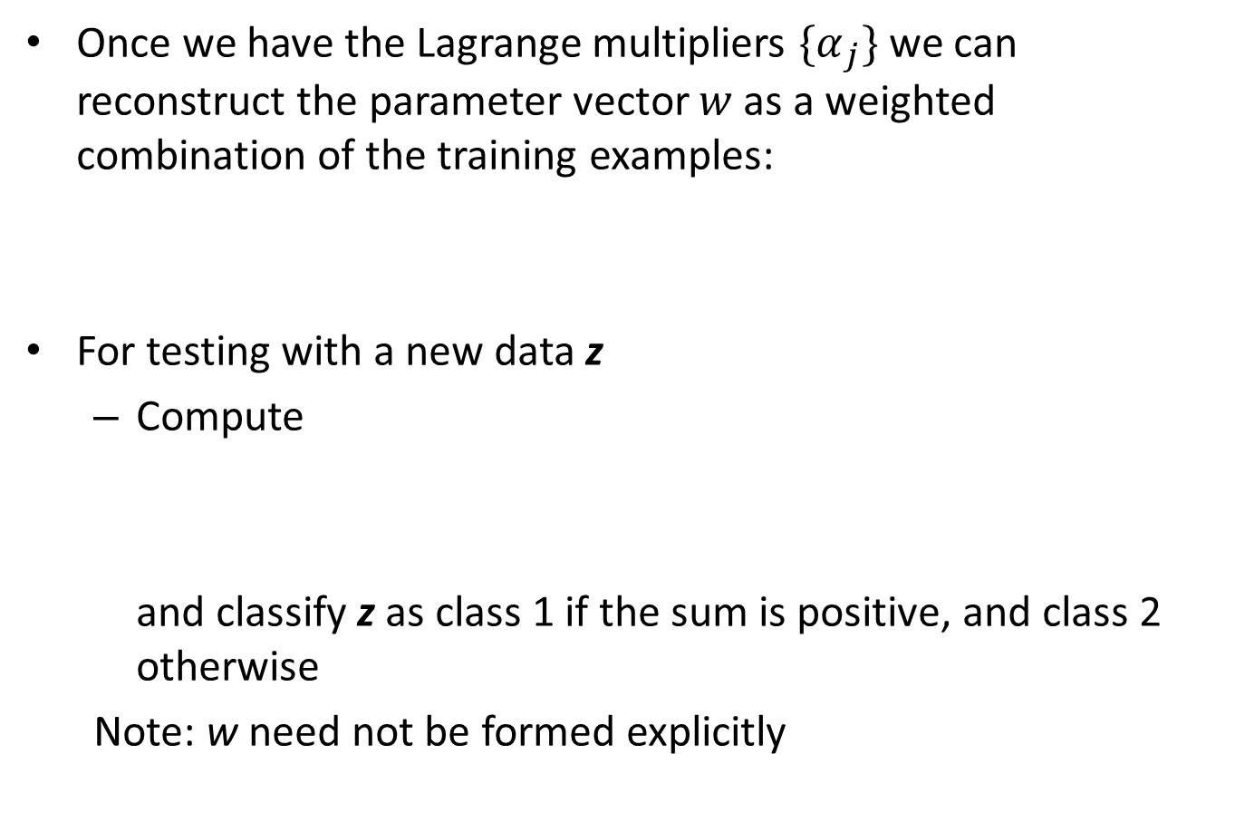
Support vector machines
Once we have the Lagrange multipliers ${\{α}_{j}\}$ we can reconstruct the parameter vector $w$ as a weighted combination of the training examples:
For testing with a new data z
Compute
and classify z as class 1 if the sum is positive, and class 2 otherwise
Note: w need not be formed explicitly

Slide 11
Solving the Optimization Problem
The discriminant function is:
It relies on a dot product between the test point x and the support vectors x_{i}
Solving the optimization problem involved computing the dot products x_{i}^{T}x_{j} between all pairs of training points
The optimal w is a linear combination of a small number of data points.

