Slide 1
Foundations of Machine Learning
Module 5: Support Vector Machine
Part D: SVM – Maximum Margin with Noise
Sudeshna Sarkar
IIT Kharagpur

Slide 2
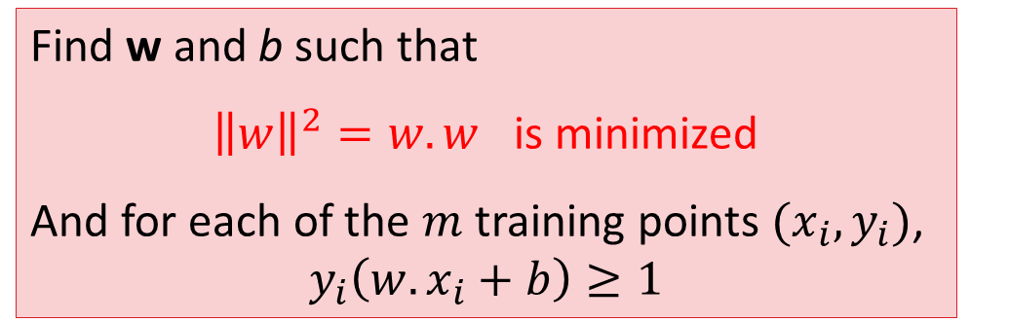
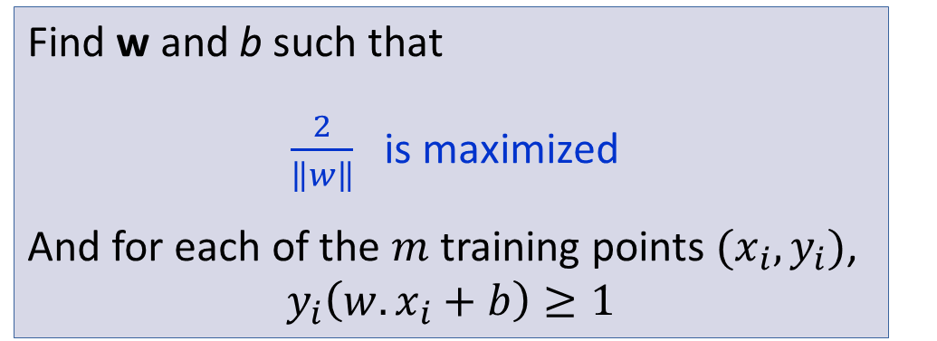
Linear SVM formulation
Find w and b such that
$\frac{2}{\left\|w\right\|}$ is maximized
And for each of the $m$ training points $(x_{i},y_{i})$,
$$y_{i}\left(w.x_{i}+b\right)≥1$$
Find w and b such that
${\left\|w\right\|}^{2}=w.w$ is minimized
And for each of the $m$ training points $(x_{i},y_{i})$,
$$y_{i}\left(w.x_{i}+b\right)≥1$$

Slide 3
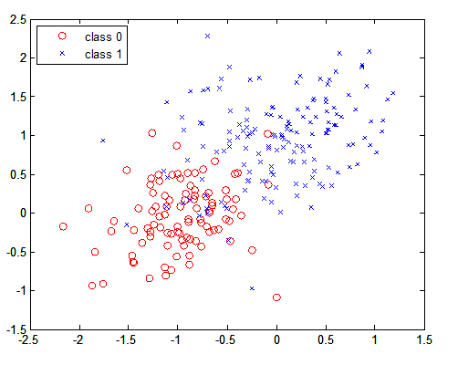
Limitations of previous SVM formulation
What if the data is not linearly separable?
Or noisy data points?
Extend the definition of maximum margin to allow
non-separating planes.

Slide 4
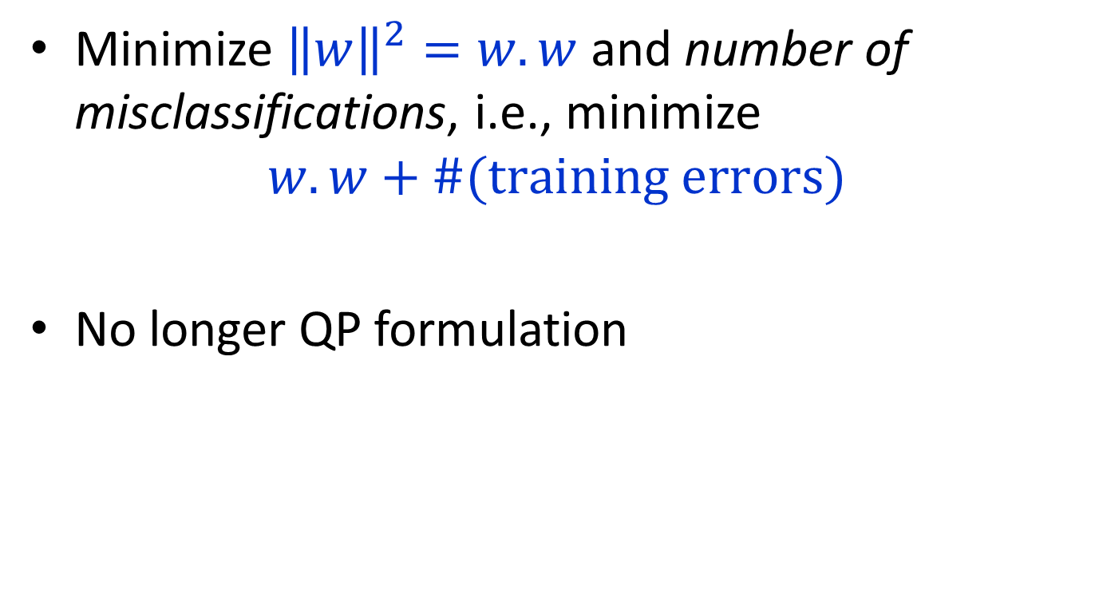
How to formulate?
Minimize ${\left\|w\right\|}^{2}=w.w$ and number of misclassifications, i.e., minimize
$$w.w+\#(\text{training} \text{errors})$$
No longer QP formulation

Slide 5
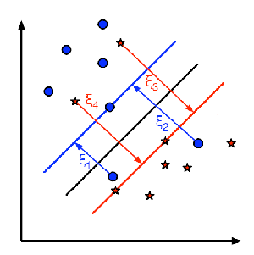
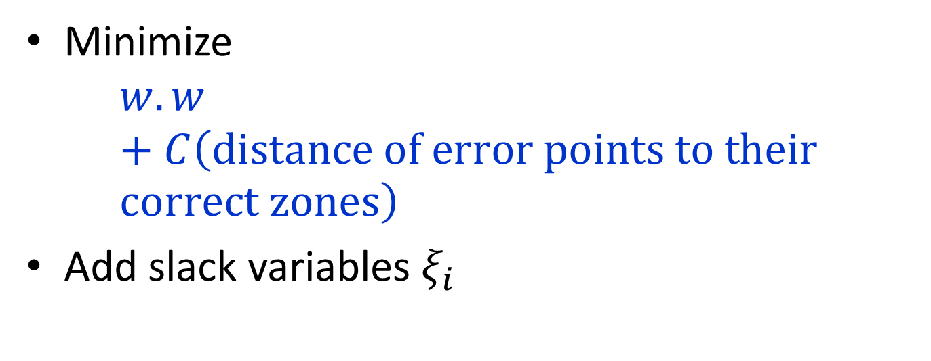
Objective to be minimized
Minimize
$$w.w+C\left(\text{distance} \text{of} \text{error} \text{points} \text{to} \text{their} \text{correct} zones\right)$$
Add slack variables $ξ_{i}$
Figure from http://docs.opencv.org/2.4/doc/tutorials/ml/non_linear_svms/

Slide 6
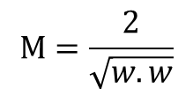
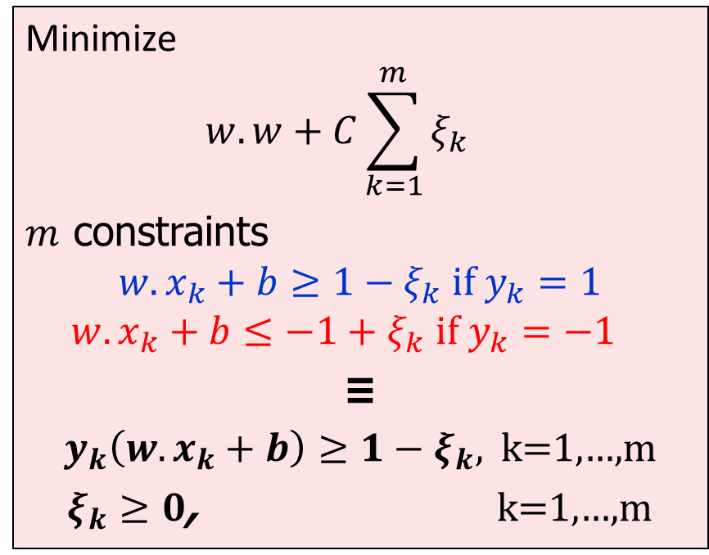
Maximum Margin with Noise
ξ₁
$$M=\frac{2}{\sqrt{w.w}}$$
wx+b=1
ξ₂
ξ₃
Minimize
$$w.w+C\sum_{k=1}^{m}{ξ_{k}}$$
$m$ constraints
$$w.x_{k}+b≥1−ξ_{k} if y_{k}=1$$
$$w.x_{k}+b≤−1+ξ_{k} if y_{k}=−1$$
≡
$y_{k}\left(w.x_{k}+b\right)≥1−ξ_{k},$ k=1,…,m
$ξ_{k}≥0$, k=1,…,m
wx+b=0
wx+b=-1
C controls the relative importance of maximizing the margin and fitting the training data.
Controls overfitting.

Slide 7
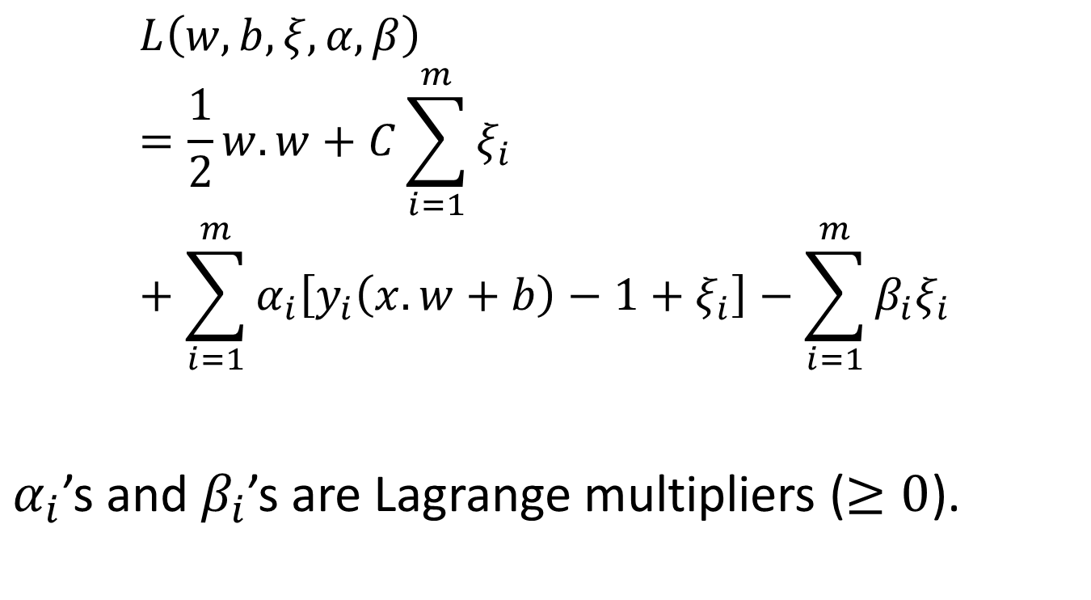
Lagrangian
$$L\left(w,b,ξ,α,β\right)=\frac{1}{2}w.w+C\sum_{i=1}^{m}{ξ_{i}}+\sum_{i=1}^{m}{α_{i}\left[y_{i}\left(x.w+b\right)−1+ξ_{i}\right]−\sum_{i=1}^{m}{β_{i}ξ_{i}}}$$
$α_{i}$’s and $β_{i}$’s are Lagrange multipliers ($≥0$).

Slide 8

Dual Formulation
Find $α_{1},α_{2},…,α_{m}$ s.t.
Linear SVM
Noise Accounted

Slide 9
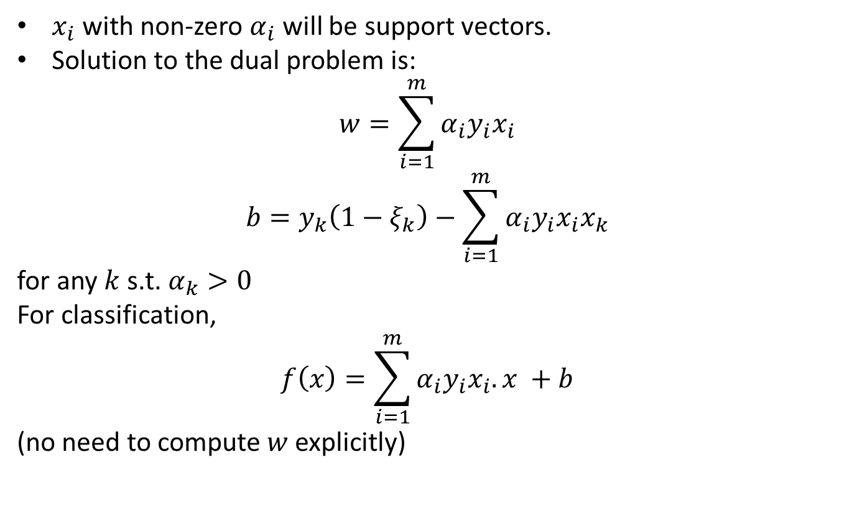
Solution to Soft Margin Classification
$x_{i}$ with non-zero $α_{i}$ will be support vectors.
Solution to the dual problem is:
$$w=\sum_{i=1}^{m}{α_{i}y_{i}x_{i}}$$
$$b=y_{k}\left(1−ξ_{k}\right)−\sum_{i=1}^{m}{α_{i}y_{i}x_{i}x_{k}}$$
for any $k$ s.t. $α_{k}>0$
For classification,
$$f\left(x\right)=\sum_{i=1}^{m}{α_{i}y_{i}x_{i}.x} +b$$
(no need to compute $w$ explicitly)

Slide 10
Thank You

