Slide 1
Foundations of Machine Learning
Module 5: Support Vector Machine
Part E: Nonlinear SVM and Kernel function
Sudeshna Sarkar
IIT Kharagpur

Slide 2
Non-linear decision surface
We saw how to deal with datasets which are linearly separable with noise.
What if the decision boundary is truly non-linear?
Idea: Map data to a high dimensional space where it is linearly separable.
  Using a bigger set of features will make the computation slow?
  The “kernel” trick to make the computation fast.

Slide 3
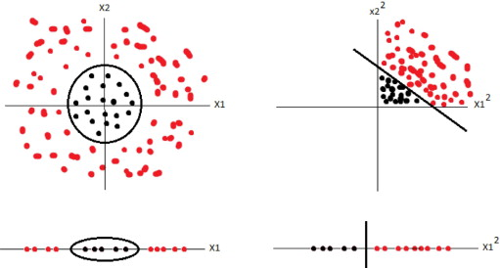

Non-linear SVMs: Feature Space
$$Φ:x →φ(x)$$

Slide 4

Non-linear SVMs: Feature Space
$$Φ:x →φ(x)$$
This slide is from www.iro.umontreal.ca/~pift6080/documents/papers/svm_tutorial.ppt

Slide 5
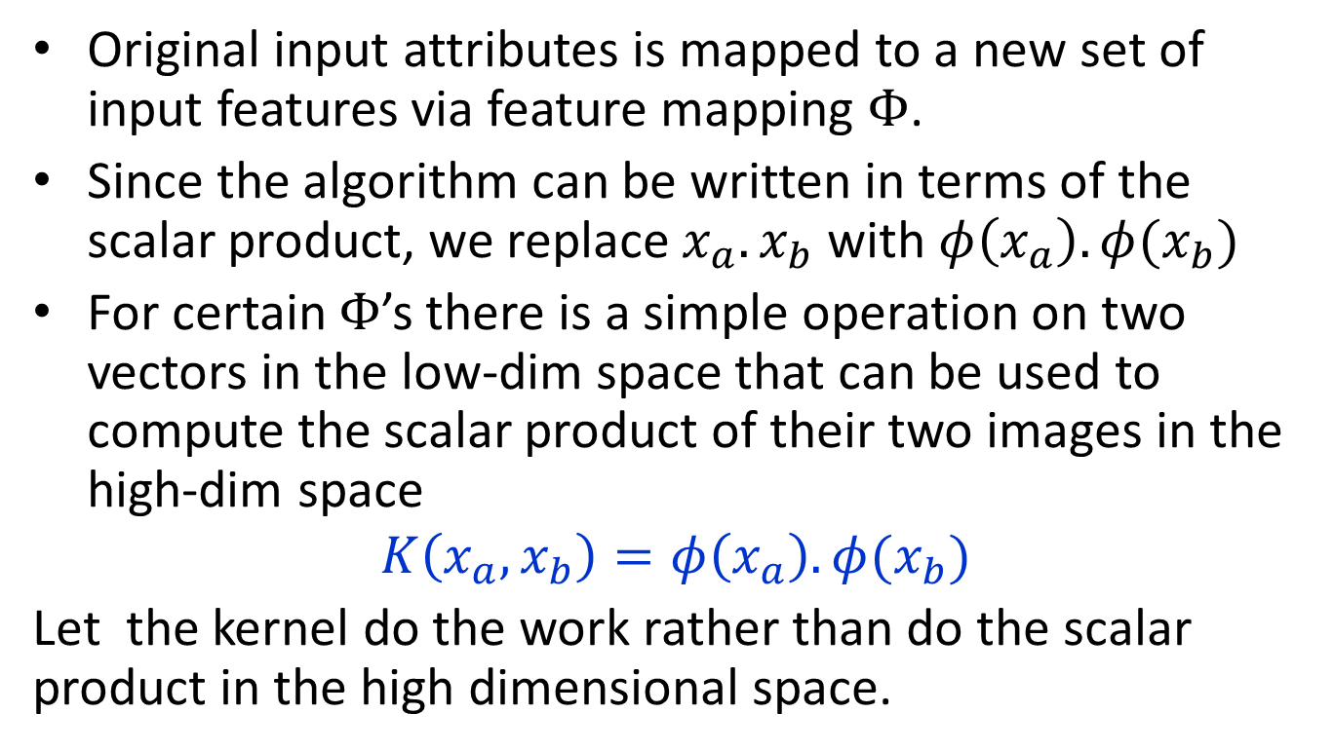
Kernel
Original input attributes is mapped to a new set of input features via feature mapping $Φ$.
Since the algorithm can be written in terms of the scalar product, we replace $x_{a}.x_{b}$ with $φ\left(x_{a}\right).φ(x_{b})$
For certain $Φ$’s there is a simple operation on two vectors in the low-dim space that can be used to compute the scalar product of their two images in the high-dim space
$$K\left(x_{a},x_{b}\right)=φ\left(x_{a}\right).φ{(x}_{b})$$
Let the kernel do the work rather than do the scalar product in the high dimensional space.

Slide 6

Nonlinear SVMs: The Kernel Trick
With this mapping, our discriminant function is now:
We only use the dot product of feature vectors in both the training and test.
A kernel function is defined as a function that corresponds to a dot product of two feature vectors in some expanded feature space:
$$K\left(x_{a},x_{b}\right)=φ\left(x_{a}\right).φ{(x}_{b})$$

Slide 7

The kernel trick
$$K\left(x_{a},x_{b}\right)=φ\left(x_{a}\right).φ{(x}_{b})$$
Often $K\left(x_{a},x_{b}\right)$ may be very inexpensive to compute even if $φ\left(x_{a}\right)$ may be extremely high dimensional.

Slide 8
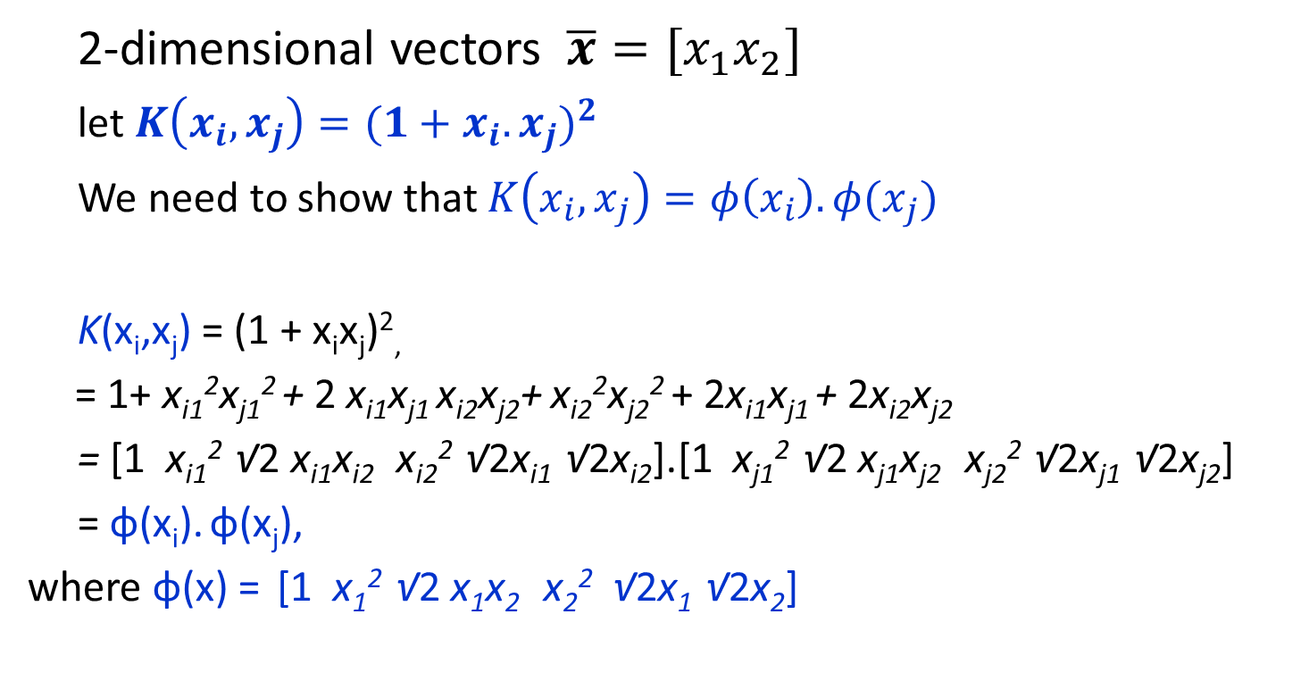
Kernel Example
2-dimensional vectors $\overline{x}=[x_{1}x_{2}]$
let $K\left(x_{i},x_{j}\right)={(1+x_{i}.x_{j})}^{2}$
We need to show that $K\left(x_{i},x_{j}\right)=φ\left(x_{i}\right).φ(x_{j})$
K(x_{i},x_{j}) = (1 + x_{i}x_{j})²,
= 1+ x_{i1}²x_{j1}² + 2 x_{i1}x_{j1} x_{i2}x_{j2}+ x_{i2}²x_{j2}² + 2x_{i1}x_{j1} + 2x_{i2}x_{j2}
= [1 x_{i1}² √2 x_{i1}x_{i2} x_{i2}² √2x_{i1} √2x_{i2}].[1 x_{j1}² √2 x_{j1}x_{j2} x_{j2}² √2x_{j1} √2x_{j2}]
= φ(x_{i}). φ(x_{j}),
where φ(x) = [1 x₁² √2 x₁x₂ x₂² √2x₁ √2x₂]

Slide 9
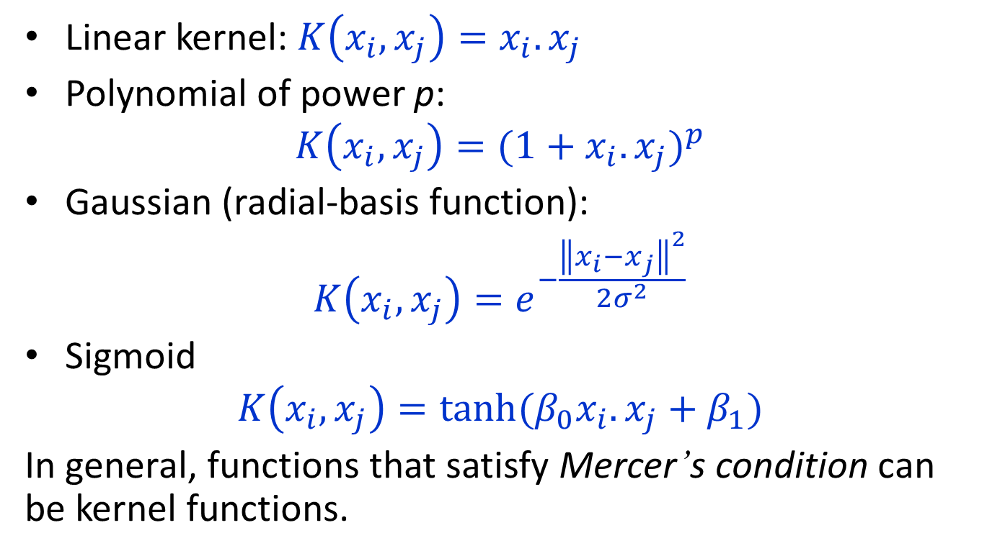
Commonly-used kernel functions
Linear kernel: $K\left(x_{i},x_{j}\right)=x_{i}.x_{j}$
Polynomial of power p:
$$K\left(x_{i},x_{j}\right)={(1+x_{i}.x_{j})}^{p}$$
Gaussian (radial-basis function):
$$K\left(x_{i},x_{j}\right)=e^{−\frac{{\left\|x_{i}−x_{j}\right\|}^{2}}{2σ^{2}}}$$
Sigmoid
$$K\left(x_{i},x_{j}\right)={tanh⁡(β_{0}x}_{i}.x_{j}+β_{1})$$
In general, functions that satisfy Mercer’s condition can be kernel functions.

Slide 10
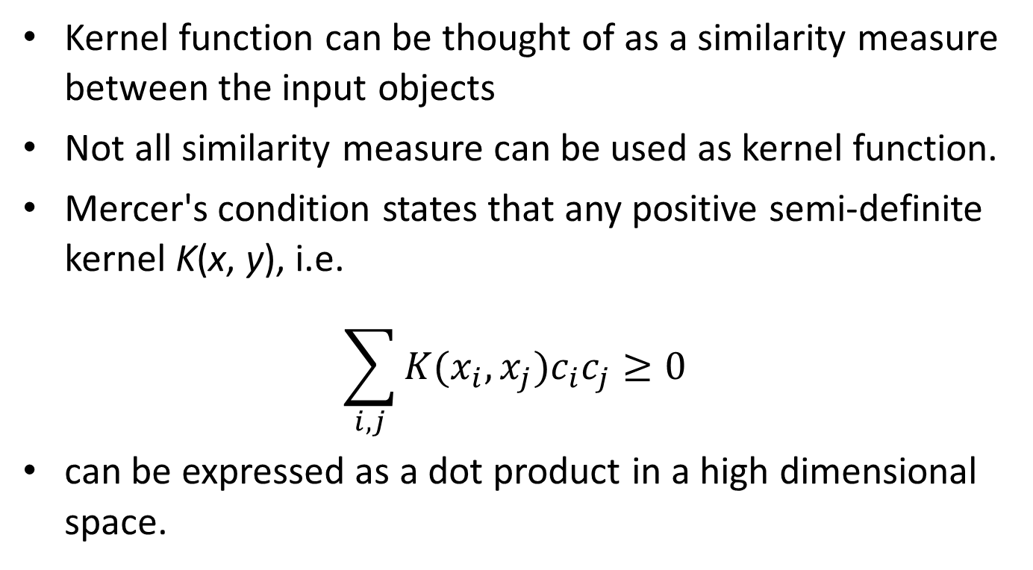
Kernel Functions
Kernel function can be thought of as a similarity measure between the input objects
Not all similarity measure can be used as kernel function.
Mercer's condition states that any positive semi-definite kernel K(x, y), i.e.
$$\sum_{i,j}{K(x_{i},x_{j})c_{i}c_{j}}≥0$$
can be expressed as a dot product in a high dimensional space.

Slide 11
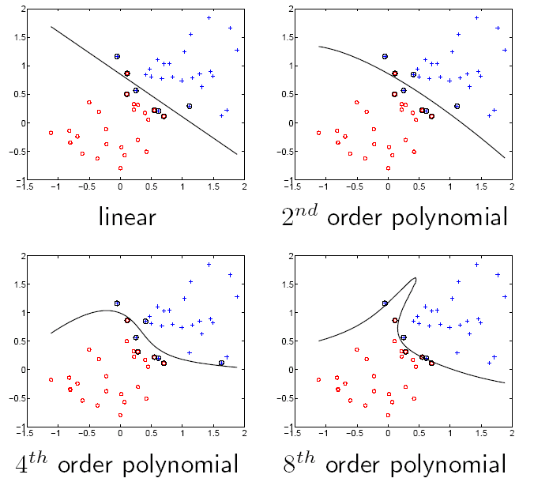
SVM examples

Slide 12
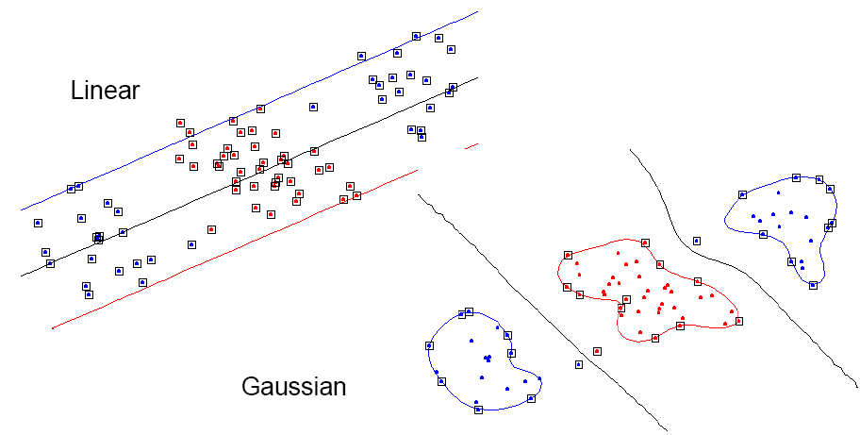
Examples for Non Linear SVMs –Gaussian Kernel

Slide 13
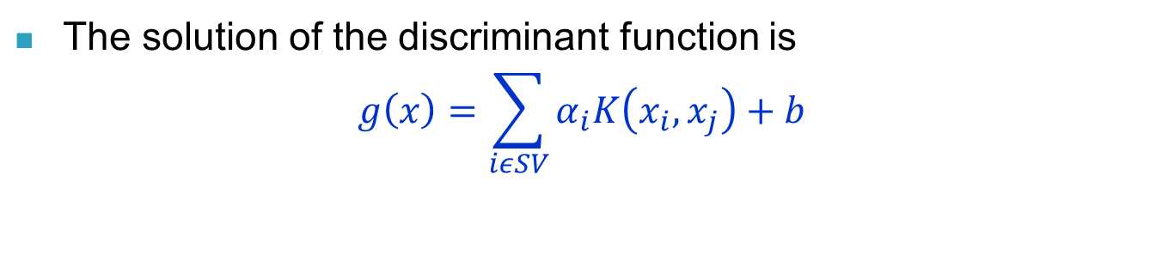
Nonlinear SVM: Optimization
Formulation: (Lagrangian Dual Problem)
such that
The solution of the discriminant function is
$$g\left(x\right)=\sum_{iεSV}{α_{i}K\left(x_{i},x_{j}\right)+b}$$

Slide 14
Performance
Support Vector Machines work very well in practice.
  The user must choose the kernel function and its parameters
They can be expensive in time and space for big datasets
  The computation of the maximum-margin hyper-plane depends on the square of the number of training cases.
  We need to store all the support vectors.
The kernel trick can also be used to do PCA in a much higher-dimensional space, thus giving a non-linear version of PCA in the original space.

Slide 15
Multi-class classification
SVMs can only handle two-class outputs
Learn N SVM’s
  SVM 1 learns Class1 vs REST
  SVM 2 learns Class2 vs REST
  :
  SVM N learns ClassN vs REST
Then to predict the output for a new input, just predict with each SVM and find out which one puts the prediction the furthest into the positive region.

Slide 16
Thank You

