Slide 1
Foundations of Machine Learning
Module 5: Support Vector Machine
Part F: SVM – Solution to the Dual Problem
Sudeshna Sarkar
IIT Kharagpur

Slide 2
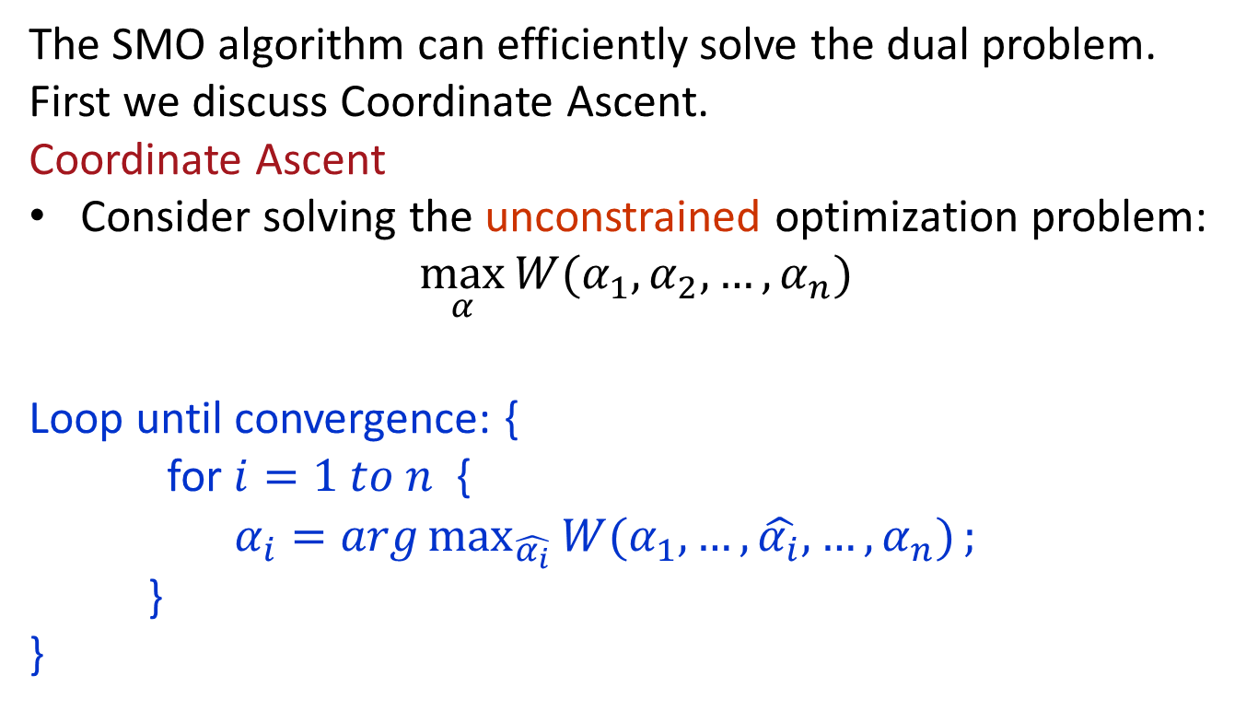
The SMO algorithm
The SMO algorithm can efficiently solve the dual problem.
First we discuss Coordinate Ascent.
Coordinate Ascent
Consider solving the unconstrained optimization problem:
$$\max_{α}{W(α_{1},α_{2},…,α_{n})}$$
Loop until convergence: {
for $i=1 to n$ {
$α_{i}=arg\max_{\hat{α_{i}}}{W(α_{1},…,\hat{α_{i}},…,α_{n})};$
}
}

Slide 3
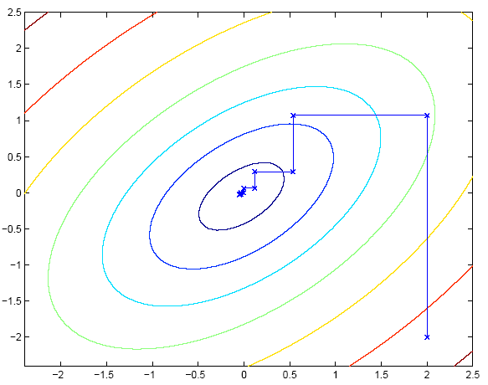
Coordinate ascent
Ellipses are the contours of the function.
At each step, the path is parallel to one of the axes.

Slide 4
Sequential minimal optimization
Constrained optimization:
Question: can we do coordinate along one direction at a time (i.e., hold all α_{[-i]} fixed, and update α_{i}?)

Slide 5
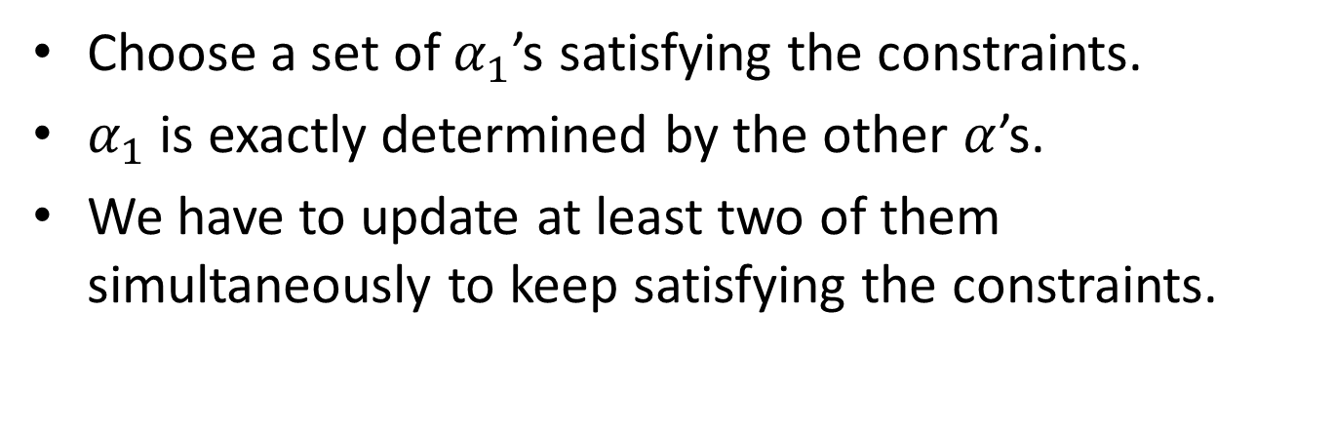
The SMO algorithm
Choose a set of $α_{1}$’s satisfying the constraints.
$α_{1}$ is exactly determined by the other $α$’s.
We have to update at least two of them simultaneously to keep satisfying the constraints.

Slide 6
The SMO algorithm
Repeat till convergence {
  Select some pair α_{i} and α_{j} to update next
  (using a heuristic that tries to pick the two that will allow us to make the biggest progress towards the global maximum).
  Re-optimize W(α) with respect to α_{i} and α_{j}, while holding all the other α_{k} 's (k ≠ i; j) fixed.
}
The update to α_{i} and α_{j} can be computed very efficiently.

Slide 7
Thank You

