Slide 1
Foundations of Machine Learning
Module 5:
Part A: Logistic Regression
Sudeshna Sarkar
IIT Kharagpur

Slide 2
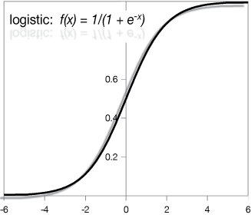
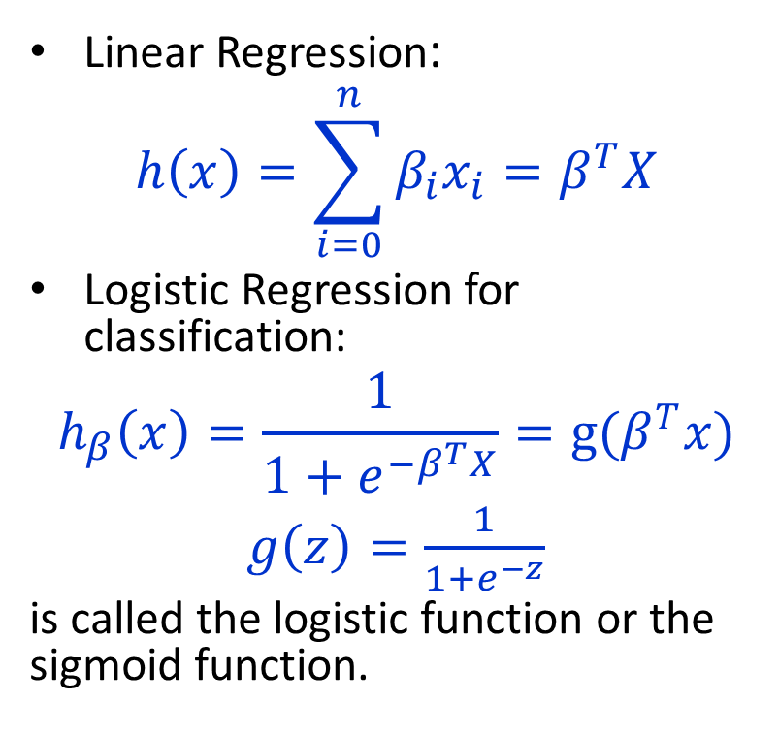

Logistic Regression for classification
Linear Regression:
$$h\left(x\right)=\sum_{i=0}^{n}{β_{i}x_{i}}=β^{T}X$$
Logistic Regression for classification:
$$h_{β}\left(x\right)=\frac{1}{1+e^{−β^{T}X}}=g(β^{T}x)$$
$g\left(z\right)=\frac{1}{1+e^{−z}}$
is called the logistic function or the sigmoid function.
Logistic:
$g\left(z\right)=\frac{1}{1+e^{−z}}$

Slide 3
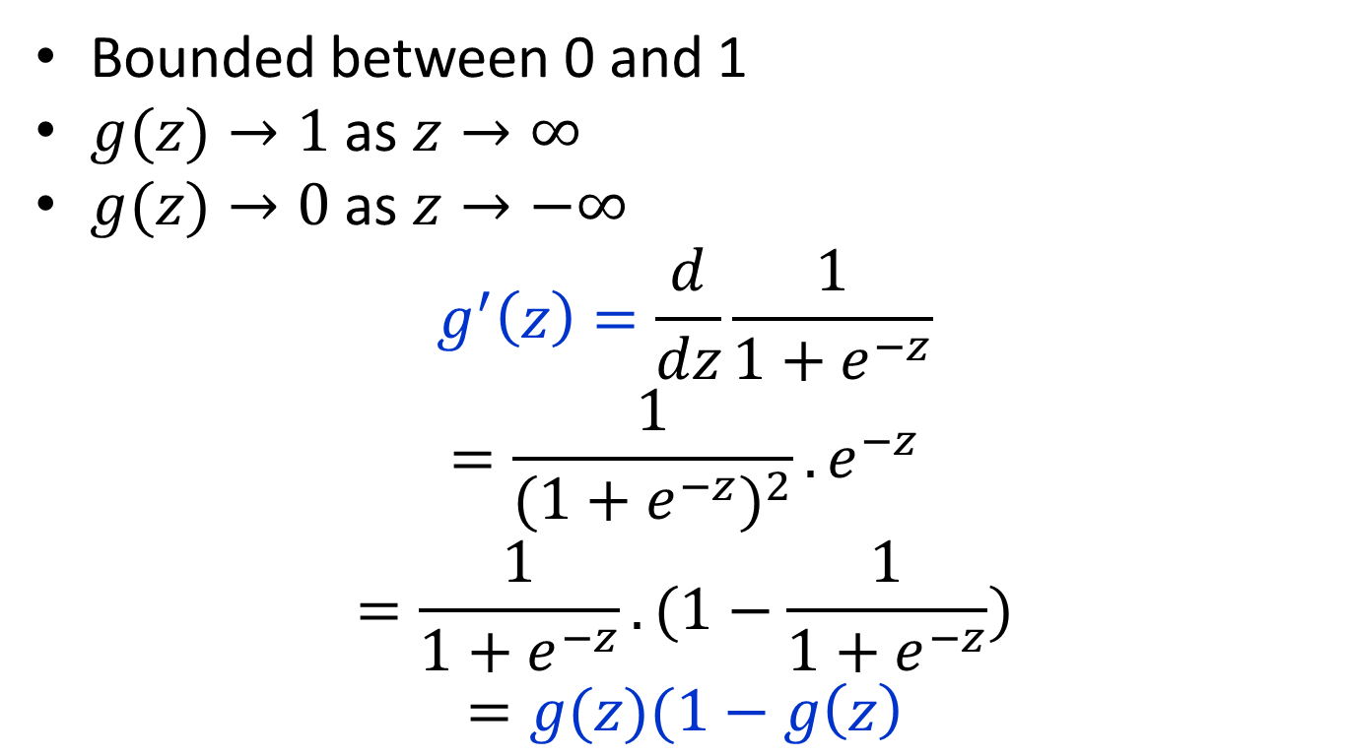
Sigmoid function properties
Bounded between 0 and 1
$g(z)→1$ as $z→∞$
$g(z)→0$ as $z→−∞$
$$g^{′}\left(z\right)=\frac{d}{dz}\frac{1}{1+e^{−z}}$$
$$=\frac{1}{{(1+e^{−z})}^{2}}.e^{−z}$$
$$=\frac{1}{1+e^{−z}}.(1−\frac{1}{1+e^{−z}})$$
$$=g(z)(1−g\left(z\right)$$

Slide 4
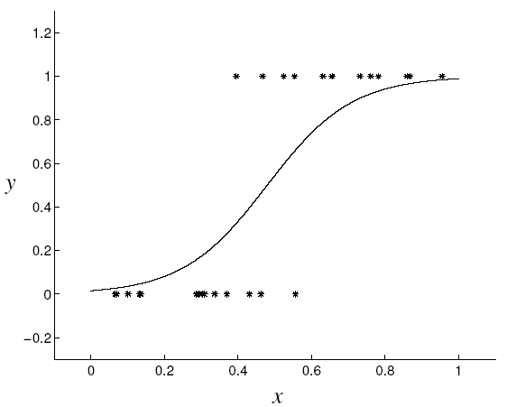
Logistic regression (sigmoid classifier)
The condition distribution: a Bernoulli
where
We can used the gradient method as in Linear Regression

Slide 5
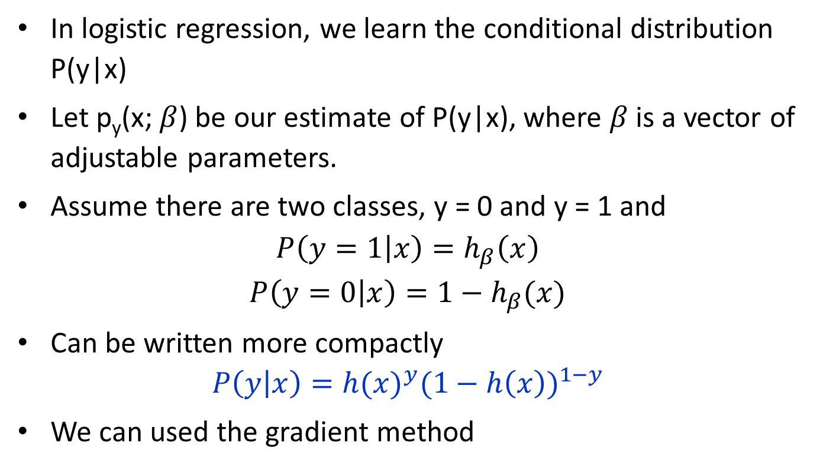
Logistic Regression
In logistic regression, we learn the conditional distribution P(y|x)
Let p_{y}(x; $β$) be our estimate of P(y|x), where $β$ is a vector of adjustable parameters.
Assume there are two classes, y = 0 and y = 1 and
$$P\left(y=1 | x\right)=h_{β}\left(x\right)$$
$$P\left(y=0 | x\right)=1−h_{β}(x)$$
Can be written more compactly
$$P\left(y | x\right)={h(x)}^{y}{(1−h\left(x\right))}^{1−y}$$
We can used the gradient method

Slide 6
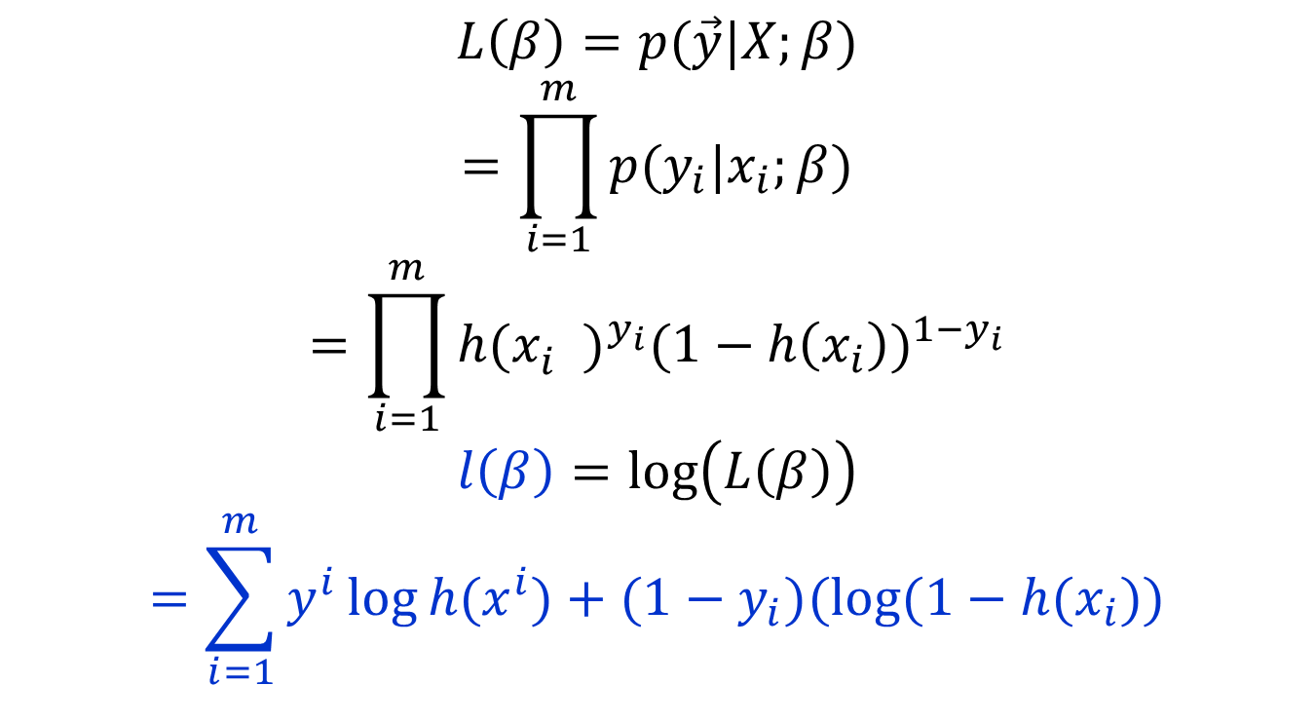
Maximize likelihood
$$L\left(β\right)=p(\vec{y}|X;β)$$
$$=\prod_{i=1}^{m}{p(y_{i}|x_{i};β)}$$
$$=\prod_{i=1}^{m}{{h(x_{i}^{})}^{y_{i}}{(1−h\left(x_{i}\right))}^{1−y_{i}}}$$
$$l\left(β\right)=\log\left(L\left(β\right)\right)$$
$$=\sum_{i=1}^{m}{y^{i}\log{h(x^{i})}+(1−y_{i})(\log{(1−h(x_{i})})}$$

Slide 7
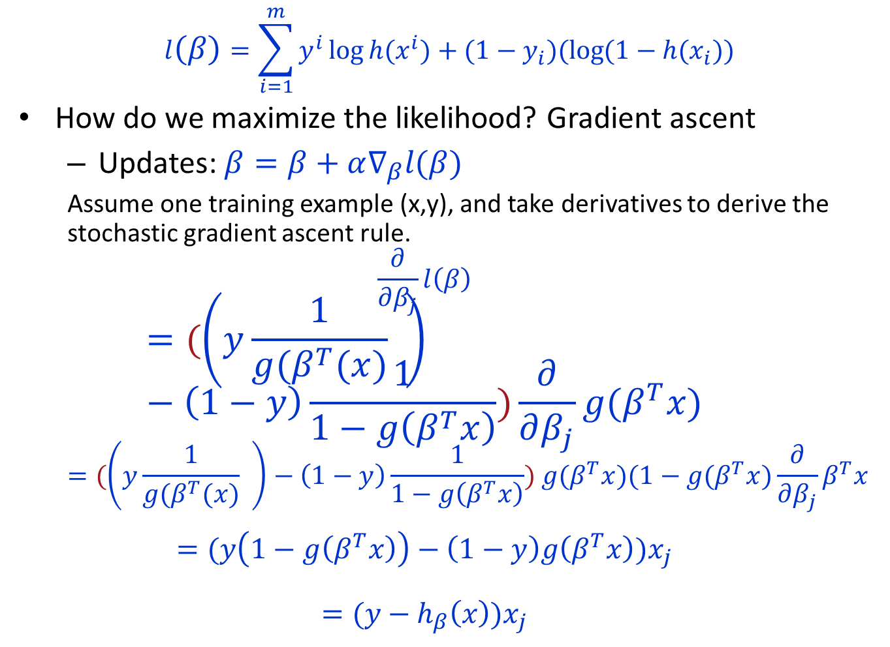
$$l\left(β\right)=\sum_{i=1}^{m}{y^{i}\log{h(x^{i})}+(1−y_{i})(\log{(1−h(x_{i})})}$$
How do we maximize the likelihood? Gradient ascent
Updates: $β=β+α∇_{β}l(β)$
Assume one training example (x,y), and take derivatives to derive the stochastic gradient ascent rule.
$$\frac{∂}{∂β_{j}}l\left(β\right)$$
$$=(\left(y\frac{1}{g(β^{T}(x)} \right)−\left(1−y\right)\frac{1}{1−g\left(β^{T}x\right)})\frac{∂}{∂β_{j}}g(β^{T}x)$$
$$=(\left(y\frac{1}{g(β^{T}(x)} \right)−\left(1−y\right)\frac{1}{1−g\left(β^{T}x\right)}) g(β^{T}x)(1−g(β^{T}x)\frac{∂}{∂β_{j}}β^{T}x$$
$$=(y\left(1−g\left(β^{T}x\right)\right)−\left(1−y\right)g\left(β^{T}x\right))x_{j}$$
$$=(y−h_{β}\left(x\right))x_{j}$$

Slide 8

$$β=β+α∇_{β}l(β)$$
$$β_{j}=β_{j}+α(y^{\left(i\right)}−h_{β}\left(x^{i}\right)){x_{j}}^{(i)}$$

