Slide 1
Foundations of Machine Learning
Module 5:
Part B: Introduction to Support Vector Machine
Sudeshna Sarkar
IIT Kharagpur

Slide 2
Support Vector Machines
SVMs have a clever way to prevent overfitting
They can use many features without requiring too much computation.

Slide 3
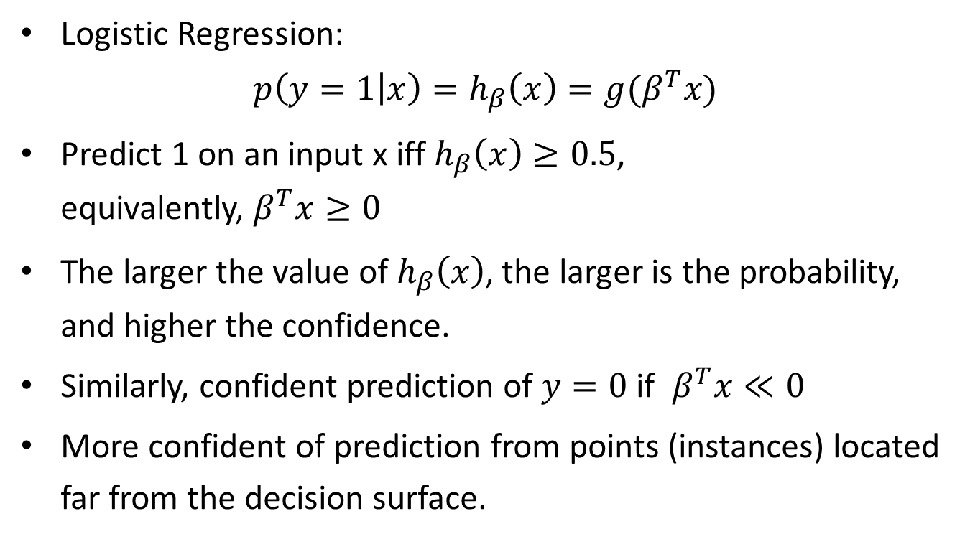
Logistic Regression and Confidence
Logistic Regression:
$$p\left(y=1 | x\right)=h_{β}\left(x\right)=g(β^{T}x)$$
Predict 1 on an input x iff $h_{β}\left(x\right)≥0.5$, equivalently, $β^{T}x≥0$
The larger the value of $h_{β}\left(x\right)$, the larger is the probability, and higher the confidence.
Similarly, confident prediction of $y=0$if $β^{T}x≪0$
More confident of prediction from points (instances) located far from the decision surface.

Slide 4
Preventing overfitting with many features
Suppose a big set of features.
What is the best separating line to use?
Bayesian answer:
Use all
Weight each line by its posterior probability
Can we approximate the correct answer efficiently?

Slide 5
Support Vectors
The line that maximizes the minimum margin.
This maximum-margin separator is determined by a subset of the datapoints.
called “support vectors”.
we use the support vectors to decide which side of the separator a test case is on.
The support vectors are indicated by the circles around them.

Slide 6
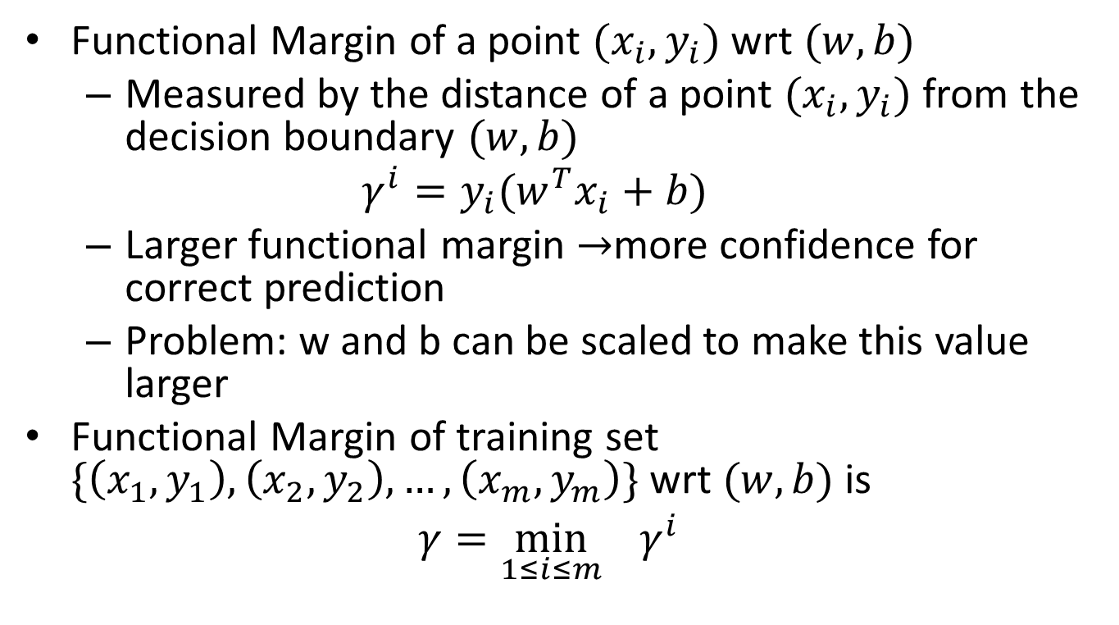
Functional Margin
Functional Margin of a point $(x_{i},y_{i})$ wrt $(w,b)$
Measured by the distance of a point $(x_{i},y_{i})$ from the decision boundary $(w,b)$
$$γ^{i}=y_{i}(w^{T}x_{i}+b)$$
Larger functional margin $→$more confidence for correct prediction
Problem: w and b can be scaled to make this value larger
Functional Margin of training set $\{\left(x_{1},y_{1}\right), \left(x_{2},y_{2}\right), …,\left(x_{m},y_{m}\right)\}$ wrt $(w,b)$ is
$${γ=\min_{1≤i≤m}{γ^{i}}}^{}$$

Slide 7

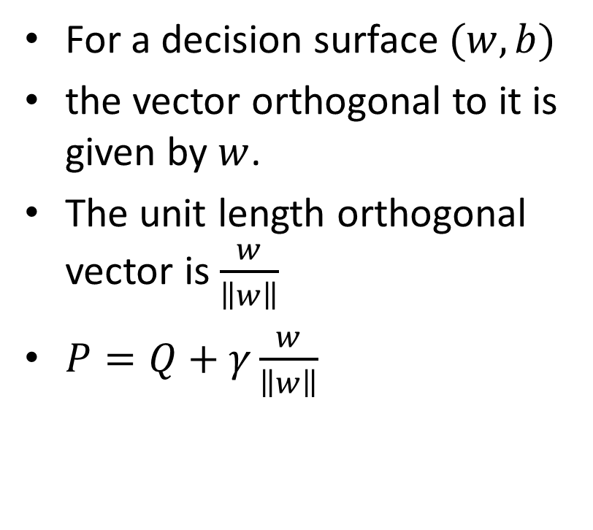
Geometric Margin
For a decision surface $(w,b)$
the vector orthogonal to it is given by $w$.
The unit length orthogonal vector is $\frac{w}{\left\|w\right\|}$
$P=Q+γ\frac{w}{\left\|w\right\|}$
P=(a1,a2)
Q=(b1,b2)
$$\overset{→}{w}$$
(w,b)

Slide 8
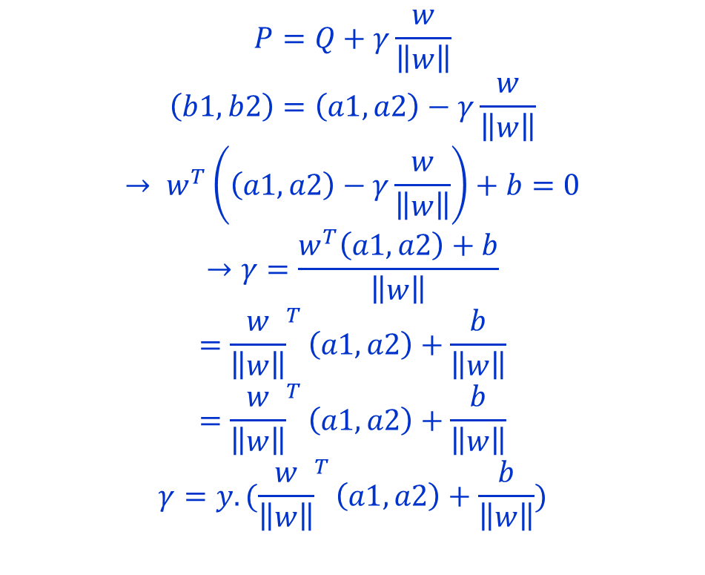
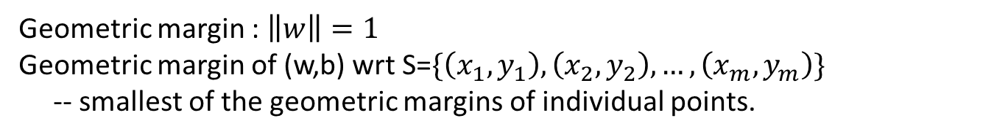
Geometric Margin
$$P=Q+γ\frac{w}{\left\|w\right\|}$$
$$\left(b1,b2\right)=\left(a1,a2\right)−γ\frac{w}{\left\|w\right\|}$$
$$→ w^{T}\left(\left(a1,a2\right)−γ\frac{w}{\left\|w\right\|}\right)+b=0$$
$$→γ=\frac{w^{T}\left(a1,a2\right)+b}{\left\|w\right\|}$$
$$={\frac{w}{\left\|w\right\|}}^{T}\left(a1,a2\right)+\frac{b}{\left\|w\right\|}$$
$$={\frac{w}{\left\|w\right\|}}^{T}\left(a1,a2\right)+\frac{b}{\left\|w\right\|}$$
$$γ=y.({\frac{w}{\left\|w\right\|}}^{T}\left(a1,a2\right)+\frac{b}{\left\|w\right\|})$$
P=(a1,a2)
Q=(b1,b2)
$$\overset{→}{w}$$
(w,b)
Geometric margin : $\left\|w\right\|=1$
Geometric margin of (w,b) wrt S=$\{\left(x_{1},y_{1}\right), \left(x_{2},y_{2}\right), …,\left(x_{m},y_{m}\right)\}$
-- smallest of the geometric margins of individual points.

Slide 9
Maximize margin width
denotes +1
denotes -1
x₂
Assume linearly separable training examples.
The classifier with the maximum margin width is robust to outliners and thus has strong generalization ability
Margin
x₁

Slide 10
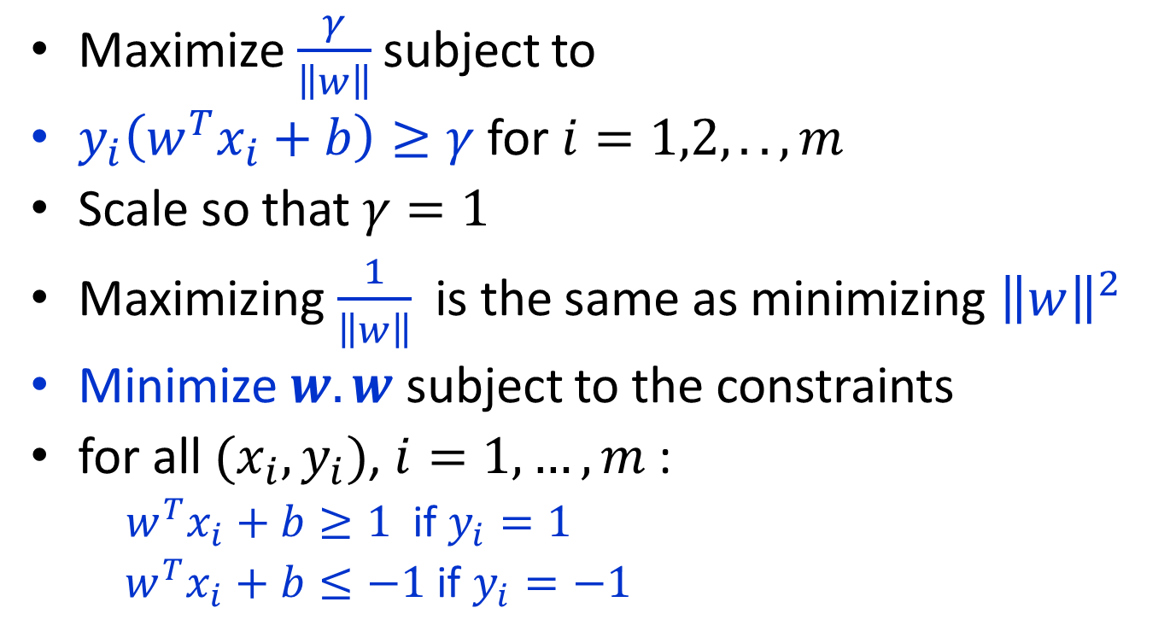
Maximize Margin Width
Maximize $\frac{γ}{\left\|w\right\|}$subject to
$y_{i}\left(w^{T}x_{i}+b\right)≥γ$ for $i=1,2, .. ,m$
Scale so that $γ=1$
Maximizing $\frac{1}{\left\|w\right\|}$ is the same as minimizing ${\left\|w\right\|}^{2}$
Minimize $w.w$ subject to the constraints
for all $(x_{i},y_{i})$, $i=1,…,m$ :
$w^{T}x_{i}+b≥1$ if $y_{i}=1$
$w^{T}x_{i}+b≤−1$ if $y_{i}=−1$

Slide 11
Large Margin Linear Classifier
Formulation:
x₂
Margin
x⁺
w^{T} x + b = 1
such that
x⁺
w^{T} x + b = 0
w^{T} x + b = -1
n
x⁻
x₁
denotes +1
denotes -1

Slide 12
Solving the Optimization Problem
s.t.
Optimization problem with convex quadratic objectives and linear constraints
Can be solved using QP.
Lagrange duality to get the optimization problem’s dual form,
Allow us to use kernels to get optimal margin classifiers to work efficiently in very high dimensional spaces.
Allow us to derive an efficient algorithm for solving the above optimization problem that will typically do much better than generic QP software.

