Slide 1
Picking MLB’s 2020 Champion
Presentation 1
Vignesh Ravi

Slide 2
Agenda
Baseball Statistics Overview
Model Selection
Predict the 2020 World Series Champion
Insights and Conclusion

Slide 3

Hitting statistics
On-Base Percentage (OBP): Frequency of batter reaching base
Slugging (SLG): Number of bases a player records excluding walks
On-Base Plus Slugging (OPS): Sum of OBP and SLG

Slide 4
OPS in context:
Top 5 teams in 2020
Source: Baseball Reference

Slide 5
Pitching statistics
Earned run average (ERA): Runs allowed per inning
Hits by 9 (H9): Average hits per game
Pitcher Wins Above Replacement (pWAR)
Captures the value a pitcher brings to a team over the average pitcher

Slide 6
pwar in context: top 10 teams in 2020
Source: Baseball Reference

Slide 7
Variables included in model
Winning Percentage (Pct)
OPS
OBP
ERA
H9
pWAR

Slide 8
Model selection

Slide 9
Dataset changes
Past 30 years data
Heavily imbalanced dataset
Over-sampling
SMOTE

Slide 10
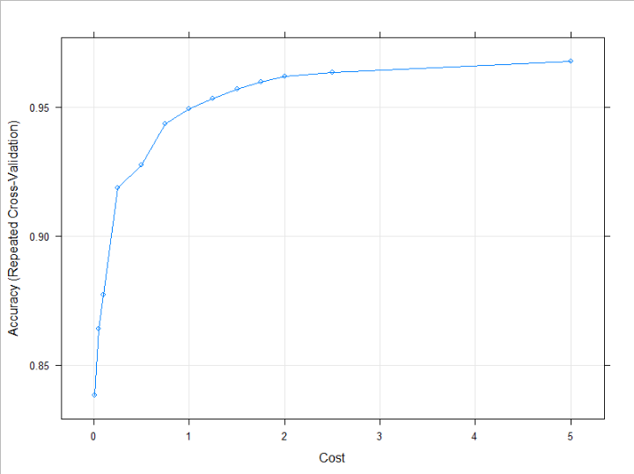
Support vector machine
Accuracy increases as model cost increases
Radial kernel implementation

Slide 11
SVM performs well in accuracy and f1 score
Statistic | Results
Accuracy | 89.66%
Sensitivity | 92.31%
Specificity | 48.00%
Recall | 92.31%
Precision | 96.66%
F1 Score | .902

Slide 12
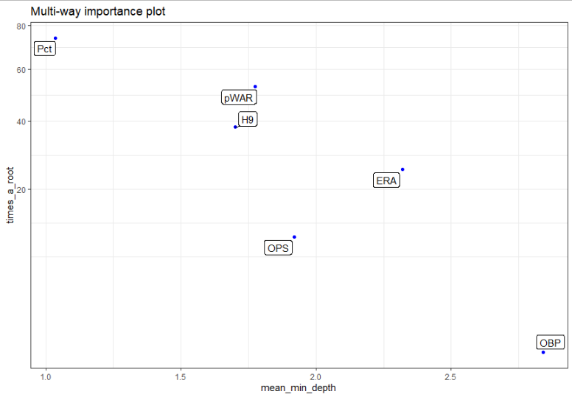
Random forest
Win percentage best indicator
pWAR and H9 about the same
Overall pitching more important

Slide 13
Random Forest performs weaker relative to svm
Statistic | Results
Accuracy | 83.33%
Sensitivity | 84.62%
Specificity | 40.00%
Recall | 84.62%
Precision | 97.95%
F1 Score | .907

Slide 14
Gradient boosted machine
Winning percentage and H9 are most important

Slide 15
GBM performs the best!
Statistic | Results
Accuracy | 91.21%
Sensitivity | 94.94%
Specificity | 54.04%
Recall | 94.94%
Precision | 96.67%
F1 Score | .910

Slide 16
2020 World Series Champion prediction

Slide 17
2020 Current season data
60 game regular season, 162 game season normally
Assumed statistical trends stay the same
Playoff format changes benefit underperformance
16 teams instead of normal 12 teams

Slide 18

Model Predictions
Models consistently only picked one winner
Oakland Athletics
4th in Winning Percentage
1st in pWAR
Top 10 among other categories

Slide 19
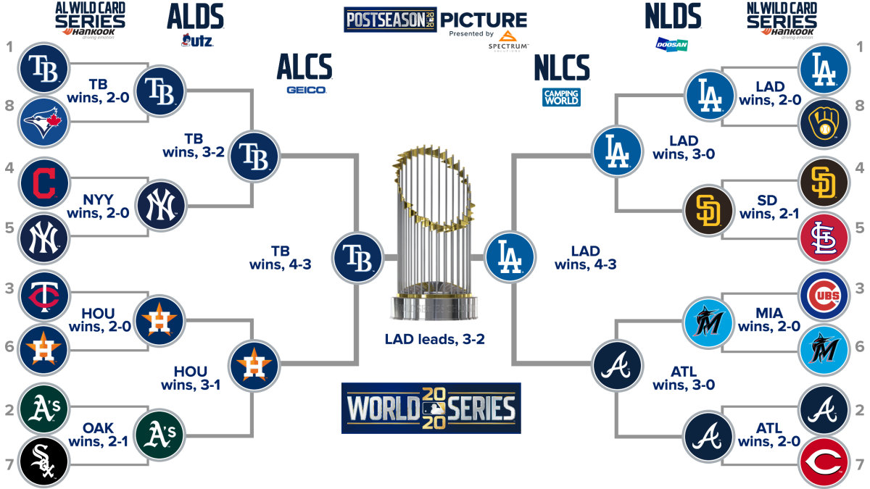
Athletics lose in alds
Source: MLB.com

Slide 20
Insights and Conclusion

Slide 21
Insights
Pleased with consistent results
Athletics were statistically the best team
Not disheartened by incorrect prediction
Predicted 2019 results correctly
“Anything can happen in playoffs”

Slide 22
Conclusion
Areas for improvement:
Introduce more factors to capture error and reduce it
L2 regularization
Increase tuning to capture greater specificity

Slide 23

Thank you! Questions?

