Slide 1

Arduino based Temperature Sensing and subsequent cooling Actuation
BY:
RAVI VATS (1MS14CS100)
SATYA TEJA C (1MS14CS110)
VISHAL DHULL (1MS14CS139)

Slide 2

Arduino based Temperature Sensing and subsequent cooling Actuation
Introduction
This practical temperature controller controls the temperature of any device according to its requirement for any industrial application, it also has a feature of remote speed control. The LM-35 Analog Temperature device is interfaced to analog pin of Arduino board, where it has built in ADC which converts these analog reading and displays it on the phone, which indicates the temperature of the device. User-defined temperature settings can be done using commands provided through android application and arduino board.

Slide 3
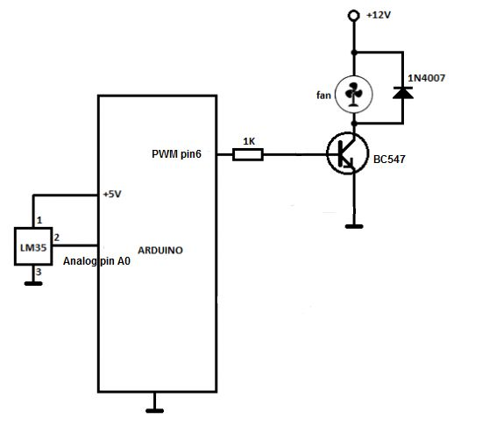
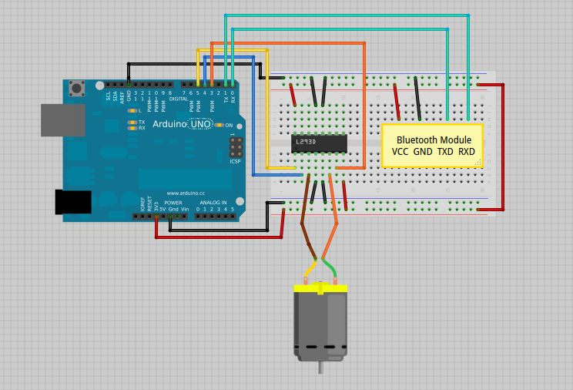
Arduino based Temperature Sensing and subsequent cooling Actuation
Block Diagram
Fig.1 Circuit Diagram for temperature controlled fan using Arduino UNO and temperature sensor LM35
Fig 2 Circuit Diagram for remotely controlled fan using Arduino UNO, HC-05 Bluetooth Module and Android application.

Slide 4
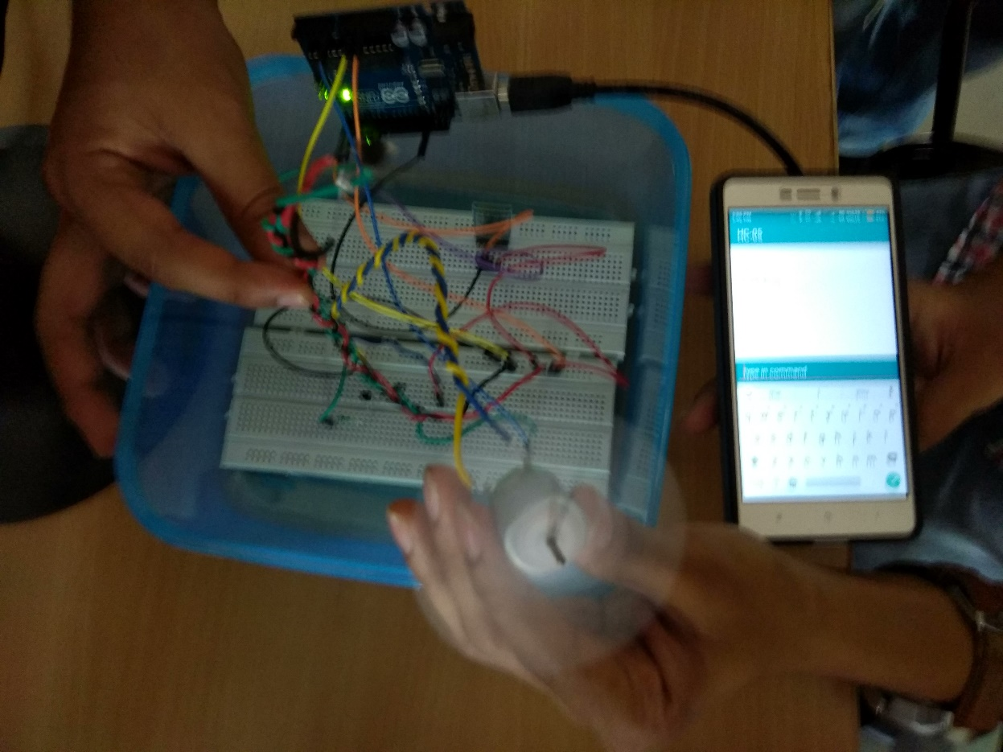
Arduino based Temperature Sensing and subsequent cooling Actuation
Actual Circuit
Fig.3 Circuit Diagram for temperature and ,manually controlled fan using Arduino UNO, temperature sensor LM35 and Android Application

Slide 5
Arduino based Temperature Sensing and subsequent cooling Actuation
Hardware Requirements
Arduino UNO
Temperature Sensor LM35
DC Motor or a simple DC fan
NPN transistor BC547
A voltage source with 12Volts
Hook up wires
Optional : voltage source socket
HC-05 Bluetooth Module

Slide 6
Arduino based Temperature Sensing and subsequent cooling Actuation
Software Requirements
Arduino IDE and Android Studio
Language: C with pre-installed APIs for Arduino UNO.

Slide 7
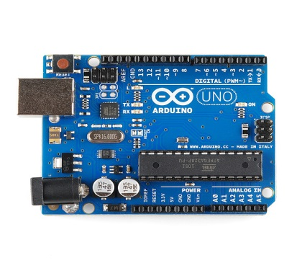
Arduino based Temperature Sensing and subsequent cooling Actuation
Arduino UNO Board
Arduino is a single-board microcontroller.
Intended to make the application of interactive objects and environments more easier.
Basically this is very user friendly. There is a microcontroller unit embedded on it.
The code is directly loaded from the computer.

Slide 8
Arduino based Temperature Sensing and subsequent cooling Actuation
Arduino
The Arduino microcontroller is an easy to use yet powerful single board computer.
It has gained considerable traction in the hobby and professional market.
The Arduino is open-source.
Which means hardware is reasonably priced and development software is free.

Slide 9
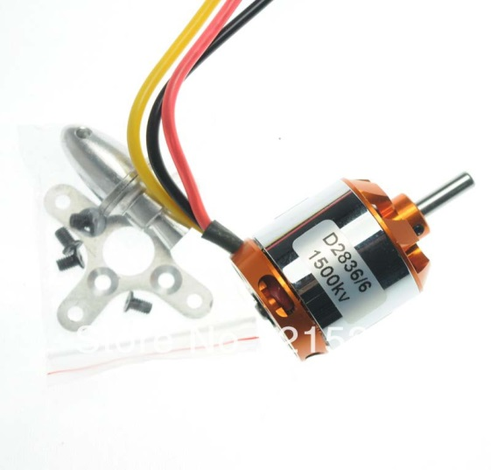
Arduino based Temperature Sensing and subsequent cooling Actuation
DC Motor
Brushless DC electric motor is a device powered by a DC electric source via an integrated power supply
It produces an AC electric signal to drive the motor.
It can give up to 10,300 rpm.

Slide 10
Arduino based Temperature Sensing and subsequent cooling Actuation
LM 35 Temperature Sensor
LM35 are used to sense the heat and an IC ADC0808 is used to convert the data into digital.
LM35 digital sensor has got 3 pin’s i.e., VCC, GND and output pin’s when LM35 is heated the voltage at output pin increases.
It is connected to the analog to digital convertor IC (ADC).
The LM35 series are precision integrated-circuit temperature sensors, whose output voltage is linearly proportional to the Celsius (Centigrade) temperature.

Slide 11
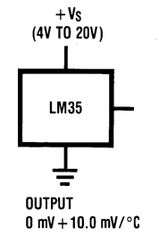
Arduino based Temperature Sensing and subsequent cooling Actuation
LM 35 Temperature Sensor
The LM35 thus has an advantage over linear temperature sensors calibrated in Kelvin.
As the user is not required to subtract a large constant voltage from its output to obtain convenient Centigrade scaling.

Slide 12
Arduino based Temperature Sensing and subsequent cooling Actuation
LM 35 Temperature Sensor
The LM35 does not require any external calibration or trimming to provide typical accuracies of ±1⁄4˚C at room temperature and ±3⁄4˚C over a full −55 to +150˚C temperature range.

Slide 13
Arduino based Temperature Sensing and subsequent cooling Actuation
Working Principle
The heart of the circuit is an Arduino board which controls all its functions.
An IC LM35 is used as temperature sensor.
The LM-35 analog temperature device is interfaced to the analog pin of the Arduino board.
It’s built-in ADC, which converts these analog reading and displays that on the phone, to indicate temperature of the device.

Slide 14
Arduino based Temperature Sensing and subsequent cooling Actuation
Working Principle
User-defined temperature settings can be done using push commands provided through Android application and Arduino board.
Maximum and minimum settings are used for allowing any necessary hysteresis.
Few push commands are used to set the fan speed i.e. fan speeds using commands 0, 1, 2, 3 etc. where zero is fan being off and five is the highest speed.
As soon the max and min temperatures are set then the Arduino program generates PWM output on the corresponding digital output according to the measured temperature.

Slide 15
Arduino based Temperature Sensing and subsequent cooling Actuation
Working Principle
This is fed to a DC Fan through a motor driver IC.
The fan speed is proportional to the temperature measured.
Standard power supply of 12 volt DC and 5 volt through a regulator are made from a step-down transformer along with a bridge rectifier and filter capacitor.

Slide 16
Arduino based Temperature Sensing and subsequent cooling Actuation
Advantages
Since it is an automated system .
It is programmed effectively so that no interruptions would stop its functionality.
To monitor the environment, that is not comfortable or possible to monitor for humans (especially for extended periods of time).
Prevents waste of energy.

Slide 17
Arduino based Temperature Sensing and subsequent cooling Actuation
Disadvantages
It can only be maintained by technical person.
Due to temperature variation, after sometimes it’s efficiency may be decreased.

Slide 18
Arduino based Temperature Sensing and subsequent cooling Actuation
Future Enhancement
This project can be enhanced by using higher power electronic devices to operate high capacity DC motors.
Regenerative braking for optimizing the power consumption can also be incorporated.

Slide 19
Arduino based Temperature Sensing and subsequent cooling Actuation
Conclusion
Arduino based Automatic Temperature Controlled Fan Speed Regulator Project was designed and Implemented. This project can be enhanced by using higher power electronic devices to operate high capacity DC motors. Regenerative braking for optimizing the power consumption can also be incorporated.

