Slide 1





Claude Code
Getting Started
Production Team Series | Part 1 of many
Engineers
Designers
QA
PMs

Slide 2
Why We're Here
2026 Goal: AI-driven development across all production teams.
Same quality bar. Remove friction. Build the skill together.
The models have the horsepower. If outcomes aren't there, it's because we haven't built the skill yet.
Two things to internalize:
This isn't optional
Identity shift
The industry is shifting. If we don't adapt, it will leave us behind - as a company and individually in our careers.
Many of us enjoy writing code - it's a craft. But the value is shifting: problem-solving and planning are becoming the core skill. Code is the medium, not the craft.
Claude Code | Ravn Production Team | Part 1
2

Slide 3
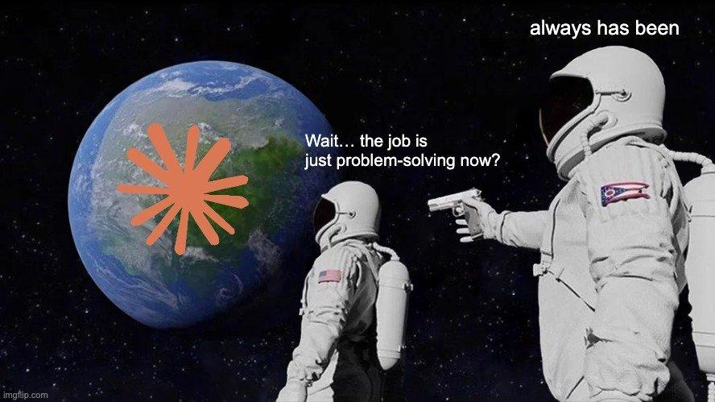
It's always been about problem-solving. We just had to type the code before.

Slide 4


The Discomfort Is Real
But it's temporary — if you push through.
It's like switching to a completely new editor
None of your shortcuts work. You feel slow. You feel annoyed. You wonder if it's even worth it.
But if you push through, you unlock speed you didn't have before.
Or like learning a new language
At first, you think in your native language and translate. It's exhausting. But eventually, you start thinking in the new language. That's where the fluency lives.
Claude Code | Ravn Production Team | Part 1
4

Slide 5




The Core Workflow
The software lifecycle doesn't change. We shift who does the typing.
01
02
03
Plan
Execute
Verify
More than before
Lean into AI
Your superpower
Clear plan = correct output.
Don't jump straight to code.
Trust the model more than
you're comfortable with.
Tests, lint, build, diff review.
Speed comes from rigor.
We'll deep-dive each phase throughout the series. Today: the foundations.
Claude Code | Ravn Production Team | Part 1
5

Slide 6
“
I thought AI-assisted development was lame. I rolled my eyes at the hype. I was convinced it would strip away everything I loved about coding.
Today, 90% of my code is written by AI.
And I’ve never enjoyed building more than I do right now.

Slide 7
The Joy Doesn’t Go Away
It just comes faster and more often.
That lit-up feeling
Same joy, faster loop
Programming has always been about building things and seeing them work. That moment when something you created comes alive — that doesn’t change. You still own the vision. You still architect the solution.
The idea-to-working-thing cycle shrinks from days to hours. You get that hit — the thing you built, shining on screen — more often. You’re not losing agency. You’re gaining leverage.
Getting out of your bubble is more fun than you think
The comfort zone feels safe, but it’s shrinking. When you step outside it, you don’t lose autonomy — you gain superpowers. You’re still the one deciding what to build, how it works, and what “good” looks like. The AI just clears the path so you can spend more time on the parts that actually matter to you.
Claude Code | Ravn Production Team | Part 1

Slide 8




Continuous Learning
Both you and the AI need to learn. Here's how.
You Learn
The AI Learns
Take ownership of your own learning
CLAUDE.md is your project's memory.
Experiment — try things that might fail
When Claude makes a mistake:
"Fix it, and add a rule to
CLAUDE.md so this doesn't
happen again."
Understand why it works (or doesn't)
Talk to Claude more than you think
Over time: fewer corrections,
cleaner PRs, faster shipping.
Ask "why did you do that?"
The repo becomes a well-oiled machine.
Claude Code | Ravn Production Team | Part 1
6

Slide 9

Talk to Claude
More than you think you should. It's a conversation, not a command line.
"Why did you do it that way?"
"What other approaches did you consider?"
Understand the reasoning
Learn alternatives
"I don't understand this part — explain it"
"That's not how we do it here — here's why..."
Don't pretend
Teach it your standards
"What could go wrong with this?"
"Before you write code, let's talk through the plan"
Surface edge cases
Plan first
The more you communicate, the better the output.
Claude Code | Ravn Production Team | Part 1
7

Slide 10


We Learn Faster Together
200+ people experimenting independently, then cross-pollinating.
Team Level
Company Level
Share in your team channel:
• Bi-weekly sessions (this series)
"Here's what worked"
• Spread wins across teams
"Here's what failed"
• Surface blockers early
"Here's a CLAUDE.md rule I added"
• Patterns that work → everyone
• 60-sec AI share in standups
Claude Code | Ravn Production Team | Part 1
8

Slide 11
Get Started Today
1
2
3
Pick one task
Plan first
Verify everything
Something small but real.
More time than feels natural.
Run tests. Read diffs.
"Help me understand this codebase"
Ask Claude to ask you questions
Speed comes from rigor
"Write tests for this function"
Refine until the plan is clear
Not from skipping steps
"Draft the spec for this feature"
Then execute
Don't YOLO
Claude Code | Ravn Production Team | Part 1
9

Slide 12
This Is Part 1
Bi-weekly sessions throughout 2026. Brick by brick.
Deep-Dive: Planning
Tips, tricks, and tools to make the most of the planning phase
Deep-Dive: Execution
When to trust, when to intervene, project standards, parallelization patterns
Deep-Dive: Verification
Diff review, testing strategies, quality gates
MCPs & Integrations
Connecting Claude to Figma, Jira, databases, your stack
Live Sessions
As tools evolve, we’ll cover changes in real-time
Cutting edge + timeless software practices — applied to AI.

