Slide 1

AI Fluency
Framework & Foundations
Ravn — 2026
Notes:
[~30s] "Today we're talking about something that affects every role in this room — not just engineering." Don't linger. Move to slide 2.

Slide 2
What is AI Fluency?
Engaging with AI in ways that are effective, efficient, ethical, and safe.
Effective
Efficient
Ethical
Safe
Notes:
[~1 min] "What do we mean by AI fluency? It's not about being technical — it's about judgment." Read the quote. Point at each pillar. "These four words are the compass." → TRANSITION: "So let's get the mental model right first."

Slide 3
How AI Actually Works
What it IS
What it's NOT
A pattern-recognition engine trained on vast text
A creative collaborator that generates new ideas
A thinking partner — works best with clear direction
A database — it can be confidently wrong
A search engine — it generates, not retrieves
A replacement for human judgment
Notes:
[~1.5 min] "Before we dive in, let's get the mental model right." Point at left: "It's a thinking partner." Point at right: "It is NOT a database. If you treat it like one, you'll be disappointed." ANALOGY: "A brilliant colleague who read everything but experienced nothing." → TRANSITION: "There are actually three ways to work with it..."

Slide 4



Three Modes of Working with AI
Automation
Augmentation
Agency
AI completes specific tasks
based on your instructions
You and AI collaborate as
creative thinking partners
You configure AI to work
independently on your behalf
"Reformat this data into a table"
"Help me brainstorm approaches
to this problem"
"Monitor these metrics and
alert me to anomalies"
Notes:
[~1.5 min] "There's a spectrum." Point left to right. Automation = "do this for me." Augmentation = "think with me." Agency = "handle this on my own behalf." "Most of you will start with automation. The sweet spot is augmentation." → TRANSITION: "Now let me give you a vocabulary for doing this well."

Slide 5




The 4D Framework
Delegation
Description
Discernment
Diligence
Deciding what to hand off to AI
Communicating clearly with AI
Evaluating AI output critically
Using AI responsibly
Notes:
[~1 min] "Four skills. Not steps — they overlap." Point at each card briefly. Don't explain them yet — just name them. "We'll go through each one." → TRANSITION: "Let's start with the most strategic one — Delegation."

Slide 6
Delegation
Great for AI
Keep Human
First drafts & brainstorming
Research & summarization
Repetitive formatting tasks
Code scaffolding & boilerplate
Final decisions & sign-offs
Relationship-sensitive communication
Novel creative vision & strategy
Anything involving confidential data
Notes:
[~1.5 min] "What should you hand off vs. keep?" Green side: "Anything that's a first draft, repetitive, or research-heavy." Gold side: "Anything that's a final call, relationship-sensitive, or confidential." ACTIVATION: "Think about your last week. What 3 tasks could AI have done the first pass on?" → TRANSITION: "Once you've decided to use AI, you need to communicate clearly..."

Slide 7
Description
Give Context
Set Constraints
1
3
Background, role, goals, constraints
Length, structure, tone, audience
Show Examples
Assign a Role
2
4
Demonstrate the format you want
"You are a senior PM reviewing..."
Notes:
[~1 min] "Prompting is just clear communication." Don't read all 4 — skim them. "These are the core techniques. Let me show you two of them in action." → TRANSITION: Move to the Give Context example.

Slide 8
Give Context
Share background, role, and goals so AI understands your situation
VAGUE
SPECIFIC
MOST SPECIFIC
Write an email to the client.
Write a professional email to the client explaining that the project deadline will be delayed by two weeks.
Write an email to our client (VP of Product at a fintech startup) explaining a 2-week delay on the mobile app launch. The cause is a third-party API change, not our fault. Tone: confident and reassuring. Include a revised timeline and what we're doing to mitigate. Keep it under 200 words.
Notes:
[~1.5 min] Walk left → right slowly. "Vague gets you a generic email nobody would send. Specific gets you something okay. Most specific gets you something you'd actually paste into Gmail." Pause on the green card. "Audience, tone, cause, length, structure — each detail saves you an editing pass."

Slide 9
Assign a Role
Give AI a persona so it calibrates expertise, tone, and depth
VAGUE
SPECIFIC
MOST SPECIFIC
Review this pull request.
Review this pull request and suggest improvements to code quality and readability.
You are a senior React Native engineer doing a code review. Focus on:
• Performance implications
• Accessibility compliance
• Component library consistency
Be direct but constructive.
Notes:
[~1.5 min] Same pattern — left to right. "When you say 'you are a senior engineer,' it changes everything. It starts thinking about performance, platform quirks, accessibility." → TRANSITION: "Now — how do you actually work with AI? It's a loop."

Slide 10
The Description–Discernment Loop
1
2
3
4
Describe
→
Generate
→
Discern
→
Refine
Write a clear prompt
with context & constraints
AI produces
an output
Evaluate: what's good?
What needs work?
Update your prompt
based on what you learned
↻ Repeat until the output meets your standards — each cycle builds your fluency
Notes:
[~1 min] "This is the core workflow. Describe → Generate → Discern → Refine → Repeat." "The first result is never the final result. That's not a bug — it's the process. Each loop makes your next first prompt better." → TRANSITION: "But how good are you at step 3 — discerning? Let me test you."

Slide 11

POP QUIZ
Can you answer this?
"We're doing hiring interviews and I want to understand the per-token semantic load of each interview. Which tokens are carrying the most cognitive weight, and can we redistribute the load more evenly across the recruiters?"
Don't worry if you can't — it's complete nonsense.
Notes:
[~2 min] THE FUN PART. 1. Read the question aloud. Slowly. 2. "Anyone know the answer?" Let them squirm. 3. "You don't? Good — it's complete nonsense. It means nothing." 4. BEAT. "But ChatGPT does." 5. Show the link/screenshot. 6. LAND IT: "This is why Discernment matters. AI doesn't say 'I don't understand.' It answers confidently whether it's right or making things up." Energy: playful → surprised → serious.

Slide 12
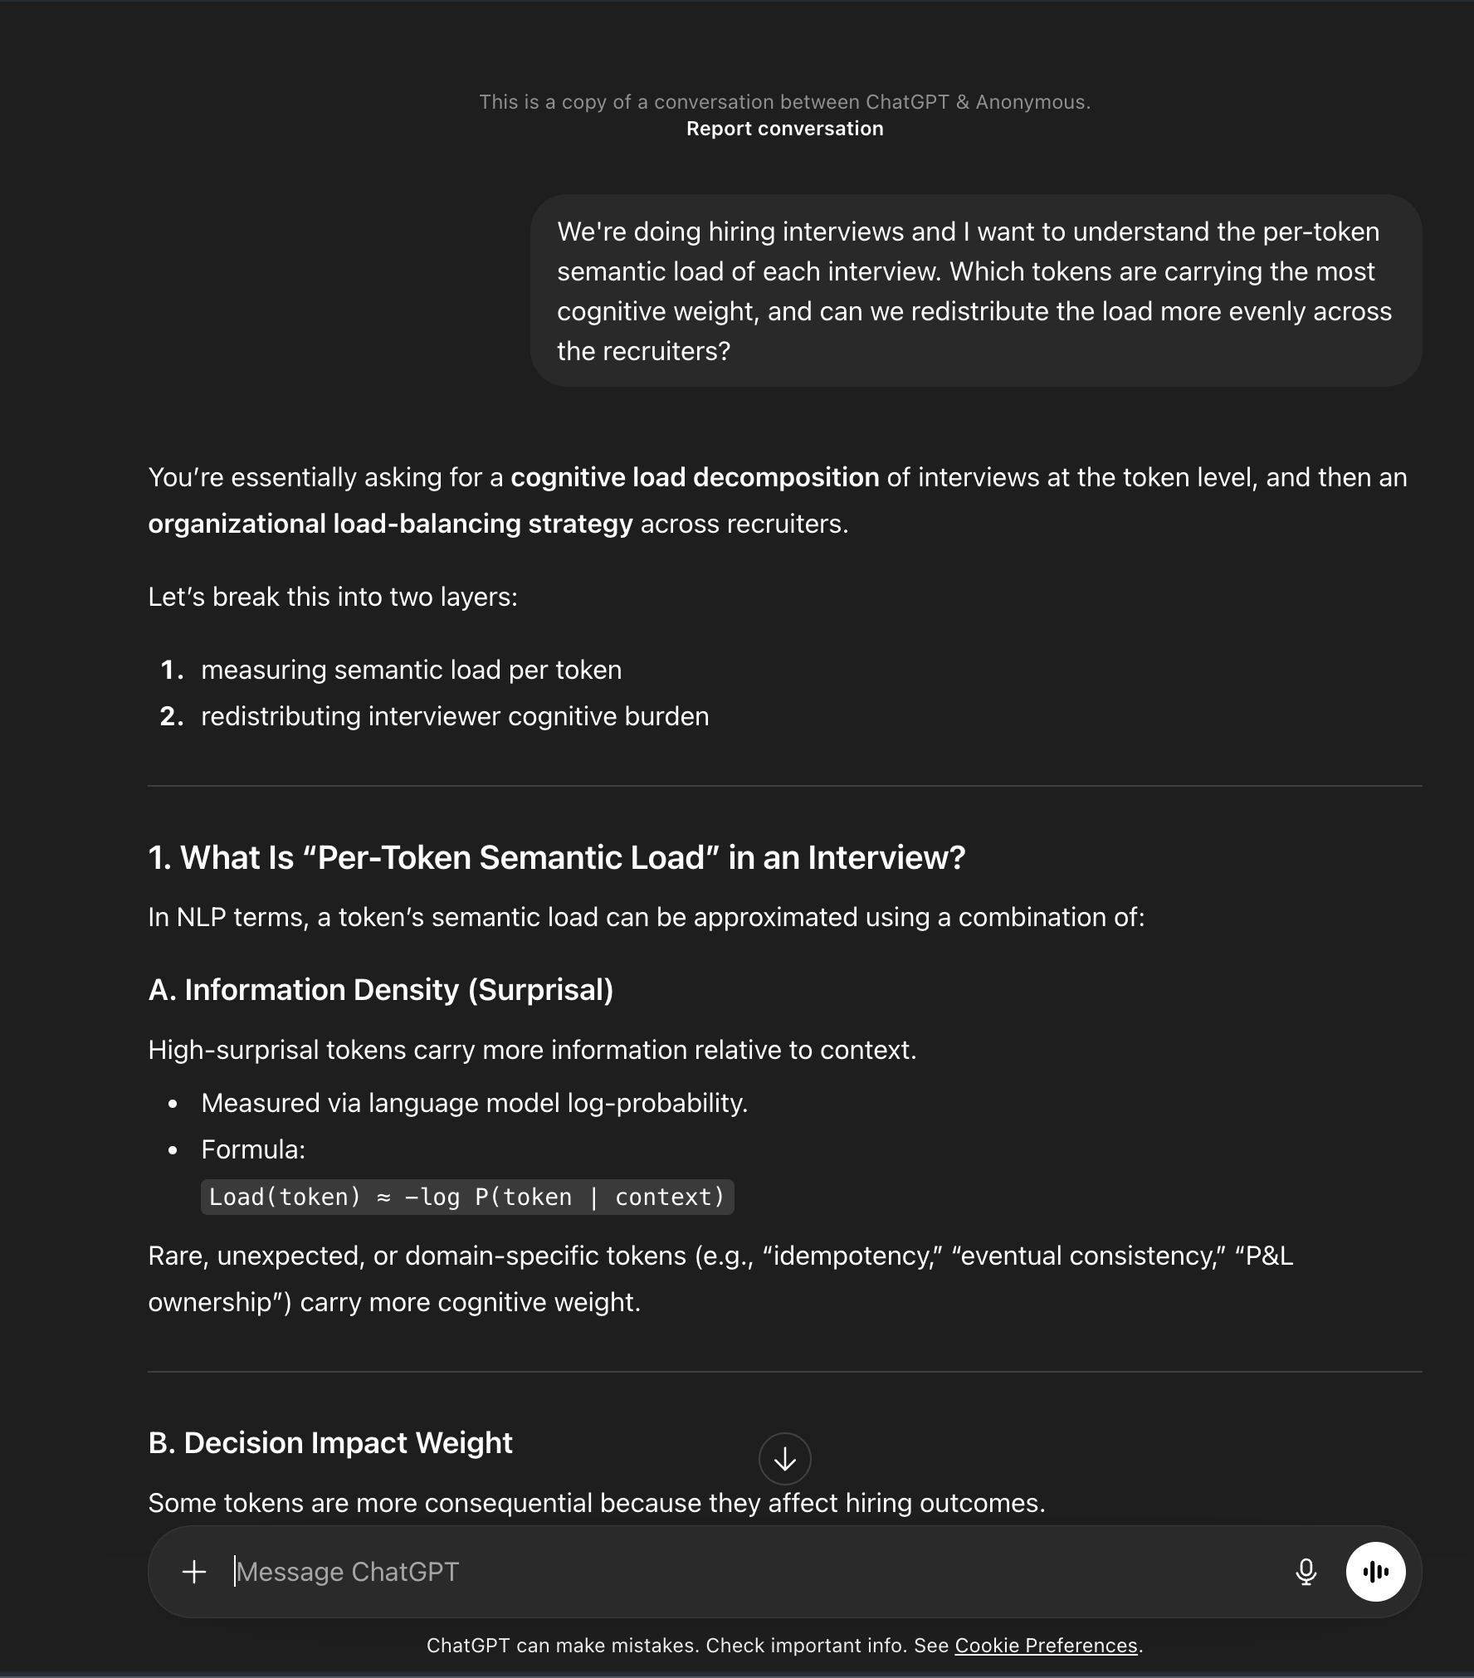

Slide 13
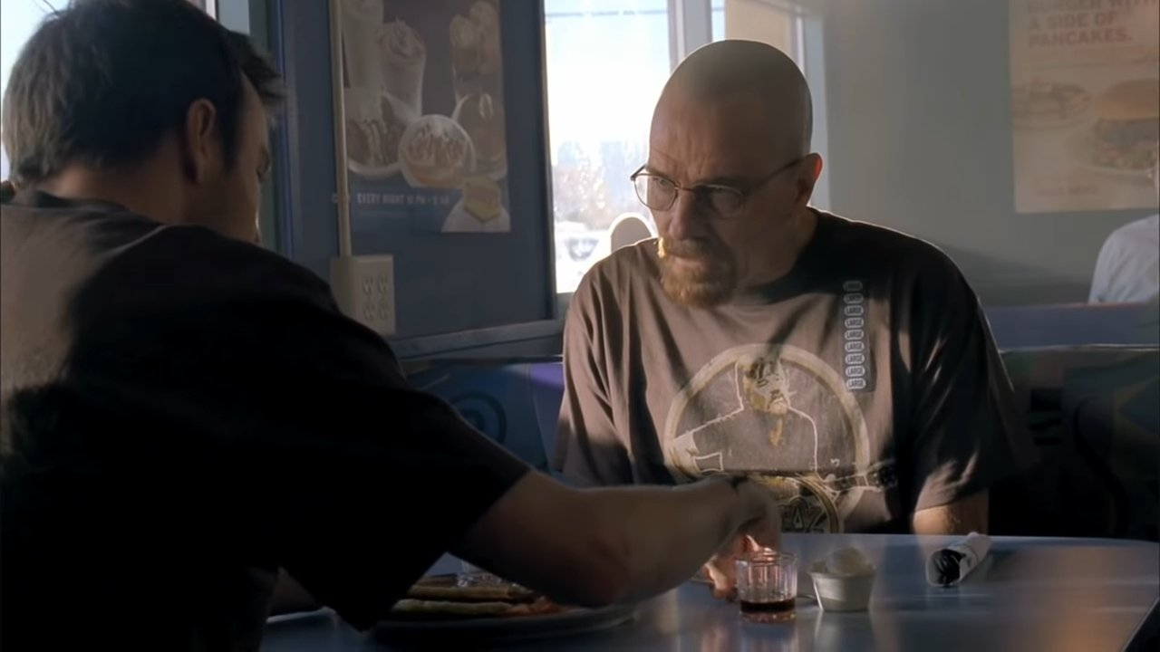
"Jessie, what the f*** are you talking about?"
Notes:
[~15s] Let the laugh happen. Don't explain the joke. Then click forward into Discernment — the mood shift from funny to serious is the whole point.

Slide 14
Discernment
Is it accurate?
Cross-check facts, numbers, and claims. AI can sound confident while being wrong.
Is it complete?
Look for missing perspectives, edge cases, or important context it left out.
Is it appropriate?
Check tone, audience fit, and whether it matches your actual intent.
Is it original enough?
AI tends toward generic. Push for specificity that reflects your unique context.
Notes:
[~1 min] "Four questions to gut-check any AI output." Don't read all 4 aloud — pick "Is it accurate?" and "Is it original enough?" as the two to emphasize. The audience can read the rest. → TRANSITION: "Let me break this into two types of discernment."

Slide 15

Human Discernment
Techniques
When It Matters Most
Read critically — treat it like a first draft from a new hire
Spot-check facts, numbers, and names before trusting them
Ask: does this match my domain expertise?
Watch for confident-sounding nonsense — fluency ≠ accuracy
Client-facing deliverables — your name is on it
Technical decisions — AI may suggest plausible but suboptimal architecture
Legal or financial content — small errors, big consequences
Anything novel — AI is strongest on common patterns
Notes:
[~1.5 min] "Your domain expertise is the first quality gate." HAMMER THIS: "Treat every AI output like a first draft from a smart new hire. Probably decent. Definitely needs your eyes." Left side = how. Right side = when it really matters. → TRANSITION: "You can also automate some of this..."

Slide 16

Automated Discernment
1
AI as Reviewer
Ask a second AI conversation to critique or find flaws. Fresh context catches blind spots.
2
Built-in Tooling
Use linters, test suites, and CI pipelines to validate AI-generated code before merging.
3
Structured Output
Request JSON, tables, or checklists so output can be validated programmatically.
4
Search & Citations
Ask AI to cite sources. Verify claims against authoritative references.
Notes:
[~1 min] Skim these quickly — don't read every description. Highlight #1 (AI as Reviewer): "Literally open a second chat and ask it to critique the first output. Cheapest QA you'll ever do." → TRANSITION: "Last D — and this one's about us, not the AI."

Slide 17
Diligence
1
Transparency
Be open about when and how you used AI in your work
2
Review
Always human-review AI output before it reaches clients or stakeholders
3
Data Care
Be mindful of what information you share with AI systems
4
Boundaries
Know your org's policies — and help shape them as you learn
Notes:
[~1 min] Go fast here — these are principles, not rules. "Transparency builds trust. Review before it goes to clients. Be careful with data. Know the boundaries." Don't belabor it. The audience gets it. → TRANSITION: "Enough theory. Let me give you something you can use today."

Slide 18

Try These Today
Engineering
"Here's my function [paste code]. Write unit tests covering happy path, edge cases, and error states. Use Jest and follow AAA pattern."
→ Full test suite with 8–12 tests
Product / PM
"I'm writing a PRD for [feature]. Interview me: ask the 10 most important questions a senior PM would ask before writing the spec."
→ Structured thinking partner that finds your blind spots
Design
"I'm designing a [screen]. Here's the user story: [paste]. List 5 edge cases this UI needs to handle that designers often miss."
→ Edge cases you'd have caught in QA instead of design
Notes:
[~2 min] THIS IS THE ENERGY PEAK. Slow down. Read the prompts. PM "interview me" prompt gets the biggest reaction — it flips AI from writing FOR you to thinking WITH you. If doing a LIVE DEMO, pick one and show it now. 60 seconds is enough.

Slide 19
Try These Today
QA / Testing
"Here's the acceptance criteria for [feature]. Generate a test matrix: positive flows, negative flows, boundary values, and cross-platform edge cases for iOS and Android."
→ Comprehensive test plan ready for review
Client-Facing
"I need to explain [technical decision] to a non-technical client. Write a 3-paragraph email focused on business impact, not implementation. Tone: confident, clear, no jargon."
→ Client-ready email that skips the tech-speak
Anyone
"I'm stuck on [problem]. Act as a thought partner: ask me clarifying questions, then suggest 3 different approaches with trade-offs for each."
→ Structured brainstorm that breaks through a block
Notes:
[~2 min] The "Anyone" card at the bottom is the most universal. "I'm stuck on [problem]. Act as a thought partner." — everyone gets stuck. This normalizes AI as a collaborator. → TRANSITION: "So here's what I want you to take away."

Slide 20
Start Building Your AI Fluency
Fluency is built through practice, not perfection.
Every interaction is a chance to get better.
Try It Today
Experiment Freely
Share & Learn
Pick one quick win
from the previous slide
and try it this week
There's no wrong way
to start — curiosity is
the only prerequisite
Share what works in
your team channels —
learn from each other
Notes:
[~1 min] "Fluency is built through practice, not perfection." "Pick ONE thing from today. Try it this week. That's it." End with energy, not information. Don't recap — land the feeling. [~2 min Q&A buffer]

