Slide 1
Power Up Automation (the “Hackathon”)
uipath.devpost.com (the “Hackathon Website”)

Slide 2
Barcode Reader (Custom Activity)
Developed a custom activity to decode different types of barcodes from an image file.
This activity will be helpful whenever we need to decode the barcode values from different invoices, files etc.
It will return the decoded output in the form of a string.

Slide 3
Barcode Reader (Custom Activity)
Functionality:
Decodes a barcode from an image file and returns the decoded value.
Properties:
Input
ImagePath (Required Argument)- Specifies the image path where the barcode is present. It is of String data type.
Output
BarcodeValue-The result after decoding the barcode. It is of String data type.

Slide 4
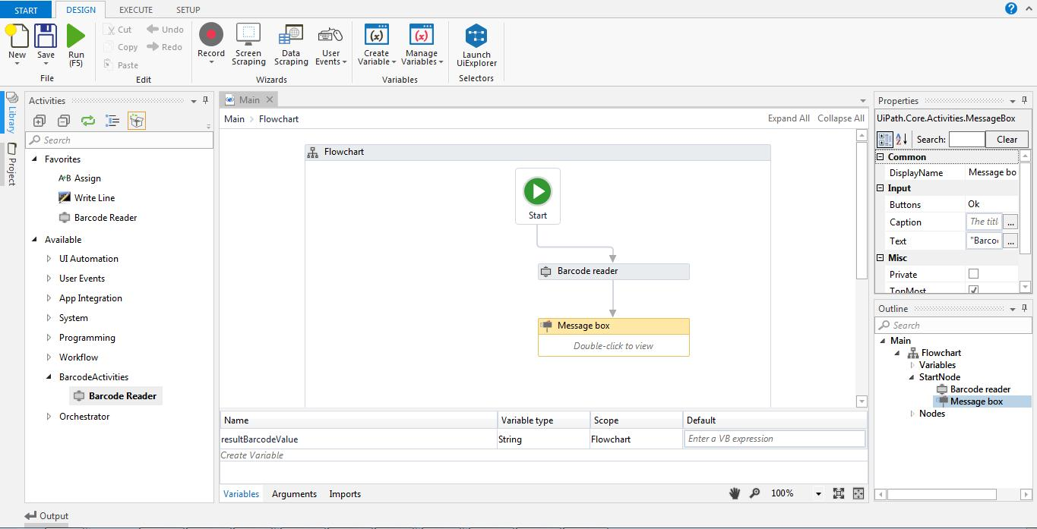
Screenshots
The below screenshot shows us the new Custom Activity named “Barcode Reader” is added in the Activities Panel and its usage in the project.

Slide 5
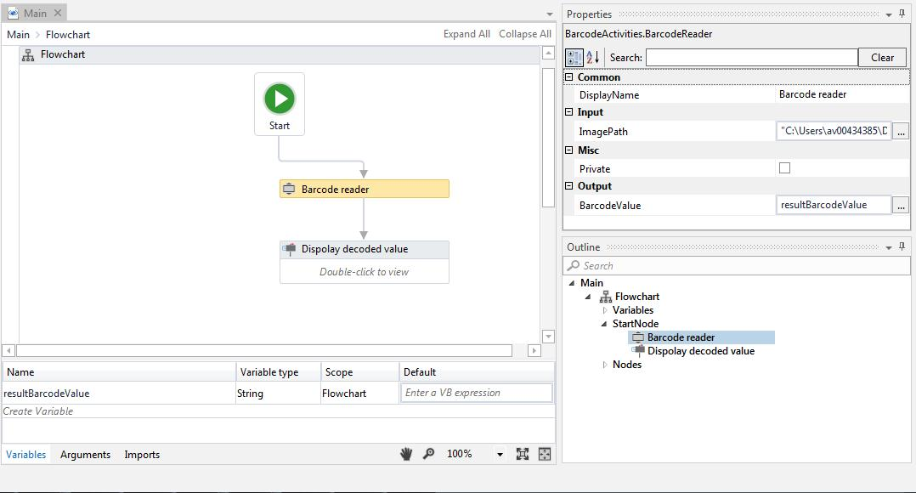
Sample Flow chart
The below flowchart is implemented for decoding a barcode and displaying it in a message box.

Slide 6
References:
Please find the below url for the sample project implementation and its usage.

