Slide 1
Portofolio
Home
Hakam Raves

Slide 2




Table of Contents
Table of Contents
About Me
Project Showcase
Job Experience
Contact Me!

Slide 3

Problem solver who leverages skillset
About Me!
Personal Information
raves.hakam@gmail.com
+6282311117335
Jakarta Barat, Indonesia
Education
Bachelor of Computer Science – Pertamina University 2023
Master of Computer Science – Binus University 2025(Expected)
Master of Applied Economy – Padjajaran University 2025(Expected)
Find Me On
linkedin.com/in/hakamraves
github.com/ravsssh
Tools
Skills
Python/R Studio
SQL
Looker Studio
Power BI
Streamlit
Arduino IDE
Microsoft Excel (Pivot Table & Chart, Data Analysis, Vlookup & Hlookup)
Data Science
Data Analyst
Machine Learning
Data Viz
Business Intelligence
Internet of Things
Econometrics
Target-oriented, fast learner and competitive team player, shaped by 10 years as a student-athlete with notable achievements and hands on job experience.

Slide 4


Fresh talent with hands-on experience
Job Experience
IT Support/Data Admin – PERTAMINA Lubricants
Oct 2023 – Sep 2023
Software Developer Intern – Indonesia Biru Foundation
Apr 2021 – Sep 2021
Oil & gas state-owned company focused on production and sales of lubricants and derivative products
Joined technical specialist function in sales and marketing as an after-sales function, I performed as a IT support and administrative (Corporate Memorandum & Procurement Inventory) for Coordinator of Field Engineer
Project 1 – Transformed manual after-sales activity dashboard to automated report and dashboard
Project 2 – Data analysis for after-sales activity SLA Regulation
Project 3 - Field Engineer Workload Analysis
Project 4 – Field Engineer Award Assesment
Project 5 – Field Engineer Travel Expense Forecasting
Tools frequently used : Looker Studio, Google Sheets, Google Apps Script, Microsoft Excel (Pivot Table, Data Analysis)
A Non Governmental-Organization focused on marine research, restoration and community development.
Joined digital marketing department as a contributor for digital transformation such as Website Developer and Android Developer for 6 months.
Project 1 – Indonesia Biru Foundation Landing Page and Coral Reef Adoption System
Project 2 – Indonesia Biru Android Application (Solution to find diving spots for tourists in the Lombok area)
Tools frequently used : Figma, Java

Slide 5
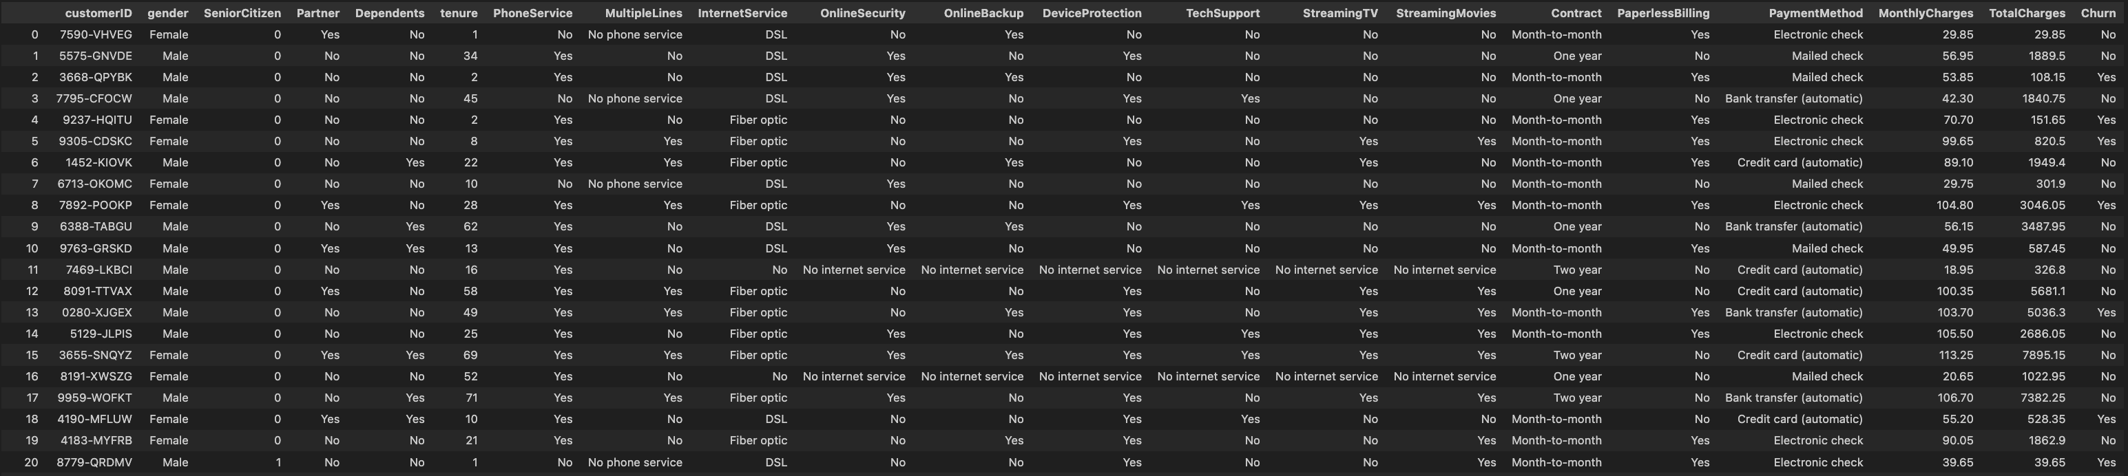
Case 1: Telco Customer Churn with Data Analyst and Machine Learning
Project Based
Telecommunication company have customer data that contain customer demographic, service subscriptions, contract and payment details.
We Analyze and solve this churn rate problem from data available.
About
Tools
Analyzes telecommunications company customer data contains 7,043 customers including demographics, service subscriptions, contract details, and payment methods.
-Python
-Microsoft Excel
Full project repository
github.com/ravsssh/TelcoCustomer

Slide 6
Enhancing Customer Retention
Executive Summary
Strategic
Pilar
Priority Initiatives
Goal
Market Impact
Strategic Impact
Business Understanding:
Financial impact.
Business problem
Project overview.
Mitigate revenue loss from churn, enhance customer satisfaction, and improve brand loyalty.
Project overview
Enable data-driven decision-making for retention.
Insight & Analysis:
Exploratory data analysis (EDA).
Patterns and correlations.
Insights why customers churn, enabling targeted interventions.
Strengthen existing customer relationships and prevent costly customer acquisition.
Transform raw data into strategic intelligence.
Customer Retention & Lifetime Value Optimization
Solution for Business:
Machine learning model to predict churners.
Identify customers likely to churn.
Focus retention efforts on high-value, high-risk customers for optimal ROI.
Churn prediction model with high accuracy and customer segmentation.
Automate and scale churn prediction capabilities.
Interpretability & Strategies:
Reveal critical churn factors
Business recommendations for retention campaigns.
Interpretable ML model for improving customer retention.
Improve effectiveness of marketing campaigns and customer service interventions.
Analytical decision-making and digital transformation.

Slide 7
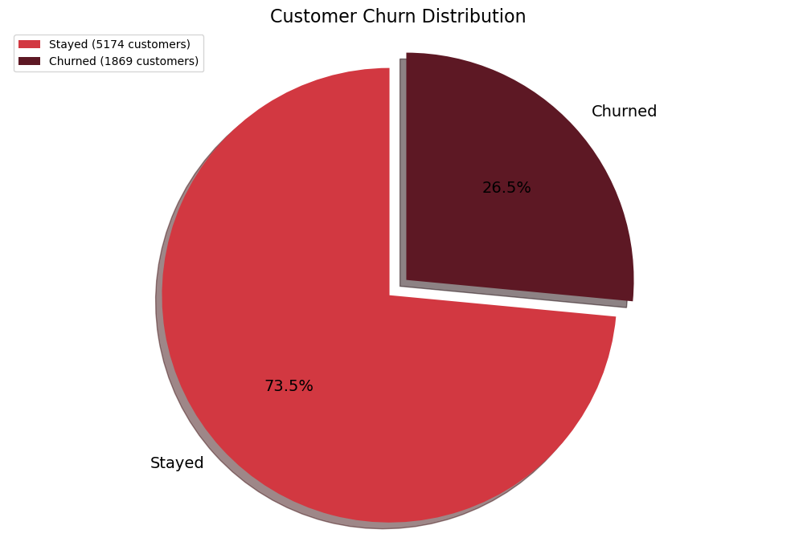

26% of churned customer represent $139,000 in monthly charges lost
Business Understanding
Each churned customer on avg a loss of approx
$74/month
Revenue
$456k
Churn Lost
$139k
While retain 73.47% of customers, the remaining churn rate presents a room for improvement.
Churn rate -> Dissatisfaction or unmet needs.
This can lead the company vulnerable to competitors who might offer better service, pricing, or features.
Key Insights
Reducing churn protects 30% revenue and strength market share
Customer acquisition is more expensive than retaining existing, resources can allocated to other growth
Understanding customer churn factor and retention strategy

Slide 8
Churn Rate hurt
Business Understanding
Pain Points
Problem Statement
-Revenue leakage
-High churn rate and Increase customer acquisition costs
-Limited understanding of customers churn factors
-Ineffective Retention Strategies
-Reduce resources
-Competitive vulnerability
Despite retaining a majority of our customers, a significant and preventable monthly revenue loss of $139,000 USD (representing 30.5% of total revenue) is occurring due to a 26.53% customer churn rate, severely impacting profitability, growth and costly customer acquisition efforts to offset these losses.
Objectives
-Identify deeply understand churn factors
-Build a predictive churn model
-Translate insight and model into actionable retention
-Reduce customer churn rate
-Improve Operational Efficiency in Retention Efforts

Slide 9
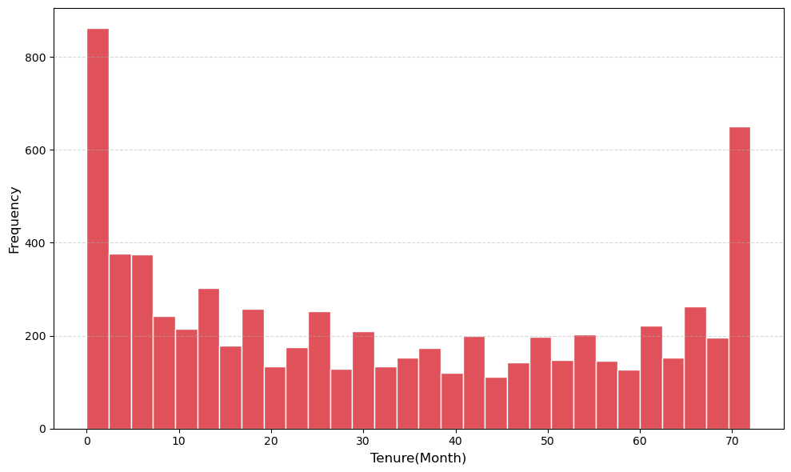
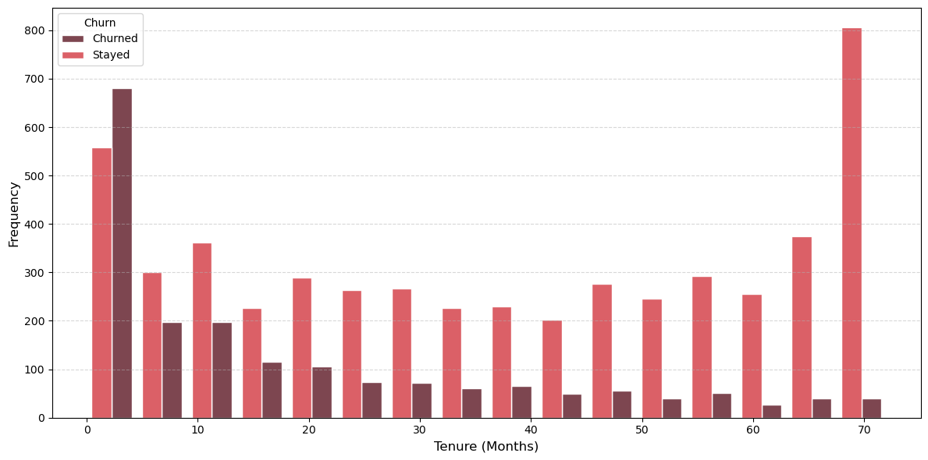
New and loyal customer is the majority, which new customer tend to churn and loyal customer tend to stay
Insight and Analysis
48% of first year customer churned
29% is first year customer
Key Insights
Target first month customer experience and bonus for loyal customer
New customer tend to churn and loyal customer tend to stay

Slide 10
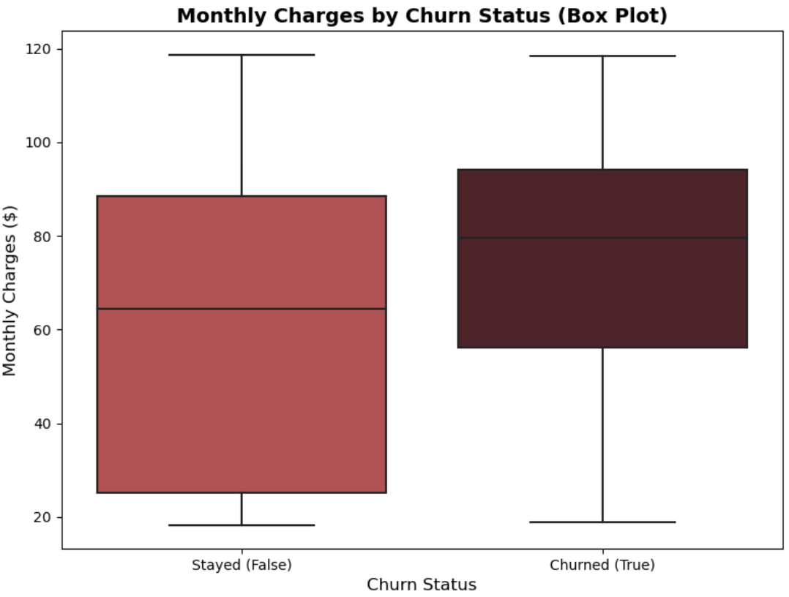
Pricing tolerance develops with tenure and relationship, New customers pay more when they leave
Insight and Analysis
Stay customers -> the longer they stay, the more they're charged
High charges
To
Low charges
To
Churned customers -> the newer they are, the more they're charged
Low charges
High charges
Key Insights
Total churned monthly revenue originates from newest customers (0-6 months) for nearly 36% ($49,896) of all lost monthly charges
Stayed customer monthly charges varieties but churned customer a bit pricey
Newcomers leave when overcharged, while veterans stay despite higher prices

Slide 11
Pricing and tenure issue solution
Insight and Analysis
New customer tend to churn and loyal customer tend to stay
Competitive pricing for new customer
30% is new customer, 48% of first year customer churned
New customers (0-6 months) for 36% ($49,896) of all lost monthly charges
Target first month customer experience and bonus for loyal customer
Stayed customer monthly charges varieties but churned customer a bit pricey
Pricing tolerance develops with tenure and strength relationship
Newcomers leave when overcharged, while veterans stay despite higher prices

Slide 12
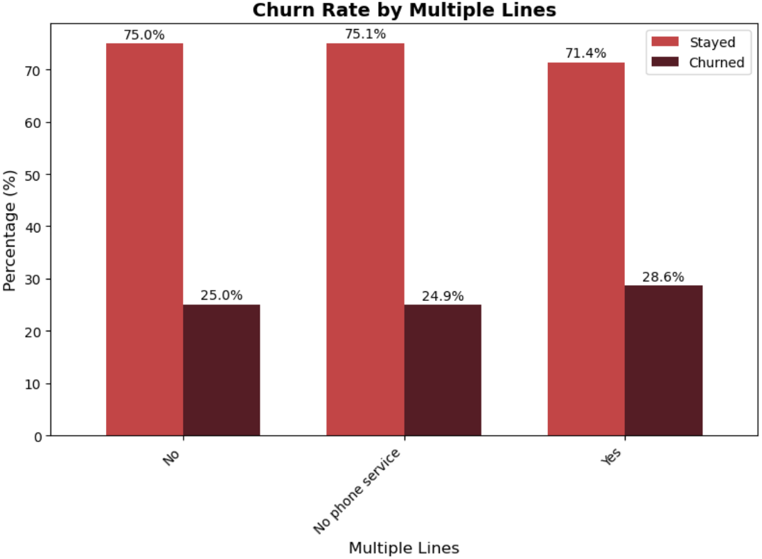
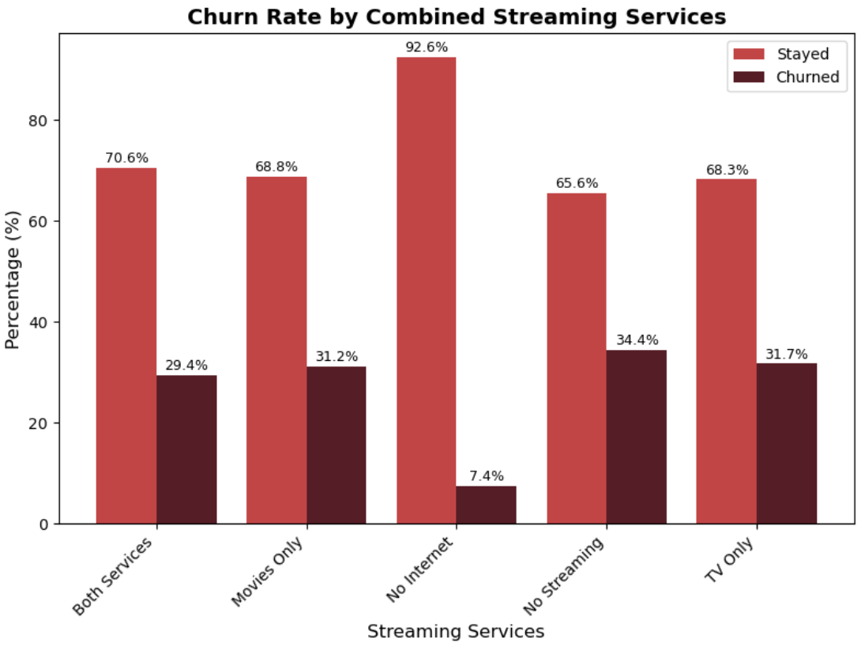
All phone and streaming services have the same churn affect
Insight and Analysis
Pricing and tenure issue solution
All phone and streaming services pricing need to be review
Promo for phone and streaming services to new customer

Slide 13
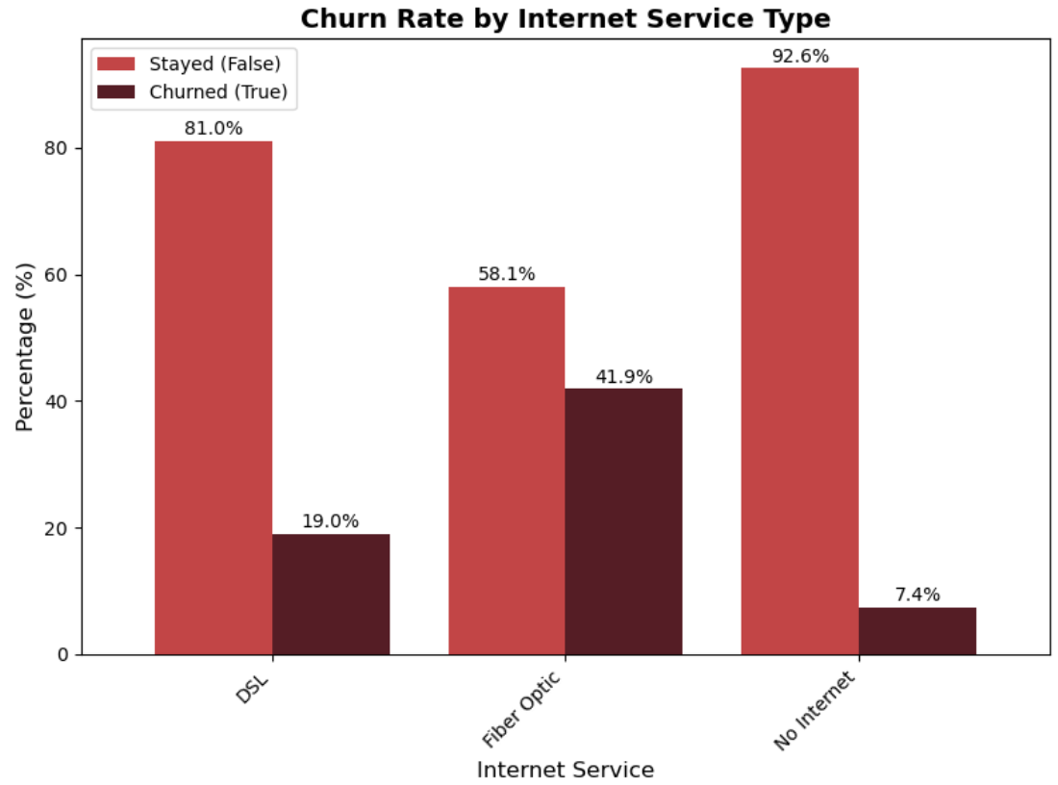
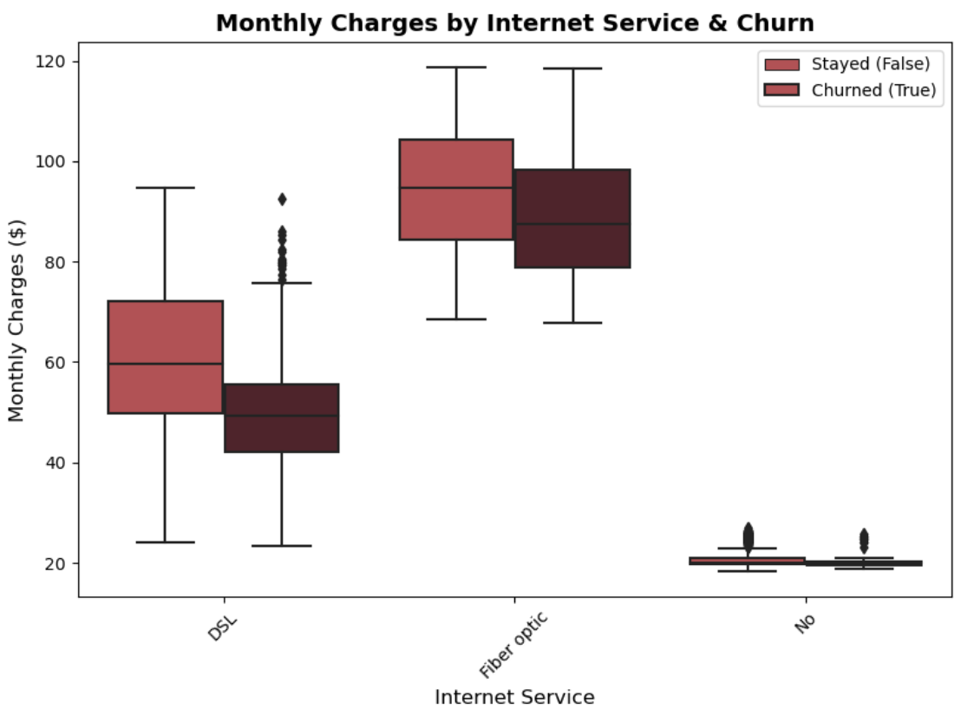
Meanwhile almost 50% fiber optic customer churn while having high charges
Insight and Analysis
Pricing and tenure issue solution
Our fiber optic services is overprice and urgently need to be review
DSL and no internet services is loyal
Internet customer need excellence customer support

Slide 14
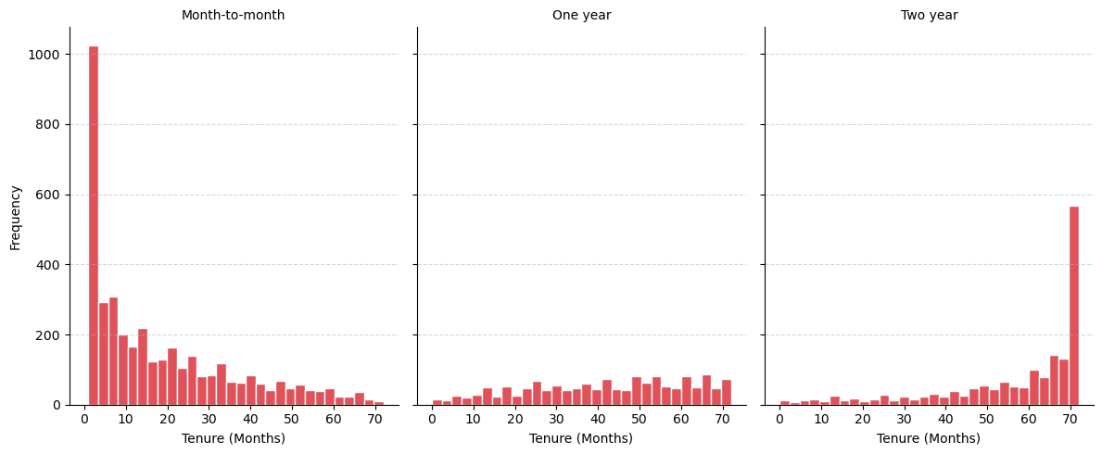
Longer contract keep customers but month to month is majority
Insight and Analysis
Key Insights
Our majority customer is month to month contract
Two year contract customer mostly loyal customer
Very low new and loyal customer at one year contract

Slide 15
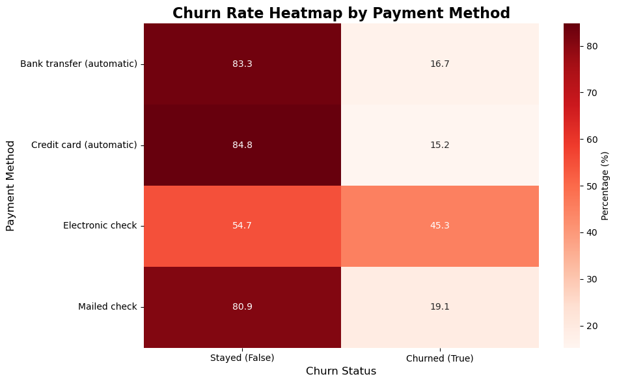
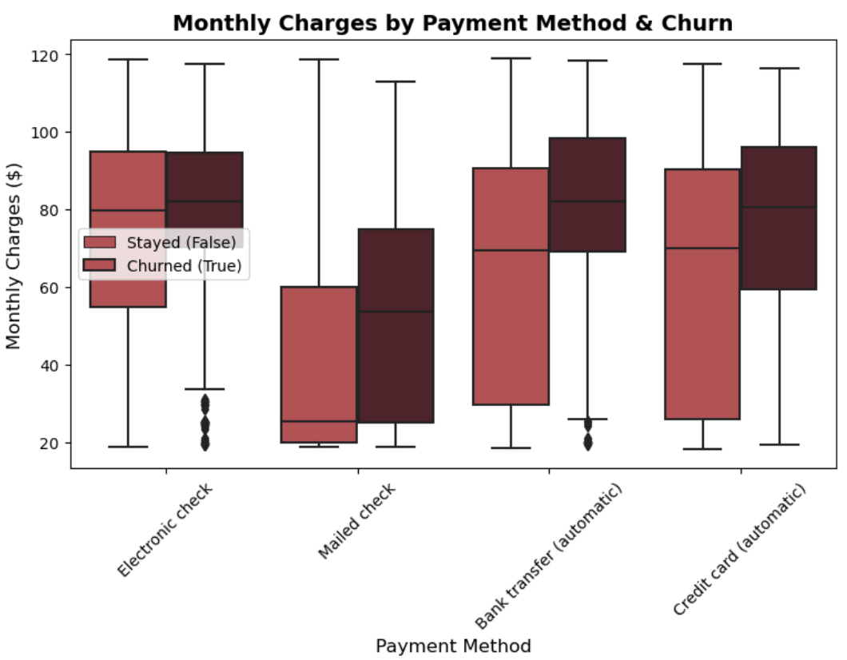
Electronic check with majority high monthly charges is our concern
Project Based
Key Insights
High charged (bad pricing) with manual payment is perfect combo for customer churned
Automatic payment have low churn rate

Slide 16
Contract and Payment issue solution
Insight and Analysis
Our majority customer is month to month contract, which is mostly low tenure
Good pricing and customer support services bundle with two year contract.
Very low new and loyal customer at one year contract
High charged (bad pricing) with manual payment is perfect combo for customer churned 45% (Electronic Check)
Convert majority customer (month-to-month) contract to two year.
Prioritize automatic payment, with bonus and bundles
Two year contract customer mostly loyal customer
Automatic payment have low churn rate 16-19%

Slide 17
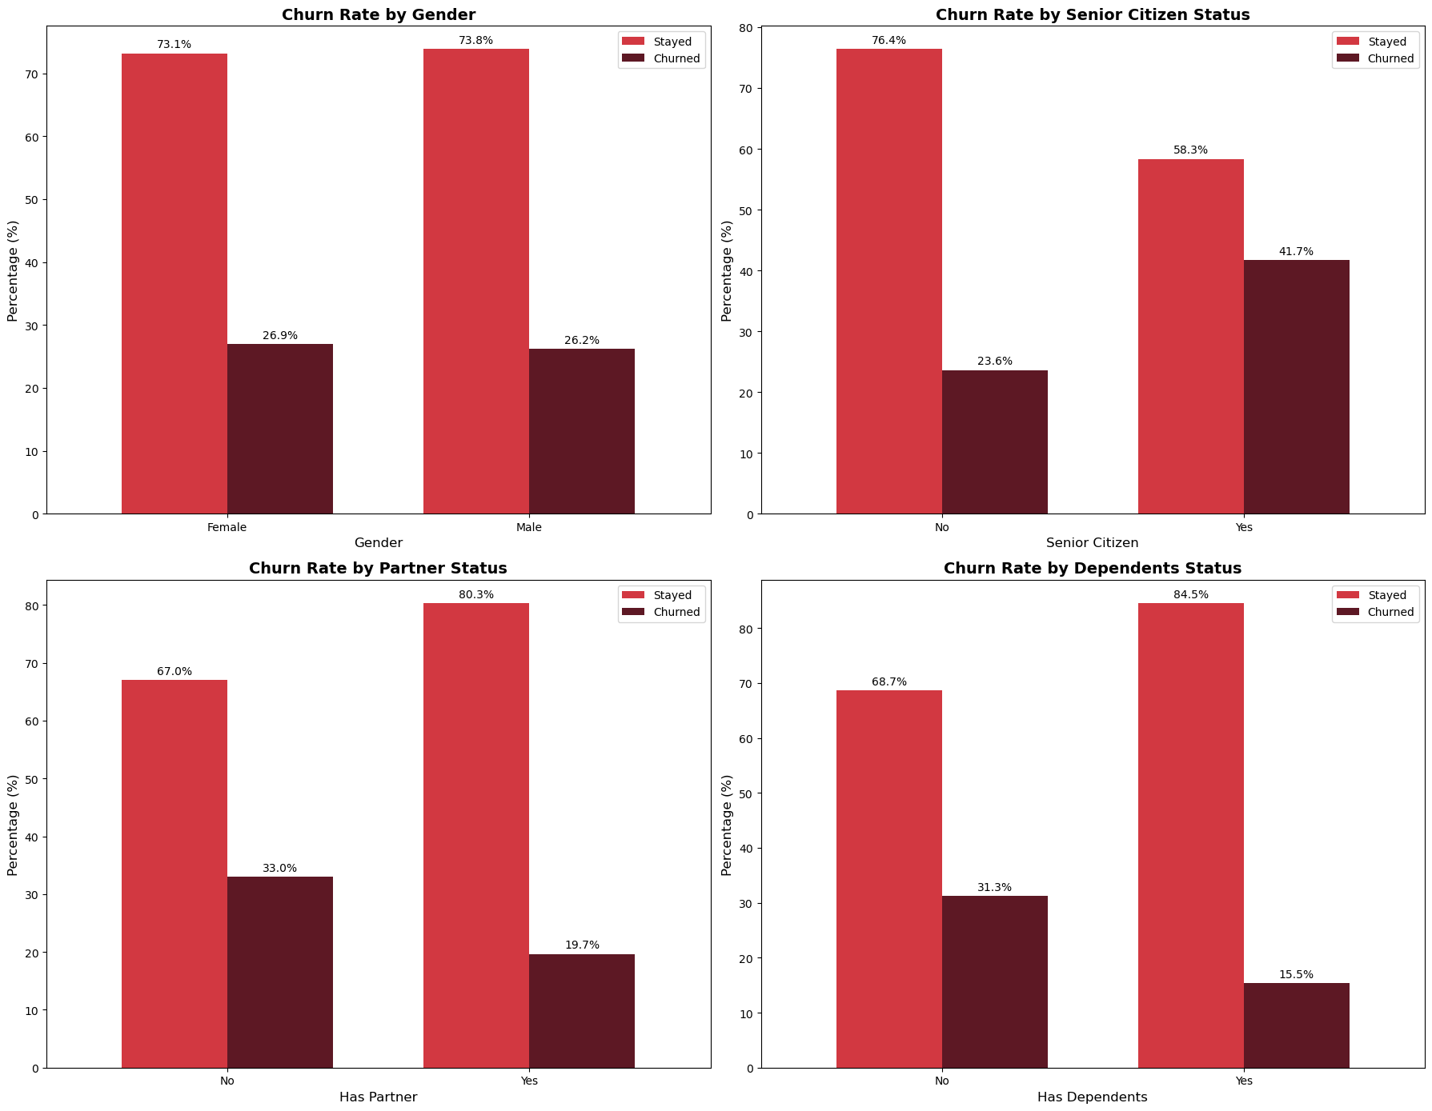
Churned customer affected by partner, dependents and senior status
Project Based
We need excellence customer support for senior citizen engagement.
-Customer support training
-Experience Hire
Partner services package, for interruption partner influence to churn
Family package for customer with dependents
Key Insights
Gender has nothing with churn
Senior citizen affect by almost 20% customer churn
Partner and dependents status by average affect 13-15% customer churn

Slide 18
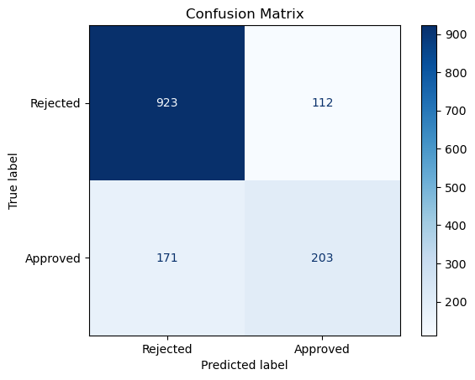
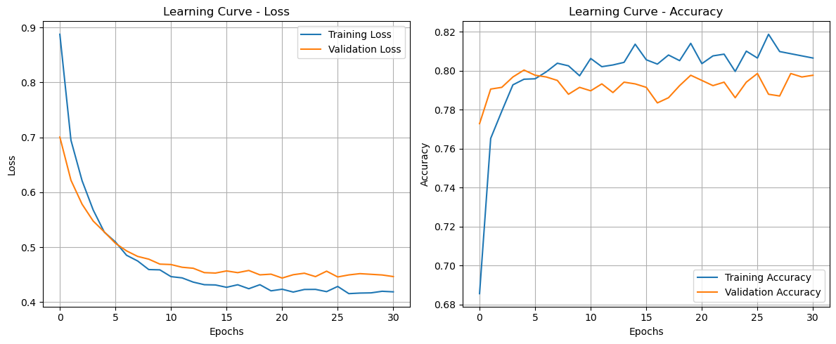
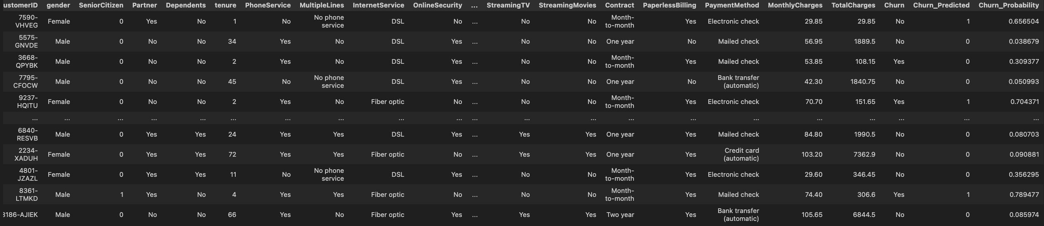
Machine Learning Model (ANN)
Project Based

Slide 19
Machine Learning Model (ANN)
Project Based
We can implement in customer relationship management website to interpret churn when the probability hit threshold number (0.5)

Slide 20
Still much to go!
Contact Me!
Personal Information
raves.hakam@gmail.com
+6282311117335
Jakarta Barat, Indonesia
Thank You!
Find Me On
linkedin.com/in/hakamraves
github.com/ravsssh

