Slide 1
Portfolio
Home
Hakam Raves

Slide 2
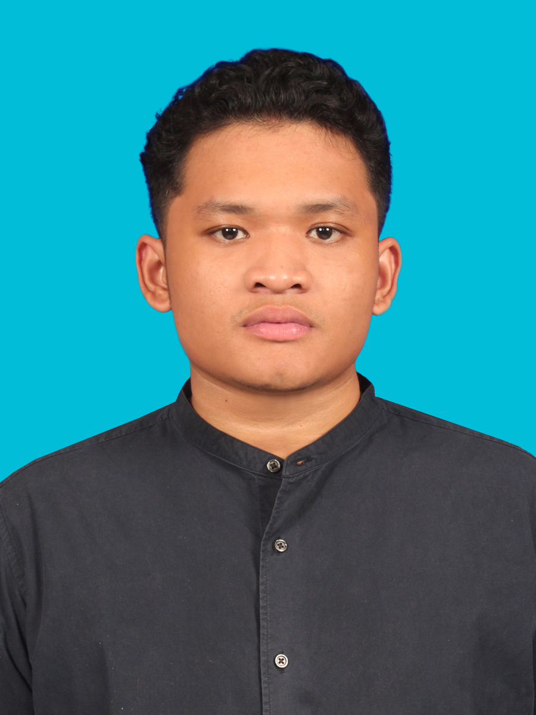
Problem solver who leverages skillset
About Me!
Personal Information
raves.hakam@gmail.com
+6282311117335 (Whatsapp)
Jakarta Barat, Indonesia
Education
Bachelor of Computer Science – Pertamina University Nov 2023
Master of Computer Science – Binus University March 2026(Expected)
Master of Applied Economy – Padjajaran University March 2026(Expected)
Find Me On
linkedin.com/in/hakamraves
github.com/ravsssh
Tools
Skills
Python/R Studio
SQL
Looker Studio
Power BI
Streamlit
Arduino IDE
Microsoft Excel (Pivot Table & Chart, Data Analysis, Vlookup & Hlookup)
Data Science
Data Analyst
Machine Learning
Data Viz
Business Intelligence
Internet of Things
Econometrics
Target-oriented, fast learner and competitive team player, shaped by 10 years as a student-athlete with notable achievements and hands on job experience.

Slide 3

Fresh talent with hands-on experience
Job Experience
Software Developer Intern – Indonesia Biru Foundation (Internship)
Apr 2021 – Sep 2021 (6 Month)
A Non Governmental-Organization focused on marine research, restoration and community development.
Joined digital marketing department as a contributor for digital transformation such as Website Developer and Android Developer for 6 months.
Project 1 – Indonesia Biru Foundation Landing Page and Coral Reef Adoption System
Project 2 – Indonesia Biru Android Application (Solution to find diving spots for tourists in the Lombok area)
Tools frequently used : Figma, Java

Slide 4

Fresh talent with hands-on experience
Job Experience
Technical Specialist Data Analyst – PERTAMINA Lubricants (Internship)
Oct 2023 – Sep 2024 (1 Year)
Oil & gas state-owned company focused on production and sales of lubricants and derivative products
Sales and Marketing division that performed after-sales activity, i've worked on Data Analyst Project with Coordinator of Field Engineer.
Project 1 – Transformed manual after-sales activity dashboard to automated report and dashboard system
Project 2 – After-sales services optimization, analyze travel hours, activity hours, activity weight, and activity value, which led to a 40% reduction in SLA activity.
Project 3 - Performance analytics, analyze KPI for 12 Field Engineers through data cleaning and preprocessing of timesheet data using Python, enabling data-driven performance evaluations.
Project 4 – Travel budget forecasting, created 6 Month travel expenses forecasts for 12 Field Engineer by utilizing past spending trends and 40% SLA after-sales activity reduction, allowing for a 40% budget reserve for strategic planning.
Project 5 – Designed and implemented data-driven assessments framework and data preprocessing for Field Engineer Award. Ensuring objective and consistent performance measurement.
Tools frequently used : Looker Studio, Google Sheets, Google Apps Script, Microsoft Excel (Pivot Table, Data Analysis)

Slide 5

Fresh talent with hands-on experience
Job Experience
Coding Teacher – Kalananti by Ruangguru (Freelance)
Jun 2025 – Now
Coding and robotic course by Ruangguru for Elementary, Middle and Senior High School Student.
As a teacher I built digital and computational thinking skills. Basic coding instructor(Python, MIT App Inventor, Java) interactive programs with structured logic, input/output handling, and error-free execution, emphasizing problem-solving and financial literacy use cases.
Mainly teach python for Senior High School and private class using Bahasa Indonesia and English as medium of interaction.
Tools frequently used : Python, Java, MIT App Inventor

Slide 6

Project
Project Showcase

Slide 7
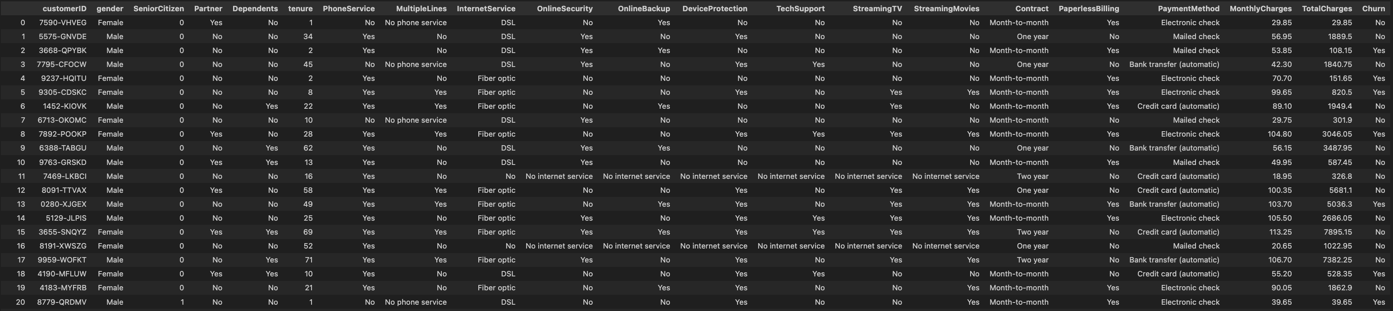
Case 1: Telco Customer Churn with Data Analyst and Machine Learning
Project Based
Telecommunication company have customer data that contain customer demographic, service subscriptions, contract and payment details.
In depth business insight and solve the problem by analyze customer data by customer profiling, predict churn and strategy to improve retention rate.
Tools
-Python
-Microsoft Excel
Full project repository
github.com/ravsssh/TelcoCustomer

Slide 8
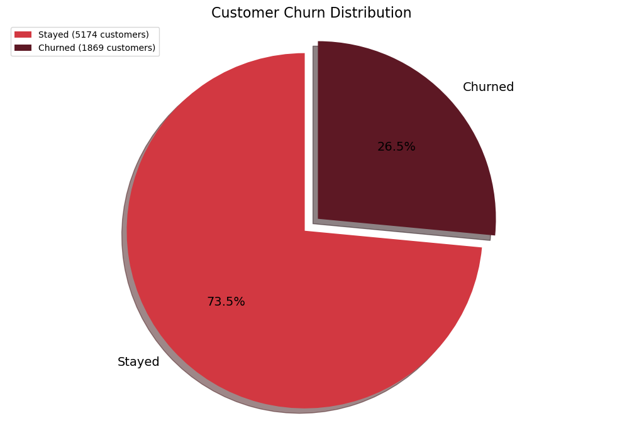
26% of churned customer represent $139,000 in monthly charges lost
Business Insight
Revenue
$456k
Each churned customer on avg a loss of approx
$74/month
Churn Lost
$139k
30% of revenue
While retain 73.5% of customers, the remaining churn presents a room for improvement.
Churn -> Dissatisfaction or unmet needs.
This can lead the company vulnerable to competitors who might offer better service, pricing, or features.
Problem Statement
Strategic Pilar | Objective Goal
Customer Profiling | Insights why customers churn and stay
Churn Prediction | Predict customer churn and Risk Level
Action to customer | Reduce churn rate
Reducing churn protects 30% monthly revenue and strength market share
Understanding customer churn factor and retention strategy
Realtime churn prediction to overcome churn customer

Slide 9
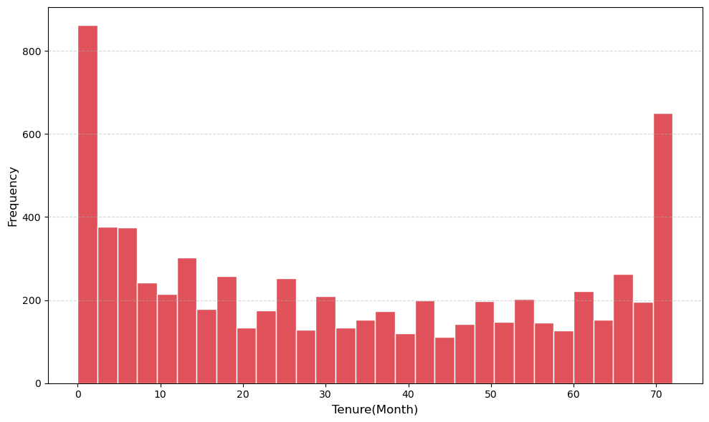
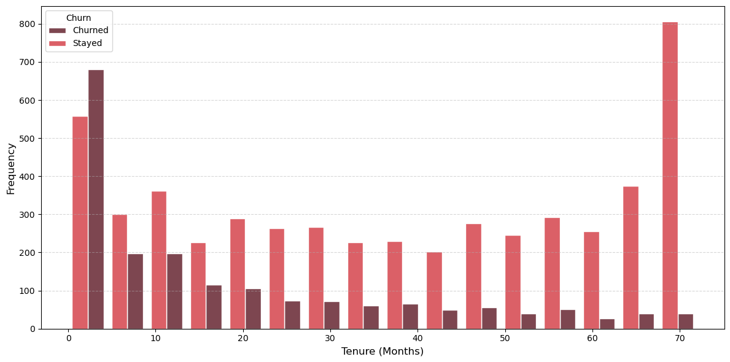
New and loyal customer is the majority, which new customer tend to churn and loyal customer tend to stay
Tenure Insight and Analysis
48% of first year customer churned
29% is first year customer
Key Insights
Target first month customer experience and bonus for loyal customer
New customer tend to churn and loyal customer tend to stay

Slide 10
Pricing tolerance develops with tenure and relationship, New customers pay more when they leave
Customer Charges Insight and Analysis
Stay customers -> the longer they stay, the more they're charged
High charges
To
Low charges
To
Churned customers -> the newer they are, the more they're charged
Low charges
High charges
Key Insights
Total churned monthly revenue originates from newest customers (0-6 months) for nearly 36% ($49,896) of all lost monthly charges
Stayed customer monthly charges low to high by tenure but churned customer vice versa
New customers leave when overcharged while loyal customer stay despite higher prices

Slide 11
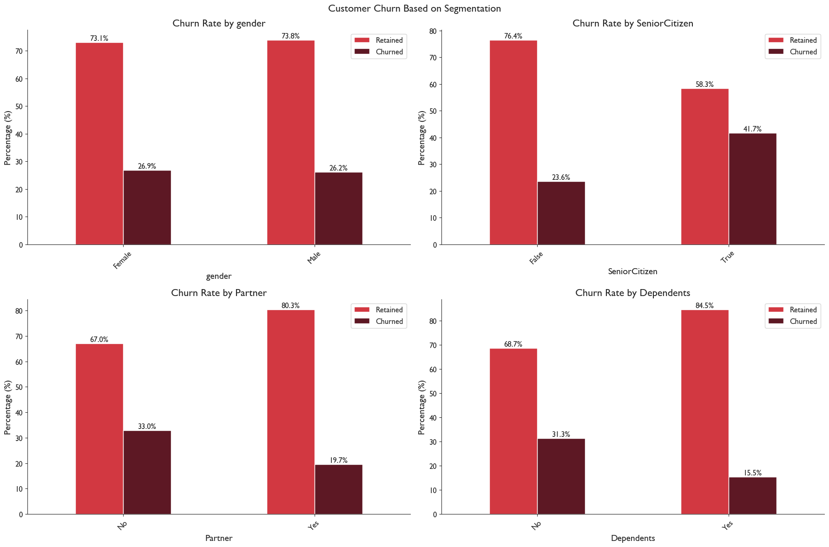
Churned customer affected by partner, dependents and senior status
Demographic Insight and Analysis
Key Insights
Gender has nothing with churn
Senior citizen affect by almost 20% customer churn
Partner and dependents status by average affect 13-15% customer churn

Slide 12
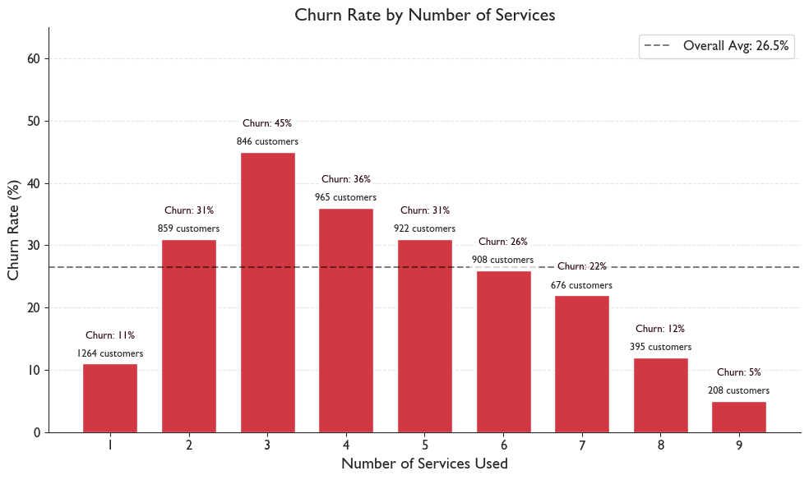
Dangerous service acquisition trap
Services Insight and Analysis
Highest churn rate occur at 2-4 service usage not single-service customer.
While successfully upselling customer into more service, but they becoming more likely to churn.
Key Insight
Fiber optic is consistently show high churn in every service combination
The more service customer use the more loyal
Online Backup, Online Security, Device Protection and Tech Support is services that most retained customer
Mostly one service usage customer is phone service user only
High service usage customer is the most loyal.

Slide 13
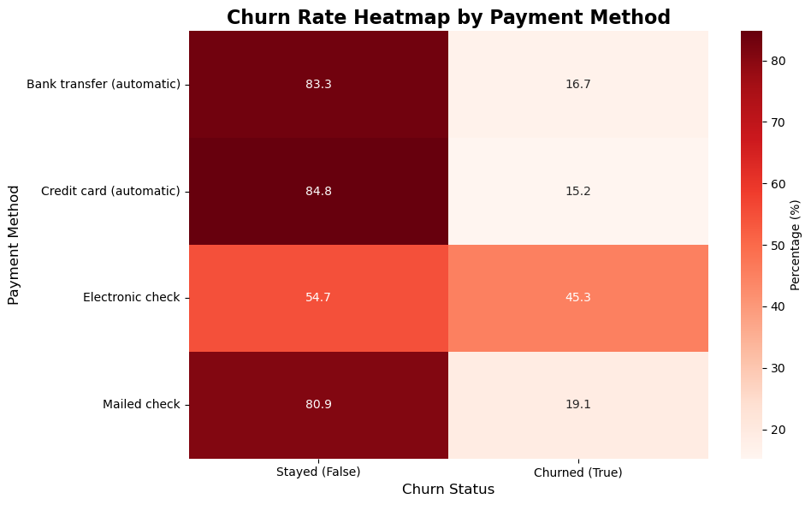
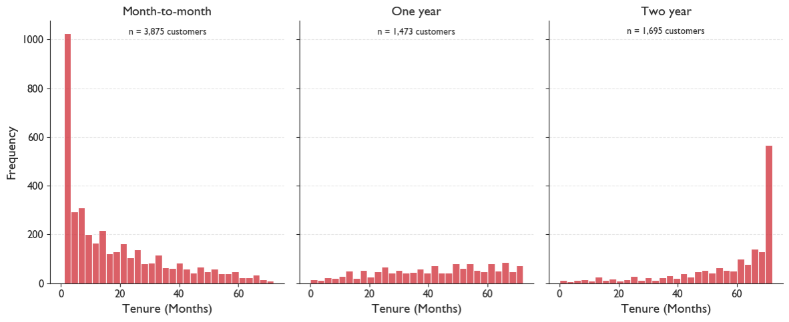
Most popular, yet most risky: E-Check and Month-to-month Contract
Payment Method Insight and Analysis
The most used payment method is E-Check
The most used contract method is Month-to-month
Key Insights
Except e-check other payment method have low churn rate
Two year contract customer mostly loyal customer
Most popular, yet most risky

Slide 14
What makes customer churn
Customer profiling
Root cause analysis
Detailed cause
Business problem
Pricing strategy
High charges
Surprise high billing for new customer
Contract structure
Low contract commitment
Majority month-to-month contract(55%)
Customer demographic
New customer
Senior citizen
Unstable life stage customer (single and no dependents)
Customer churn
26% customer rate
$139K Monthly Loss
$74/Customer
Service Portfolio
Poor services
No services bundle
Poor fiber optic services
Customer lifecycle
Low tenure
Poor senior citizen customer experience
Payment Method
Majority manual payment
E-check & Mailed-check

Slide 15
What makes customer stay
Customer profiling
Service optimization
Multi-service adoption
Service satisfaction
Full ecosystem
Support service
Relationship Maturity
High tenure
Price tolerance (low charges to high charges)
Engagement depth
Customer demographic
Non-senior citizen
Partnered customer
Stabil customer (dependents)
Commitment structures
Long contract
Payment method (automatic payment)
Switching cost

Slide 16
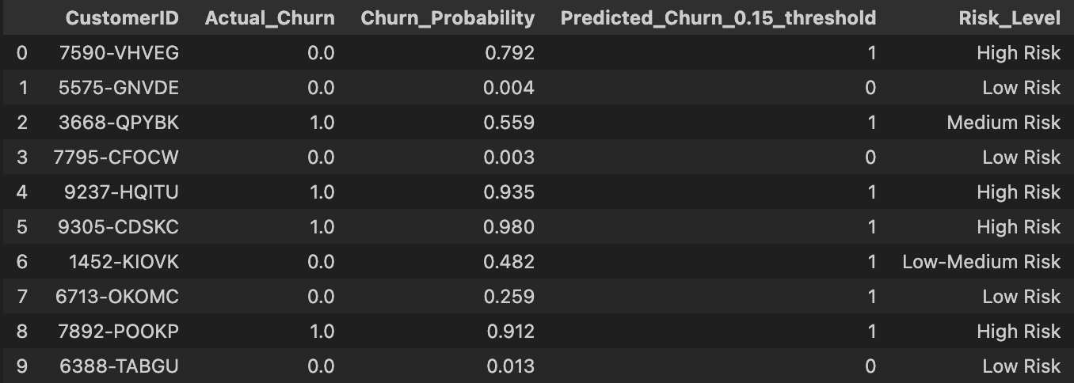
Prediction Model (ANN)
Churn Prediction
Model 93% detecting churn customer in data test (Recall 93%).
Predicted churn customer categorize to:
High risk -> 70% probability
Medium risk -> 50% probability
Low-medium risk -> 30% probability
Low Risk -> under 30%
Top 3 features driving churn:
Tenure
Month-to-month contract
Fiber optic internet service
Top 3 features prevent churn:
Bank transfer (automatic
Online security
Tech support

Slide 17
Action suggestion
Action to customer
Enhance onboarding program and built customer relationship that develop tenure and price tolerance
Revamp ux for improvement in payment and contract to aim longer and automatic payment with added incentive
Enhance customer support for senior citizen
Implement machine learning model in customer relationship management dashboard for early warn
Review pricing strategy and service portfolio with customer demographic need matching (family plan or partner plan)
Audit fiber optic service, investigate service quality, pricing and customer satisfaction
Create loyalty bonus program
Redesign service bundling, create pathways that move customers directly from one service to 7+ (full ecosystem)

Slide 18
Still much to go!
Contact Me!
Personal Information
raves.hakam@gmail.com
+6282311117335 (Whatsapp
Jakarta Barat, Indonesia
Thank You!
Find Me On
linkedin.com/in/hakamraves
github.com/ravsssh

