Slide 1
Travel website companies - Recommendations
Sruthi Ravula
Ritu Palod

Slide 2
Objective
Improving user experience on travel website (Expedia.com)
Provide user specific recommendations
Predicting the hotels the user is likely to book.
Recommend a package for a user based on historic data of the users.

Slide 3
Developed Models
1. Developed recommendation engine using Map Reduce and Mahout for travelers using the Expedia data for both existing and new customers
2. Learning to rank hotels to maximize purchases using Machine Learning.

Slide 4
Expedia Dataset:
Input fields
Time of booking
Site information
Geographic information of user
Booking details: No of bookings, clicks, check-in date, check-out date, no of guests, package or not
Destination Id
Hotel ID and country
Marketing Channel

Slide 5
Model 1: Recommendations
Use Case1: Recommendations for current user
1.a Travel Package Recommendation
Developed a recommendation engine based on user preference and similarity co-occurrences.
1.b Hotel Recommendation once user enters destination.
Suggest hotel from the recommendations based on the user preference.
Use Case2: Recommendations for new customers

Slide 6
Use Case1.a: Travel Package Recommendation
Step1 : Native Map Reduce
Developed a map reduce algorithm which uses the input fields such as user id, destination id, hotel cluster id, bookings, clicks and other variables
Map Reduce Program when run generates the scores for each hotel in a destination based on number of user bookings and clicks.
The score is calculated as below:
Hotel score = 5*(no of bookings) or 1*(no of clicks)

Slide 7
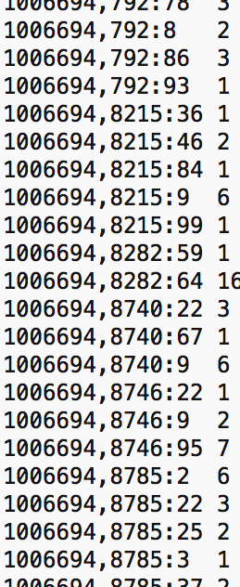
Step 1: Output
Step2 : Mahout User-based Recommender
Output from step 1 is served as input
to Mahout recommender

Slide 8
Use Case1.a: Travel Package Recommendation
Step2 : Mahout User-based Recommender
The output from step1 is used as input to Mahout taste recommendation engine.
Input [ user_id, dest_id+hotelclusterId, preference]
Finding similar users using similarity co-occurrence matrix.
Generate recommendations from users with similar taste
Step3 : Map Reducer Viewer to format the output

Slide 9
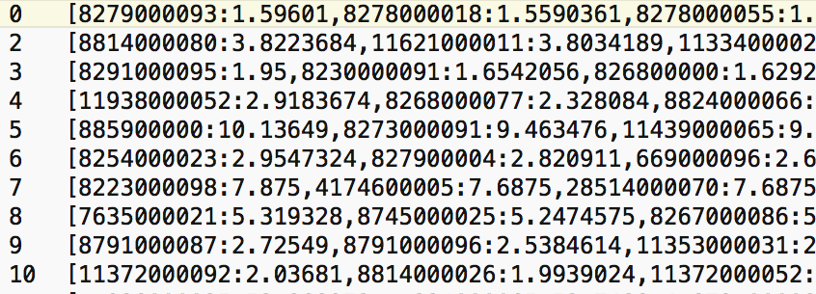
Use Case 1A: Final Output
In the output rows, the first column indicates User ID, the second column indications recommendations
For example, in the first row 8279000093, 8279 indicates destination ID, 93 indicates hotel ID while 1.59601 indicates score

Slide 10
Use Case1.b: Hotel Recommendation
Recommend hotel based on user similarity and preference when a destination is selected by user.
Using the travel package recommendation output, suggest hotel from the recommendations available.
If the destination does not match any of the recommendations available display the most popular hotels.

Slide 11
Use Case 2: Recommendation for new customers
Recommendation for a new Customer using the historic data
Identify the hotels in a destination Id that are booked from the specific user city, and sort the hotels in order of number of bookings.
When a new customer looks for a hotel in a destination from a specific city, the hotels will be recommended based on the above information.

Slide 12
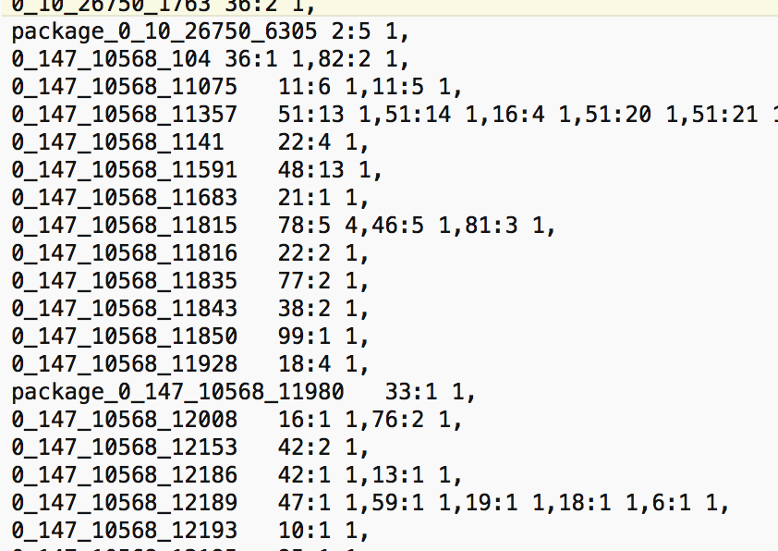
Use Case2: Output

Slide 13
Model 2: Machine Learning – USE CASES
Its recommending users base on users history and its competitor information as to
A. Which user will just browse through the site
B. Which user would end up clicking and booking through Expedia
Yield :- If the Recommendation system, which Expedia recommends to its users, improves even by 1 % , we have given Expedia a huge profit.

Slide 14
Expedia data set:
2.2 GB Data Set
54 Variables
400,000 Unique Searches
10 million rows training Data
6 million rows Test Data
Null values, Missing Values

Slide 15
Yearly Revenue of Expedia is $4,800,000,000 so, 1% increase in conversion rate is $48,000,000

Slide 16
Data Flow Model
Data Cleaning
Feature Engineering
Model
Ensemble Learning
Final Prediction
Exploratory Data Analysis
Data Cleaning ←------10 % ----------→ | Exploratory Data Analysis/ Feature Engineering ←------- 40 % --------→ | Modeling ←------ 30 % ---------→ | Ensemble Learning ←-------- 20 % -------→
←--------------------------------------- Relative Time-------------------------------→

Slide 17
Inputs
We have a dataset that includes shopping and purchase data as well as information on price competitiveness. The data are organized around a set of “search result impressions”, or the ordered list of hotels that the user sees after they search for a hotel on the Expedia website. In addition to impressions from the existing algorithm, the data contain impressions where the hotels were randomly sorted, to avoid the position bias of the existing algorithm. The user response is provided as a click on a hotel or/and a purchase of a hotel room.
S.No | Type
1 | User Past Information
2 | Hotel and its location attributes
3 | Search Parameters
4 | Competitors Price Information

Slide 18
Input Variables
S.No | Column Name | Data Type | Description
1 | srch_id | Integer | The ID of the search
2 | date_time | Date/Time | Date and time of the search
3 | site_id | Integer | ID of the Expedia point of sale(i.e. Expedia.com, Expedia.co.uk)
4 | visitor_location_country_id | Integer | The ID of the country the customer is located
5 | visitor_hist_starrating | Float | The mean star rating of hotels the customer has previously purchased; null signifies there is no purchase history on the customer
6 | visitor_hist_adr_usd | Float | The mean price per night (in US$) of the hotels the customer has previously purchased; null signifies there is no purchase history on the customer
7 | prop_country_id | Integer | The ID of the country the hotel is located in
8 | prop_id | Integer | The ID of the hotel
9 | prop_starrating | Integer | The star rating of the hotel, from 1 to 5, in increments of 1.

Slide 19
S.No | Column Name | Data Type | Description
10 | prop_review_score | Float | The mean customer review score for the hotel on a scale out of 5, rounded to 0.5 increments.
11 | prop_brand_bool | Integer | +1 if the hotel is part of a major hotel chain; 0 if it is an independent hotel
12 | prop_location_score1 | Float | A (first) score outlining the desirability of a hotel’s location
13 | prop_location_score2 | Float | A (second) score outlining the desirability of the hotel’s location
14 | prop_log_historical_price | Float | The logarithm of the mean price of the hotel over the last trading period. A 0 will occur if the hotel was not sold in that period.
15 | position | Integer | Hotel position on Expedia's search results page. This is only provided for the training data, but not the test data.
16 | price_usd | Float | Displayed price of the hotel for the given search. Note that different countries have different conventions regarding displaying taxes and fees and the value may be per night or for the whole stay
17 | promotion_flag | Integer | +1 if the hotel had a sale price promotion specifically displayed
18 | gross_booking_usd | Float | Total value of the transaction. This can differ from the price_usd due to taxes, fees, conventions on multiple day bookings and purchase of a room type other than the one shown in the search

Slide 20
S.No | Column Name | Data Type | Description
19 | srch_destination_id | Integer | ID of the destination where the hotel search was performed
20 | srch_length_of_stay | Integer | Number of nights stay that was searched
21 | srch_booking_window | Integer | Number of days in the future the hotel stay started from the search date
22 | srch_adults_count | Integer | The number of adults specified in the hotel room
23 | srch_children_count | Integer | The number of (extra occupancy) children specified in the hotel room
24 | srch_room_count | Integer | Number of hotel rooms specified in the search
25 | srch_saturday_night_bool | Boolean | +1 if the stay includes a Saturday night, starts from Thursday with a length of stay is less than or equal to 4 nights (i.e. weekend); otherwise 0
26 | srch_query_affinity_score | Float | The log of the probability a hotel will be clicked on in Internet searches (hence the values are negative) A null signifies there are no data (i.e. hotel did not register in any searches)
27 | orig_destination_distance | Float | Physical distance between the hotel and the customer at the time of search. A null means the distance could not be calculated.

Slide 21
S.No | Column Name | Data Type | Description
28 | random_bool | Integer | +1 when the displayed sort was random, 0 when the normal sort order was displayed.
29 | comp1_rate | Integer | +1 if Expedia has a lower price than competitor 1 for the hotel; 0 if the same; -1 if Expedia’s price is higher than competitor 1; null signifies there is no competitive data
30 | comp1_inv | Integer | +1 if competitor 1 does not have availability in the hotel; 0 if both Expedia and competitor 1 have availability; null signifies there is no competitive data
31 | comp1_rate_percent_diff | Float | The absolute percentage difference (if one exists) between Expedia and competitor 1’s price (Expedia’s price the denominator); null signifies there is no competitive data
32 | comp2_rate, comp2_inv, comp2_rate_percent_diff | Integer,Integer,Float | (same, for competitor 2 through 8)

Slide 22
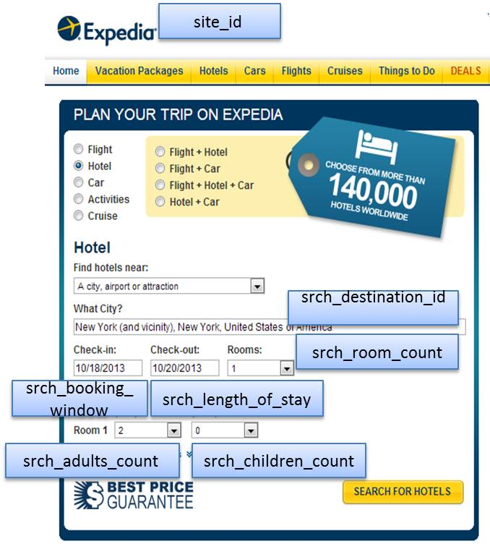
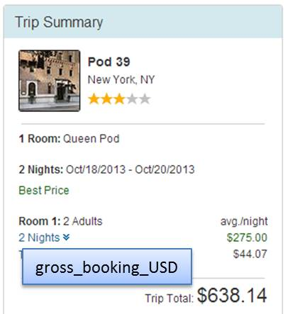
Descriptive View

Slide 23
Exploratory Data Analysis
“Hotel” refers to hotels, apartments, B&Bs, hostels and other properties appearing on Expedia’s websites. Room types are not distinguished and the data can be assumed to apply to the least expensive room type.
Most of the data are for searches that resulted in a purchase (62%), but a small proportion are for searches not leading to a purchase.
The data size is Test – 1.5 GB, Train – 2.3 GB
We achieved a 48 % accuracy in it, the highest achieved accuracy is 54 %.
Notes:
In statistics, exploratory data analysis (EDA) is an approach to analyzing data sets to summarize their main characteristics, often with visual methods. A statistical model can be used or not, but primarily EDA is for seeing what the data can tell us beyond the formal modeling or hypothesis testing task.

Slide 24
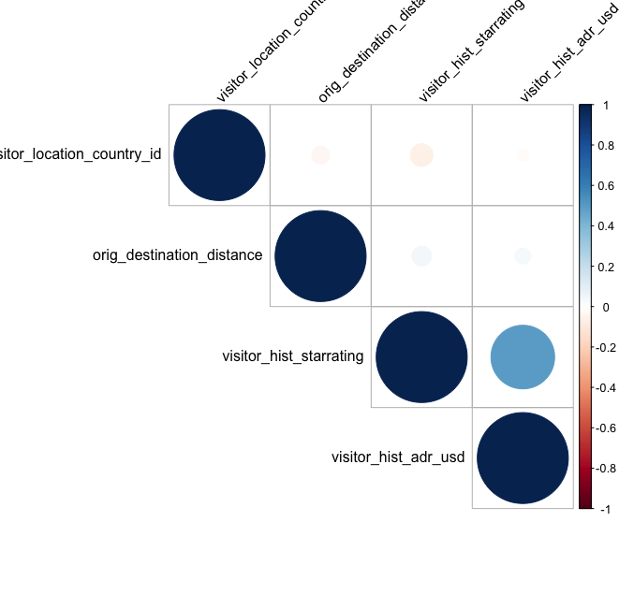

Slide 25
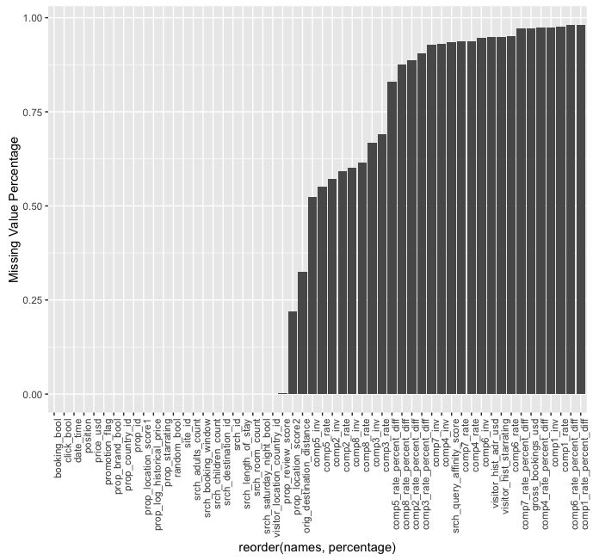

Slide 26
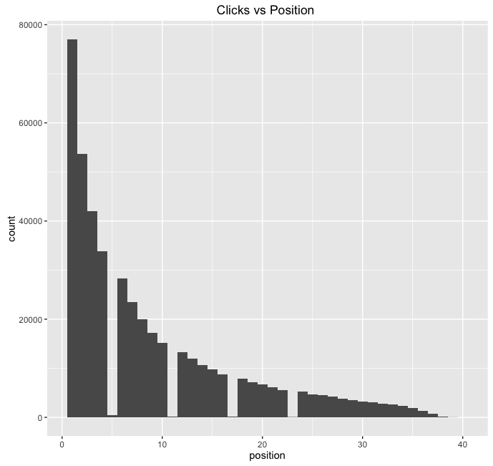

Slide 27
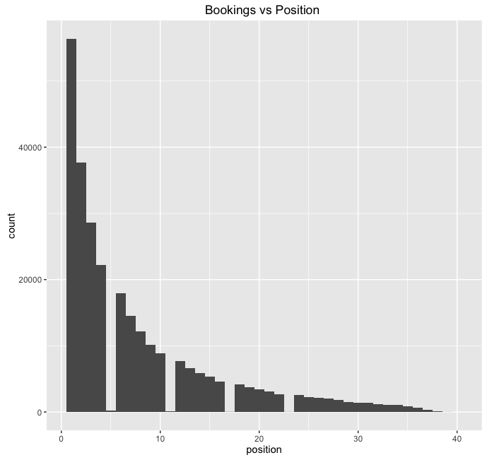

Slide 28
THANK YOU

