Slide 1

Inventra
Intelligent Inventory Management System
Authentication & Product Management Control
Seminar Presentation: Module 1 & 2

Slide 2

Table of Contents
Module 1: Authentication - Registration & Login
System Architecture - Layered Design
Module 2: Inventory Management - Stock Control
Data Flow - Visualization & Persistence
Pseudocode - Line-by-line logic
Summary - Key takeaways

Slide 3






Module 1: Authentication
Purpose: Secure identity management and access control.
Sign-Up
JWT Auth
Recovery
Secure registration process with salted hashing algorithms.
Stateless session management using JSON Web Tokens.
Automated forgot password link generation and dispatch.

Slide 4
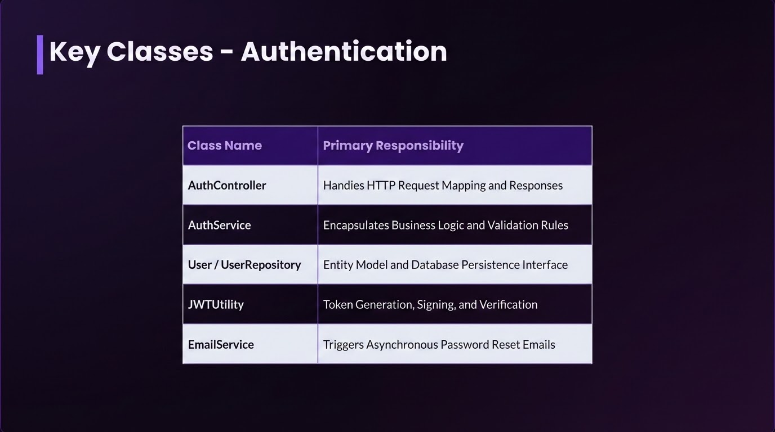

Slide 5
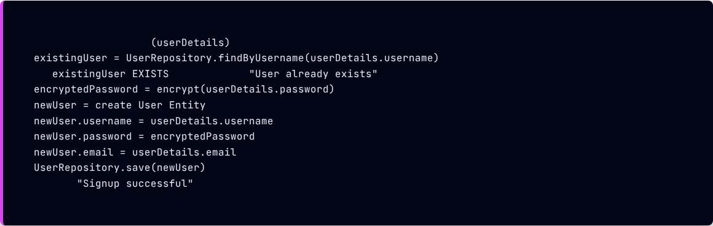
Sign-Up Service Implementation
CLASS
AuthService
FUNCTION
registerUser
IF
THEN RETURN
RETURN
END FUNCTION

Slide 6
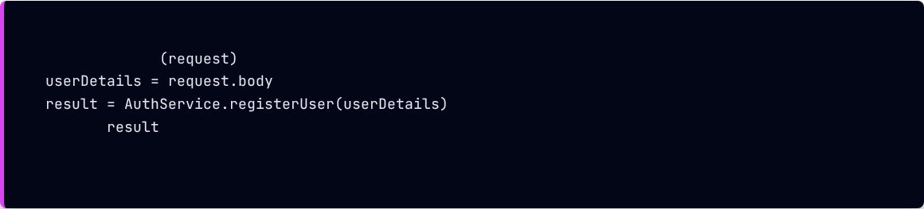
Sign-Up Controller Pseudocode
CLASS
AuthController
FUNCTION
signup
RETURN
END FUNCTION
END CLASS

Slide 7
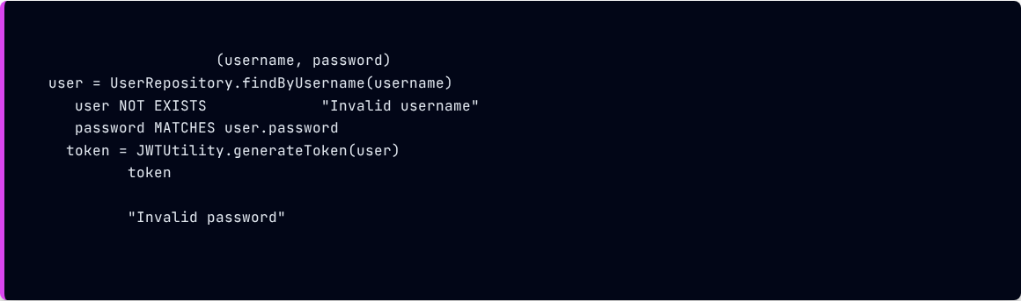
Sign-In Service Implementation
CLASS
AuthService
FUNCTION
authenticate
IF
THEN RETURN
IF
THEN
RETURN
ELSE
RETURN
END IF
END FUNCTION

Slide 8
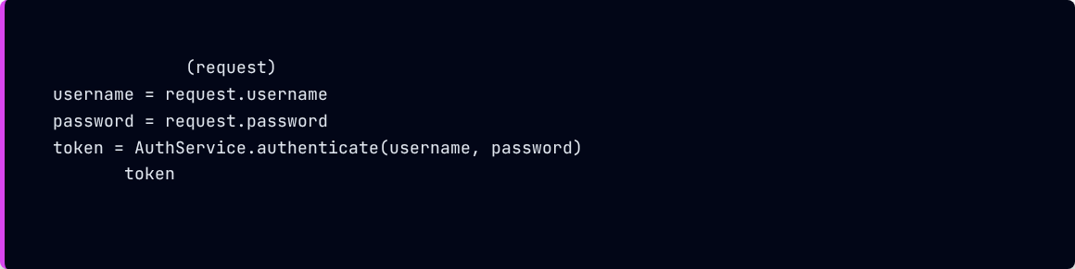
Sign-In Controller Pseudocode
CLASS
AuthController
FUNCTION
signin
RETURN
END FUNCTION
END CLASS

Slide 9
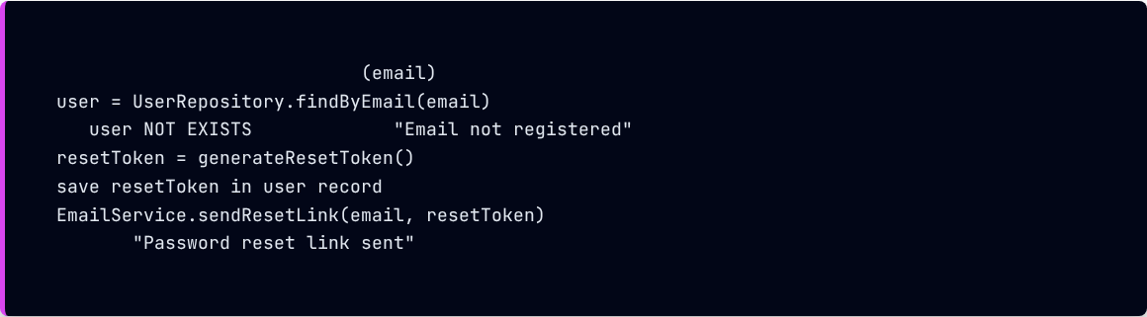
Forgot Password Logic
CLASS
AuthService
FUNCTION
processForgotPassword
IF
THEN RETURN
RETURN
END FUNCTION

Slide 10
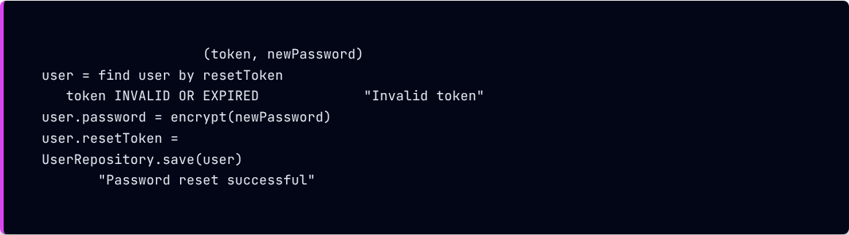
Reset Password Logic
CLASS
AuthService
FUNCTION
resetPassword
IF
THEN RETURN
NULL
RETURN
END FUNCTION

Slide 11
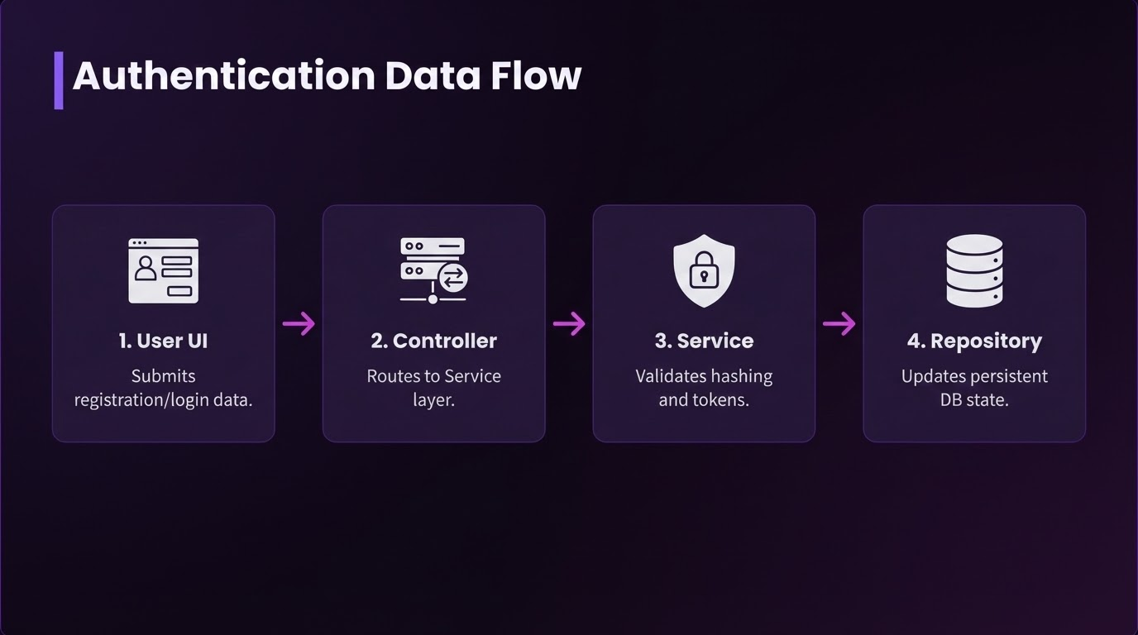

Slide 12
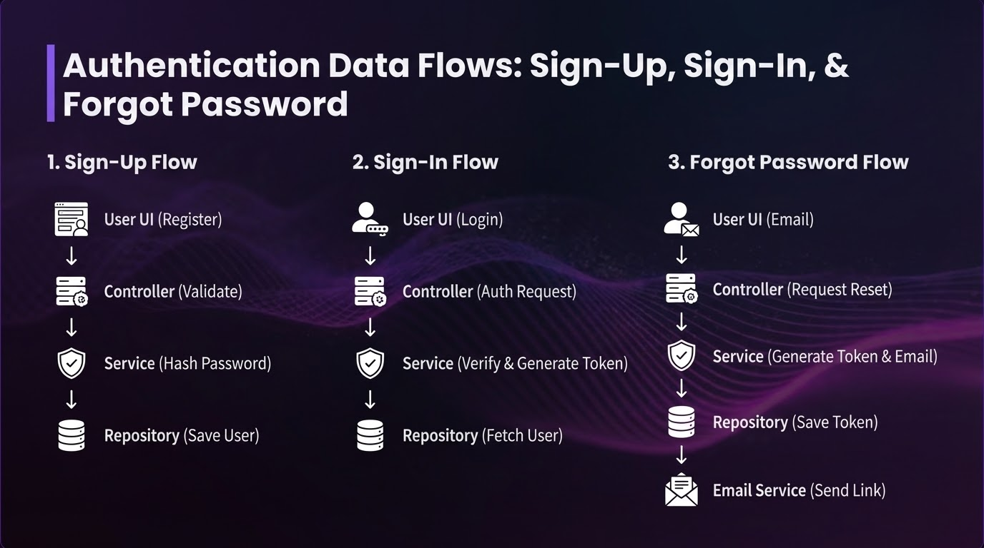

Slide 13






Module 2: Inventory Management
Purpose: Track stock levels and prevent supply chain disruption.
SKU Validation
Real-time Tracking
Safety Stock
Prevent item duplication using unique SKU identifiers.
Automated alerts when inventory falls below minimum levels.
Transactional Stock In/Out updates with historical logging.

Slide 14
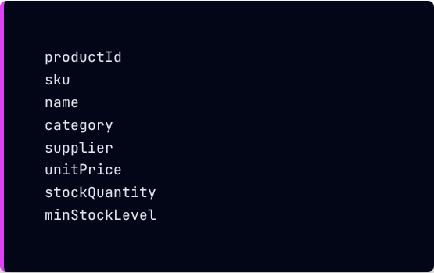
Product Entity Model
SKU: Primary unique identifier.
CLASS
Product
// PK
Stock: Tracked in real-time.
// Unique
Alerts: Driven by minStockLevel.
END CLASS

Slide 15
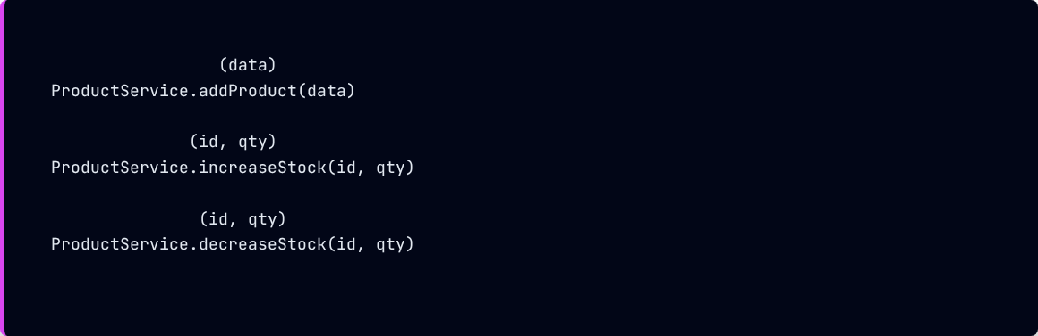
Product Controller Operations
CLASS
ProductController
FUNCTION
addProduct
END FUNCTION
FUNCTION
stockIn
END FUNCTION
FUNCTION
stockOut
END FUNCTION
END CLASS

Slide 16
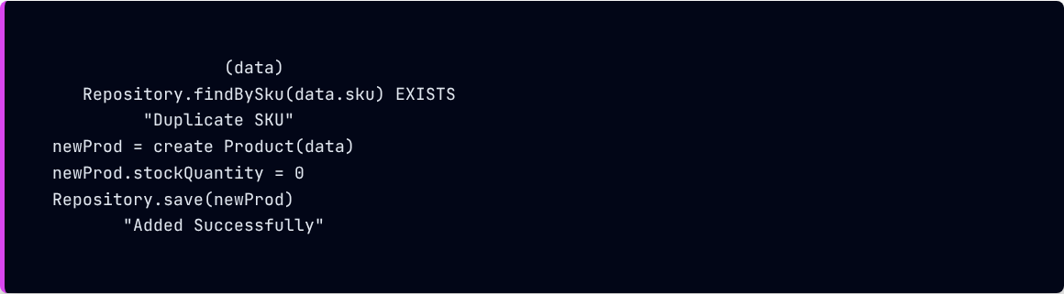
Product Service Logic
CLASS
ProductService
FUNCTION
addProduct
IF
THEN
RETURN
RETURN
END FUNCTION

Slide 17
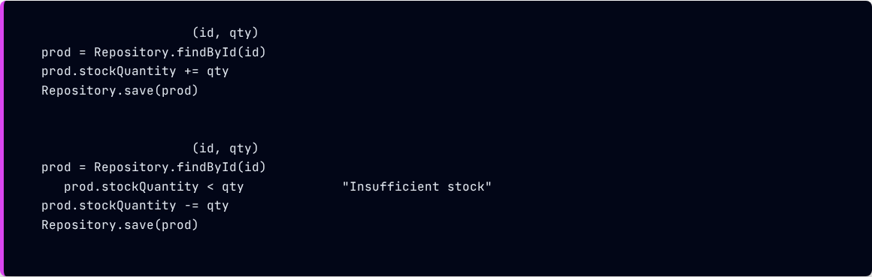
Stock In/Out Pseudocode
FUNCTION
increaseStock
END FUNCTION
FUNCTION
decreaseStock
IF
THEN RETURN
END FUNCTION

Slide 18
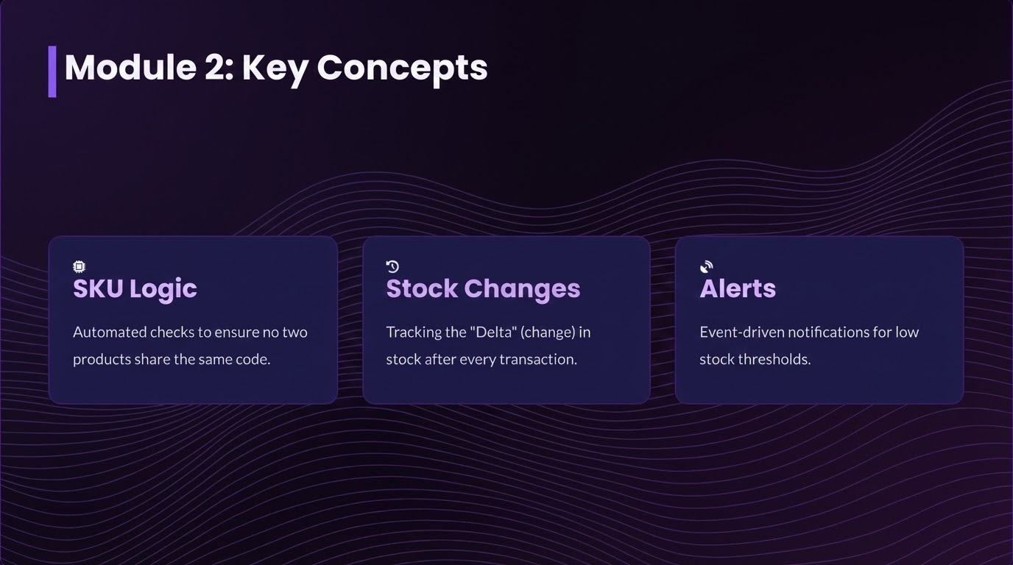



Module 2: Key Concepts
SKU Logic
Deltas
Alerts
Automated checks to ensure no two products share the same code.
Tracking the "Delta" (change) in stock after every transaction.
Event-driven notifications for low stock thresholds.

Slide 19
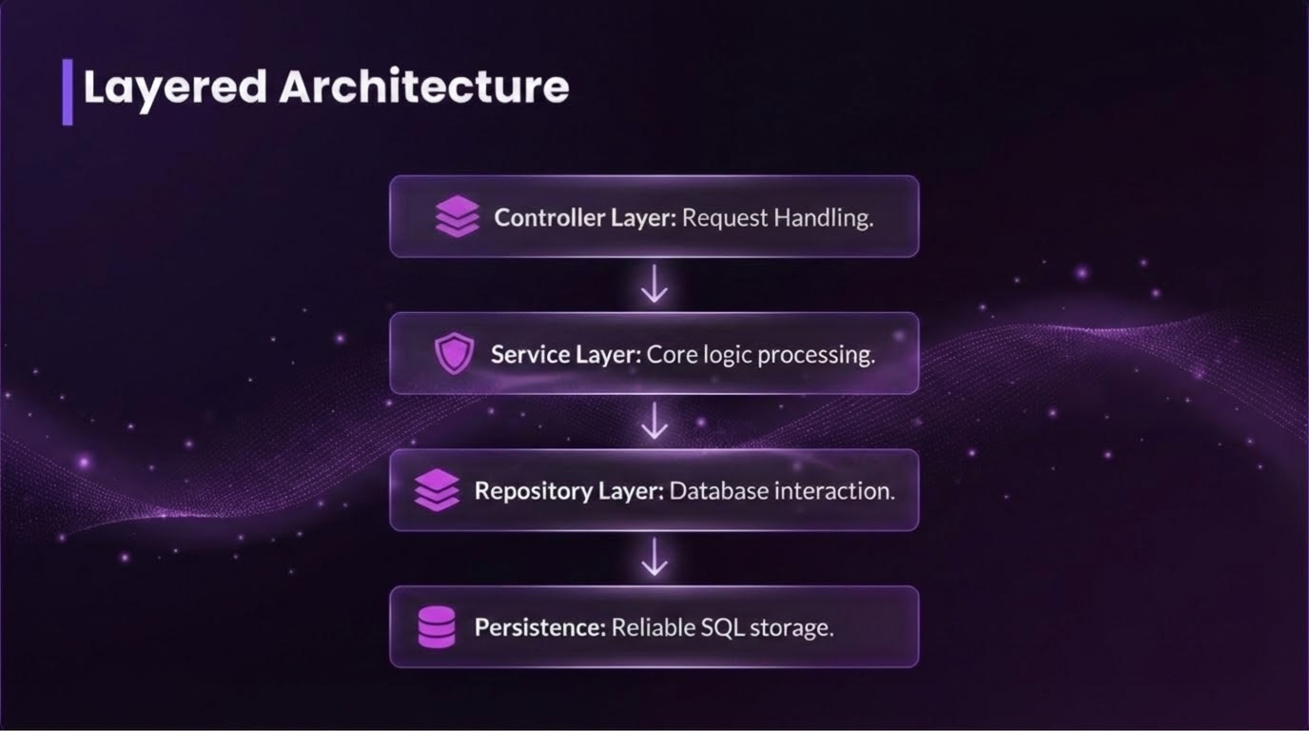

Slide 20
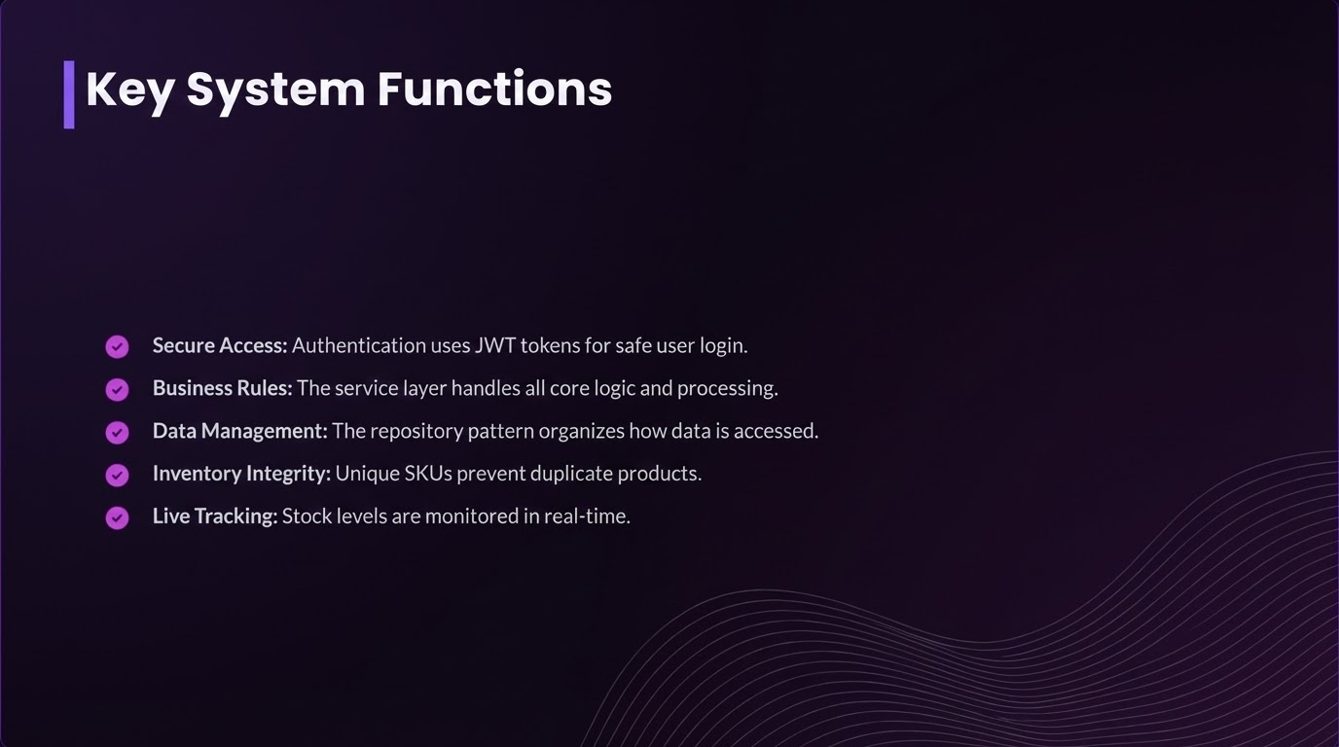

Slide 21

Thank You!
Inventra Modules 1 & 2 - Seminar Completed
Any Questions?

