Slide 1

INVENTRA
INTELLIGENT INVENTORY MANAGEMENT
Milestone 3 Presentation: Intelligent Alert Management

Slide 2
System Definition
Inventra is a rule-driven inventory monitoring system implemented in Java, designed to detect stock threshold violations and manage alert generation efficiently using stack-based state tracking.

Slide 3


MODULE 1: AUTHENTICATION
Identity & Access Control
Responsible for verifying user identity and controlling access level based on roles (Admin, Manager, Staff).
Prevents unauthorized system entry
Layered Architecture: UI → Controller → Service
Password encryption via Base64/Hashing

Slide 4
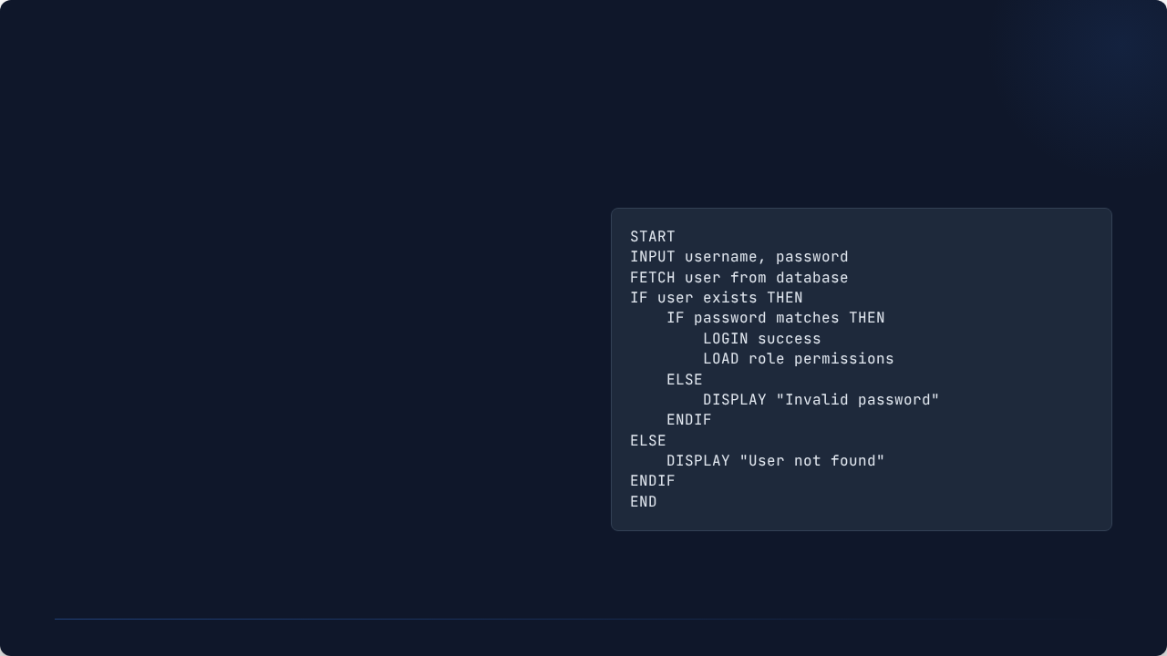
AUTHENTICATION LOGIC
Auth Workflow: Input credentials → Check Database → Validate Password → Load Role Permissions.
Layer Responsibility: AuthService handles business logic while UserRepository manages data.

Slide 5
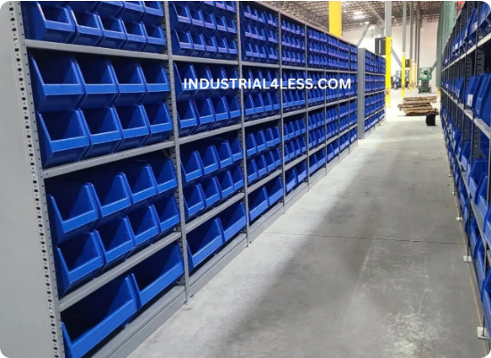
MODULE 2: INVENTORY MANAGEMENT
Real-Time Stock Tracking
The core operational module responsible for managing product metadata and maintaining accurate stock counts.
SKU Validation: Prevent duplicate entries
Stock Operations: Automated Stock-In/Out
Continuous availability tracking

Slide 6
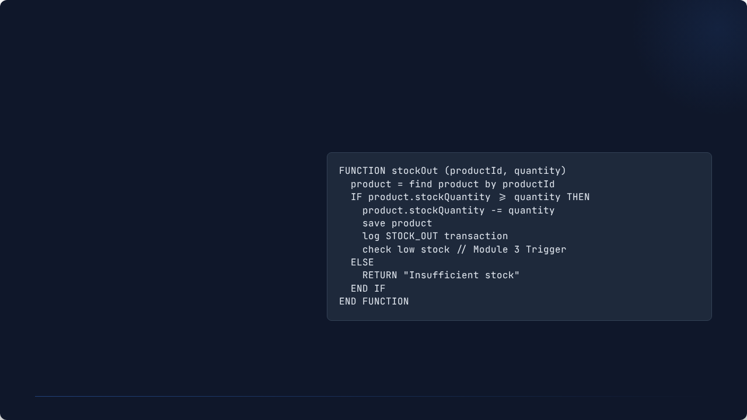
STOCK OUT LOGIC
Ensures inventory integrity by preventing negative stock levels and triggering low-stock alerts.
Validates quantity availability
Logs transactions for audit trails
Module 3 Trigger: Checks minStockLevel

Slide 7
Module 3: Inventory Alerts
Advanced intelligence and automation added to provide real-time notification control and prevent alert fatigue.

Slide 8

INTELLIGENT HANDLING
Problem Addressed
In traditional systems, the same low-stock alert is generated repeatedly, causing alert fatigue and potential neglect of critical issues.
The Solution
Controlled alert generation using a Stack data structure. The system verifies the top of the stack before adding new notifications to ensure only meaningful alerts are shown.

Slide 9
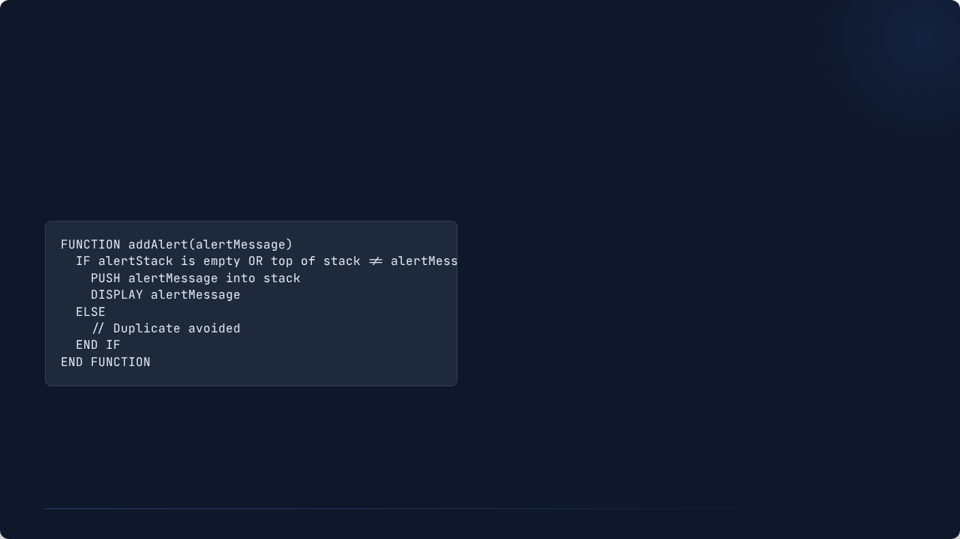
ALERT MANAGER PSEUDOCODE
Duplicate Prevention: Comparison logic checks peek() value.
Trigger: Logic runs silently in the background after every stock change.
Action: Sends alerts to dashboard, email, or SMS.

Slide 10
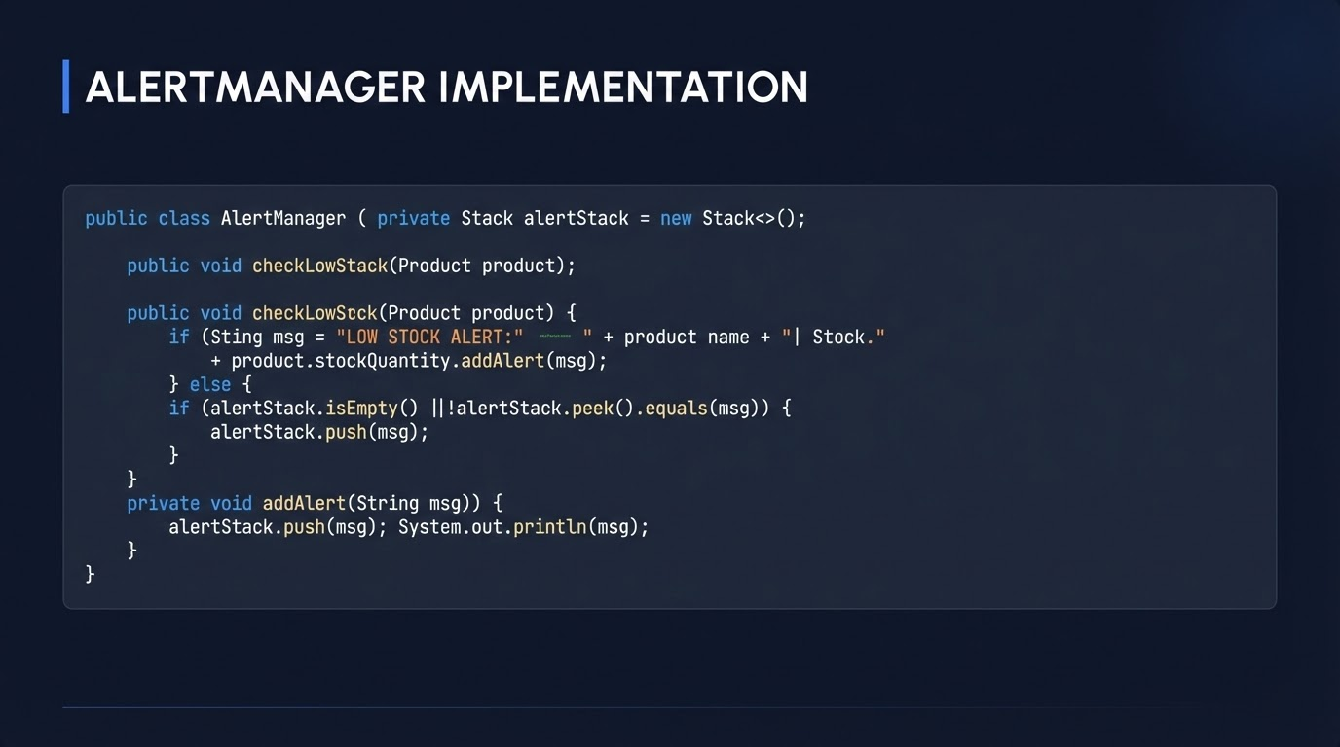

Slide 11
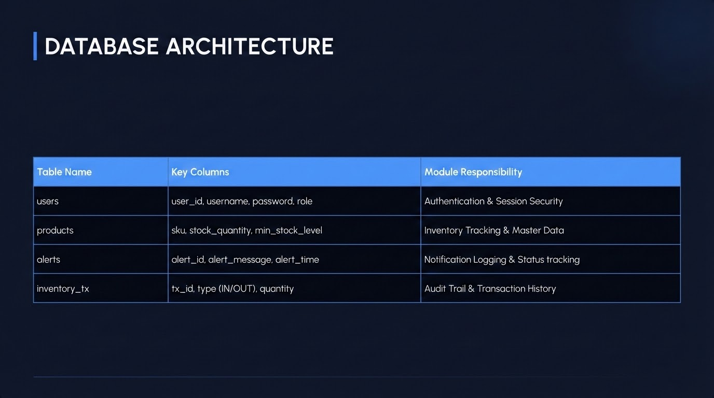

Slide 12
THANK YOU
INVENTRA: Intelligent Inventory Management System
Detailed Module 3 Analysis Completed

