Slide 1
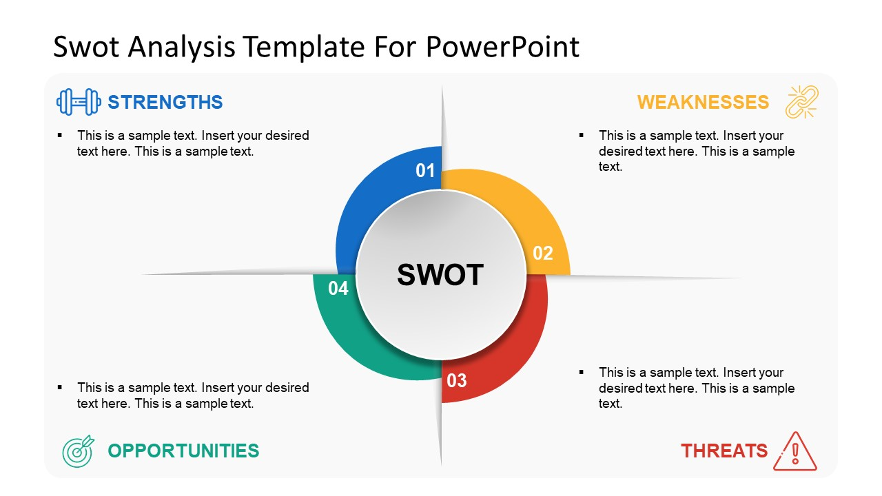
SWOT analysis – you try!
-
-
-
-
-
-
-
-
-
-
-
-
-
-
-
-
-

